Slide 1
Transportation Committee
Faye DiMassimo, AICP
Renew Atlanta General Manager
February 14, 2018

Slide 2
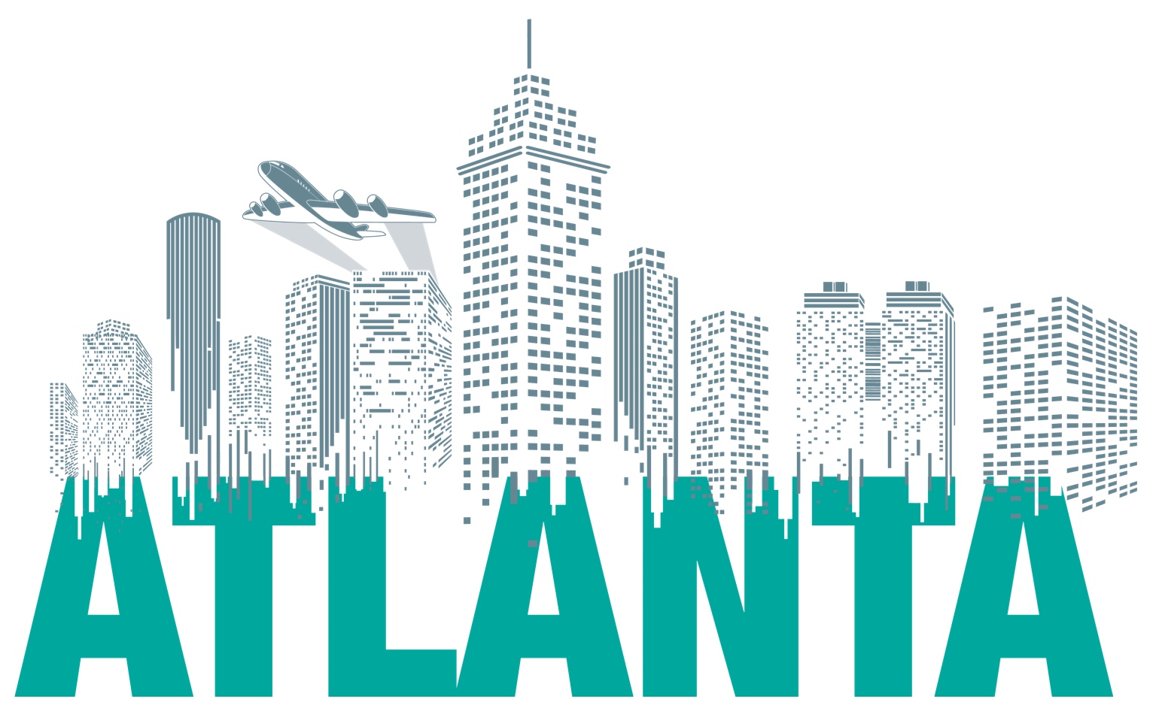
Vision & Mission Statement
Vision: Renew Atlanta Bond and TSPLOST will be the industry capital program delivery standard of excellence with consistent high quality and value that delivers innovation, sustainability and equity to our community.
Mission: The City of Atlanta’s Renew and TSPLOST programs strive daily to earn the confidence of residents as well as community leadership through innovation and the effective and efficient delivery of over $500 million of infrastructure. Renew/TSPLOST is reducing the City’s infrastructure backlog and increasing economic competitiveness, improving health and safety, environmental sustainability and mobility in our transportation, public buildings and spaces. Through smart business practice and transparency in operations, we will attract partnerships in delivery that increase competition while continually assessing quality and performance. Strong, effective program and project controls, financial management, equity in design and prioritization of internal and external communication are deeply rooted in a culture of excellence and integrity. Every day is a day of accomplishment.
Core Values: Integrity • Quality/Value • Innovation • Equity – A City for Everyone

Slide 3
Program Overview & History
Renew Atlanta is an infrastructure improvement program that was developed by Mayor Kasim Reed and the Atlanta City Council to address Atlanta’s critical needs through bond dollars that will allow the City to make urgent repairs to Atlanta’s infrastructure without raising property taxes. Voters overwhelmingly approved the infrastructure bond program through two ballot questions in a special election held on March 17, 2015.
The $250 million program is the first major investment in Atlanta’s aboveground infrastructure in more than a decade and a first step toward resolving an infrastructure repair backlog of more than $900 million.
TSPLOST & MARTA:
On November 8, 2016, City of Atlanta voters approved two ballot referenda authorizing investment in transit and transportation infrastructure. The City of Atlanta TSPLOST (special purpose local option sales tax for transportation) passed by 68% and the MARTA expansion passed by 71%.
The TSPLOST took effect on April 1, 2017, and will generate approximately $300 million over a five-year period to fund significant and expansive transportation projects citywide. The TSPLOST adds 4/10 of a penny in sales tax, or an additional 4 cents on a $10 purchase.
MARTA’s new half-penny sales tax for transit expansion and enhancements in the City of Atlanta took effect on March 1, 2017. Over a period of forty years, this half-penny sales tax will generate an estimated $2.6 billion, allowing MARTA to make major investments in transit infrastructure, including introducing high-capacity rail improvements, building new infill rail stations within the City, purchasing new buses, adding more frequent service, and introducing new bus routes.

Slide 4
Renew Atlanta/TSPLOST Program Life Cycle
Project Close-Out
Bond/TSPLOST Funding
Project Delivery
Program Management Plan
Project Construction
Project Conceived
Continuous
Progress Reporting
Project PIP Review Board
Project Funded
Project Design (60%)
Project Legislated
Project Activated
Project Req./POs

Slide 5
Key Accomplishments to Date
Renew Atlanta from December 2015 to date:
From 90 to 509 projects active
From $13.8M to $172.1M Under Contract
Goal: $167.5M by end of term
Quick start on TSPLOST
TSPLOST: $14.4M
MARTA Coordination on TSPLOST
$98M partnership funding from GDOT
Increased competition
December 2017 Diversity Payments Issued: 36.1%
North Avenue Smart Corridor – 2 awards and counting
Equity in Design
Traffic signalization improvements, including TSPLOST operational cost capitalization
Citywide impact
Resurfacing: $42.5M under contract/complete
Traffic management: $23.3M under contract/complete
Safer Roads Challenge designation
Lead development of MARTA IGA
Governance – Multilayered internal and external, Project Control Board, City Council, Internal Audit, Infrastructure Stakeholder Committee, Finance and ACP Infrastructure Task Force
Martin Luther King, Jr. Recreation & Aquatic Center completion
Project Snapshot to Date
109 miles paved or underway
30,101 linear feet of repaired or new sidewalk complete or underway
5 bridges underway/under design
68/900 signals improved /connected (includes TCC)
14 complete streets under design
9 facilities renovated
15 facilities underway
12 art projects underway
17 art pieces restored

Slide 6
Renew Atlanta/TSPLOST Program to-Date: Capital Project Capability-Build
Accomplishments
Opportunities / Challenges
Business Culture aimed at quality, equity and performance
Program Management:
Ramped up team by only 25% for additional $300M TSPLOST deployment
Solid scopes and cost estimates – ongoing
Market competitiveness
TSPLOST readiness – separate financial management system
Communication and Reporting:
“Design Developing / Dirt's Moving & Under Construction” weekly updates
monthly website updates
Renew/TSPLOST Project Update Portal (NotifyATL notification system)
Daily tweets
Public meeting recaps
24-hour standard response time – building public trust and confidence
Internal audits – 3 completed, 2 underway
Renew Lessons Learned – have citywide applicability
Expectation management
Utility coordination complexity
Communication
Ongoing
Project readiness: ensuring projects are meaningfully scoped and ready to go – ongoing
Project quality and project controls – ongoing
Event traffic management plan – stadium, per request of the Transportation Committee
Smart Corridor Suite – North Avenue, Campbellton Road, event venues, Buckhead

Slide 7
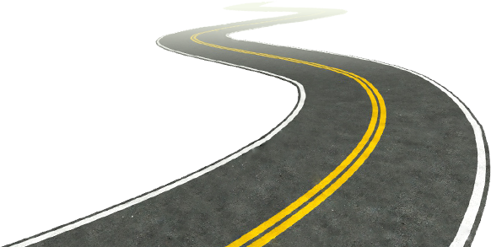
Key Renew Atlanta Horizontal Projects
Bridges:
Powers Ferry Road
Childress Drive
Central Ave
West Lake
Complete Streets:
Monroe Drive
Lynhurst Drive
Dekalb Avenue
Cascade Road/Avenue
Resurfacing:
10th Street
Piedmont Avenue
Campbellton Road
Marietta Street
Wieuca Road
Roadway Construction (unpaved roads):
Main Street
James Street
Wade Avenue
Westminister Drive
Hirsch Street
Traffic Communications Corridors:
COP
Campbellton Road
Monroe Drive
Marietta Street
All School Zone Beacons completed

Slide 8
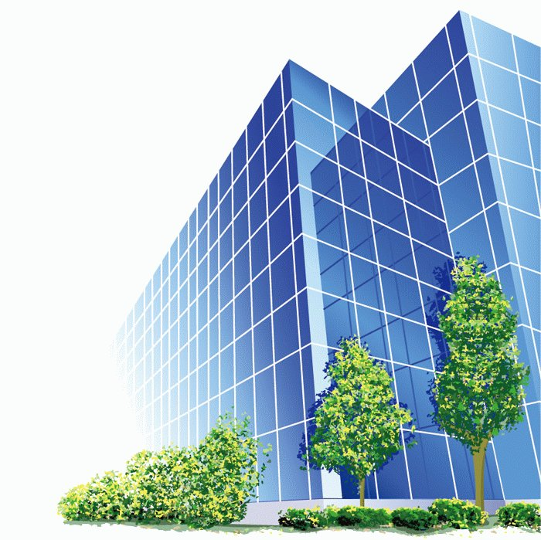
Key Renew Atlanta Vertical Projects
Public Safety:
Operation Shield Video Integration wall upgrade
Video Integration Center (VIC) network upgrades and CCTV expansion for Atlanta 911 Center
Over 10K total cameras now feeding into VIC
72 pan tilt zone cameras and 82 license plate readers installed to date
Public Safety – Atlanta Fire Rescue:
AirVac 911 exhaust systems in 25 Atlanta Fire Rescue stations
Gear Grid overgarment lockers in 23 Atlanta Fire Rescue stations
Window Replacements completed in Fire stations 8, 9, 10, 17
Roof Replacement at Fire Station #10 complete
Public Buildings:
Transportation, Sanitation and Fleet Management renovations at DPW Claire Drive
Roof Replacement at Historic City of Atlanta Hall and Annex (Atlanta City Hall Complex) complete
Parks and Recreation:
Martin Luther King, Jr. Recreation and Aquatic Center complete
Lake Claire Playground and ACA access ramp complete
Dunbar Neighborhood Center ADA Upgrades complete
3

Slide 9
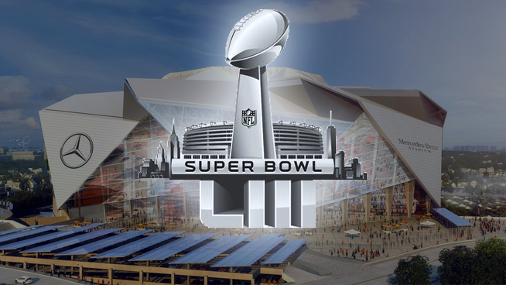
Smart City Initiatives
Philips Arena, Georgia World Congress Center, Mercedes Benz Stadium, Centennial Olympic Park, etc.
Recent active traffic management efforts:
Saturday, August 26th – Atlanta Falcons first preseason home game
Thursday, August 31st – Atlanta Falcons weeknight game
Saturday, September 2nd – Chic-Fil-A College Kick Off Games
Monday, September 4th – Chic-Fil-A College Kick Off Games
National Football Championship
Super Bowl January 2019 – here we come!
“ I just wanted to express my gratitude on all of the coordinated efforts that have made real, measurable improvements to the fan experience coming to and leaving from our games thus far. The attention to each detail and the follow up emails and meetings have been incredibly helpful to make immediate improvements and to make sure all are aligned on the playbook we are using. Thank you very much. ”
– Mike Gomes, SVP, Fan Experience,
AMB Sports + Entertainment
“ We had 50 members of the CFP production team in the city this weekend observing all operations and they were very pleased with traffic!!
Congratulations on all the great work you and the team have done!! ”
– Amy Patterson, Manager, Operations & Logistics, Atlanta Football Host Committee

Slide 10
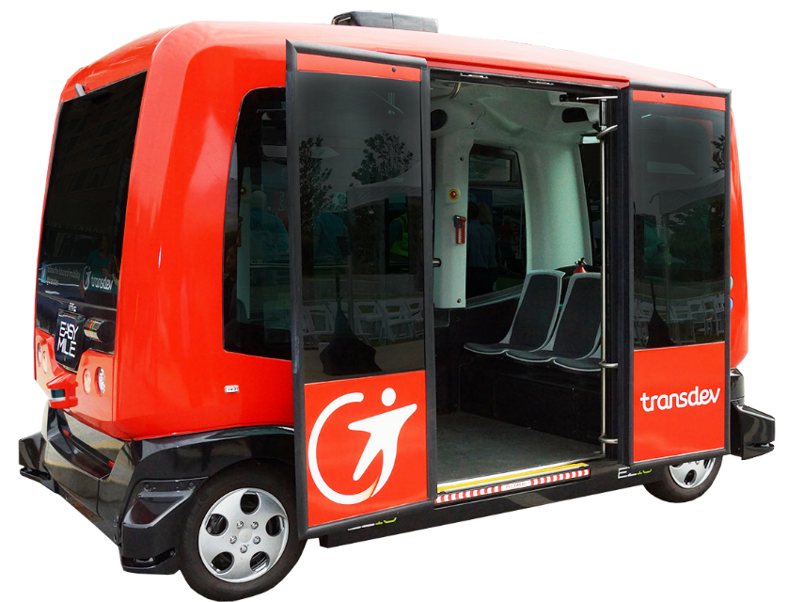
A public demonstration and “living lab” for IoT deployment, data collection/analytics, autonomous vehicles, and partnerships.
Deploy smart city data platform and demo open APIs, advanced analytics and data visualization tech
100+ IoT sensors (see, hear, smell) along 5 miles, 18 signalized intersections)
APIs
Citizen kiosks delivering wayfinding, transit updates, emergency messages, etc.
Re-pave, re-stripe, repair the entire corridor and upgrade street signs
Connected and coordinated traffic signals with advanced traffic responsive signal timing
North Avenue is the first major corridor located in the Midtown “smart” zone that we are actively working on to collect real-time data and demonstrate how we can use it to improve the corridor.

Slide 11
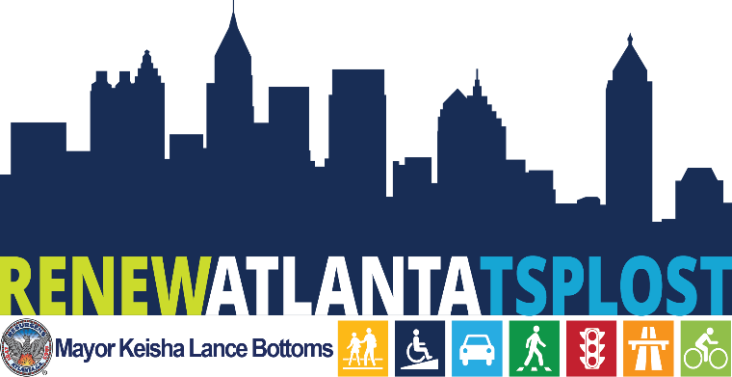
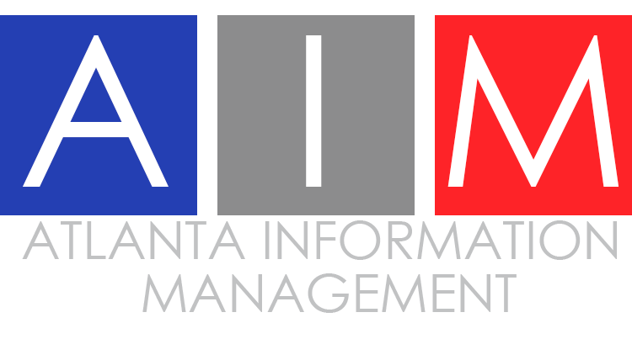
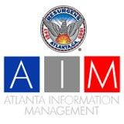
Suite of Smart Corridors
City of Atlanta Partnerships:
Event management – traffic management for special events
North Avenue Smart Corridor – AV, connected vehicles, data analytics
Campbellton Road Smart Corridor – transit
Buckhead – traffic management
Ted Turner Drive – sustainability

Slide 12
Together for Safer Roads is an innovative coalition that brings together global private sector companies, across industries, to collaborate on improving road safety.
Increased Safety
Members actively work together to create a measurable and sustainable impact in road safety by:
Leveraging member companies’ collective intellectual capital and expertise to advance best practices for companies and their fleets
Addressing strategic road safety challenges in select locations by working with local government and stakeholders
Identifying actionable insights through data collection and management to advance innovative solutions
Collaborating with the broader road safety community to be the leading voice for the private sector
FEBRUARY 21, 2017
Washington, D.C. – Together for Safer Roads (TSR), a coalition of global private sector companies, is partnering with three cities around the world — Atlanta, Ga., USA; São Paulo, Brazil; and Shanghai, China — to identify and address the cities’ strategic road safety challenges.

Slide 13
North Avenue Adaptive Traffic Control System: “Surtrac”
Responds to real-time events on demand
Real-time optimization of complex, dynamic traffic flows for all mobility
Expected results:
lower travel times for all users
Fewer stops
Less time idling
lower emissions
Combines artificial intelligence with traffic theory
Not a fixed timing plan, instead traffic control that adapts to actual urban traffic in real-time
Specific for urban road networks of multiple competing dominant flows that shift dynamically through the day

Slide 14
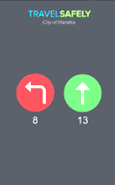
North Avenue: “Everything Connected to Everything”
Emergency vehicle preemption, signals change to green for faster response times
Infrastructure connected to vehicles/phone
Travel Safely App
City of Atlanta

Slide 15
Key City of Atlanta TSPLOST Projects: Year 1
ABI ROW (monthly loan portion payback) $9,160,968.89
North Avenue Complete Street $2.1M This Complete Street finishes the residential end beyond the limits of the Smart Corridor
Campbellton Smart Corridor $4.2M
Cascade Complete Street $3.1M
MLK $5M
Multi-use Trail: Atlanta Memorial Park $2.2M
Multi-use Trail: Proctor Creek Greenway $3.6M
Signalization Citywide $2.2M
Partnership Funding:
GT MOU Traffic $350,000
10th Street Multimodal Bridge/MA $2,100,000
MLK Bridge $7,000,000
Pending $2,000,000
Program Management $2,490,349.20
State’s Administrative Fee $522,973.30
Projects Contingency* $4,296,015.41
Piedmont Corridor Strategic Implementation Plan and Market Analysis
TOTAL (Revenue Forecast @100% of Year 1) $52,820,306.80 *Proper program contingency costs as well as to account for potential under forecast collections

Slide 16
Partnership Efforts
Atlanta Committee for Progress (ACP)
Infrastructure Task Force oversight
Georgia Pacific Communications plan review
Customer service training
Mentor/protégé program
Georgia Tech MOU Smart City collaboration
Georgia Pacific/Koch Industries – Smart city visit

Slide 17
Action Items Underway
Resurfacing audit response
Administration transition plan support
MARTA IGA implementation
Major development coordination
TSPLOST start up

Slide 18
Key Challenges for Renew Atlanta/TSPLOST
Initial scope and cost estimate challenges
Competition
Maintaining pace through transition
Continued education of internal/external partners on financial management requirements for Renew and TSPLOST funding
Communication/Getting the word out

Slide 19
Looking Forward for Renew Atlanta/TSPLOST
Transition pace
Securing additional scenario-based partnership funding
Curbside infrastructure management opportunities
Advancing technology deployment
After North Avenue, event management expansion, Campbellton, Buckhead Loop, Beltline, AV on North Avenue
Smart Transportation expansion – system wide traffic management, potential RFIs
Development infrastructure support
Gulch, Underground, Summerhill, Fort Mac, Amazon?, and more
Communication and maintaining public trust and confidence
Vertical portfolio competition June 2018
Fully activated MARTA IGA coordination
Competition:
 | # OF BIDDERS | UNDER BUDGET | LOW BID | HIGH BID | BID DIFFERENTIAL
FC-9403 GDOT GROUP A | 4 | YES | $14,393,616.31 | $17,747,093.14 | 23.30%
FC-9580 LOCAL GROUP 1 | 3 | YES | $4,095,721.91 | $4,165,941.78 | 1.71%
FC-9962 LOCAL GROUP 2 | 5 | YES | $3,983,344.76 | $5,508,638.10 | 38.29%
FC-9561 STREETCAR | 1 Bidder

Slide 20
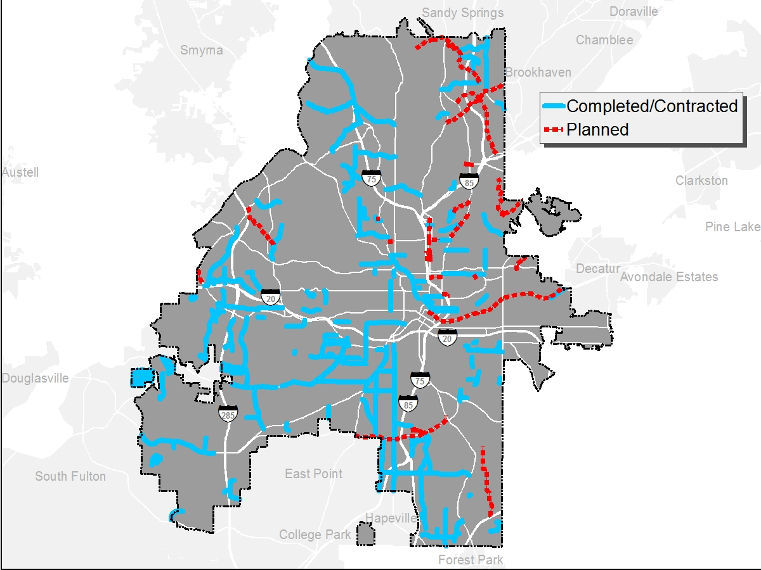
Resurfacing Projects

Slide 21
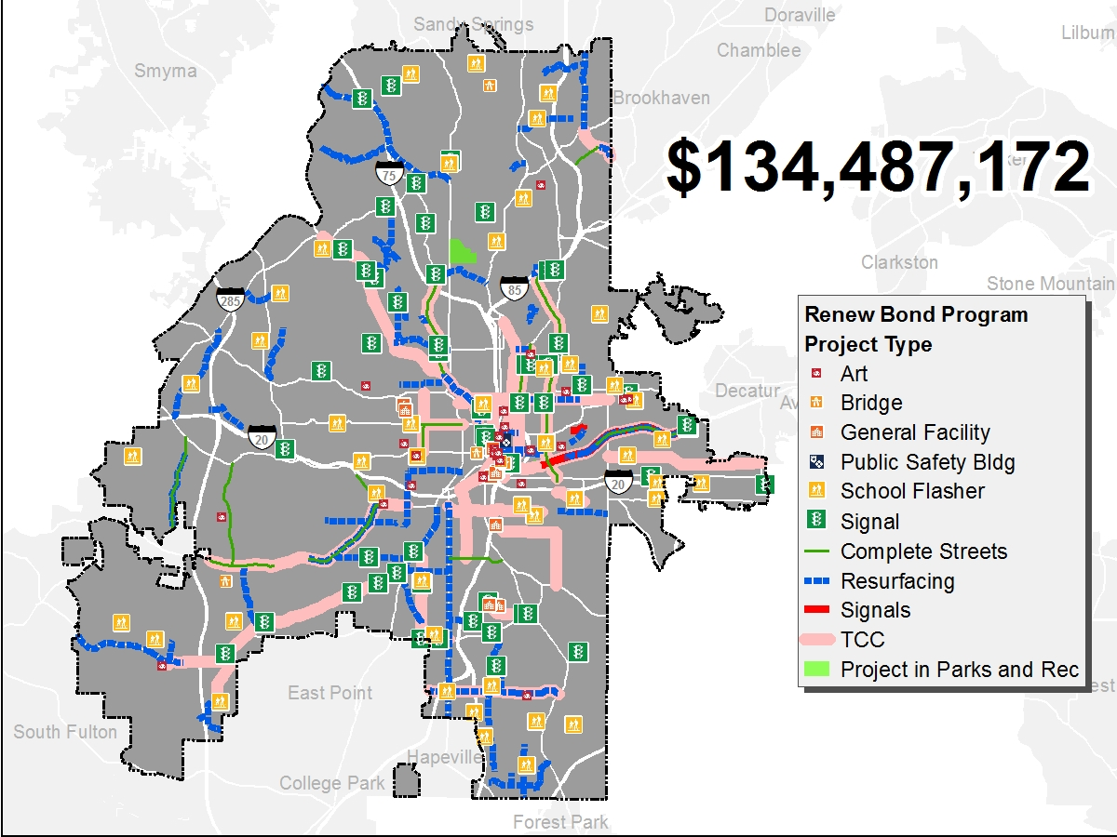
Citywide Bond Projects
Under Contract

Slide 22
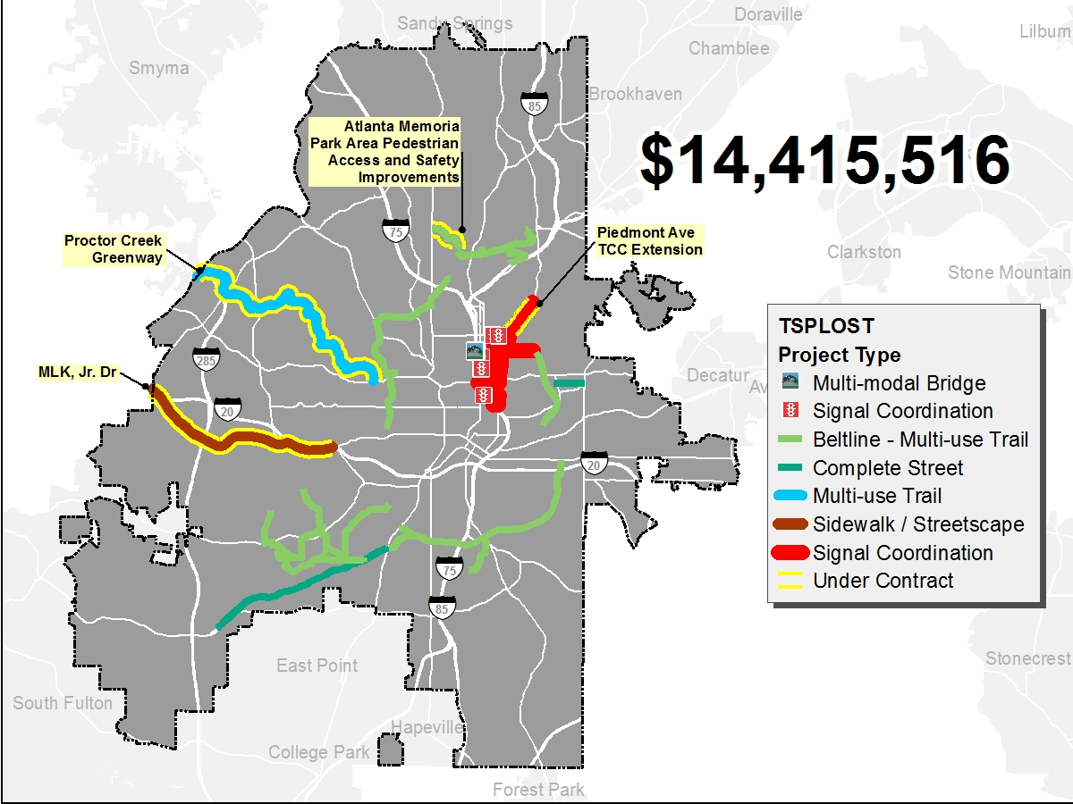
TSPLOST Projects
Under Contract

Slide 23
