Slide 1

City Utilities Committee | February 13, 2018
FY18Q2 Quarterly Report
MAYOR KEISHA LANCE BOTTOMS | WILLIAM M. JOHNSON, COMMISSIONER

Slide 2
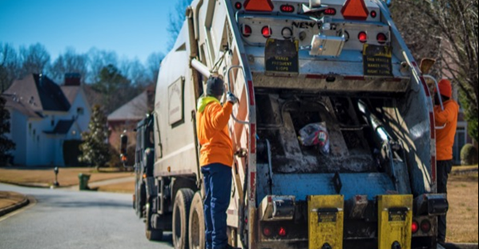
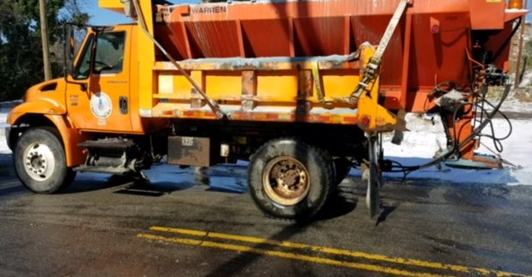
What We do
The Department of Public Works is the primary agency that plans, designs, constructs and maintains the City of Atlanta's transportation infrastructure, promotes clean, green environments within our communities, repairs nearly 5,700 city vehicles and heavy equipment, and supports economic development throughout the city.

Slide 3
Fiscal management

Slide 4
FY18 BUDGET SNAPSHOT
DEPARTMENT | BUDGET | ACTUALS | % SPEND
General Fund | $ 46,083,784.00 | $ 23,312,535.00 | 51%
Solid Waste Revenue Fund | $ 51,130,117.00 | $ 26,949,609.84 | 53%
Fleet Services Fund | $ 33,400,588.00 | $ 14,354,934.99 | 43%
TOTAL | $ 130,614,489.00 | $ 64,617,079.83 | 49%

Slide 5
SOLID WASTE SERVICES

Slide 6
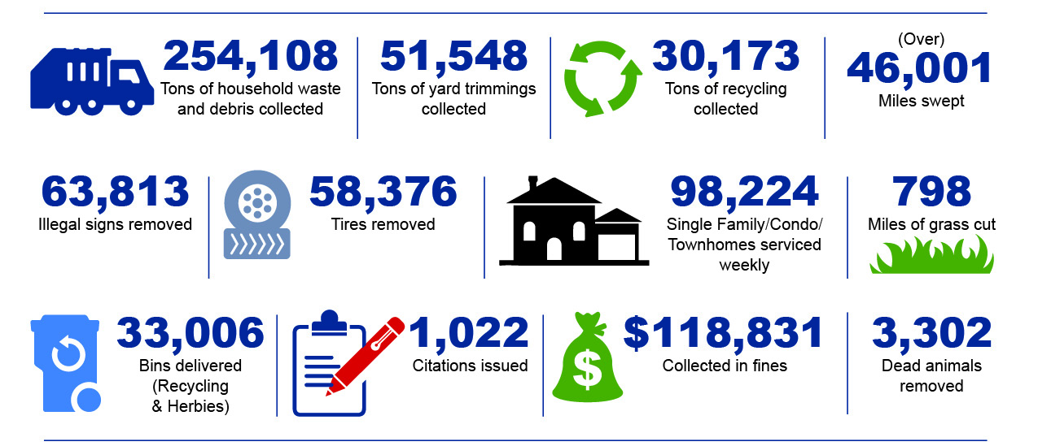
Solid Waste Services
Monica, please update numbers:
254,108 Tons of household waste and debris collected
51,548Tons of yard trimmings collected
30,173 Tons of recycling collected
46,001 Miles swept
63,813 Illegal signs removed
98,224 Single Family/Condo/Townhomes serviced weekly
58,376 Tires removed
798 Miles of grass cut
33,006 Bins delivered
1,022 Citations issued
$118,831 Collected in fines
3,302 Dead animals removed
Calendar Year 2016 – December 2017

Slide 7
Solid waste
The Office of Solid Waste Services consists of education and enforcement, right-of-way (ROW) maintenance, residential street sweeping, and weekly
pickup of household garbage, recycling, and yard trimmings.
Performance Metrics
Weekly Service Output
Performance Measure - Percentage - | Initiative | 2018 Target | FY17 Q3 | FY17 Q4 | FY18 Q1 | FY18 Q2
Single Family Garbage Pickups Collected On Scheduled Day | Merit and Excellence | 99.9% | 99.89% | 99.94% | 99.94% | 99.94%
Bulk Rubbish Pickups Collected As Requested/Scheduled | Merit and Excellence | 99.9% | 99.95% | 99.97% | 99.91% | 99.89%
Yard Trimmings Pickups Collected On Scheduled Day | Merit and Excellence | 99.9% | 99.83% | 99.91% | 99.88% | 99.87%
Recycling Pickups Collected On Scheduled Day | Merit and Excellence | 99.9% | 99.84% | 99.93% | 99.92% | 99.92%
Description | Demand
Collections Residential Garbage | 96,000 per week
Backyard Garbage | 1,577 per week
Recycling Residential | 96,000 per week
Residential Yard Trimmings | 96,000 per week
Bulk Collections | Avg. 700 per week
Notes:
Info is based on scheduled work: Over 270,000 touch points each week across the 3 lines of business
Through the 2nd quarter of the fiscal year averaging 99.9% meeting our performance metrics
High as a percentage, but we are having challenges with on time service delivery especially through the end of last quarter and into this quarter.

Slide 8
Sws service requests by service delivery type
Service Delivery Report
Weekly Service Output
Description | Demand
Collections Residential Garbage | 96,000 per week
Backyard Garbage | 1,577 per week
Recycling Residential | 96,000 per week
Residential Yard Trimmings | 96,000 per week
Bulk Collections | Avg. 700 per week
SLA Target: 90%
Problem Description Q2FY18 | % SLA Met | Number of Service Requests | Number of Service Requests Meeting SLA
Missed Residential Yard Trimmings | 73.12% | 1,860 | 1,360
Missed Bulk Collections | 98.25% | 1,599 | 1,571
Missed Collections Residential Garbage | 72.14% | 1,303 | 940
Missed Recycling | 72.34% | 893 | 646
Missed Collections Day of Service | 85.47% | 592 | 506
Bin Pick Up | 92.88% | 562 | 522
Dead Animal Removal | 94.42% | 251 | 237
Contamination: Improper use of a recycling cart | 81.08% | 185 | 150
Row Maintenance In Quad Schedule | 86.59% | 179 | 155
Illegal Dumping In Quad | 94.59% | 148 | 140
Total Q2FY18 | 82.24% | 7,572 | 6,227

Slide 9

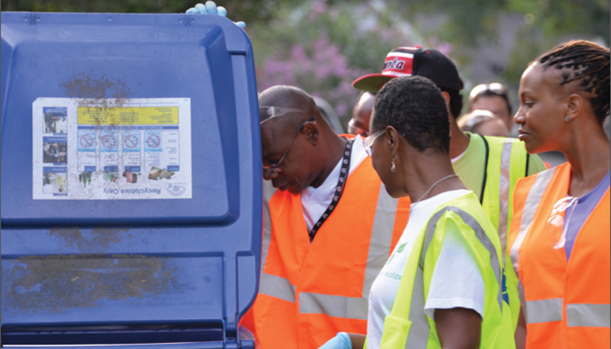

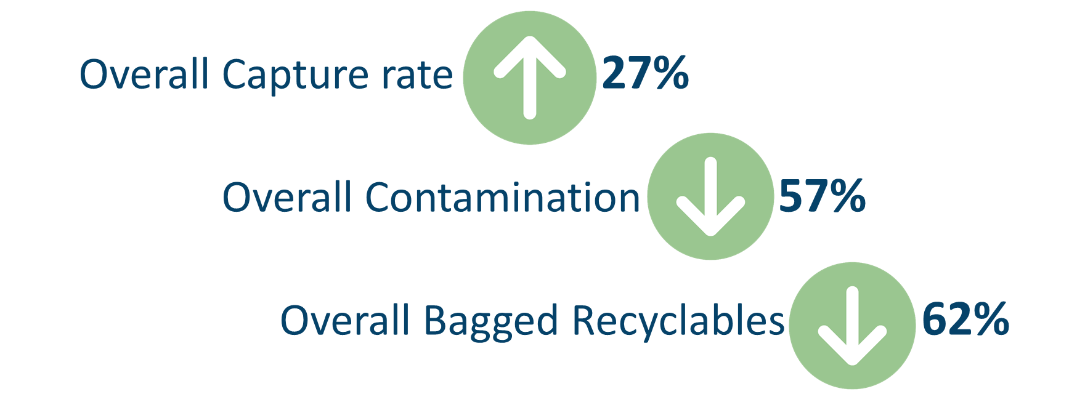
Solid waste
Recycling and Sustainability
Recycling Initiative
  Recycling Partnership Grant “Feet on the Street” Pilot
    4 Recycling Routes – Ansley Park/Midtown, Grant Park, West End & Collier Heights
Action:
Overall Community Improvement Award from Keep Georgia Beautiful Foundation
Results:

Slide 10
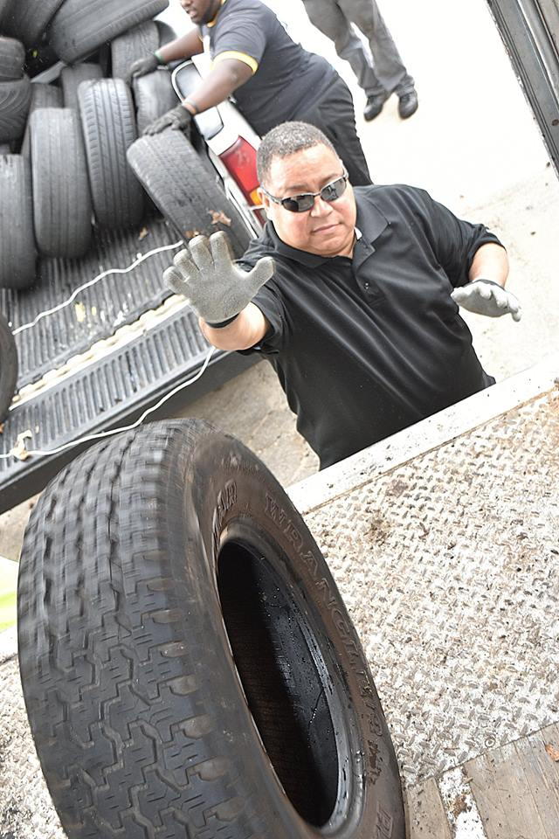
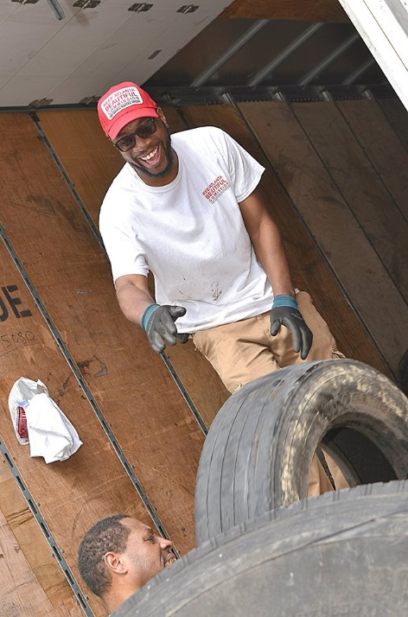
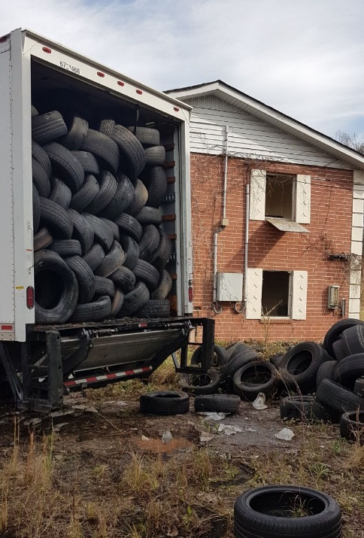
Solid waste
Calendar Year | Annual Collection | Annual Cost | Avg. Monthly Collection | Avg. Monthly Cost
2014 | 21,209 | $159,067.50 | 1,767 | $13,255.63
2015 | 21,467 | $161,002.50 | 1,789 | $13,416.88
2016 | 37,278 | $279,585.00 | 3,107 | $23,298.75
2017 | 21,098 | $158,235.00 | 1,758 | $13,186.25
Scrap Tire Abatement
Abatement
43% YTD decrease of roadside collection resulting in $121,350 cost avoidance
SWEET utilizing GIS Blight Application to track & monitor citywide illegal dumpsites
Semi-annual Scrap Tire Drive
Partnered with City Council, Department of Corrections, Liberty Tire Recycling and CHaRM
Collected approximately 4,000 scrap tires; $30,000 cost avoidance
EPD Scrap Tire Reimbursement Grant
Awarded up to $41,600 EPD Scrap Tire Reimbursement Grant
Approved Roadside & Amnesty Collection Agreements
Pending APD Clean & Close Illegal Dumpsite Projects

Slide 11
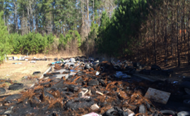
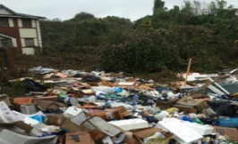
Solid waste
Solid Waste Education & Enforcement Team (SWEET)
Quarter | Courtesy Tickets | Citations Issued | Percent Compliance | Fines Collected
3rd Quarter FY17 | 1366 | 226 | 83.50% | $19,237
4th Quarter FY17 | 1137 | 194 | 82.90% | $18,680
1st Quarter FY18 | 1416 | 260 | 81.60% | $41,753
2nd Quarter FY18 | 1,070 | 151 | 85.90% | $24,315
Average | 1247.25 | 207.75 | 83.48% | $25,996
Total | 4989 | 831 | 83.48% | $103,985
During Q1FY18, the SWEET team:
Issued 1,070 citations, down 24% from Q1FY18
Compliance was up 4.3 percentage points from Q1FY18
YTD: $66,068 in fines collected

Slide 12
Fleet services

Slide 13
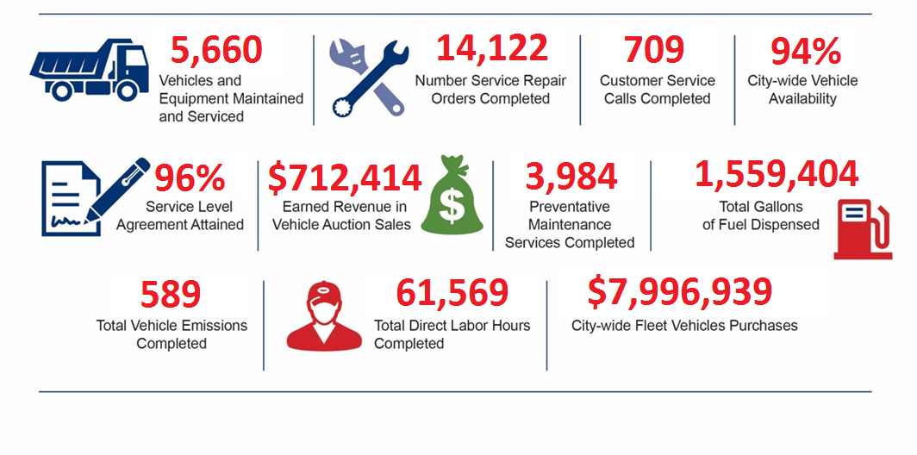
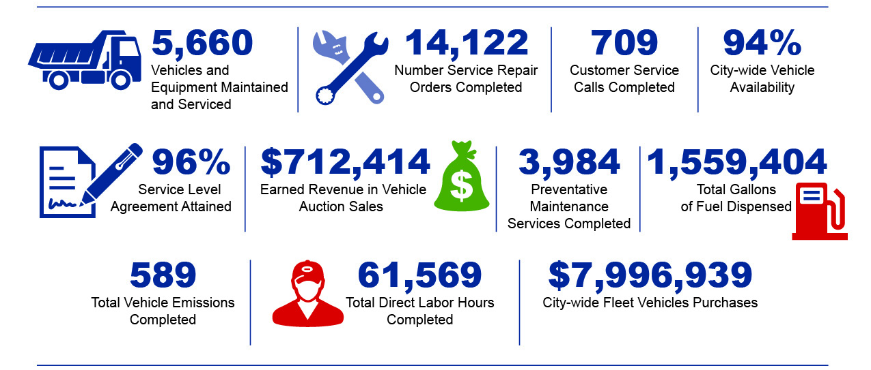
FLEET SERVICES

Slide 14
Fleet Services
The Office of Fleet Services is responsible for maintaining nearly 5,700 pieces of rolling equipment, including critical services for Atlanta Fire Rescue and Atlanta Police Dept.
Availability
Performance Measure | Initiative | FY 2017 Target | FY17 Q3 Actual | FY17 Q4 Actual | FY18 Q1 Actual | FY18 Q2 Actual
Patrol Cars | Public Safety | 100% | 100% | 83% | 85% | 88%
Motorcycles | Public Safety | 100% | 100% | 100% | 100% | 100%
Aerial Buckets | Public Safety | 100% | 100% | 100% | 100% | 100%
Pothole Trucks | City Infrastructure | 100% | 100% | 100% | 100% | 100%
Ladders | Public Safety | 100% | 100% | 100% | 100% | 100%
Pumpers | Public Safety | 100% | 100% | 100% | 100% | 100%
Rear Loaders | Public Safety | 100% | 98% | 92% | 88% | 88%
Sewer Cleaners | Public Safety | 100% | 99% | 99% | 92% | 95%
Paint Trucks | City Infrastructure | 100% | 100% | 100% | 100% | 100%
Platform Sign Trucks | City Infrastructure | 100% | 98% | 100% | 98% | 100%
Asphalt Planner | City Infrastructure | 100% | 63% | 47% | 100% | 100%
Note: Availability is based on a target of 70

Slide 15
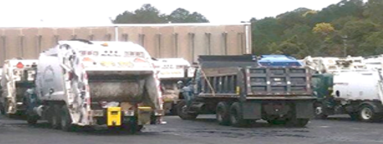
FLEET SERVICES
Rear Loader Update
Current Rear Loader Status
Total Rear loader Fleet | 87
Average inoperable daily | 26
Average Daily Availability¹ | 61
Route Requirement | 58
Vehicle breakdown (loss factor) daily | 5
Spare requirement² | 10
Total Daily Requirement | 73
Shortage | 12
An average of 61 rear loaders are available daily.
Seventy three are needed daily for normal operation.
There is a functional shortage of 12 rear loaders.

Slide 16
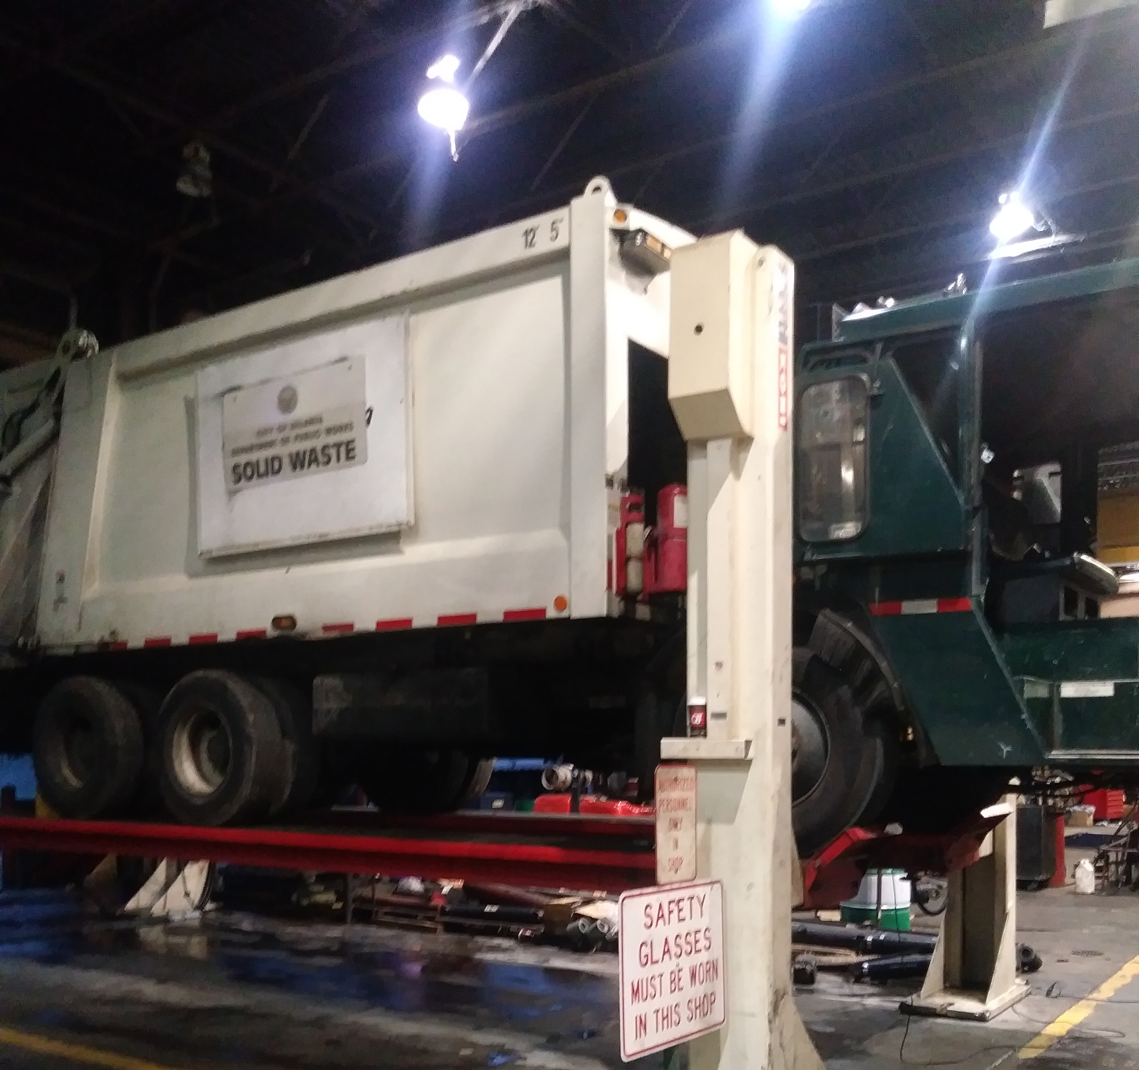
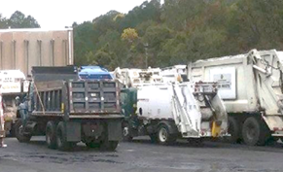
Fleet Services
PM Compliance
Department | FY17Q3 | FY17Q4 | FY18Q1 | FY18Q2
Airport Fire & Rescue | 100% | 100% | 99% | 100%
Airport Police | 99% | 99% | 100% | 99%
Corrections | 99% | 94% | 94% | 93%
DPW - Solid Waste Services | 94% | 96% | 93% | 95%
DPW - Transportation | 95% | 96% | 93% | 95%
Fire Rescue | 97% | 97% | 96% | 97%
Parks & Recreation | 95% | 95% | 93% | 93%
Police Department | 97% | 97% | 95% | 95%
Watershed - Drinking Water | 92% | 92% | 90% | 91%
Watershed - Waste Water | 88% | 92% | 91% | 92%

Slide 17
Emergency Management

Slide 18
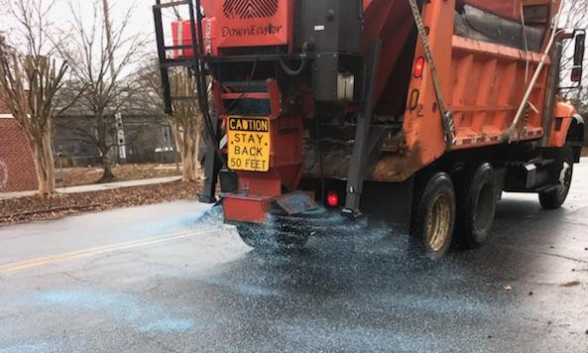

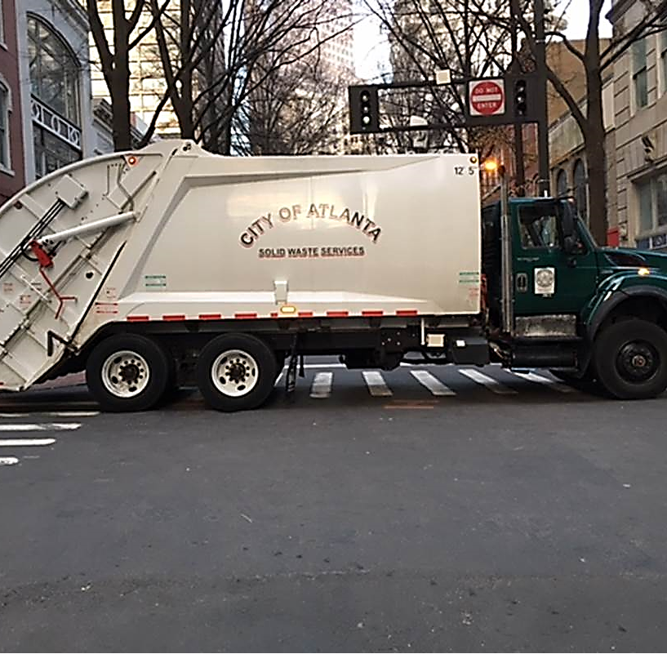
Emergency Management
October - December 17, 2017
Implemented a Level 3 Response activation for
December 7-9, 2017 winter weather event: 3,600 lane miles treated, 65,000 gallons of brine and 36 tons of salt
Provided public safety support by solid waste equipment fortifications for seven special events (cumulative total of 56 trucks deployed) for the following events:
  Pride Parade
  Veterans Day Parade
  Tree Lighting at Lenox Square
  Christmas Parade
  SEC Football Game
  2 NFL Football Games

Slide 19
Safety

Slide 20
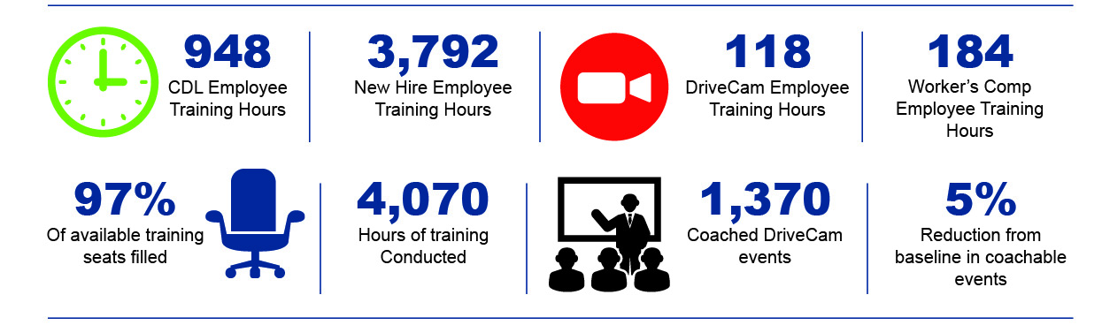
SAFETY
Performance Metrics - Initiatives
Safety Trainings

Slide 21



safety
Total Injuries
Total Accidents
Total Incidents
Performance Metrics
29 34 21
Total Events
84
Accidents | P | NP | Total
SWS | 5 | 14 | 19
OOT | 1 | 5 | 6
OFS | 1 | 3 | 4
Total | 7 | 19 | 29
Accidents | P | NP | Total
SWS | 9 | 10 | 19
OOT | 8 | 4 | 12
OFS | 2 | 1 | 3
Total | 19 | 15 | 34
Incidents | P | NP | Total
SWS | 2 | 13 | 15
OOT | 1 | 3 | 4
OFS |  | 1 | 1
SWEET |  | 1 | 1
Total | 3 | 18 | 21
Accidents | P | NP | Total
Q3FY17 | 56 | 37 | 93
Q4FY17 | 57 | 44 | 101
Q1FY18 | 71 | 30 | 101
Q2FY18 | 53 | 29 | 84
Total | 237 | 140 | 379
BACK
IS THE MOST INJURED BODY PART
MAKING UP
26 %
OF INJURIES
HEAD injuries make up 22%, while hand and legs make up 15% of all injuries.
All ACCIDENTS involved a moving vehicle.
63% of Preventable accidents involved sideswipes
60% of Non- Preventable accidents involved city vehicles being hit by citizens.
Most INCIDENTS except 3 were considered Non-Preventable.
Non-Preventable Incidents are attributed to Vehicle Malfunction and flying debris.
Overall Events decreased by 19% Q1FY18 to Q2FY18
Preventable Events decreased 25% from Q1FY18 to Q2FY18
Note: P = Preventable NP = Non-Preventable

Slide 22
safety
Performance Metrics
Injuries decreased 44% from Q1FY18 to Q2FY18
Accidents decreased 11% from Q1FY18 to Q2FY18
Incidents increased 31% from Q1FY18 to Q2FY18

Slide 23
POTHOLE REPAIRS

Slide 24
POTHOLE REPAIRS
During Q2 FY18, 640 potholes were completed.
One pothole truck was run on a daily basis.
Two months into FY18Q3, we have completed 282 potholes.
On average, we are running three trucks daily, with plans on staffing a fourth truck by the end of February.

Slide 25
HUMAN RESOURCES

Slide 26




Human resources
Staffing Scorecard: Department of Public Works
Overall Goal Status | Public Works Status
Green (90-100% fill rate): Solid Waste Services Yellow (70-89% fill rate): Office of the Commissioner, Fleet Services, Streetcar Services and Transportation Red (>70% fill rate): None | Total Positions: 1,041 Open: 113 (11% vacancy rate) *Vacant positions (excluding in process) / Total Positions On hold: 1 Recommended / In Process: 37 (3.5%) Filled: 890 Percentage Filled: 85.5% (filled/total positions)
90 Day Plan- Vacancy Control | Key Initiatives
Continued Hiring Blitz events scheduled for Solid Waste & Transportation Same day pre-employment physical/drug screening after hiring blitz selection Conduct on-going touchpoint meetings between hiring managers and HR recruitment lead Ensure all critical DPW vacancies filled within 60 days | Hiring focus on new key transportation frontline/ leadership positions and the Government District initiative (partial driver of increased vacancies) Hire 2 CDL instructors to provide training opportunities for heavy equipment operators and increase internal promotions Developing partnership with Atlanta Technical College for creation of SW Apprenticeship Program

Slide 27


