Slide 1

Transportation Committee Quarterly Report
November 15, 2017

Slide 2
Fiscal management

Slide 3
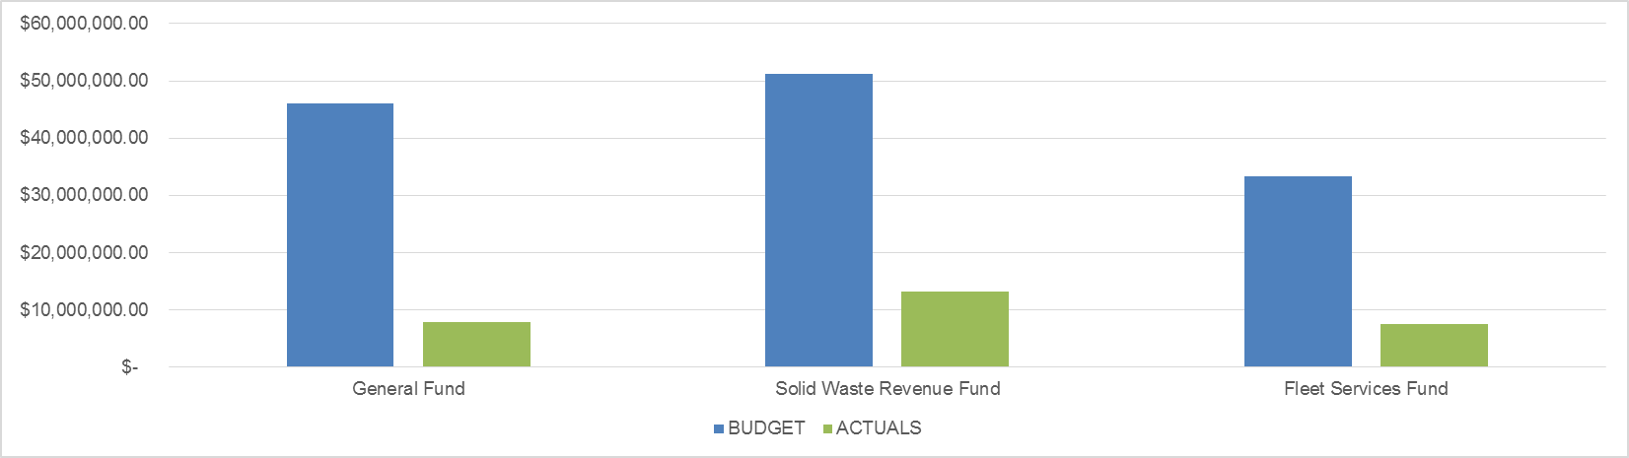
FISCAL MANAGEMENT
FY18 BUDGET
DEPARTMENT | 1Q BUDGET | 1Q ACTUALS | % (OVER)/ UNDER BUDGET
General Fund | $ 11,520,946.00 | $ 7,956,985.32 | 31%
Solid Waste Revenue Fund | $ 12,782,529.25 | $ 13,162,105.75 | -3%
Fleet Services Fund | $ 8,350,147.00 | $ 7,539,945.34 | 10%
TOTAL | $ 32,653,622.25 | $ 28,659,036.41 | 12%

Slide 4
Fiscal management
General Fund
Notes:
General Fund includes Transportation and administration functions
Total General fund budget was about $55M
44% for contracted services, 29% for personnel costs
20% for supplies, and materials

Slide 5
Fiscal management
Solid Waste Revenue Fund
Notes:
Solid waste revenue fund total was $46.54M
Under budget on personnel (constantly staffing and filling vacancies)
Over budget on operating and maintenance expense – direct reflection of equipment maintenance costs, disposal expenses, sunken costs

Slide 6
Fiscal management
Fleet Services Fund
Notes:
Fleet services under budget on supplies and salaries
Over budget slightly – Contracted services
Overall under budget
Reflection of the work that is being done in working with the employee team implementing MANAGED COMPETITION

Slide 7
transportation

Slide 8
transportation
The Office of Transportation consists of Transportation Planning, Operations,
Engineering and Right-of-Way Maintenance
Performance Metrics
PERFORMANCE MEASURE | INITIATIVE | 2018 TARGET | FY18 1Q ACTUAL
Percentage of Reactive Bridge Inspections Completed Within 10 Days of Report or Request | City Infrastructure | 90% | 93.00%
Percentage of Pothole Repairs Completed Within 72 Hours | City Infrastructure | 90% | 85.09%
Percentage of of Asphalt Point Repairs Completed Within 30 Calendar Days of Work Order Creation | City Infrastructure | 90% | 76.12%
Percentage of Concrete Repairs Completed Within 30 Days of Work Order Creation | City Infrastructure | 90% | 91.39%
Percentage of Emergency traffic signal repairs completed within 12 hours of receipt/report | City Infrastructure | 95% | 96.53%
Notes:
*Concrete and asphalt/potholes numbers were affected by weather (rain)

Slide 9
transportation
Service Requests Received, Closed By OOT & Quantity of Completed Work By Service Type
Office Of Transportation | Number of Service Requests Received | Number Past Due | Percentage Past Due | Percent of OOT Service Requests
ADA ramp installed. | 15 | 0 | 0.00% | 0.28%
Asphalt Point Repair | 134 | 32 | 23.88% | 2.52%
Bridge Routine Repairs | 157 | 11 | 7.01% | 2.95%
Concrete/Sidewalk Small Repairs | 337 | 29 | 8.61% | 6.33%
Emergency Repair Replacement Signs | 151 | 27 | 17.88% | 2.84%
Emergency Traffic Signal Repair | 950 | 33 | 3.47% | 17.84%
Loose Metal Plates in the Right of Way | 81 | 0 | 0.00% | 1.52%
Non Emergency Signal Repair | 430 | 22 | 5.12% | 8.08%
Pavement Markings | 107 | 0 | 0.00% | 2.01%
Potholes | 1026 | 153 | 14.91% | 19.27%
Street Name Signs | 242 | 9 | 3.72% | 4.54%
Traffic Study | 120 | 0 | 0.00% | 2.25%
Warning Signs And Object Markers | 219 | 6 | 2.74% | 4.11%

Slide 10
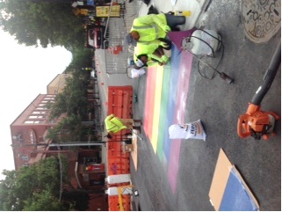
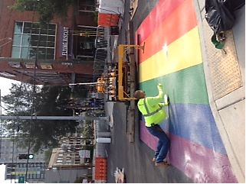
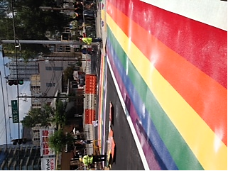
transportation
Rainbow Crosswalk Installation – Intersection of Piedmont Avenue and 10th Street

Slide 11
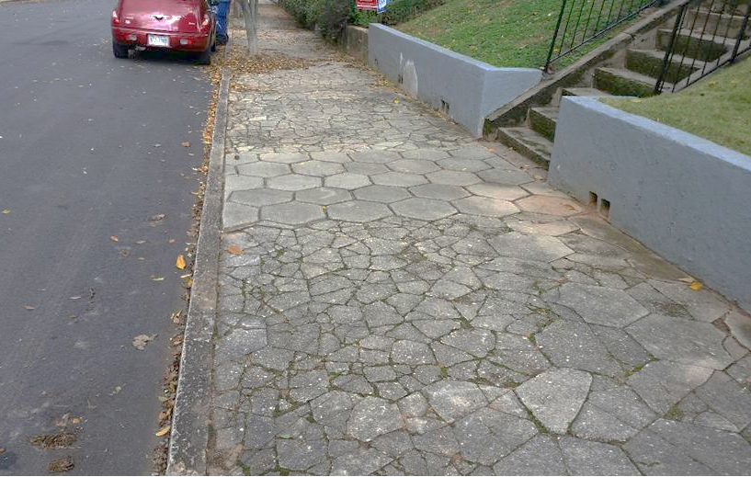
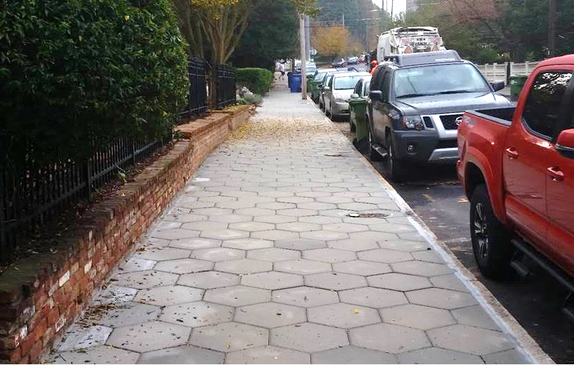
transportation
Sample of Sidewalk Repair: 400 block of Grant Street, SE
BEFORE
AFTER

Slide 12
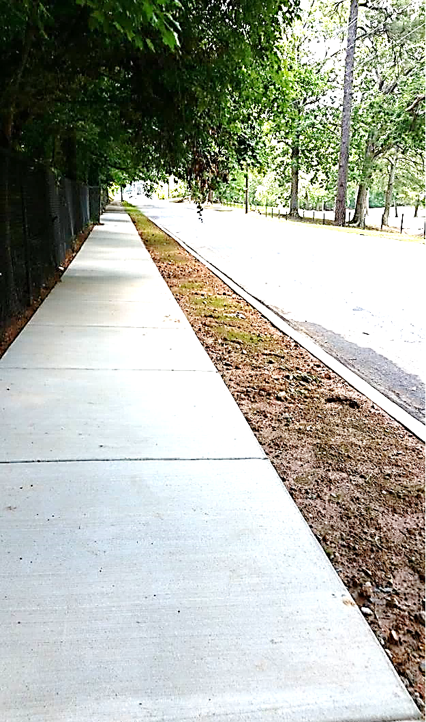
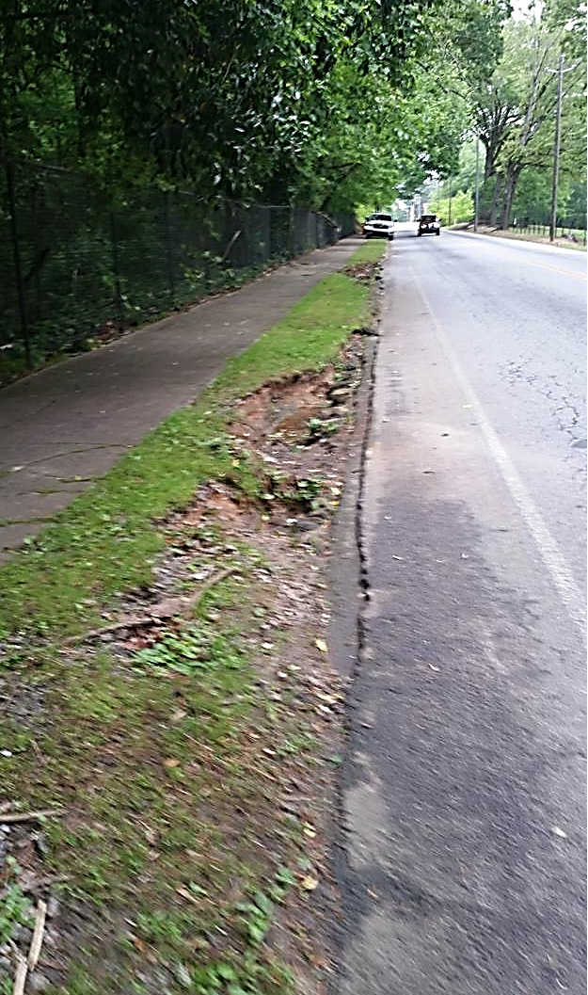
transportation
Sample of Sidewalk Repair: Joseph E. Boone Boulevard, NW
BEFORE
AFTER

Slide 13
safety

Slide 14

safety
Performance Metrics
Initiatives
  Training
    Filled 97% of available training seats
    Conducted 237 safety activities to promote safety
      CDL, New hire, Refresher, Drivecam, Worker’s comp, Emergency Preparedness, Flagger, Defensive Driving, CPR, Supervisors, Facility inspections and Shelter in place
    Conducted 5,809 hours of training
  Drivecam
    1370 events coached
    5% reduction from baseline in coachable events
Notes:
Safety focus on training and awareness
5800 training hours to our employees
97% of our total training capacity
Focus on active coaching based on drive cam observations with a goal of reducing unsafe work practices – Operating equipment

Slide 15

safety
Performance Metrics
Notes:
Accidents continue to trend down while injuries remain flat
In addition to training we have increased availability of personal protective equipment for employees working with Andrea McClain as part of a City Wide initiative

Slide 16
safety
Performance Metrics
Notes:
Accidents continue to trend down while injuries remain flat
In addition to training we have increased availability of personal protective equipment for employees working with Andrea McClain as part of a City Wide initiative

Slide 17
Fleet services

Slide 18
Fleet Services
The Office of Fleet Services is responsible for maintaining nearly 5,600 pieces
of rolling equipment, including critical services for Fire and Police.
Availability
PERFORMANCE MEASURE | INITIATIVE | FY 2017 TARGET | FY18 – Q1 ACTUAL
Patrol Cars | Public Safety | 100% | 85%
Motorcycles | Public Safety | 100% | 100%
Aerial Buckets | Public Safety | 100% | 100%
Pothole Trucks | City Infrastructure | 100% | 100%
Ladders | Public Safety | 100% | 100%
Pumpers | Public Safety | 100% | 100%
Rear Loaders | Public Safety | 100% | 88%
Sewer Cleaners | Public Safety | 100% | 92%
Paint Trucks | City Infrastructure | 100% | 100%
Platform Sign Trucks | City Infrastructure | 100% | 98%
Asphalt Planner | City Infrastructure | 100% | 100%
Notes:
Fleet availability is a key measure
Like to see 100%
Above 90% is still very good
Some equipment requires hard to get parts and some changes in procurement practices are causing limitations in the availability of parts
May result in higher equipment costs as we may be forced to carry more parts than we normally would to mitigate

Slide 19
Fleet services
PM Compliance
Department | Q1
Airport Fire & Rescue | 99%
Airport Police | 100%
Corrections | 94%
DPW - Solid Waste Services | 93%
DPW - Transportation | 93%
Fire Rescue | 96%
Parks & Recreation | 93%
Police Department | 95%
Watershed - Drinking Water | 90%
Watershed - Waste Water | 91%
Summary | Q1
Average | 90%
Notes:
Key measure affecting availability is PM activity
Work with all departments to maintain equipment
Major issue occurs – Departments making equipment available for scheduled maintenance
Measure of that… by department
Huge improvement over time in general

Slide 20
Human resources

Slide 21

HUMAN RESOURCES
Staffing Scorecard: Week of October 1, 2017
Overall Goal Status | Public Works Status
Green (90-100% fill rate): None Yellow (70-89% fill rate): Office of the Commissioner, Fleet Services, Solid Waste Services, Streetcar Services, and Transportation Red (>70% fill rate): None | Total Positions: 1,049 Open: 143 (13.6% vacancy rate) *Vacant positions (excluding in process)/Total Positions On hold: 0 Recommended/In Process: 59 (5.6%) Filled: 847 Percentage Filled: 80.8% (filled/total positions)
90 Day Plan- Vacancy Control | Key Initiatives
Continued Hiring Blitz, job fairs, and professional organizations to recruit hard- to-fill positions for Solid Waste & Transportation Conducted on-going touchpoint meetings between hiring managers and HR recruitment lead Ensured all critical DPW vacancies filled within 60 days | Hiring focus on new key transportation frontline/ leadership positions and the Government District initiative (partial driver of increased vacancies) Hire 2 CDL instructors to provide training opportunities for heavy equipment operators and increase internal promotions

Slide 22
Atlanta streetcar

Slide 23
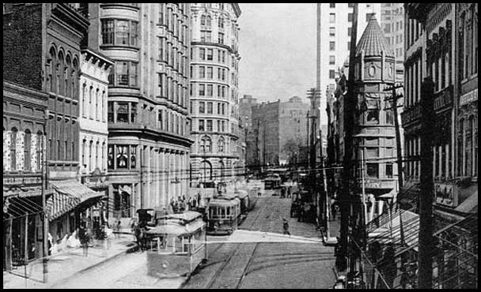
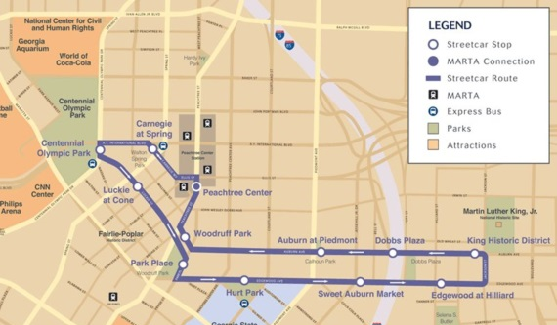
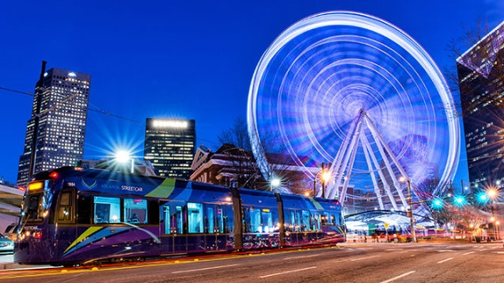
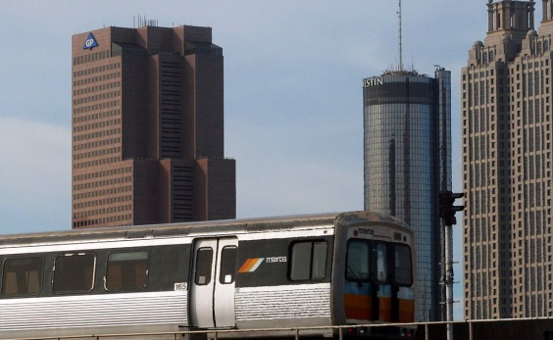
Phase One: East-West Route
The Atlanta Streetcar project is a cooperative effort by the City of Atlanta (COA), the Atlanta Downtown Improvement District, Inc. (ADID), and the Metropolitan Atlanta Rapid Transit Authority (MARTA).
Phase One of the Atlanta Streetcar opened December 30, 2014, providing a modern streetcar that connects the Centennial Olympic Park area to the Martin Luther King Jr., National Historic Site.
  Length: 2.7 track miles
  Number of Stops: 12
  Fleet Size: 4 Siemens S70 Vehicles
  Frequency: 10 – 15 minutes
  Hours of Operation: 7 days per week
    Monday-Thursday: 6:00 am – 11:00 pm
    Fridays: 6:00 am – 1:00 am
    Saturdays: 8:30 am – 1:00 am
    Sundays: 9:00 am – 11:00 pm
FY 2017 Accomplishments
All Governing documents submitted and accepted by GDOT
Closure of all 66 Corrective Action Plans (CAPS) assessed GDOT
Substantial improvements in performance and customer service
Continued efforts to improve operational and maintenance effectiveness and efficiency
FY 2018 Initiatives
Complete Threat-Vulnerability Assessment
Conduct Emergency Preparedness Exercise with AFD and APD
Complete Triennial Safety & Security Audit
Transfer Ownership and Operations of the Atlanta Streetcar to MARTA

Slide 24
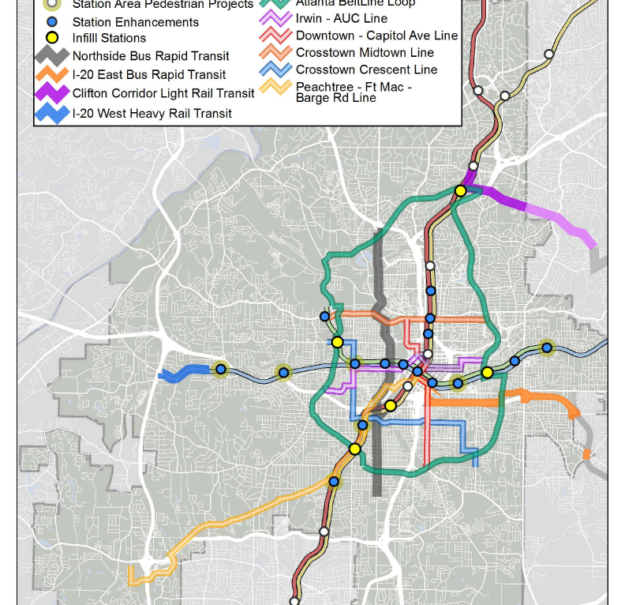
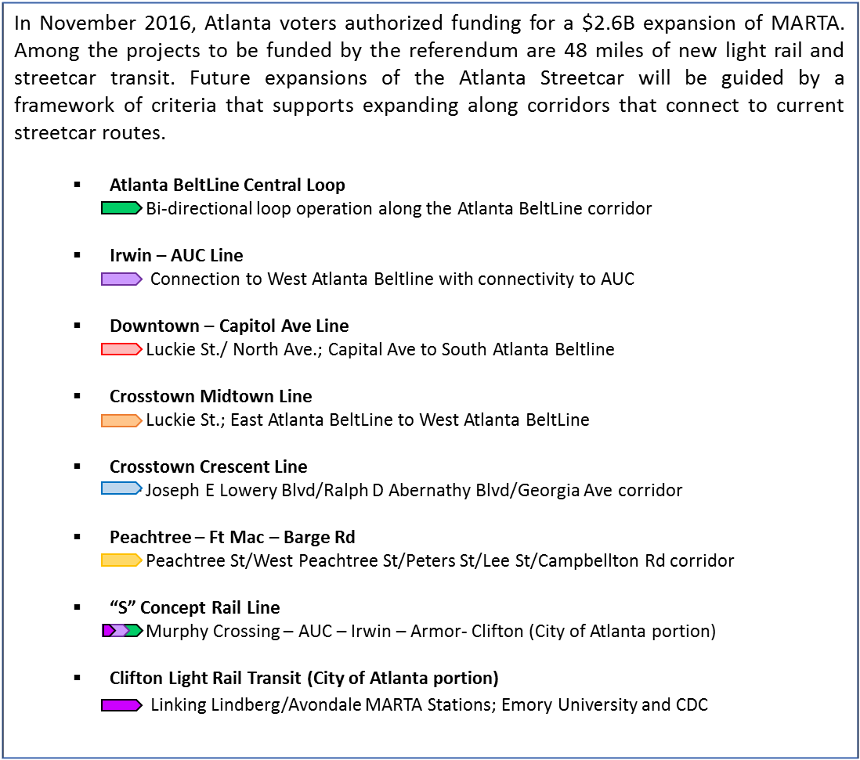

ATLANTA STREETCAR
Future Expansion

Slide 25
Atlanta streetcar
Service Performance
September 2017
Cumulative
Passengers | 33,934
Revenue Hours | 914
Passengers/Revenue Hour | 37.13
1,605,665
37,680
42.61
Revenue Miles | 4,199
167,272
Services Consumed | Average Weekday | Average Saturday | Average Sunday | Annual Total
Unlinked Passenger Trips (UPT) | 1,000 | 2,158 | 1,035 | 124,866
Passenger Miles Traveled (PMT) | 849 | 2,179 | 1,077 | 104,933
Reportable Accidents | 0
11
Avg Daily Fleet Status | 163%

Slide 26
Atlanta streetcar
FISCAL YEAR | BUDGET | ACTUAL | %
2015 | $ 5,208,671 | $ 2,470,923 | 47%
2016 | $ 5,387,632 | $ 4,801,032 | 89%
2017 | $ 5,281,115 | $ 6,241,399 | 118%
2018 | $ 7,337,853 | $ 640,189 | 9%
Operations & Maintenance Budget
The Atlanta Streetcar O&M Budget is $7.3M for 2018
38% of this budget is for Salaries and Benefits
39% of this budget is for Consulting/Professional Services

Slide 27
Capital projects

Slide 28
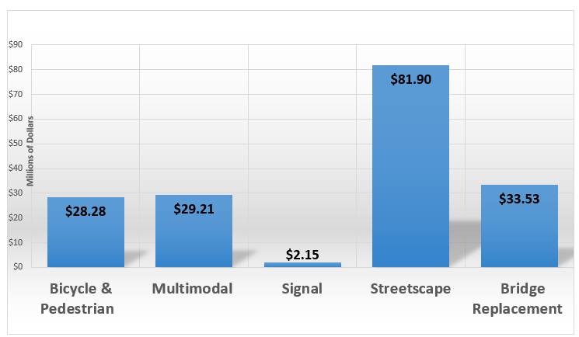
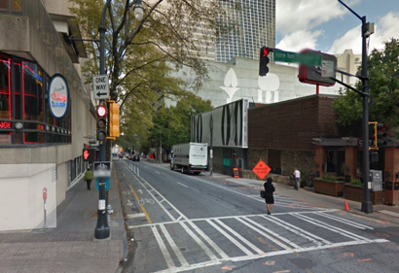
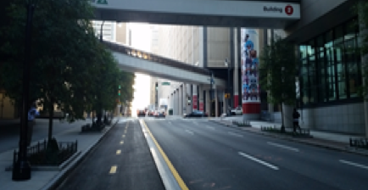
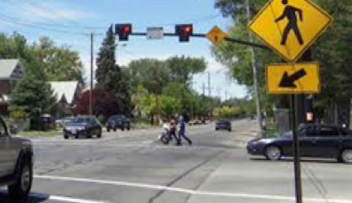
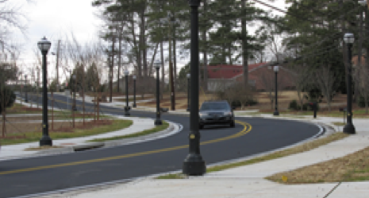
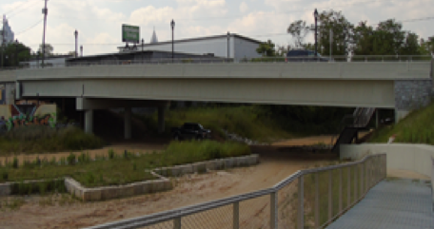





Capital projects
Capital Projects Program Overview Department of Public Works
Bicycle & Pedestrian Projects include: Bicycle Lanes Multi-use Paths Trails Multimodal Improvements: Access to Transit Connectivity via multiple transit modes Signal Improvements Include: Hawk Signals School Flashers Traffic & Pedestrian Signals | Streetscapes include: Sidewalk & Curb Enhancements Landscaping Pedestrian Lighting Bridges: Repair Replacement
Current Program Estimates 5-YR Total: $175.07M; 36 Projects
$28.28M
Bicycle & Pedestrian Projects:11
$29.21M Multimodal
Projects: 8
$2.15M Signals
Projects: 3
$81.90M Streetscape
Projects: 12
$33.53M Bridge Replacement Projects: 2

Slide 29
Capital projects
Key Accomplishments
Look Ahead
Lynhurst groundbreaking, Nov. 2, 2017
GA Power utility relocation for MLK project underway GA Power mobilized to site on Oct. 9, 2017
Construction for Broad Street Pedestrian project has started and expected to be completed December 2017
Award construction contract for MLK in November 2017
Bid package for Spring Street Bridge expected on the street November 2017
Construction for Gateway Priority Projects is underway
Continue to identify funding sources for Gateway Project $3.5M Shortfall 3.
Cost Details
 | $175.07M Program Budget | $158.73 Commitments | $16.34M Funding gap | $1.58M Spent To date | 0 Closed projects | $40.86M Under construction
EBO Snapshot
31.6% EBO Design Goal | 50.9% EBO Design Actual | 37.9% EBO Construction Goal | 66.7% EBO Construction Actual
Contract Snapshot
18 Contracts Awarded | 36 Active Projects

Slide 30


