Slide 1
Solid Waste Briefing
Presented to City Utilities Council – November 14, 2017

Slide 2
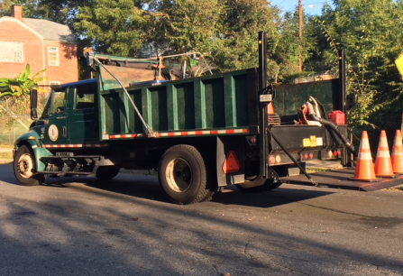
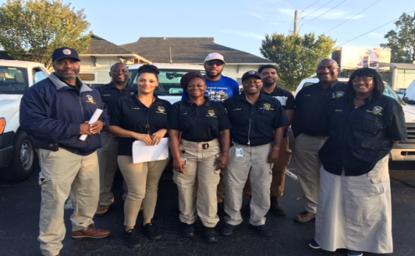
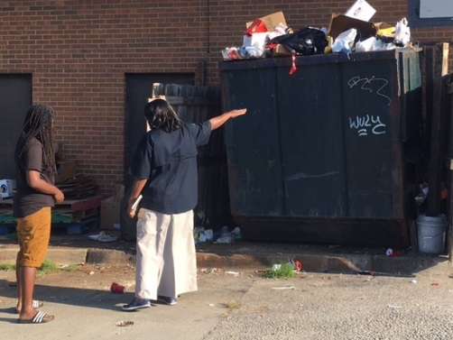
City of Atlanta’s Solid Waste Services
COLLECTIONS | SPECIAL OPERATIONS | EDUCATION & ENFORCEMENT | COMMERCIAL
Curbside Collections & Disposals Backyard Collections & Disposal Recycling Yard Trimming Collections & Disposal City Facility Collections | Bin Delivery Dead Animal Removal Bulk Waste Collection Right-of-Way Maintenance Street Sweeping Illegal Dumping Illegal Sign Removal Special Event Staffing Vacant Lot Cut & Clean Residential Street Sweeping Right-of-Way Grass Cutting | Solid Waste Education Enforcement Team Keep Atlanta Beautiful | Multi-Family Residential Garbage
Notes:
Solid waste operations:
Residential Services make up about 95% of the solid waste collections services provided net of the special ops category
Special Ops includes street sweeping, ROW Maintenance, bulk waste collection, vacant lot cleaning, etc.
Multi-family residential waste collection – most all new construction in the City falls within this category

Slide 3
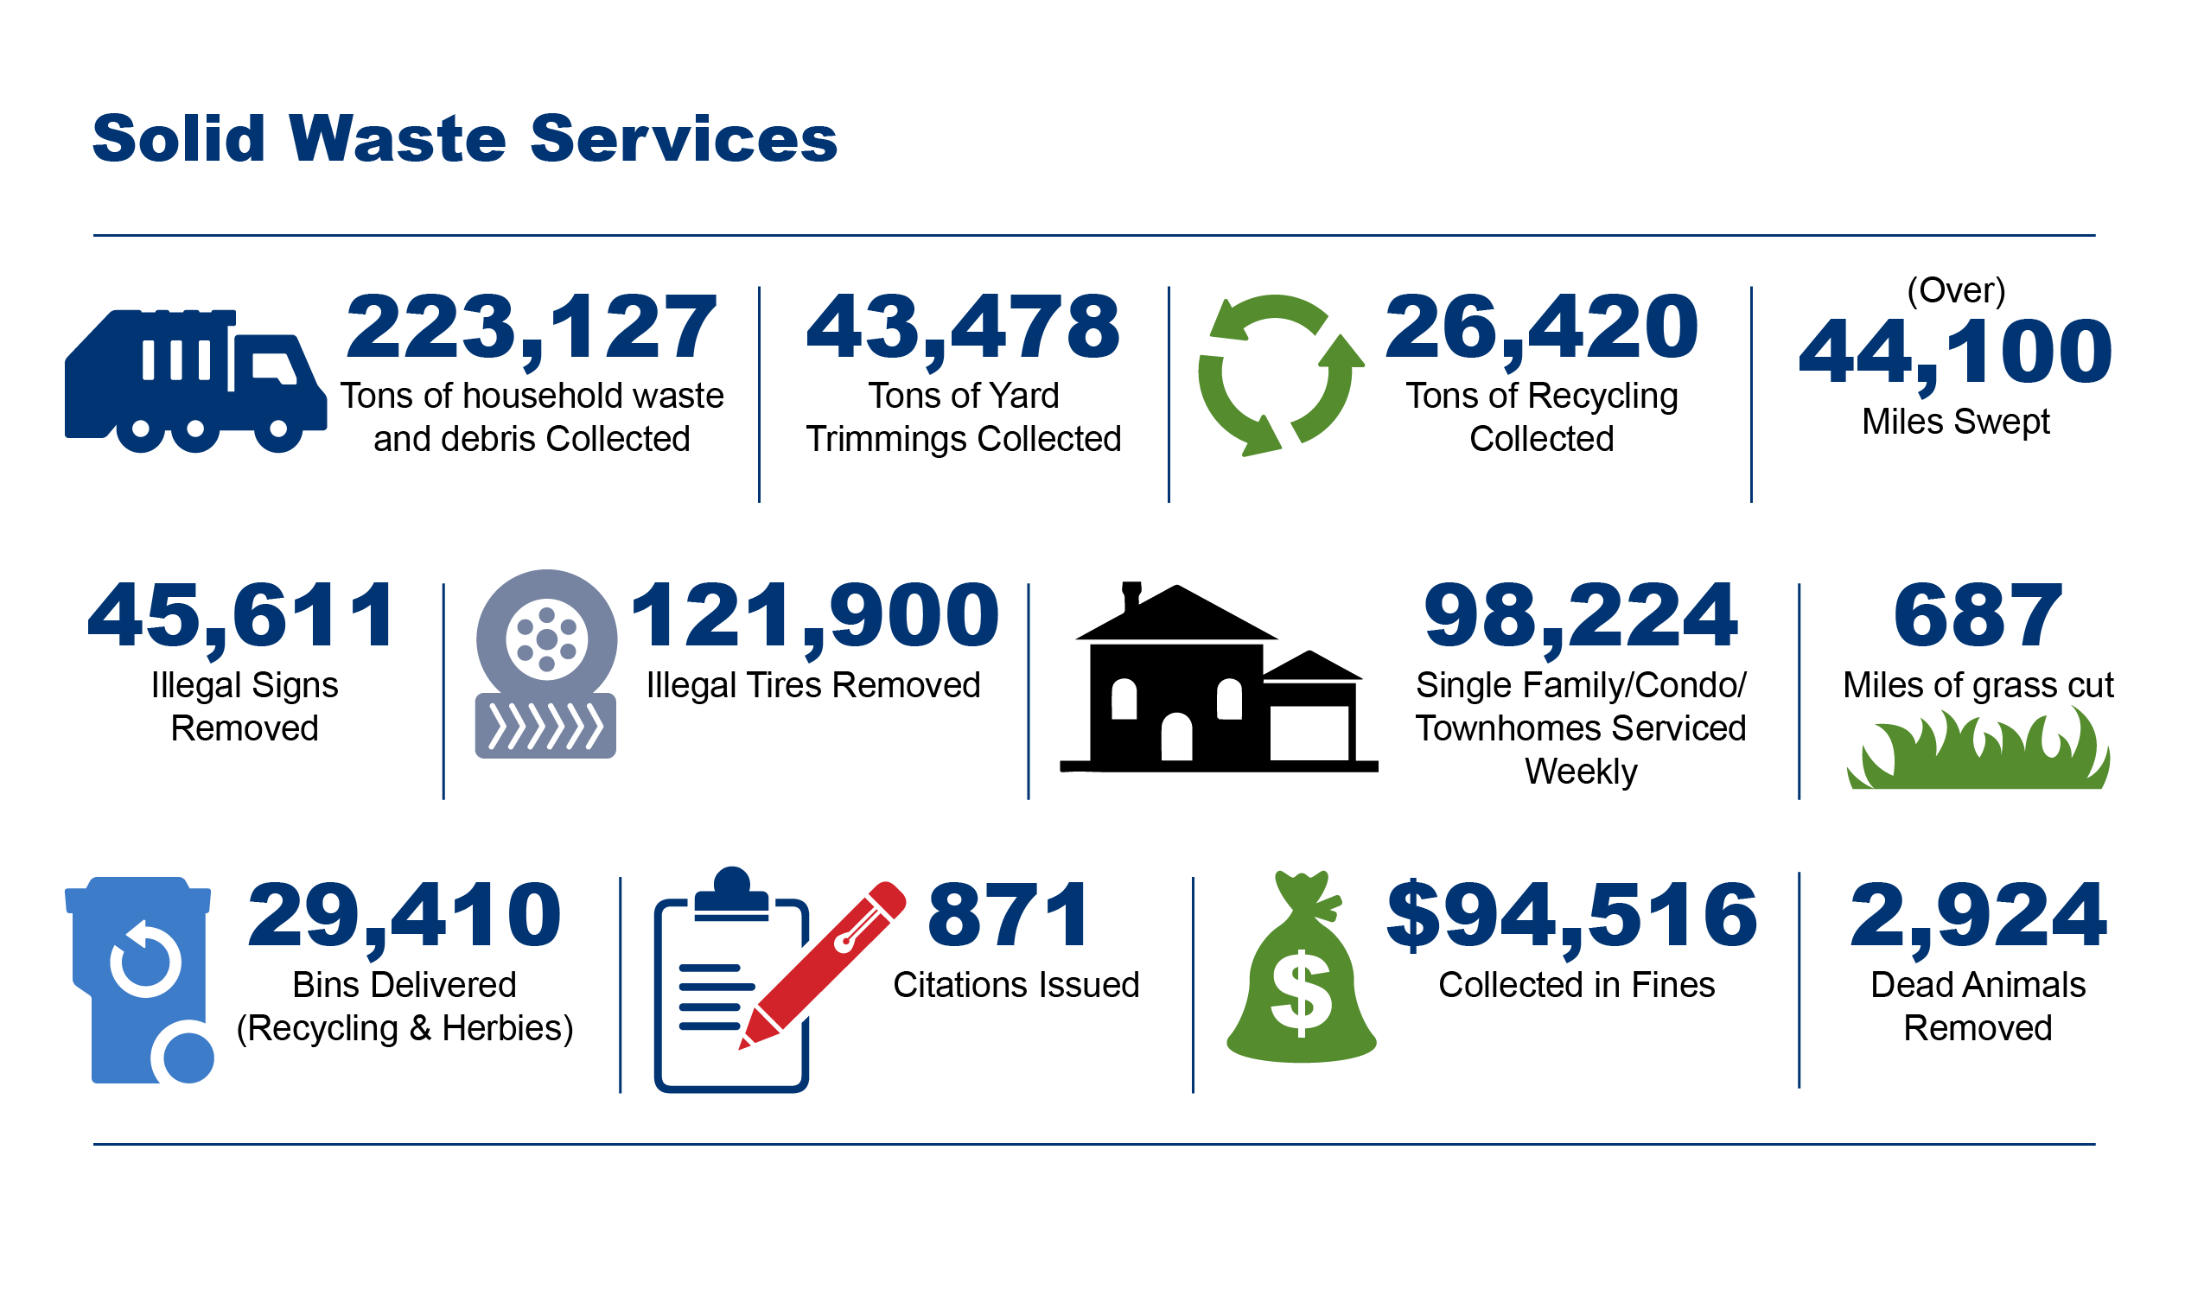
Solid Waste Services By the Numbers
Calendar Year 2016 – September 2017
Notes:
Just by the numbers…
98,000 customers weekly between residential ingle family, condos, and townhomes serviced
223,000 tons household waste (Calendar year 2016-September 2017)
43,000 tons Yard waste
26,420 tons Recycling or only around 12% during that period by tonnage
Lack of robust education
Lack of accountability and participation – Multi-family

Slide 4
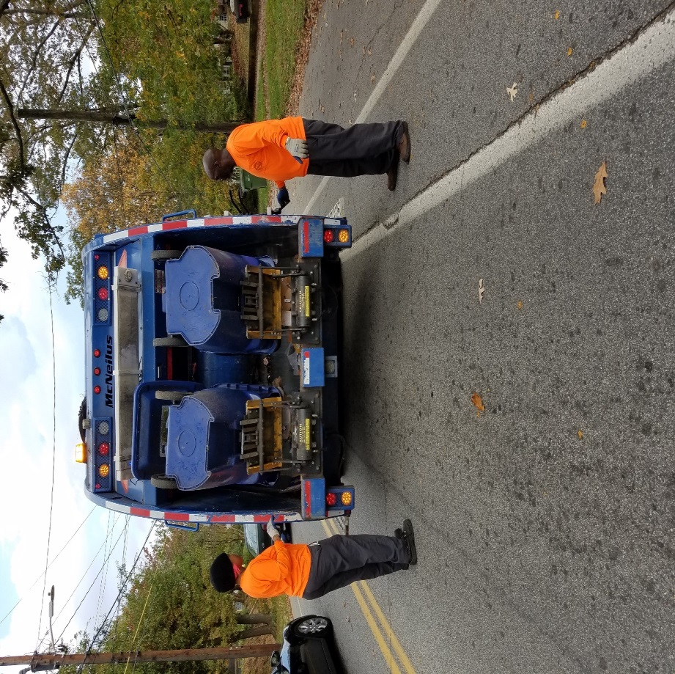
Impacts on Revenue
Last Rate Adjustments
**2002- Front Footage Corner Lot Reduction
2004- Garbage Increase
**2010- Recycling Increase
Citywide Technology Implementations
Legacy Costs
Employee Pension and Healthcare
Landfill & Post Closure Care
Escalating Costs
Fuel
Disposal
Outdated equipment
Increased labor costs
Increased maintenance costs
Cost of living salary adjustments totaling 17.5% since 2002
Aging Fleet/Escalating Maintenance Costs
Fluctuation of Recycling Revenues Due to Commodities Market
Notes:
Historic Rate adjustments have not covered operating expenses
Front footage reductions 2002
Recycling fees were to be set at $129 in 2010, but only $88.00
Citywide Technology Implementations
Oracle
Hansen
ATL 311
Legacy Costs make up about 18% of the total Operating Expense
Recycling Processing fluctuates
Historically Major operating expense
Currently 6-month Agreement that returns about $2.50/ton
Note: Major operating expense is labor followed by maintenance, fuel, etc.
Solution is to modernize fleet – picture of 3 man recycling route and truck

Slide 5
Current Budget Position
Notes:
Largest cost category across all business lines is labor – 53%
Efficiencies need to result in re-allocating labor to perform other business functions while modernizing the fleet to reduce maintenance expenses as well

Slide 6
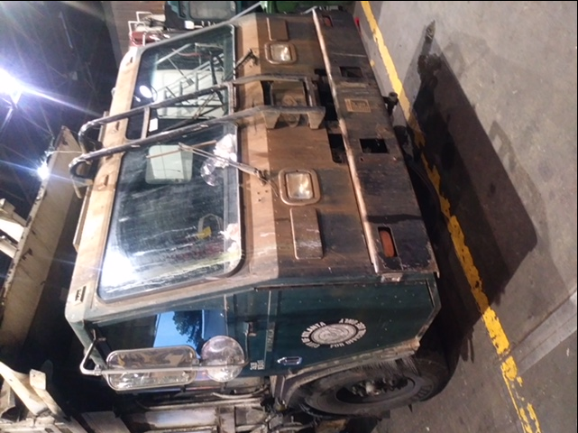
Age of Fleet
Notes:
We have 88 trucks in our fleet and have experienced days with as many as 37 trucks down
Red bars – Past life cycle (Over 30% of the fleet)
2013s – Internationals with bad maintenance history (Over 27% of the fleet)
2014s & 2017s – CNGs with high maintenance costs low reliability (28%)
All trucks in pics are at Fleet Services today
Looking at our fleet, there are a core group of 11 trucks that are consistent, others, not at all
None of the trucks allow for modern efficient collection methodology
Limited capital available for vehicles – competing with other priorities
Capital Lease Program available to assist with modernizing the fleet as part of the total plan

Slide 7
Current Financial Position
Service | On-Going O&M Expenses | Legacy Costs | City Overhead Charges | Total Expenses | Total Revenues | Deficit
GARBAGE | $ 25,156,208 | $ 5,595,502 | $ 2,177,666 | $ 32,929,376 | $ 29,093,481 | $ 3,835,895
RECYCLING | $ 9,580,667 | $ 882,420 | $ 685,859 | $ 11,148,946 | $ 7,907,582 | $ 3,241,364
COMMERCIAL | $ 1,671,854 | $ 167,679 | $ 9,104 | $ 1,848,637 | $ 1,213,934 | $ 634,703
FRONT FOOTAGE | $ 14,595,888 | $ 2,617,727 | $ 1,461,460 | $ 18,675,075 | $ 12,915,120 | $ 5,759,955
TOTAL | $ 51,004,617 | $ 9,263,328 | $ 4,334,089 | $ 64,602,034 | $ 51,130,117 | $ 13,471,917
Notes:
$14 Million revenue shortfall in 2017
Residential Single-family Fee recovers about 95% of the costs
Recycling Fee recovers about 82% of the costs
Multi-family Fee only recovers 70% of the costs
Front Footage Fee only recovers 76% of the costs
Revenue on Commercial does not include recycling revenue
Based on historical contracts, the city has paid for recycling processing. therefore using conservative financial modeling we do not anticipated in the future.

Slide 8
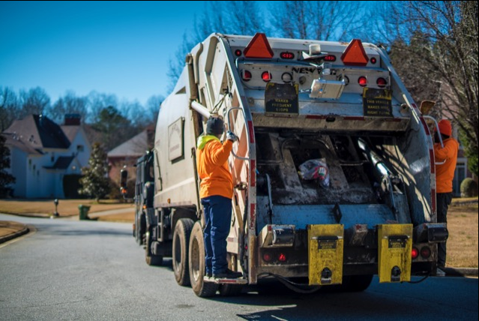
Solid Waste Management Plan Benefits
Eliminate front footage for residents
Provide option for smaller waste containers
Reduce reliance on General Fund and control cost
Long-term contracts for material processing and disposal
Increase recycling to progress toward 90% diversion goal
Modernize fleet to reduce maintenance costs
$13 to $15 per hour for City waste collectors
Notes:
Elimination of the front footage fee should benefit all residential customers
Provides smaller waste container options at reduced solid waste rates to encourage recycling
Rate adjustments close the gaps and eventually brings the solid waste enterprise into the black
Long term processing and disposal agreements provide long term stability and security for capacity and rates
Allows the City to expand services and collect more information on diversion and recycling
As we modernize our fleet, we will increase collection efficiency reduce maintenance costs, and diversify service offerings to retain jobs and improve overall diversion rates.
Meet Council’s $15/per hour living wage

Slide 9
Solid Waste Management Plan Benefits
Improvements to Collection Program
64 and 32-gallon trash bins available by request
Create incentives to recycle more
Residents pay a variable rate, comparable to other cities, based on amount of service they use
Bulk Waste
Expansion of CHaRM to four locations citywide
Bulk waste drop-off for residents at each location
Additional Benefits
Increased public education for cleaning and greening for our communities
Collect or franchise commercial and multi-family waste
Substantially increase enforcement activities
Partner with key stakeholders in the community
Notes:
Bulk Waste strategy will provide service on a scheduled basis for atlanta residents only
Will build on our relationship with CHARM and provide up to 4 waste drop-off locations City-wide
Will include Hard to Recycle Materials and BULK WASTE DROPOFF
Provides for a much greater level of dedicated commitment to public education in schools and communities
More than double our enforcement efforts on illegal dumping, recycling compliance, and other activities

Slide 10
Benchmarking Study
10 Cities Benchmarked
Community | Residential Base and Recycling Fee | Backdoor Fee | Extra Waste Fee | Yard Waste Fee | Bulky Waste Fee
Atlanta, GA | $395.19 | $962.21 | no | Included | Included
Marietta, GA | $260 to $576 | NA | yes | Included | Per item
Douglasville, GA | $198 to $312 | No | $1 per bag | Included | Per item
Seattle, WA | $256 to $1,224 | Yes | Included | Included | $30 per item
Portland, OR | $294 to $498 | $352 to $556 | $5 per bag | Included | Per Item
Miami, FL | $508 | yes | no | Included | Included
Oakland, CA | $294 to $1,130 | yes | yes | Included | Included
Minneapolis, MN | $306 to $342 | no | $15 | Included | Included
El Paso, TX | $204 | yes | $5 per bag | Included | $35 per item
Notes:
Benchmarking included a large number of Cities from every region of the Country
Collected best practices from both private and publicly operated services
Compared rates and services
Found that the proposed solid waste rates are comparable to other Cities and less than many
Service offerings by City of Atlanta often exceeded the service offerings by other municipalities

Slide 11
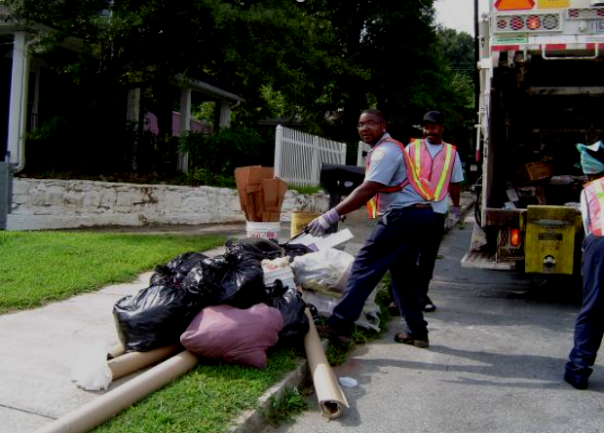
Exceeding Other Communities
Cleaning, Greening, and Community Beautification
In addition, Solid Waste provides a number of services that are not provided by other City solid waste departments
Set-out limits are less restrictive than is typically provided in other cities in order to minimize litter
Signage Removal
Right-of-Way Maintenance
Street Basket Collection
Street Sweeping
Dead Animal Collection
Vacant Lot Cleaning
11
Notes:
Many of the areas where service levels are exceeded include:
Excess trash beyond the amount that fits inside of the city provided container
Excessive amounts of yard waste set-out
Signage removal
ROW Maintenance
Vacant Lots
Also worth noting that the City only provides residential service
Very little provision of Multi-Family, Commercial, and Roll-off services
These services are usually provided to spread costs over larger customer base and reduce overall expense to residents

Slide 12
Proposed Rate Increase
Services | Current Rate | 2018 Rate | 2019 Rate | 2020 Rate
Recycling | $ 88.00 | $ 102.24 | $ 116.49 | $ 130.73
Residential Single-family | $ 307.19 | $ 326.73 | $ 346.27 | $ 365.81
Residential Backyard | $ 962.21 | $ 1,023.37 | $ 1,084.53 | $ 1,145.69
Residential Multi-family (Less Than 6 Units) | $ 307.19 | $ 326.73 | $ 346.27 | $ 365.81
Parcel Type | Proposed Rate
Residential | $0
Residential Vacant Lots | $500
Commercial Parcels | Proposed Rate
1 – 100 ft. | $700
101 – 200 ft. | $1,500
201 – 450 ft. | $3,000
451 – 700 ft. | $5,000
701 – 850 ft. | $7,000
> 850 ft. | $10,000
Notes:
Rates proposed for calendar year 2018, 19, 20
Fiscal Years 2019, 20, 21 (retro to Jan 1st) – Tax Roles
We anticipate that we will ultimately be forced to go to Monthly Billing as part of the solution
Replacing the Front footage fee is a lot assessment
Zero on Residential developed lots
$500 for vacant lots
Rate table for rates on commercial lots based on lot size
The condos and townhomes are treated as residential developed lots

Slide 13
Impact to Typical Homeowner
Fees | Current | Proposed 2018 | Proposed 2019 | Proposed 2020
Recycling | $88.00 | $102.24 | $116.49 | $130.73
Residential Single-Family | $307.19 | $326.73 | $346.27 | $365.81
Front Footage Fee (Typical) | $60.00 | $0.00 | $0.00 | $0.00
Total | $455.19 | $428.97 | $462.76 | $496.54
Notes:
Impacts on typical rate payer may be a reduction in the total paid during the first year of the increase due to the elimination of the front footage fee
by year 2 and three there are slight increases over today’s rate.
It should be noted that the current bills do not break out the separate costs for recycling fees from solid waste fees on the tax bills, but rather shows the consolidated cost for the services

Slide 14
Summary of Solid Waste Ordinance and Rates
Sec. 130-1: Definitions Changes/Additions:
Container
Extra garbage
Paper bags: (Removal of Kraft bags)
Recycling contamination
Sec. 130-36
Collection containers for yard trimmings
Extra yard trimmings
Sec 130-37
Garbage collection container size
Containers shall not be overfilled to prevent closure of lid
Extra garbage requires prepaid sticker
Contaminated recycling – fee after being tagged three times
Sec 130-43
Collection of solid waste and recyclable materials from commercial properties
Sec 130-45
Collection containers for construction and demolition wastes
Sec 130-84 Rate and Charges
Vacant Parcels: $500 per parcel
Extra Garbage/Overfilled Bins $12 per bag/occurrence
Additional Bulk waste collection: $325 per address
Non-containerized yard trimmings: $2 per bag
Pay-As-You Throw (PAYT)
64 and 32-gallon trash bins available by request
Creates incentive to recycle more and generate less waste
Residents pay a variable rate based on the amount of service they use
Notes:
This slide shows many of the sections of the waste ordinance that would be changed to facilitate implementation of the proposed rates and changes
Pay as you throw:
Pre-paid stickers for extra trash, extra yard waste
Variable rates with smaller container sizes available to those who focus on recycling and produce less solid waste
Extra Charges for bulk waste collection beyond 2 times per year on-call per residential customer
Allows for solid waste and recycling collection from commercial, industrial, and C&D Customers

