Slide 1
Defined Contribution (“DC”) Plan
RETIREMENT BENEFIT
LIMITED
Limited to the amount of money in employee’s DC Retirement Account
Employee Contribution:
LIMITED
% of salary to DC Retirement Account from each paycheck
City Contribution:
LIMITED
Amount equal to % of employee’s salary to her/his DC Retirement Account
DC Retirement Account
*An investment account *Employee directs how money is invested
*Value at retirement is based on amount invested and performance of investment

Slide 2
Defined Benefit (“DB”) Pension Plan
RETIREMENT BENEFIT
UNLIMITED
Pension payment for entire life of employee,
and for life of surviving qualified beneficiary
Employee Contribution:
LIMITED
Percentage of salary to pension plan from each paycheck
City Contribution:
Unlimited Amount needed to fulfill lifetime retirement obligation

Slide 3
Seminal Fact About DB Pension
RETIREMENT BENEFIT
UNLIMITED
Pension payment for entire life of employee,
and for life of surviving qualified beneficiary

Slide 4
Reed Administration: A Legacy of Fiscal Strengthening
Because of our efforts, Atlanta is in the strongest financial condition in more than a generation.
In 2010, we started out with our heaviest lift – pension reform. Our solution has become a model for other cities in America.
Since then, we have built our cash reserves from $7.4 million to over $175 million today. We have balanced our budget for eight consecutive years, without once turning to a property tax increase. We have moved our credit rating eight positions, to AA+, the second highest credit rating that a City can have.
Now is the time to take this last final big vote on a fiscally smart, good government policy proposal.
- Mayor Kasim Reed

Slide 5
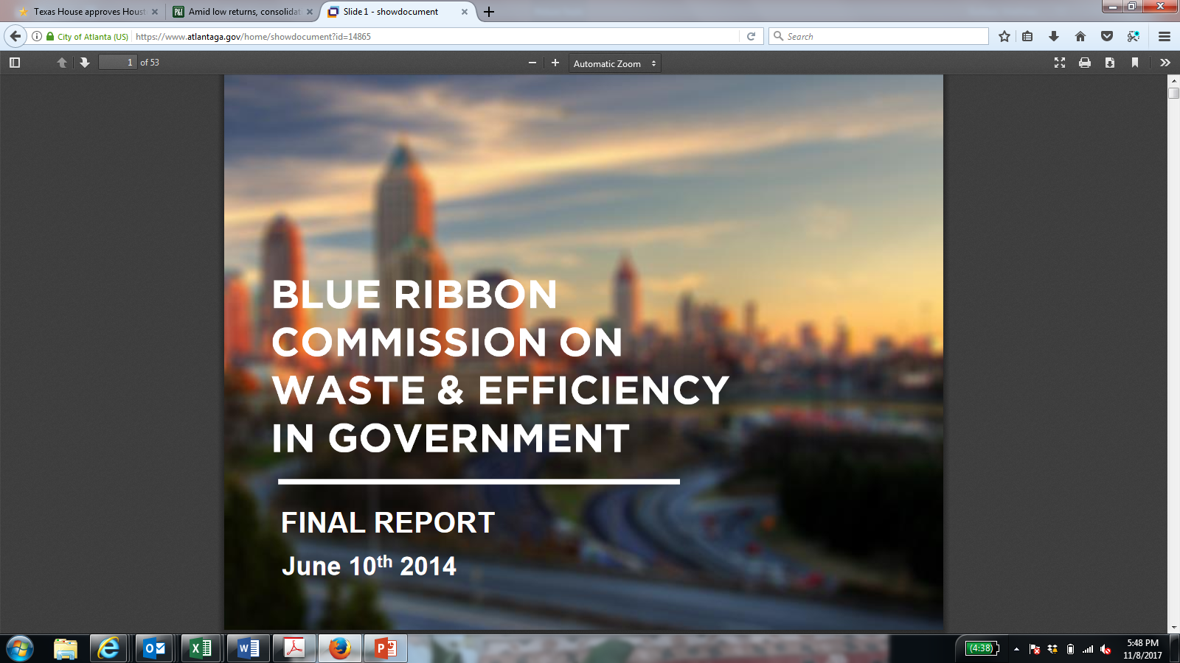
2014 Blue Ribbon Commission on Waste & Efficiency in Government Recommendation

Slide 6
17-O-1589 Proposed Improvements to Governance of Pension Boards
What are we proposing?
Ensuring that the investment decisions for employee pensions are the best they can be by:
Bringing together the three pension boards into one investment board to achieve lower costs in administrating three employee pension funds
Implementing best practices such as bringing more expert capability to the board, improving board training qualifications and increasing transparency
While still maintaining the funds separately and creating administrative sub-committees for claims and non-investment administration
Benefits
Reduce the administrative costs of servicing three separate boards, e.g., actuarial, legal, investment consultants, third party administrators
Ensure investment performance is optimized, so that the annual pension contribution cost from the General Fund is the lowest it can be in all financial cycles
And pushes out as far as possible the financial cap that triggers further potential pension changes

Slide 7
What Proposal Does and Does Not
What this will NOT do:
Does NOT affect your paycheck or retirement check
Does NOT co-mingle the three funds – they will be maintained separately
Does NOT eliminate representation on Board of plan participants: both active and retire representation remains on the Board
What this will do:
Bring more financial expertise to the pension investment decisions, in line with best practices
Save administrative costs by consolidating advisors/consultants across three funds
Increase transparency through additional reporting requirements

Slide 8
Pension Fund Investment Returns

Slide 9
City of Atlanta Contributions Including General Fund, Aviation, Watershed and various other enterprise funds

Slide 10
Current structure
Description |  | General Employee | Police | Fire
Participants |  | Eligible non-sworn employees & Legacy APS participants | Police sworn employees | Fire sworn employees
Approx. Value of Fund Assets (9/01/2017) |  | $1.341b | $1.041b | $661.5m
Investment Consultant |  | Callahan | Marquette | Consequent
Third Party Administrator |  | GEM Group | Zenith American | Zenith American
Actuary |  | Segal | Southern Actuarial | Southern Actuarial
Outside Counsel |  | Peter Chan Morgan, Lewis, Bockius, LLP | Helen Cleveland Cleveland Gilbreath, LLC | Ed Emerson Morris, Manning and Martin LLP
COA Resources |  | Cost of DHR, Finance, Law Indirect Costs varies | Cost of DHR, Finance, Law Indirect Costs varies | Cost of DHR, Finance, Law Indirect Costs varies
Total Investment and Admin. Expenses | FY10 | $4.79M | $3.20M | $2.37M
 | FY11 | $5.24M | $2.97M | $2.35M
 | FY12 | $4.97M | $3.44M | $2.58M
 | FY13 | $4.25M | $3.15M | $2.59M
 | FY14 | $14.11M* | $4.49M | $3.56M
 | FY15 | $5.56M | $3.85M | $3.21M
 | FY16 | $4.60M | $3.55M | $2.98M
 | FY17 | $5.02M | $4.17M | $3.04M
* FY14 General administrative expense includes City indirects from previous years allocation not charged

Slide 11
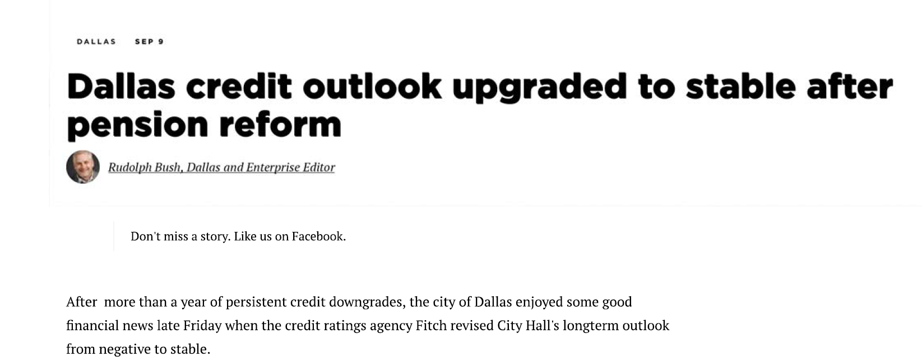
Best practice in Pension Governance
Dallas
Board Makeup
11 Trustees
6 appointed by Mayor
1 Police active or retired, elected by members
1 Fire active or retired, elected by members
3 appointed by nominations committee
Mix of Outsiders & Plan Representation
✓
6 Mayor appointees (majority) have background in finance and investment
Expertise Requirements
✓
All trustees must have demonstrated financial, accounting, business, investment, budgeting, real estate, or actuarial expertise
Consolidated governance
✓
Police and Fire Pension System

Slide 12
Proposed Governance Changes
Description | Current | Future
Assets | Multiple investments with @ 25% of fund families existing across all 3 Boards | Combined assets of @$ 3.435b which will provide greater leverage and desirability in the external market
Board Governance | 3 Boards | 1 COA Investment Board 5 Committees 1-3 General EE, APD, AFR, 4 Governance/Compliance 5 Audit
Board Composition | Mayoral Appointment, Standing Members, Participant Elections | Mayoral Appointment, Standing Members, Council Appointment, Participant Elections
Investment Consultant | 3 Firms | 1 Firm selected by Investment Board
Third Party Administrator | 2 Firms | 1 Firm selected by Investment Board
Actuary | 2 Actuaries with different philosophies | 1 firm selected by Investment Board
Outside Counsel | 3 Firms | 1 firm selected by Investment Board
COA Resources | Charge back varies from DHR, Finance & Law | Defined Administrative Overhead and Indirect Cost

Slide 13
Desired Outcomes
Lower Administrative Cost
A reduction of 20% in administration cost is $1.4 million per year
Reduce Investment Management Cost
A reduction of 10% in Investment Management Cost is $2.9 million per year
Performance Improvement
A overall performance improvement of 1% based on a focus on manager selection and asset allocation across all plan would improve performance by $32.6 million across the three plans.
General: $15.5 million
Fire: $6.6 million
Police: $10.5 million

Slide 14
Impacts of Proposed Changes
Impacts for ALL stakeholders (plan participants, elected officials, taxpayers)
Improved returns and lower administrative costs = Lower City of Atlanta contributions (e.g., General Fund and enterprise funds) and ability to invest further in city services
Pushes out as far as possible the financial cap that triggers further potential pension changes
Impacts for Pension Board Trustees
Governance responsibilities for generating returns and managing risk to be supplemented and shared with additional member experts
Access to best-available external advice at lower costs
Ability to better align expertise and experience with trustee role (investment vs. administrative)
Impacts for plan participants
Greater visibility into board activities
Greater confidence in pension performance due to increased expertise
No impact on paycheck

Slide 16
From Borders, 298 Ga. at 192:
"In addition, the General Assembly has expressly authorized municipalities to establish and finance retirement systems and to provide retirement and pension benefits. OCGA § 36–34–2(4) confers upon the governing body of any municipal corporation,
'[t]he power to establish merit systems, retirement systems, and insurance plans for all municipal employees and to establish insurance plans for school employees of independent municipal systems and to provide the method or methods of financing such systems and plans[.] ...
(Emphasis supplied.)'"

Slide 17
Annual Required Contribution (Slide from Efficiency Commission, 2014)
Currently expect to hit 35% cap (and trigger employee cost sharing) by 2029. Estimate that 50 bps improvement in rate of return delays trigger by 3-5 years; 100 bps improvement likely avoids trigger altogether.

