Slide 1
CITY of Atlanta CDHS Committee meeting
Cary S. Burgess SVP, Operations, Guest Services & Community Affairs

Slide 2
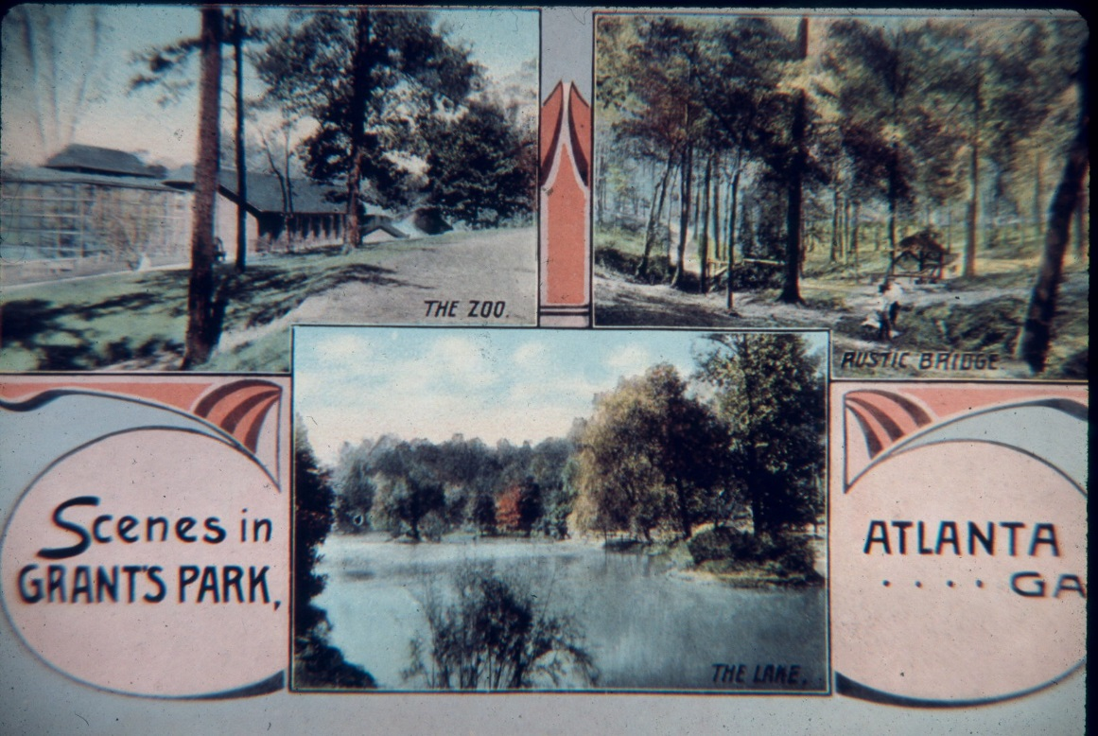
128 years wild: at home in Grant Park since 1889

Slide 3
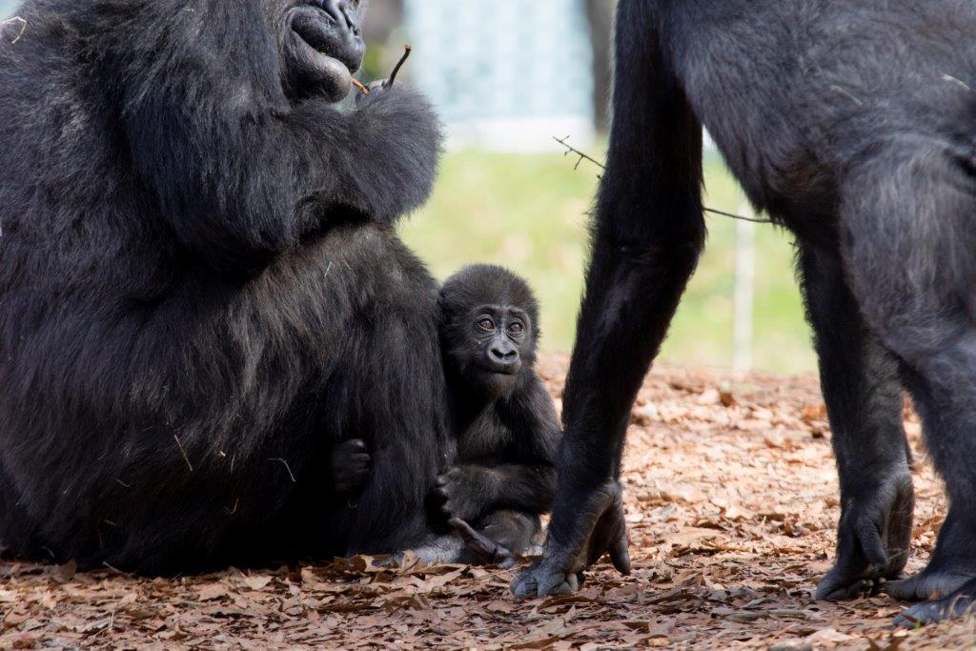
Home of North America’s largest zoological population of great apes and a national leader in the care and study of gorillas and orangutans

Slide 4
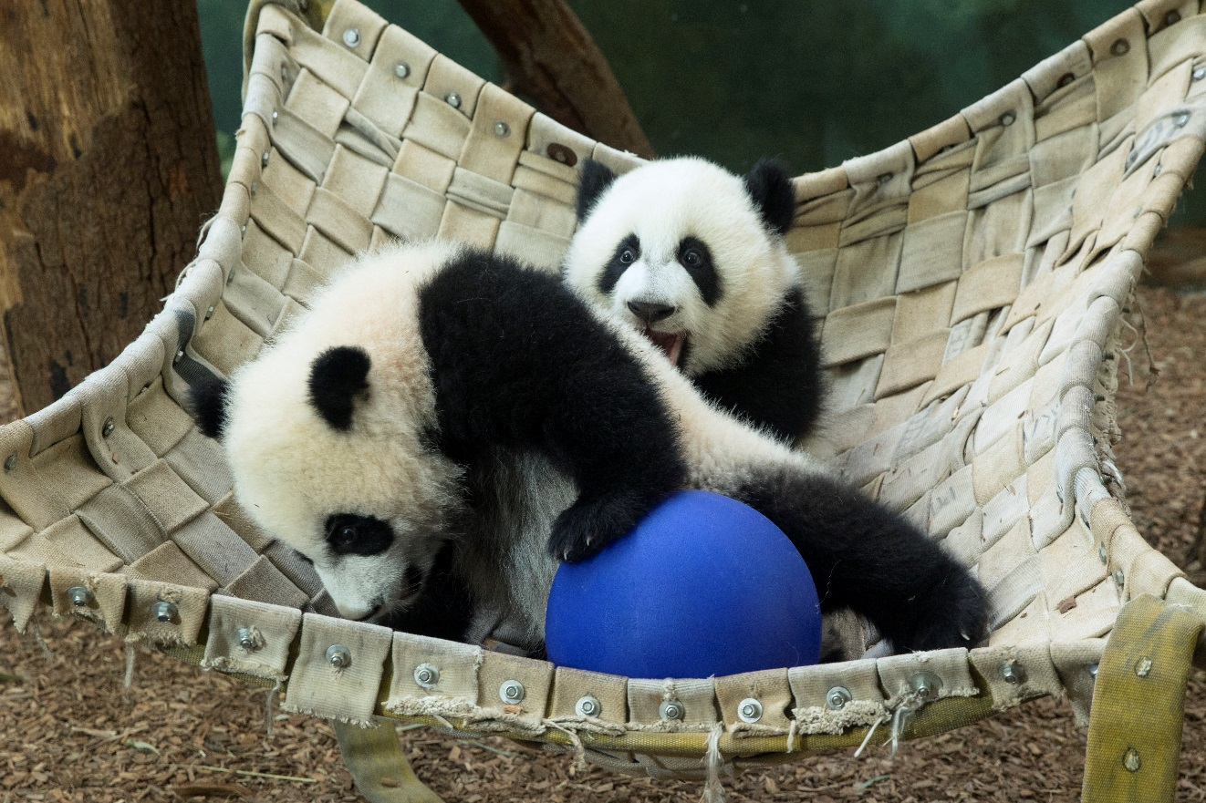
One of only four zoos in the U.S. housing giant pandas – our most significant financial investment in wildlife conservation

Slide 5
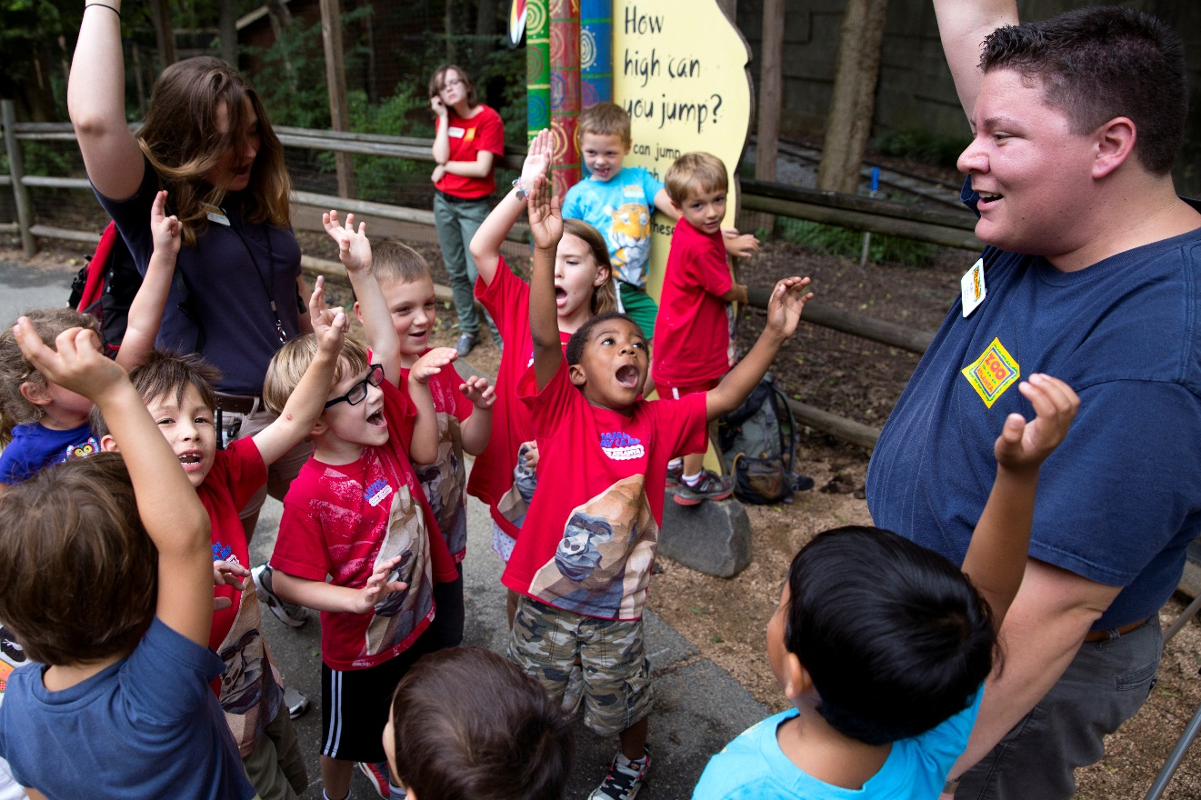
A vital partner for Georgia educators and lifelong learning for more than 151,000 students in 2016

Slide 6
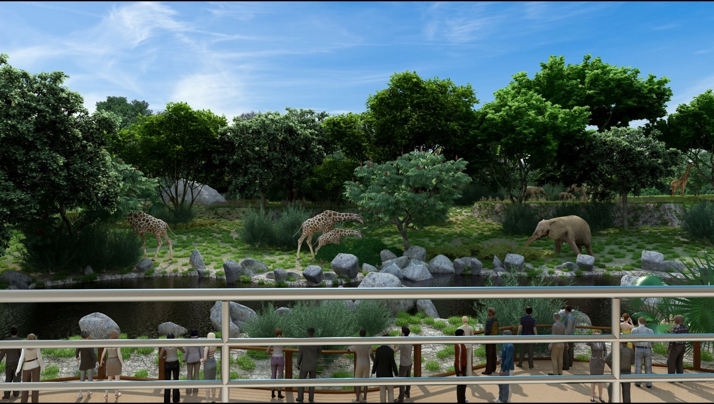
The Zoo’s Grand New View

Slide 7
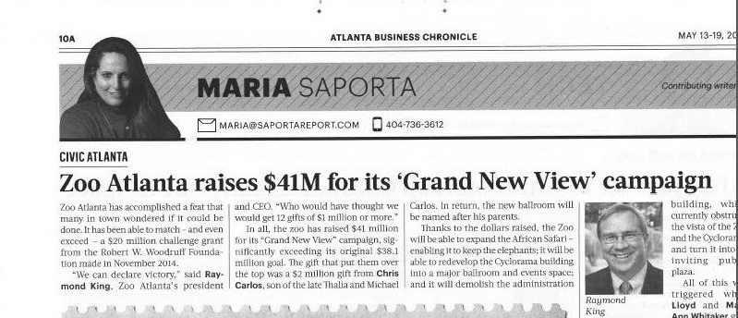
Success for Grand New View: Elephants, Events and Expansion

Slide 8
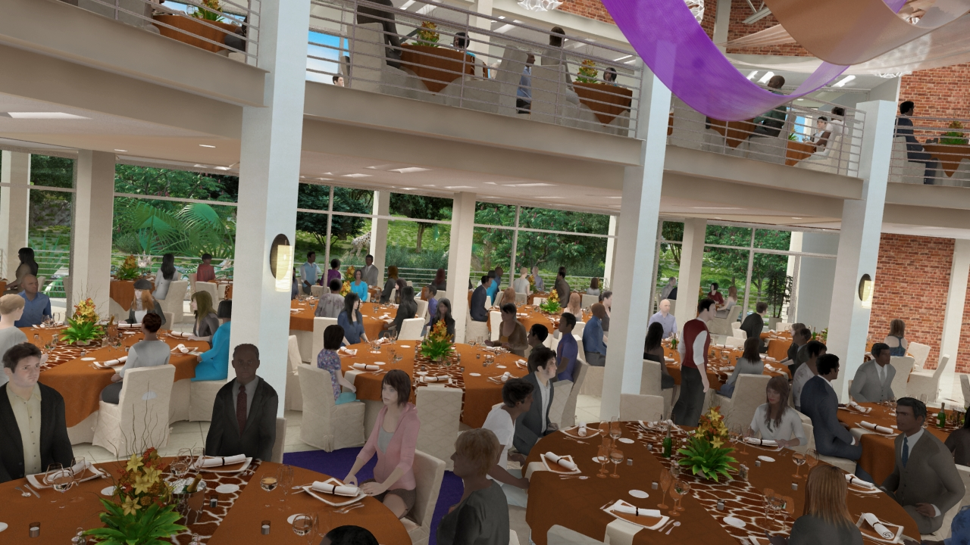
Grand New View: state-of-the-art event space concept

Slide 9
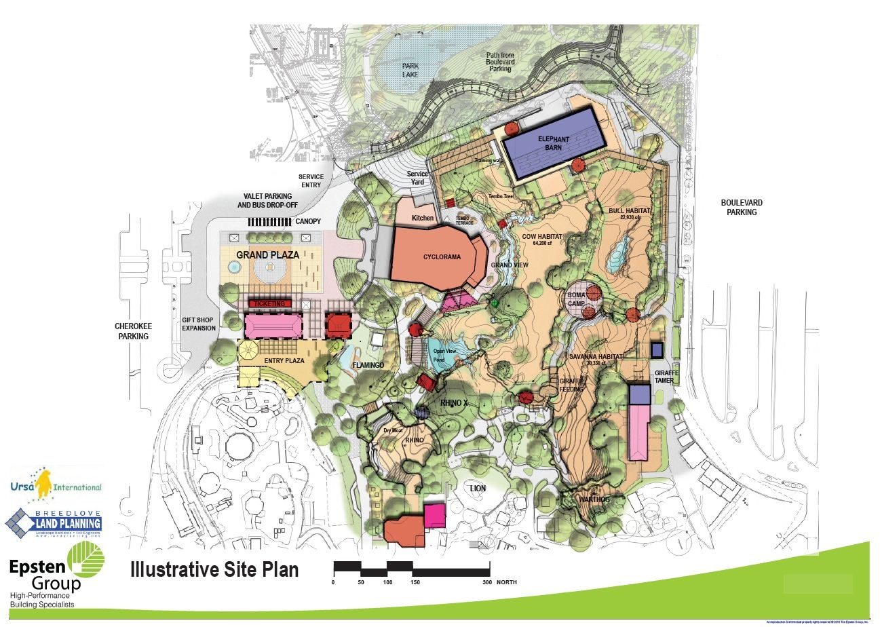

Slide 10
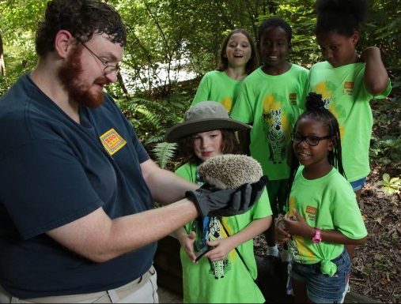
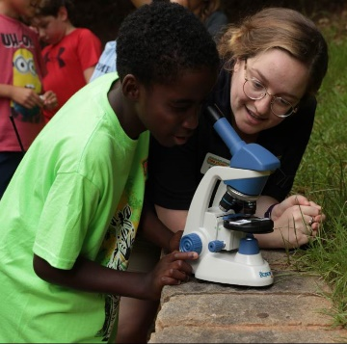
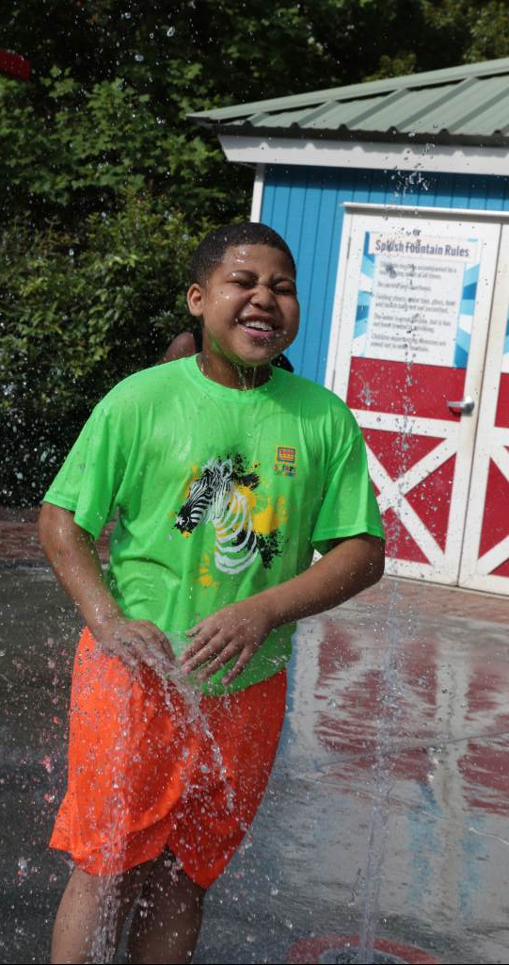
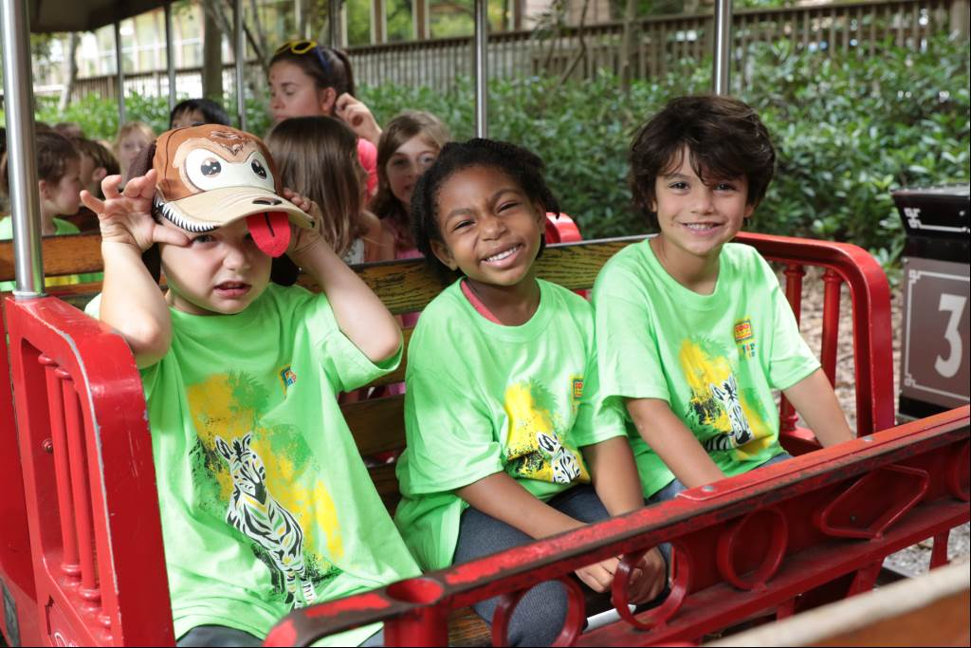
Safari Day Camp Scholarship Program
60
youth were able to attend one week of Summer Safari Day Camp!
Week | Awarded | Participated
July 10 – 14, 2017 | 16 | 16
July 17 – 21, 2017 | 20 | 20
July 24 – 28, 2017 | 12 | 12
July 31 – Aug 4, 2017 | 13 | 12

Slide 11
2017 Public Events
March 18 10am – 3pm Spring Educator Appreciation Day (7,500)
April 1 – 9 Spring Break (77,000)
April 23 – 29 Volunteer Appreciation Week (26,000)
April 22 9:30am – 1pm Zoos Go Blue – Autism Awareness (8,000)
April 29 5:30pm – 8:30pm Members Only Night (3,000)
May 6 6:30pm – 12am Beastly Feast (1,200)
May 13 10am – 4pm Endangered Species Day/Girl Scout Day (6,500)
May 27 4:30pm – 10pm Brew at the Zoo (3,500)
June 5 – 9 8am – 5:30pm Art Gone Wild Paint Out Week (16,500)
June 16 7:00 pm – 10:00pm Art Gone Wild Preview Party (200)
June 17, 18 9:30am – 5:30pm Art Gone Wild Art Sale (8,000)
July 16–22 National Zookeeper Week (24,000)
August 5, 6 10am – 4pm Wild World Weekend (9,000)
August 12 5:30pm – 8:30pm Members Only Night (3,000)
August 19, 20 9:30am – 5:30pm Fulton County/City of Atlanta Family Days (23,000)
September 9 10am – 3pm Play the Animal Way & Boy Scout Day (5,000)
September 16 10am – 3pm Fall Educator Appreciation Day & Red Panda Day (7,500)
September 23 5:00pm – 9:00 Sippin’ Safari & International Rhino Day (2,500)
October 21, 22, 28, 29 9:30am – 3pm Boo at the Zoo (16,000 - 20,000)
November 17, 18 10:00 am – 4:30 pm Zoo Partner Holiday Tree Trim New Event
November 25 –December 24 9:30 am – 4:30 pm Jungle Bells New Event
December 2 – 3 8:30am – 4:30pm Cookies with Santa (2,000)

Slide 12
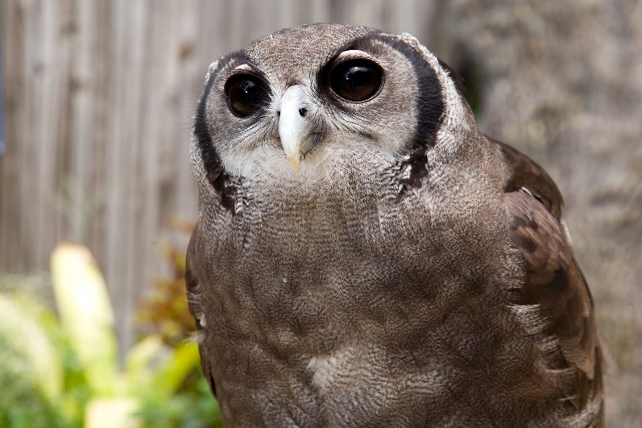
Lyndsay Newton Birds & Program Animals Keeper
Special Animal Presentation

Slide 13
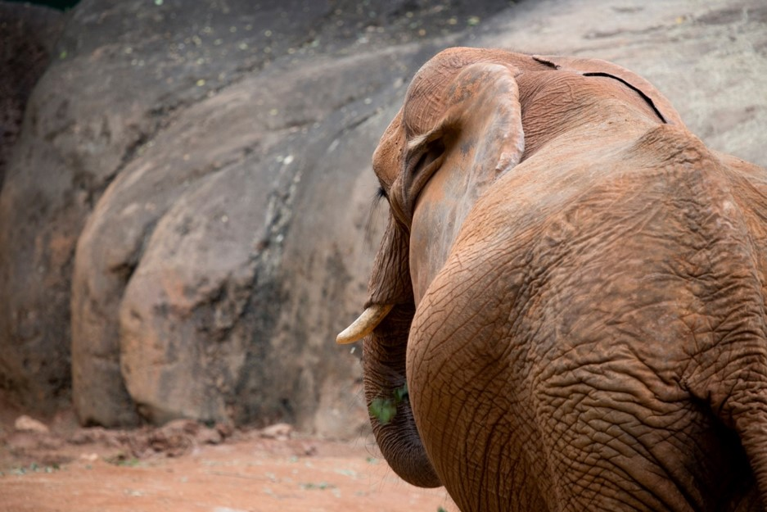
Thank you!

