Slide 1



City Council Quarterly Update
Atlanta Information Management
Presented By
Samir Saini
Chief Information Officer, AIM
Presented By:
Samir Saini
Chief Information Officer

Slide 2


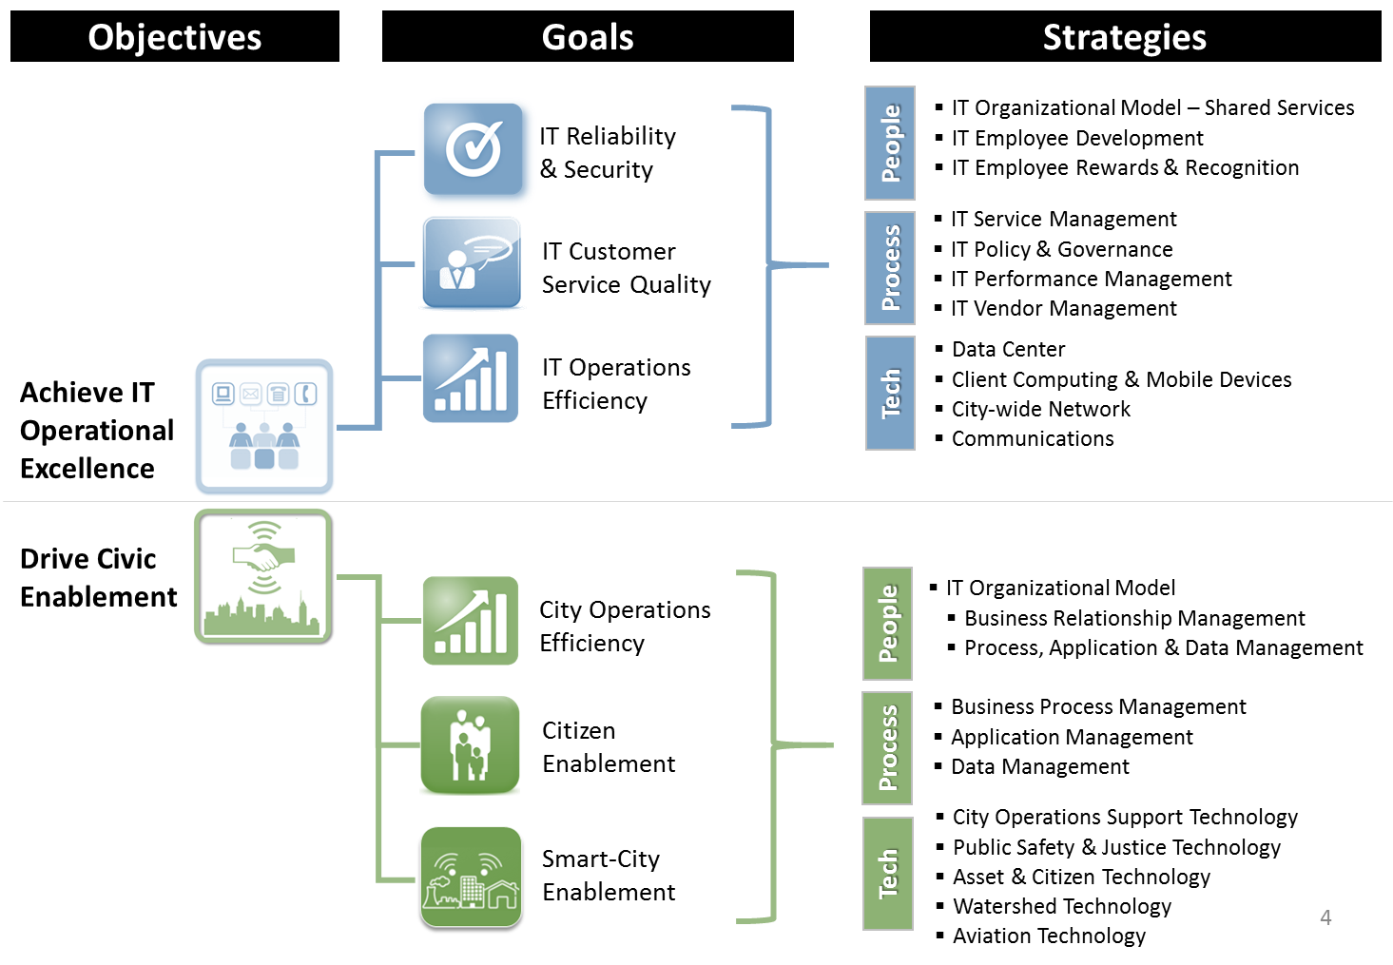
AIM Objectives, Goals, Strategies
Customers
Mayor’s Executive Office
Watershed Management
Hartsfield-Jackson Int’l Airport
Atlanta Police Department
Atlanta Fire and Rescue
Department of Corrections
Judiciary Branch
Dept. of Public Works
Dept. of City Planning
Dept. of Parks & Recreation
Dept. of Sustainability
Workforce Dev. Agency
Atlanta 311
Dept. of Finance
Department of Procurement
Department of HR
Dept. of Law

Slide 3

AIM IT Scope, By the #s
9410
customers
1352 953
servers
165 200
supported
city sites
120 179
active
projects
156
active IT
vendors
8 5
data centers
1493
network devices
31,000
emails received
per day
946
network attacks
blocked per day
187
active IT
Contracts
145 432
city apps
4344 4982
service tickets
per month
6216
PCs &
laptops
6000 4948
mobile devices
282
pcs & laptops
per tech supported

Slide 4



AIM IT Service Portfolio
General
Services
Operational
& Consulting
Accounts & Access Services
Files & Documents
Employee Services
Communication Services
Collaboration Services
Help & Support
Equipment & Software
Education/Training Services
Connectivity
Project Management
Application Support
Solution Development
Data Analytics & Reporting
Geospatial Analysis & Reporting
Business Analysis
RFI/RFP Evaluation
Cyber Security Consulting
Contract Management

Slide 5
System Availability & Performance Health
August
Performance Overview (Aug 16 to Aug 17)
Type | Actuals | Target
Critical | 99.79% | 99% MIN
High | 99.83%
Essential | 100%
Important | 99.68%
Systems Availability above target(99%)
# Outages ↓ 4(50% since 8/16. Duration ↓ 51%
Note: Downtime ↓due to continued focus on responsive incident management and infrastructure stabilization.
FY17 Q4 / FY18 Q1 Accomplishments
ATL2 Watershed Refresh - Upgraded HQ circuits from 10mb to 100mb
ATL2 Remote sites upgraded – 72 of 78 (92%)
AT&T Ready Metro-E Conversion to ASE – 46 of 116 (40%) completed
311 Call Center Contact Solution Telephony Upgrade(30%)
Upgrade Kronos Timekeeping System – 6X performance boost
Decommissioned legacy Nortel phone system affecting all City Hall
FY18 Q2 Plans
ATL2 Remote sites upgraded (Physical Network) – 78 of 78 (100%)
AT&T Ready Metro-E to ASE Conversion – 58 of 60 (97%)
VoIP Deployment Critical Public Safety (APD/AFD) – 10 of 12 (83%)
Server Virtualization– 95% complete
Critical App Back-ups to MS Azure Cloud – 50% complete
Migrate At Risk EOL 2003 Servers to 2008+ - 99% complete

Slide 6



Service Desk Health
August
Performance Overview (Aug 16 – Aug 17)
Type | Actuals | Target
Incidents Resolved | 82% | 85% MIN SLA
Requests Resolved | 92%
Total Ticket Resolution 90%, above 85% target
Incidents resolved (82%) below SLA;
Trend: Since Aug ’16 - ↑ 11%, Volume ↑ 35.8%.
Requests resolved (93%) exceeded SLA
Trend: Since Aug’16 SLA is ↑3%, Volume ↑ 16%
FY17 Q4 / FY18 Q1 Accomplishments
Office 2016 Deployment – 2222 of 3809 (58%) complete
IE 11 Upgrade (Aviation Services) – 938 of 1236 (76%) complete
Capriza Mobile App Pilot: Improve AIM Service Desk ticket updates
FY18 Q2 Plans
Office 2016 Deployment –100% complete
Pilot Windows 10
Skype for Business rollout
Capriza Chatbot – password reset pilot
Deploy Intune – Strengthen Mobile Device Mgmt
Complete ITSM/ITIL procedures and Service Catalog
Improve self-service password reset capability

Slide 7

Cyber Security Health
Performance Overview (Aug 16 – Aug 17)
↓63.0% - Blocked Network attacks (73K to 27K)
↓29.4% - Malware blocked from ‘calling home’ (17 to 12)
↓24.1% - “Phishing” Email Risk (249K to 189K)
New Security Metrics starting Q2/3
FY17 Q4 / FY18 Q1 Accomplishments
ISO Certification Audit Complete w/ Recommendations & Responses
External Vulnerability Assessment w/ Recommendations/Responses
Strengthened internal security monitoring and detection to mitigate malicious malware attacks
Security Awareness Training – Completion 92%, Adoption in the New Employee Orientation
Security Awareness Training
Completion Progress (92%)
GF/DWM 6177
Aviation 778
Field Employees 1193
New employees 57
Invest Atlanta 20
Total Trained 8,225
Email Security
Incident Reporting
Intro to Security Awareness
Passwords
Phishing
Public WiFi
FY18 Q2 Plans
Identity Access Management – strengthen secure access to city electronic resources
Patch Management – Improve the timely application of software updates across servers, applications, databases, and endpoints.
Strengthen VPN Access Controls & Request Fulfillments with Online Request Forms
Roll out new Security Metrics

Slide 8

Project Management Delivery & Performance
August
Performance Overview (Aug 16 – Aug 17)
Type | Actuals | Target
Control | 77.39% | >70%
Caution | 11.76% | <20%
Critical | 4.20% | <10%
Projects in “Control” ↓ 12% - (77.4%). Projects in “Critical” ↑ 10.5% - (4.20%). Projects in “Caution” ↑ 38.5% - (11.8%). All status within targets
FY18- 122 Active, 49 On-Hold - Across 16 Depts.
FY-17 close out- 118 Completed (32-Q1, 26-Q2, 25- Q3, 35- Q4);
FY17 Q4 /FY18 Q1 Accomplishments
Stage-gate review process rolled out for COO Top Projects
PMO organizational re-structure – Phase I complete
Cristo Rey HS/GSU CIS Internship programs complete
MS Project Online Implementation – Phase I Complete
FY18 Q2 Plans
  Re-vamping of PMO processes for project in-take, classification and approvals
  Complete PMO re-organization
  Complete Customer Service Training Course
  Complete onboarding of all active projects to MS Project Online

Slide 9
PMO: FY17 Year End
Notes:
Before diving into the priority projects, provide an overview of the Project Portfolio.

Slide 10
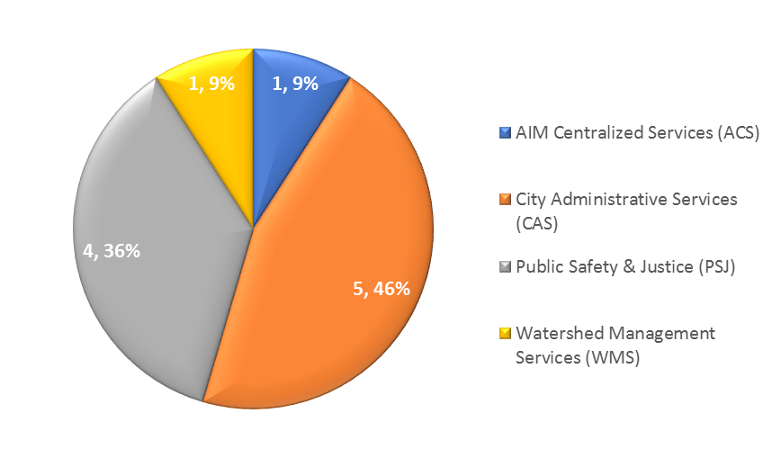


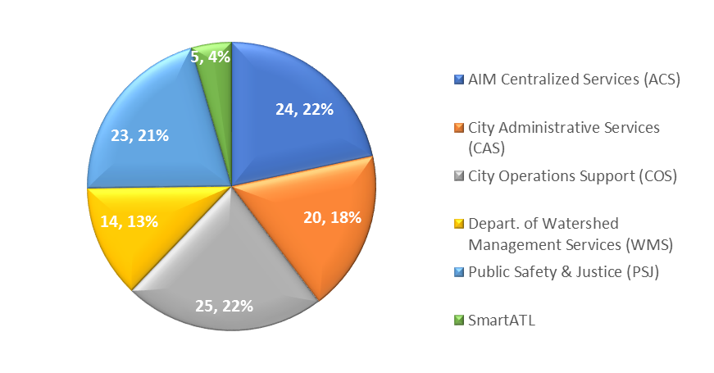
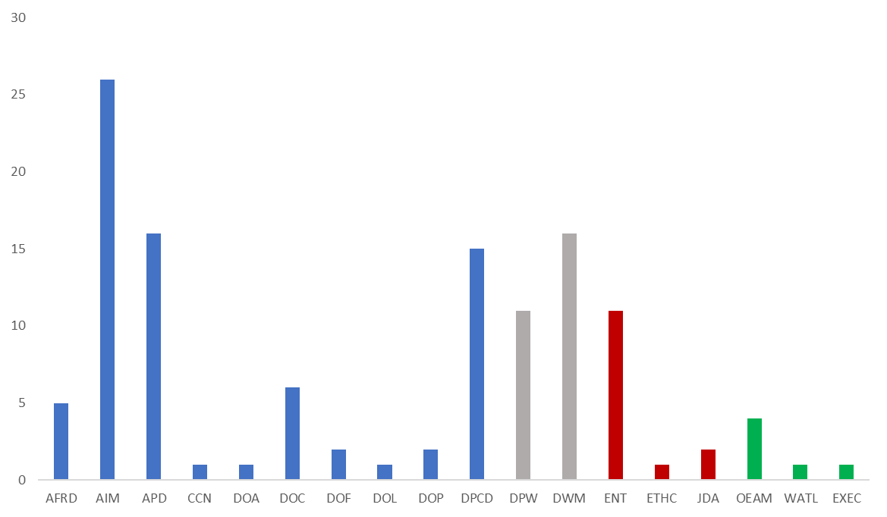
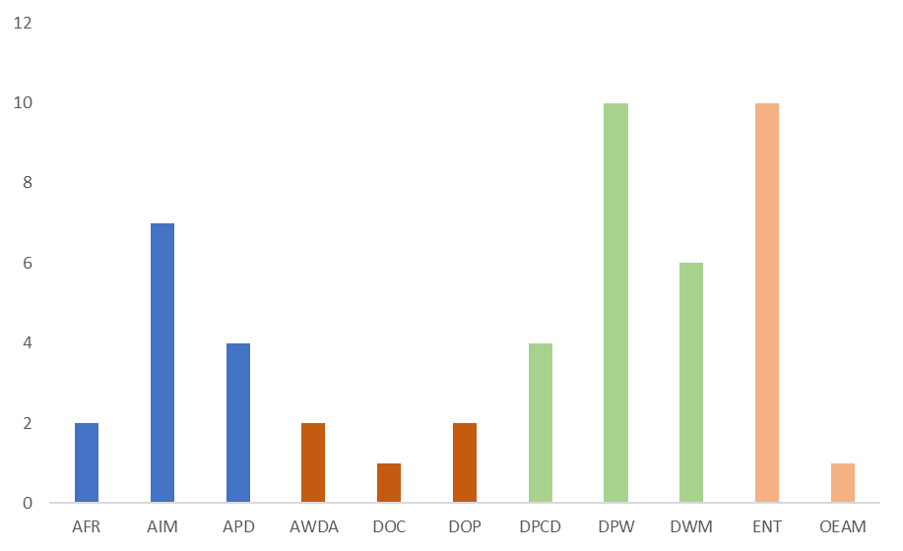


PMO: FY18– Year to Date
11 Projects
Implemented Q1
111 Projects
To Be Implemented End of Fy18
Notes:
Before diving into the priority projects, provide an overview of the Project Portfolio.

Slide 11

FY18 Q1 Implemented Projects (11)
FY18 Q1 Implemented Projects (11)
# | Dept | Name
1 | AFR | Accela
2 | AIM | Mircosoft Online Project Server
3 | AIM | Open Enrollment for year 2018
4 | AIM | Numara Mobile Application
5 | AIM | Oracle User Interface Enhancements
6 | APD | Improve Crime Analysis Management (Implement Microsoft Power BI)
7 | DHR | Open Enrollment 2018
8 | DOC | Efforts to Outcome Software
9 | DWM | SMART BENCH
10 | JA | Pre-Trial Intervention
11 | OEAM | Ethics Move from the 12th Floor CHT to 3rd Floor Atrium

Slide 12
FY18 Q2 Projected to Be Implemented (44)
FY18 Q2 Projects to be Implemented
# | Dept | Project Name
1 | AFRD | APD Public Safety Academy move to 786 Cleveland Avenue
2 | AFRD | AFR Scheduling and Deployment Management System (Phase 2)
3 | AIM | VPN Consolidation
4 | AIM | GMS, DPS MIGRATION
5 | AIM | Penetration Testing - phase2
6 | AIM | EGIS Data Migration (AVS)
7 | AIM | Firing Range
8 | APD | Mercedes Benz Stadium Data Center Connection Project
9 | APD | Replace Zone 3 Police Precinct
10 | APD | Search360 Upgrade to Slingshot
11 | APD | CopLogic
12 | APD | Move Zone 4 Investigations to 711 Fulton Industrial Blvd
13 | APD | City Adminiistrative Services (CAS)e Management Improvement
14 | APD | VIC Network UPgrade
15 | DHR | WellnessCenter - Timeline_08102017
16 | DOA | Email Archiving Function Enhancement and Upgrade Tech Source One
17 | DOC | Camera Proof of Concept
18 | DOC | Corrections PC Refresh
19 | DOP | Procurement Document Management System
20 | DPCD | Accela Software Assessment - Procurement
21 | DPCD | EDR Software - Procurement
22 | DPCD | QMS Customer Queue Mgt - Procurement

Slide 13
FY18 Q2 Projected to Be Implemented (44) (cont’d)
FY18 Q2 Projects to be Implemented
# | Dept | Project Name
23 | DPCD | Upgrade Accela Master Scripts Library to Version 3
24 | DPW | StreetCar Primavera Contract Management Server Buildout
25 | DPW | MaxView Server Installation
26 | DPW | Assessment Strategy for Fleet Assetworks Application
27 | DPW | Atlanta Streetcar (ASC) Mobile Application Program - Phase 1A 090817
28 | DPW | Atlanta Streetcar (ASC) Traffic Signal Expansion Project (Project)
29 | DPW | Fleet Mgmt System Implementation
30 | DPW | Fuel RFP 1
31 | DWM | Kronos Enhancements DWM
32 | DWM | OSS iAuditor Heath & Safety
33 | DWM | Document Managemetn Solutions
34 | DWM | Open Records Management System
35 | DWM | Online Utility Exhcnage
36 | DWM | Maximo Optimization Upgrade Project
37 | DWM | DWM OPA Business Performance Analytics Tool
38 | DWM | Hansen Application Decommission Strategy
39 | ENT | Office 2016 Upgrade
40 | JDA | APD CITATION TICKET TO PAYMENT- Stabilization (Phase 2)
41 | OEAM | Convergint Security Systems Services Project
42 | OEAM | Flatiron Building WEI Phase 2 The Point
43 | OEAM | Improve City Services with ATL311 Mobile App
44 | WATL | Metal Plates Waze Integration

Slide 14


SEPTEMBER 2017
Thursday, September 14th: North Avenue Ribbon Cutting | Friday, September 15th: “Experience Smart ATL”

