Slide 1
Atlanta False Alarm Reduction Program
September 8, 2017

Slide 4
False Alarm Reduction By Zone
Zone | 2017 YTD | 2014 | % Difference
1 | 2469 | 4684 | -47%
2 | 7653 | 12040 | -36%
3 | 2955 | 5074 | -42%
4 | 4605 | 6965 | -34%
5 | 2057 | 3629 | -43%
6 | 4802 | 7855 | -39%
Difference |  |  | -42%

Slide 5
Atlanta False Alarm Program Benefits
Reduction in overall cost to the Police Department as a result of the reduction in number of false alarms calls
Saved 2500 man hours in false alarm costs to PD in 2015*
Saved 3500 man hours in false alarm costs to PD in 2016*
Reduction in overall false alarms despite an increase in alarm users of at least 10,000 each year since the inception of the program
Additional resources available to respond to actual emergencies
Alarm locations with false alarms has deceased from 17,440 in 2014 to 16,154 in 2016 despite a 33% increase in alarm locations.
*Based on average response times for each call of 15 min.

Slide 6
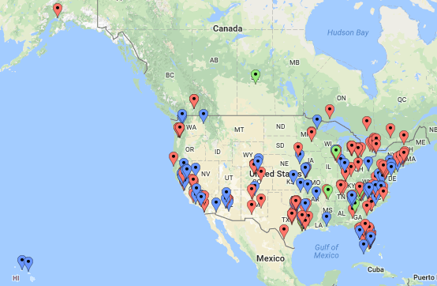
CryWolf Customers

