Slide 1
Performance Audit: Parks Maintenance
Amanda Noble, City Auditor
Team: Micheal Jones, Randi Qualls, Ivy Williams, and Diana Lynn
CD/HS Committee
August 29, 2017

Slide 2
Why This Audit?
In our 2015 risk assessment, the Department of Parks and Recreation had the seventh highest risk score for risk factors including:
Size and complexity
Spending on capital outlay and commodities
Budget-to-actual variances
Relatively high overtime
Injury on the job
Sick leave hours

Slide 3
Background
Divided into four offices
Office of Park Design:
Plans parks and recreation centers
Maintains list of parks and assets
Office of Parks:
Maintains parks and related amenities
Uses two-week maintenance schedule
Accredited since 2009 with CAPRA
Notes:
The Department of Parks and Recreation is responsible for designing, planning, and maintaining parks, playgrounds and recreation centers for the city. The department consists of four offices:
• Office of Parks
• Office of Recreation
• Office of Park Design
• Office of Management Services
The Office of Park Design plans the city’s parks and recreation centers and maintains records of park assets.
The Office of Parks is primarily responsible for maintaining all parks and related amenities.
The Department of Parks and Recreation has been accredited since 2009 for its compliance with CAPRA (Commission for Accreditation of Park and Recreation Agencies) standards. Accreditation requires
completion of a five-year application process that includes self-assessments and external evaluations by the commission to review evidence that the agency successfully meets national standards of best practices.

Slide 4
Background (Cont.)
Parks classified by:
Park size
General use and development
9 park types

Slide 5
Background (Cont.)
Parks maintenance occurs year-round
-- Occurs on two-week schedule
-- Mowing Season runs from April-October
-- Off-season runs from November-March
Most maintenance is considered a routine service
Routine Services
Skilled Services
Mulching
Mowing
Pruning
Weeding
Removing litter
Picking up garbage
Removing graffiti
Painting
Plumbing
Repairing fixtures, HVAC, or electrical services
Notes:
Parks maintenance crews conduct routine maintenance following an annual two week mowing schedule. Along with mowing, which occurs seasonally from the beginning of April to the end of October,
maintenance crews provide year-round maintenance services for parks and park amenities, such as playgrounds, basketball and tennis courts, and pavilions.
The department categorizes maintenance activities as routine services or skilled services. Most of the Office of Parks’ work is routine services, which include mulching, mowing, pruning, weeding, removing litter, and
picking up garbage. Skilled services include removing graffiti, painting, plumbing, and repairing fixtures, HVAC, or electrical services for parks and related amenities.

Slide 6
Audit Scope and Methodology
Scope
Inspections conducted from January – March 2017
Records reviewed from January 2015 – December 2016
Methodology
Interviewed subject matter experts and stakeholders
Inspected a random sample of 40 parks
Reviewed CAPRA’s accreditation standards and best practices
Reviewed city code and standard operating procedures
Reviewed federal recommendations for playgrounds
Analyzed work order management data and reporting
Observed parks supervisors who manage maintenance
Analyzed overtime and sick leave hours
Notes:
We conducted park inspections from January through March 2017. We reviewed records from January
1, 2015, through December 31, 2016. We recognize our park inspections were conducted during the department’s off-season that occurs from November through March. According to CAPRA standards, park inspections should be completed from the perspective of the user. Since the city’ parks are used year-round, the user would not have different expectations for parks based upon whether it was the mowing season or off-season.
Our audit methods included:
• interviewing subject matter experts who manage, conduct, or inspect parks and playground maintenance
• interviewing park users and city council staff to identify stakeholder concerns
• inspecting a random sample of 40 parks
• reviewing CAPRA standards and accreditation handbook for certification requirements and industry best practices
• reviewing city code and standard operating procedures related to parks maintenance
• reviewing federal recommendations for playground maintenance standards
• analyzing work order management software records for service request and work order data related to problem and safety condition reporting
• observing parks supervisors who manage routine maintenance
• analyzing overtime and sick leave hours for parks maintenance employees recorded in Oracle
We randomly selected 44 parks, including one of each of the nine park types and a small, medium, and large park within each of the twelve City Council districts. One park was randomly selected in
both the park types and council district samples, which reduced the total number of parks selected from 45 to 44. We could not locate four of the parks selected and assessed 40 parks.

Slide 7
Findings
Most parks we inspected showed need for improvement
Average score of sample = 73%
⅓ of sample scored Unacceptable or Poor overall
Variation in park conditions appears to be related to size
Small parks scored higher
Parks maintained by partner agencies scored 15%+
Reliance on seasonal model could limit ability to meet performance standards
Money spent on overtime could have hired a full-time crew of six
Notes:
The average score for the parks we inspected was 73%. Fifteen of the 40 parks we inspected scored below 70%, indicating the park was in poor condition, according to the department’s quality assessment
form, which establishes high standards. Ten parks scored between 70% and 80%, indicating the park needed improvement, and fifteen parks scored 80% or better, indicating the park was in good or
excellent condition. Most play surfaces were in good to excellent condition.
Small parks—those of one acre or less—in our sample scored higher than larger parks. While the parks’ condition varied by six percentage points among maintenance districts, parks in our sample that are maintained by third parties scored an average of 15 percentage points better than the sample parks maintained by city crews.
Supervisors attributed poor park conditions to lack of staff. The department increases parks maintenance staffing during mowing season, but staffing during the off-season may not keep up with year-round needs. Most parks in our sample had few inspections documented during the off-seasons in 2015 and 2016. The Office of Parks collected about half as many inspections as would be expected if they were conducted on a ten-day cycle.
With the overtime paid to parks maintenance employees in 2015 and 2016, the department could have hired a full-time crew of five or six staff. The Department of Parks and Recreation paid parks
maintenance employees over $540,000 in overtime in 2015 and 2016, with the majority of hours accrued during the mowing season. The department added 12 full-time parks maintenance positions in the fiscal year 2017 budget, but it filled the positions in March, after we conducted our inspections.

Slide 8
Most Parks Showed Need For Improvement
Average score for the parks we inspected was 73%
15 of the 40 parks scored below 70
10 parks scored between 70% and 80%
15 parks scored 80% or better
Department didn’t conduct an annual inspection on all parks
Park inspector is responsible for inspecting open parks that the city maintains
Our sample included:
2 closed parks
3 undeveloped parks
9 parks that are maintained by a third party
Notes:
The average score for the parks we inspected was 73%. Fifteen of
the 40 parks we inspected scored below 70%, indicating the park was
in poor condition, according to the department’s quality assessment
form. Ten parks scored between 70% and 80%, indicating the park
needed improvement, and fifteen parks scored 80% or better,
indicating the park was in good or excellent condition. Exhibit 6
displays these results along with the department’s 2015 and 2016
annual inspection scores, when available. Missing data points reflect
that the department didn’t conduct an annual inspection. According
to the Office of Parks, the park inspector is responsible for
inspecting only open parks that the city maintains, but our sample
included two parks that are currently closed, three parks that the
department characterized as undeveloped and, therefore, not
maintained, and nine parks that are maintained by a third party.

Slide 9
Cleanliness, Tree and Natural Area Maintenance Top List of Problems Observed
Source: Auditor’s Park Quality Assessments of Sampled Parks collected Q1 2017
Notes:
Two-thirds of the parks we inspected warranted ratings of three or below for leaf and debris removal, a criterion of cleanliness on the inspection form. A rating of three indicates minor leaf and debris
problems, relatively new issues, or sloppy clean-up of executed maintenance services. A rating of two indicates visible signs of leaves, limbs, and debris left for a week or more. According to the department’s operations manual, ratings of three or below on a park inspection are unacceptable. We observed large piles of leaves throughout many park walkways and covering drainage pipes; 19 of for drainage system, primarily due to leaves clogging the catch basins. Other cleanliness problems that we frequently observed
included litter (55%), dirt on hard surfaces (48%), graffiti (41%), weeds growing in the cracks of hard surfaces (39%), and full garbage cans with trash around the cans or cans without liners (39%).
We observed fallen tree limbs at 49% of the parks we inspected. Maintenance of rules signs was a problem at 54% of the parks we inspected. We also observed problems with natural area maintenance including invasive species (40%) and lack of clear perimeters between natural and formal maintenance areas (48%).
We did not rate every park in our sample on each criterion because not every item was applicable to each park. We didn’t rate the parks on lawn maintenance, such as mowing and trimming, because lawns were
dormant. While we observed ant beds in most of the parks in our sample, the department stopped assessing pest management in the parks in 2011. Office of Parks staff suggested that the pest management assessment should be reinstated.

Slide 10
Vandalism and Potential Safety Hazards Identified
Notes:
We observed vandalism, such as offensive graffiti, and 18 safety-related problem conditions at eight city parks during our inspections and reported them to the Office of Parks. As of April 2017, the department had resolved 12 of the problems, but 5 hadn’t been entered into the work order management software for a service request or work order.
According to the operations manual, parks supervisors are responsible for barricading or using caution tape to safeguard areas with safety hazards and for noting the safety problem on their inspection forms. The district manager reviews the inspection forms and checks to ensure that all data is correct and that items and problems are entered into the system and addressed. Surveys indicated that the supervisors followed up on reported maintenance issues until the work order was resolved.

Slide 11
Carried Over Problems Contributed to Poor Conditions
Park Name (District) | DPR 2015 Inspection | DPR 2016 Inspection | CAO 2017 Inspection | Conditions Identified in at least Two Inspections
Grove Park (D9) | 80% | 78% | 77% | Mulch piles, tennis court fencing
John C. Burdine Ctr. (D12) | 74% | 78% | 58% | Invasive species on tree, hanging tree limbs, tree limbs down, dumped timbers
Chosewood Park (D1) | 78% | 71% | 55% | Bent rules signs, graffiti on tennis court wall
Freedom Park (D2) | 77% | 77% | 59% | Dirty park rules sign, hanging tree limbs, broken lights
Rose Circle Park (D4) | 78% | 78% | 66% | Low hanging trees need pruning
Coan Park (D5) | 71% | 79% | 63% | Worn playground cushioning/border, graffiti in pavilion, Damaged benches
Deerwood Park (D11) | 70% | 70% | 56% | Damaged benches, graffiti on park rules sign
Source: Auditor’s scores of Sampled Parks Q1 2017 and Park Inspectors scores 2015-2016
Notes:
We noted needed repairs in seven of our inspections of city parks that the department’s inspector had previously identified in an annual review. Six of the seven parks scored below 70%. Carryovers are unacceptable conditions that should be documented during the inspection and scheduled for review during the following inspection to assess if the condition was resolved.
The operations manual requires park supervisors to submit a justification and associated work order for scores of three or less on their routine inspections, but the 2015 and 2016 park inspector forms we reviewed had no justifications or work orders associated with unacceptable scores recorded. Instead, the inspector reported the findings to the park supervisor for service request reporting and follow-up.

Slide 12
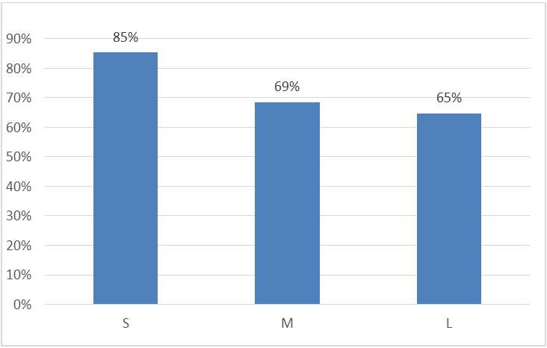
Smaller Parks Scored Higher
Source: Auditor’s scores of Sampled Parks Q1 2017
Notes:
Small parks scored higher than medium and large parks, and medium-sized parks scored slightly better than large parks (see Exhibit 11). The 14 small parks in our sample had an average score of 85% compared to 69% for the 11 medium parks and 65% for the 15 large parks. Park size plays a role in maintenance because larger parks usually offer more amenities, such as ball fields, tennis courts, playgrounds, and
trails. Those additional amenities require increased resources to maintain the parks to the department’s standards.

Slide 13
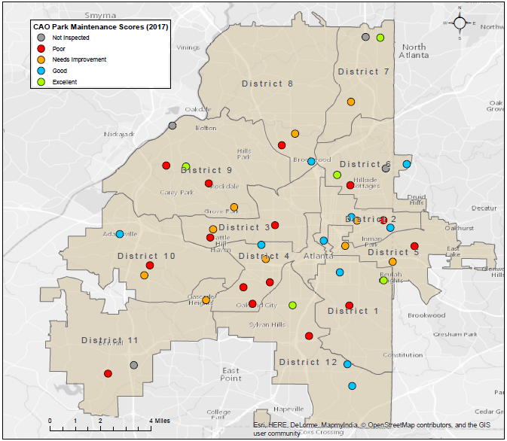
Park Conditions Varied Little by Council District
Source: Auditor’s scores of Sampled Parks Q1 2017
Notes:
Our interviews with stakeholders suggested some had concerns about maintenance standards not being the same among council districts. While our samples were too small to generalize our results across all parks in the districts, we observed some differences in the condition of parks by City Council District.
For example, two of three parks we inspected in Council District 3 scored below 60% and the third was 76%, while three parks we inspected in Council District 12 scored 80% or higher and the fourth scored 66%

Slide 14
Supervisors Attributed Poor Park Conditions to Lack of Staff
Suggested maintenance crews are not adequately staffed
Factors affect their ability to complete the mowing schedule on time
Weather conditions
Equipment breakdowns
Special events
Permanent staffing of three to five employees per crew year round
Each park district has four to five crews
10 seasonal employees assigned to each park district
Department received 12 additional permanent park maintenance employees
Notes:
The department increases parks maintenance staffing during mowing season, but staffing during the off-season may be inadequate to keep up with year-round maintenance needs. Park inspections occur
mostly during mowing season, although maintenance is needed year round. While we agree that lawn maintenance requires additional resources, it may be unrealistic, given Atlanta’s temperate climate,
to consider five months of the year as off-season.
The supervisors we interviewed suggested maintenance crews are not adequately staffed and factors such as weather conditions, equipment breakdowns, and special events, affect their ability to complete the mowing schedule on time. The department has permanent staffing of three to five employees on each maintenance crew year round. Each park district has four to five crews responsible for parks within the district. During the mowing season, the Office of Parks assigns an additional ten seasonal employees to
each park district. Staff told us they are expected to catch up on backlogged maintenance during the off-season, but don’t have time.
The department received 12 additional permanent park maintenance employees during the fiscal year 2017 budget and hiring was completed in March 2017, after we conducted our inspections.

Slide 15
Inspections Not Conducted Year-round
Park inspections occur mostly during mowing season
Office of Parks collected about half as many inspections as expected
Operations manual states supervisors conduct park inspections within 24 hours after crews have completed maintenance services during the 10-day mowing schedule
Manual doesn’t specify whether inspections should be conducted during mowing season or throughout the year
10-day schedule is used throughout the year
Notes:
Parks supervisors are responsible for conducting a routine inspection for each park after maintenance is complete. While routine maintenance is expected year round, weather permitting, most parks in our sample had few inspections documented during the off-seasons in 2015 and 2016. The Office of Parks collected about half as many inspections as would be expected if they were conducted on a two-week mowing cycle. According to the operations manual, park supervisors are responsible for conducting park inspections within 24 hours after crews have completed maintenance services during the 10-day mowing schedule. The manual doesn’t specify whether inspections should be conducted during mowing season only or throughout the year, but the 10-day schedule is used throughout the year. Current practice doesn’t indicate that supervisors formally inspect or submit inspections outside the mowing season.

Slide 16
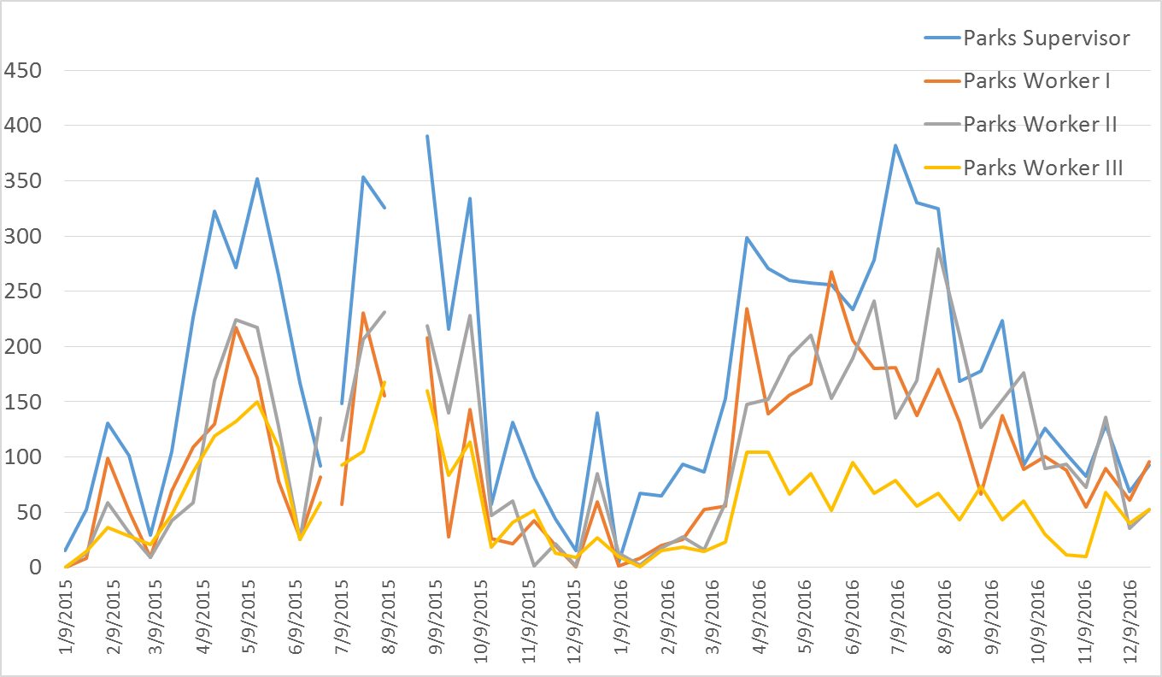
Park Maintenance Employees Receive Year-round Overtime
Source: Oracle Reports from January 1, 2015 through December 31, 2016
Notes:
Parks maintenance employees worked over 23,000 hours of overtime in 2015 and 2016, totaling $543,539. The department paid yearround overtime to parks maintenance employees, but paid more hours around the mowing season (see Exhibit 15). The gaps in the graph reflect pay periods when no overtime was accrued for these positions.
Overtime paid to the maintenance crews could have hired a team of five full-time employees with benefits during 2015 and added another park worker I position to the same team in 2016. The team of five would include one park supervisor, one park worker I, two park worker II position and one park worker III position.

Slide 17
Recommendations
In order to ensure city parks are maintained to performance and safety standards, the Commissioner of Parks and Recreation should:
Ensure that employees are following procedures to review safety conditions and promptly initiate repairs.
Compare annual inspections year-to-year and develop a report for department management reflecting the status of carryover issues
Develop a maintenance classification system that outlines how each park type will be maintained according to size and amenities
Notes:
In order to ensure city parks are maintained to performance and safety standards, the Commissioner of Parks and Recreation should:
1. Ensure that employees are following procedures to review safety conditions and promptly initiate repairs
2. Compare annual inspections year-to-year and develop a report for department management reflecting the status of carryover issues
3. Develop a maintenance classification system that outlines how each park type will be maintained according to size and amenities

Slide 18
Recommendations (con’t)
Assign all parks maintained by city crews to a park district to ensure routine maintenance is performed consistently and to the department’s standards
Clearly identify all decommissioned parks
Annually inspect parks that are maintained by partnerships
Formally document present and future agreements between all entities and persons who maintain city parks and update the list annually
Notes:
In order to ensure city parks are maintained to performance and safety standards, the Commissioner of Parks and Recreation should:
4. Assign all parks maintained by city crews to a park district to ensure routine maintenance is performed consistently and to the department’s standards
5. Clearly identify all decommissioned parks
6. Annually inspect parks that are maintained by partnerships
7. Formally document present and future agreements between all entities and persons who maintain city parks and update the list annually

Slide 19
Recommendations (con’t)
Ensure that supervisors and district managers inspect parks throughout the year
Clarify the operations manual to require park supervisors to report routine inspections year-round
Monitor inspection results throughout the year to assess whether staffing levels are adequate to meet performance standards
Notes:
In order to ensure city parks are maintained to performance and safety standards, the Commissioner of Parks and Recreation should:
8. Ensure that supervisors and district managers inspect parks throughout the year
9. Clarify the operations manual to require park supervisors to report routine inspections year-round
10. Monitor inspection results throughout the year to assess whether staffing levels are adequate to meet performance standards

Slide 20
Recommendations (con’t)
Clarify expectations regarding cleanliness of natural areas
Include pest management expectations on the inspection form and the standards used by park staff to evaluate the condition during the routine inspections
Notes:
In order to ensure city parks are maintained to performance and safety standards, the Commissioner of Parks and Recreation should:
11. Clarify expectations regarding cleanliness of natural areas
12. Include pest management expectations on the inspection form and the standards used by park staff to evaluate the condition during the routine inspections

