Slide 1

City Utilities Council | July 25, 2017

Slide 2
TABLE OF CONTENTS
Fiscal Management | 3-6
Solid Waste Services | 7-19
Fleet Services | 20-24
Capital Projects | 25-27
Safety | 28-31
Human Resources | 32-34

Slide 3
Fiscal management

Slide 4
Fiscal management
General Fund
Notes:
General Fund includes Transportation and administration functions
Total General fund budget was about $55M
44% for contracted services, 29% for personnel costs
20% for supplies, and materials

Slide 5
Fiscal management
Solid Waste Revenue Fund
Notes:
Solid waste revenue fund total was $46.54M
Under budget on personnel (constantly staffing and filling vacancies)
Over budget on operating and maintenance expense – direct reflection of equipment maintenance costs, disposal expenses, sunken costs

Slide 6
Fiscal management
Fleet Services Fund
Notes:
Fleet services under budget on supplies and salaries
Over budget slightly – Contracted services
Overall under budget
Reflection of the work that is being done in working with the employee team implementing MANAGED COMPETITION

Slide 7
SOLID WASTE SERVICES

Slide 8
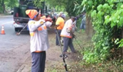
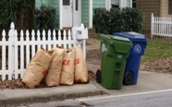
Solid waste
The Office of Solid Waste Services consists of Education & Enforcement, Right-of-way Maintenance, Residential Street Sweeping, and weekly
pick-up of household garbage, recycling, and yard trimmings.
Performance Metrics
Performance Measure | Initiative | 2017 Target | FY17 Q1 | FY17 Q2 | FY17 Q3 | FY17 Q4
Percentage of Single Family Garbage Pickups Collected On Scheduled Day | Merit and Excellence | 99.9% | 99.92% | 99.80% | 99.89% | 99.94%
Percentage of Bulk Rubbish Pickups Collected As Requested/Scheduled | Merit and Excellence | 99.9% | 99.98% | 99.97% | 99.95% | 99.97%
Percentage of Yard Trimmings Pickups Collected On Scheduled Day | Merit and Excellence | 99.9% | 70.12% | 67.55% | 99.83% | 99.91%
Percentage Recycling Pickups Collected On Scheduled Day | Merit and Excellence | 99.9% | 99.85% | 96.69% | 99.84% | 99.93%
Notes:
Solid waste services about 94,000 locations on a regular schedule each week
Pick-ups collected on the scheduled day over 99.9% of the time
Residential
Recycling
Bulk Pick-ups
And Yard waste

Slide 9

Solid waste
Operating Highlights For Atlanta Stats
Description | FY17 Q1 Percentage SLA Met |  | FY17 Q2 Percentage SLA Met |  | FY17 Q3 Percentage SLA Met |  | FY17 Q4 Percentage SLA Met
Bin Delivery and Pick-up |  | 100.0% |  | 99.8% |  | 99.7% |  | 99.4%
Dead Animal Removal |  | 100.0% |  | 97.6% |  | 100.0% |  | 99.8%
Illegal Dumping |  | 100.0% |  | 99.3% |  | 99.8% |  | 99.6%
Missed Collections |  | 91.9% |  | 96.6% |  | 99.6% |  | 99.2%
ROW Maintenance |  | 99.1% |  | 99.4% |  | 99.5% |  | 99.6%
New Backyard Services |  | 99.5% |  | 100.0% |  | 100.0% |  | 100.0%
Solid Waste Services |  | 95.5% |  | 97.9% |  | 99.7% |  | 99.4%
Notes:
Other key metrics and highlights where we are performing well above 99%
Bin Delivery
Backyard Service
Illegal Dumping Response/Clean-up
Right of Way Maintenance (litter, mowing, etc.)

Slide 10
Customer service
Performance Metrics - Total DPW Service Request Historical Data
Transportation Performance Measure | Initiative | FY17 Q1 Actual | FY17 Q2 Actual | FY17 Q3 Actual | FY17 Q4 Actual | Totals
Transportation Services #SR | Merit And Excellence | 3,295 | 3,024 | 4,395 | 4,526 | 15,240
Transportation Services No. Of SR Meeting SLA | Merit And Excellence | 3,101 | 2,759 | 4,265 | 4,240 | 14,365
Percentage Of SR's Meeting SLA |  | 94.11% | 91.24% | 97.04% | 93.68% | 94.26%
Solid Waste Service Performance Measure | Initiative | FY17 Q1 Actual | FY17 Q2 Actual | FY17 Q3 Actual | FY17 Q4 Actual | Totals
Solid Waste Services | Merit And Excellence | 11,957 | 10,530 | 13,004 | 10,558 | 46,049
Solid Waste Services No. Of SR Meeting SLA | Merit And Excellence | 11,275 | 9,566 | 12,687 | 10,296 | 43,824
Percentage Of SR's Meeting SLA |  | 94.30% | 90.85% | 97.56% | 97.52% | 95.17%
DPW Performance Measure | Initiative | FY17 Q1 Actual | FY17 Q2 Actual | FY17 Q3 Actual | FY17 Q4 Actual | Totals
DPW | Merit And Excellence | 15,252 | 13,554 | 17,399 | 15,084 | 61,289
DPW No. Of SR Meeting SLA | Merit And Excellence | 14,376 | 12,325 | 16,952 | 14,536 | 58,189
Percentage Of SR's Meeting SLA |  | 94.26% | 90.93% | 97.43% | 96.37% | 94.94%

Slide 11
Sws service requests by service delivery type
Service Delivery Report FY17 4th Qtr. (Part 1 of 3)
(Includes Hansen & ATL311 Service Requests)
Problem Description 4Q FY17 | Number of Closed SWS Requests | Number Past Due | Percentage Past Due | Percentage of SWS Service Requests
Bin Pick Up | 419 | 0 | 0.00% | 3.97%
City Council Inquires Requiring Action | 32 | 0 | 0.00% | 0.30%
Contamination: Improper use of a recycling cart | 371 | 1 | 0.27% | 3.51%
Dead Animal Removal | 293 | 9 | 3.07% | 2.78%
Illegal Dump Site | 1 | 1 | 100.00% | 0.01%
Illegal Dumping In Quad | 152 | 2 | 1.32% | 1.44%
Illegal Dumping Out Of Quad | 109 | 0 | 0.00% | 1.03%
Illegal Dumping Visibility Issue | 118 | 1 | 0.85% | 1.12%
Inquiry of information on scheduling a Neighborhood cleanup | 8 | 8 | 100.00% | 0.08%
Missed Bulk Collections | 931 | 0 | 0.00% | 8.82%
Missed Collections Backyard Garbage | 87 | 0 | 0.00% | 0.82%
Notes:
The next 3 slides provides service requests by type
Majority of the requests received during 4th quarter last year were
Missed pick-ups (all lines of service)
New Bin delivery requests
Bin replacement requests
With 10,556 requests for the quarter, 97.5% were completed on time

Slide 12
Service Delivery Report FY17 4th Qtr. (Part 2 of 3)
Problem Description 4Q FY17 | Number of Closed SWS Requests | Number Past Due | Percentage Past Due | Percentage of SWS Service Requests
Missed Collections Day of Service | 631 | 5 | 0.79% | 5.98%
Missed Collections Dumpster Garbage | 9 | 0 | 0.00% | 0.09%
Missed Collections Residential Garbage | 1538 | 87 | 5.66% | 14.57%
Missed Recycling Backyard | 37 | 0 | 0.00% | 0.35%
Missed Recycling Residential | 951 | 72 | 7.57% | 9.01%
Missed Residential Yard Trimmings | 949 | 61 | 6.43% | 8.99%
Neighborhood Cleanup - Dumpster Delivery and pick up | 0 | 0 | 0.00% | 0.00%
New Backyard Services | 44 | 0 | 0.00% | 0.42%
New Bin | 591 | 4 | 0.68% | 5.60%
Purchased Bin | 71 | 0 | 0.00% | 0.67%
Replacement Bin | 2629 | 6 | 0.23% | 24.91%

Slide 13
Service Delivery Report FY17 4th Qtr. (part 3 of 3)
Problem Description 4Q FY17 | Number of Closed SWS Requests | Number Past Due | Percentage Past Due | Percentage of SWS Service Request
Replacement Bin Garbage | 43 | 0 | 0.00% | 0.41%
Replacement Bin Recycling | 6 | 0 | 0.00% | 0.06%
Row Grass Cutting Out Of Quad | 115 | 0 | 0.00% | 1.09%
Row Maintenance In Quad Schedule | 144 | 1 | 0.69% | 1.36%
Row Maintenance Visibility Issue | 101 | 2 | 1.98% | 0.96%
Row Street Sweeping | 47 | 0 | 0.00% | 0.45%
Row Street Sweeping Out Of Quad | 129 | 0 | 0.00% | 1.22%
Grand Total | 10556 | 260 | 2.46% | 100.00%

Slide 14
Completed requests BY COUNCIL DISTRICT
Council Report Table 4th Quarter
Council Person 4Q FY17 | Number of Closed Solid Waste Requests | Number Past Due | Percentage Past Due | Percentage of Total Service Requests
District 1 – Carla Smith | 533 | 15 | 2.81% | 5.18%
District 2 – Kwanza Hall | 452 | 11 | 2.43% | 4.39%
District 3 – Ivory Young | 403 | 21 | 5.21% | 3.92%
District 4 – Cleta Winslow | 527 | 26 | 4.93% | 5.12%
District 5 – Natalyn Archibong | 598 | 15 | 2.51% | 5.81%
District 6 – Alex Wan | 564 | 16 | 2.84% | 5.48%
District 7 – Howard Shook | 408 | 17 | 4.17% | 3.96%
District 8 – Yolanda Adrean | 755 | 31 | 4.11% | 7.34%
District 9 – Felicia Moore | 607 | 22 | 3.62% | 5.90%
District 10 – C.T. Martin | 681 | 18 | 2.64% | 6.62%
District 11 – Keisha Bottoms | 625 | 17 | 2.72% | 6.07%
District 12 – Joyce Sheperd | 642 | 16 | 2.49% | 6.24%
Post 2 – Mary Norwood | 0 | 0 | 0.00% | 0.00%
Post 3 - Andre Dickens | 0 | 0 | 0.00% | 0.00%
Council President – Ceasar Mitchell | 3 | 0 | 0.00% | 0.03%
District Not Entered | 3495 | 37 | 1.06% | 33.96%
Grand Total | 10293 | 262 | 2.55% | 100.00%

Slide 15
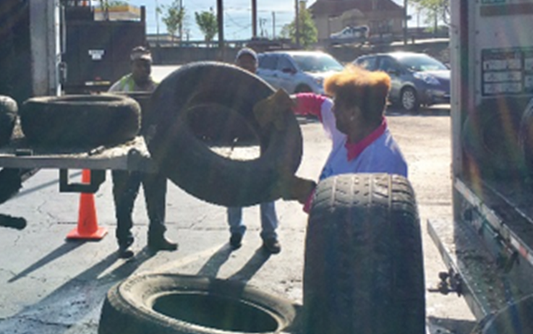
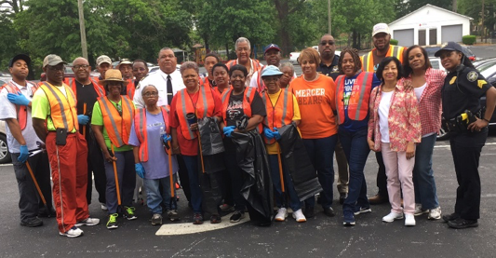
Solid waste
Keep Atlanta Beautiful Commission Litter Abatement
Clean It Up Atlanta
Grove Park Community
80 tons of trash & debris removed
Adopt-a-Spot Program
50 miles of public spaces de-littered
Neighborhood Cleanups
Collected over 50,000 lbs. of trash & debris
Spring City-Wide Scrap Tire Drive
Approximately 5,000 illegally-dumped scrap tires collected
Earth Day on English Avenue
Engaged over 1,000 volunteers for two-day clean-up projects
Project Learning Garden Summer Program – Perkerson Recreation Center
Partnered with District 12, Capt. Planet Foundation, & Parks & Rec.

Slide 16

Solid waste
Operating Highlights – Recycling and Sustainability
Recycling Initiative
  Recycling Partnership Grant
  “Capture Rate Study” (Waste Audit)
    Goal – Understand how various educational messages affect recycling behavior
    Roughly 4,000 homes included in pilot
    4 different routes – Ansley Park / Midtown, Grant Park, West End, & Collier Heights
    Findings will guide citywide communication and operations strategy
  Preliminary Data from April 2017 (Data is a representative sample of 4,000 homes in the pilot.)
    On average, 43% of all waste generated by households was recyclable
    52% of recycled samples contained bagged materials
    38.6% Average Contamination Rate
  “Feet on the Street”
    Eight-week educational outreach program started July 24th
    Goal – Increase Participation / Decrease Contamination
    Rubicon Global App will be used to document information gathered during pilot

Slide 17
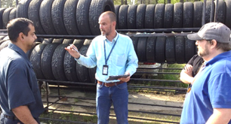
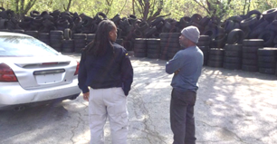
Solid waste
CY Year | Annual Collection | Annual Cost | Avg. Monthly Collection | Avg. Monthly Cost
2014 | 21,209 | $159,067.50 | 1,767 | $13,255.63
2015 | 21,467 | $161,002.50 | 1,789 | $13,416.88
2016 | 23,580 | $176,850.00 | 2,620 | $19,650.00
2017 | 12,971 | $97,282.50 | 2,161 | $16,213.75
Scrap Tire Abatement
Partnership with the Code Enforcement Commission
GIS Application training to track and eliminate illegal dumping
S.W.E.E.T. Scrap Tire Generator Enforcement
GA EPD Local Government Scrap Tire Abatement Reimbursement Grant
Pending application for removal of approximately 20,000 scrap tires
*FY17 Q4

Slide 18
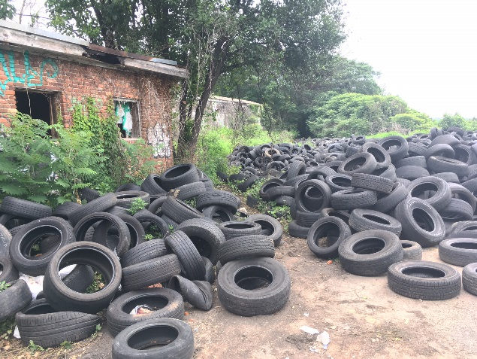
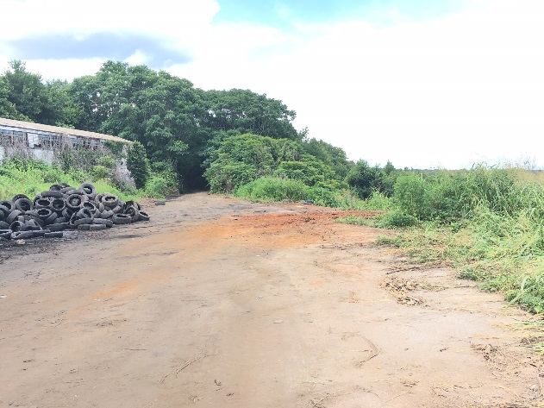
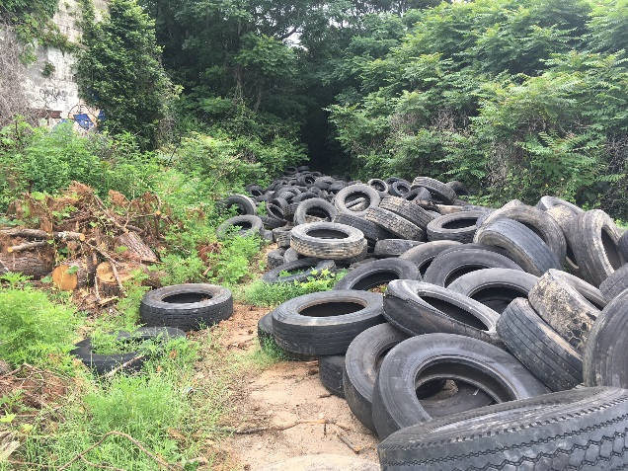
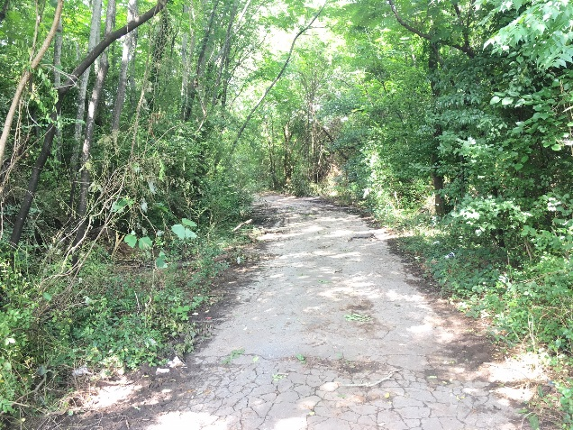
Solid waste
Honor Farm Illegal Dumping
Abatement
4,362 tires removed; 124 tons of debris removed
Pending GA EPD Application for reimbursement
Security
Gate posts installed at each property entrance
Pending installation of perimeter fence, surveillance cameras, and gated entrances
Intergovernmental Partnerships
Mayor’s Office, DPW, GA Environmental Protection Division, DeKalb County Fire Marshal & Code Enforcement, and GA Dept. of Natural Resources
Notes:
Solid waste crews and heavy equipment working to remove tires at Honor Farm
Last Quarter – 4300 tires, 124 tons of debris
Working with GA DEP, DeKalb County, OEAM
Installing fencing, cameras, trying to establish sting operations, increased enforcement
Fire hazard, public health, others

Slide 19
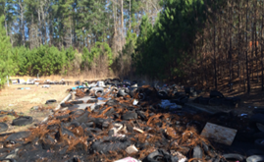
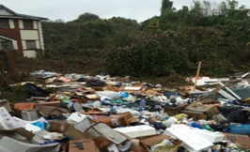
Solid waste
Solid Waste Education & Enforcement Team (SWEET)
Quarter | Courtesy Tickets | Citations Issued | Percent Compliance | Fines Collected
FY17 1st Quarter | 892 | 364 | 59.2% | $20,773
FY17 2nd Quarter | 978 | 191 | 80.5% | $14,846
FY17 3rd Quarter | 1366 | 226 | 83.5% | $19,237
FY17 4th Quarter | 1137 | 194 | 82.9% | $18,680
Average | 1093.25 | 243.75 | 77.7% | $18,384
Total | 4373 | 975 | 77.7% | $73,536
During Q4, FY17, the SWEET team continued their enhanced inspections resulting in 1137 courtesy tickets and 194 citations.
Notes:
Sweet team activities resulted in 194 Citations and almost $19,000 in fines collected.
Expect this activity level to continue and ultimately increase as we focus on illegal dumping and recycling enforcement.

Slide 20
Fleet services

Slide 21

Fleet services
The Office of Fleet Services utilizes Public Surplus.com to conduct online auctions for the surplus of equipment.
Operating Highlights
Notes:
Fleet services utilizes Public Surplus .com to dispose of equipment as it exceeds its useful life cycle
Last quarter Fleet generated $319K in revenue from the sale of this equipment
Over $900K for the year

Slide 22
Fleet Services
The Office of Fleet Services is responsible for maintaining nearly 5,600 pieces of rolling equipment, including critical services for Fire and Police.
Availability
Performance Measure | Initiative | FY 2017 Target | FY17 Q1 Actual | FY17 Q2 Actual | FY17 Q3 Actual | FY17 Q4 Actual
Patrol Cars | Public Safety | 100% | 100% | 94% | 100% | 83%
Motorcycles | Public Safety | 100% | 100% | 100% | 100% | 100%
Aerial Buckets | Public Safety | 100% | 100% | 100% | 100% | 100%
Pothole Trucks | City Infrastructure | 100% | 98% | 100% | 100% | 100%
Ladders | Public Safety | 100% | 100% | 100% | 100% | 100%
Pumpers | Public Safety | 100% | 100% | 100% | 100% | 100%
Rear Loaders | Public Safety | 100% | 94% | 99% | 98% | 92%
Sewer Cleaners | Public Safety | 100% | 84% | 98% | 99% | 99%
Paint Trucks | City Infrastructure | 100% | 94% | 100% | 100% | 100%
Platform Sign Trucks | City Infrastructure | 100% | 100% | 99% | 98% | 100%
Asphalt Planner | City Infrastructure | 100% | 66% | 38% | 63% | 47%
Notes:
Fleet availability is a key measure
Like to see 100%
Above 90% is still very good
Some equipment requires hard to get parts and some changes in procurement practices are causing limitations in the availability of parts
May result in higher equipment costs as we may be forced to carry more parts than we normally would to mitigate

Slide 23
Fleet services
PM Compliance (part 1 of 2)
Department | FY17 Q1 | FY17 Q2 | FY17 Q3 | FY17 Q4
Airport Fire & Rescue | 94% | 100% | 100% | 100%
Airport Police | 100% | 100% | 99% | 99%
Aviation Department | 98% | 98% | 97% | 98%
Corrections | 99% | 99% | 99% | 94%
AIM | 88% | 71% | 92% | 83%
DPW - Commissioner's Office | 100% | 92% | 100% | 100%
DPW - Office Of Fleet Services | 97% | 99% | 100% | 100%
DPW - Solid Waste Services | 90% | 94% | 94% | 96%
DPW - Transportation | 89% | 94% | 95% | 96%
Finance | 100% | 90% | 81% | 96%
Notes:
Key measure affecting availability is PM activity
Work with all departments to maintain equipment
Major issue occurs – Departments making equipment available for scheduled maintenance
Measure of that… by department
Huge improvement over time in general

Slide 24
Fleet services
PM Compliance (part 2 of 2)
Department | Q1 | Q2 | Q3 | Q4
Fire Rescue | 92% | 100% | 97% | 97%
Human Resources | 68% | 100% | 100% | 100%
Mayor's Office | 87% | 80% | 85% | 93%
Parks & Recreation | 94% | 92% | 95% | 95%
Planning | 94% | 96% | 96% | 95%
Police Department | 95% | 97% | 97% | 97%
Solicitor, Courts, Law | 90% | 84% | 89% | 78%
Watershed - Drinking Water | 88% | 87% | 92% | 92%
Watershed - Waste Water | 86% | 84% | 88% | 92%
Total | 92% | 93% | 96% | 96%

Slide 25
Capital projects

Slide 26
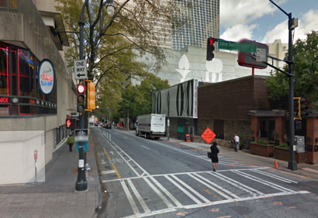
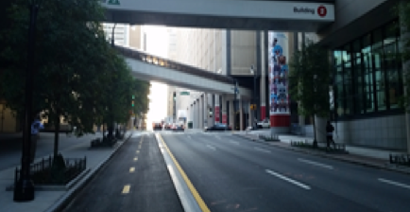
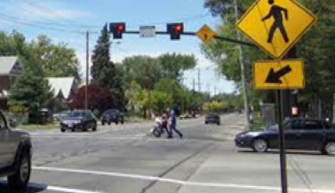
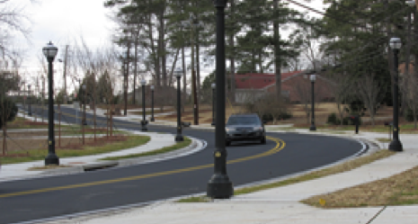
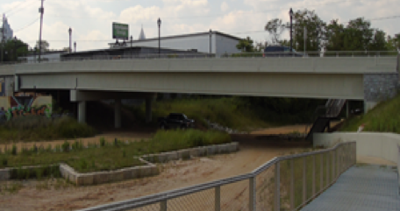





Capital projects
Capital Projects Program Overview
Bicycle & Pedestrian Projects include: Bicycle Lanes Multi-use Paths Trails Multimodal Improvements: Access to Transit Connectivity via multiple transit modes Signal Improvements Include: Hawk Signals School Flashers Traffic & Pedestrian Signals | Streetscapes include: Sidewalk & Curb Enhancements Landscaping Pedestrian Lighting Bridges: Repair Replacement
Current Program Estimates 5-YR Total: $140M; 31 Projects
$26.48M
Bicycle & Pedestrian Projects:10
$30.33M Multimodal
Projects: 8
$0.70M Signals
Projects: 2
$72.28M Streetscape
Projects: 10
$10.33M Bridge Replacement Projects: 1
Notes:
$140M total Budget
Bike and pedestrian safety improvements $27M
Multi-modal Projects (connect bikes, pedestrians, motorists, and transit)
Signals – much of the signal activity is being done in RENEW Program, and incorporated within Streetscape and Multi-modal projects
Streetscapes, and Bridge work

Slide 27

Capital projects
Key Accomplishments
Look Ahead
Completed medians construction along MLK Innovation Corridor
Bids for MLK were received on June 23, 2017
Proposals for Spring Street RFP were received on June 27, 2017
Award construction contract for MLK in July 2017
Submit bid package for Spring Street Bridge in August 2017
Continue to identify funding sources to eliminate funding shortfalls
Cost Details
 | $140.12M Program Budget | $123.57M Commitments | $14.55M Funding gap | $21.78M Spent To date | 11 Closed projects | $9.48M Under construction
EBO Snapshot
31.6% EBO Design Goal | 50.9% EBO Design Actual | 37.9% EBO Construction Goal | 66.7% EBO Construction Actual
Contract Snapshot
20 Contracts Awarded | 31 Active Projects
Notes:
Last Quarter – Completed medians on MLK
Received bids for the LCI work on MLK from Northside to Ollie Streets
Received proposals for the spring street improvements from Peachtree to 17th
For the overall program over 60% of the work is being performed by local disadvantaged business enterprises

Slide 28
Safety

Slide 29
safety
Performance Metrics
Initiatives
  Training
    Filled 97% of available training seats
    Conducted 237 safety activities to promote safety
      CDL, New hire, Refresher, Drivecam, Worker’s comp, Emergency Preparedness, Flagger, Defensive Driving, CPR, Supervisors, Facility inspections and Shelter in place
    Conducted 5,809 hours of training
  Drivecam
    1370 events coached
    5% reduction from baseline in coachable events
Notes:
Safety focus on training and awareness
5800 training hours to our employees
97% of our total training capacity
Focus on active coaching based on drive cam observations with a goal of reducing unsafe work practices – Operating equipment

Slide 30
safety
Performance Metrics
Notes:
Accidents continue to trend down while injuries remain flat
In addition to training we have increased availability of personal protective equipment for employees working with Andrea McClain as part of a City Wide initiative

Slide 31
safety
Performance Metrics
Notes:
Safety Metric – want to see preventable accidents trending down
Up in Q4
Continued focus on awareness and training
Data Analysis to target problem areas
New employees
Personal injuries

Slide 32
HUMAN RESOURCES

Slide 33
Staffing scorecard
Overall Goal Status
Public Works Status
Green (90-100% fill rate): Fleet Services
Yellow (70-89% fill rate): Office of the Commissioner, Solid Waste Services, Streetcar Services, and Transportation
Red (<70% fill rate): None
Total Positions: 965
Open: 77 (8.8% vacancy rate) *Vacant positions
(excluding in process)
Total Positions
On hold: 8
Recommended/In Process: 50
Filled: 830
Percentage Filled: 86%
(filled/total positions)
Notes:
8.8% vacancy rate excluding those in various stages of hiring
Major changes – Organizationally to accommodate new initiatives
Key partner and member of our team
Excellent Job – Commissioner Yancy, Nia Parker and our DPW Team

Slide 34
Staffing scorecard
90-Day Plan: Vacancy Control
Key Initiatives
Three Hiring Blitz events scheduled for Solid Waste
Conducted on-going touchpoint meetings between hiring managers and HR recruitment lead
Ensured all critical DPW vacancies filled within 60 days
Hiring focus on new key Transportation frontline/leadership positions (partial driver of increased vacancies)
Provide training opportunities for heavy equipment operators to increase internal promotions
Utilize hiring blitzes, job fairs, and professional organizations to recruit hard-to-fill positions
Notes:
Hiring Blitzes
Key Transportation Leadership Recruitments underway
Hard to fill
Heavy Equipment Operators
Engineers/Technical Positions
Salary Competativeness

Slide 35


