Slide 1
Finance/Executive Committee Update
July 2017
Rocky Atkins
Executive Director
Office of Customer Service

Slide 2
The Last 4 Months
Focus on people
Employee engagement – unlocking potential
Call center technology upgrades – dual monitors, new PCs
Call center staffing, key hires
Capability assessment
Utilization of technology
311 best practice
FY18 Budget

Slide 3
The Last 4 Months
Collaboration across departments
Process improvements with DWM, DPW
Proactive engagement / communications
Focus on service request issues including premature closures & duplicates
Outreach / raising the profile
Community meetings and events (Senior Fair, Fight the Blight and others)
Prominent position on the new City of Atlanta web site

Slide 4
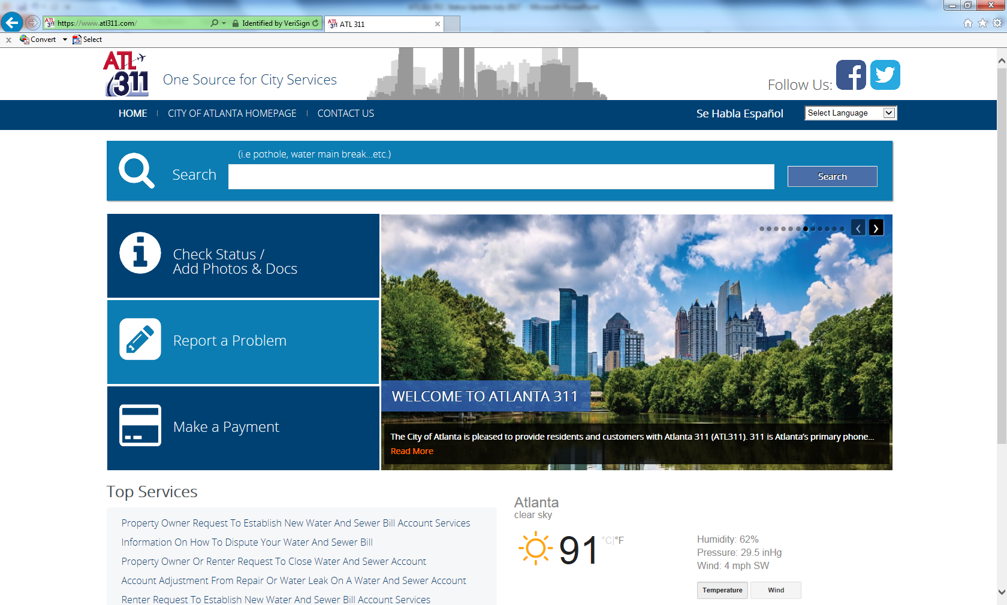
ATL311 Portal

Slide 5
Performance Reports

Slide 6
311 Volume
March was 311’s busiest month ever.

Slide 7
311 Call Volume by Department
Jan – Mar spike in Finance volume due to business license renewals.

Slide 8
Average Call Handling Time (AHT)
Increased focus on First Contact Resolution driving up AHT.

Slide 9
311 Service Level
Service level target is 85% of calls answered within 20 seconds.
March, April impacted by business license renewals, DWM Amnesty Program and Invoice Cloud implementation.

Slide 10
District-level Reporting
Service request volume by district / department
SLA Performance by district / department
Top call drivers – General Info and Fulfillment
Complaints by district / department

Slide 11
Next 6 Months
Continue to collaborate with other departments
Alignment with DWM customer service initiatives
Code Enforcement, Courts (under assessment)
Infrastructure upgrades
Improved analytics / reporting
Auto Call Back
Ramp up Social Media / Everbridge
Service Order Management
311 Mobile App

Slide 12
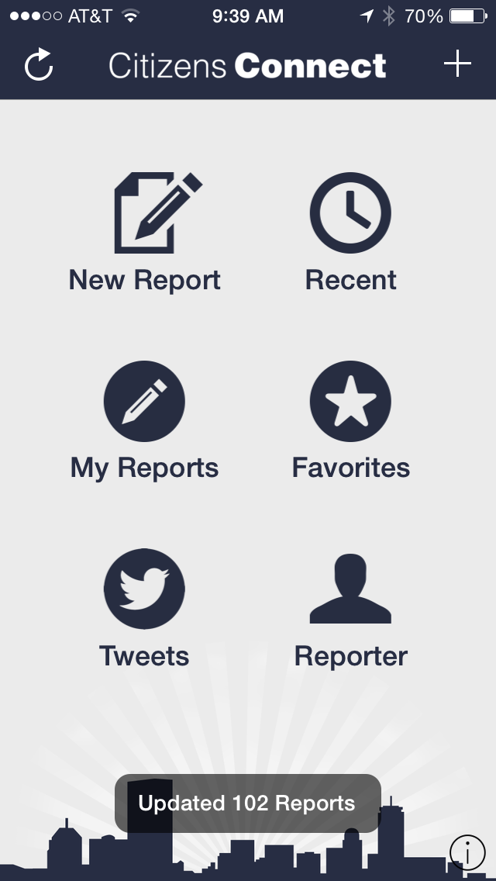
311 Mobile App
ATL311
Sample configuration shown, completely customizable to meet our requirements
Submitting a service request with a photo is fast, easy
Notification via the app when a service request is updated or closed
Map view of all open service requests

Slide 13
One Source for City Services
Questions?

