Slide 1
Homeless Opportunity Bond:
Funding a ClearPath to Make Homelessness Rare, Brief and Non-Recurring in Atlanta
FEC Committee • July 12, 2017

Slide 2
What is a Homeless Opportunity Bond?
Municipal bond that supports capital projects to reduce homelessness, primarily housing solutions
Implementation of housing examples include: purchases, new builds, long-term leases, renovations of existing facilities, and also associated services and administrative costs
Implementation timelines are typically within 5 years; impacts span the useful life of the physical assets as well as the “social impacts” to tax rolls, employment, mental health system, criminal justice system
Benchmarks
LA and Hilton Foundation committed over $150M for supportive housing development in first year of a $1.2B bond passed in 2016
Dallas is reviewing funding potentially up to $25M from its next municipal bond package for permanent supportive housing
Denver Social Impact Bond of up to $11.42M in 2016 targets most vulnerable
Portland committed additional $11.5M in 2017 over annual $15M for a $26.5M investment
Houston committed $44M in 2011 to create 766 units of permanent supportive housing for homeless over 4 years

Slide 3
Why Atlanta?
Since 2013, Atlanta has made meaningful progress to further alignment of major funders, public agencies, service providers and interested individuals through:
Organizing and local planning via the City Council-authorized homeless Continuum-of-Care;
the creation of 501c3 Partners for HOME to administer the CoC and leverage private and public funding;
ongoing partnership with the Regional Commission on Homelessness at the United Way of Greater Atlanta
In this time, we have honed our understanding of our homeless population, population needs and sub-segments. Through several pilots of evidence-based strategies and housing interventions, we have demonstrated substantial reductions in homelessness

Slide 4
City of Atlanta’s Approach to Homelessness: the Continuum-of-Care
In 2013, City Council authorized the establishment of the Atlanta Homeless Continuum-of-Care (CoC) as its system wide entity for addressing homelessness in the City of Atlanta as well as authorized the incubation of 501c3 Partners for HOME to operate and administer the CoC
Coordination both with the external community of funders, providers, advocates and homeless individual and also with internal City of Atlanta agencies:
CoA Finance / Office of Grants Management
Mayor’s Office of Human Services and Constituent Services
Atlanta Police Department HOPE (Homeless Outreach & Policing Enforcement) team
Department of Corrections
The Municipal Community Court and associated offices (Public Defender, City Solicitor)
Atlanta Homeless CoC Key Activities
Promotes communitywide commitment to the goal of ending homelessness
Promotes access to and effect utilization of mainstream programs
For Atlanta, over 69 service agencies participate
Oversight provided by a Governing Council, comprised of State, City, Faith and Provider representation
Applies for and monitors $7M annually which funds permanent housing solutions
Develops, and executes strategic plan
Performance reporting and oversight of data quality into HMIS

Slide 5
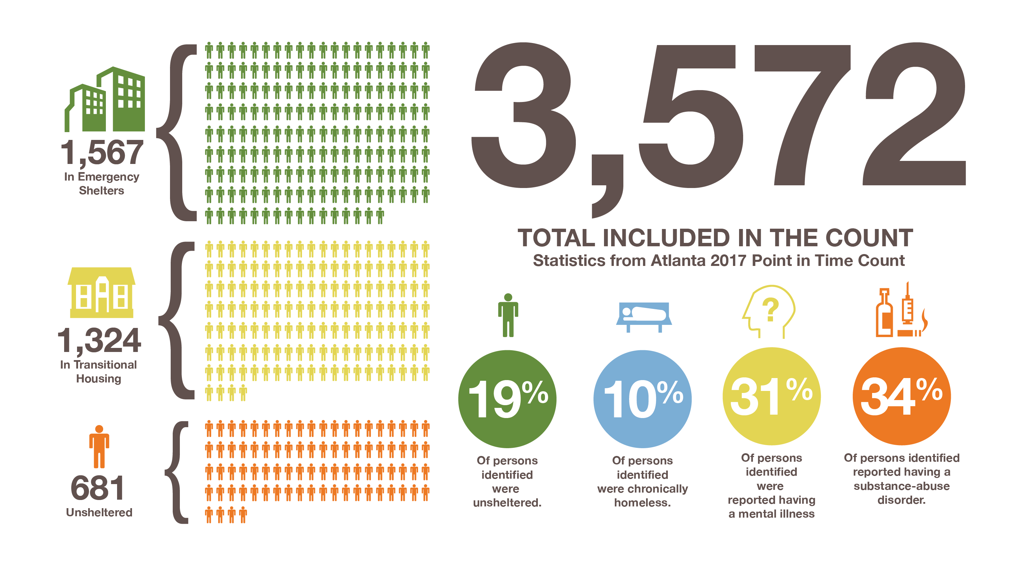
Homelessness in Atlanta Today
(See Key Terms Glossary on next slide)

Slide 6
Key Terms Glossary
Using Housing First as our foundation…
Emergency shelter – short term bridge housing for all
Transitional housing – long term temporary housing (6-24 months) with intensive services. Ideally suited for domestic violence, youth, and substance abuse
Rapid rehousing – short or medium term, flexible financial assistance and services to quickly re-house and stabilize individuals and families
Permanent Supportive Housing – evidence based housing intervention that combines non-time-limited housing assistance with intensive wrap around supportive services. Ideal for chronically homeless
Chronic homelessness—an individual who has a disabling condition AND has been homeless for the last 12 months or had 4 episodes in last 3 years = 12 month

Slide 7
Substantial progress in decreasing homelessness in recent years
More than 1,650 City of Atlanta homeless veterans have successfully moved into permanent housing since 2011.
**PIT count not conducted in 2012

Slide 8
CoA’s ClearPath Strategic Plan to end homelessness in Atlanta
Building on our recent progress in reducing homelessness, a community-based strategic planning effort was undertaken in 2016-2017 to define a ClearPath Strategic Plan to making homelessness rare, brief and non-recurring in Atlanta
Focus on key subpopulations and needs-based intervention strategies
Brings local pilots to scale, such as system-wide coordinated intake & assessment
Utilizes evidenced-based sustained housing solutions already proven in Atlanta, such as rapid-rehousing and permanent supportive housing
City Council formally adopted this plan on June 19, 2017, via Ordinance 17-O-1243
Our key Continuum-of-Care partners, in particularly the philanthropic community, is challenging the City of Atlanta to match up to $25M of funding to accelerate and ensure full implementation of the plan

Slide 9
ClearPath Strategic Planning: Starts with Coordinated Intake & Assessment
Evolution to a Coordinated System
Programs
Present: Diverse group of independent providers using lots of methods to achieve various goals
Crisis response system
Vision: A collective network of providers aligning coordinated efforts and resources to maximize impact

Slide 10
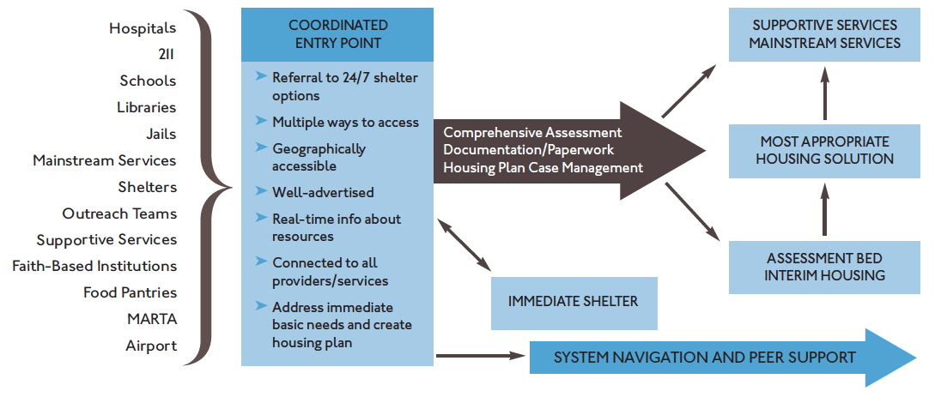
Coordinated Entry System Map
Coordinated Intake & Assessment Process Map

Slide 11
ClearPath Strategic Plan Key Goals
Achieved by the new system design and collective impact model
Goal: Rare, brief and nonrecurring | Approach | Timeline
End Veteran Homelessness | Refine coordination and targeting | 2017
End Chronic Homelessness | Add permanent supportive housing units and bridge to Medicaid service funding | 2019
End Youth Homelessness | Spectrum of youth-focused interventions (Rapid Rehousing, Transitional, Host Homes) | 2020
End Family Homelessness | Access to affordable units and employment | 2020
Leverage, align and strategically allocate resources | Emphasis on maximizing sustainability, e.g., mainstream funding | Ongoing

Slide 12
Proposed Homeless Opportunity Bond Projects
Emergency Shelter:
Capital costs will be used towards facility renovation, acquisition and rehabilitation and operation.
2-3 shelter projects will create 270 new emergency, low-barrier shelter beds for temporary placement while individuals await a permanent housing unit
These new shelter beds will serve men, women and families.
Costs:
Year 1: $2.45M
Year 2: $3.07M
Year 3: $2.05M
Permanent Supportive Housing for Chronically Homeless:
Ending chronic homelessness requires the creation of 200 housing placements each year, for the next three years. Placements will be created through the acquisition, renovation and operation of existing housing stock.
Chronic homeless projects will facilitate creation of 500 units of housing and associated services via scattered site and housing projects
Prioritization of those with severe disabilities and long time homelessness
Costs:
Year 2: $6,230,000
Year 3: $10,750,000
Fully Execute Coordinated Entry (Outreach/Intake/Assessment):
In order to manage the surge of placements, fully operational coordinated access points are required.
Coordinated access points will be equipped with four vehicles and staff to assist with transporting clients to view housing units and acquire necessary documentation for housing placement
Cost: $400,000

Slide 13
Anticipated Homeless Opportunity Bond Outcomes
Funds will be maximized by matching an additional $25 million in private dollars and will leverage $66 million in public resources for a total investment of greater than $115M
Goals | Outcomes
End Veteran Homelessness | 147 Veterans will be permanently housed 147 Veterans will be connected to employment, education and support services
End Chronic Homelessness | 500 disabled individuals permanently housed Significant cost savings to emergency services including EMS, APD, City and County jail, emergency rooms
End Youth Homelessness | 450 young adults (ages 18-24) removed from street and placed in safe, permanent housing Reduction of risky behavior Connection to employment, education and support services
End Family Homelessness | 300 heads of household will obtain employment 300 families will be permanently housed and paying rent Savings to emergency shelter and crisis systems

Slide 14
Proposed Timeline
Subject to Funds Availability
Y1 |  |  |  | Y2 |  |  |  | Y3
Q1 | Q2 | Q3 | Q4 | Q1 | Q2 | Q3 | Q4 | Q1 | Q2 | Q3 | Q4
Shelter 1 (outside CoA – philanthropic funds only)
Shelter 2
Shelter 3
Permanent Supportive Housing (PSH) Phase 1 (225 units)
PSH Phase 2 (325 units)
Coordinated Intake & Assessment – Vehicles & Staff

Slide 15
Peachtree-Pine Shelter Closure (1 of 2)
The City of Atlanta is partnering with the Regional Commission on Homelessness at the United Way (RCOH) and other service providers to meet the demand for housing and shelter created by Peachtree and Pine’s closure.
We are working with the current shelter management and where possible, are seeking housing solutions for those individuals now.
Starting August 28, interim shelter operations will begin under the new owner. RCOH and the City are working with new owner to secure an experienced operator who will operate the facility in order to facilitate a gradual closure, while remaining current residents needs are addressed and new shelter beds are created.
We are and will seek to connect current residents to solutions using the CoC’s Coordinated Entry system to ensure we are best meeting each individual’s housing needs:
Assess all individuals in the facility to identify their permanent housing needs
Target chronically homeless individuals for Permanent Supportive Housing
Prioritize non-chronic individuals for connection to Rapid Rehousing subsidy, support and employment services
Promote reunification for those with family

Slide 16
Peachtree-Pine Shelter Closure (2 of 2)
Resources utilized will include philanthropic support, homeless opportunity bond resources as already identified in the overall plan/project list, and additional resources from public agencies, e.g.,
Increase rapid rehousing resources through public and private commitments
Optimizing current resources, such as Tenant Based Rental Assistance (TBRA) through HOME
Working with State agencies (DBHDD, DCA) and Atlanta Housing Authority for additional surge resources such as vouchers, subsidies and services
Shelter capacity will be replaced through creation of 2-3 new shelters as planned for the homeless opportunity bond, which can include rehabilitation or utilization of existing or closed shelters

Slide 17
Legislative authorization of agreement with InvestAtlanta
Bond issuance and administration
Quarterly reporting on progress via CDHS committee updates
Proposed Homeless Opportunity Bond
Next Steps

