Slide 1
City of Atlanta
COVID-19 Funds Report
Department of Finance
October 23, 2020

Slide 2
COVID-19 Reporting Requirements
The City of Atlanta adopted four pieces of legislation which required the Chief Financial Officer to prepare and submit certain reports in a timely fashion regarding the financial impact of COVID-19.
20-R-3773 requires the “Chief Financial Officer provide a report on the accounting of all federal and state funds the City of Atlanta has received or will receive to assist with battling the harmful effects of the COVID-19 pandemic.”
20-R-3774 requires the “Chief Financial Officer to provide the Council President and all members of the City Council an accounting of all funds that will be contributed to non-profit and philanthropic organizations as part of the City’s emergency assistance in response to the COVID-19 pandemic.”
20-R-3787 (not to exceed $5M) and 20-R-3914 (not to exceed $20k) requires that the “Chief Financial Officer shall submit to the Atlanta City Council and to the Atlanta Ethics Office before the 15th of each month a report listing for the previous month, the details of ... each donation . . .”

Slide 3
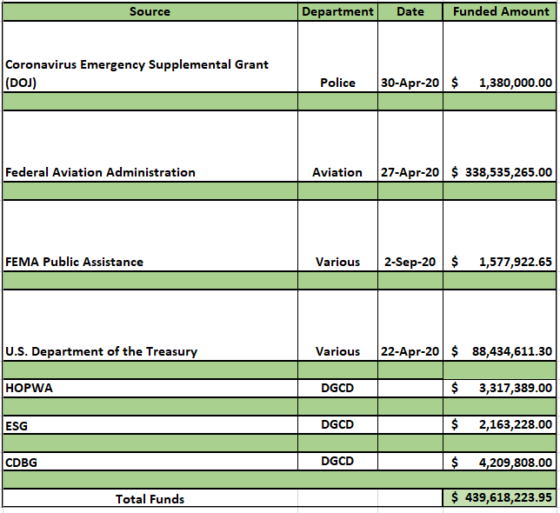
Federal Funds 20-R-3773

Slide 4
CRF Obligation & Spend Breakdown 20-R-3773
U.S. Treasury Cares Act:
Funded Amount- $88.4M
Obligated Costs - $44.7M
Actual Costs - $22.7M
Available Balance - $43M

Slide 5
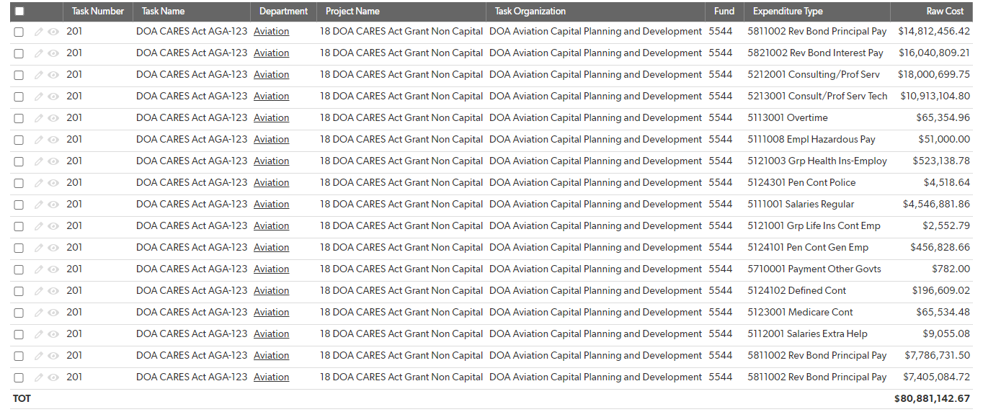
FAA Spend Breakdown 20-R-3773
Federal Aviation Administration (FAA):
Funded Amount- $338.5M
Obligated Costs - $80.8M
Actual Costs - $80.8M
Available Balance - $257.6M

Slide 6
Non-Profit and Philanthropic Organizations 20-R-3774
Entity | Purpose | Allocated | Disbursed | Recipients
Georgia's Own Credit Union | To provide financial support to employees of City of Atlanta contractors ($2,000) | $ 1,500,000.00 | $ 1,500,000.00 | 750
Invest Atlanta (SBCLF)* | To provide financial support to small businesses impacted by COVID-19 ($5,000-$30,000) | $ 1,500,000.00 | $ 1,550,000.00 | 59
Invest Atlanta (United Way) | To provide financial support to the homeless population | $ 1,000,000.00 | $ 1,000,000.00 | 500
*includes $50k donation received from Arthur Blank Foundation

Slide 7
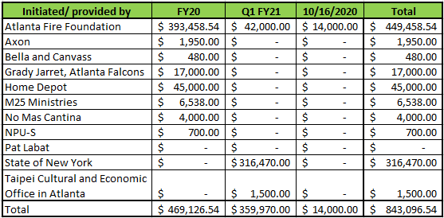
Donations (Summary)
20-R-3787 and 20-R-3914

Slide 8
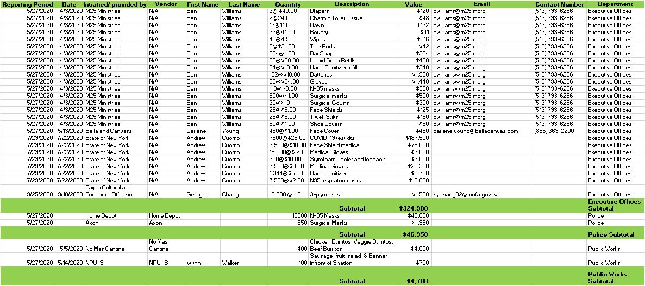
Donations (Detail)
20-R-3787 and 20-R-3914
EOC 1

Slide 9
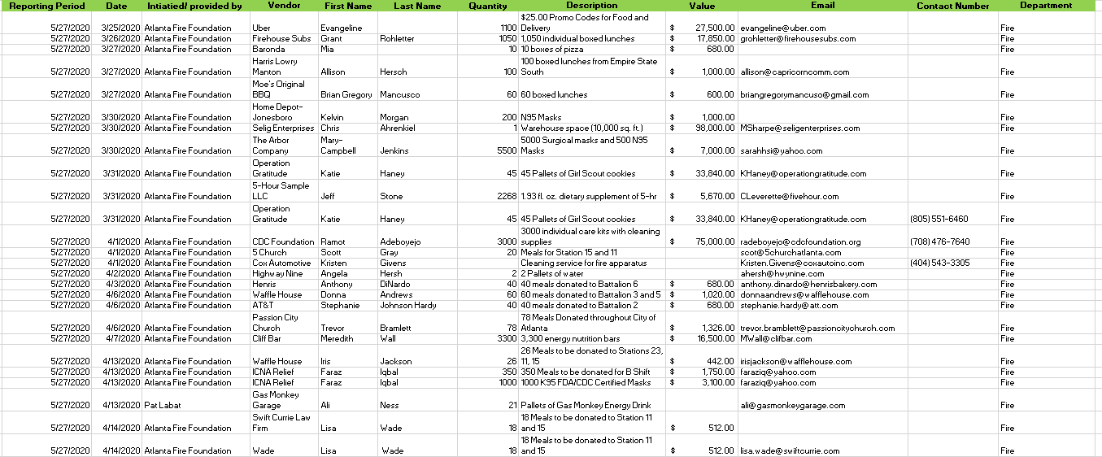
Donations (Detail) con’t
20-R-3787 and 20-R-3914
Fire 1

Slide 10
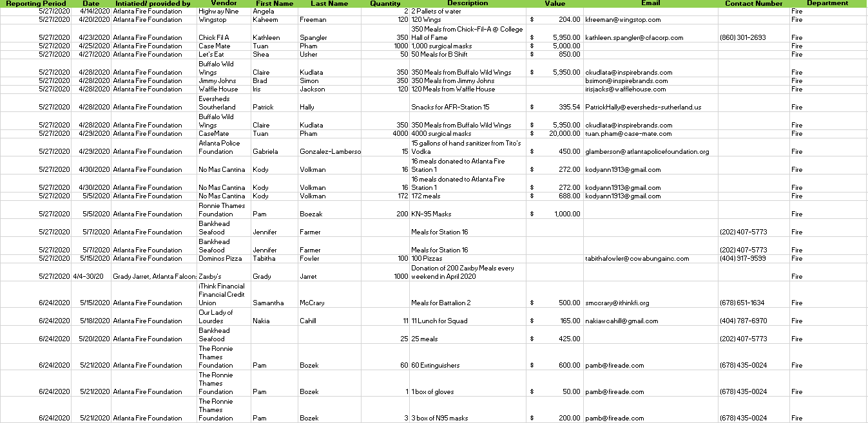
Donations (Detail) con’t
20-R-3787 and 20-R-3914
Fire 1

Slide 11
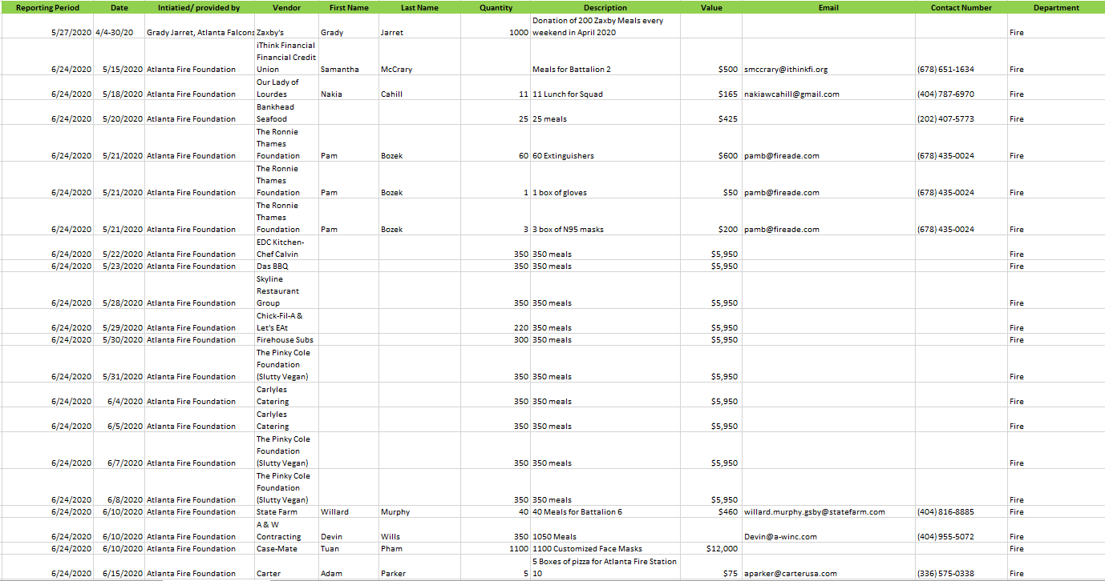
Donations (Detail) con’t
20-R-3787 and 20-R-3914
Fire 1

Slide 12
Donations (Detail) con’t
20-R-3787 and 20-R-3914
Fire 1

Slide 13
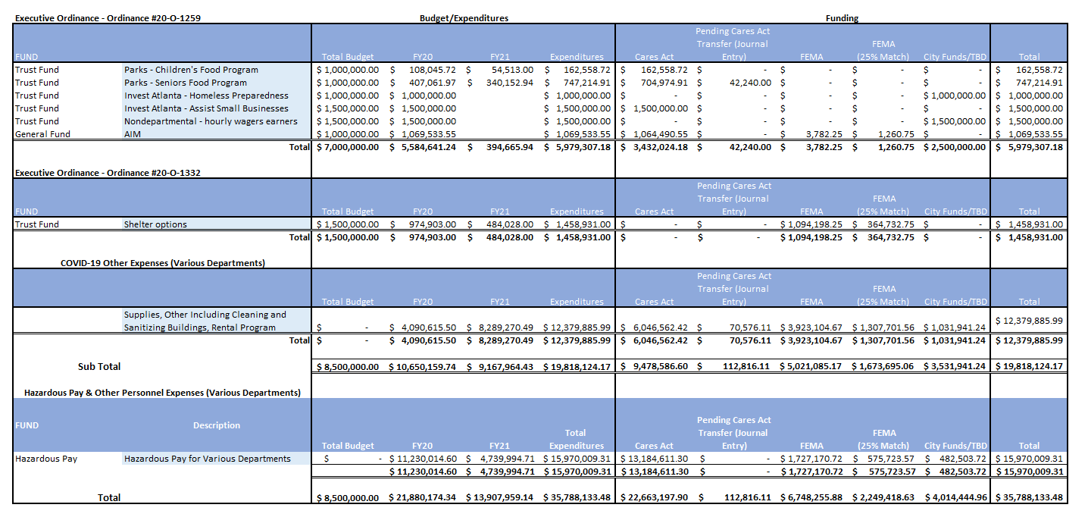
COVID-19 Expenditures (Function Activity 5510001)
As of October 16, 2020

