Slide 1
City of Atlanta, department of finance FY17 Third quarter report May 24, 2017
J. Anthony Beard, CFO | John Gaffney, Deputy CFO

Slide 2
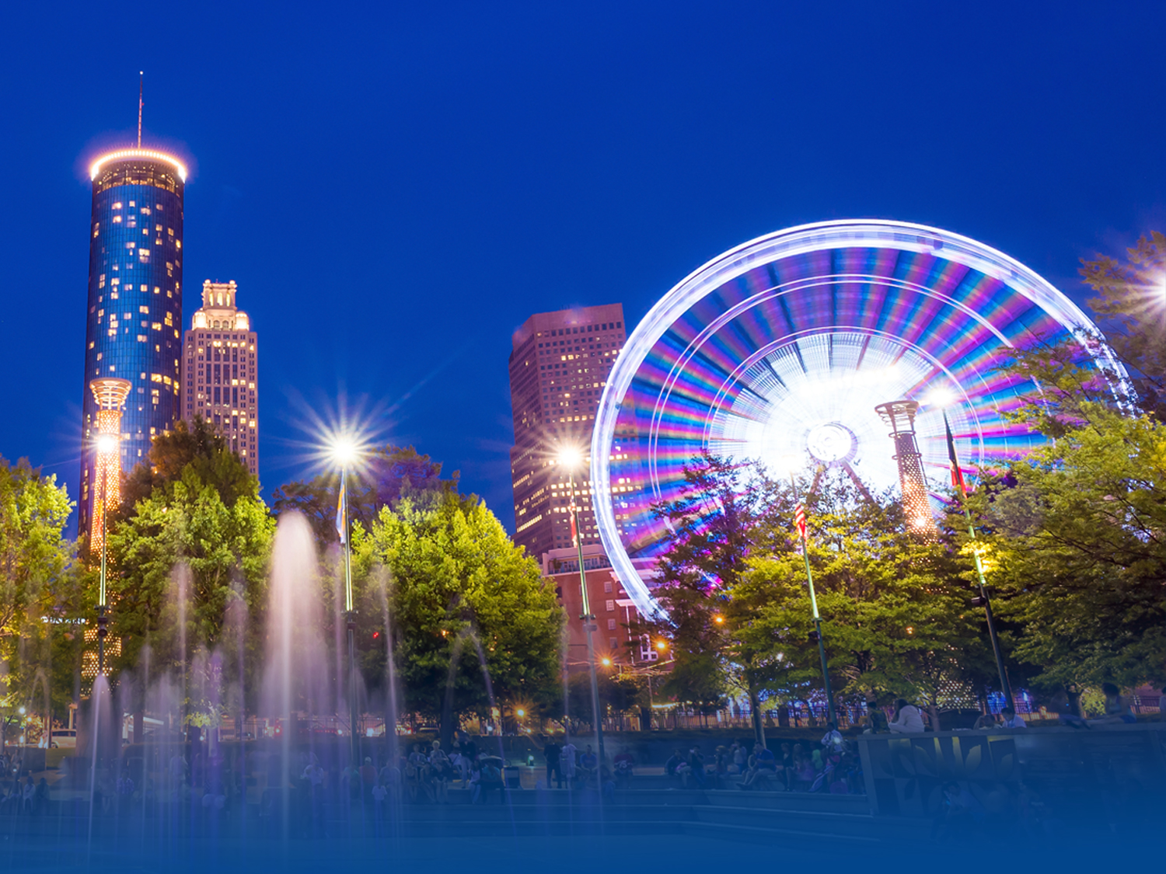
AGENDA
OPERATING FUNDS OVERVIEW
Governmental Funds Overview
General Fund
General Fund Balance Projection
Special Revenue Funds
Proprietary Funds Overview
Enterprise Funds
Proprietary Fund Balance
CASH POOL REPORT
STATEMENT OF CASH FLOWS
DEBT/INVESTMENT PORTFOLIOS
BOND RATINGS

Slide 3
GOVERNMENTAL FUNDS OVERVIEW

Slide 4
GENERAL FUND ACTUAL TREND As of March 31, 2017 (000's)
As of March 31, 2017, General Fund revenues are projected to be on target.
Notes:
Due to challenges in the Fulton County Assessor’s office, the 2016 tax bills did not go out consistent with last year.

Slide 5
FY17 GENERAL FUND BUDGET PROJECTION (000's)
The General Fund expenditures are projected to be over budget by $8.5MM.
The General Fund revenues are projected to be on target.
Notes:
General Fund is under budget by $3MM: Surplus of $14MM in Nondepartmental and $3MM in City Council offset by overages of $8MM in Police, $2MM in Fire, $2MM in AIM, and $2MM in Corrections.

Slide 6
FY17 GENERAL FUND DEPARTMENT HIGHLIGHTS The Department of Police Services (000's)
The Atlanta Police Department is expected to be over budget by 6.91% or $12.6MM which is due mainly to salary increases and overtime.
Notes:
$8.4MM: Due to overtime of $10.6MM offset by vacant positions of $7.5MM, salary increases of $2.3MM, 15 COPS Grant positions transferred to General Fund of $900K and uniform expenses of $1.3MM.

Slide 7
FY17 GENERAL FUND DEPARTMENT HIGHLIGHTS Non-Departmental (000's)
Non-Departmental is projected to be under budget by 2.54% or $2.7MM due mainly to the restricted reserves.
Notes:
$8MM Reserves offset by $1.8MM Public Safety Equipment, $1.2MM City of Refuge, $550K Honeywell, and $270K Westside.

Slide 8
FY17 GENERAL FUND DEPARTMENT HIGHLIGHTS Department of Corrections (000's)
The Department of Corrections is expected to be over budget by 3.3% or $1.2MM due to overtime and various contract services.
Pharmaceutical and Utility
expenses
Notes:
Over budget due to Overtime $544K and various funded and unfunded contract services such as Emergency Replacement of Domestic Water System ($274K), Electrical Repairs ($58K), Elevator Modernization ($65K), Access Control ($33K), Emergency Water Damage Repairs ($13K), Leak Repair at 143 Alabama St ($3K), Reentry Tracking System ($20K), Program Instruction ($30K), Body Worn Camera ($100K), and Promotional testing ($19K).
Pharmaceutical per year – currently averaging $333,600.00. The not to exceed amount of the contract was increased to $350,000.00.

Slide 9
FY17 GENERAL FUND DEPARTMENT HIGHLIGHTS Department of Parks and Recreation (000's)
The Department of Parks and Recreation is expected to be over budget by 11.09% or $3.8MM.
Notes:
Overage due to:
1. Extra help due to transition of Camp Best Friends staffing out of Trust Funds – $327,405 over budget
2. Repair/maintenance of equipment and facilities - $445,956 over budget
3. Water/Sewer - $148K over budget

Slide 10
FY17 GENERAL FUND DEPARTMENT HIGHLIGHTS The Department of Public Works (000's)
The Department of Public Works is expected to be under budget by 1.25% or $582K, which is due mainly to Purchased/Contracted Services.
Notes:
Over $2MM in unfunded projects include:
1. Perry Blvd Collapse ($1.5MM)
2. Piedmont Drainage ($900K)
3. Northside Drive Utility Relocations ($600K)
4. NCR ROW Improvements ($800K)
5. West Marietta Blvd Swell enclosure ($300K)
6. Piedmont Wall collapse & drainage ($2MM)

Slide 11
FY17 GENERAL FUND DEPARTMENT HIGHLIGHTS Department of Fire Services (000's)
The Department of Fire Services is expected to be over budget by 2.7% or $2.2MM due mainly to salary increases and overtime.
Fire station, building and communication needs, and EMS medical supplies.
Maintenance Repairs for Stations and Buildings
Notes:
Over budget due to salary increases of $2.3M and overtime of $168K offset by vacant positions.

Slide 12
Proprietary Funds Overview

Slide 13
FY17 Airport Revenue Fund Projection (000's)
$90MM savings related to:
$80MM reserves
$8MM service contracts
$2MM vacant positions

Slide 14
FY17 Water & Wastewater Revenue Fund Projection (000's)
$68MM savings related to:
Fund-wide reserves
GEFA loan reserves
Bad debt reserves
Notes:
The Water & Wastewater fund revenue variance due to Water revenue more than anticipated. Expenditure Variance is due mainly to GEFA loan reserves, fund wide reserves, and bad debt reserves.

Slide 15
ENTERPRISE RENEWAL & EXTENSION FUND BALANCE
As of March 31, 2017 (000's)

Slide 16
Cash Pool Report
Notes:
John Gaffney will present the Cash Pool and Cash Flow reports.

Slide 17
Investment in the Cash Pool As of March 31, 2017 (000's)
Funds with Positive Balances Total $2.1B
Notes:
Other:
Group Insurance 10,715
Solid Waste Revenue 1,646
Capital Finance 12,564
Solid Waste R&E -
Park Improvement 6,974
Special Assessment 2,663
Building Permits Revenue 8,947
Hotel/Motel Tax 1,133
Civic Center R&E 603
Annual Bond 346
Perpetual Care 282
Downtown Parking Project Fund 177
Rental/Motor Vehicle Tax -
Total 46,050

Slide 18
Investment in the Cash Pool As of March 31, 2017 (000's)
Funds with Negative Balances total $34MM

Slide 19
General Fund Statement of cash flows report

Slide 20
FY16 vs. FY17 General Fund Cash Flows (000's)
Ending Balance as of March 31, 2017 Totals $287,218
Notes:
Due to challenges in the Fulton County Assessor’s office, the 2016 tax bills did not go out consistent with last year.

Slide 21
Debt/Investment Portfolios
Notes:
Paul Kwaw will present the Debt and Investment portfolios and bond ratings.

Slide 22
Debt Portfolio – Total Debt Outstanding As of March 31, 2017 (000's)
Total Debt Outstanding is $6.94B
 | Q3 FY17 | Q3 FY16
General Obligation | $350,285 | $354,380
General Fund & Other | $278,499 | $307,432
Tax Allocation Districts | $499,385 | $441,410
Department of Aviation | $2,880,645 | $3,002,125
Department of Watershed | $2,929,672 | $2,978,556

Slide 23
Investment Portfolio As of March 31, 2017
Total Investment Portfolio Totaled $2.6B
Notes:
3Q’16 investment portfolio value totaled $2.511 billion

Slide 24
Investment Portfolio As of March 31, 2017
2Yr Treasury
 | March 2016 | June 2016 | Sept 2016 | Dec 2016 | March 2017
Interest | $6.32MM | $7.58MM | $9.42MM | $11.82MM | $13.58MM
**Numbers do not reflect approx. $34MM in the Atlantic TAD
Notes:
**These number do not reflect approx. $34mm in the Atlantic TAD

Slide 25
BOND RATINGS

Slide 26
BOND RATINGS As of March 31, 2017
 | MOODY’S | S&P | FITCH
General Obligation Bonds | Aa2 Positive Outlook | AA+ Stable Outlook | AA+ Stable Outlook
Water & Wastewater | Aa2 Stable Outlook | AA- Stable Outlook | A+ Stable Outlook
Airport Senior Lien GARBs | Aa3 Stable Outlook | AA- Stable Outlook | A+ Stable Outlook
Airport Subordinate Lien GARBs and PFCs | Aa3 Stable Outlook | AA- Stable Outlook | A+ Stable Outlook
Airport Senior Lien CFC’s | A1 Stable Outlook | AA- Stable Outlook | A+ Stable Outlook
GARB: General Airport Revenue Bond
PFC: Passenger Facility Charge Revenue Bond
CFC: Customer Facility Charge Revenue Bond
26
Notes:
Rating Upgrades
Moody’s GO Ratings outlook upgrade from Aa2 to Aa1
S & P GO ratings upgrade from AA to AA+

Slide 27
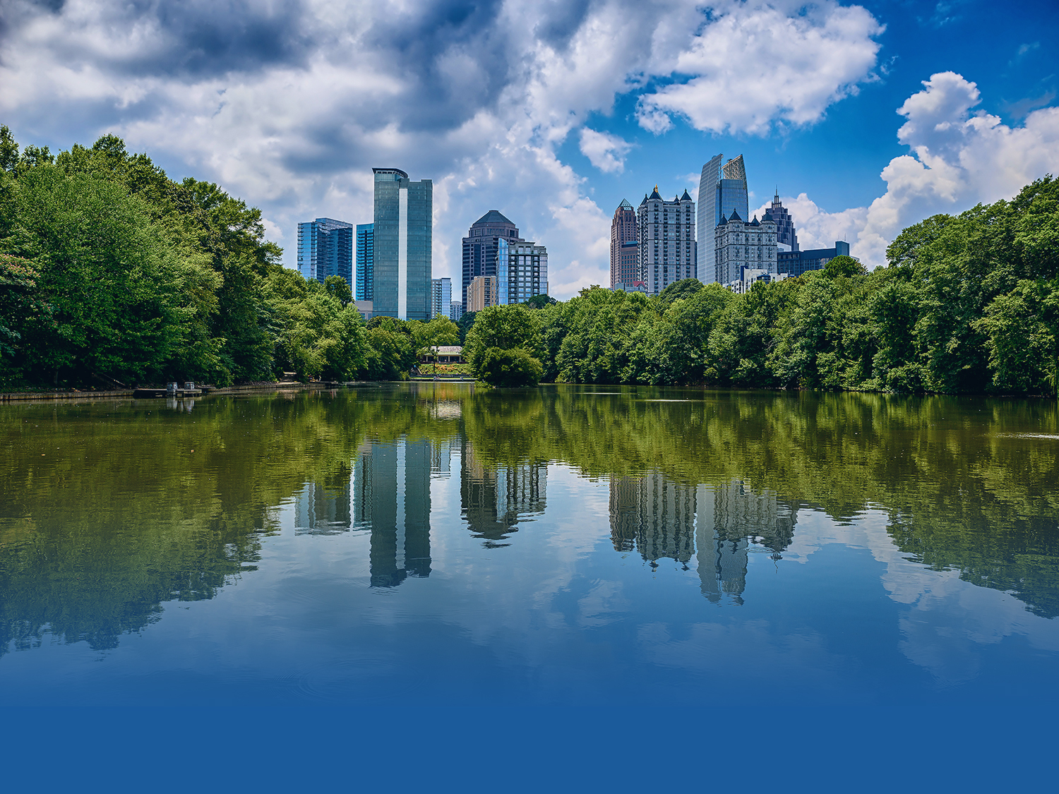
QUESTIONS/ANSWERS SESSION

