Slide 1
Atlanta/Fulton County Pre-Arrest Diversion Initiative Presentation to Atlanta City Council CDHS Committee May 23, 2017

Slide 2
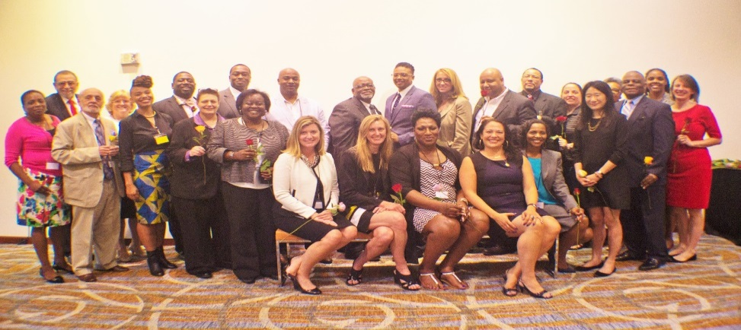
The Design Team
In December 2015 the Atlanta City Council and Fulton County Board of Commissioners passed parallel resolutions for the creation of a Pre-Arrest Diversion Design Team
Over 50 experts representing APD, Atlanta City Council, Atlanta Public Defender’s office, Atlanta Solicitor’s Office, Service Providers, and their Fulton County counterparts were gathered to form the Design Team which launched in June 2016
Notes:
Pre-Arest Diversion public safety and health initiative built to address the root causes of addiction, mental health issues, and poverty. The initiative is modeled after Seattle's LEAD program launched in 2011 which saw a 60% reduction in recidivism in the first pilot year alone. In December 2015 Atlanta City council [you all] and Fulton county passed resolutions for the creation of a Pre-Arrest Diversion Design Team meant to develop an operational workplan for the development of PAD in Atlant/Fulton County. Over 50 representatives of APD, Atlanta City Council, Atlanta Public Defenders office, Atlanta Solicitors Office, Service Providers, and more were gathered to form the Design Team which launched in June 2016.

Slide 3
Research
Compared crime data from APD Zones 3, 5, and 6
Analyzed APD data related to quality of life, narcotics, and prostitution-related crimes, to determine:
Top calls for service
Most common arrest charges
Demographics of potential PAD participants
Reviewed snapshots of Atlanta City Detention Center and Fulton County Jail population charges and analyzed the average days before release
Reviewed current Atlanta Pre-Trial Intervention, Alternative courts, and Sentencing options
Interviewed potential participants, neighborhood leaders, and business owners
Conducted focus groups with 40 APD officers from Zones 5, 6 and COPS Unit
Solicited public input at PAD Townhall at Ebenezer Baptist Church
Independent process and outcome evaluation to be conducted by Morehouse School of Medicine and Emory School of Public Health

Slide 4
Pre-Arrest Diversion
Individuals disproportionately impacted by racial disparities in policing, arrests and sentencing
Individuals typically excluded from other programs
Individuals who have had multiple contacts with the criminal legal system and are at high risk of recidivism

Slide 6
PAD Initiative Pilot
Atlanta/Fulton County Pre-Arrest Diversion Initiative, Inc. independent coordinating entity
Operational Working Group: Implementing Agencies
Policy Advisory Committee: Community Stakeholders
Law Enforcement Sub-Committee
Evaluation Committee

Slide 7
Pilot Area
Pilot area includes up to 8 APD beats in Zones 5 and 6, in Midtown, Downtown and Old Fourth Ward
Goal of 150 participants
505
509
603
508
510
604
511
512

Slide 8
Start-Up Milestones
$75,000 in start-up investment from City of Atlanta allowed us to:
Establish PAD, Inc. as an independent entity
Staff the initiative: Director, PAD Social Services Network Coordinator, Care Navigation Supervisor (in progress) and two Peer Support Specialists (in progress)
Execute MOU between criminal justice stakeholders (authorized by Fulton County BOC 5/17)
Award an independent process and outcome evaluation awarded to Morehouse School of Medicine and Emory University School of Public Health
Begin development of PAD Social Service Network
Conduct outreach in Pilot area: Potential participant, social service and faith providers, neighborhood association, business community, law enforcement agencies, public townhall attended by 100 stakeholders
Planned by July 2017:
Training APD Officers in harm reduction, science of addiction, cultural competency, and PAD protocol
Training for PAD Social Service Provider Network

Slide 9
Cost Benefit Analysis
Costs
Cost of outreach/case management services [Direct funding]
Costs of program services (drug treatment, mental health care, healthcare, housing, etc.) [Public/private partners and direct funding]
Savings
Cost of jail booking [Public savings]
Reduction in jail bed days and services [Public savings]
Reductions in emergency department usage [Public savings]
The marginal costs of other criminal justice services (prosecution, public defense, court time) [Public savings]

Slide 10
City of Atlanta Budget Analysis
COSTS | SAVINGS
Law Department Finance Department Intergovernmental Affairs Human Services Department City of Atlanta Continuum of Care Police Department (possible) | Corrections Public Defender Office Solicitor’s Office Judicial Agencies Fire and Rescue Services Police Department (possible)

Slide 11
Fulton County Services
Health & Human Services | 2017 Approved Budget
Health and Wellness | $17.9 Million + additional state funds
Behavioral Health & Developmental Disabilities | $9.22 Million
Family and Children Services | $2.3 Million
Housing & Community Development | $8.65 Million

Slide 12
Anticipated Economic Impact
Numerous studies have shown that the public cost of homelessness is at least $40,000 a year per person, on average. Homelessness, drug addiction, and cycles of extreme poverty lead to unemployment, which, alone, carries with it steep public costs. Substance abuse treatment costs taxpayers from $2,000 to $7,000 a year per person.
However, “according to several conservative estimates, every dollar invested in addiction treatment programs yields a return of between $4 and $7 in reduced drug-related crime, criminal justice costs, and theft. When savings related to healthcare are included, total savings can exceed costs by a ratio of 12 to 1.”
Notes:
See studies referenced in Molly Moorhead, “HUD Secretary says a homeless person costs taxpayers $40,000 a year,” Politifact, March 12, 2012, http://www.politifact.com/truth-o-meter/statements/2012/mar/12/shaun-donovan/hud-secretary-says-homeless-person-costs-taxpayers/.
NIDA, “Principles of Drug Addiction Treatment: A Research-Based Guide (Third Edition),” December 1, 2012, https://www.drugabuse.gov/publications/principles-drug-addiction-treatment-research-based-guide-third-edition on 2017.

Slide 13
Pilot Initiative Budget
 |  | Annual | Total (2-yr)
Client Services | Gap funding for housing, food & clothing, education/training, drug treatment, mental health services, legal assistance | $475,000 | $950,000
Care Navigation Staffing | Care Navigation Supervisor, Care Navigators (2), Peer Support Specialists (2) | $182,813 | $365,626
Program Management | Director, Service Network Coordinator, Administrative Support | $167,500 | $335,000
Operations & Training | Computers, outreach materials, mobile unit, office space, meetings & training | $188,350 | $376,700
TOTAL |  | $1,013,663 | $2,027, 326
Notes:
$538,663 is the cost of program operations, management, and care navigation.

Slide 14
Funding Sources for Pilot Year 1
Confirmed/Received for July 1
$250,000 grant from Open Society Foundations
$75,000 from Fulton County Justice Reinvestment Committee
$50,000 from Central Atlanta Progress/Atlanta Downtown Improvement District
Additional Requests/Pending
City of Atlanta
Fulton County Operational Budget
Community Foundation of Atlanta
Midtown Alliance
Old Fourth Ward Business Association
Other philanthropic and corporate funders

