Slide 1


CITY OF ATLANTA
DEPARTMENT OF AVIATION
A PRESENTATION BY ROOSEVELT COUNCIL, JR.
AIRPORT GENERAL MANAGER
FY 2018 Operating Budget | May 17, 2017

Slide 2
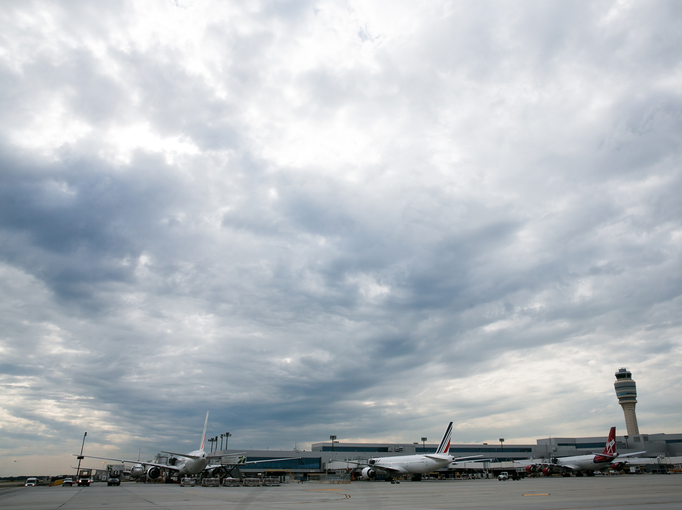
Operating Budget
Agenda
Vision/Mission Statement
ATL’s Strategic Priorities
Organizational Chart
Key Performance Metrics
FY17 Accomplishments
Smart Lanes
FY18 Highlights
Proposed Operating Revenue Plan
Proposed Operating Expenses
Debt Service Coverage GARBS
Bridge to Operational Breakout
Proposed Personnel Actions

Slide 3
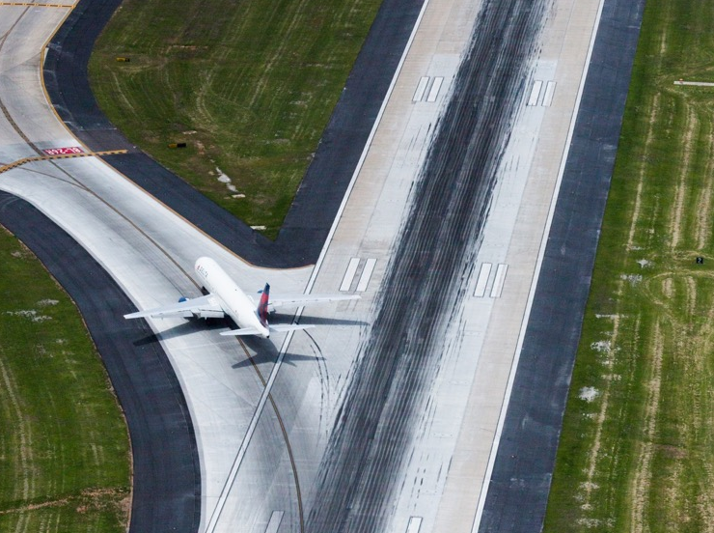
VISION
To be the global leader in airport efficiency
and customer service excellence.
MISSION
Our mission is to provide the Atlanta region a safe, secure and cost-competitive gateway to the world that drives economic development, operates
with the highest level of customer service
and efficiency, and exercises fiscal
and environmental responsibility.

Slide 4

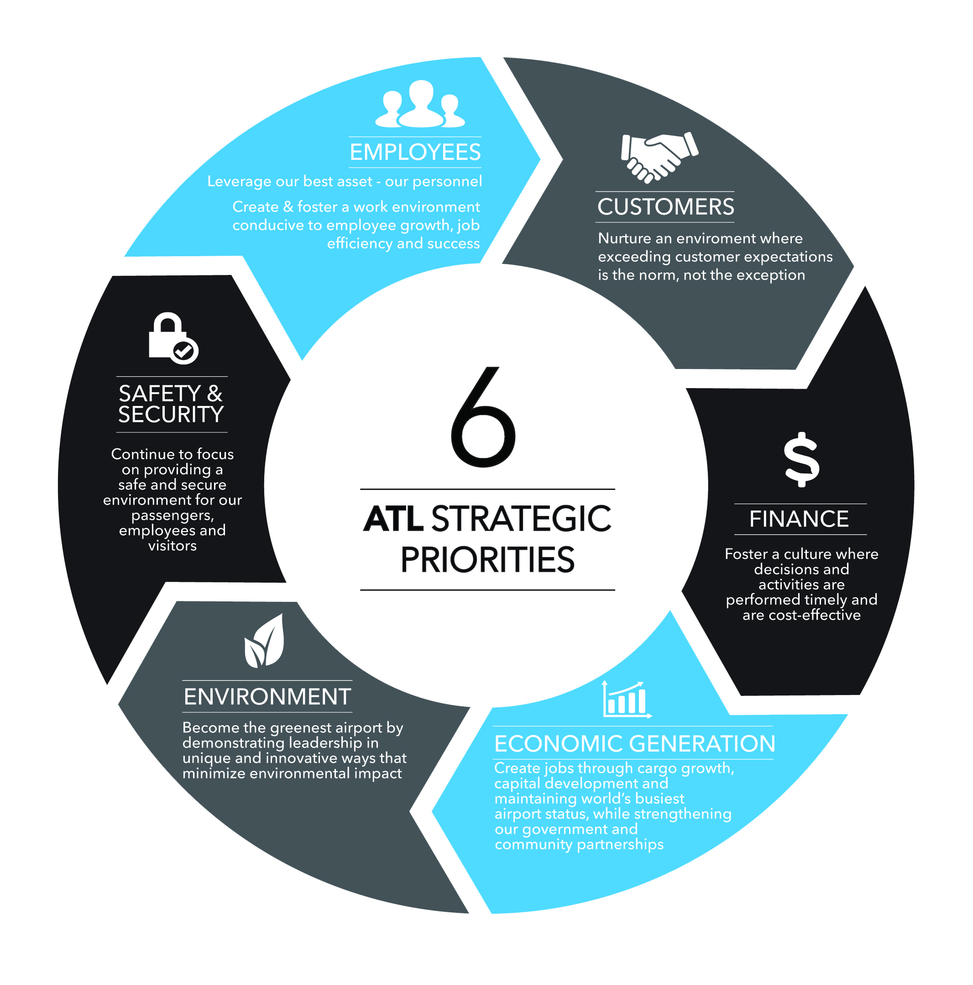
Operating Budget
ATL’s Strategic Priorities

Slide 5
Operating Budget
Organizational Chart: Aviation

Slide 6
Operating Budget
Key Performance Metrics
 | FY 2015 Actual | FY 2016 Actual | FY 2017 Projected | FY 2018 Target
Airport Customer Satisfaction | N/A | N/A | 85% | 85%
Bond Coverage Factor (Garbs) | 1.88 | 2.06 | 1.73 | 1.60
Airport Parking Revenue (in millions) | $124.0 | $132.1 | $130.1 | $127.6
Airport Commercial Revs. excl. Parking (millions) | $141.5 | $153.5 | $160.2 | $167.5
Total Passengers Handled | 98.3 | 103.7 | 106.3 | 109.0
Cargo Volume (Metric Tons) | 624,327 | 626,082 | 657,000 | 684,000
Notes:
There are an abundant number of activities/ variables that may be referred to as an Airport’s key factors. The performance in the areas these varying factors often determine the degree and or level of success of an Airport. Key activities/ variables are numerous but Hartsfield Jackson highlights six areas:
Customer Satisfaction – ability to satisfy & accommodate customers as measured by ACI-NA
Bond Coverage Factor – measured ability to cover outstanding debt
Parking Revenue – measured performance of the single largest revenue generator
Commercial Revenue – measured performance of the largest revenue category
# of Passengers Handled - Identifies size & ability to accommodate customers
Cargo Volume – Measure of metric tons handled and market penetration

Slide 7
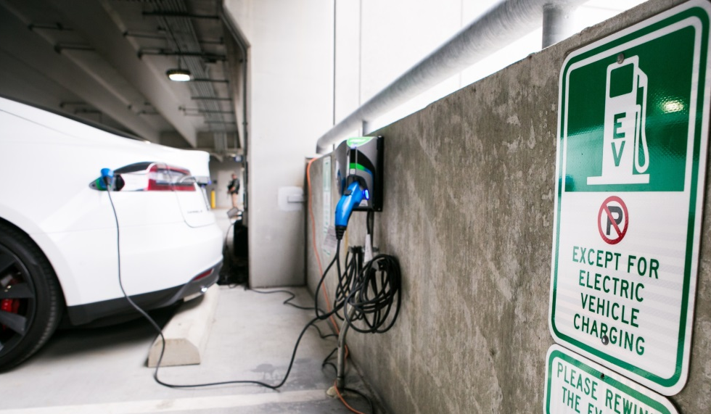
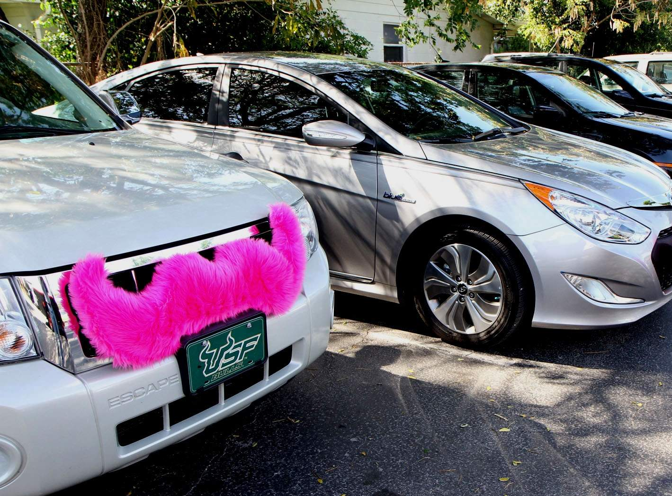
Operating Budget
FY 2017 Accomplishments
Integrated Transportation Network Companies (Uber and Lyft) into ATL operations, providing customers with more transportation options.
Unveiled 102 electric vehicle charging stations.
Completed Cargo Building C, adding 110,000 square feet.
Launched TruckPass staging lot to increase efficiency in cargo staging and loading operations.
7

Slide 8
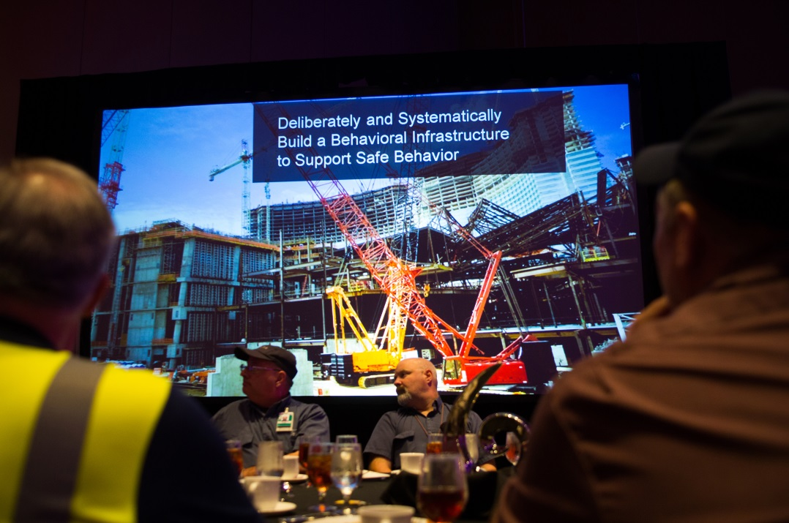
Operating Budget
FY 2017 Accomplishments
Airport Concessions received Best Airport Dining Award from Global Traveler, USA for third straight year.
Fitch Ratings upgraded to AA- from A+ the rating on the general airport revenue bonds. Fitch has also affirmed the A+ rating on the passenger facility charge (PFC) and subordinate lien revenue bonds.
S&P Global Ratings affirmed its AA- rating the general airport general revenue bonds and hybrid passenger facility charge (PFC) subordinate-lien bonds.
ATL signed Sister Airport
Agreement with Israel’s Ben Gurion International Airport.
Inaugural OneATL Safety and Risk Management Expo on Aug. 24, 2016, included safety-related workshops and demonstrations.
8

Slide 9
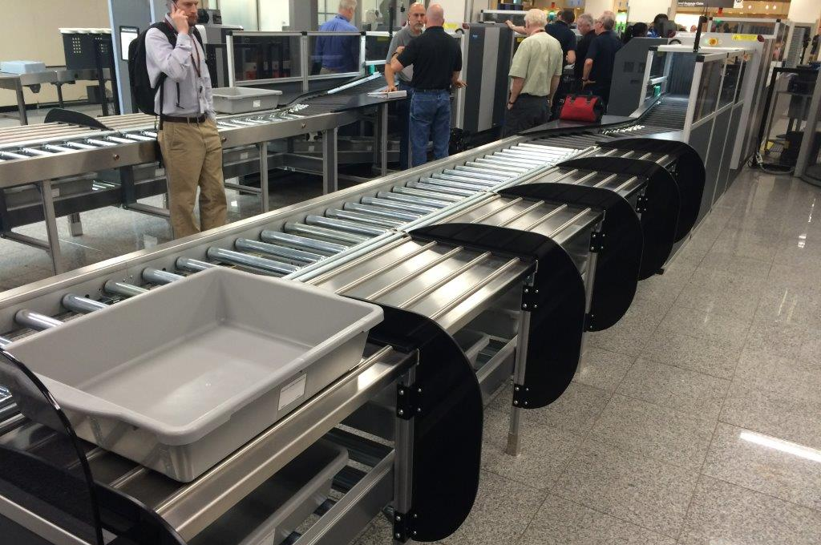
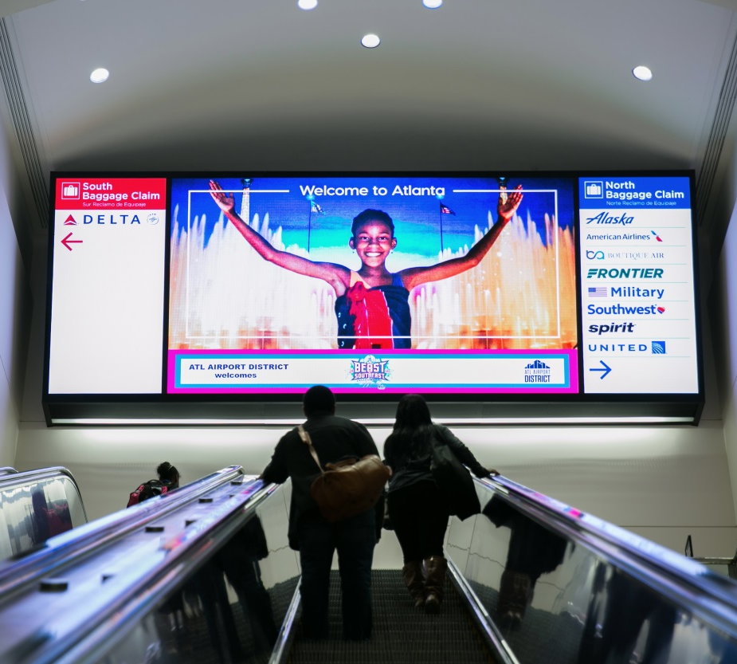
Operating Budget
FY 2017 Accomplishments
Completed West Crossover video wall, which delivers
City and ATL messaging.
Completed installation, ahead of schedule, of the Automated Screening Lanes (Smart Lanes) to improve passenger screening process and reduce wait times.
9

Slide 10
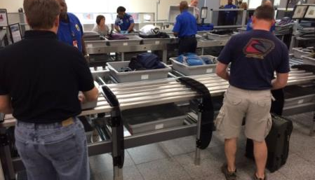
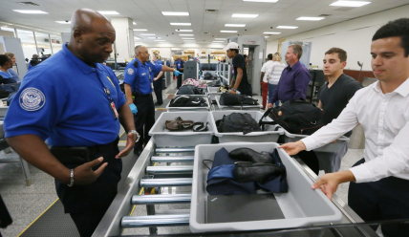
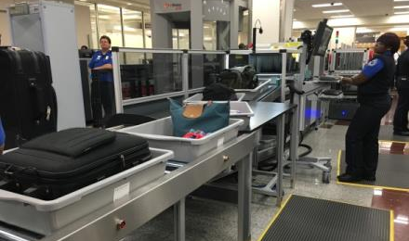
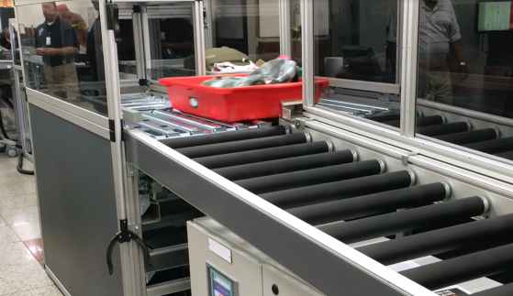
Operating Budget
Smart Lanes: How They Work
Passenger places all items into bin, pushes bin onto automated belt and proceeds to screening.
Passenger walks up to an open position at the automated belt.
Any bin containing an item of concern is diverted to a secured belt for additional screening.
Bin proceeds on automated belt to X-ray screening.

Slide 11
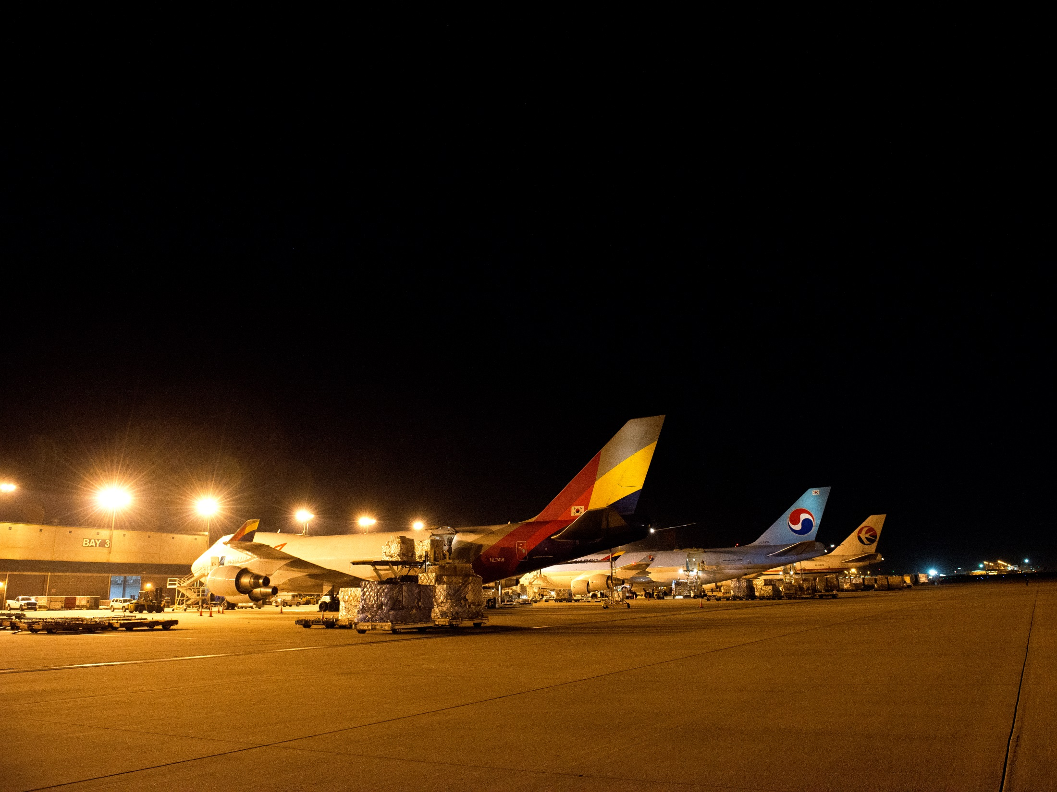
Operating Budget
FY 2018 Highlights
Initiate cargo site prep 2A/2B to support cargo expansion.
Begin replacement of 116 boarding bridges .
Begin construction on ATL West Deck, which will provide 5,200 spaces to replace parking lost during ATLNext construction.
Construct Fire Station 40, upgrading old fire station.
Develop and implement operations’ plan to manage canopy construction.
Procure and install a wait-time tracking system at all security checkpoints to provide customers with wait times with more accuracy and in real time.
Procure and install a customer satisfaction survey system to enable
real-time feedback on Airport conditions and services.
11

Slide 12
Operating Budget
FY 2018 Proposed Operating Revenue Plan
Notes:
FY18 Operating Budget is anticipated to increase by $4.7 MM (.9%) over the FY17 operating budget.
Aeronautical
Aeronautical revenues will decrease by $4.45 MM (2.4%). The decrease is primarily due to the anticipated decrease in cost recoveries. The decrease is anticipated to be approximately $28.1 MM which will be partially offset by a $15.9 MM increase in Landing Fees.
Non-Aeronautical
Non-aeronautical revenues are to increase $9.2MM (2.8%). The increase is due to the anticipated increase in concessions ($7.25MM) and ground transportation ($6.5 MM) revenues. The Ground Transportation revenue is expected to increase due to the new TNC activity anticipated.

Slide 13
Operating Budget
FY 2018 Proposed Operating Expenses

Slide 14
Operating Budget
Debt Service Coverage GARBS
Notes:
Debt Service Coverage is estimated to finish as follows:
- 1.51 for FY18
1.73 for FY17

Slide 15
Operating Budget
FY 2018 Bridge to Operational Breakout
Notes:
Debt Service Coverage is estimated to finish as follows:
- 2.00 for FY17
1.51 for FY18
Principal and Interest payments are scheduled to decrease approximately $27.46 million in FY 2017 as the Garb debt service related to AIP #11 (5th Runway) will be funded by PFC dollars.

Slide 16
Operating Budget
Proposed Personnel Actions
Notes:
The Aviation headcount = 647 in the FY17 Budget. This headcount excludes positions in Police, Fire, and the other support departments citywide.
The Support Departments include the following:
Airport Police positions = 214 and Airport Fire = 246.5
Aviation funds approximately 79 positions in various City
Departments that provide assistance with Airport matters.
The departments include:
Law, Finance, Audit, Executive Offices
Human Resources, Information Management
Dep’t of Procurement, and Contract Compliance
The Grand Total is 1,187 positions however, that number will increase as
there will be newly created positions in FY18.

Slide 17

Operating Budget
Questions and answers

