Slide 1
THE FUTURE WE WANT.
THE SERVICE YOU DESERVE.
DEPARTMENT OF FINANCE FY2018 BUDGET BRIEFING MAY 17, 2017
J. ANTHONY BEARD, Chief Financial Officer | JOHN GAFFNEY, Deputy Chief Financial Officer

Slide 2
OVERVIEW
SECTION 1
SECTION 2
SECTION 3
About The Department of Finance
FY2017 Top Accomplishments
Looking Ahead to FY2018

Slide 3
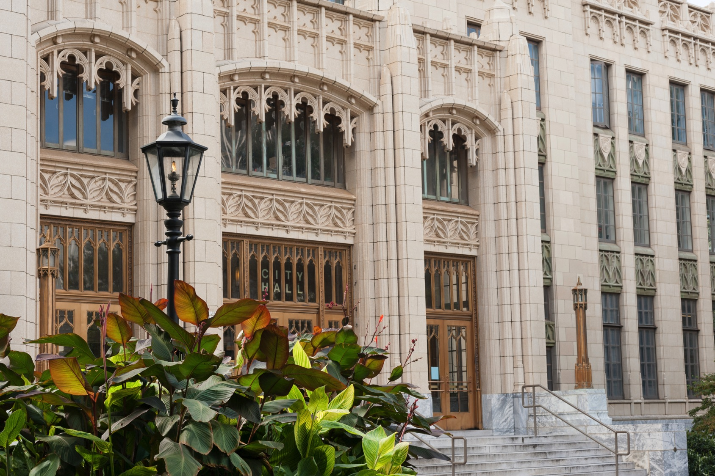
ABOUT THE DEPARTMENT OF FINANCE
SECTION 1

Slide 4
THE DEPARTMENT OF FINANCE
Our Mission
To provide leading financial management practices in order to achieve City of Atlanta goals and objectives while delivering timely, clear, and accurate financial information and analyses in accordance with legal requirements, ethical practices and industry standards to elected officials, City departments and the community at large.
Our Vision
To be the preeminent financial services organization in municipal government and to set the standards by which other institutions measure success.

Slide 5
OUR PEOPLE
Abernathy IV, Ralph D
Adegboye, John A
Akaose, Nwagu Ola
Anderson, Janette R
Arefaine, Hanna
Asamoah, Frances E
Assefa, Fikerte
Beard, J. Anthony (Jim)
Bell, Onanechice T
Black, Sabrina Julks
Blair, Lynquez O
Booker-Mayes, Teresa R
Bostic, Danielle Yasheaka
Boyd, Juliana J
Brown, Daniel Asher
Brown, Yvette I
Burton, Lora C.
Burwell, Valencia R
Byrd, Kiona K.
Cadres, Dana C
Carlisle-Joseph, Marlena
Carr, Youlanda
Carter, Karen
Chambers, Felicia M
Chapman, Nicole M
Coley, Cassandra A
Corey, Harold S
Daniel, Felicia Neal
Daniely, Charlotte N
Davis, Anthony J
Davis, Bertha L
Dickerson, Ralph III
Dismuke, Shona D
Dixon, Chantel D.
Dominguez, Maria
Douse, Nora D
Dozier, Navarone J
Duncan, Gloria S
Fahie, Shameka A.
Ferrell, Lolita R
Floyd, Gary P
Foster, Tina T.
Franklin, Monique N.
Gabriel, Shawn A.
Gaffney, John
Gilbert, Derrick Scott
Good, David M
Goode, Carlisha L
Goodman, Jenema L.
Gray, Buffy D
Griffin, Jamella N
Hakizimana, Jean-Marie
Han, Yu Rim
Hannah, Lee E
Harden, Catriena Michelle
Holborough, Reynold
Holmes, Pamela
Hopkins, Andrea K.
Jackson, Sherry
Jarrells, Veronica D
Jefferson, Shaherah V
Johnson, Chukwufumnanya
Johnson, Dorian M
Jonas, Jorge
Jones, Mellisa
Jones, Sharon R
Jones, Tiffany M
Jones, Tonya D
Kassa, Sable
Kelly, Candyse N
Kelly, Melita L
Kendrick, LaTonya H
Kirschbaum, Eugene T
Knight, Alison Andree
Knight, Angelique S.
Knight, Natalie D
Kwaw, Paul H
Lang, LaResha M.
Lee, Paulette M.
Lewis, Rosalie P
Lloyd, Katherine S
Lucas, Melanie
Luke, Porsha L
Manuel, Thelinjoris R
Mathis, Tammy L
Matthews, Joi Crystaline
McClain, Jermaine
McGarity, Jessime K
McIver, Patricia E
Merritt, Barbara Letresa
Miller, Dave Andrew Jr
Miller, Joseph Charles
Mitchell, Marilyn Y
Mitchell, Patricia A
Montgomery, DeeDee P.
Moore, Tarolyn
Morris, Thelma B.
Newman, Terri L
Nguyen, Misa
Oberender, David M
Parker, Charlene
Parker, Felicia Michelle
Pease, Samantha D
Perdue, Alicia D
Peterkin, Jeremie S
Pettaway, Will D
Pinan, Alfonso
Potla, Swathi
Prince, Genet D
Puckett, Tamika
Rajdev, Madhavi
Ravoori, Susmitha
Rhodes, Veronica
Robinson, Delisha L
Runnels, Maria A
Sellers, Cynthia D
Sherman, Ameralis J
Simmons, Atwua Martine
Simmons, Bernranda
Smith, John W.
Smith, Petrina
Stevenson, Sandra
Stewart, Stacy Kristy
Stroud, Dennis L
Sullivan, Michael Drew
Sutton, Karen F
Tallon, Kimberly Jannill
Taylor, Anne M.
Taylor, Beryl A
Taylor, Connie
Techane, Addis A
Thompson, Alicia F
Toorie, Gairy
Wapples, Patrice M
Washington, Deborah Ann
Washington, Toya L
Watson, Phyllis A.
Wells, Aaron Thayer
Wells, Debbie S
White, Meisha B
Wiley, Ariel R
Williams, Dana N.
Williams, Geraldine C
Williams, Jonathan Sr
Williams, Shelia Denise
Williams, Tamara
Winfield, Felecia D
Woods, Laurette T.
Yates, Robert Keith
Young, Felicia J.
Zeigler, Denise A

Slide 6
THE DEPARTMENT OF FINANCE
We provide many services to the City of Atlanta and our internal/external customers
Serve as a strategic business partner and an area of support
Manage and account for financial resources, as well as the conduct and oversight of financial activities
Embrace innovative approaches to deliver quality services

Slide 7
THE DEPARTMENT OF FINANCE
Division | Chief/Director
Objectives
CHIEF FINANCIAL OFFICER Jim Beard, CFO John Gaffney, DCFO | Promotes actions to achieve the City’s priorities Establishes and maintains sound fiscal policies Delivers accurate status of City’s current and future financial position Improves the effectiveness, efficiency, and integration of the City’s business processes
BUDGET & FISCAL POLICY Youlanda Carr Chief | Monitors and reports economic and financial trend forecasts Coordinates preparation of City’s Operating and Capital Improvement Budgets and Five-Year Financial Plan
CONTROLLER Madhavi Rajdev Controller | Maintains City’s financial systems and fiscal controls Manages employee payroll and accounts payable functions Coordinates the annual audit and preparation of City’s year end CAFR
7

Slide 8
THE DEPARTMENT OF FINANCE
Division | Chief/Director
Objectives
TREASURY, DEBT & INVESTMENTS Paul Kwaw Interim Chief | Manages the City's cash and investment activities; assists in the structure and execution of short and long-term debt Facilitates financial planning efforts
REVENUE Felicia Daniel Interim Chief | Administers and collects fines, fees and taxes including sales and hotel/motel taxes, and business license fees Responds to customer inquiries and provides for the collection of delinquent monies owed to City
GRANT SERVICES Lee Hannah Director | Manages and disburses funds allocated to the City of Atlanta from HUD, CDBG, ESG, HOME and HOPWA Manages grants from state governments, foundations and private entities
ENTERPRISE RISK MANAGEMENT Tamika Puckett Director | Manages the City’s Workers’ Comp program, insurance programs, OCIP for Hartsfield-Jackson Int’l Airport Pursues the subrogation interests of the City Reviews contracts and financial documents from vendors Operates as safety advocate for the City, including management of the Driver Risk Management Program
8

Slide 9
THE DEPARTMENT OF FINANCE
Division | Chief/Director
Objectives
FINANCIAL SYSTEMS SERVICES Alfonso Pinan Director | Manages the systems that support financial business functions Serves as level 1 and level 2 technical support for Finance Provides end-user training, third-party software support, as well as system implementations and compliance
MANAGEMENT CONSULTING SERVICES Jonathan Williams Director | Provides value added services that identify and validate strategic goals Determines key process improvement opportunities Identifies and eliminates systemic waste, conduct process improvement projects, implement performance management measurement systems, perform financial modeling, impact analysis, benchmark data and best-in-class processes
ADMINISTRATIVE SERVICES Laurette T. Woods Director | Responsible for department operations optimization Manages administrative functions including the City’s Records Management Unit Coordinates centralized department contracts and purchasing controls, budget development, ongoing expense management, workforce planning and space management
9

Slide 10
THE DEPARTMENT OF FINANCE
Each year, we publish various financial documents, including:
Comprehensive Annual Financial Report – Award winner 31 years in a row
Popular Annual Financial Report – Award winner 5 years in a row
Annual Budget Book – Award winner 6 years in a row
Annual Five-Year Plan
Annual Debt Book
Annual Investment Report
Annual Risk Report
Annual Grant Reporting
Annual Arbitrage Rebate Report
Budget Commission Report
Quarterly Financial Report
Monthly Financial Report
Numerous Ad Hoc Reports
31
5
6

Slide 11
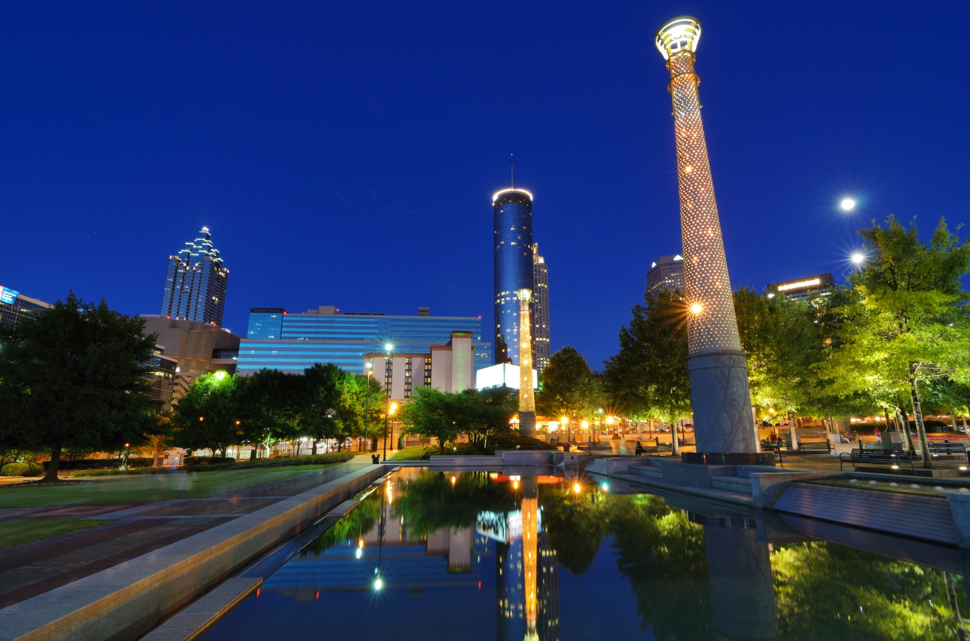
SECTION 2
FY2017 TOP ACCOMPLISHMENTS

Slide 12
FY2017 TOP ACCOMPLISHMENTS
Revenue
Identified the vendor to replace Revenue Business License Management System.
Completed the Revenue Billing and Collections Analysis and Revenue forecast model methodology.
Participated in the procurement and selection of the vendor for the Citywide parking contract.

Slide 13
FY2017 TOP ACCOMPLISHMENTS
Treasury
Treasury
Treasury
Executed 2 bond transactions for the Beltline TAD and DWM.
Achieved
62%
year-over-year increase
investment income ~ $47MM.
Executed 3 General Fund supported refunding transactions totaling $67.9 million, generating $9.8 million in present value savings or $887K annually over the next 11 years.

Slide 14
FY2017 TOP ACCOMPLISHMENTS
Budget
Treasury
Received GFOA’s Distinguished Budget Presentation Award for the FY2017 Adopted Budget Book.
Adopted the FY2017 General Fund Budget of
Budget
$607MM
without utilizing Fund Balance.
Conducted the Hyperion System Upgrade to improve performance, browser compatibility, incorporate two new budget applications, budget reporting functionality, and facilitate future enhancements.

Slide 15
FY2017 TOP ACCOMPLISHMENTS
Controller
AMERICAN EXPRESS TRAVEL PORTAL
FY2016 AUDIT & PAFR
Successful implementation of the American Express portal for travel and closure of all outstanding travel advances.
Successful completion of FY2016 audit with no material findings and successful redesigning of the FY2016 Popular Annual Financial Report (PAFR).
FIXED ASSET RECONCILIATION
Successful reconciliation of City Fixed Assets based on physical inventory assessment completed by Duff & Phelps.

Slide 16
FY2017 TOP ACCOMPLISHMENTS
Financial Systems
Treasury
ORACLE ERP Upgrade Completed the DOF Business Processes Assessments to establish the readiness of DOF for the Oracle upgrade and to recommend potential policy and procedure enhancements to improve DOF organizational efficiencies.
AMERICAN EXPRESS TRAVEL PORTAL
Implemented the Concur travel portal and integrated it with the Oracle iExpense module.
HYPERION SYSTEM UPGRADE
Completion of the Hyperion system upgrade to move to the latest Hyperion version.

Slide 17
FY2017 TOP ACCOMPLISHMENTS
Grants
Assisted departments in locating
Engaged Collaborative Solutions Inc. (CSI) to provide a
$14M IN GRANT AWARDS
for transportation, neighborhood revitalization, workforce development and homelessness programs utilizing the eCivis grant management system.
FOUR DAY TRAINING
and technical assistance workshop in October and November 2016.

Slide 18
FY2017 TOP ACCOMPLISHMENTS
Enterprise Risk
Management
Management
Consulting
Lead and completed financing negotiations for Philips Arena.
Completed Fleet Management analysis to support restructuring initiative.
Successfully added an additional 741 DriveCam units to City vehicles.
Subrogation cost recoveries in FY2017 were $411,899
Completed Revenue billing & collections analysis and Revenue forecast model methodology.

Slide 19
SECTION 3
LOOKING AHEAD TO FY18

Slide 20
LOOKING AHEAD TO FY2018
FY18 OPERATING BUDGET Department of Finance

Slide 21
LOOKING AHEAD TO FY2018
Issue Homeless Opportunity Bonds to enable the administration to address homelessness in the City
Generate investment income equal to FY17 ($47M) or higher
Refund outstanding bonds that will generate savings of 3% or more
Work towards the partial termination of the DWM outstanding Hedge (SWAP) agreements
Execute a bond transaction to provide financing for the Zoo Atlanta Parking Project
Increase Subrogation annual recoveries by 50%
MAXIMIZE RETURN through critical investments and alternative sources of funding

Slide 22
LOOKING AHEAD TO FY2018
Transition supplier maintenance from Procurement to Finance
Restructure Accounts Payable (AP) automation
Integrate Hyperion with Oracle to streamline data workflow and functionality
Oracle ERP Upgrade
Oracle Human Capital Management (HCM) cloud solution for payroll
Create a Capital Budgeting Task Force
Implement Business License Tracking and Origami Risk Management Systems
LEVERAGE TECHNOLOGY
for productivity and business efficiency gains

Slide 23
LOOKING AHEAD TO FY2018
Enhance the competency, agility, performance and development of employees through training
Create Budget University training for the City of Atlanta
Succession planning with cross training to ensure there are no gaps in job functions
Provide process and financial training for staff to include Six Sigma Certification
Professional skills enhancement that will improve job performance
STRENGTHEN THE WORKFORCE
through building a competitive professional staff

Slide 24
LOOKING AHEAD TO FY2018
Total FTE position count is 145.67
125.01 positions are general funded
20.66 positions are enterprise funded
FTE count does not reflect grant funded positions
General Fund position count increased by 5.00 since FY17 Adopted Budget
2 FTEs were created during the fiscal year
2 FTEs were transferred in from Solid Waste Fund
1 FTE was transferred in from Building Permits Fund
PERSONNEL CHANGES

Slide 25
LOOKING AHEAD TO FY2018
Two Position Creations (part of the 5.00 FTE increase)
Office of The Controller: 1 Payroll Specialist
Office of The Controller: 1 Financial Analyst
Two Position Transfers from Solid Waste Fund
Office of Revenue: 1 Customer Service Supervisor
Office of Revenue: 1 Customer Service Representative
One Position Transfer from Building Permits Fund
Office of Revenue: 1 Accounting Technician
PERSONNEL CHANGES

Slide 26
QUESTIONS & ANSWERS

