Slide 1
Council
Budget Overview
Samir Saini
Chief Information Officer 5.16.17

Slide 2
Order of Discussion
Introduce Team
CIO’s 3rd Left: Errin Baugh, DCIO Project Management Officer
CIO’s 2nd Left: Kelvin Brooks, Information Security Officer
CIO’s 1st Left: Jason Watkins, Chief Technology Officer
CIO’s 1st Right: Daphne Rackley, Chief of Staff
CIO’s 2nd Right: Vijay Gogineni, DCIO City Administrative Services (CAS)
CIO’s 3rd Right: Kirk Talbott, DCIO City Operations Services (COS) & SmartATL
Department Overview (See presentation)
Objectives & Goals
FY17 Accomplishments
FY18 Plans
AIM Operating Budget Highlights (See Budget Book p. 173-185. General Fund on p.174)

Slide 3
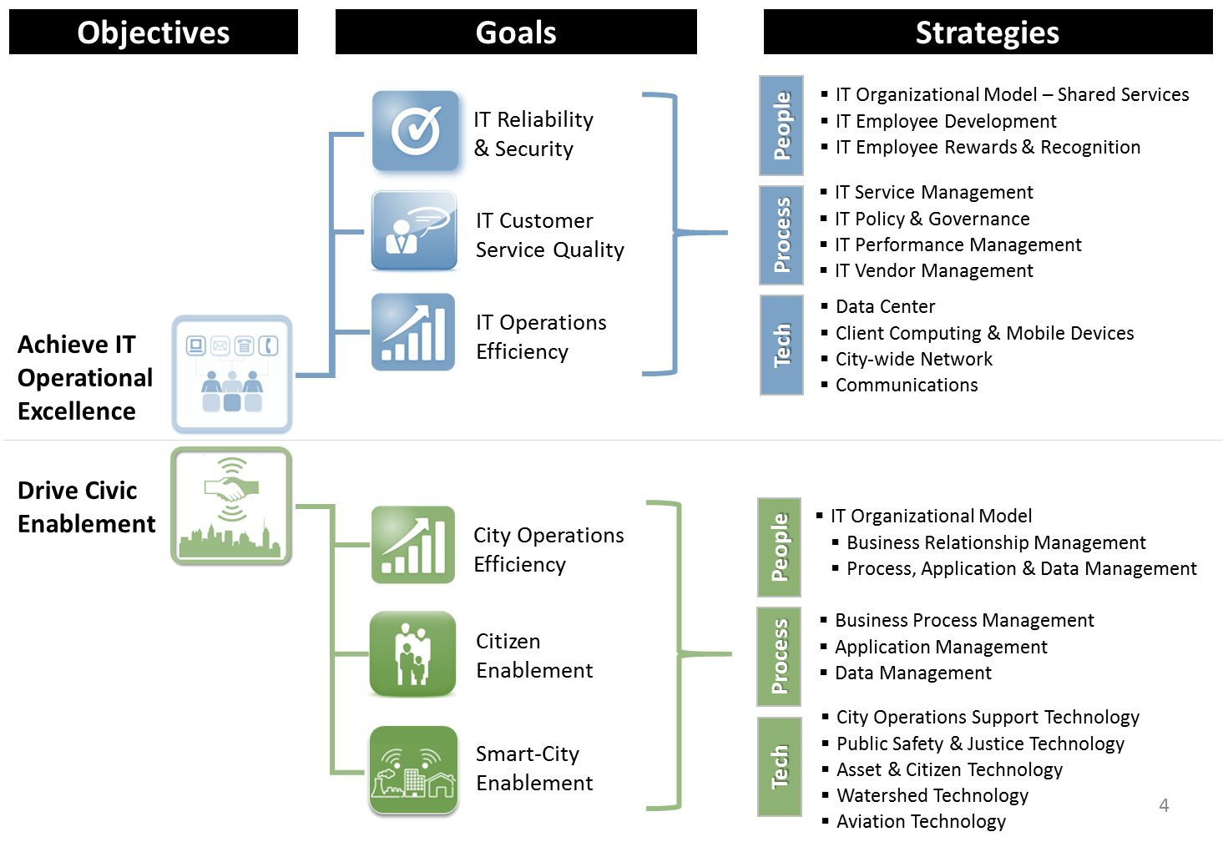
AIM Objectives, Goals, Strategies

Slide 4
System Availability & Performance Health
March
Performance Overview (Mar 16 to Mar 17)
System Availability 3/15 – 3/17
Type | Actuals | Target
Critical | 99.50% | 99% MIN
High | 99.92%
Essential | 100%
Important | 100%
Systems Availability above target(99%)
# Outages ↓ 43% since Mar16. Duration ↓ 65%
Note: Downtime ↓due to continued focus on responsive incident management and infrastructure stabilization.
FY17 Accomplishments
Increased real-time application performance monitoring/alerts
Strengthened internal system change control processes
ATL2 Watershed - Upgraded 72 Marietta circuits 10mb to 100mb
Server Virtualization
Windows 2003 Web & Shared Server Upgrades
Kronos Infrastructure and Application boosting performance by 6X
Courtview Infrastructure Upgrade
FY18 Plans
ATL2 Remote Sites Network Upgrades
AT&T Ready MetroE to ASE Conversion (Data Connectivity)
Watershed Network Refresh
Critical App Back-ups in Alternate Datacenter

Slide 5
Cyber Security Health
Performance Overview (Mar 16 – Mar 17)
↓17.1% - Blocked Network attacks (35K to 29K)
89.1% - Malware blocked from ‘calling home’ (55 to 6)
17.1% - “Phishing” Email Risk (322K to 267K)
Fy17 Accomplishments
ISO Certification Program: Shift from financial risk focus to overall risk focus
Phase I & II Cyber Security Awareness Training
Advanced Threat Protection & Ransomware Detection
VPN Online Remote Access Request w/ 2 Factor Authentication
Bit-9 Rollout: Phase II Medium Enforcement
Fy18 Plans
VPN Consolidation Full Implementation
ISO Certification Completed
Managed Security Services Provider:
Firewalls
SIEM (Security Information and Event Management)
Intrusion Prevention

Slide 6
Service Desk Health
March
Performance Overview (Mar 16 – Mar 17)
Type | Actuals | Target
Incidents Resolved | 83% | 85% MIN SLA
Requests Resolved | 92%
Total Ticket Resolution (incidents/requests) 90%, above target
Incidents resolved (83%) below SLA; Trend: Since Mar ’16 - ↔ Unchanged, Volume ↑ 27.1%.
Requests resolved (92%) exceeded SLA Trend: Since Mar’16 SLA is ↑1%, Volume increased by 24%
Overall trend ↑ due to Office 365 completion, Close SLA monitoring, less PC deployments & moves due to Restacking.)
Fy17 Accomplishments
Office 2016 Core Features (Word, Excel, Powerpoint, etc.)
Windows 10 Proof of Concept (250 PCs)
Completed ITSM/ITIL Workshops (Incident, Change, Problem and Request)
Implement New Email Spam Filtering
Realigned network and email account creations from level 3 to level 1
Improve self-service password reset capability (Network, Oracle)
FY18 Plans
Microsoft 365 Phase III (Skype, OneDrive, Sharepoint Enhancements)
Windows 10 City-wide
IT Service Management (ITSM) ServiceNow Implementation Phase I
Incident Management, Request Fulfillment, Service Catalog, Self-Service Portal, Problem Management, Knowledge Management, Change Management

Slide 7
Project Management Delivery Performance
March
Performance Overview (Mar 16 – Mar 17)
Type | Actuals | Target
Control | 82.11% | >70%
Caution | 13.01% | <20%
Critical | 4.88% | <10%
Projects in “Control” ↓ 7%. Projects in “Critical” ↑ 28%
Q3 FY17 - 182 Projects across 16 city departments
117 Active, 65 Not Started, 65 On-Hold - Across 16 Depts.
84 Completed (33-Q1, 26-Q2, 25 Q3); 61 projects projected for Q4; 56 projects projected for completion in Fy18.
Fy17 Accomplishments
Process: Roll-out of Stage-gate review process for COO’s Top Projects (40)
People: Change Champion Program; Customer Service Training Course; Leadership Training Program for Directors & Managers (Gartner); Conduct Business Analysis and Agile training (in-house)
Technology: MS Project Proof of Concept; Jira Roll-out to OPA and AIM fast track projects (work type 4)
Fy18 Plans
Process: Project Prioritization Enhancements
People: Internal Customer Service Training Courses
Technology: MS Project Online Implementation

Slide 8
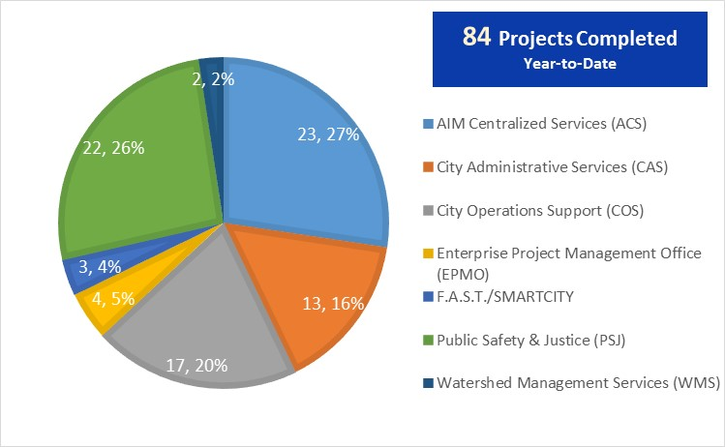
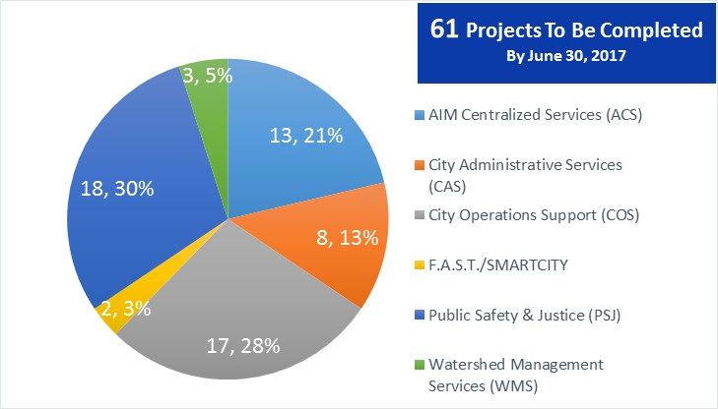
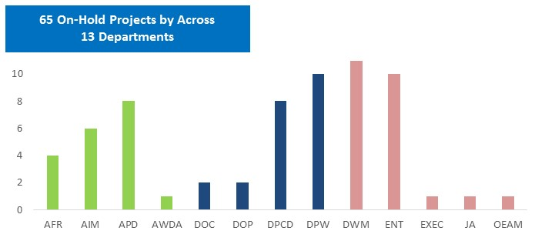
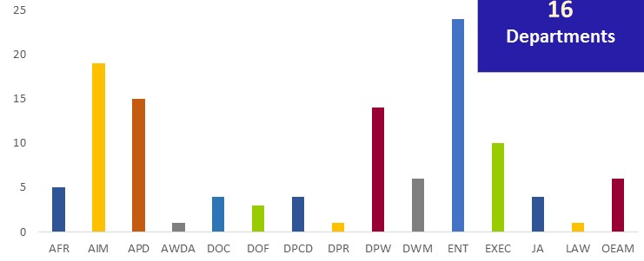
PMO FY17 as of Fy17 Q3
8
117 Active Projects
65 Projects On Hold
Notes:
Before diving into the priority projects, provide an overview of the Project Portfolio.

Slide 9
PMO FY18: By the Numbers
Notes:
Before diving into the priority projects, provide an overview of the Project Portfolio.

Slide 10
FY18 “Active” Projects
Public Safety & Justice (PSJ) – 12
JA - Case Management Improvement
APD – Crime Analytics
APD – Technology Upgrades (ie PSIM, E-911 CAD, RMS, etc. pending final approvals)
APD 496 Citizen Online Self-Service Reporting (Coplogic )
APD Zone 3 Headquarters
APD-246 Improve Police Transparency (Body Camera)
APD Operation Shield CCTV Expansion Project (Bond)
APD VIC Network Upgrades
APD Improve APD Recruitment Process
DOC Efforts to Outcome Software
DOC Camera Proof of Concept
DOC Improve Public Communication with New Website
City Administrative Services (CAS) – 9
ENT Human capital Management (HCM)
ENT Oracle Upgrade R12 (Financials)
ENT Kronos Enhancements Phase II
DOF Payment Card Industry Data Security Standard (PCI DSS)
ENT Oracle Self Service Reporting
ENT Numara Mobile Application
ENT Oracle User Interface Enhancements
LAW Law Case Management System
MAYOR Office of Ethics E-File Upgrade
City Operations Services (COS) - 13
AWDA Directorpoint Software Licenses
AWDA WorkSource Atlanta Client Relationship Management Software
DOF Business License, Revenue Taxation and Cashiering System (ie BLISS)
DPCD Kiva-Accela Data Migration
DPCD City Projects Database System Replacement
DPW Atlanta Streetcar Vehicle Camera System Upgrade Project
DPW 3M Traffic Sign Inventory
DPW Centralized Permits (Transportation/Right of Way), Special Events, Film)
DPW Fleet Managment System Implementation
DPW Fleet Fuel Management RFP
DPW ASC Website Re-design and On-Call Marketing Services
DPW Solid Waste Route Optimization
Metal Plates / Google Waze Integration
Watershed Management Services (WMS) - 6
Linear Asset Inventory and Workflow Project
Open Records Management System
Enterprise IVR Implementation Project (ie Payment Arrangements, Service Requests, Mass Communications, etc.)
Smart Water Analytics (pending final approvals)
Maximo Optimization 7.6 Upgrade
Water & Sewer Billing Enhancements – Several Projects are pending final approvals (AMI & enQuesta enhancements)
Notes:
Before diving into the priority projects, provide an overview of the Project Portfolio.

Slide 11
SmartATL – North Ave Smart Corridor Demonstration
A public demonstration and “living lab” to showcase how IoT and Big Data analytics can be used in improve the corridor
North Avenue
Smart Corridor
North Avenue Smart Corridor Ribbon Cutting Event: 9/2017
100+ IoT sensors (see, hear, smell) along 5 miles, 18 signalized intersections)
Autonomous Vehicles and connected vehicle demonstrations
Deploy smart city data platform and demo open APIs, advanced analytics and data visualization tech
Re-pave, re-stripe, repair the entire corridor and upgrade street signs
Connected and coordinated traffic signals with advanced traffic responsive signal timing
Notes:
Before diving into the priority projects, provide an overview of the Project Portfolio.

