Slide 1
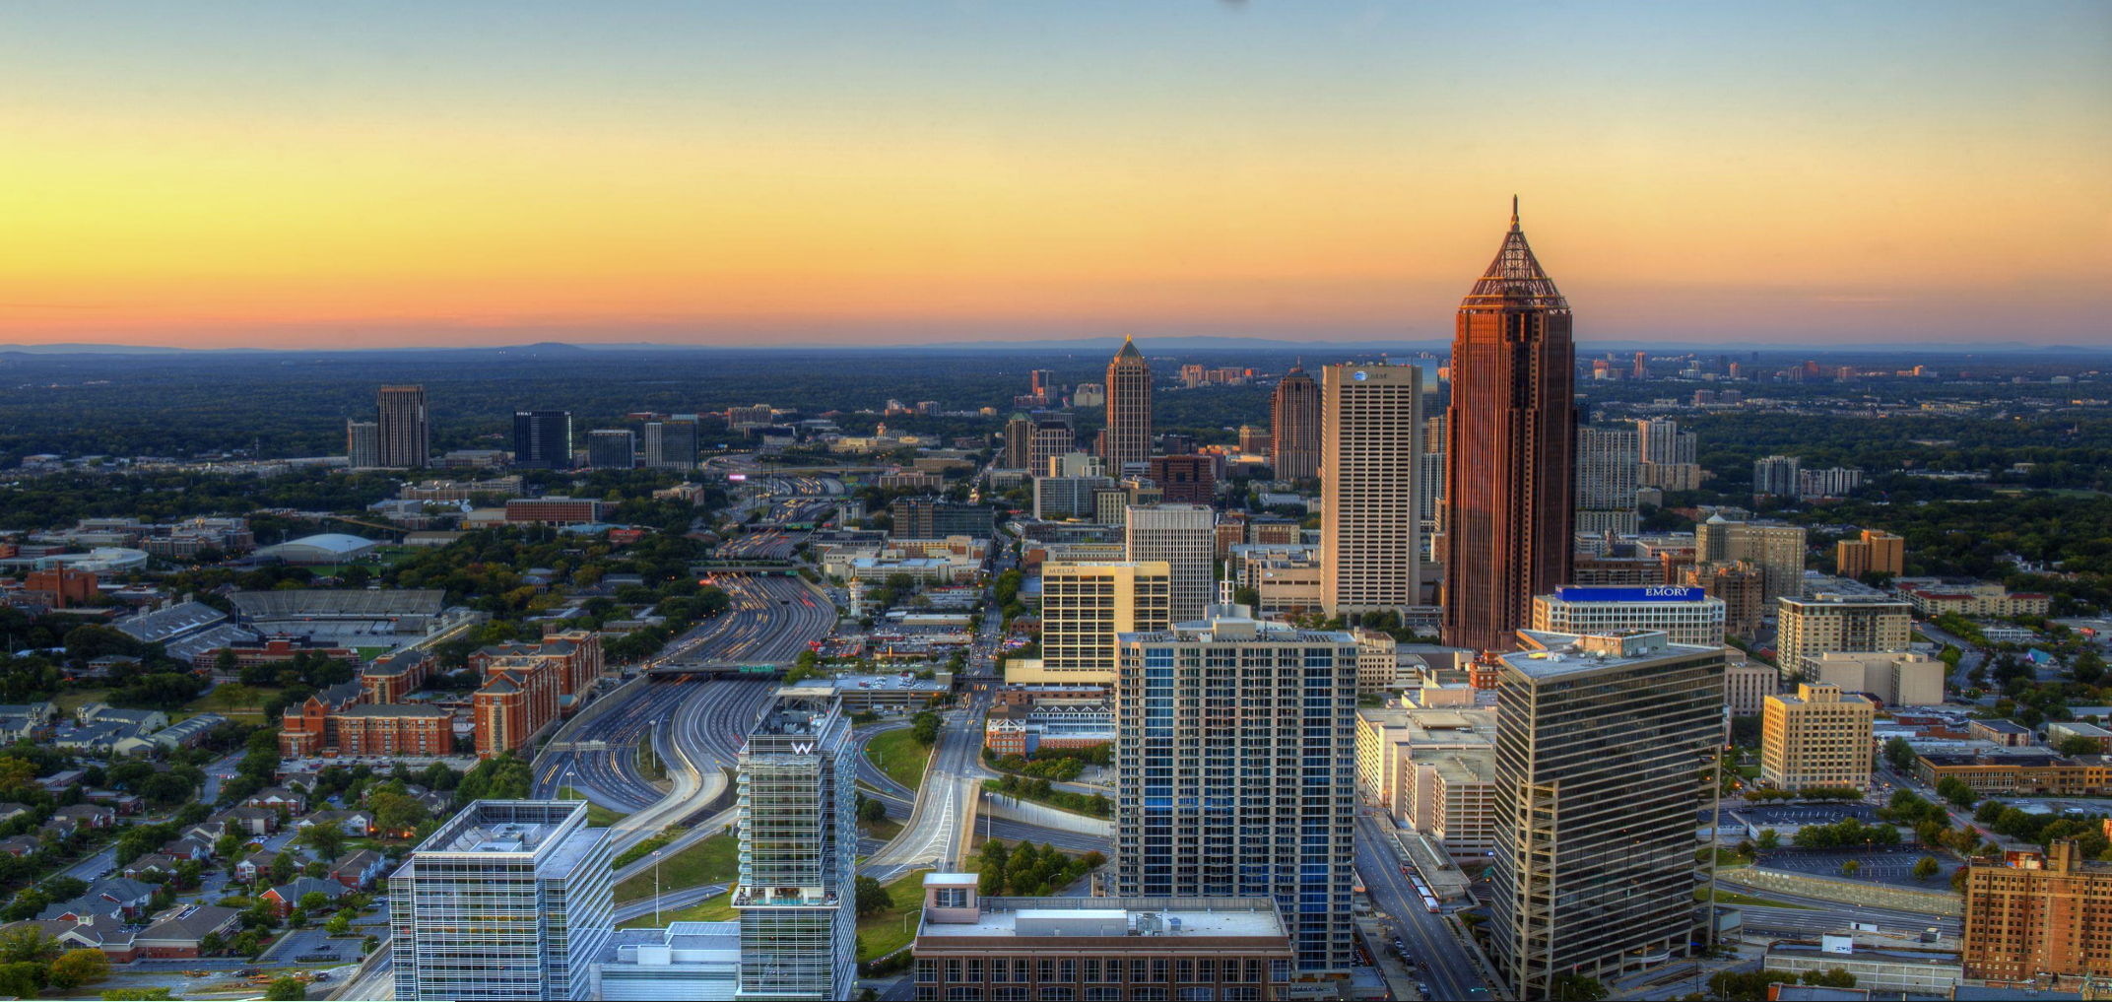
Finance/Executive Committee (FEC)
Quarterly Update
Samir Saini
Chief Information Officer
5.10.17

Slide 2
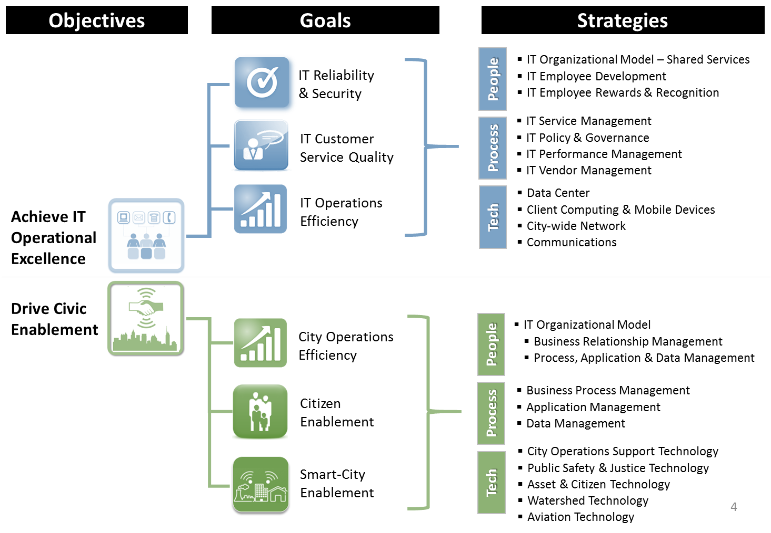
AIM Objectives, Goals, Strategies

Slide 3
AIM Support By the Numbers – Major Changes [2015 vs. 2017]
9410
customers
1352 953
servers
165 200
supported
city sites
120 179
active
projects
156
active IT
vendors
8 5
data centers
1493
network devices
31,000
emails received
per day
946
network attacks
blocked per day
187
active IT
Contracts
145 432
city apps
4344 4982
service tickets
per month
6216
PCs &
laptops
6000 4948
mobile devices
282
pcs & laptops
per tech supported

Slide 4
System Availability & Performance Health
March
Performance Overview (Mar 16 to Mar 17)
System Availability 3/15 – 3/17
Type | Actuals | Target
Critical | 99.50% | 99% MIN
High | 99.92%
Essential | 100%
Important | 100%
Systems Availability above target(99%)
# Outages ↓ 43% since Mar16. Duration ↓ 65%
Note: Downtime ↓due to continued focus on responsive incident management and infrastructure stabilization.
FY17 Q3 Accomplishments
Increased real-time application performance monitoring/alerts
Strengthened internal system change control processes
ATL2 Watershed Refresh - Upgraded 72 Marietta circuits from 10mb to 100mb
ATL2 Remote sites upgraded – 30 of 88 (34%)
AT&T Ready MetroE Conversion to ASE – 10 of 60 (17%) completed
Upgrade Kronos Infrastructure and Application boosting performance by 6X
FY17 Q4 Plans
ATL2 Remote sites upgraded (Physical Network Infrastructure) – 46 of 88 (52%)
AT&T Ready MetroE to ASE Conversion (Data Connectivity) – 26 of 60 (43%)
Server Virtualization– 90% complete
Centralized monitoring of critical applications (GF/DWM) – 100% complete
Critical App Back-ups in Alternate Datacenter – 50% complete
Migrate At Risk EOL 2003 Servers to 2008+

Slide 5
Service Desk Health
March
Performance Overview (Mar 16 – Mar 17)
Type | Actuals | Target
Incidents Resolved | 83% | 85% MIN SLA
Requests Resolved | 92%
Total Ticket Resolution (incidents/requests) 90%, above target
Incidents resolved (83%) below SLA;
Trend: Since Mar ’16 - ↔ Unchanged, Volume ↑ 27.1%.
Requests resolved (92%) exceeded SLA
Trend: Since Mar’16 SLA is ↑1%, Volume increased by 24%
Overall trend ↑ due to Office 365 completion, Close SLA monitoring, less PC deployments & moves due to Restacking.)
Q3 Accomplishments
Office 2016 Deployment – 439 of 3755 (12%) complete
Completed ITSM/ITIL Workshops (Incident, Change, Problem and Request)
PC Refresh - Deployed 494 of 576 (86%)
On boarded Continuous Improvement/Knowledge Manager “ITIL Expert”
Realigned network and email account creations from level 3 to level 1
Q4 Plans
Office 2016 Deployment –100% complete
FY’17 PC Refresh – 100% Complete
Windows 10 Proof of Concept (250 PCs)
Complete ITSM/ITIL policies, processes and procedures
Realign VPN account creations from level 3 to level 1
Complete Service Catalog
Improve self-service password reset capability (Network, Oracle)

Slide 6
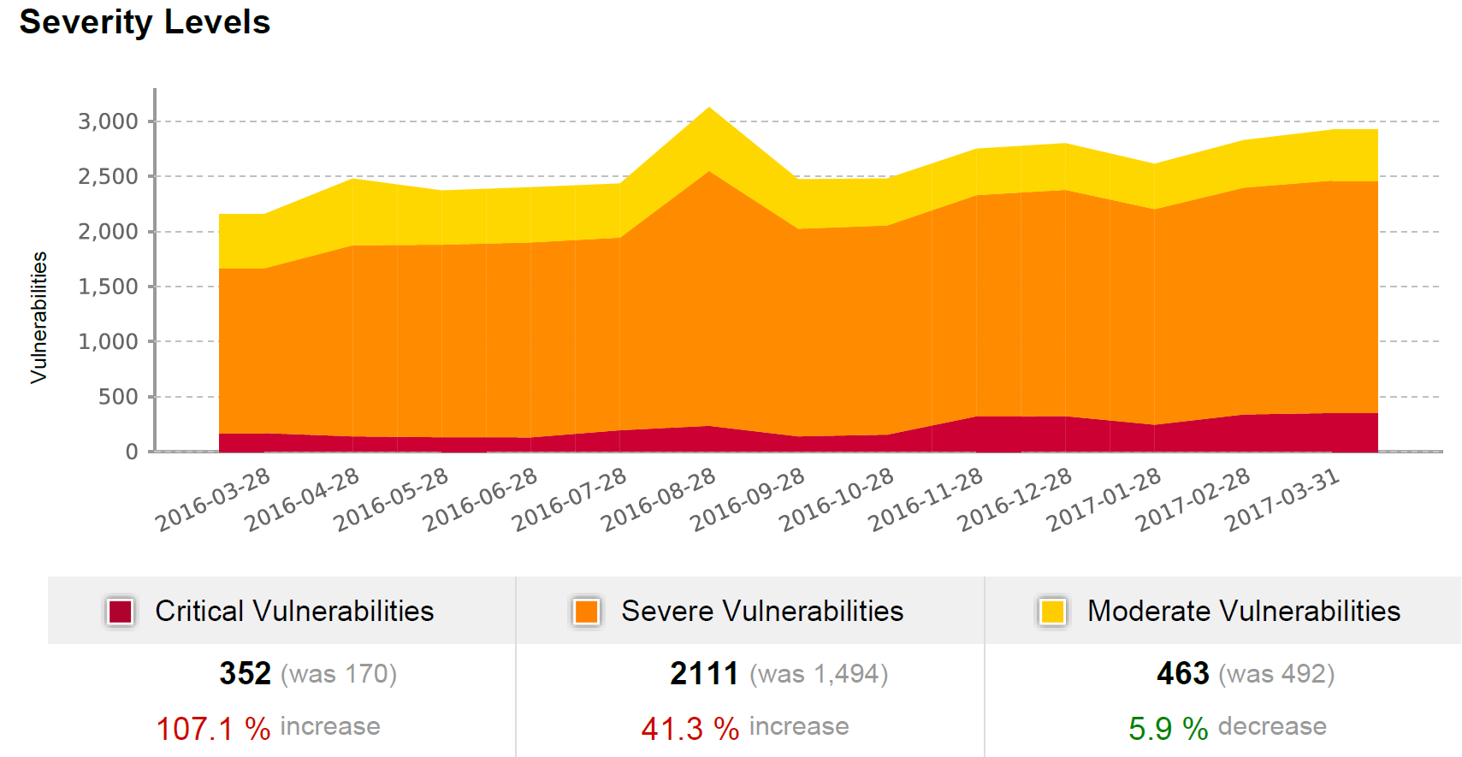
Cyber Security Health
Performance Overview (Mar 16 – Mar 17)
↓17.1% - Blocked Network attacks (35K to 29K)
89.1% - Malware blocked from ‘calling home’ (55 to 6)
17.1% - “Phishing” Email Risk (322K to 267K)
Q3 Accomplishments
ISO Certification Program: Shift from financial risk focus to overall risk focus
Phase I Cyber Security Awareness Training: (95% Complete)
Phase II Cyber Security Awareness Training: Roll-out complete
AIM Pilot for new Email Threat Protection solution in O365 Cloud
VPN Remote Access – Procurement/Legislation/Contract complete.
Completed the FBI audit with APD on CJIS cystems
Vulnerabilities - December 2016
Q4 Plans
Deploy advanced email threat protection solution via O365 city-wide
Deploy advanced ransomware detection/prevention agent
Deploy online remote access request and VPN solution w/ 2FA city-wide
ISO Certification Program: Complete Application Risk Assessment for APMS
Bit-9 Rollout: Phase II Medium Enforcement
SIEM (Security Information and Event Management) - Advance deployment

Slide 7

Project Management Delivery Performance
March
Performance Overview (Mar 16 – Mar 17)
Type | Actuals | Target
Control | 82.11% | >70%
Caution | 13.01% | <20%
Critical | 4.88% | <10%
Projects in “Control” ↓ 7%. Projects in “Critical” ↑ 28%
Q3 FY17 - 182 Projects across 16 city departments
117 Active, 65 Not Started, 65 On-Hold - Across 16 Depts.
84 Completed (33-Q1, 26-Q2, 25 Q3); 61 projects projected for Q4; 56 projects projected for completion in Fy18.
Q3 Accomplishments
Process: Roll-out of Stage-gate review process for COO’s Top Projects (40)
  Pass #1 completed for top 40 projects. (work type 1)
  Project Management Policy, EQMP policies completed
People: Change Champion Program & PMO Process Improvement Focus Group
Technology: MS Project Proof of Concept Completed; Jira Roll-out to OPA and AIM fast track projects (work type 4)
Q4 Plans
  Process: Pass #2 Stage Gate roll-out for COO Top Projects (work types 1 &3)
  People/Training:
    Complete Customer Service Training Course;
    Leadership Training Program for Directors & Managers(Gartner);
    Conduct Business Analysis and Agile training (in-house)
  Technology:
    Complete MS Project Online implementation
    Complete Sharepoint Governance Site Re-design

Slide 8
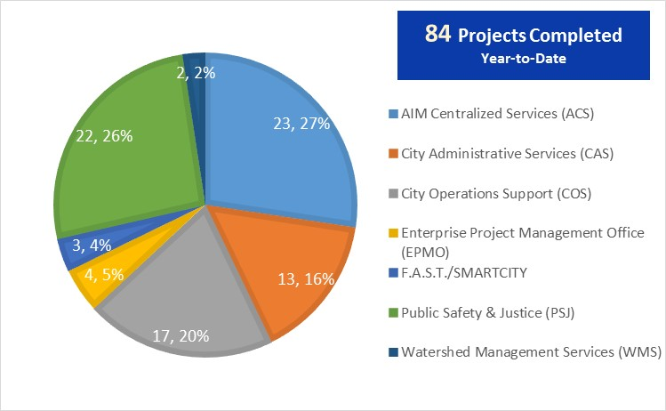
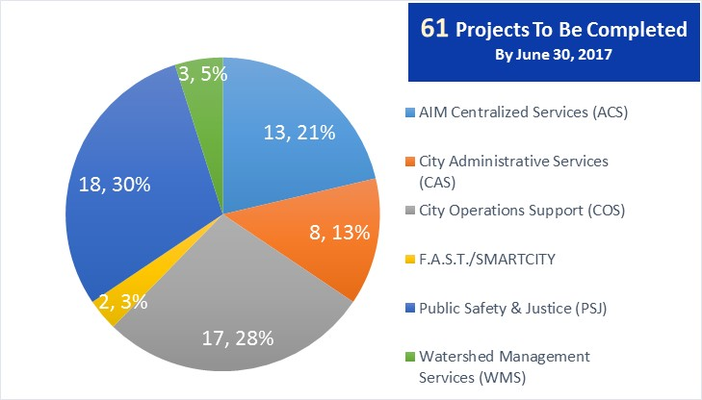
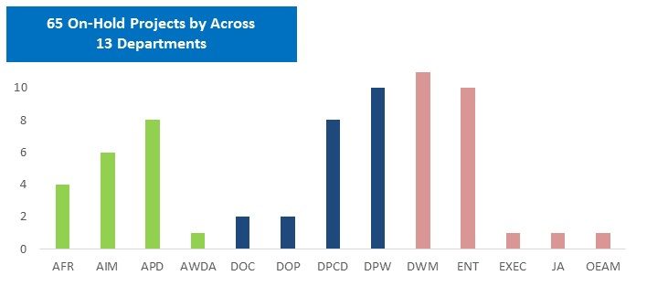
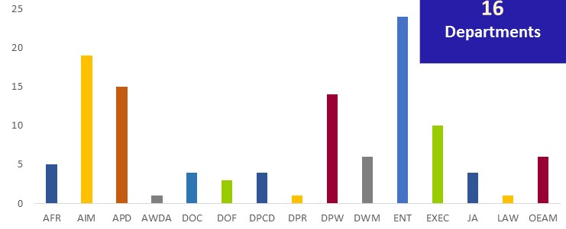
PMO: By the Numbers
61 Completing by June 2017
56 Completing by Dec
8
117 Active Projects
65 Projects On Hold
Notes:
Before diving into the priority projects, provide an overview of the Project Portfolio.

Slide 9
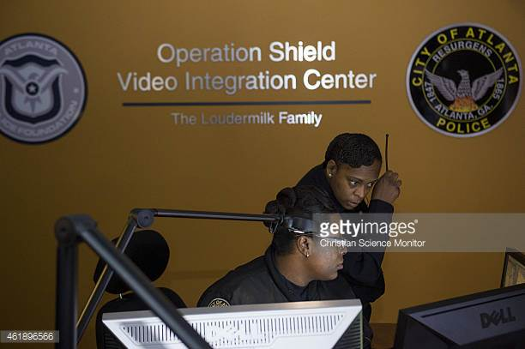
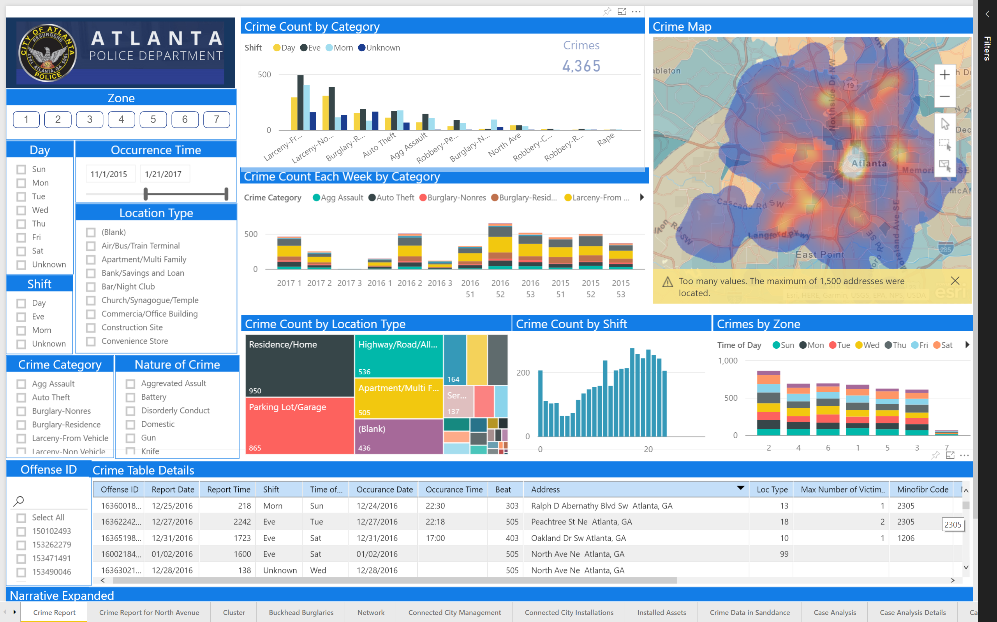

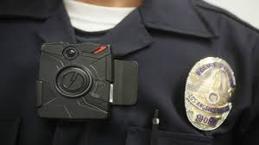


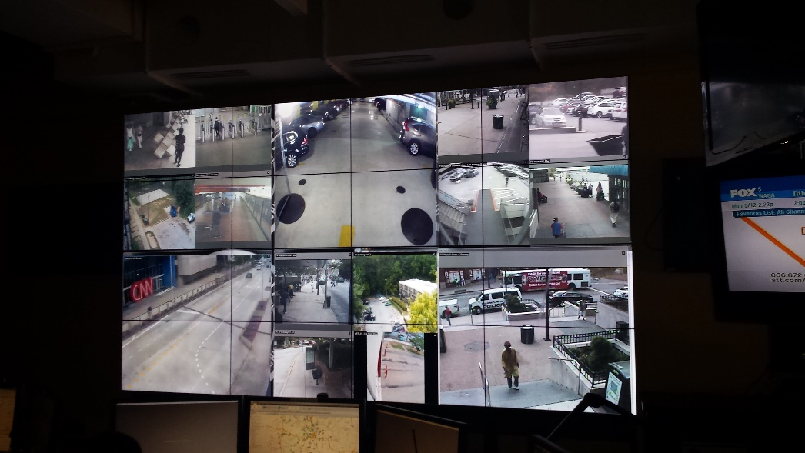
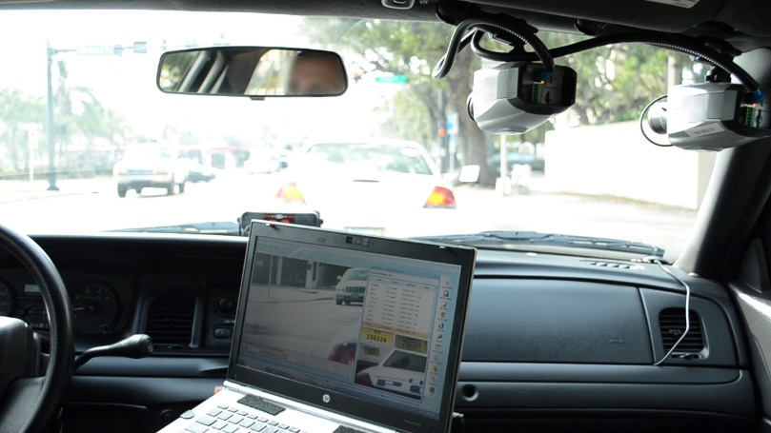

Public Safety & Justice (PSJ)
PSJ Depts | APD, AFR, DOC, DOC, Judicial Agencies | Project Stats: | Fy17: 40 (28%) Completed: 22 Remaining: 18 Fy18 Jul-Dec: 8 On-Hold: 15 (23%)
VIC Camera Expansion
All Zones
Real-Time
Crime Analytics
Dashboards
Electronic
Citations
Body
Cameras
Video Mgmt
Cloud Storage
VIC Video Wall Replacement
Mobile License Plate Reader
Notes:
Before diving into the priority projects, provide an overview of the Project Portfolio.

Slide 10
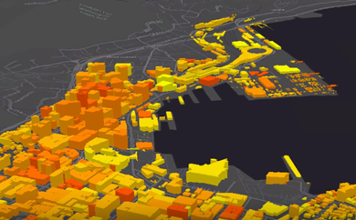








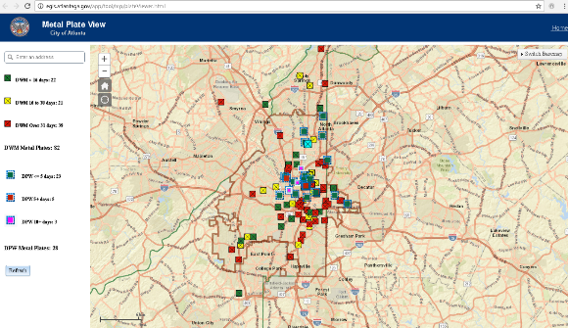
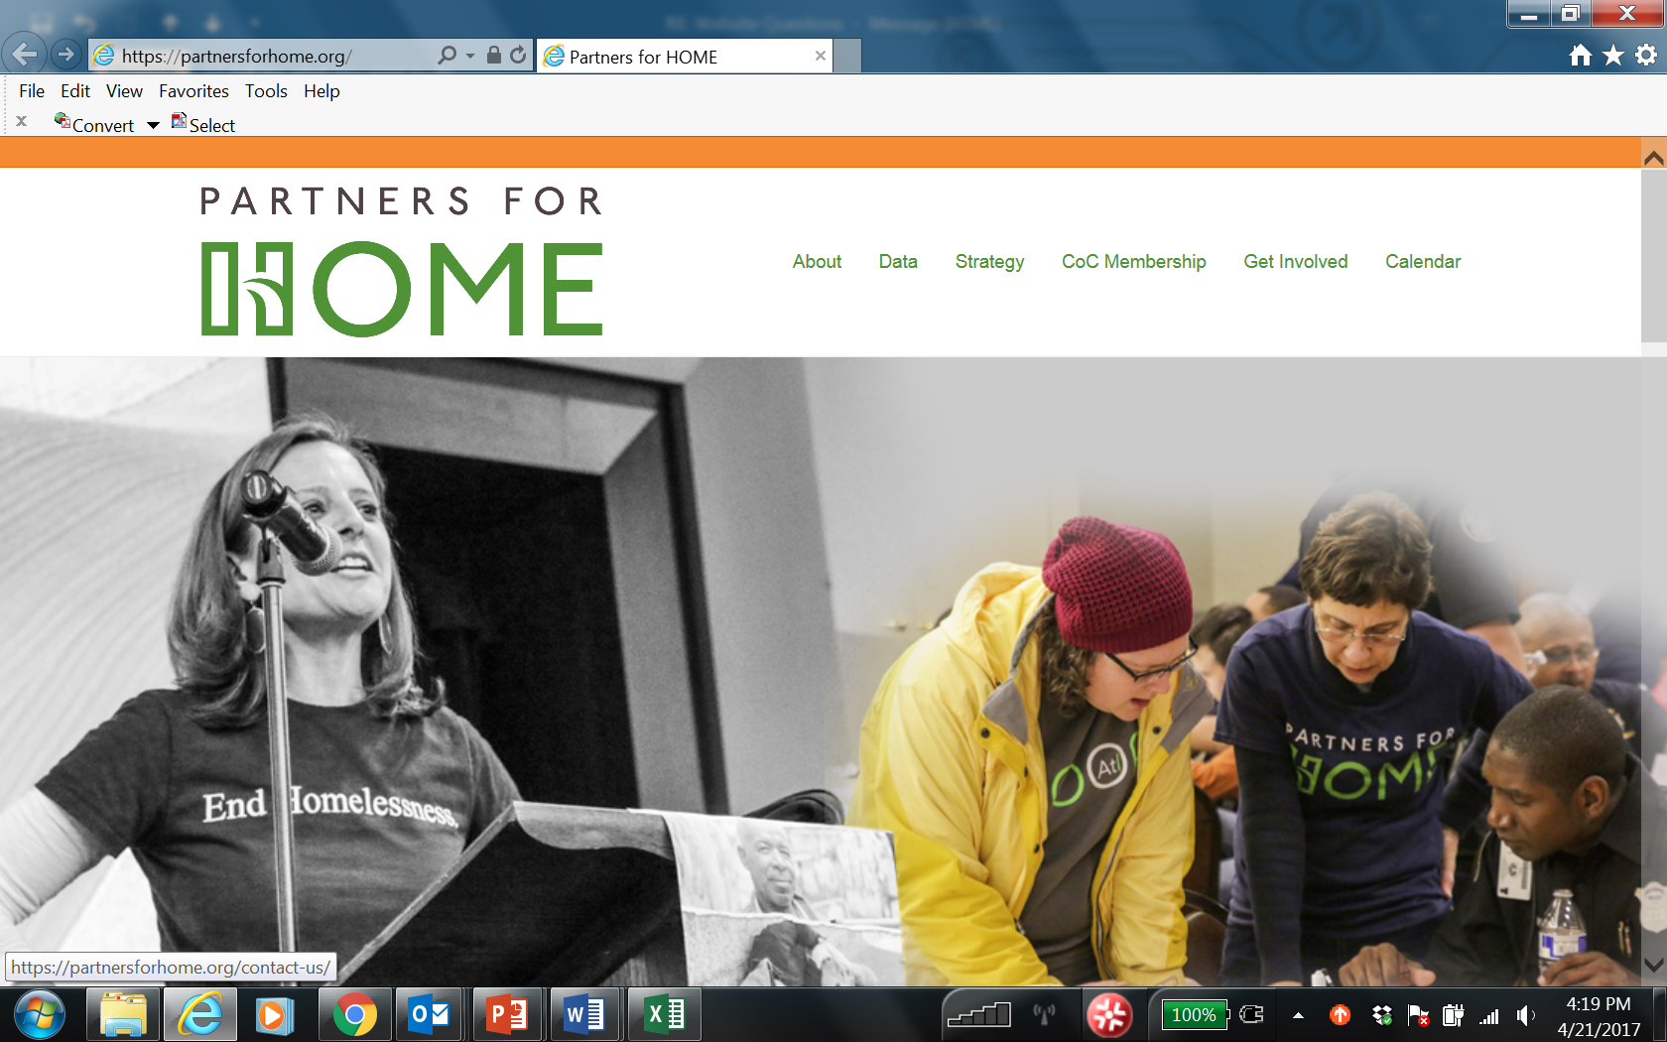
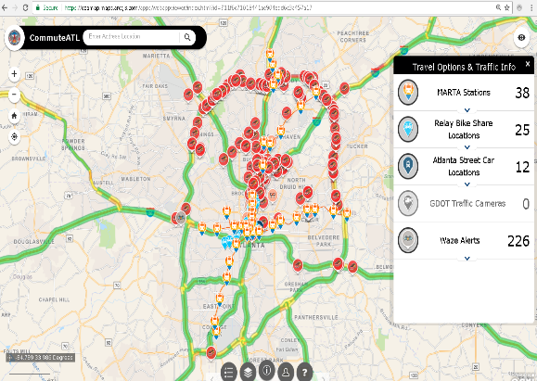
City Operations Services (COS)
Fy17 Completed
Fy17 To Be Completed
COS Depts | DPW, DPCD, DPR, AWDA, 311, EO | Project Stats: | Fy17: 34 (23%) Completed: 17 Remaining: 17 Fy18: Jul-Dec: 10 On-Hold: 20 (31%)
Enterprise GIS Data Migration
(Planning, Public Works, Parks)
Streetcar Mobile App
DPW Pavement Mgmt. System
Planning: Interactive Voice Recognition (IVR) Upgrade
Document Solutions
DWM Metal Plate
Tracker
Websites
Partners for Homeless
Emergency
Preparedness
Partners for Homeless
Human Services
International Affairs
Immigrant Affairs
Emergency Preparedness
CommuteATL.com
Notes:
Before diving into the priority projects, provide an overview of the Project Portfolio.

Slide 11



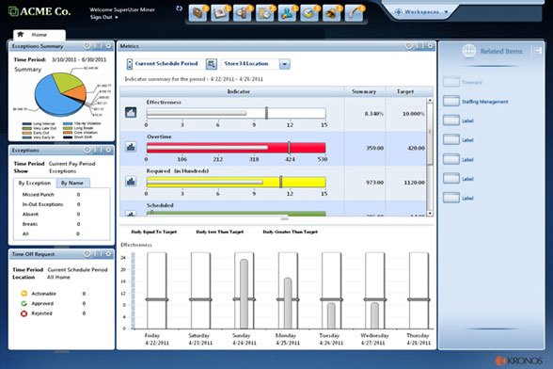

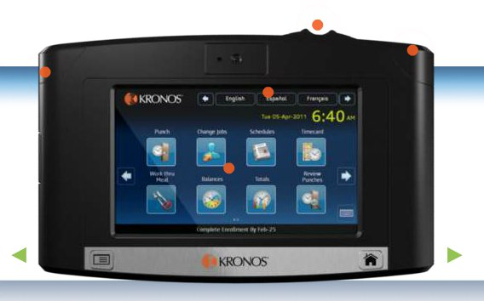

City Administrative Services (CAS)
Fy17 Completed
Fy17 To Be Completed
CAS Depts | DOF, DOP, DHR, DOL, Council Ethics, Audit, OCC, Safety | Project Stats: | Fy17: 21 (14%) Completed: 13 Remaining: 8 Fy18 Jul-Dec: 7 On-Hold: 5 (8%)
Finance Hyperion Budget Enhancements
Kronos
Timekeeping
Reporting
Automation
Notes:
Before diving into the priority projects, provide an overview of the Project Portfolio.

Slide 12



Watershed Management Services (WMS)
Fy17 Completed
Fy17 To Be Completed
WMS Depts | DWM | Project Stats: | Fy17: 5 (3%) Completed: 2 Remaining: 3 Fy18 Jul-Dec: 1 On-Hold: 11 (17%)
Maximo Vertical Asset Inventory Consolidation
Payment
Gateway
Notes:
Before diving into the priority projects, provide an overview of the Project Portfolio.

Slide 13

Digital Inclusion
  ConnectHome Pilot Initiative
    7’ tablet w/Bluetooth keyboard, 12 months
    internet, digital literacy training
Community Name | # Families Served | # Kids Served
Martin Street Plaza Apartments (AHA Family Community) | 70 | 117
Adamsville Afterschool Program (Centers of Hope) | 122 | 202
Westminster Apartments (AHA Family Community) | 10 | 15
Welcoming Atlanta (Office of Immigrant Affairs) | 161 | 333
West Highlands (AHA Mixed-Income Community) | 53 | 105
LAPPS (APS-ESOL) | 49 | 111
 | 465 | 883
Recreation Center | # Google Chrome Computers | Updates Made | Date Completed
Adamsville | 25 | Paint, New Furniture | 4/11/17
Rosel Fann | 25 | Paint, New Furniture | 4/11/17
Pittman | 14 | Paint, New Computer, Tables/Chairs, New Furniture | 4/17/17
South Bend | 10 | Paint, New Computer, Tables/Chairs, New Furniture | 5/28/17
Google Fiber, a National Sponsor of ConnectHome, partnered with the COA to leverage labs that are already in the recreation centers to bridge the divide and reach a larger group in the community.
Notes:
Before diving into the priority projects, provide an overview of the Project Portfolio.

Slide 14
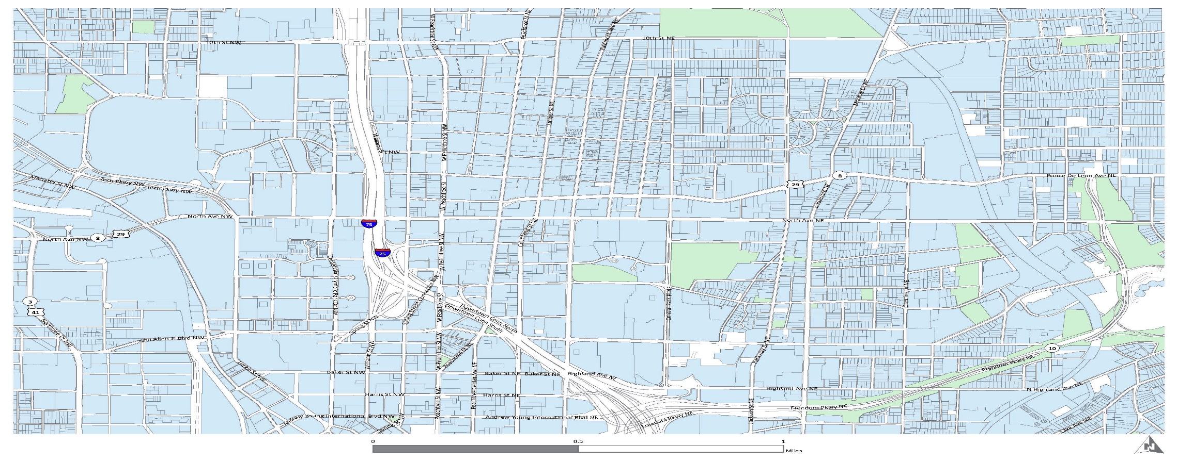



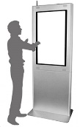






SmartATL – North Ave Smart Corridor Demonstration
A public demonstration and “living lab” to showcase how IoT and Big Data analytics can be used in improve the corridor
North Avenue
Smart Corridor
North Avenue Smart Corridor Ribbon Cutting Event: 9/2017
First-ever high-speed public WIFI on a City of Atlanta corridor
100+ IoT sensors (see, hear, smell) along 5 miles, 18 signalized intersections)
Citizen kiosks delivering wayfinding, transit updates, emergency messages, etc.
Deploy smart city data platform and demo open APIs, advanced analytics and data visualization tech
Re-pave, re-stripe, repair the entire corridor and upgrade street signs
Connected and coordinated traffic signals with advanced traffic responsive signal timing
APIs
Notes:
Before diving into the priority projects, provide an overview of the Project Portfolio.

