Slide 1

Atlanta City Council
City Utilities Committee
Quarterly Update
May 9, 2017

Slide 2


Reports to Council

Slide 3
Water Loss Audit (17-C-5035)
What is happening in other cities and throughout the U.S.?
Backlog of hydrant leaks and other leaks
  Update on slide 38
Plan of action to staff and fix leaks
  Update on slide 13
City | Water Loss Control Actions
Nashville, TN | District Metered Areas; monitoring sub areas to identify areas of leakage; continuous monitoring of flows
Nova Scotia, Canada | District Metered Areas; advanced pressure management; focus on apparent losses by disallowing use of hydrants for retail supply purposes; launching installation of Advanced Metering Infrastructure (AMI) system in 2017
Philadelphia Water | AMR installed in 1999; full-scale DMA with advanced pressure management; acoustic leak detection sensors for large diameter transmission mains; cut non-revenue water by 1/3rd

Slide 4
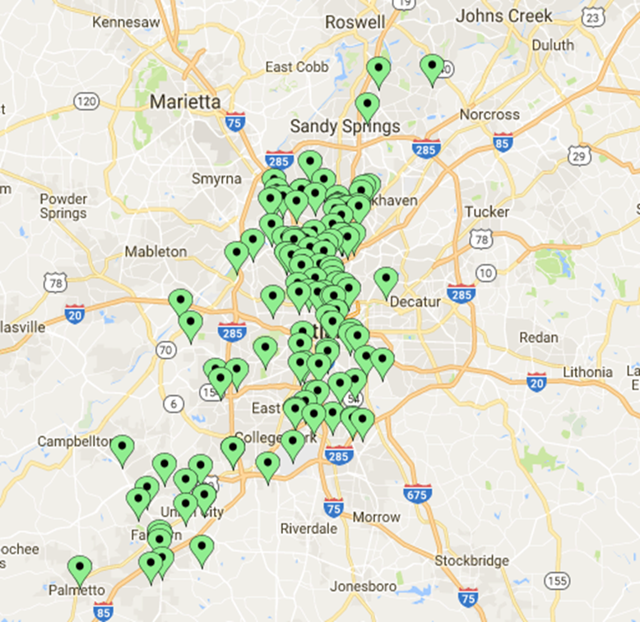
Large Metered Water Accounts
Metric | Total
Large water meters in system | 3,249
Active large metered water accounts | 2,664
Large meter repairs (Jan-Mar) | 318
Number of large metered accounts investigated for no sewer | 132

Slide 5
Billing Issues/Revenue Recovery
Large meter account review (Audit Team Review):
  Review of Top 200 accounts; 12 meters identified for repair
  Review of 21 wholesale accounts; 2 meters identified for repair
  Reviewed 322 large meter accounts; 13 meters identified for repair
541 zero consumption accounts reviewed (small and large meters); 3 large meters need repair
Total recovered by Audit Team (Jan-present): $814,857.79
20 large metered accounts selected for meter health analytics pilot
Activity Description | Totals
Total number of large meter accounts without sewer identified | 132
Number of accounts validated to have water service only | 95
Number of accounts validated to have water and sewer services | 37
Number of accounts sewer service added to as a result of the review | 37
Demand letters sent* | 21
Demand letters being prepared | 3
Accounts requiring additional investigation prior to sending demand letters | 12
Current total backbill amount | $ 2,464,040.22
Current amount paid | $ 118,837.20
*One account holder has two accounts.

Slide 6
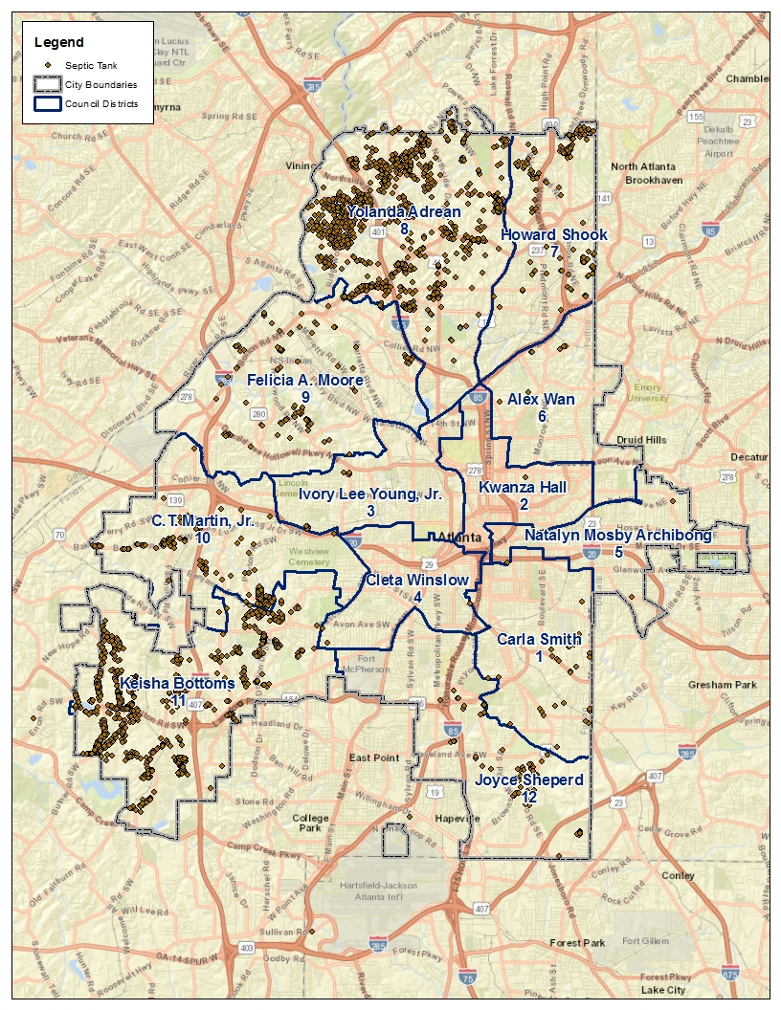
Septic Tanks
Council District | Septic Tank Count
1 | 38
2 | 1
3 | 11
4 | 4
5 | 2
6 | 8
7 | 135
8 | 1002
9 | 117
10 | 142
11 | 775
12 | 60
Total | 2,295

Slide 7
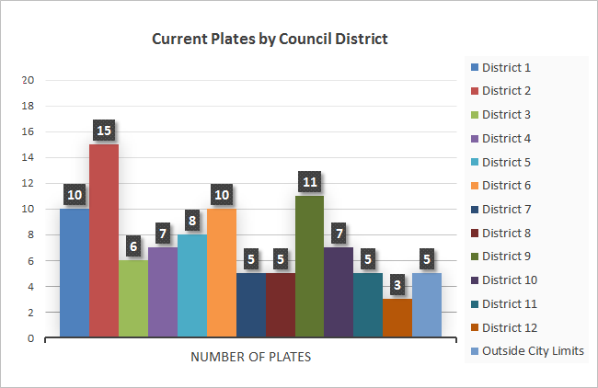
Metal Plate Overview
As of April 5, 2017
Number of Plates in Place: 97 Average Age of Current Plates: 91 Days
Install Dates of Current Plates
Aging of Current Plates
Current Plates by Council District
As of April 5, 2017
Number of Plates Removed: 83 Average Age of Plates Removed: 25 Days

Slide 8
2017 CUC Goals & Objectives

Slide 9
Water & Sewer Appeals Board
Membership: Proposed changes should help broaden the pool of eligible persons for Council Members’ nominations
Meeting location concerns: Hosting board meetings in one of the Council committee rooms; DWM agrees with this change
Proposed legislative changes:
  Increase the amount paid for each board meeting from $50 to $100 per board member
  Increase the annual cap from $6,000 per year to $10,500 per year for each board member
  Replace the mandatory requirement for board members from residential property management, plumbing or property maintenance
Training and other efforts:
  3 training sessions with WSAB members in the following areas
    Billing; dispute resolution; meter reading; meter investigations
  Provided each Board member training guides
  Refresher training throughout the year
  Board members now access information via tablet or laptop versus paper documents

Slide 10
USGS Partnership
Purpose
  To have an objective 3rd party (United States Geological Survey - USGS) collect and provide empirical data and scientific analysis on surface water quality data in order to drive policy, demonstrate transparency in light of the consent order, potentially prioritize some CIP projects, and determine effectiveness of work/CIP over time.
Current Contract Period
  January 1st 2017 – December 31st 2017; the last renewal term of a one year contract with three (3) one year renewal options.
Benefits
  Provides/collects samples required by the Metro District
  USGS rain gauges supplement DWM rain gauge network
  Web based tools and data
Contract Value
  For 11 instrumented stations, bacteria samples & web based data: $602,085.60 authorized for current term (Resolution No. 16-R-4746)
  This cost does not include scientific analysis or ad-hoc reports.
Report on Water Quality (based on collected data)
  There is publication being compiled that speaks to the data/trends for the Atlanta monitoring stations; Analysis and reports can be conducted if given a specific objective or a specific parameter

Slide 11
Convenience Fee
Eliminating fees increases collections and reduces administrative work
High fees have lowered online adoption
Department intends to absorb the entire cost of processing online payments
Considerations:
Credit card transactions account for a disproportionate share of costs
  These costs are driven by a handful of very large customers
  Limiting the number of extremely high-dollar credit card transactions by establishing a cap of $2,500 per transaction.
Cost Composition All Types
Online Payment Costs

Slide 12
Capital Improvement Plan
On track to complete $200M of CIP spending in FY17
More balanced approach to CIP funding between water and wastewater
DWM equity funds approximately 60% of 5 year CIP
Stormwater only represents 7% in the current 5 year CIP
  Limited to 10% of MOST proceeds ($12.5M)
  Does not address comprehensive need which is projected at $30M annually to fund growing CIP needs

Slide 13
Infrastructure Maintenance
Repair Plan
Water leaks are being addressed with the following actions:
Enhanced the First Response to water leaks by cross-training first responder units for both Collections and Water Distribution divisions; considering use of Investigations Unit for rapid response
Addressed internal dispatch issues to ensure that the first responders are dispatched immediately to water leak/main break emergency locations
Purchasing more leak detection equipment
HR is assisting with additional recruitment efforts to staff vacant crews; equipment purchases/rentals planned;
Utilizing contractors to supplement the City to continue addressing backlog and incoming service requests
Implementing water main renewal and replacement program starting with RENEW ATL and DPW CIP project locations
Large diameter water main condition assessment
Plans for system wide leak detection
Assessing upgrades as part of ESCO contracts

Slide 14
DWM 2017 Q1 Highlights

Slide 15
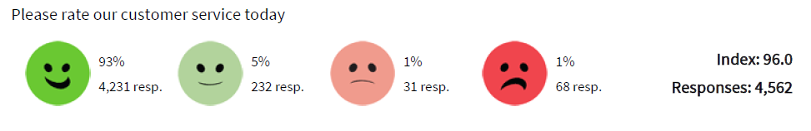
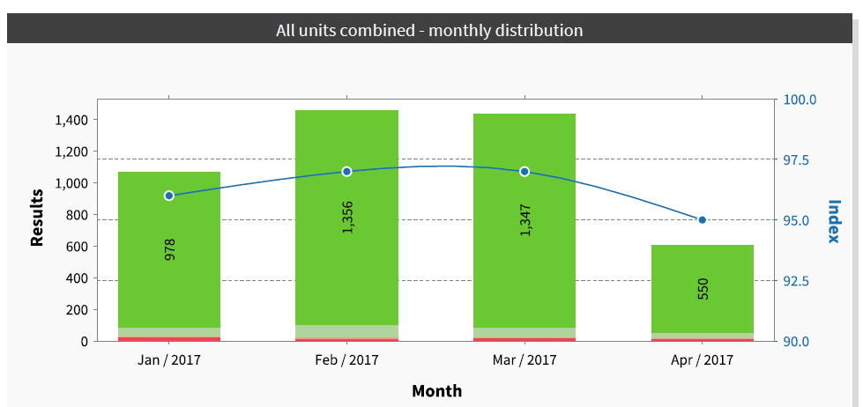
Happy or Not Results
Service Delivery

Slide 16
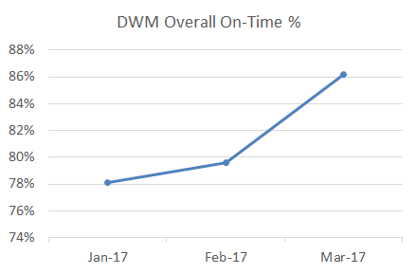

Service Request & Work Order
Performance
Service Delivery
DWM Overall Service Request & Work Order Fulfillment
January 2017 - March 2017
Overall SR/WO on-time performance increased 10.4% during the quarter.

Slide 17
Service Requests Performance
Service Delivery
11% overall improvement for Linear Infrastructure Operations

Slide 18
Linear Infrastructure Operations
Service Delivery
OLIO Received 5,164 Service Requests During the Quarter
Includes activity for SRs created within the month; inspected and resolved figures are a subset of the total.

Slide 19
CAST – Escalated Issues
Service Delivery
Customer Assurance and Satisfaction Team (CAST) handles escalated service requests from 311 and Commissioner’s Office
Top concerns handled by CAST
  Account/Billing Adjustment
  Leaking or Broken Water Meter
  Restoration due to water related repairs
  Possible water leak or main break
  Disputed Water Bill
CAST Issues by Council District January - March 2017
Council District | No. of Issues
 | JAN | FEB | MAR
District - 1 | 182 | 0 | 11
District - 2 | 208 | 2 | 17
District - 3 | 172 | 2 | 11
District - 4 | 152 | 0 | 9
District - 5 | 279 | 3 | 19
District - 6 | 357 | 4 | 14
District - 7 | 317 | 2 | 19
District - 8 | 423 | 5 | 30
District - 9 | 204 | 7 | 17
District - 10 | 214 | 0 | 24
District - 11 | 163 | 1 | 30
District - 12 | 196 | 1 | 12
Outside of City | 1138 | 7 | 94
Grand Total | 4006 | 34 | 307

Slide 20
Billing Issue Resolutions
Service Delivery
Summary of corrective actions:
  11 accounts back billed and sent a sewer demand letter
    Total amount back billed for the 11 accounts: $2,143,629.23
    Amount collected: $118,837.20
    11 additional letters have been mailed; amount back billed $320,411.32
  Reviewed top 200 large meter accounts
    5 accounts under billing
    $814,857.79 billed and collected
    12 meters are awaiting repairs
Additional mitigation measures:
  Timely completion of meter/register repair or replacement
    Completed 318 large meter repairs (Jan – Mar 2017)
    Completed over 26,000 register replacements (Sep 2016 – Mar 2017)
  Continue to develop account audit and review criteria
  Expand proactive communication regarding consumption and billing (high consumption notification calls and mailers)

Slide 21
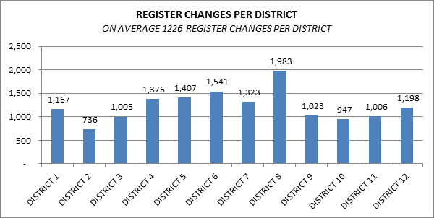
Billing Issues Update: Estimated Bills
Service Delivery
1.8% of active accounts (inside city) are receiving estimated bills due to needed repairs
Industry benchmark is 3%; DWM target is less than 1%
Council District | Total No. of Accounts | Number Estimated | Percentage
1 | 7,656 | 149 | 1.95%
2 | 5,740 | 114 | 1.99%
3 | 6,129 | 144 | 2.35%
4 | 7,498 | 123 | 1.64%
5 | 10,446 | 268 | 2.57%
6 | 11,299 | 211 | 1.87%
7 | 8,583 | 126 | 1.47%
8 | 12,139 | 253 | 2.08%
9 | 7,708 | 176 | 2.28%
10 | 7,787 | 144 | 1.85%
11 | 9,754 | 83 | 0.85%
12 | 6,468 | 54 | 0.83%
 | 101,207 | 1,845 | 1.82%

Slide 22
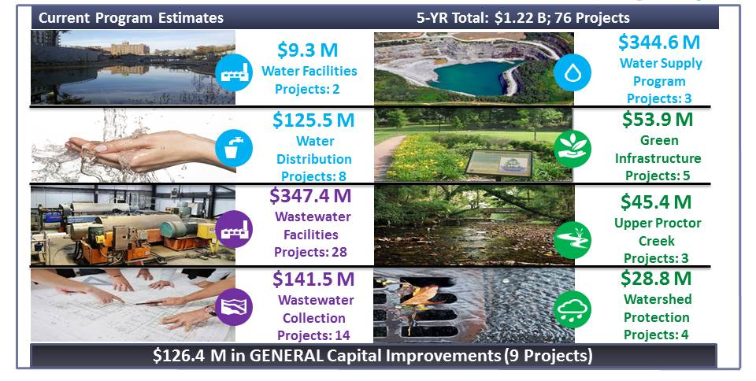
Capital Improvement Program
Infrastructure Stability

Slide 23
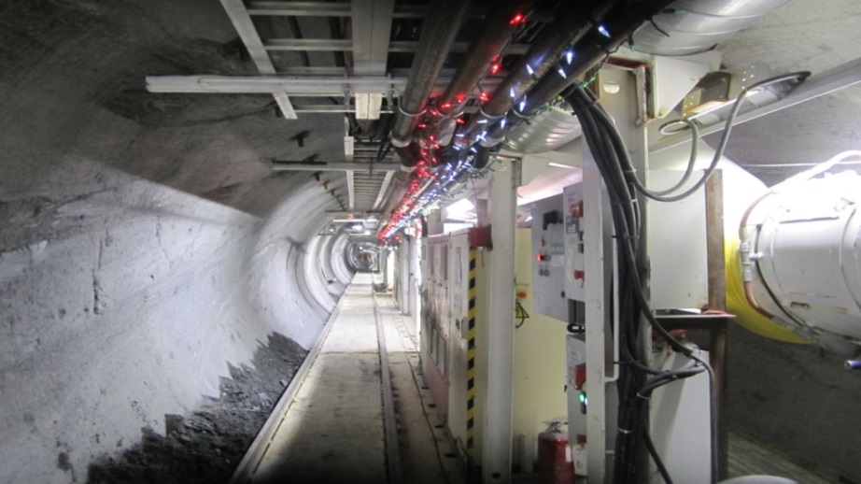
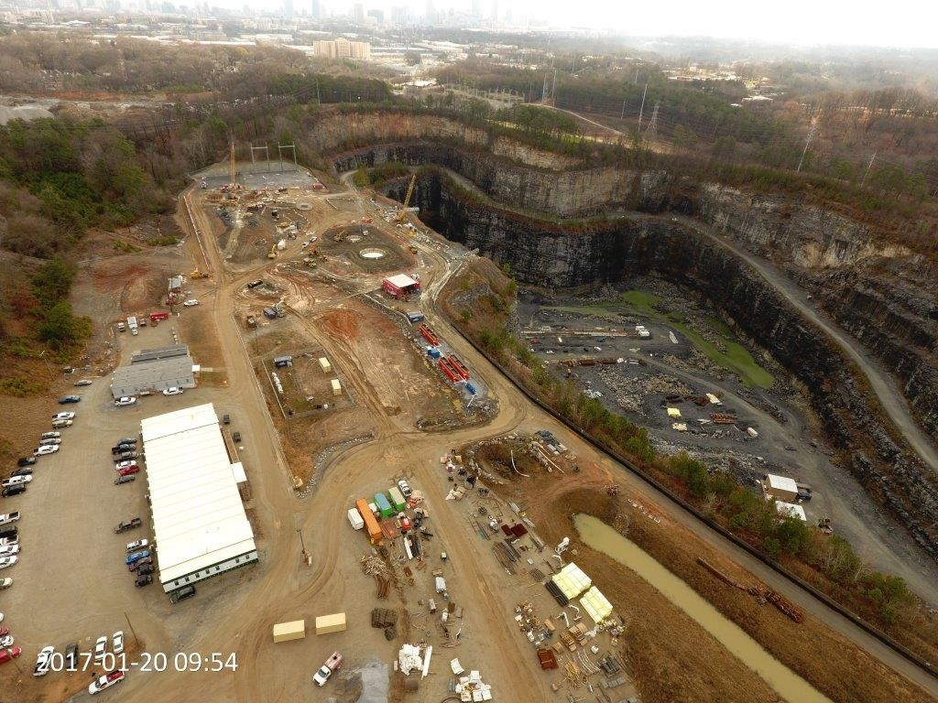
Raw Water Supply Program
Infrastructure Stability
Program Scope
  Two (2) new pump stations (at Quarry and Hemphill WTP)
  Conveyance tunnel: 10 ft. diameter; 23,800 feet long
  Repurpose Bellwood Quarry
  Condition assessment and rehabilitation of raw water mains
Project Benefits
  Increase water supply to 30+ days
  Eliminates frequent corrective and emergency repairs on aged existing raw water pipelines (1890, 1908, 1924 and 1975)
Program Cost: Current program estimate is $342M (D, C, CM, Land); Engineer of Record Services: $14.2M
  Authorized Construction: $231.6M
  CGMP 1A - $19,728,230
  CGMP 1B - $86,180,313
  CGMP 2 - $24,205,660
  CGMP 3 - $9,851,663
  CGMP 4 - $91,636,047

Slide 24
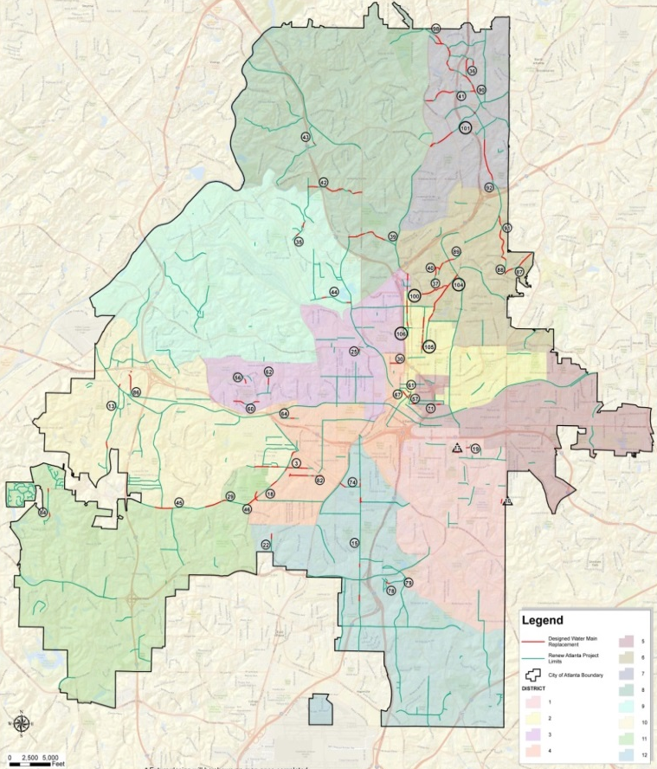
Renew ATL Water Line
Renewal & Replacement
Infrastructure Stability
Renew Atlanta
  Currently have 110 bid-ready projects identified
  Construction from May 2017 to April 2018
  More projects slated to be developed
Department of Watershed Management
  Working closely with Renew ATL to assess needed corrective actions before resurfacing efforts
  Assessed 81 out of the 110 projects
  Designed 9 water main replacement projects to meet Renew ATL’s May 2017 schedule
  Currently assigning additional design work to A/E firm

Slide 25
Renew ATL Water Line
Renewal & Replacement
Infrastructure Stability
Project Name | Renew ATL Procurement Packages | Water Main Replacement Length (ft) | Pipe Diameter | DWM Number | Council District | Expected Completion Date | Renew ATL Expected Start
Gilbert Street | Local Group 1 | 506 | 8 | 10 | 1 | 4/22/2017 | 6/5/2017
Rosalia Street | Local Group 1 | 580 | 8 | 17 | 1 | 4/28/2017 | 7/3/2017
Ready for Construction (Permitted)
Project Name | Renew ATL Procurement Packages | Water Main Replacement Length (ft) | Pipe Diameter | DWM Number | Council District | Expected Completion Date | Renew ATL Expected Start
Beecher St | GDOT Group A | 3,208 | 8 | 3 | 11,10,4 | 5/18/2017 | 5/8/2017
Fairburn Rd | GDOT Group A | 1,066 | 24, 30, 36 | 13 | 10,11 | 5/21/2017 | 5/29/2017
Stanton Road | GDOT Group A | 217 | 8 | 22 | 12 | 5/31/2017 | 7/24/2017
Cascade Road - Phase 1 | GDOT Group A | 1,901 | 8 | 29 | 11 | 5/28/2017 | 8/21/2017
Collier Rd | GDOT Group A | 4,219 | 8 | 39 | 8 | 8/5/2017 | 10/9/2017
Peachtree Battle Ave | GDOT Group A | 3,202 | 8 | 42 | 8 | 7/31/2017 | 10/16/2017
Howell Mill Resurfacing | GDOT Group A | 200 | 8 | 43 | 8 | 7/22/2017 | 10/23/2017
Huff Rd | GDOT Group A | 765 | 8 | 44 | 9 | 6/15/2017 | 11/6/2017
Cascade Road - Phase 2 | GDOT Group A | 282 | 8 | 45 | 11 | 6/5/2017 | 4/2/2018
Cascade Rd - Phase 3 | GDOT Group A | 3,565 | 8 | 46 | 10,11,4 | 9/29/2017 | 4/9/2018

Slide 26
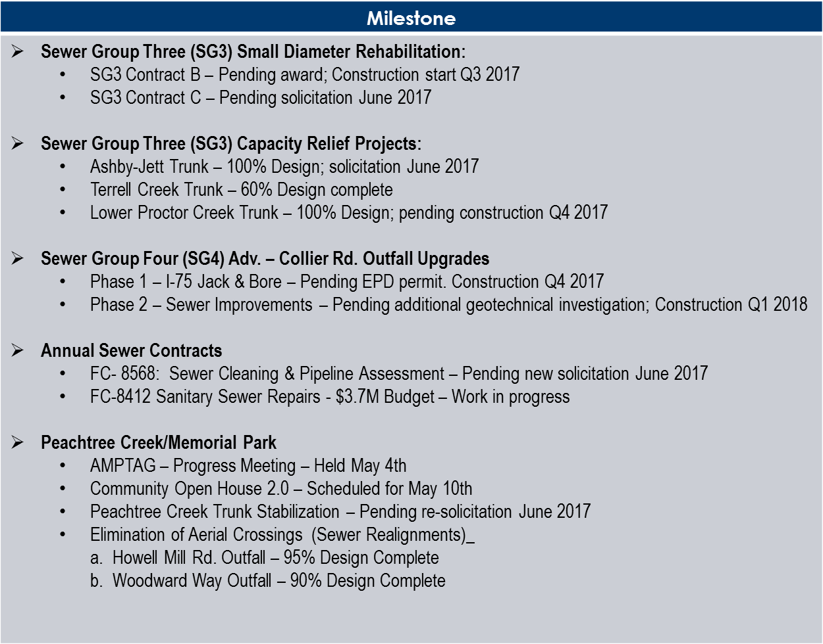
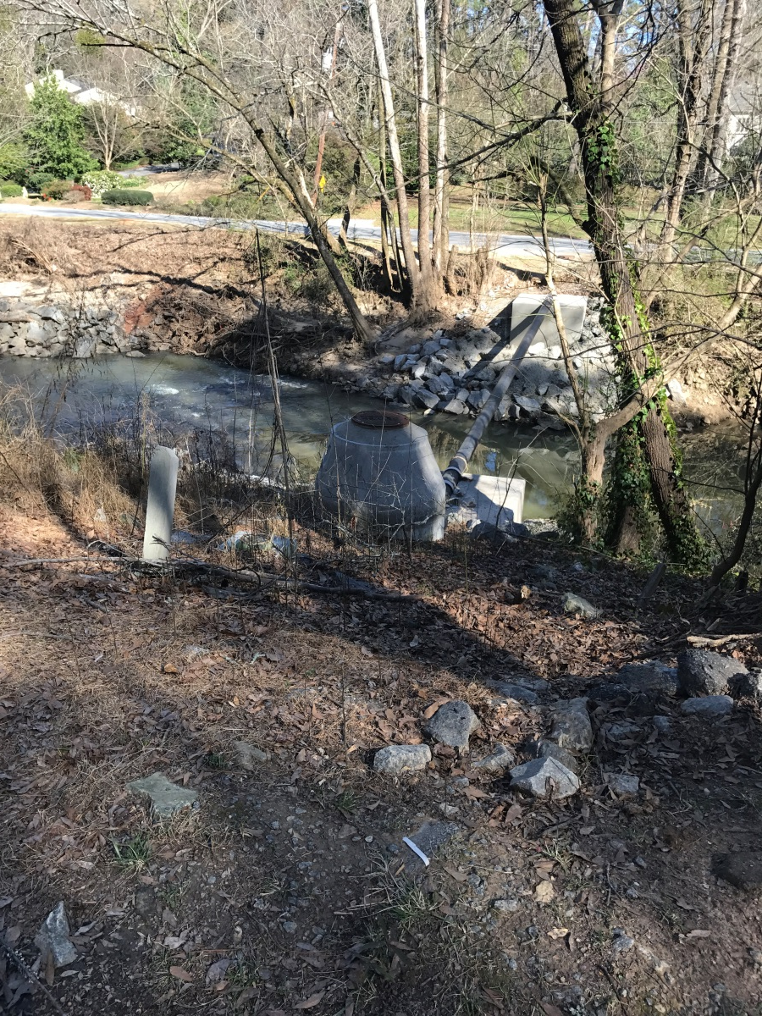
Clean Water Atlanta
Infrastructure Stability

Slide 27
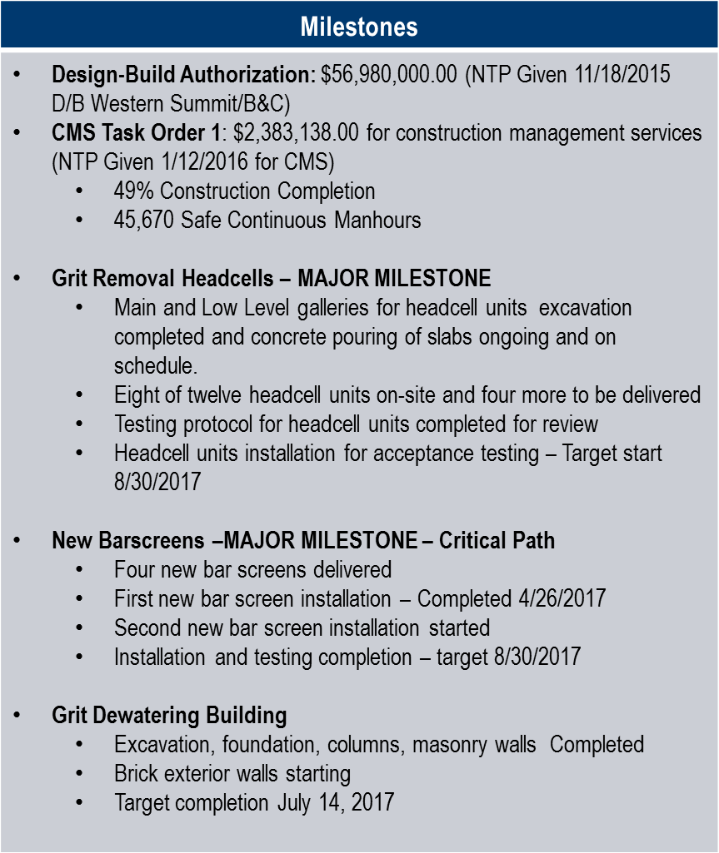
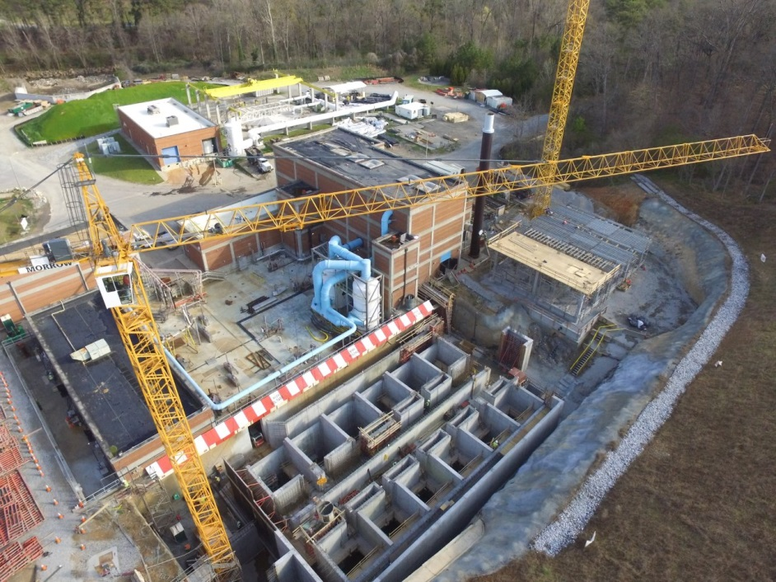
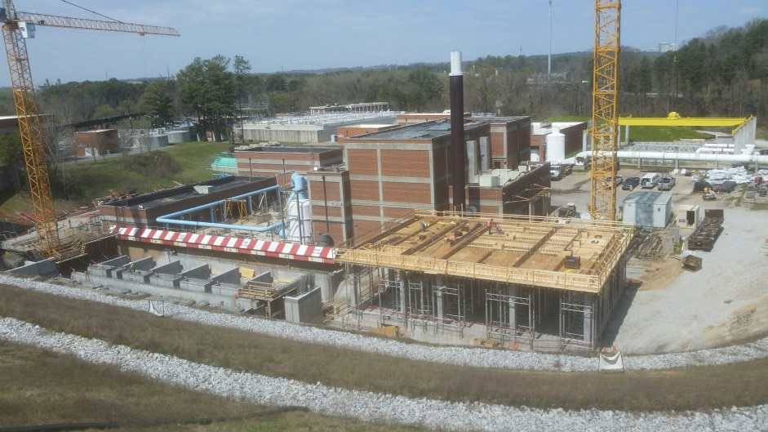
RM Clayton Headworks
Infrastructure Stability

Slide 28
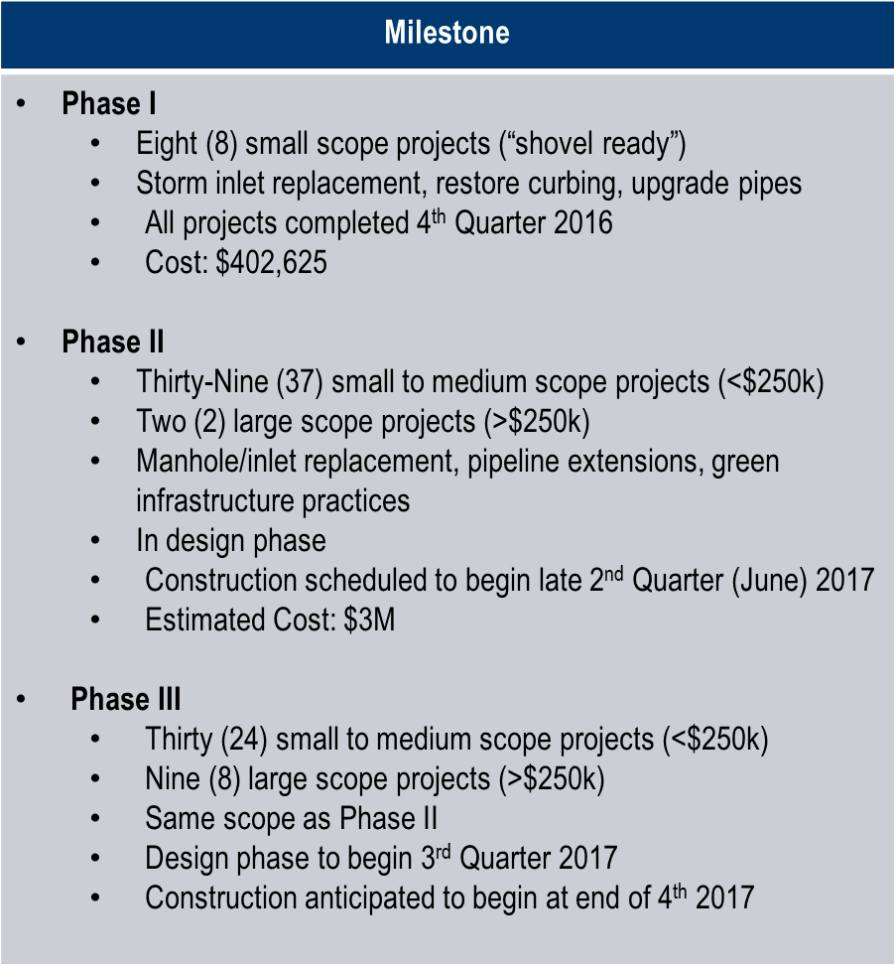
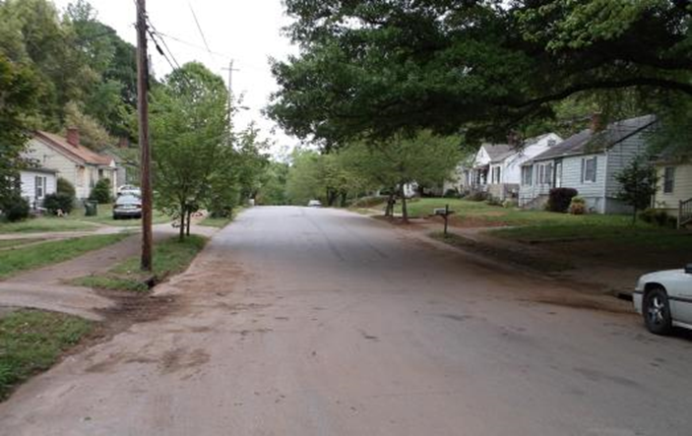
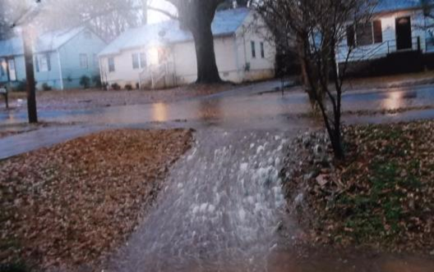
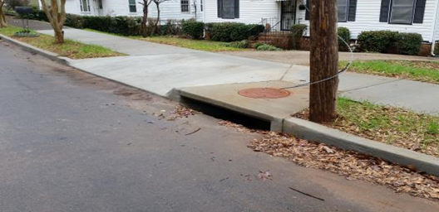
MOST Funded Stormwater Projects
Infrastructure Stability
Location: 525 Erin Avenue, SW
Issue: Street Flooding – Jumping Curb
Resolution: Reconstruct 2 Inlet Tops – Repair Sidewalk/Aprons

Slide 29
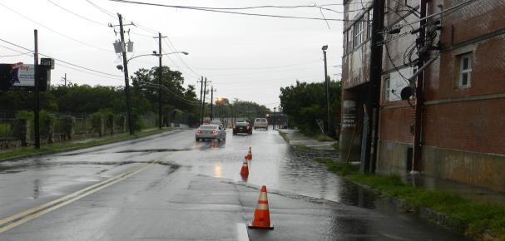
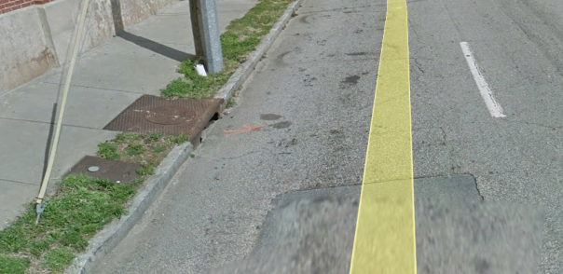
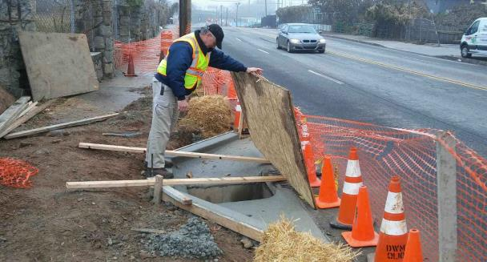
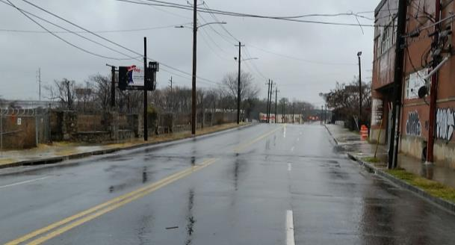
MOST Funded Stormwater Projects
Infrastructure Stability
Location: 555 Whitehall Street, SW
Issue: Street Flooding
Resolution: Reconstruct 4 Inlet Tops - Upgrade to GDOT Type C
Before Upgrades
Before Upgrades – Small Inlet
During Construction – Larger Inlet
After Upgrades – During Rainfall

Slide 30
Upper Proctor Creek Capacity Relief:
Rodney Cook, Sr. Park in Historic Vine City
Infrastructure Stability
Milestone | Status/Target
Groundbreaking Ceremony scheduled Construction Manager at Risk (CMaR) selection legislation 90% construction drawings to be submitted for DWM and CMaR review Funding legislation drafted Phase 1 of Right of Way transfer from DPW to DPR and DWM (Rock St, Thurmond St, and Vine St) | May 19th at 11:30am Cycle 8 (Full Council Approval May 1st) May 12th Cycle 10 (Full Council Approval June 19th) Legislation passed Cycle 6

Slide 31
Vacancy Report
Workforce Development
Office | Filled | Vacant | Critical Vacancies | Total
Commissioner's Office | 89 | 12 | 2 | 101
Water Treatment and Reclamation | 243 | 51 | 13 | 294
Engineering | 183 | 24 | 3 | 207
Customer Care and Business Services | 223 | 25 | 2 | 248
Watershed Protection | 139 | 24 | 12 | 163
Financial Administration | 52 | 6 | 1 | 58
Safety, Security & Emergency Management | 54 | 7 | - | 61
Linear Infrastructure Operation | 370 | 111 | 54 | 481
Total | 1353 | 260 | 87 | 1613
1613 Authorized Positions
1353 Filled, 260 Vacant
73 Extra Help

Slide 32
On-going Efforts
Workforce Development
Preparing for the 2017 DWM Summer Internship Program
  Required to have completed at least one year of college
  Received more than 600 applicants
  Focused on applicants with STEM majors
Completed over 600 transactions since January
  92 candidates hired, rehired or moved from extra help
  129 employees promoted, transferred, etc.
  125 employees retired, resigned or separated
Meetings with external workforce development agencies
Finalizing re-entry program with DOC

Slide 33
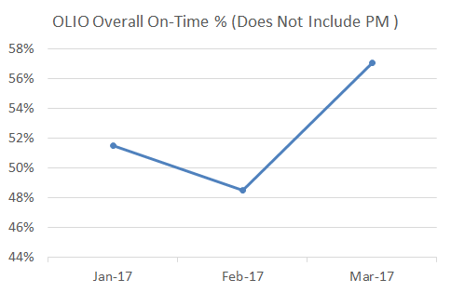
Linear Infrastructure Operations
Operational Efficiency
On-time performance of main break repairs increased significantly due to increased productivity in March; February performance decreased due to the closure of previously completed work in the work order system.
Hydrant complaints and check for leaks are being inspected more quickly.
The percentage of valve and broken service line repairs addressed within SLA is increasing.

Slide 34
Linear Infrastructure Operations
Operational Efficiency
Service Requests
The percentage of service requests inspected within SLA exceeded 90% during the quarter.

Slide 35
Linear Infrastructure Operations
Operational Efficiency
Work Orders
The backlog of open work orders decreased from 869 in January to 468 in March, representing a 46% decrease.

Slide 36
Linear Infrastructure Operations
Operational Efficiency
Work Orders Created and Completed
January through March 2017
Work Order Activity
OLIO created 18,001 Work Orders during the quarter; 7,230 consisted of non-preventative maintenance work
OLIO also closed 7,799 non-preventive maintenance work orders during the period
More work was closed than created, indicating that the work was opened prior to the period

Slide 37
Linear Infrastructure Operations
Operational Efficiency
Work Backlog
Backlog is defined as work orders, created through December 31, 2016, that are still open
We are currently reviewing the backlog to determine whether the work has been completed and the status updated in the work order management system

Slide 38
Linear Infrastructure Operations
Operational Efficiency
Hydrant Work Orders (Both CSTAT and Non-CSTAT)
The backlog of open work orders decreased from 952 in January to 641 in March, representing a 33% reduction.

Slide 39
FY 2017 Budget
Financial Resilience
Revenue Breakdown
Allocation of Funds
Estimated Revenues $596 Million
Estimated Expenditures of $596 Million
IJ Revenue
Fees/Services (tap meter sales, stormwater charges interest earnings, administrative services – Fulton County
Other City Departments
Non-Departmental (indirect costs, PILOT/franchise fees, OPEB, GEFA payments/reserve, bad debt reserve, fund-wide reserve)
 | OPERATION & MAINTENANCE (O&M)
 | Personnel | Non-Personnel
FY17 Budget | $118.4 | $117.0
Through 3rd QTR of FY17 | $82.2 | $66.6
% Spent | 69.4% | 56.9%

Slide 40
FY17 Service Revenues
Financial Resilience

Slide 41
FY17 MOST Revenues
Financial Resilience

Slide 42
FY17 Operational Results
Financial Resilience
Fiscal Year 2017
Month | Revenues |  | Expenses
 | Projected | Actual | Actual
Jul '16 | $50.26 | $52.04 | $27.24
Aug '16 | $102.37 | $105.71 | $61.64
Sep '16 | $149.06 | $157.85 | $156.50
Oct '16 | $197.61 | $213.31 | $238.10
Nov '16 | $244.59 | $265.74 | $263.90
Dec '16 | $287.67 | $316.60 | $290.09
Jan '17 | $332.78 | $367.45 | $314.70
Feb '17 | $371.03 | $412.20 | $338.30
Mar '17 | $417.55 | $450.12 | $371.90
Apr '17 | $460.86
May '17 | $507.53
Jun '17 | $553.63

Slide 43
Personnel Expenses
Financial Resilience
FY 2016
FY 2017
FY 16 Budget $111.7 million
FY 16 Actual $105.8 million
FY 17 Budget $118.5 million
FY 17 YTD Actual 2QFY17 $82.2 million

Slide 44
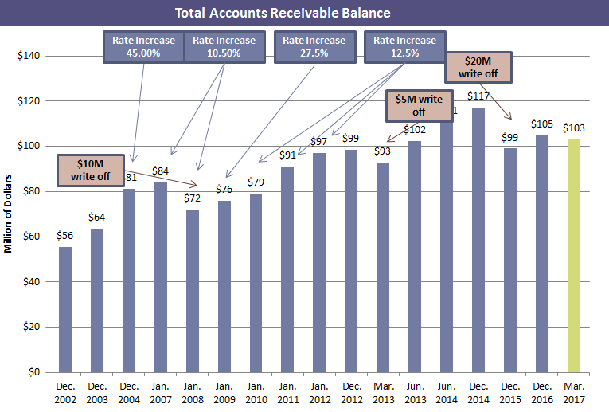
Accounts Receivables
Financial Resilience
Multi-Family: $2.0M in Q1 (63 accounts)
Commercial Accounts: $1.8M in Q1 (956 accounts)
Note: Figure includes current and delinquent receivables.
Total delinquent balances were $99.2M as of 3/31/17

Slide 45
Aged Account/Receivables
Financial Resilience
All Active Accounts in Arrears*
ANALYSIS FOR ACTIVE ACCOUNTS
STATUS GROUP | ACCOUNTS | AR VALUE | AR %
Multi-family Group | 906 | $11,149,901 | 18%
Single-family Group | 20,554 | $46,841,848 | 76%
Commercial/Industrial Group | 549 | $3,705,852 | 6%
TOTALS | 20,461 | $61,697,601 | 100%
Multi-family Active Aged Receivables
$in Millions
Single-family Active Aged Receivables
Commercial Active Aged Receivables
$in Millions
$In Millions
6,981 accounts
$3.7
* Excludes accounts that are in dispute or legal status as of March 31, 2017

Slide 46
Collection Efforts
Financial Resilience
Commercial Accounts (OFA)
Vacant Accounts (OFA & OSS)
Multi-Family Accounts (OFA)
Amnesty Program (OFA)
  FY17 Performance
  $6,464,509.49 collected
  2,996 delinquent payments collected
  $441,496.88 in secured payment plans
  Next Steps
  Increase shut-offs to 50 accounts per week
  Maximize collection efforts with site visits by collections staff for larger commercial water users
  FY17: Performance
  Commercial (OFA)
  $1,445,886.74 collected
  116 new service accounts enforcement
  Residential (OSS)
  $405,684.05 collected
  774 new service accounts enforcement
  Next Steps
  Continue new service enforcement and collection action against commercial and residential accounts.
  FY17: Performance
  $2,451,235.72 collected
  Top 50 delinquent accounts isolated for collection efforts
  Next Steps
  Execute disconnection strategy with notifying 25 accounts per week for disconnection of services
  March – April 7, 2017
  Results
  $694,453.62 collected during the program
  $2,468,988.96 in secured payment plans
  Statistics
  3,104 Customers Screened
  2,526 Qualified
  1,113 Accepted
- 9 Annexed Fulton
- 353 Outside City
- 751 Inside City
  Next Steps
  Initiate service terminations for residential accounts

Slide 47
Vacant Accounts w/ Consumption
Financial Resilience
Accounts Resolved January through March 2017
DWM modified the process for handling accounts with vacant consumption on March 1st, resulting in an increase in the number of customers setting up service and making payments for unbilled consumption.
DWM expects to have the backlog of accounts with vacant consumption cleared by September 2017

Slide 48
Spill Data
Compliance
Quarter | 2015 | 2016 | 2017
Q4 | 76 | 32 | -
Q3 | 39 | 28 | -
Q2 | 47 | 41 | -
Q1 | 32 | 88 | 56
Total | 194 | 189 | 56
Major Spills (> 10,000 Gallons) | 17 | 9 | 5
Spills Prevented (Flow Monitoring Alert Program) | 14 | 21 | 1

Slide 49
Major Spills
Compliance
No. | Date/Location/Receiving Water | Details
1 | January 13th 348 ARMOUR CIRCLE Peachtree Creek | Volume: 13,450 gallons Cause: Debris; Line clogged with cement CCTV identified source as Argos Cement; Referred to DWM Industrial Pretreatment Program for Enforcement
2 | January 21st 2800 MARTIN L KING JR DR SW Utoy Creek | Volume: 26,250 gallons Cause: Debris Line cleared, normal flow resumed
3 | February 8th 1841 WELLS DR SW Utoy Creek | Volume: 346,500 gallons Cause: Sewer main collapse due to falling tree roots Bypass pumping system installed
4 | February 10th 1841 WELLS DR SW Utoy Creek | Volume: 27,250 gallons Cause: Bypass plug failure due to brittle, aged pipe Bypass active, Repairs pending completion of final design
5 | March 21th 860 MIRROR LAKE ROAD/FLINT RIVER PUMP STATION Flint River | Volume: 266,382 gallons (worst case estimate) Cause: Separation of force main segments – ground shift Bypass pumping; storage at pump station; continuous hauling to Utoy Creek ; Repairs completed within 45 hours from discovery of incident

Slide 50
Training and Development
Safety
Indicator | Jan-17 | Feb-17 | Mar-17 | 3-MONTH AVERAGE
# of Seats Available | 520.00 | 345.00 | 495.00 | 303.22
# of Seats Filled | 205.00 | 236.00 | 155.00 | 135.33
# of Total Hours | 1,052.00 | 838.00 | 530.25 | 654.36

Slide 51
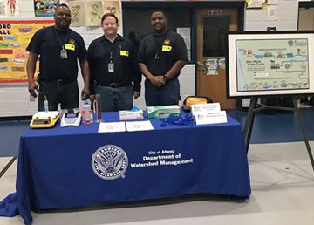
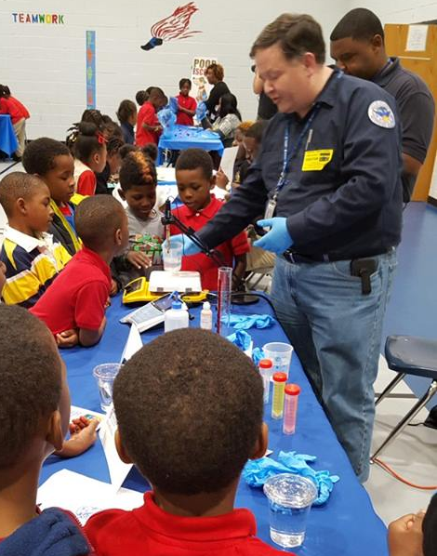
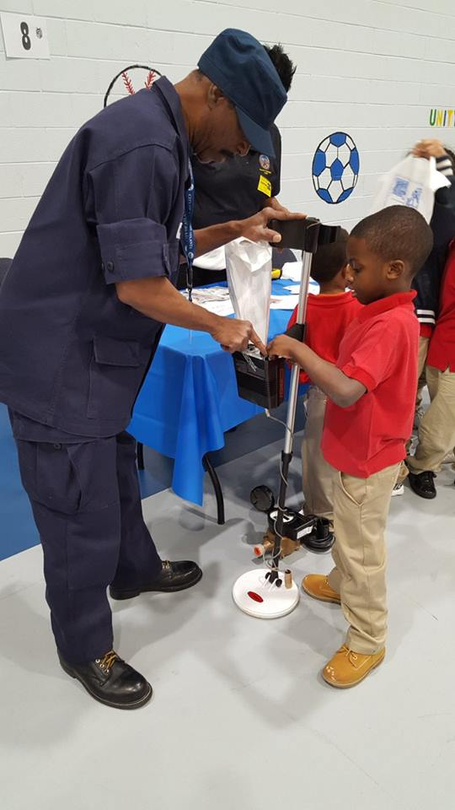
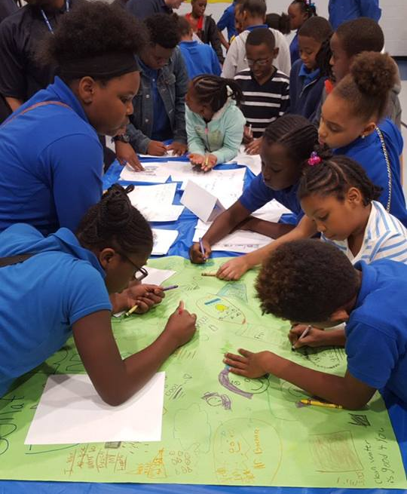
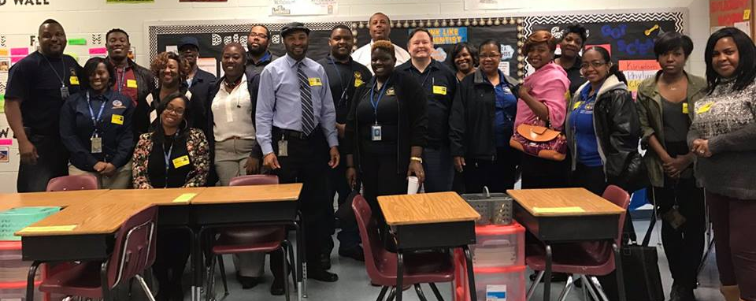

COMMUNITY OUTREACH
Community Events – The City of Atlanta Department of Watershed Management partnered with the Atlanta Public School’s Tuskeegee Airmen Global Academy for an “Atlanta Watershed” inspired career day.
The students met Department of Watershed employees and learned first-hand about the benefits of clean water and how water is prepared to drink.

Slide 52
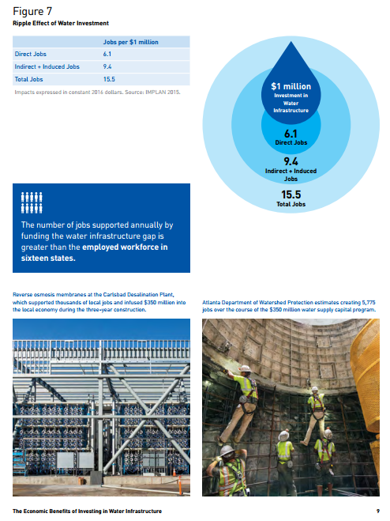


Slide 53

Please help us celebrate!!

