Slide 2
2017 FEC
Atlanta Professional Firefighters
IAFF-Local 134
May 4, 2017

Slide 3
Atlanta Professional Firefighters
Represent sworn members of the AFRD
Firefighter
Sergeant
Lieutenant
Captain
Diverse group of men and women
Multi-ethnic
Multi-racial
LGBT

Slide 4
The Mission of the Local 134
"The Atlanta Professional Fire Fighters are dedicated to represent, protect, and be advocates for the sworn members of the Atlanta Fire and Rescue Department. We will be proactive to fight for equality, safety, development, and the longevity of our members."

Slide 5
Social and Political Awareness
Community Food Bank
DNC Chair vote
Atl Pride Parade
300 canned foods delivered to Lutheran Community Food Ministry
DNC Chairman Tom Perez and L134 President Paul Gerdis
L134 member AFRD Sgt Clark

Slide 6
Social and Political Awareness
Unity
Monthly guest speakers
GA Rep Gravley
L134 President with Progressive Firefighters of Atlanta
City Council President Mitchell visiting L134 meeting.
Author of HB 146, FF Cancer Protection

Slide 7
Squad 4 Firefighter Frank Martinez
May 7, 1991 – December 20, 2016

Slide 8
The Atlanta Firefighter What does it take?
Rigorous background check
9 months of fire science and hands on training
Intense physical and mental training
State mandated testing
6 months of emergency medical training
CPR certification
National Registry testing
Recognize signs of symptoms of major medical emergency
Calculate dosage and administer proper life saving medication

Slide 9
What does it cost to train an Atlanta Firefighter?
$80,000 per recruit

Slide 10
Firefighter Retention
Graduated Recruit School
Currently w/ AFRD
Total Separation
2016 – 85
2015 – 0
2014 – 78
2013 – 131
Total -- 294
2016– 79
2015 – 0
2014 – 62
2013 -- 88
Total -- 229
2016 – 6
2015 – 0
2014 – 16
2013 – 43
Total -- 65

Slide 11
65 recruits x $80k =
$5.2 million

Slide 12
Firefighter exit interviews
28 responded to the L134 exit interview
21 left the City of Atlanta for another Fire Department, EMS, or public safety field position
100% stated compensation was #1 contributing factor for leaving
12 would consider returning to the City of Atlanta in the future

Slide 13
Metro Atlanta vs. City of Atlanta
OTP
ITP
Clayton County
$40,626/yr
Cobb County
$40,272.96/yr
Gwinnett County
$39,633/yr
Henry County
$39,403
Dekalb County
$38,151/yr
Atlanta
Starting Salary = $35,255.25

Slide 14
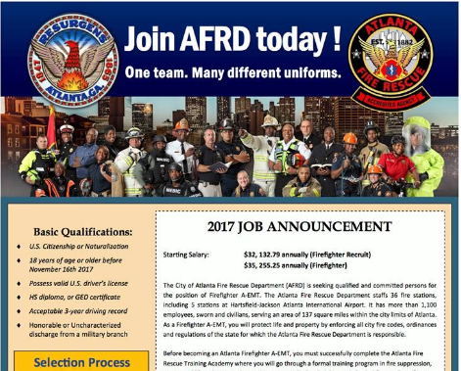
Metro Atlanta Firefighter Job Postings
Starting Salary
$36,555 – Fire Recruit
$38,151 - Firefighter
Starting Salary:
$32,132.79 Recruit
$35,255.25 Firefighter

Slide 15
Firefighter Rank Tier Program
 | Time in Service (months) | Annual Salary
Tier 1 | 0 –60 | $41,132.23
Tier 2 | 60- 120 | $44,061.87
Tier 3 | 120 + | $47,200.18
3.5% increase for FF with current salary above tier and without time in service.

Slide 16
Estimated Expense of FF Rank Tier Program
 | Total Members | Current salary | Proposed Expense | Proposed New Salary
Tier 1 | 165 | $5,984,680.57 | $514,211.77 | $6,498,892.34
Tier 2 | 141 | $5,290,754.61 | $936,660.07 | $6,227,414.68
Tier 3 | 73 | $3,108,379.03 | $429,215.97 | $3,537,595.00
 | 379 | $14,383,814.20 | $1,880,087.81 | $16,263,902.00
+20% OT and Pension expense | $2,256,105.37
Proposed Salary + 20% | $18,520,007.40

Slide 17
Firefighter I, II, III Program
Firefighter Development
Pay Incentive
Firefighter I
Extra Engine Driver --40 hours class
Firefighter II
Extra Engine Driver
Extra Truck Driver -- 40 hour class
OR
Extra Engine Driver
Acting Officer in Charge – 80 hrs
Firefighter III
Extra Engine Driver
Extra Truck Driver
Acting Officer In Charge
1.75% pay incentive for each 40 hour class
Extra Engine Driver
Extra Truck Driver
3.5% increase for 80 hour class
Acting Officer in Charge

Slide 18
In the last 8 years
Changes in the City
Remained the same
AFRD Chief pay increase
APD: all ranks pay increase
AFRD Captain, Lieutenant, and Sergeants pay increase
City Councilmember pay increase
Firefighter salary

Slide 19
City Council members, let's do the right thing and implement the Firefighter Rank Tier Program.
Questions?

