Slide 1
Public Works FY18 Proposed Budget: $115,403,083
General Fund $41,975,379
Enterprise Funds $73,427,704
FY10 Budget FY18 Budget $91,596,542 $115,403,083
Ongoing Operations
Strategic Initiatives
 | Strategic Objective | Outcome Metrics | Initiative
New in FY18 | Increase maintenance and repair of aging city horizontal infrastructure | Increase # of miles repaved | Additional funding to create a recycled asphalt paving program
Continued from FY17 | Increase maintenance and repair of aging city horizontal infrastructure | Increase % of transportation service requests completed within standard Increase # of miles repaved | Additional funding to annual sidewalk maintenance contracts Continued outsourcing of contract milling Pavement preservation program Sign replacement program In-house thermoplastic striping In-house bridge repair Increase pay for technical positions to reduce attrition and attract quality candidates
Oversee and maintain the City's transportation infrastructure in the Public Right-of-way
Manage large-scale infrastructure capital projects
Lead transportation planning efforts
Oversee Atlanta Streetcar

Slide 2
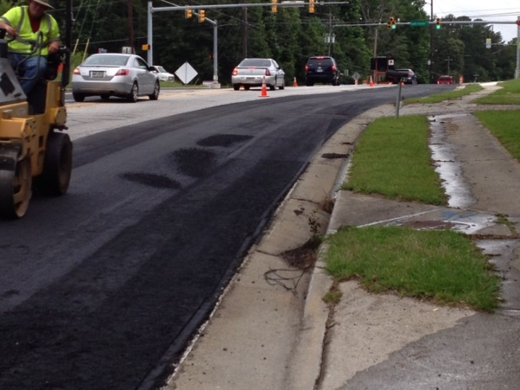
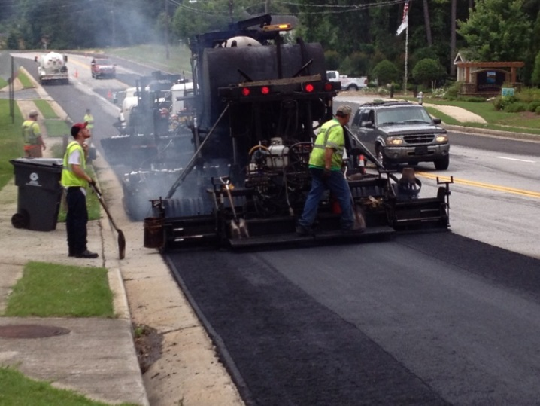
Public Works FY18 Proposed Budget: $115,403,083
HOT IN-PLACE RECYCLED ASPHALT (HIPRA)

Slide 3
Public Works FY18 Proposed Budget: $115,403,083
Non-Operating Funds: $54,174,317
 | Trust Funds | Grant Funds | Impact Fee Funds
Fund balances | $26,246 | $30,803,482 | $23,344,589
Principal objectives (Ongoing initiatives) | Roadway and sidewalk improvements Traffic signal installations | Roadway and corridor improvements Government center improvements MLK Jr. Drive corridor improvements

Slide 4
Public Works Fleet Services FY18 Proposed Budget: $30,080,957
Fleet Service Fund $30,080,957
FY10 Budget FY18 Budget $26,911,282 $30,080,957
Ongoing Operations
Strategic Initiatives
 | Strategic Objective | Outcome Metrics | Initiative
Continued from FY17 | Enhance ability to meet Departmental fleet maintenance service level agreements | Increase % of vehicles maintained within scheduled preventative maintenance period | Managed competition for parts
Acquire, maintain and dispose of the City of Atlanta’s motorized equipment fleet of 4,673 units and 756 components, totaling over 5,429 pieces
Purchase and dispense over three million gallons of fuel
Partners with other City departments in the delivery of critical City fleet management services

Slide 5
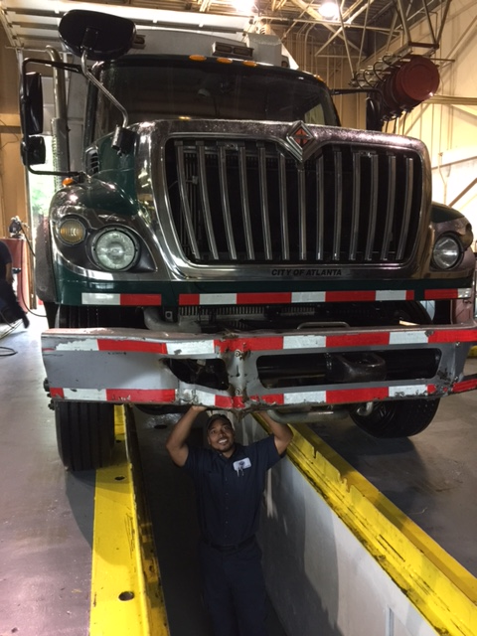
Public Works Fleet Services FY18 Proposed Budget: $30,080,957
Medium/Heavy Duty Xpress Lube Shop

Slide 6
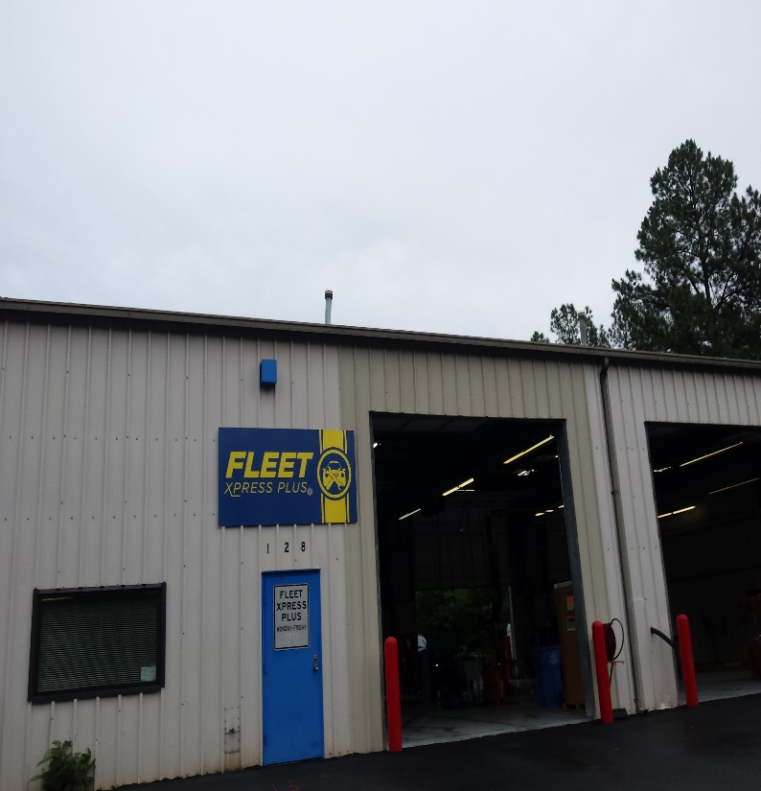
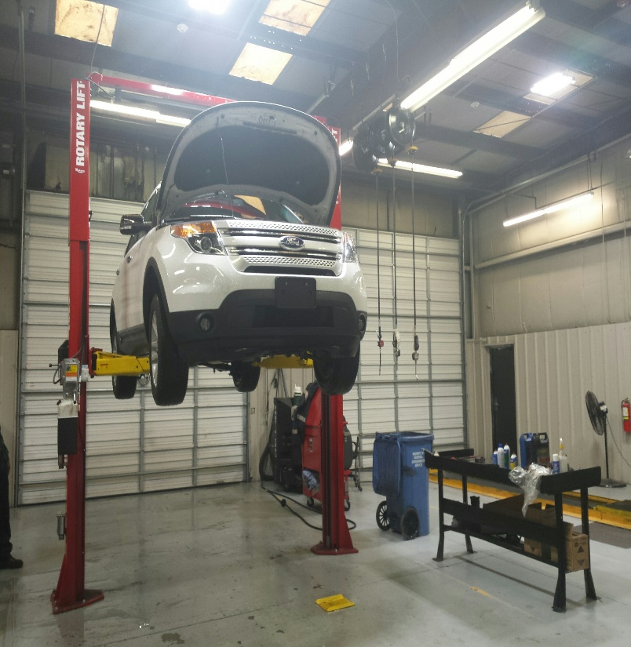
Public Works Fleet Services FY18 Proposed Budget: $30,080,957
Light Duty Xpress Lube Shop

Slide 7
Public Works Solid Waste Services Budget FY18 Proposed Budget: $42,456,788
Solid Waste Fund $42,456,788
FY10 Budget FY18 Budget $40,557,661 42,456,788
Ongoing Operations
Strategic Initiatives
 | Strategic Objective | Outcome Metrics | Initiative
Continued from FY17 | Maintain ability to regularly meet solid waste collection standards | Maintain 99% solid waste collection rates | Review operations to increase route efficiency.
Collect and dispose of solid waste, including garbage, recycling and yard trimmings
Lead waste reduction and recycling efforts
Lead landfill post-closure management
Manage services such as street sweeping and cleaning, right of way mowing and cleaning and dead animal removal
Facilitate the Keep Atlanta Beautiful program
Assist with city-wide emergency operations

