Slide 1
City of Atlanta, department of finance FISCAL YEAR 2016 RESULTS
MARCH 15, 2017
MADHAVI RAJDEV, CONTROLLER

Slide 2
City Revenues
Notes:
The total overall revenue for FY16 was $2.3B which remained the same as last year FY15. About roughly a third was generated by airport and general fund revenues and Watershed contributed 26% of the total revenues. Solid waste is at 2% and building permit is at 1% which will consolidate with general fund in FY17. Investment revenue was at 3%

Slide 3
Government-wide Changes in Net Position
Statement of Changes in Net Position as of June 30, 2016
($-Millions) | Governmental Activities | Business-type Activities | Total 2016 | Total 2015
Revenues
Program Revenues | $ 219 | $ 1,303 | $ 1,523 | $ 1,575
General Revenues | 755 | 42 | 797 | 744
Total Revenues | 974 | 1,345 | 2,320 | 2,319
Expenses
General Government | 309 | - | 309 | 473
Public Safety | 334 | - | 334 | 318
Water and Wastewater System | - | 451 | 451 | 443
Department of Aviation | - | 641 | 641 | 629
Sanitation | - | 61 | 61 | 60
Other | 193 | 27 | 220 | 191
Total Expenses | 836 | 1,180 | 2,016 | 2,114
Increase in Net Position before transfers | 138 | 165 | 304 | 205
Transfers in(out) | (116) | 116 | - | -
Increase (decrease) in Net Position | 22 | 281 | 304 | 205
Net Position, Beginning of Period | (524) | 7,194 | 6,669 | 6,464
Net Position, End of Period | $ (502) | $ 7,475 | $ 6,973 | $ 6,669
Notes:
The net position for the city increased by $304M which was due to an increase of $22M in governmental activities and $282M increases in Business type activities. The governmental activity increase related to increase in operating grants and contributions among other things and business type activities net position increased due to increase in charges for services capital grants and contributions and investment income. Program Revenues includes charges for services and General Revenues include property and sales taxes. The total revenues remained flat between FY15 and FY16 total expenses decreased by $98M.

Slide 4
Government-Wide Statement of Net Position
Statement of Net Position as of June 30, 2016
($-Million) | Governmental Activities | Business-type Activities | Total 2016 | Total 2015
Current Assets | $ 926 | $ 3,807 | $ 4,733 | $ 4,432
Capital Assets, Net of Depreciation | 1,116 | 10,914 | 12,030 | 11,957
Deferred Outflows of Resources | 127 | 341 | 468 | 420
Total Assets and Deferred Outflows | 2,169 | 15,062 | 17,231 | 16,809
Current Liabilities | 183 | 481 | 664 | 651
Non-Current Liabilities | 2,391 | 7,070 | 9,461 | 9,241
Deferred Inflows of Resources | 97 | 36 | 133 | 248
Total Liabilities and Deferred Inflows | 2,671 | 7,587 | 10,258 | 10,140
Net Investment in Capital Assets | 7 | 5,380 | 5,387 | 4,882
Restricted Net Position | 638 | 1,043 | 1,681 | 1,680
Unrestricted Net Position | (1,147) | 1,052 | (95) | 107
Total Net Position | $ (502) | $ 7,475 | $ 6,973 | $ 6,669
Notes:
This presents the statement of total net position for the city. The total assets exceeded total liabilities by $6.9 roughly $7B. About 78% of the net position is invested in capital assets like building equipment, land etc. and 25% is restricted as of FY16 end. Restricted net position primarily means the usage of those funds is subject to external restrictions like laws or regulations or other governments etc. The unrestricted net position is negative $95M due to the booking of GASB 68 reporting of pension liability causing the government wide net position to be negative $1.1B offset by positive unrestricted net position of $1B. The deferred inflows of resources relates to unearned revenue (liability) and deferred outflow (asset) relates to investments, gain/loss activity., deferred outflow contribution pension etc.

Slide 5
Financial Highlights by Fund
Fiscal 2016 Financial Summary
Fund ($-Millions) | Revenues | Change in Fund Balance/Net Position | Ending Fund Balance/Net Position
General Fund* | $ 568 | $ 2 | $ 153
Capital Project | $ 4 | $ (29) | $ 298
Non-Major Governmental | $ 311 | $ (9) | $ 328
Department of Watershed | $ 467 | $ 164 | $ 2,736
Department of Aviation | $ 487 | $ 125 | $ 4,792
Non-Major Enterprise | $ 78 | $ (7) | $ (41)
Internal Service Funds:
Fleet Service Funds | $ 34 | $ 4 | $ (26)
Group Insurance | $ 144 | $ (2) | $ 11
* Includes Pilot & Franchise Fees & Hotel-Motel Excise Taxes which are shown in Other Financing Sources in the City CAFR
Notes:
This shows a fund level summary of the financial statements. The top 3 funds are the governmental funds which had total revenues of $883M with an ending fund balance of $779M. The total general fund revenues were $568M including PILOT and Franchise Fees ($19M) and Hotel Motel Taxes ($18M). The Budgeted general fund revenue of $593M needs to be adjusted for budgeted transfers (reported as other financing sources) and indirect cost (reflected as an offset to general government expenditures) .
The capital project funds negative change in fund balance reflects the spending on renew Atlanta projects.
The non major governmental funds includes TADS, grants E911 and debt service funds. The negative change in NP is due to the increase in GO bonds debt service payments.
DWM reported total revenues of 467M with ending fund balance of $2.7B and DOA reported net revenues of $487M with ending fund balance of $4.8B.
The non major enterprise funds include solid waste, underground, building permits, civic center etc. The negative change in net position was due to operational deficits in solid waste fund and operational losses incurred on properties like underground and civic center pending sale. The overall net position was negative due to booking of pension liability related to GSASB 68 to the solid waste and building permit funds.
The fleet services fund balance was negative due to accumulated deficits over last several years. The proposed legislation will address this deficit. The group insurance fund reported total revenues of $144M with net position balance of $11M at the end of FY16

Slide 6
General Fund Financials: Balance Sheet
Positive General Fund Balance Sheet Changes
Fund Balance increased by $146M from the beginning of FY 2010.
Maintained liquidity while growing fund balance and paying down debt
Cash balance has increased by 61%
Due From Other Funds reduced by 52%
Receivables balance reduced by 12%
Due to Other Funds reduced by 75%
Notes:
This slide presents the comparative balance sheet for general fund between 2009 to 2016. The cash position is much stronger and it has increased by around 60%, the due from other funds which includes the deficit fund balances of $64M and other interfund receivables has reduced by more than 50%. The Due to other funds which includes the DWM MOU balance of $46M as of FY16 has reduced by more than 75%. The current DWM MOU balance as of FY17 is $36M. The graphs show the healthy trend of huge reduction in due from other funds, due to other funds along with a steady increase in cash balance.

Slide 7
General Fund Financials: Trending Revenues
Overall revenue growth of 12% since 2012.
Licenses and Permits revenue contributes to over 32% increase in revenue.
Property Taxes continue to rise despite consistent millage rate roll-backs.
Public Utility, Alcohol and other taxes contributes to 20% increase in revenue.
Hotel-Motel taxes have grown by $5.5M or 43% growth compared to 2012.
Notes:
* Pilot and Franchise Fees and Hotel-Motel Revenue are shown in Other Financing Sources and Uses as Transfers In in the CAFR
Total Revenues
Notes:
The next two slides show the trending of total revenues and expenditures. The total revenue has steadily increased over the years with an overall growth of 12% since 2012. Licenses and permits contribute the largest to the overall increase followed by public utility and other taxes. Property taxes continue to rise despite consistent millage rate roll backs.

Slide 8
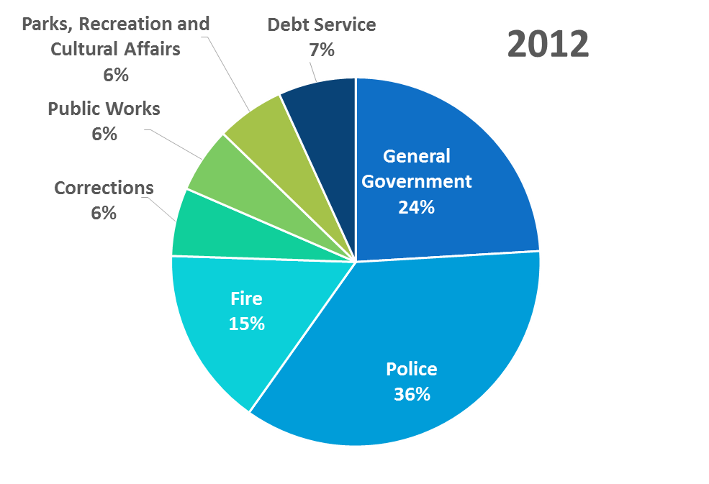
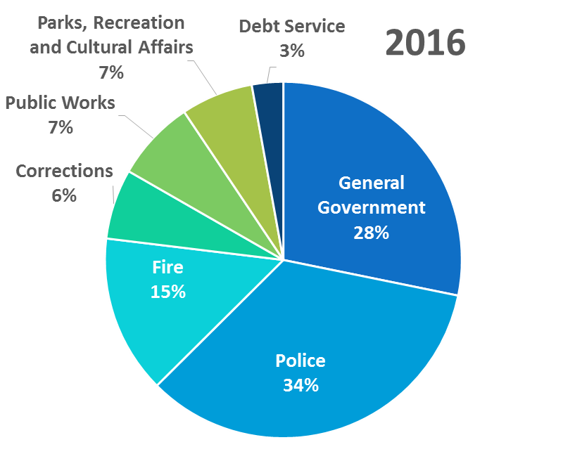
General Fund Financials: Trending Expenditures
Overall expense growth of 19% since 2012
About 50% of the increase was for General Government activity and roughly 43% of the increase was due to Public Safety expenditures
General Government expenditures increased mainly due to some long term capital expenditures incurred in 2016
Debt Service payments have declined by over 50%
Notes:
* Other Financing Sources and Uses is not shown and includes Transfers Out to deficit funds; additionally certain debt service payments are reflected as Transfers Out
Notes:
The general fund expenditures have increased 19% since 2012 with roughly 50% of the increase attributed to general government expenditures. The increase was primarily due to some long term capital expenditures in FY16. About 43% of the increase was related to public safety expenditures. Debt service payments declined by over 50% over that period.

Slide 9
Fund Balance and Deficit Funds
Operating surpluses have enabled a 53% reduction in fund deficits and restored fund balance
Notes:
Here you can see the consistent increase in fund balance position for general fund while steadily reducing the deficit fund balances. Since 2009 the fund balance has increased by $146M and the deficit fund balance has reduced by more than $70M. The remaining deficit fund balance of $64M mainly relates to fleet fund (24), solid waste (18) , E911 (5) underground (13M) and civic center (4).

Slide 10
FY16 General Fund Balance
Unrestricted Fund Balance is over 22% of budgeted expenditures
Total Fund Balance has grown by $146 million since the beginning of FY2010
Budgeted reserves and strong cost control were key factors in restoring fund balance
$153 million is the largest fund balance the City has had in the last 10 years
Unrestricted fund balance above 20% is available for one-time, nonrecurring purchases as long as a portion goes toward reducing any remaining deficit funds
25% budget
$142M
Notes:
Per legislation 12-O-0501 – Per City’s fund balance policy, city is required to maintain a unrestricted fund balance of 15% of its budgeted expenditures. Since 2013, city has consistently reported unrestricted net position of more than 20% touching as high as 25% in FY2015. Any balance in excess of 20% is available for one time non recurring expenditures as long as the deficit funds are being paid off. Keeping the deficit fund balance low is in the best interest of the city as that contains the restricted portion of fund balance and increases the unrestricted portion of the fund balance. The FY16 general fund net position was $153M the highest balance since 2010.

Slide 11
Pensions and other post employment benefits
Annual Pension Expenses
Annual OPEB Costs
54,235
16,454
PENSION OPEB
Pension Liability and Funded Percentage
$1.48B
The FY16 actuarial assessment determined the City was at 25.9% well within the 35% cap placed by 2011 pension reforms
Notes:
Here is a quick look at Pension and OPEB expenses. The general fund pension expenses increased due to change in funding method for general pension from ultimate entry age normal cost method to traditional entry normal cost method. The fire and police annual expenses have decreased due to change in demographics and investment returns. The General pension funded percentage remained consistent at 62% compared to FY15 and the funding percentage for Fire and Police decreased slightly from 78% to 76%. Per FY16 assessment of pension costs, City was at 25.9% well within the 35% cap placed by 2011 pension reforms.
OPEB pay as you go costs have remained constant in the $40M range, The unfunded actuarial liability for OPEB is at $1.1B. Implementation of GASB 75 will require us to book this liability in our financial statements just like Pension GASB 68. This will be effective FY18.

Slide 12
Fy 2016 results
Thank you!

