Slide 1
Work Session on Marijuana Regulation Sec. 106-182. – Marijuana
Presentation by Attorney Mawuli Davis
Tuesday, March 21, 2017
Committee Room 1
2:00 – 4:00 p.m.

Slide 2
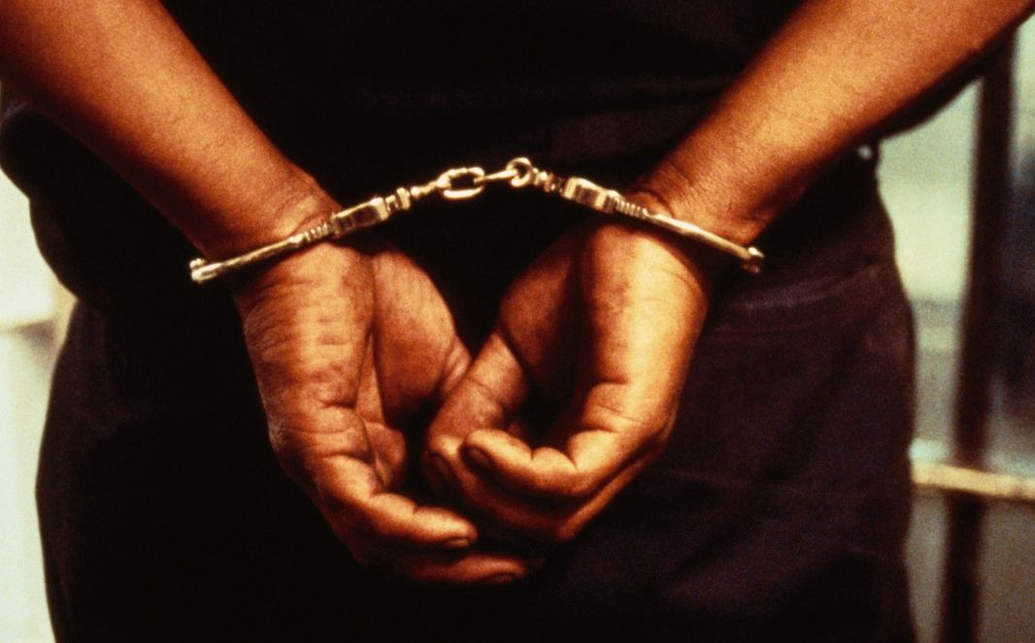
The History of the Value of Black Life

Slide 3
Black life does not historically matter to American law:
War on Drugs informs New Jim Crow Era, perpetuating use of the law to inform the racist manipulation of Black American life

Slide 4
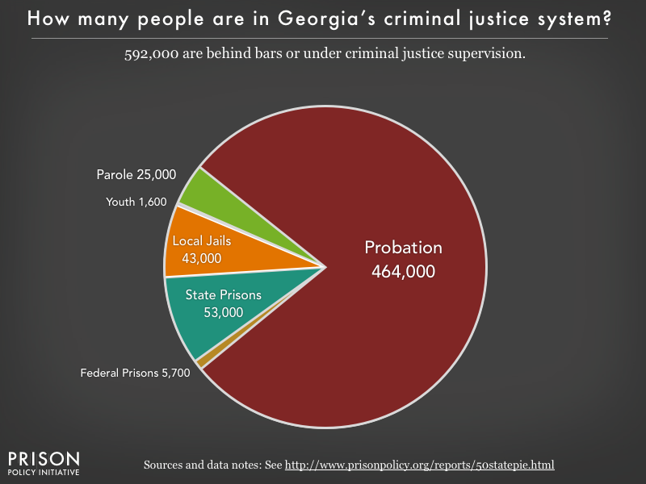

Slide 5
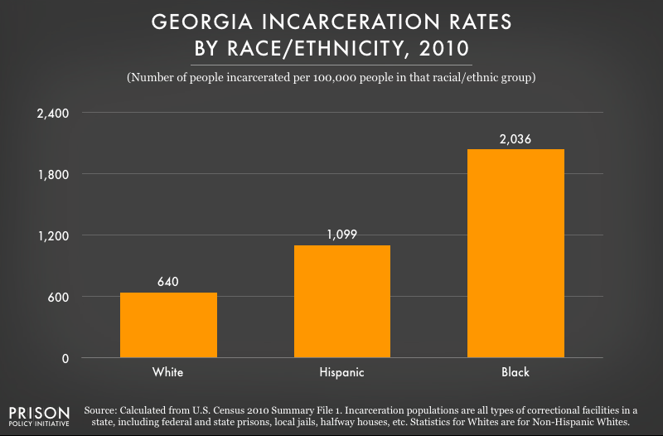
Georgia’s Incarceration Rates

Slide 6
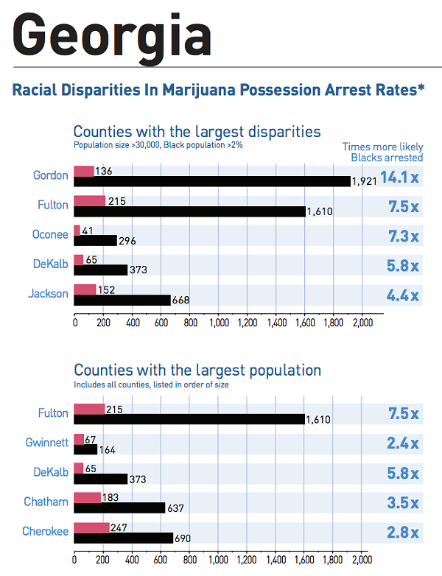
Source: https://www.aclu.org/gallery/marijuana-arrests-numbers

Slide 7
Marijuana Arrests throughout the United States
Of the 8.2 million marijuana arrests between 2001 and 2010, 88% were for simply having marijuana
Nationwide, the arrest data revealed one consistent trend: significant racial bias. Despite roughly equal usage rates, Blacks are 3.73 times more likely than whites to be arrested for marijuana.

Slide 8
Marijuana Convictions as a Start of A Criminal Record
“Marijuana arrests tend to be young people’s first point of contact with law enforcement. What is seen as a simple marijuana arrest can undo a life. These encounters being so prevalent can also normalize the experience of dealing with the police.”
Asha Bandele, Senior Director Drug Policy Alliance

Slide 9
THANK YOU
Work Session on Marijuana Regulation Sec. 106-182. – Marijuana
Presentation by Attorney Mawuli Davis
Tuesday, March 21, 2017
Committee Room 1
2:00 – 4:00 p.m.

