Slide 1
Quarterly TAD Update
CDHS
March 14, 2017

Slide 2



TAD Accomplishments
$ϱϴϮ MillioŶ iŶ TAD ďoŶds issued
$ϱϬϳ MillioŶ iŶ TAD iŶǀestŵeŶts
$ϯ.ϴ BillioŶ iŶ diƌeĐt pƌiǀate iŶǀestŵeŶt leǀeƌaged*
TAD pƌopeƌty ǀalues haǀe gƌoǁŶ ϴ tiŵes fasteƌ
thaŶ ŶoŶ‐TAD pƌopeƌty ǀalues iŶ the City
*Ŷot iŶĐludiŶg BeltLiŶe
Ϯ

Slide 3

Growth in Assessed Value ($ Million)
$ϭ,ϲϬϬ
$ϭ,ϰϬϬ
$ϭ,ϯϴϳ
$ϭ,ϮϬϬ
$ϭ,ϬϬϬ
$ϴϬϬ
$ϳϬϭ
$ϲϵϯ
$ϲϬϬ
$ϱϯϴ
$ϱϰϯ
$ϰϬϬ
$Ϯϳϭ
$ϯϬϬ
$ϮϬϬ
$ϭϱϯ
$ϭϭϰ
_{$ϭϭϲ} $ϭϮϴ
$ϲϲ
$ϯϳ
$ϱϳ
$ϰϮ
$ϱϭ
$Ϯϳ
$ϯϱ
$Ϭ
$ϳ
$ϭ
Westside
AtlaŶtiĐ StatioŶ
Eastside
PeƌƌǇ BoltoŶ
PƌiŶĐetoŶ Lakes
BeltLiŶe
CaŵpďelltoŶ Road
Holloǁell/ML KiŶg
MetƌopolitaŶ
Stadiuŵ
Base
ϮϬϭϱ
ϯ

Slide 4
Westside

Slide 5
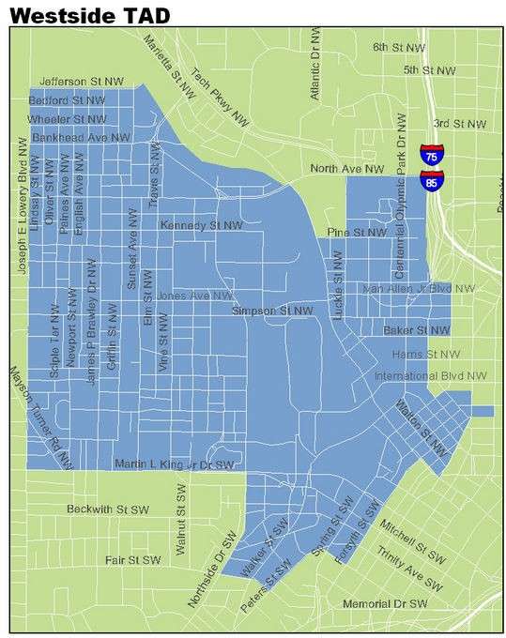

Funded/Approved Projects
1,706 residential units
  24% affordable
526,000 retail sq. ft.
2.0 M office sq. ft.
1,020 hotel rooms
1.5 miles of streetscape and pedestrian improvements
2.7 mile Atlanta Streetcar
19,000 sq. ft. Job Training Center
Land Acquisition/Neighborhood Stabilization
Parks and Greenspace
Security Camera Network
Financial Empowerment Center
Owner-Occupied Rehab Program_{ϱ}

Slide 6
Westside TAD Approved Projects 2013-Current
PROJECT | CATEGORY | COMMITTED
CoŵŵuŶitǇ IŵpƌoǀeŵeŶt FuŶd ;ϭϬ pƌojeĐts appƌoǀedͿ | CoŵŵuŶitǇ PƌojeĐt | $ϭϱ,ϬϬϬ,ϬϬϬ
Moƌƌis BƌoǁŶ College AĐƋuisitioŶ | Neighďoƌhood StaďilizatioŶ | $ϭϬ,ϴϮϱ,ϬϬϬ
AtlaŶta Betteƌ BuildiŶgs ChalleŶge | EŶeƌgǇ CoŶseƌǀatioŶ | $ϴ,ϬϬϬ,ϬϬϬ
Post CeŶteŶŶial | CatalǇtiĐ ResideŶtial | $ϰ,ϯϱϬ,ϬϬϬ
CastleďeƌƌǇ Paƌk | CatalǇtiĐ Hotel aŶd ResideŶtial | $ϰ,ϮϬϬ,ϬϬϬ
LaŶd AĐƋuisitioŶ aŶd AsseŵďlǇ | Neighďoƌhood StaďilizatioŶ | $ϯ,ϳϬϬ,ϬϬϬ
Façade IŵpƌoǀeŵeŶt GƌaŶts ;ϵ pƌojeĐts appƌoǀedͿ | Façade IŵpƌoǀeŵeŶt | $Ϯ,ϬϬϬ,ϬϬϬ
FlatiƌoŶ BuildiŶg | Joď CƌeatioŶ aŶd RedeǀelopŵeŶt | $ϭ,ϱϬϬ,ϬϬϬ
AtlaŶta StƌeetĐaƌ | IŶfƌastƌuĐtuƌe | $ϭ,ϯϰϰ,ϴϲϵ
MLK, Jƌ. Dƌiǀe Coŵplete StƌeetsĐape | IŶfƌastƌuĐtuƌe | $ϭ,ϯϬϬ,ϬϬϬ
BooŶe Blǀd. GƌeeŶ Stƌeet | IŶfƌastƌuĐtuƌe | $ϭ,ϬϬϬ,ϬϬϬ
AtlaŶta StƌeetĐaƌ Puƌple LiŶe EA | IŶfƌastƌuĐtuƌe | $ϲϱϬ,ϬϬϬ
JudiĐial IŶ Reŵ – Code CoŵpliaŶĐe/Blight ƌeŵoǀal | Neighďoƌhood StaďilizatioŶ | $ϱϬϬ,ϬϬϬ
Moƌƌis BƌoǁŶ ClosiŶg/CaƌƌǇiŶg Costs | Ϯ Yeaƌs | $ϯϳϱ,ϬϬϬ
CoŵŵuŶitǇ ResouƌĐe CeŶteƌ ;Westside WoƌksͿ EƋuipŵeŶt | WoƌkfoƌĐe TƌaiŶiŶg aŶd SeƌǀiĐes | $ϯϬϬ,ϬϬϬ
GA TeĐh EŶteƌpƌise Paƌk EǆpaŶsioŶ StudǇ | Joď CƌeatioŶ/Neighďoƌhood ReǀitalizatioŶ | $ϭϬϬ,ϬϬϬ
TOTALS |  | $ϱϱ,ϭϰϰ,ϴϲϵ
ϲ

Slide 7

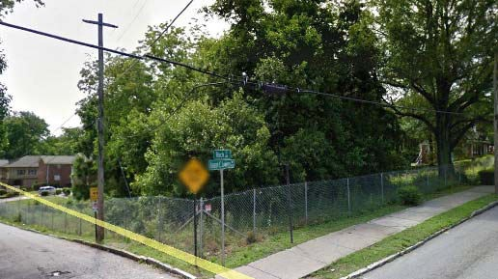
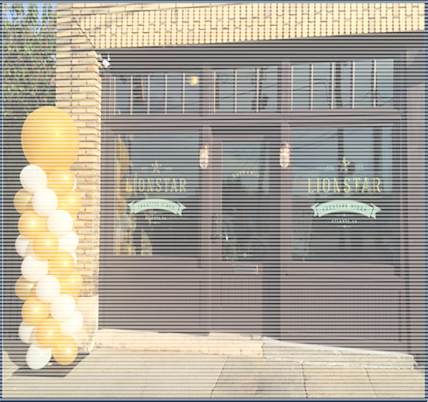
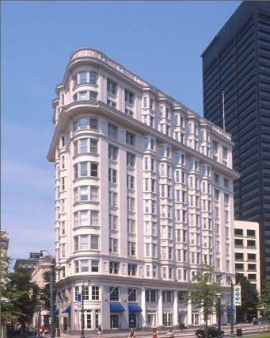
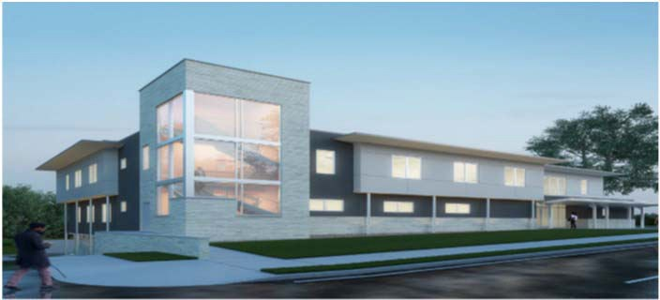
2013 - 2016 Projects
Community Improvement Fund
Downtown Façade Improvement Grant
Flatiron Entrepreneurship Hub
$15.0 M allocated
10 projects - $8.6 M approved
$2.0 M allocated
9 projects - $1.3 M approved
$1.5 M allocated
ϳ

Slide 8
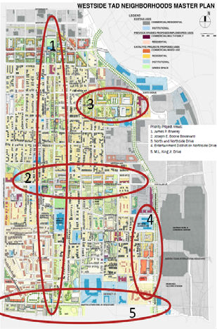
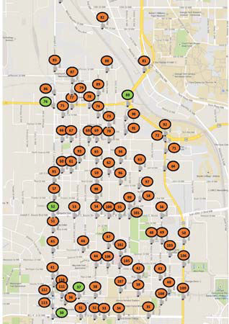
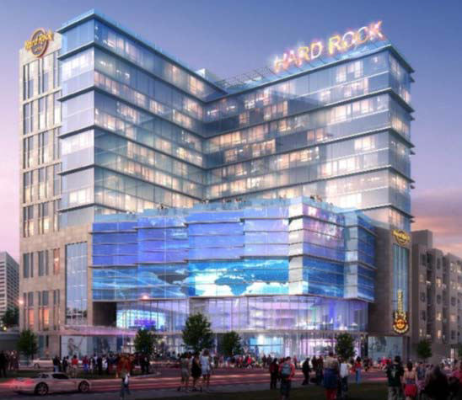
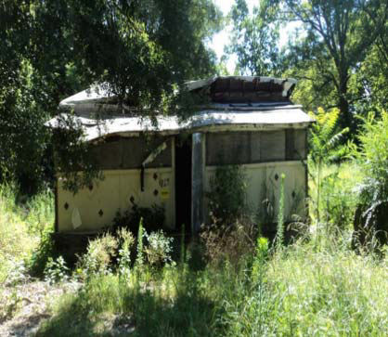
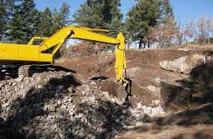
2013 - 2016 Projects
Catalytic Projects
Judicial In Rem-Code Compliance
Land Assembly
Operation Shield – Security Network
$15 M allocated
2 projects - $8.5 M approved
$500 K approved
$3.7 M approved
$1.2 M approved
ϴ

Slide 9
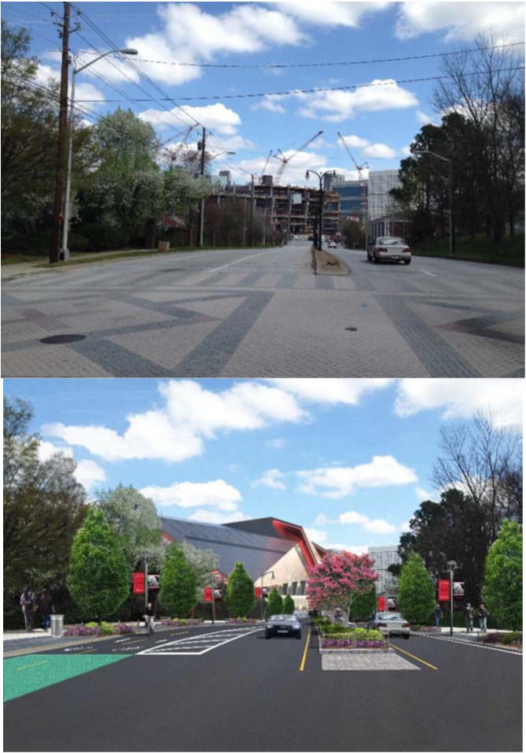
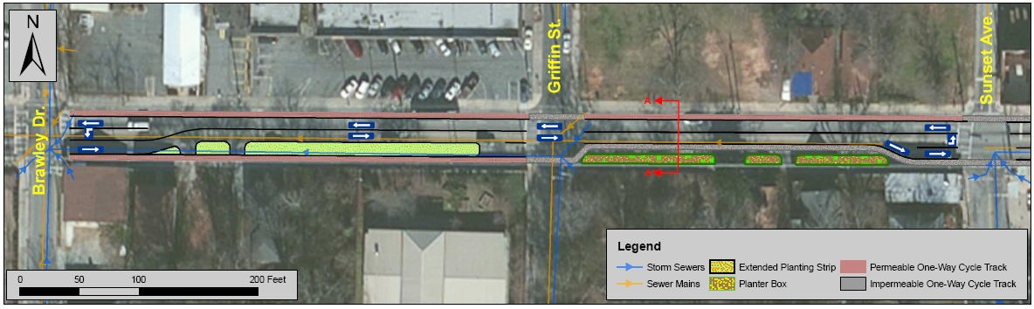
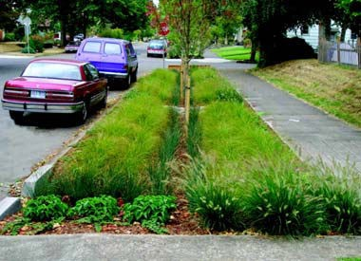
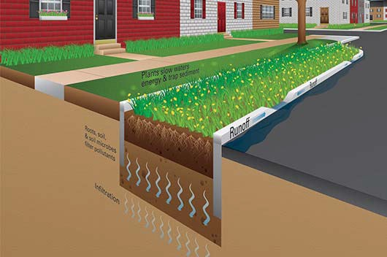
2013 - 2016 Projects
MLK, Jr. Drive Complete Street Boone Blvd Green Street
$1.3 M approved
$1 M approved
ϵ

Slide 10
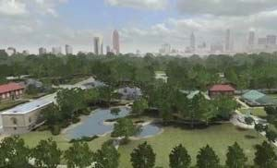
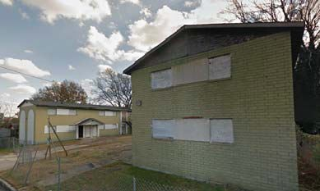
Concepts Under Consideration
Vine City Community Center
Community Improvement Fund Phase II Projects ($6.4M)
New Resurgens Fund Application
Small, Multi-Family Redevelopment
RFP for Single-Family Redevelopment
Partnership with Trio Lease-to- Homeownership Program
Parks and Greenspace
  Cook Park
  Boone Park West (Proctor Village)
ϭϬ

Slide 11
Princeton Lakes

Slide 12
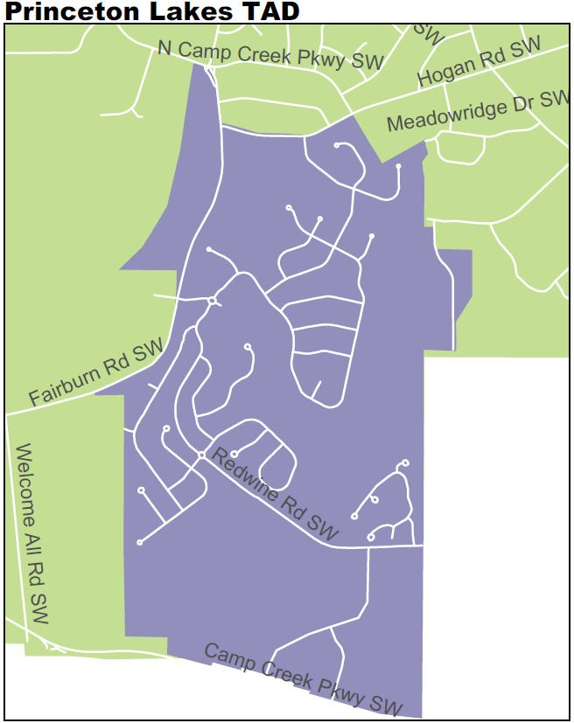


Funded Projects
1,620 residential units
460,767 retail sq. ft.
92,000 office sq. ft.
160 hotel rooms
Fire Station
Completion Status
  Substantially Complete
Next Steps
  Complete fire station
ϭϮ

Slide 13
Atlantic Station

Slide 14
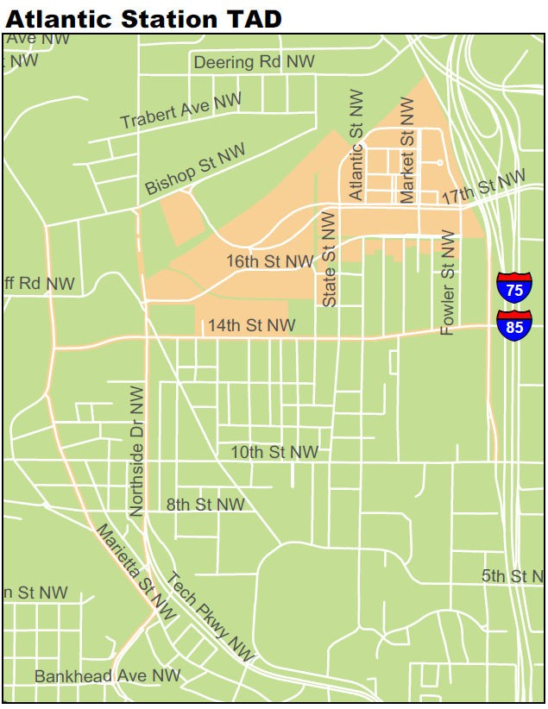


Funded PƌojeĐts
3,600 residential units
  23% affordable
1.3 M retail sq. ft.
1.4 M office sq. ft.
101 hotel rooms
7,200 structured parking
1.35 miles of streetscape & connectivity improvements (sections of Howell Mill Rd., Marietta St. and 14th St.)
Completion Status
Approaching Completion
ϭϰ

Slide 15

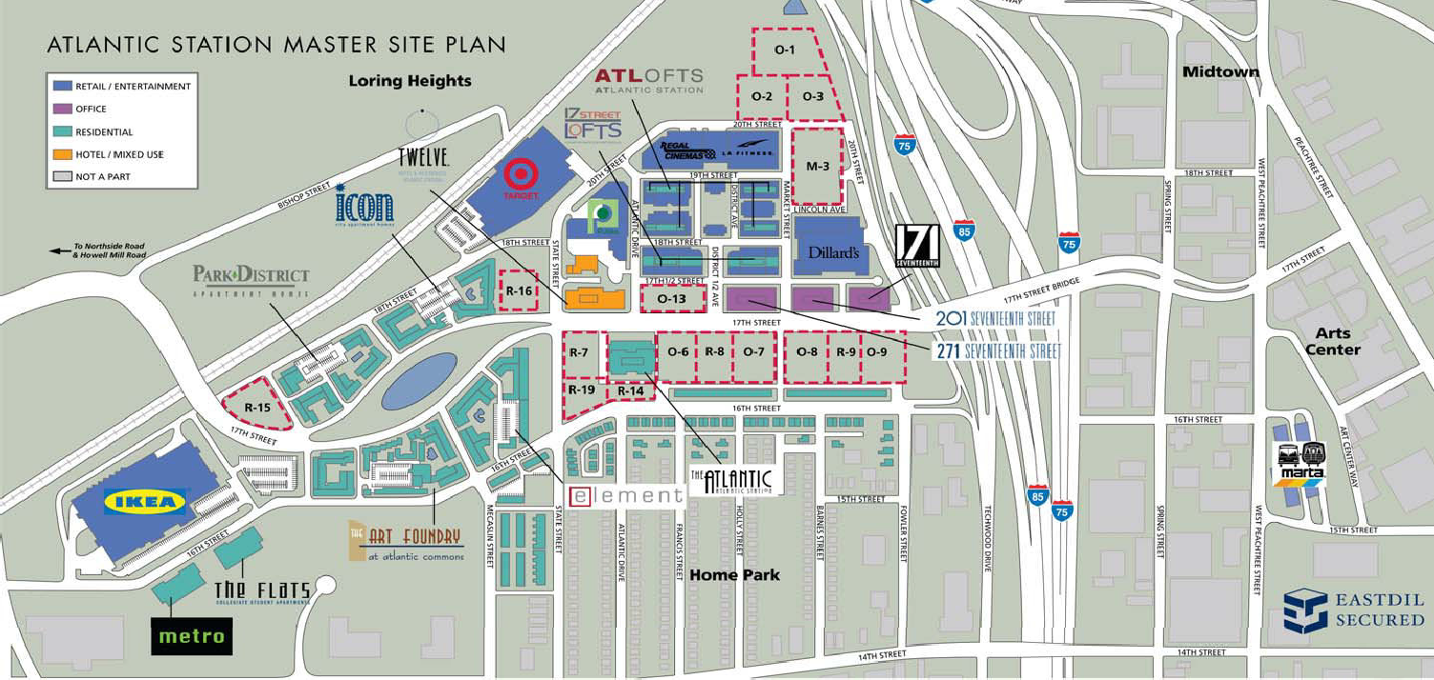




















Completion Status
ϭϱ

Slide 16
Concepts Under Consideration
Connectivity Improvements/ Transportation Infrastructure
14th Street (From Northside Dr. to I-75/85)
Northside Drive
ϭϲ

Slide 17
Perry Bolton TAD

Slide 18
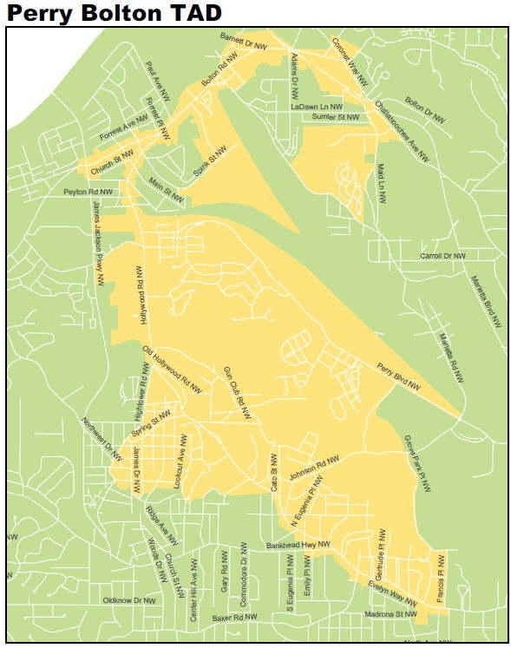


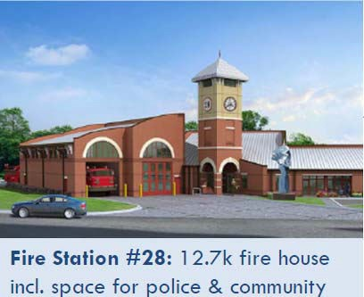
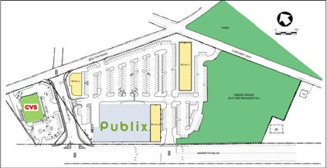
Approved Projects
West Highlands 1,606 residential units
  37% affordable
Moores Mill Village 114,000 retail sq. ft. (includes Publix grocery store)
Moores Mill Rd. Extension
Recent Accomplishments
Moores Mill Village under construction
Fire Station #28 Completed
GƌoĐeƌ
Mooƌes Mill Village

Slide 19
Concepts Under Consideration
Redevelopment Plan Recommendations
  Marietta Blvd./Bolton Road Intersection
  Housing Rehabilitation
  Grove Park Revitalization
ϭϵ

Slide 20
Eastside TAD

Slide 21
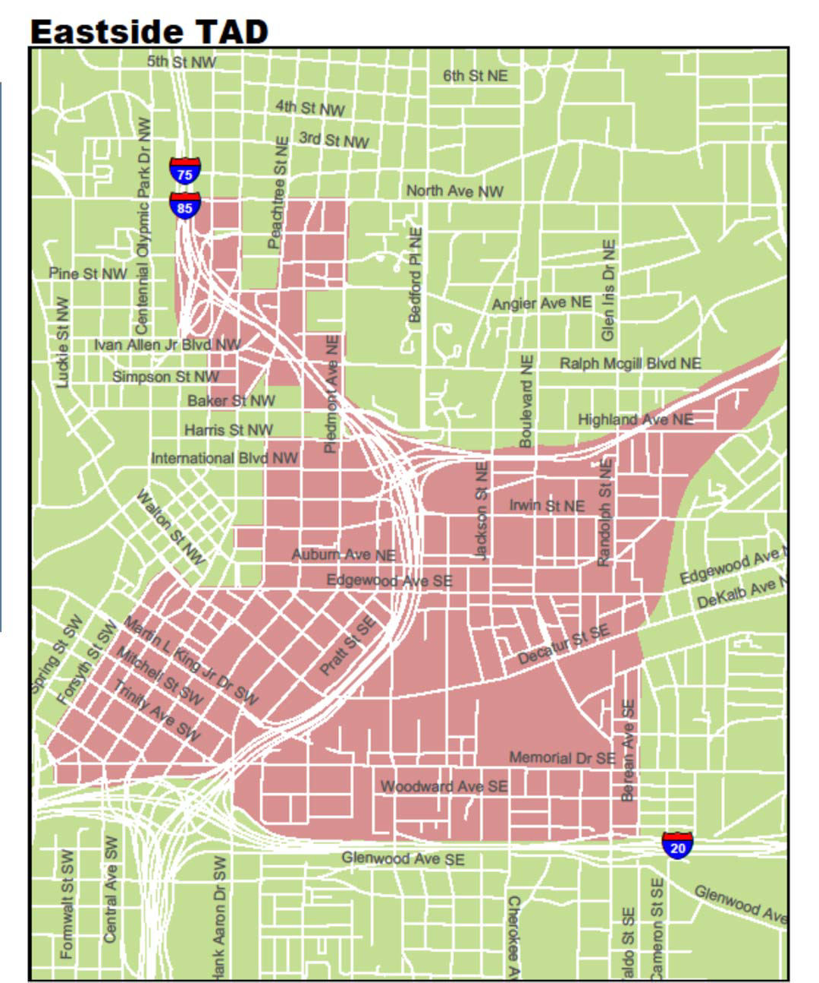

Funded Projects
1,439 residential units
  32% affordable
133,000 retail sq. ft.
266,000 office sq. ft.
102 hotel rooms
2,400 structured parking
Memorial Dr. Greenway Acquisition Phase I
ReĐeŶt Accomplishments
Downtown Façade Improvement Grant Program Phase II
ETAD Grant Application Released
Sweet Auburn Ballroom
Memorial Dr. Greenway Acquisition
Ϯϭ

Slide 22
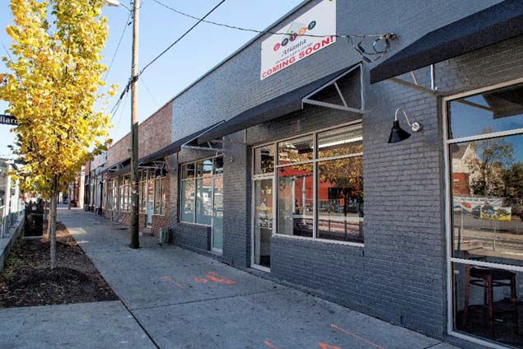
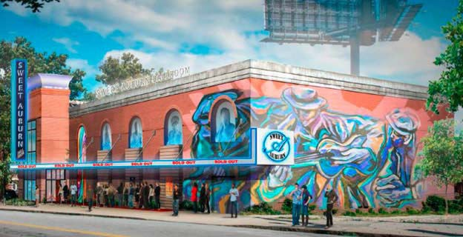
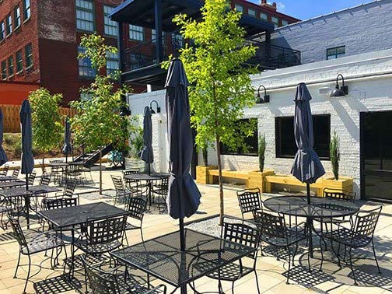
2013 - 2016 Projects
Downtown Façade Improvement Grants
Sweet Auburn Ballroom
$1 M approved. $5.4 M total cost
$3.0M allocated
12 projects approved - $900K
ϮϮ

Slide 23
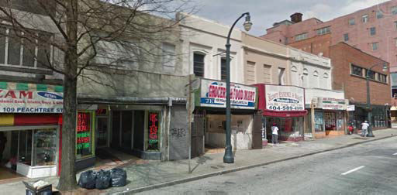
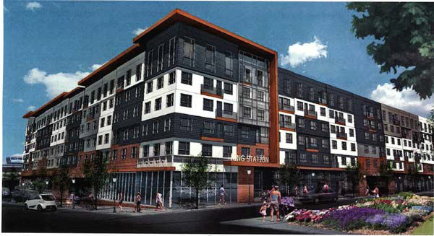
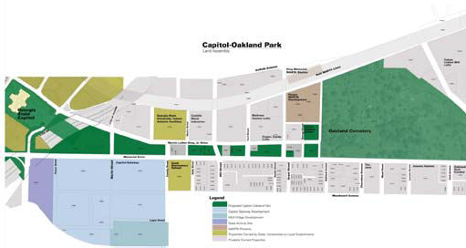
Concepts To Consider
Underground Atlanta
Atlanta Streetcar Extension
Memorial Drive Greenway Development
Sweet Auburn Revitalization
King Memorial TOD
South Downtown Arts Revitalization
Public Parking Garage
Sweet Auburn/Old Fourth Ward
Historic Building Reuse
Medical Arts Building
Oddfellows Building
Kiser Building
South Peachtree/Broad Street
South Peachtree
King Memorial TOD
Memorial Drive Greenway
Ϯϯ

Slide 24
Commercial Corridor TADs

Slide 25
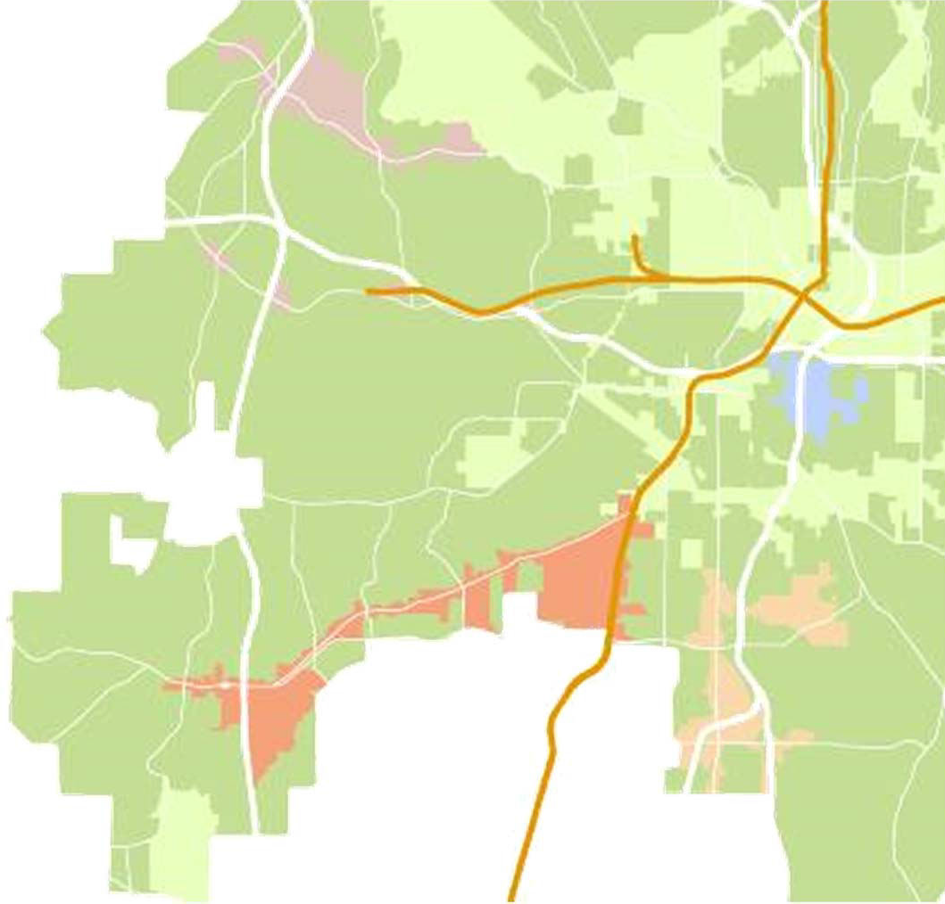
Commercial Corridor TADs
Created in 2006
No APS participation
Hollowell/ML King
•
Spur catalytic mixed-use, development, Create jobs
Support
Stadium Neighborhoods
Catalytic commercial revitalization
Infrastructure
Quality of life projects
Campbellton Road
Metropolitan Parkway
Pay-as-you-go financing
Alternative to bonds (require larger projects, $5+ million)
Developer reimbursed as increment collected
Ϯϱ

Slide 26
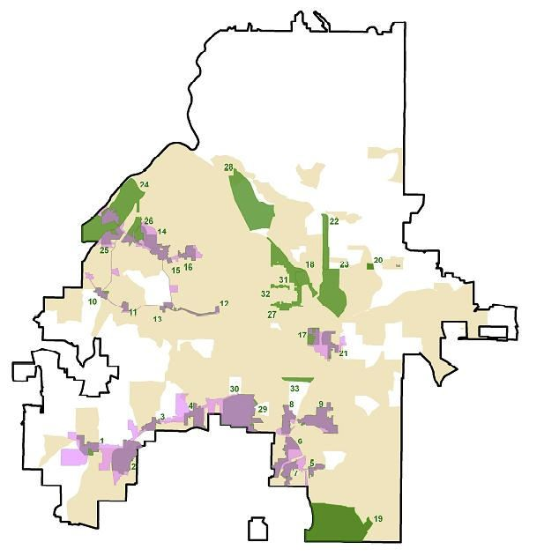
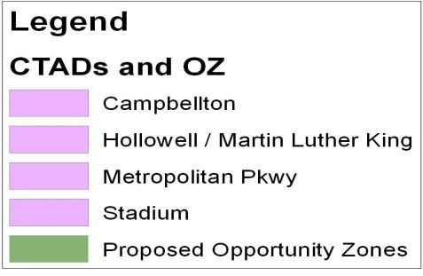
Commercial Corridor TADs
Initiatives
Opportunity Zones
  $3,500 tax credit/job
  Application for 22 new zones, 9 zones approved (2,532 acres)
Fresh Food Initiative
Hollowell / M L KiŶg
Collaborate with other orgs. to bring fresh food to food deserts
$2.0 M project min. (vs. $5.0 M)
Stadiuŵ Neighborhoods
Livable Centers Initiative (LCI)
CaŵpbelltoŶ Road
Partnership with ARC, CoA, & local businesses to create plans
Designation prioritizes area for regional transportation funding
5 LCIs
Recently Completed LCI Studies
MetropolitaŶ Parkway
Stadium Neighborhoods
Campbellton Road/Ft. McPherson
Ϯϲ

Slide 27
Campbellton Road TAD
Accomplishments
Campbellton Rd. Ped. Improvements
($200k)
Opportunity Zone Designation (Fort McPherson)
Security cameras ($500k)
Lee St. Multi-Use Trail ($350k)
Concepts Under Consideration
LCI Planning Grant ($50k match)
MILRA/Ft. Mac Rd. Extension ($510k)
Ft. McPherson infrastructure improvements
Greenbriar Pkwy LCI improvements
Ϯϳ

Slide 28
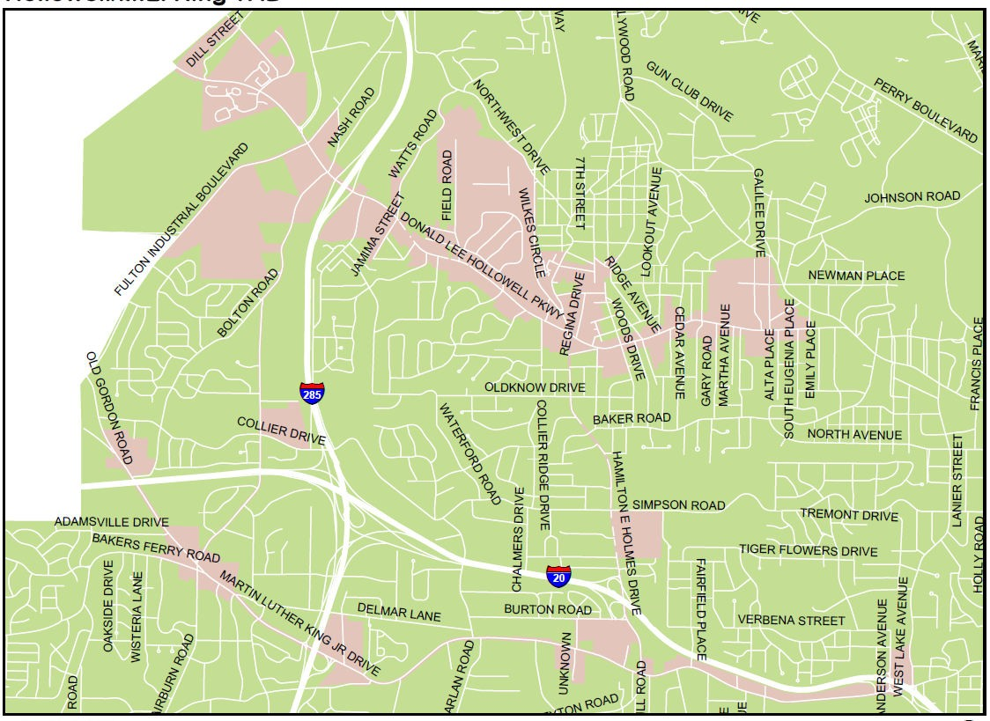
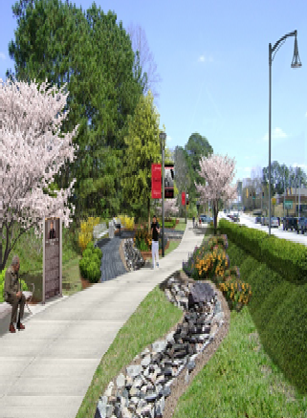
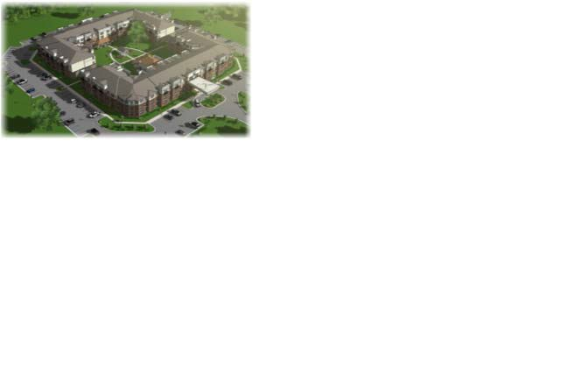
Hollowell/M.L. King TAD
Accomplishments
Opportunity Zone Designation (Atlanta Industrial Park)
MLK Dr. Streetscape Funding ($1.4M)
The Remington Senior Housing (Pay-As- You-Go)
Concepts Under Consideration
StƌategiĐ AĐƋuisitioŶ foƌ CoŵŵeƌĐial RedeǀelopŵeŶt
PoteŶtial MARTA TOD PƌojeĐts
– HE Holŵes, Westlake ;IŶŶoǀatioŶ VillageͿ

Slide 29
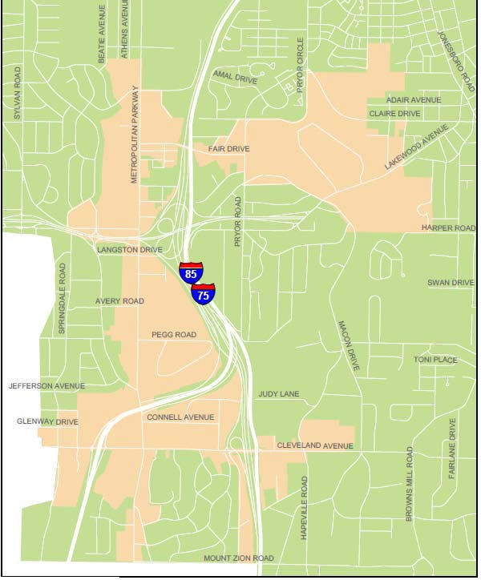
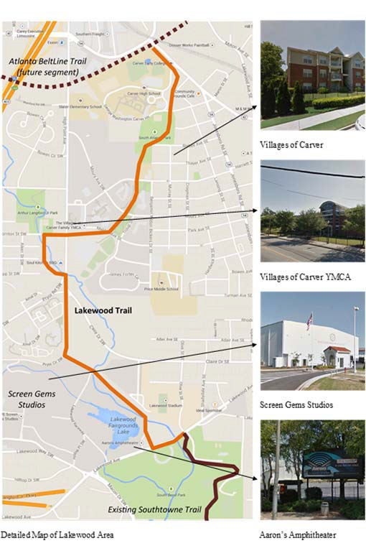
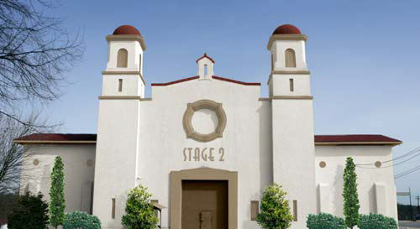
Accomplishments
Metropolitan Parkway TAD
Screen Gems (Pay- As-You-Go)
Cleveland Ave. Streetscape ($200k)
Lakewood Multi-Use Trail ($250k)
Concepts Under Consideration
Metropolitan Pkwy/Cleveland Ave Redevelopment
LCI Improvements
Crossroads Shopping Center Redevelopment
Ϯϵ

Slide 30
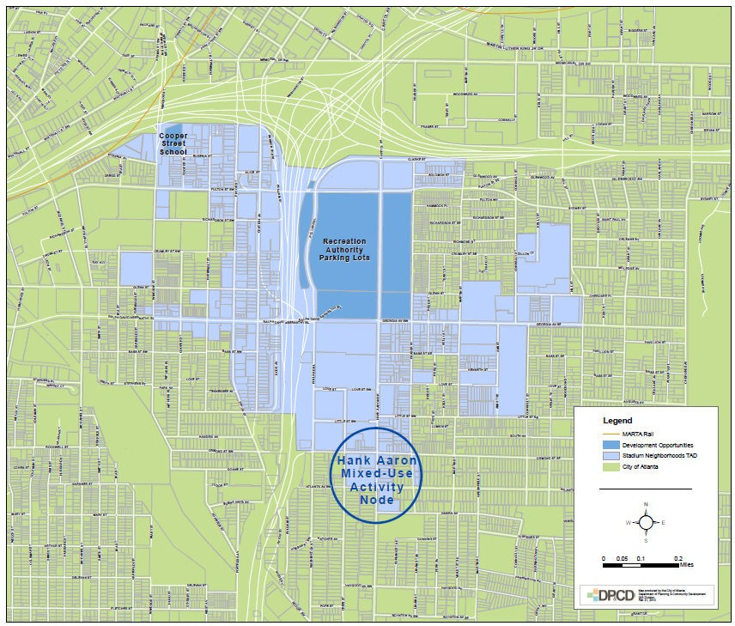
Stadium Neighborhoods TAD
Accomplishments
LCI Planning Grant ($25k match)
Concepts Under Consideration
LCI Plan Recommendations (Infrastructure and Redevelopment)
Redevelopment Opportunities for Turner Field area (Carter & GSU)
ϯϬ

