Slide 1

Department of Public Works
Atlanta City Council | City Utilities Committee
Departmental quarterly update
February 28, 2017
Kasim Reed
Mayor
Larry King
Deputy Commissioner
William M. Johnson
Commissioner

Slide 2





HUMAN RESOURCES
Staffing Scorecard: Week of February 20, 2017
Overall Goal Status | Public Works Status
Green (90-100% fill rate): Fleet Services Yellow (70-89% fill rate): Office of the Commissioner, Solid Waste Services, Streetcar Services, and Transportation Red (>70% fill rate): None | Total Positions: 965 Open: 74 (8.6% vacancy rate) *Vacant positions (excluding in process)/ Total Positions On hold: 9 Recommended/In Process: 45 Filled: 837 Percentage Filled: 86.7% (filled/total positions)
90 Day Plan- Vacancy Control | Key Initiatives
Overall Vacancy reduction by 2% Partner with Talent Acquisition to identify key initiatives to reduce time to fill Ensure all critical DPW vacancies filled within 60 days Develop plan to gain process efficiencies within DPW HR ex. Authorization to Fill (ATF) process | Develop a retention strategy for Solid Waste and Equipment Operators I, II, III Provide training opportunities for heavy equipment operators to increase internal promotions Utilize hiring blitzes, job fairs, and professional organizations to recruit hard to fill positions

Slide 3
FY17 BUDGET
 |  |  |  | Budget | Actual | %
General Fund |  |  |  | 37,585,502.00 | 27,277,682.29 | 73%
Solid Waste Revenue Fund |  |  |  | 55,607,233.00 | 31,081,905.07 | 56%
Fleet Services Fund |  |  |  | 33,400,588.00 | 18,209,508.11 | 55%
 | TOTAL |  |  | 126,593,323.00 | 76,569,095.47 | 60%
Notes:
General Fund supports Office of the Commissioner and Office of Transportation. General Fund is trending over budget due to emergency projects: Piedmont and Morningside; Perry Blvd; MLK and Lynhurst projects.

Slide 4
GENERAL FUND
General Fund allocation for FY17 is $37.5M.
36% of the General Fund allocation is for Salaries and Benefits ($13.5M).
8M of the 11.6M allocated for Supplies is electricity for citywide signals and lights.

Slide 5
SOLID WASTE REVENUE FUND
The Solid Waste Revenue Fund Budget is $55.6M
50% of this budget is for Salaries.
15% of the Solid Waste budget is for Indirect Costs or charges from other departments.

Slide 6
FLEET SERVICES FUND
Fleet Services Budget for FY17 is $33.4M.
$8M of the supplies budget is allocated for city-wide fuel; $4.8M is allocated for purchase of parts for repairs.

Slide 7
COUNCIL REPORT TABLE 4th Quarter
Council District | Total No. of Service Requests Submitted | Closed Solid Waste % | Closed Transportation % | Past Due % | Percent of Total Service Requests
Council President – Ceasar Mitchell | 9 | 33.33% | 66.67% | 0.00% | 2.99%
District 1 – Carla Smith | 18 | 5.56% | 94.44% | 16.67% | 5.98%
District 2 – Kwanza Hall | 2 | 0.00% | 100.00% | 0.00% | 0.66%
District 3 – Ivory Young | 6 | 83.33% | 16.67% | 0.00% | 1.99%
District 4 – Cleta Winslow | 54 | 90.74% | 9.26% | 5.56% | 17.94%
District 5 – Natalyn Archibong | 64 | 37.50% | 62.50% | 15.63% | 21.26%
District 6 – Alex Wan | 29 | 41.38% | 58.62% | 24.14% | 9.63%
District 7 – Howard Shook | 20 | 20.00% | 80.00% | 0.00% | 6.64%
District 8 – Yolanda Adrean | 13 | 61.54% | 38.46% | 0.00% | 4.32%
District 9 – Felicia Moore | 31 | 38.71% | 61.29% | 19.35% | 10.30%
District 10 – C.T. Martin | 13 | 15.38% | 84.62% | 15.38% | 4.32%
District 11 – Keisha Bottoms | 28 | 78.57% | 21.43% | 10.71% | 9.30%
District 12 – Joyce Sheperd | 9 | 0.00% | 100.00% | 33.33% | 2.99%
Post 1 – Michael Bond | 4 | 75.00% | 25.00% | 25.00% | 1.33%
Post 2 – Mary Norwood | 0 | 0.00% | 0.00% | 0.00% | 0.00%
Post 3 - Andre Dickens | 1 | 0.00% | 100.00% | 0.00% | 0.33%
Mayor's Office | 0 | 0.00% | 0.00% | 0.00% | 0.00%
District Unknown | 0 | 0.00% | 0.00% | 0.00% | 0.00%
Totals | 301 | 48.17% | 48.17% | 12.62% | 100.00%

Slide 8
CUSTOMER SERVICE PERFORMANCE METRICS
PERFORMANCE MEASURE | INITIATIVE | 1Q 2016 ACTUAL | 2Q 2016 ACTUAL | 3Q 2016 ACTUAL | 4Q 2016 ACTUAL | TOTAL
Transportation No. of SR | Merit and Excellence | 3,295 | 3,024 | 4,395 | 4,524 | 15,238
Transportation No. of SR meeting SLA | Merit and Excellence | 3,101 | 2,759 | 4,265 | 4,239 | 14,364
Percentage of SR's Meeting SLA |  | 94.11% | 91.24% | 97.04% | 93.70% | 94.26%
PERFORMANCE MEASURE | INITIATIVE | 1Q 2016 ACTUAL | 2Q 2016 ACTUAL | 3Q 2016 ACTUAL | 4Q 2016 ACTUAL | TOTAL
Solid Waste Services No. of SR | Merit and Excellence | 11,957 | 10,530 | 13,004 | 10,558 | 46,049
Solid Waste No. of SR meeting SLA | Merit and Excellence | 11,275 | 9,566 | 12,687 | 10,296 | 43,824
Percentage of SR's Meeting SLA |  | 94.30% | 90.85% | 97.56% | 97.52% | 95.17%
PERFORMANCE MEASURE | INITIATIVE | 1Q 2016 ACTUAL | 2Q 2016 ACTUAL | 3Q 2016 ACTUAL | 4Q 2016 ACTUAL | TOTAL
DPW No. of SR | Merit and Excellence | 15,252 | 13,554 | 17,399 | 15,082 | 61,287
DPW No. of SR meeting SLA | Merit and Excellence | 14,376 | 12,325 | 16,952 | 14,535 | 58,188
Percentage of SR's Meeting SLA |  | 94.26% | 90.93% | 97.43% | 96.37% | 94.94%
Total DPW Service Request Historical Data
Notes:
SRs are created from 311 (Siebel system) and DPW (Hansen system).

Slide 9
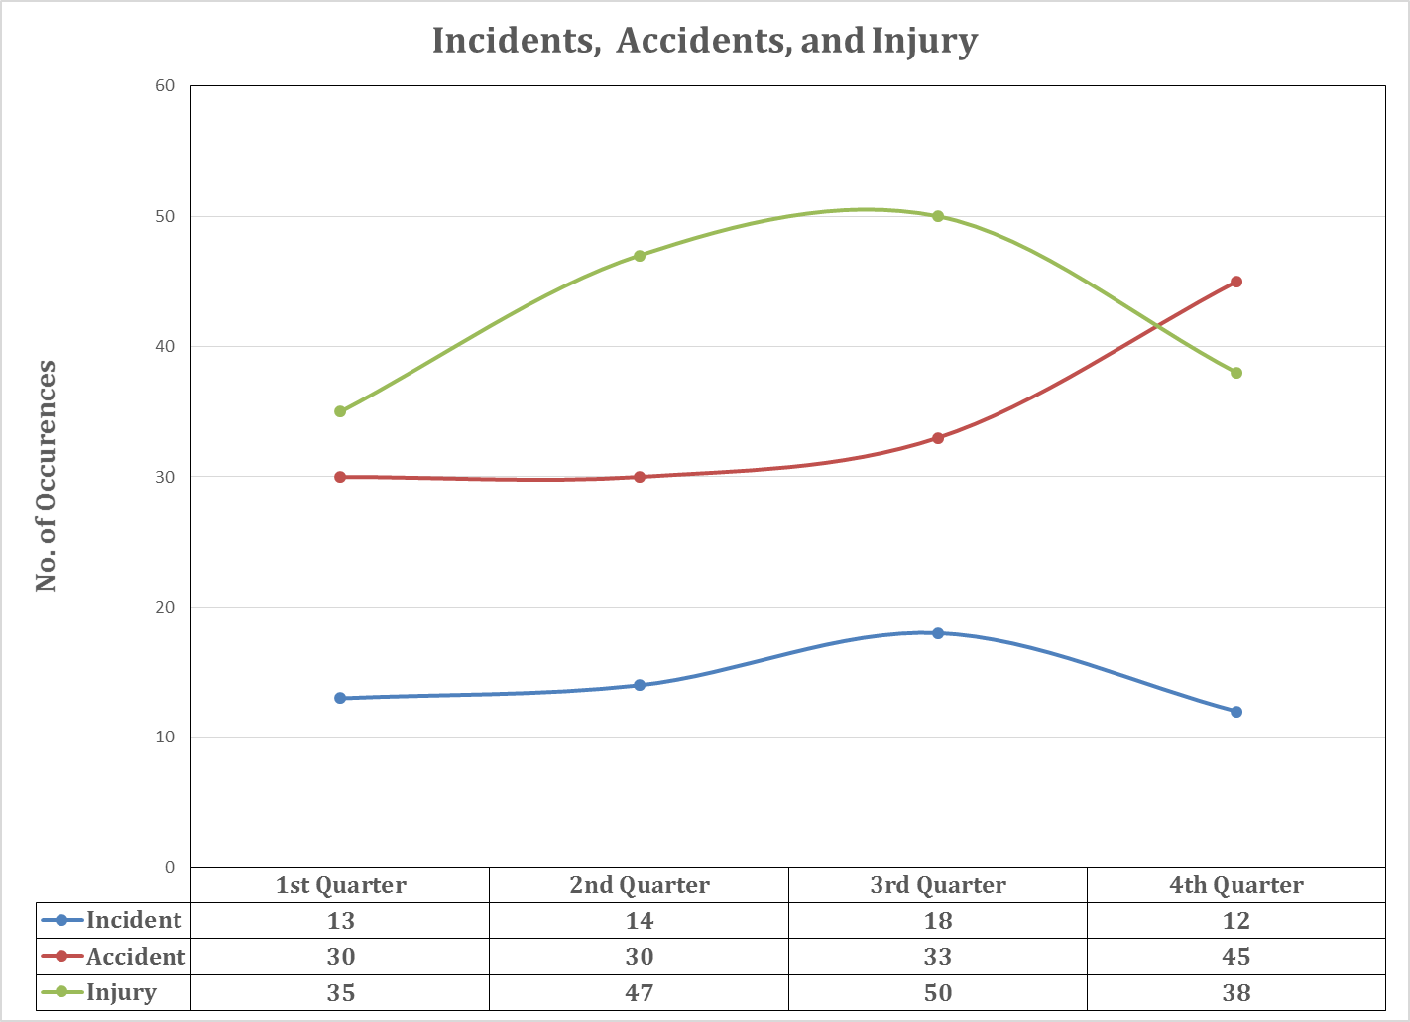
PERFORMANCE METRICS

Slide 10
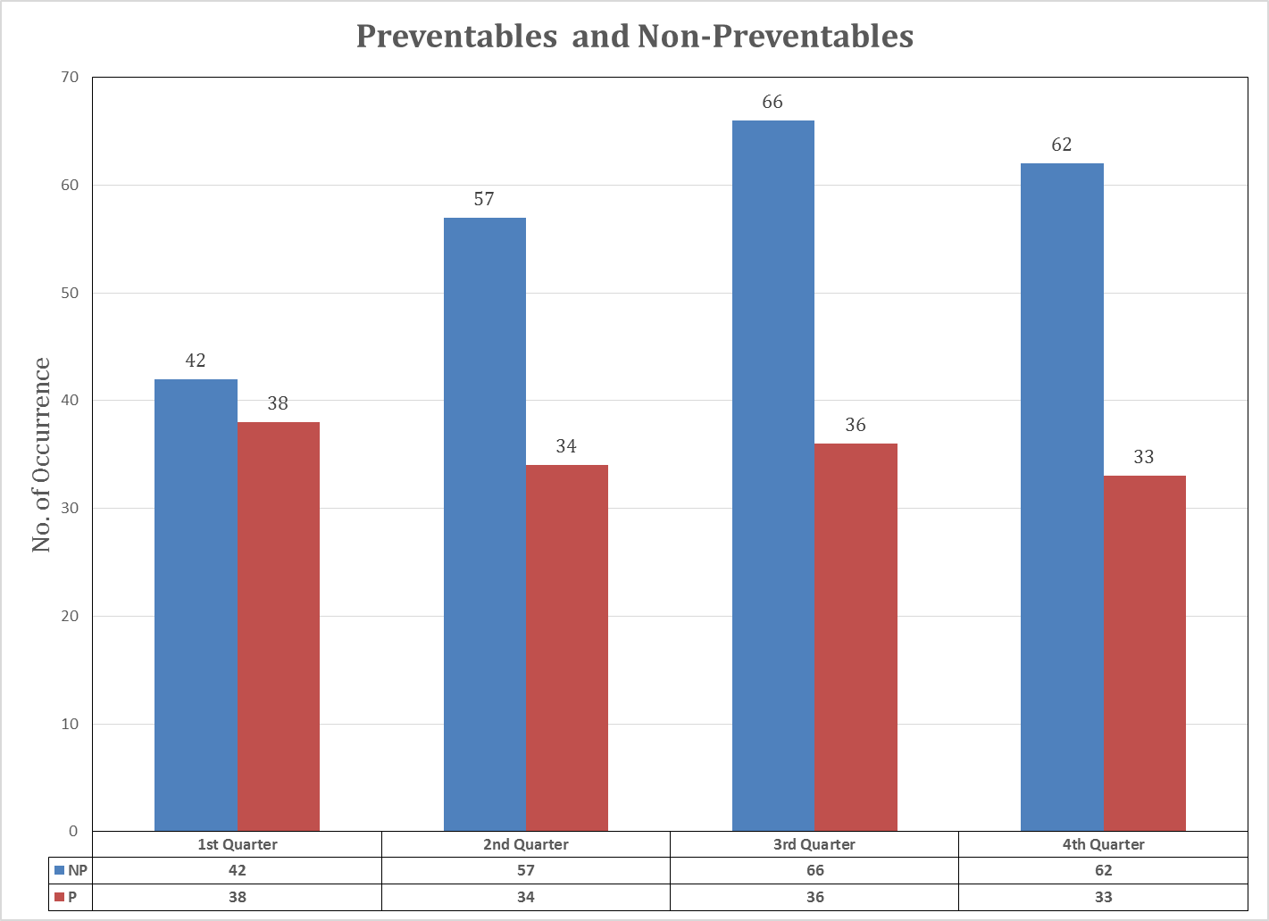
PERFORMANCE METRICS

Slide 11
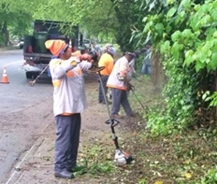
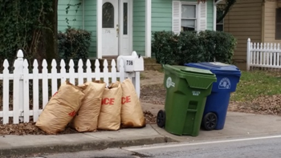
PERFORMANCE METRICS
PERFORMANCE MEASURE | INITIATIVE | 2016 TARGET | 1Q 2016 ACTUAL | 2Q 2016 ACTUAL | 3Q 2016 ACTUAL | 4Q 2016 ACTUAL
Percent of Single Family Garbage Pickups Collected on Scheduled Day | Merit and Excellence | 99.9% | 99.92% | 99.80% | 99.89% | 99.91%
Percent of Bulk Rubbish Pickups Collected as Requested/Scheduled | Merit and Excellence | 99.9% | 99.98% | 99.97% | 99.95% | 99.97%
Percent of Yard Trimming Pickups Collected on Scheduled Day | Merit and Excellence | 99.9% | 70.12% | 67.55% | 99.83% | 99.93%
Percent Recycling Pickups Collected on Scheduled Day | Merit and Excellence | 99.9% | 99.85% | 96.69% | 99.84% | 99.92%
The Office of Solid Waste Services consists of Education & Enforcement, Right-of-way Maintenance, Residential Street Sweeping, and weekly
pick-up of household garbage, recycling, and yard trimmings.

Slide 12

OPERATING HIGHLIGHTS FOR ATLANTA STATS
Description | 1Q Percent SLA Met | 2Q Percent SLA Met | 3Q Percent SLA Met | 4Q Percent SLA Met
Bin Delivery and Pick-Up | 99.95% | 99.77% | 99.96% | 99.77%
Dead Animal Removal | 99.66% | 100% | 100% | 99.67%
Illegal Dumping | 100% | 99. 78% | 100% | 99.80%
Missed Collections | 68.89% | 73.09% | 94.09% | 96.97%
New Backyard Services | 100% | 100% | 99.18% | 100%
ROW Maintenance | 99.51% | 99.58% | 99.18% | 99.48%
Solid Waste Services | 86.20% | 84.11% | 97.32% | 98.45%

Slide 13
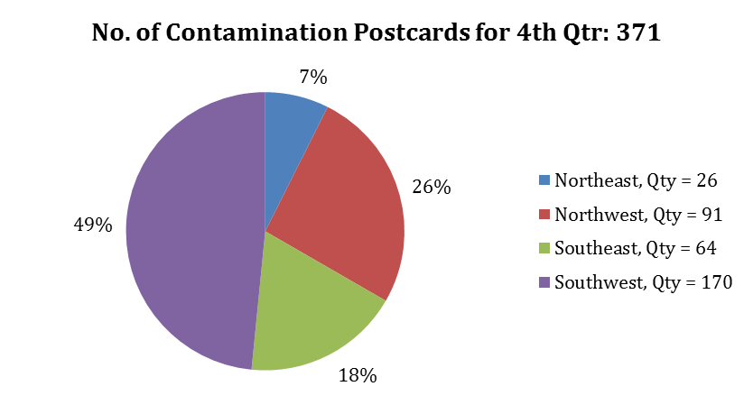
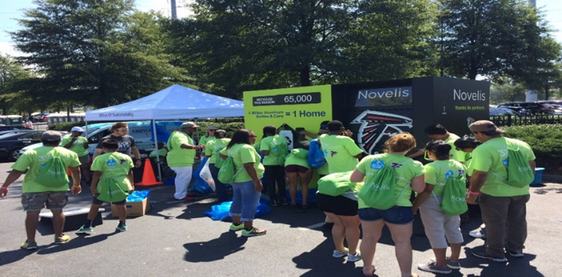
OPERATING HIGHLIGHTS – RECYCLING AND SUSTAINABILITY
Recycling Data
Month | Pounds Per Household
October | 28.69
November | 23.52
December | 25.88
Average Per Month | 26.03
*Annual Household Goal: 400 lbs. per year. Equates to 26.12 lbs per month.
Recycling Initiatives
  Novelis “Recycle for Good” Campaign
  Atlanta Falcons Season-Long Aluminum Collection
  Rubicon Global Pilot – Waste Data & Technology
  “Clean Streets” Cigarette Recycling Program
Recycling Outreach & Education
  Monthly Atlanta Recycle Day
  Contamination Postcards

Slide 14
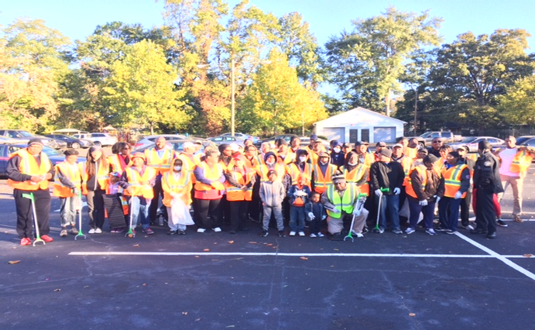

KEEP ATLANTA BEAUTIFUL COMMISSION
Litter Abatement
Adopt-A-Spot Program
6 new groups in high litter areas
Cleanup Supplies provided for over 30 events
Neighborhood Cleanups
Cascade Heights Cleanup – Partnership with DPW, Local Non-Profit, Area Businesses, Churches, & APD Code Enforcement
        65 Volunteers
        2,000 Lbs. of Trash & Debris

Slide 15
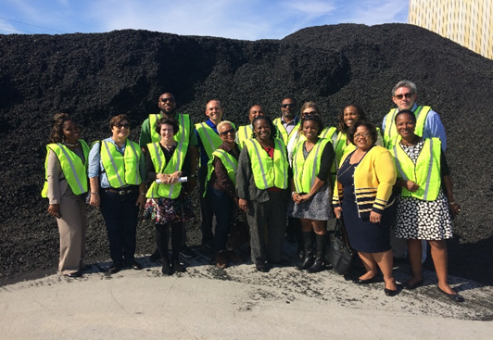
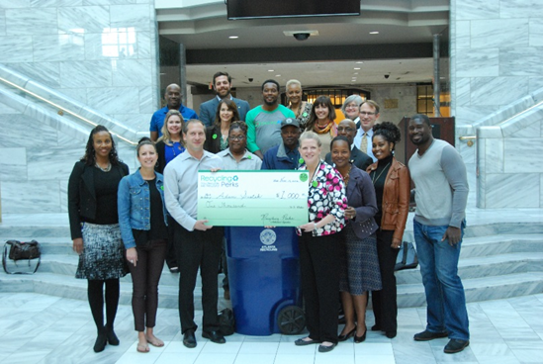
KEEP ATLANTA BEAUTIFUL COMMISSION (Continued)
Events/Projects
Fort McPherson Fall Festival
  Partnered with Councilmember Joyce Sheperd & Fort McPherson LRA
  Presented DPW & Keep Atlanta Beautiful Commission Initiatives
NPU-K Beautification
  Trees Atlanta & NPU-K Tree Planting on MLK Jr. Dr. & Connecting Streets
Litter & Recycling Story time at Northwest Library
America Recycles Day Event with Councilmember Keisha Lance Bottoms & Mayor’s Office of Sustainability
Liberty Tire Recycling Tour with City Council, DPW, & Keep Atlanta Beautiful Commission Stakeholders

Slide 16
Recycling Stakeholders
City of Atlanta
DPW - Public Works
Keep Atlanta Beautiful Commission
Hard to Recycle Items
CHaRM
Scrap Tires
WRAP – Environmental Protection Agency
Film Plastic
Data Management
Rubicon
Regrig
GA Tech
Other Partners
Recycling Perks
ATL Recycles Committee

Slide 17
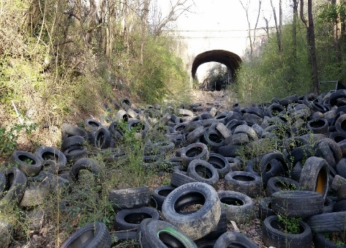
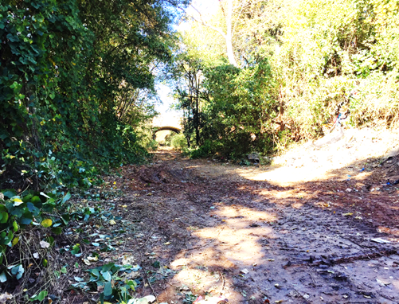
Scrap Tire Abatement
Partnership with the Code Enforcement Commission
  City-Wide Scrap Tire Generator Workshop
  Scrap Tire Education & Enforcement Training
Scrap Tire Amnesty Events – Partnership with Atlanta City Council & Liberty Tire Recycling
  Semi-annual Residential Scrap Tire Drive – Approx. 5,000 tires
  1st Annual Business Amnesty Event – Approx. 2,000 tires
Local Government Scrap Tire Abatement Grant, Georgia Environmental Protection Division
  Reimbursed for abatement of over 2,000 scrap tires located in Northwest Atlanta.
  Awarded funding to assist with the cleanup of 4,000 scrap tires located in
  Southeast Atlanta
Before
DPW Scrap Tire Collections & Costs
Year | Annual Collection | Annual Cost | Avg. Monthly Collection | Avg. Monthly Cost
2014 | 21,209 | $159,067.50 | 1,767 | $13,255.63
2015 | 21,467 | $161,002.50 | 1,789 | $13,416.88
2016 | 23,580 | $176,850.00 | 2,620 | $19,650.00
After

Slide 18
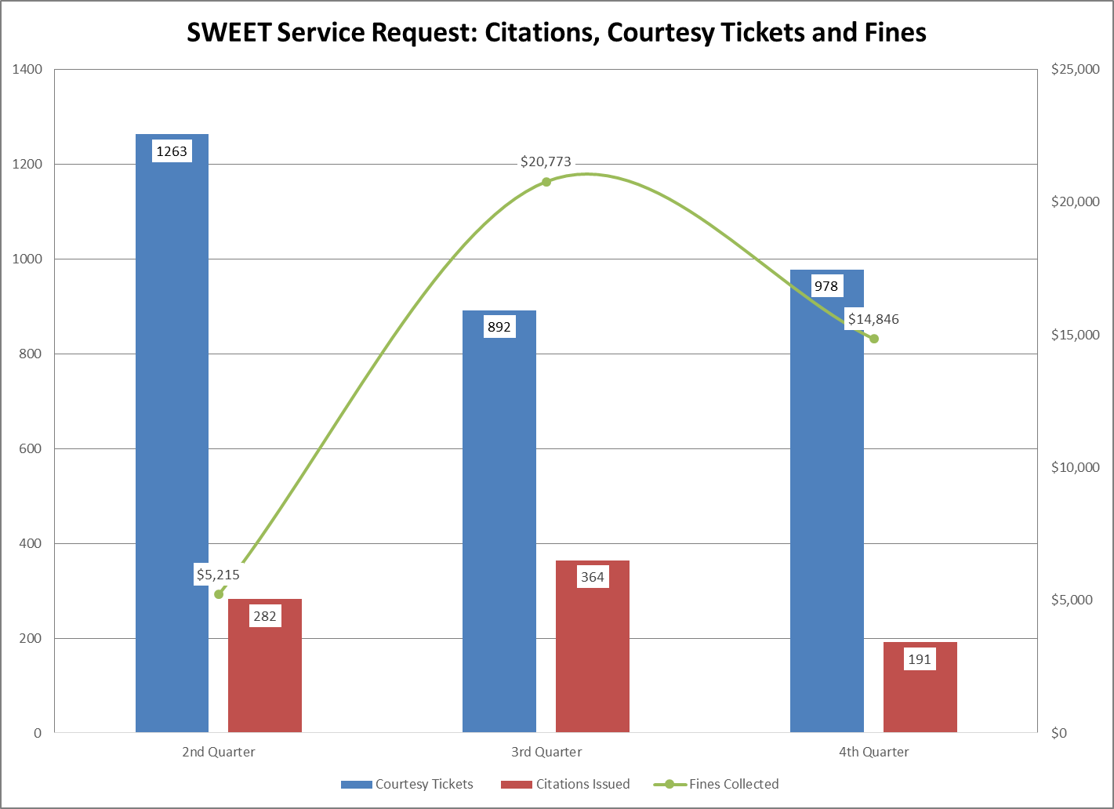
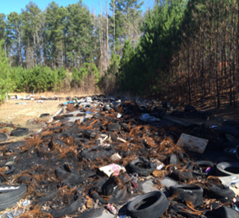
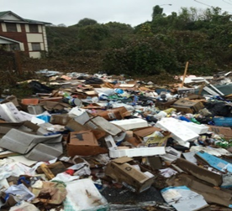
SOLID WASTE EDUCATION & ENFORCEMENT TEAM
Quarter | Courtesy Tickets | Citations Issued | Percent Compliance | Fines Collected
2Q | 1,263 | 282 | 77.7% | $5,215
3Q | 892 | 364 | 59.2% | $20,773
4Q | 978 | 191 | 80.5% | $14,846
Average | 104,433 | 279 | 73.28% | $13,611.33
Total | 3,133 | 837 | 73.28% | $40,834
During the 4th quarter the SWEET team enhanced their inspections resulting in an increase in the number of courtesy tickets given from 892 to 978 tickets. This is a percent increase of 9.64% from 3rd quarter.
The increase in courtesy tickets resulted in a percent compliance increase of 35.95%. This also precipitated a decrease of 47.53% in citations written.

Slide 19
OPERATING HIGHLIGHTS
The Office of Fleet Services utilizes
Public Surplus.com to conduct online auctions for the surplus of equipment.

Slide 20
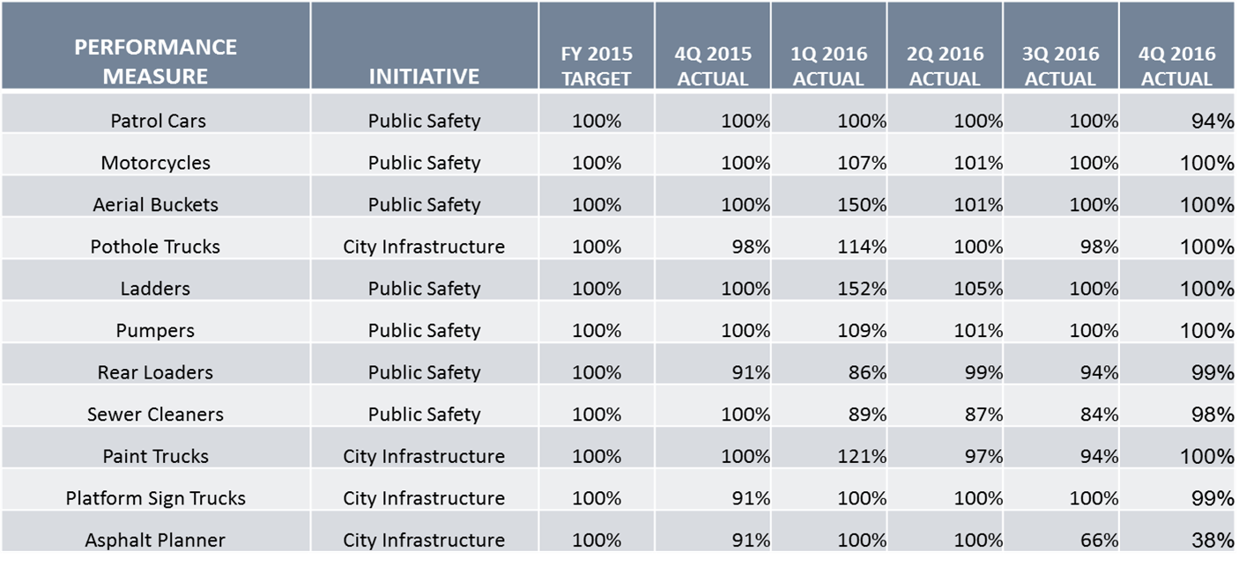
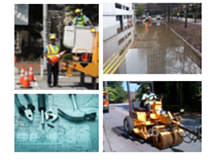
AVERAGE VEHICLE AVAILABILITY
AVAILABILITY
The Office of Fleet Services is responsible for maintaining nearly 5600 pieces of rolling equipment including critical services for Fire and Police.

Slide 21
PM COMPLIANCE
Department | Q1 | Q2 | Q3 | Q4
Airport Fire & Rescue | 100% | 99% | 94% | 100%
Airport Police | 99% | 99% | 100% | 100%
Aviation Department | 93% | 98% | 98% | 98%
Corrections | 100% | 100% | 99% | 99%
AIM | 70% | 100% | 88% | 71%
DPW - Commissioner's Office | 100% | 100% | 100% | 92%
DPW - Office Of Fleet Services | 95% | 97% | 97% | 99%
DPW - Solid Waste Services | 91% | 92% | 90% | 94%
DPW - Transportation | 90% | 90% | 89% | 94%
Finance | 100% | 100% | 100% | 90%
Fire Rescue | 92% | 92% | 92% | 100%
Human Resources | 75% | 100% | 68% | 100%
Mayor's Office | 87% | 88% | 87% | 80%
Parks & Recreation | 89% | 94% | 94% | 92%
Planning | 96% | 94% | 94% | 96%
Police Department | 94% | 95% | 95% | 97%
Solicitor, Courts, Law | 95% | 95% | 90% | 84%
Watershed - Drinking Water | 68% | 84% | 88% | 87%
Watershed - Waste Water | 78% | 84% | 86% | 84%
Total | 87% | 92% | 92% | 93%

Slide 22
Thank you

