Slide 1
Atlanta Streetcar Quarterly Update
Atlanta City Council
Transportation Committee
March 1, 2017
10:30 AM

Slide 2
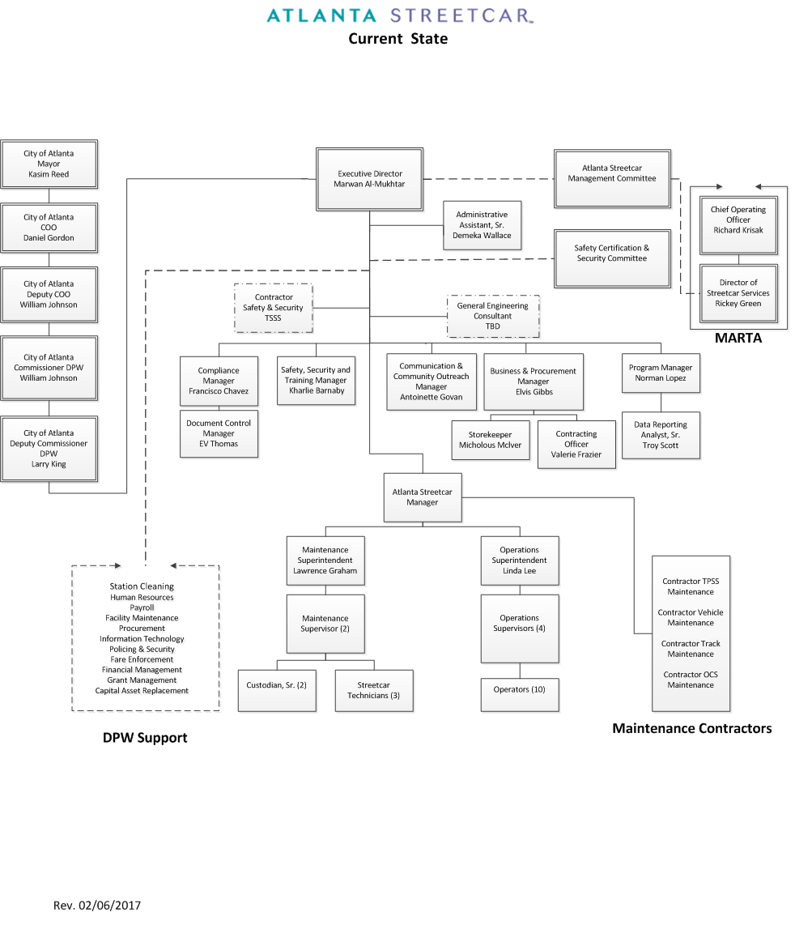
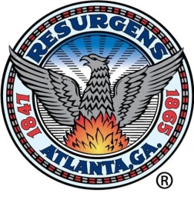
Organization Structure – Current Staffing
CITY OF ATLANTA DEPARTMENT OF PUBLIC WORKS
2

Slide 3
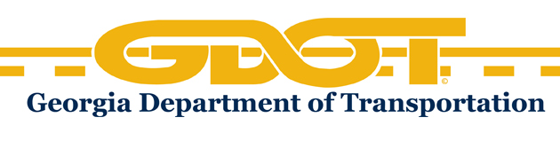
Georgia Department of Transportation
2015 Safety and Security Special Assessment
Corrective Action Plans
GDOT issued 34 finding and 66 CAPs (Corrective Action Plans)
CAP Implementation Status
All 66 CAP Responses Accepted = 100%
A total of twenty (20) CAPs (30%) are now closed and no further action is required
Sustainability Action Plan
Sustainability Action Plan recently submitted to GDOT identifies the specific management and organizational goals, actions, resource requirements, schedule, and performance measures to build the necessary organizational capacity and capabilities to safely and effectively operate, and maintain the Atlanta Streetcar System.
CITY OF ATLANTA DEPARTMENT OF PUBLIC WORKS
3

Slide 4
Operations and Maintenance
PASSENGER RIDERSHIP
Service performance
January 2017
Cumulative
Passengers | 32,934
Revenue Hours | 1,994
Passengers/Revenue Hour | 16.52
1,291,996
29,677
43.5
Revenue Miles | 10,731
133,971
Total Trips Operated | 3,990
On-Time Performance | 98.2%
96.7%
Total Accidents | 0
Preventable | 0
Non-Preventable | 0
20
11
9
Headways Variance (approximate)
1 Vehicle | 30 minutes
2 Vehicles | 15 minutes
3 Vehicles | 9 minutes
FISCAL YEAR | BUDGET | ACTUAL | ( % )
2015 | $ 5,208,671 | $ 2,197,542 | 42%
2016 | $ 5,387,632 | $ 4,805,813 | 89%
2017 | $ 5,281,115 | $ 2,248,738 | 43%
CITY OF ATLANTA DEPARTMENT OF PUBLIC WORKS

Slide 5
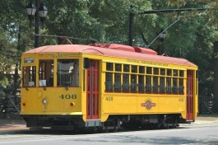
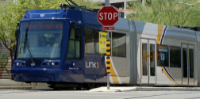
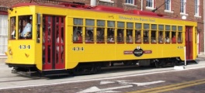
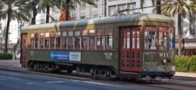
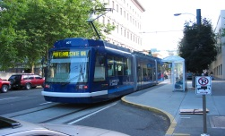
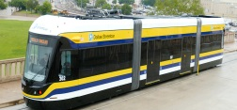
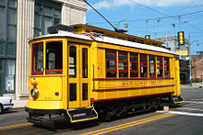
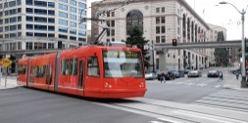
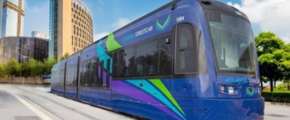
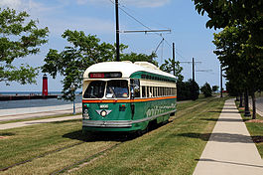
Fare Revenue
Total Revenue | $ 201,592
FY 16 | $ 100,283
FY 17 | $ 101,308
City / System |  | Farebox Recovery % | * Passengers
 | Little Rock, AR Central Arkansas Transit Authority | 8.6% | 99,500
 | Tucson, AZ Sun Link | 20.7% | 15,743,501
 | Tampa-St. Petersburg, FL Hillsborough Area Regional Transit Authority | 30.1% | 277,806
 | New Orleans, LA New Orleans Regional Transit Authority | 25.3% | 7,475,260
 | Portland, OR Portland Streetcar, Inc. / TriMet | 4.3% | 4,441,261
 | Dallas, TX Dallas Area Rapid Transit | 13.7% | 30,116,600
 | Memphis, TN Memphis Area Transit Authority | 18.5% | 1,060,061
 | Seattle, WA King County Department of Transportation | 14.3% | 707,712
 | Kenosha, WI-IL Kenosha Transit | 8.1% | 45,054
 | Farebox Recovery 4.5% | * Passengers 620,158
* Average Calendar Year Passenger Ridership
CITY OF ATLANTA DEPARTMENT OF PUBLIC WORKS
5

Slide 6
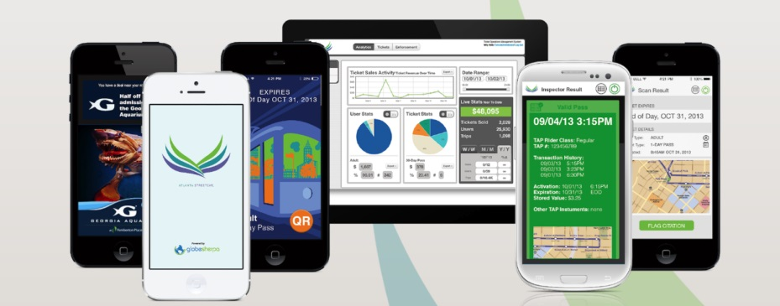
Fare Collection – Mobile Fare Payment Application
FC-8331, Atlanta Streetcar Mobile Fare Payment Application
Design & Development – Complete
Beta Test & Security Penetration Testing – Complete
GDOT Safety & Security Certification Approval – Complete
Application will support existing fare products plus 5, 7 and 30-day pass products and facilitate group ticket sales
TOTAL Downloads
1
4
0
6
ASC Mobile Application – Phase II
On-Board Validators
Merchant Integration
Commuter Transit Benefits
RideTap – Rideshare, carshare, bikeshare and more…
5
4
3
TOTAL $ales | $2,549
CITY OF ATLANTA DEPARTMENT OF PUBLIC WORKS

Slide 7
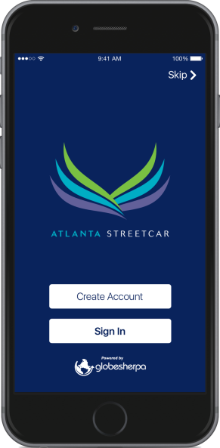
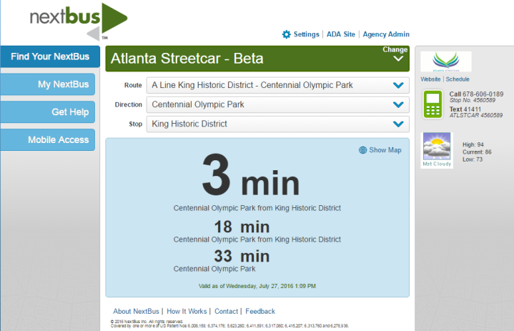
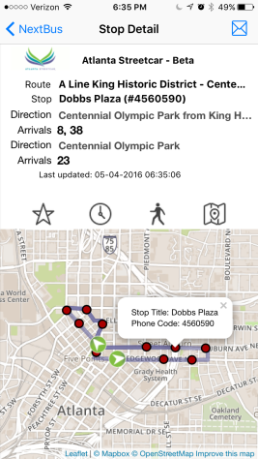
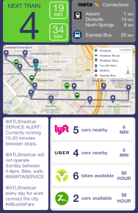
Real-Time Passenger Information System
FC-8332 Real-Time Passenger Information System
Real‐time digital message signs will improve accessibility to transit by increasing information provided to existing and potential transit riders and reducing frustration associated with unknown wait times.
NextBus Website and SMS Text Messaging - Complete
ASC Mobile Application Integration - Complete
Transit Real-Time Arrival Information Pilot Project
The City of Atlanta, in coordination with Midtown Alliance, Central Atlanta Progress, and the Metropolitan Atlanta Rapid Transit Administration (MARTA), is managing a project to bring real‐time transit arrival displays to key corridors and locations in Downtown and Midtown Atlanta.
12 Existing Streetcar Stops, 18 key bus stops in Midtown & Mitchell Street exit of Atlanta City Hall, which is served by three MARTA bus routes and several regional express bus routes.
Funding Source: “New” Congestion Mitigation & Air Quality (CMAQ) Grant
FTA Grant: GA-95-X051
Funding Amount: $ 375,000
CITY OF ATLANTA DEPARTMENT OF PUBLIC WORKS

Slide 8
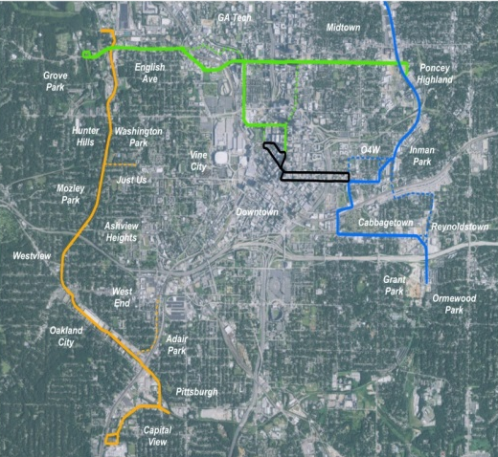
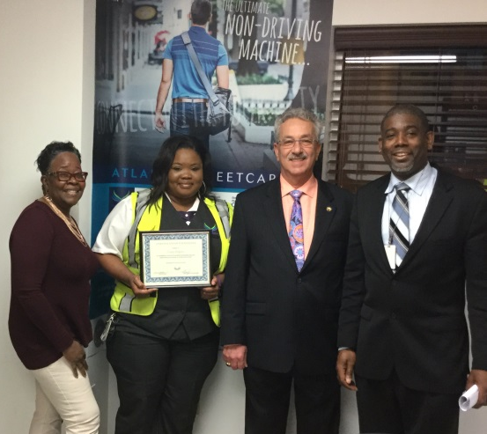
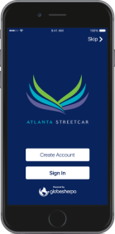
ASC Program Highlights and Milestones
MARTA Referendum & TSPLOST
In November 2016, Atlanta voters authorized funding for a $2.6 billion expansion of MARTA and $300 million for transportation infrastructure. These historic votes put Atlanta on the path to be one of the most connected cities in the country.
First
Mobile
Ticketing
App
for a transit system in Metropolitan Atlanta
Zero Accidents in 2017
CAPS 100% Accepted – 30% Closed
* ASC Operator Eraka Kilgore – One (1) Year No Accidents
Strengthening the Management Team
Fully Staffed with Qualified Employees
Employee Morale is Up
Thank You!
CITY OF ATLANTA DEPARTMENT OF PUBLIC WORKS

