Slide 1
Atlanta Commission on Aging
Atlanta City council
Community Development/human services committee
September 24, 2019

Slide 2
Mission
The Atlanta Commission on Aging was established to address the special needs of the elderly as it relates to city services delivery.
It also serves as an on-going Advisory Body to the Mayor and City Council on matters relating to the delivery of services to, and the quality of life for Atlanta’s older adult population.
The Atlanta Commission on Aging meets at the C.T. Martin Recreation Center on the third Tuesday of each month at 10:00 am.

Slide 3
Members
Evelyn Brown – Chair, Mayor’s Office
Drewnell Thomas – Vice Chair, City Council President
Joyce Brayboy-Jones – Council District 3
Linda Broady-Myers – Post 3
Diane Brown – Council District 12
Delores Lattimore – Mayor’s Office
Ernestine Mitchell – Council District 4
George Pilkington – Council District 9
Tinnie Prather – Council District 1
Jackie Sims – Council District 11
Yvonne Shaw – Post 1
Annie Wright – City Council President
Vacancies – CD 2, CD 5, CD 7, CD8, CD10, Post 2

Slide 4
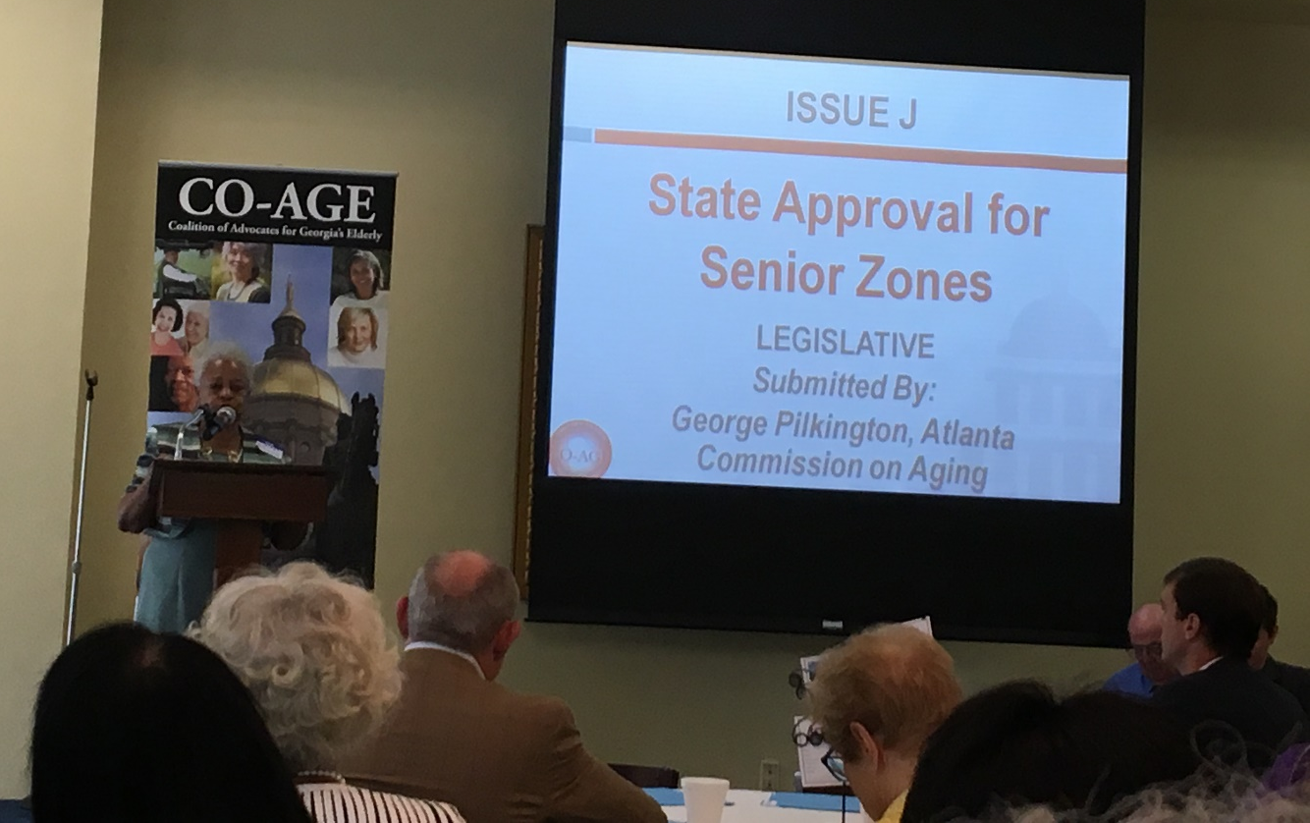
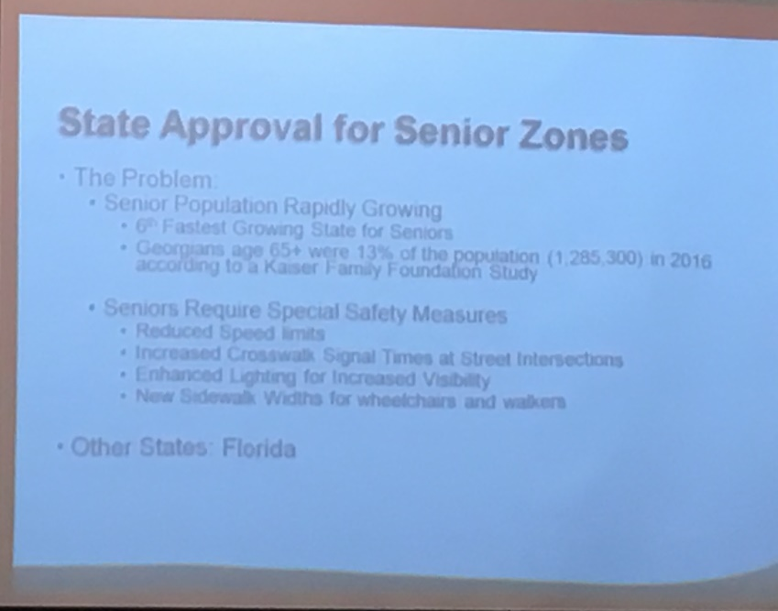
Senior Zone Advocacy with CO-AGE

Slide 5
Annual Seasoned Ball
For residents of the City of Atlanta age 62 and older

Slide 6
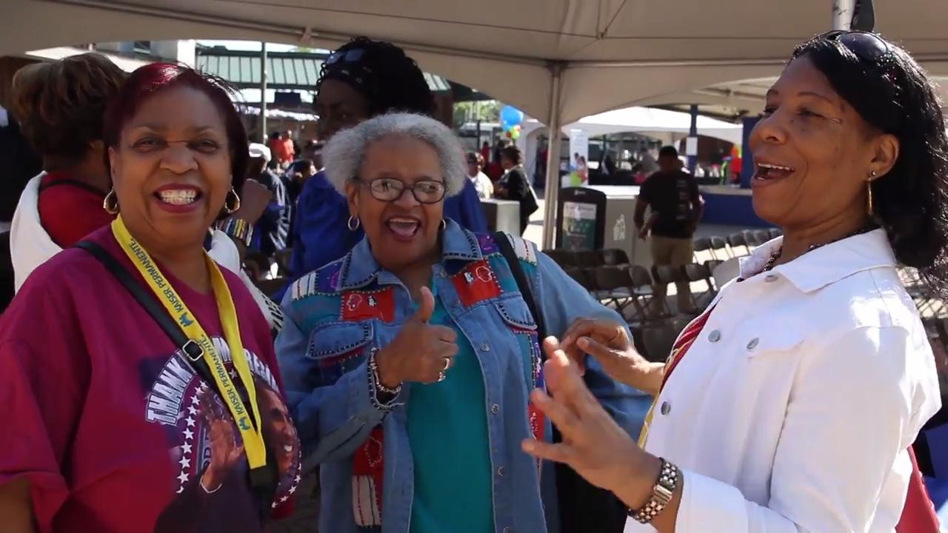
2019 Aging Well Expo
Celebrating Older Americans Month

Slide 7
Senior Satisfaction Survey
Seniors rated their level of satisfaction with city services on a scale of 1-5.

Slide 8
2019 Senior Satisfaction Survey Results

Slide 9
2019 Senior Satisfaction Survey Results

Slide 10
2019 Senior Satisfaction Survey Results

Slide 11
2019 Senior Satisfaction Survey Results

Slide 12
2019 Senior Satisfaction Survey Results

Slide 13
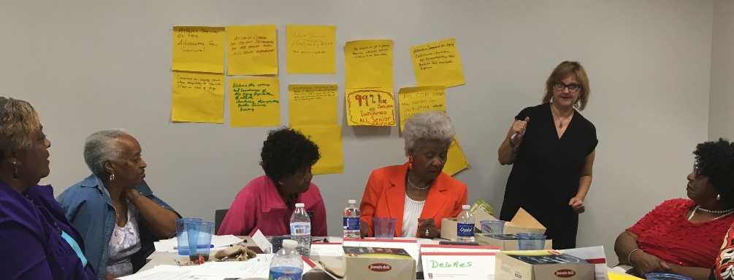
2019 Goal Setting Session
Facilitated by the Carl Vinson Institute of Government

Slide 14
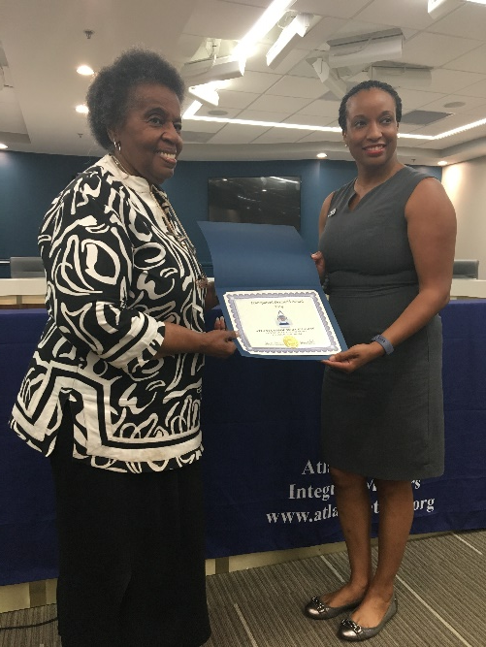
2019 Transparent Diamond Award

Slide 15
Aging In Place
Miriam Thompson – Metro Resource Center
Adult Day Care Services

Slide 16
Sanitation Services
Robert Whitehead – installation chief
Department of public works, solid waste services

Slide 17
Transportation
Nurudeen Olayiwola- transportation director
Department of public works

Slide 18
ADA Compliance
Betty Smoot-Madison, Senior Director of planning Department of public works

Slide 19
Uber/Lyft Services for Fulton County Seniors
Penelope greer, transportation coordinator
Futon County department of senior services

Slide 20
Fraud Prevention
Carolyn cartwright, Volunteer
Atlanta Regional commission

Slide 21
Thank You!

