Slide 1
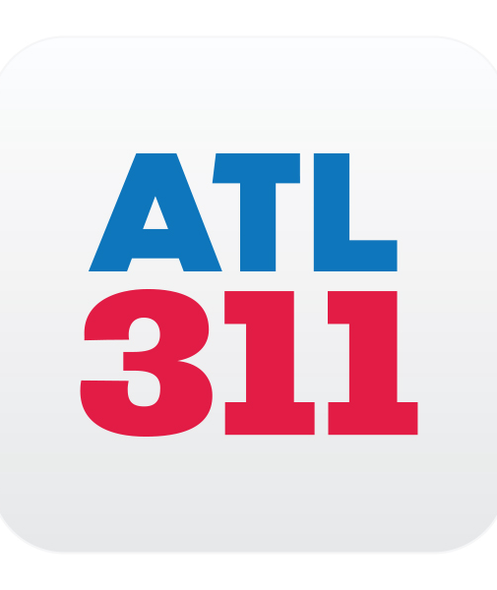
Finance/Executive Committee Update
June 2019
Salethea Graham
Executive Director
Department of Customer Service

Slide 2
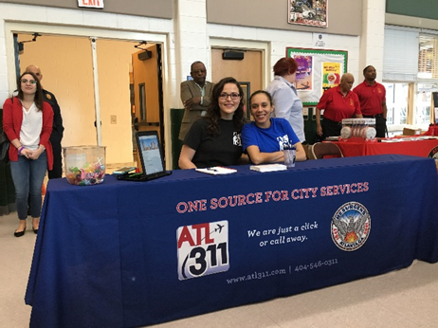
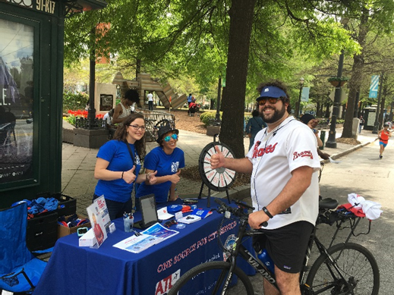
FY19 Highlights
Began handling calls for Municipal Court and Office of Film & Entertainment
Launched the ATL311 Mobile App
Attended more than 90 community events across all council districts
Added survey options to increase customer feedback

Slide 3
Municipal Court Abandon Rate/Avg Speed of Answer
Dramatic service improvement for Municipal Courts

Slide 4
ATL311 Call Volume
Municipal Courts added ~12K calls per month starting in July

Slide 5
Top 5 Service Requests
Request Type | Count | Department
Property Owner or Renter Request to Establish New Water and Sewer Bill Account Services | 34,425 | Department of Watershed Management
Account Information for Active Water And Sewer Account | 33,021 | Department of Watershed Management
How much is my court fine and how do I pay? | 30,592 | Municipal Court
When is my court date and time? | 21,040 | Municipal Court
Balance Information For Active Water And Sewer Account | 17,961 | Department of Watershed Management

Slide 6
Workload By Department
Call volume + talk time percentage by department

Slide 7
Service Requests by Channel
Goal is to diversify support channel mix

Slide 8
Post Call Survey
Total May Surveys 297

Slide 9
ATL311 Social Media
*May 2018-May 2019
Follow @ATL311

Slide 10
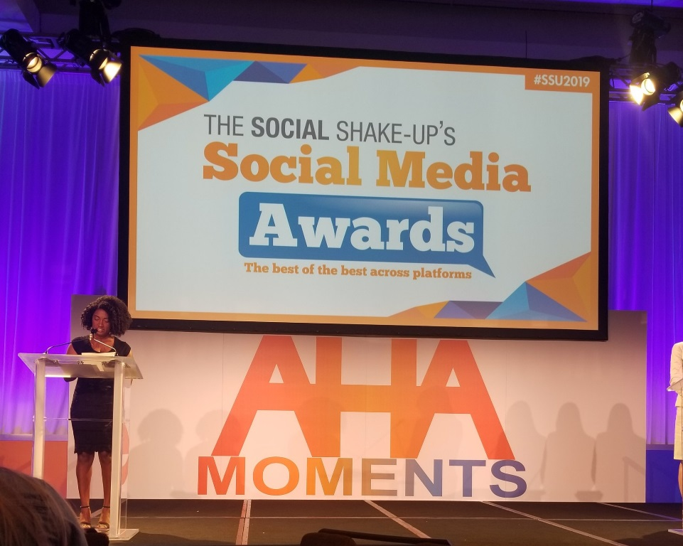
ATL311 Social Media Award
ATL311’s Social Media Specialist, Aubrianna, named 2018 Movers and Shakers Winner
Selected by demonstrating she is an industry thought leader in the use of social media

Slide 11
One Source for City Services
Questions?

