Slide 1
Finance/Executive Committee Update
March 2019
Rocky Atkins
Commissioner
Department of Customer Service

Slide 2
FY19 Overview To-Date
Operational metrics stabilizing after a challenging 12 months
Began handling calls for Municipal Courts and the Office of Film & Entertainment
Launched the ATL311 mobile app
Supported a wide range of departmental initiatives
Social media / community outreach
Employee update
On track to finish FY19 well under budget

Slide 3
ATL311 Call Volume
FY19 avg monthly calls handled YTD – 46,600
2017 avg monthly calls handled – 33,800
Post-cyber attack impact March - June
Municipal Courts added ~12K calls per month starting in July
Seasonal drop in November - December

Slide 4
ATL311 Service Level
% of calls answered within 20 seconds
Nov/Dec impacted by 3 separate system and power outages

Slide 5
Municipal Court Abandon Rate/Avg Speed of Answer
Dramatic service improvement for Municipal Courts

Slide 6
Workload By Department
Call volume + talk time percentage by department

Slide 7
Departmental Collaboration & Operational Improvements
Partnered with departments across the City on a wide range of issues and initiatives, including:
Operation Fix It
Dockless mobility devices
DPW route changes and bulk scheduling process
DWM new service process
DPW / Code Enforcement complaints handling
Implemented post-call surveys earlier this month

Slide 8
ATL311 Mobile App
Soft launch July 2018
DPW and Code Enforcement
Official launch October 2018
Phase II released February 2019
Spanish option
Ability to upload videos
Enhanced mapping capabilities (intersections)
Over 6,500 downloads to-date
Potholes are the number 1 service request type

Slide 9
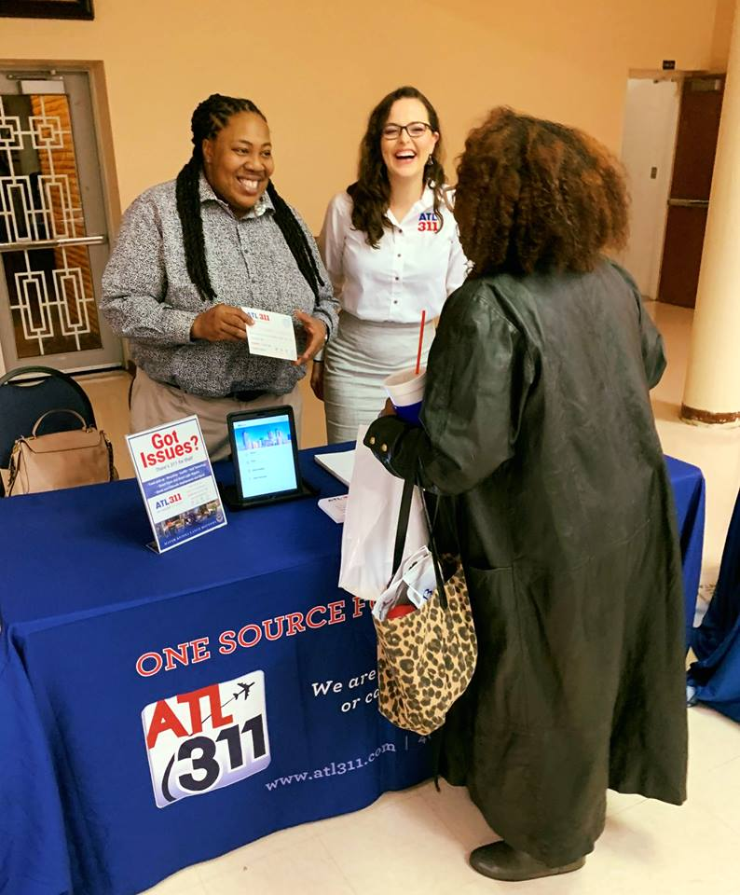
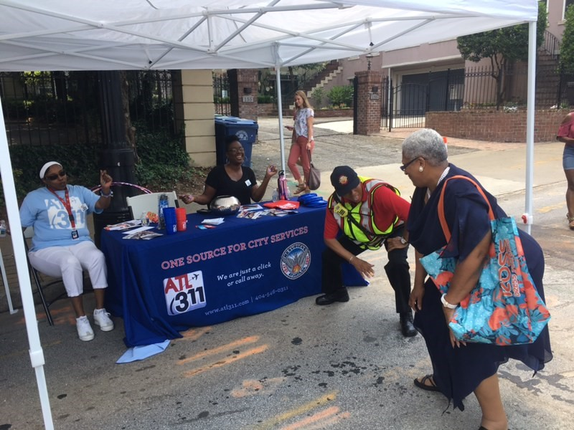
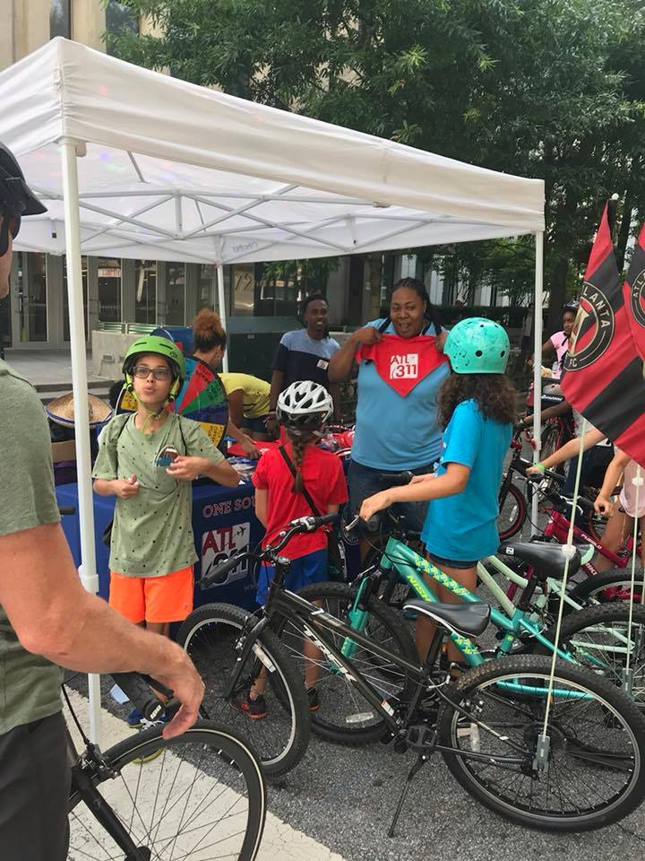
Community Outreach
Attended 60+ events across all City Council Districts (FY19 YTD)

Slide 10
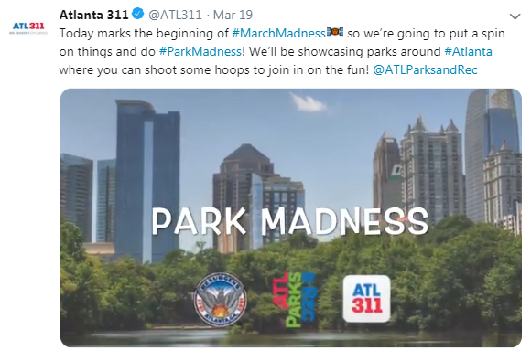
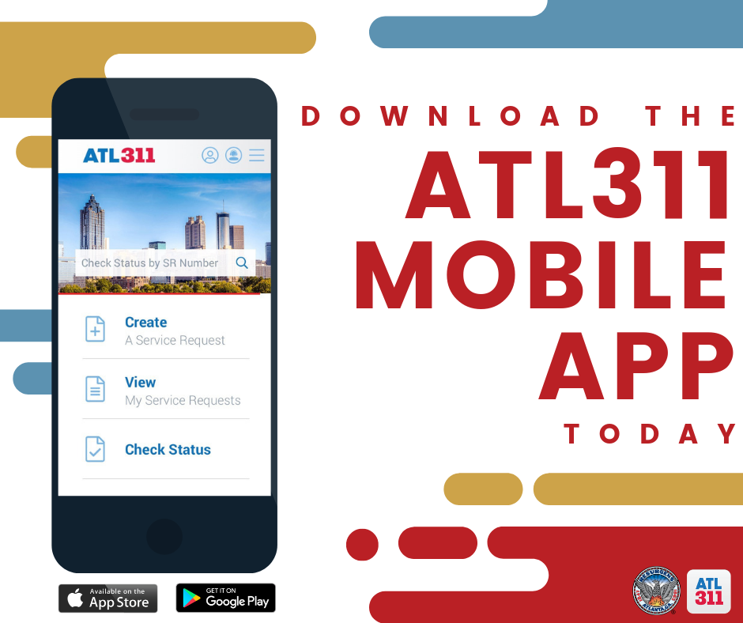
ATL311 Social Media Campaigns

Slide 11
ATL311 Social Media Service Requests
Follow @ATL311

Slide 12
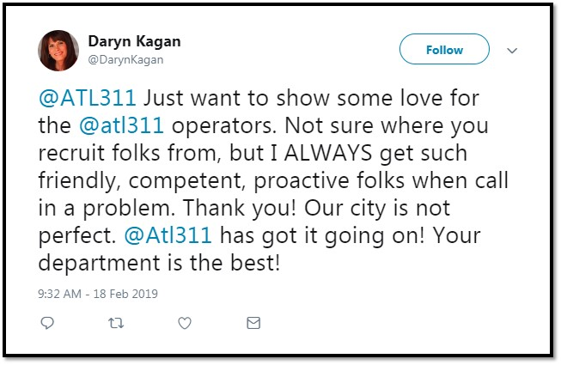
ATL311 Social Media Compliments

Slide 13
Employee Update
Organizational changes
New ATL311 Operations Director, Kenneth Butler
Escalation team
Align agents with supervisors by shift
Revamped recognition / incentive program
Plans to revamp training / on-boarding
New hire class in April
The way you treat your employees is the way they will treat your customers (credit: Richard Branson)

Slide 14
One Source for City Services
Questions?

