Slide 1
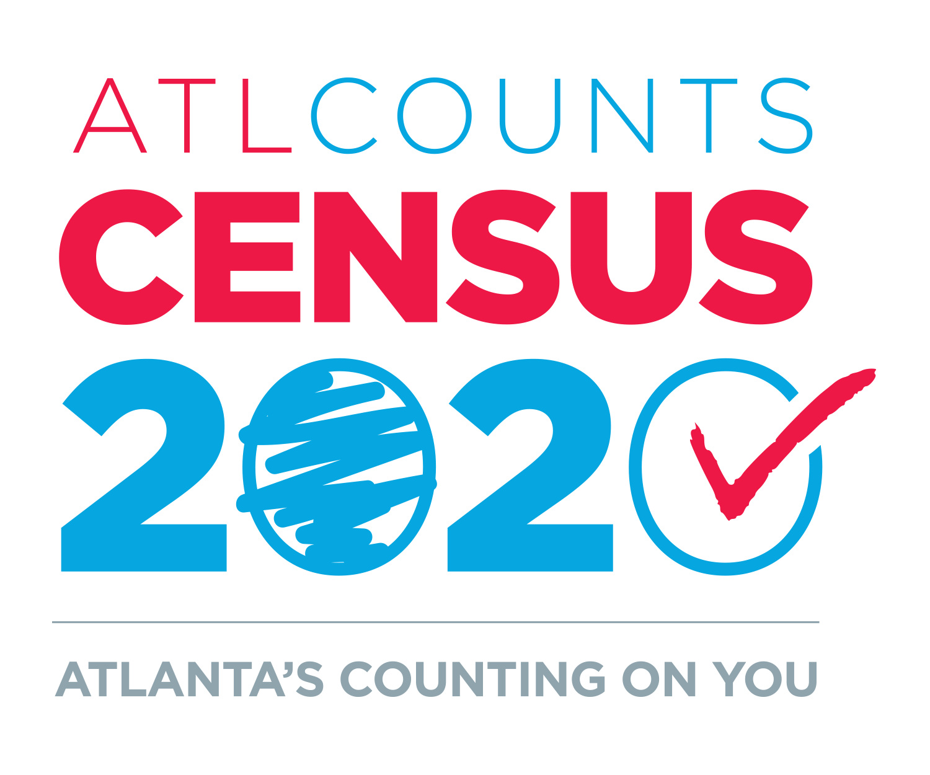

Slide 2
2020 Census
The 2020 Census results will guide the distribution of more than $675 billion in federal funding and becomes part of the basis for decisions that impact where roads, hospitals and schools are built.
The 2020 Census is also the first digital census, with a sharp reduction in paper questionnaires to be distributed, and most households will be expected to respond online using computers, mobile phones or other devices.
Atlanta Mayor Keisha Lance Bottoms has focused the City on a goal of increasing its census participation rate in 2020.
City of Atlanta Census Participation Rate
80%
74%
2020
2010
ATLANTA’S COUNTING ON YOU

Slide 3
The Difference in 2020
3 Ways to Respond
Mail
Unlike in previous years, the Census Bureau will mail a census questionnaire if a citizen requests a paper form by calling the Census Bureau
Online
This is the first digital census where citizens will be able to respond online.
The Census Bureau is encouraging most citizens to respond online
Phone
The Census Bureau will be available via phone to help citizens respond to their census questionnaires
In March 2020, the Census Bureau will mail each citizen a post card with a unique ID they will use to fill out the form.
ATLANTA’S COUNTING ON YOU

Slide 4
Additional Challenges for 2020 Census
Fewer Federal Resources
The number of enumerators has been reduced from 500,000 in 2010 to 300,000 in 2020.
Until this year, Congress seriously underfunded efforts to prepare for the census, some regional offices have been closed, and resources for outreach and education have been cut.
Citizenship Question
18 states and several cities sued the federal government alleging the inclusion of a question about citizenship is unconstitutional. Three federal courts have agreed and the Supreme Court has decided to hear the case in April and issue a ruling by June.
ATLANTA’S COUNTING ON YOU

Slide 5
Local Updated Census Addresses (LUCA)
The city’s census work started last March with adding and updating addresses used by the Census Bureau.
Last summer, the Department of Planning, in conjunction with the Office of Equity, updated our address database.
By the Numbers
New Addresses Added – 14,805
Addresses Corrected – 64,421
Addresses Deleted – 3,578
Total Addresses – 269,422
ATLANTA’S COUNTING ON YOU

Slide 6
City of Atlanta Complete Count Committee
The Complete Count Committee (CCC) is made up of community influencers who work to create localized messaging that resonates with the population in their interest area. They are trusted voices and are best suited to mobilize community resources in an efficient manner. The CCC will play a key role in developing partners to educate and motivate residents to participate in the 2020 Census, especially in our hard to count communities.
The CCC provides a vehicle for coordinating and nurturing cooperative efforts between our local government; communities; and the Census Bureau. The CCC will create subcommittees to help get the work done.
50+ stakeholders committed to Atlanta who can offer resources, networks, and expertise in:
Outreach
Communications/Media
Fundraising
Data and Technology
ATLANTA’S COUNTING ON YOU

Slide 7
2020 Census Key Dates
ATLANTA’S COUNTING ON YOU

Slide 8
Examples of Ways to Bridge the Digital Divide
The City will ask locations with public Wi-Fi to serve as census hubs and promote census and available Wi-Fi, e.g., have stickers in shop windows and table tents on library kiosks.
Make available iPads, laptops and Wi-Fi in sites with high traffic, e.g., recreation centers, senior centers and at community events.
The City will promote the ability for residents to complete census by phone or on paper.
ATLANTA’S COUNTING ON YOU

Slide 9
Next Steps
Census Campaign Headquarters
Grand Opening
April 1 Kick-Off Rally
Lunch and Learn
ATLANTA’S COUNTING ON YOU

