Slide 1
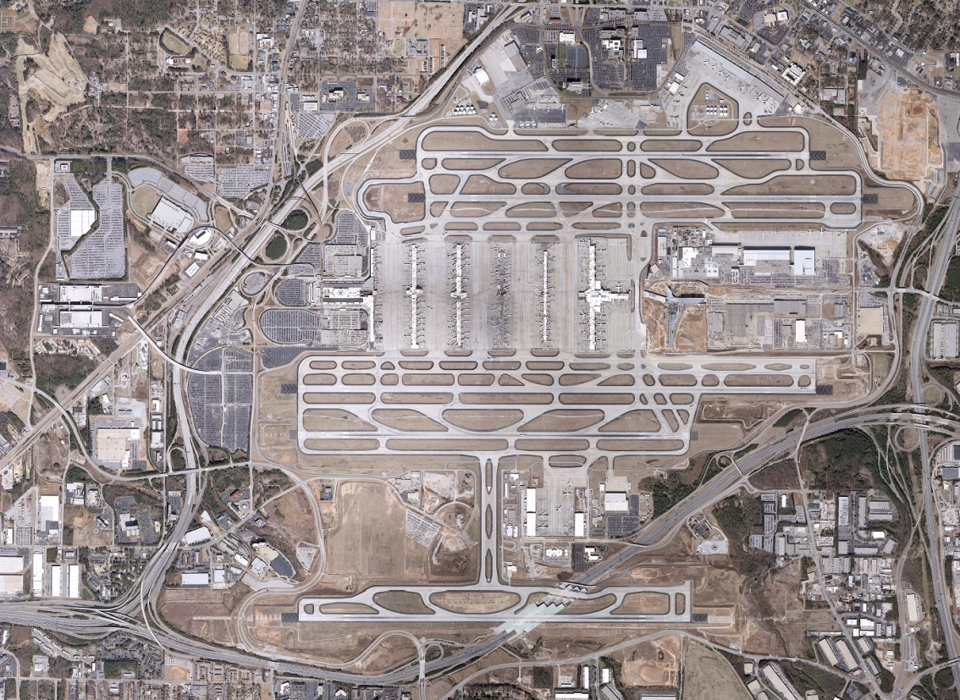
Airport Ground Transportation System
Airport Commercial Ground Transportation System
Hartsfield-Jackson Atlanta International Airport has many transportation options for passengers traveling to/from the Airport. They include the following:
ATL
Taxis
Limos
Uber/ Lyft
Shared Ride
Local/ Regional
Hotel Courtesy Shuttles
Off-Airport Parking
Charters
Rental Cars
MARTA
Greyhound
Terminal to Terminal
HARTSFIELD-JACKSON
By John Selden
Aviation General Manager

Slide 2
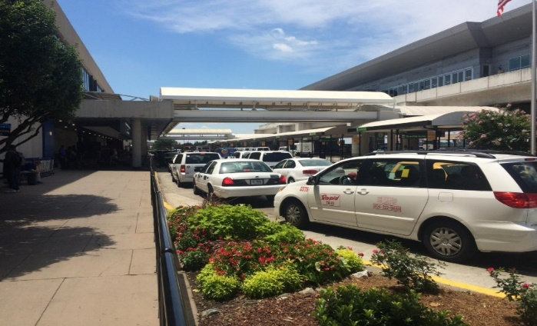
GROUND TRANSPORTATION
TAXICABS
18 Taxicab Companies providing 836 vehicles at the Airport
FY18 Taxicab Trip Activity & Revenue
562,127 trips
$883,991 generated revenue
Represents 15.2% of all ground transportation trips
Taxicab Fare
$30 Flat Rate to Downtown
$32 Flat Rate to Midtown
$40 Flat Rate to Buckhead
Airport Fees
Permit Fee - $50/vehicle
Trip Fee - $1.50/pickup
HARTSFIELD-JACKSON
Airport Ground Transportation System

Slide 3
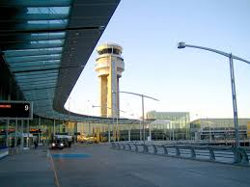
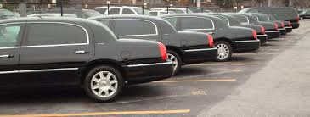
GROUND TRANSPORTATION
LIMOUSINES
HARTSFIELD-JACKSON
316 Limousine Companies providing 1,530 vehicles at the Airport
FY18 Limo Trip Activity & Revenue
258,342 trips
$479,461 generated revenue
Represents 6.2% of all ground transportation trips
Limousine Cost
Trips are prearranged and cost is dependent upon passenger destination
Airport Fees
Permit Fee - $50/vehicle
Trip Fee - $1.50/pickup
Airport Ground Transportation System

Slide 4
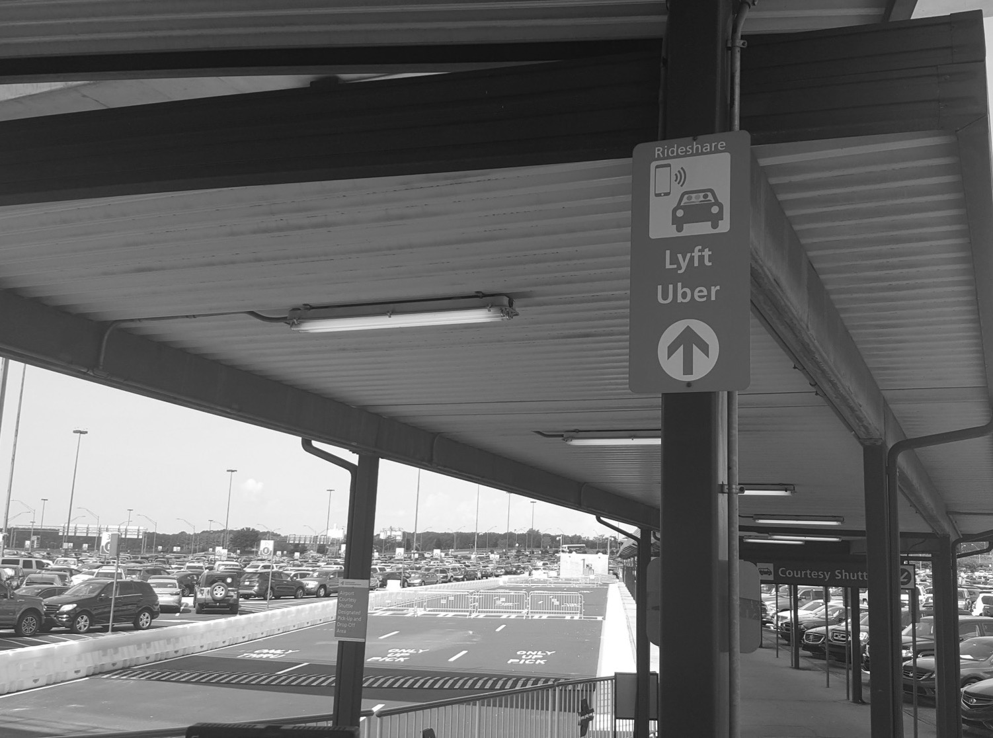
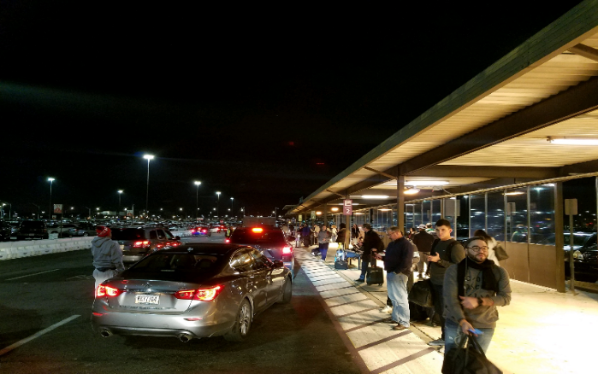
GROUND TRANSPORTATION
RIDESHARE
HARTSFIELD-JACKSON
2 Rideshare Companies (Uber & Lyft) providing 2,000+ vehicles at the Airport
FY 18 Rideshare Pickup Activity & Revenue
2,018,371 trips
$8,151,418 generated revenue
Represents 48.2% of all ground transportation trips
Rideshare Fare
Fares vary and are subject to surge pricing
Airport Fees
Permit Fee - $50/vehicle
Trip Fee - $1.50/pickup plus
Security Fee - $2.35/pickup
Airport Ground Transportation System

Slide 5
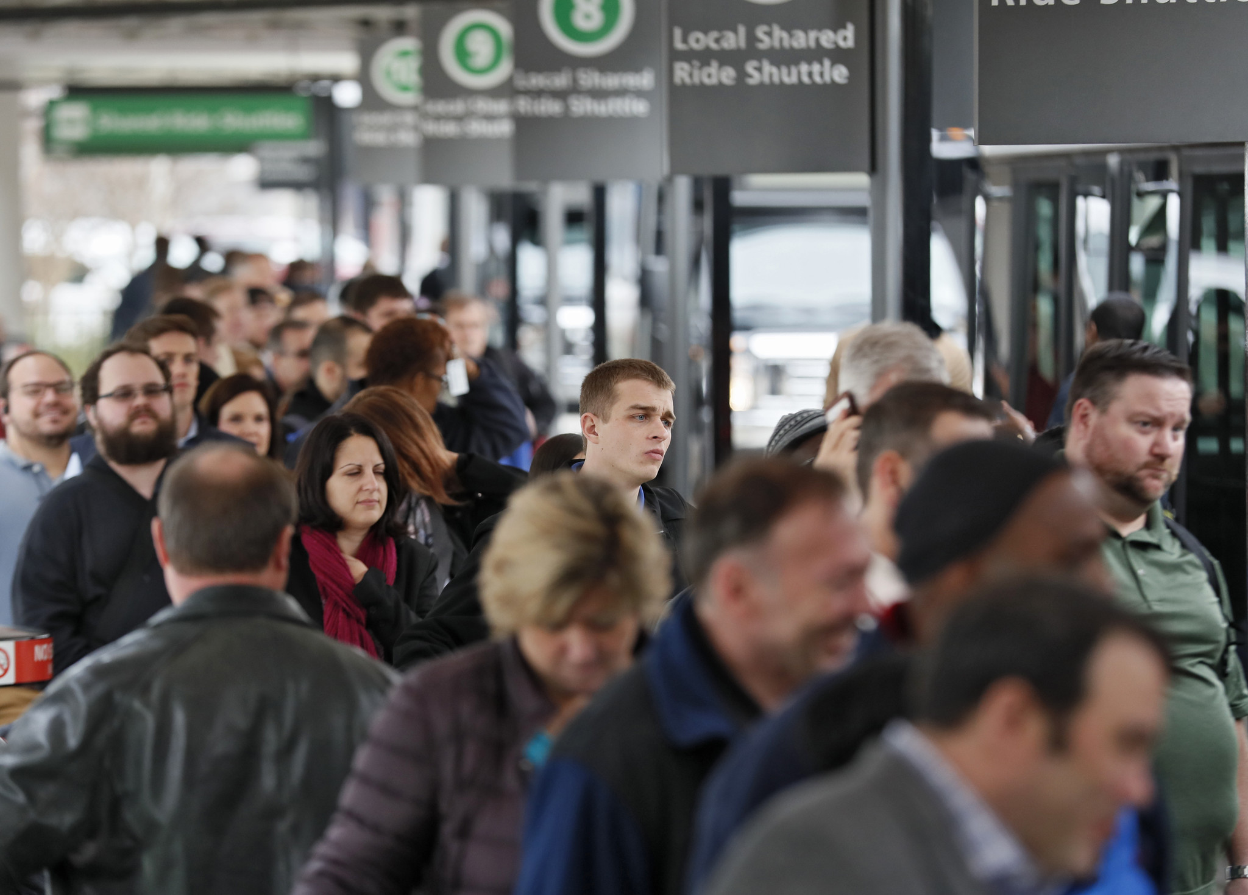
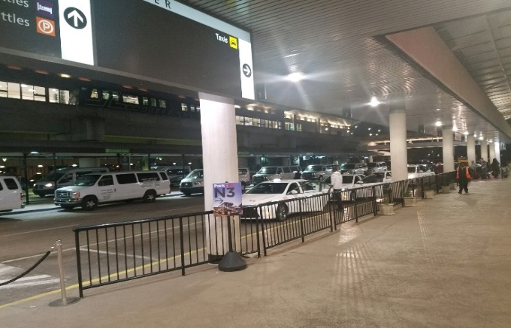
GROUND TRANSPORTATION
SHARED RIDE (Local & Regional)
25 Shared-Ride Companies (12-Local & 13 Regional) providing 212 vehicles at the Airport
FY18 Shared-Ride Trip Activity & Revenue
114,003 trips
$49,659 generated revenue
Represents 2.4% of all ground transportation trips
Share-Ride Fare (local)
$16 Flat Rate to Downtown
$18.50 Flat Rate to Midtown
$30 Flat Rate to Buckhead
Regional fares are dependent on passenger destination
Airport Fees
Metro (Local): 5-7% of gross receipt
Permit Fee: Non-Metro (Regional): $600/year for use of designated loading space) plus $100/vehicle (no trip fee)
HARTSFIELD-JACKSON
Airport Ground Transportation System

Slide 6
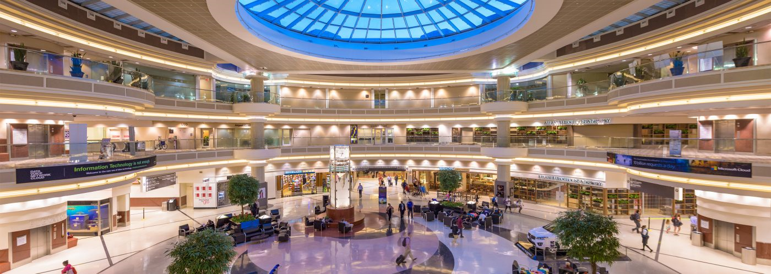
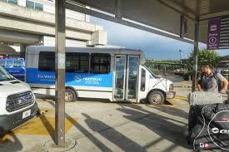
GROUND TRANSPORTATION
HOTEL/MOTEL
HARTSFIELD-JACKSON
57 Hotel/Motel Companies providing 134 courtesy shuttles at the Airport
FY18 Taxicab Trip Activity & Revenue
430,408 trips
$111,584 generated revenue
Represents 15.2% of all ground transportation trips
Hotel/Motel Fare
Courtesy shuttle
Airport Fees
Permit Fee: $360/ vehicle per year plus $10/hotel room (9,105 rooms)
Trip Fee: None
Airport Ground Transportation System

Slide 7
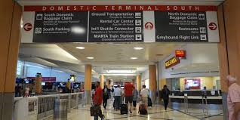
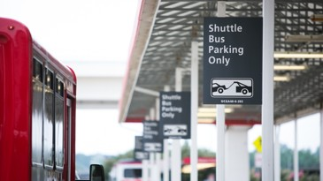
GROUND TRANSPORTATION
OFF-AIRPORT PARKING
HARTSFIELD-JACKSON
12 Off-Airport Parking Companies providing 163 vehicles at the Airport
FY18 Off-Airport Parking Trip Activity & Revenue
680,954 trips
$262,461 generated revenue
Represents 16.2% of all ground transportation trips
Off-Airport Parking Fare
Courtesy shuttle
Airport Fees
Permit Fee: $360/ vehicle per year plus $10/parking space (21,469 parking spaces)
Trip Fee: None
Airport Ground Transportation System

Slide 8
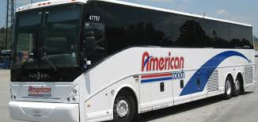
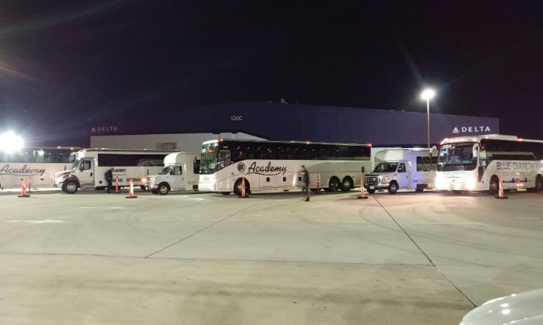
GROUND TRANSPORTATION
CHARTER
HARTSFIELD-JACKSON
25 Charter Companies providing 353 vehicles at the Airport
FY18 Charter Trip Activity & Revenue
61,933 trips
$13,834 generated revenue
Represents 1.5% of all ground transportation trips
Charter Fare
Dependent upon passenger destination
Airport Fees
Permit Fee: $0.10/seat
Trip Fee: None
Airport Ground Transportation System

Slide 9
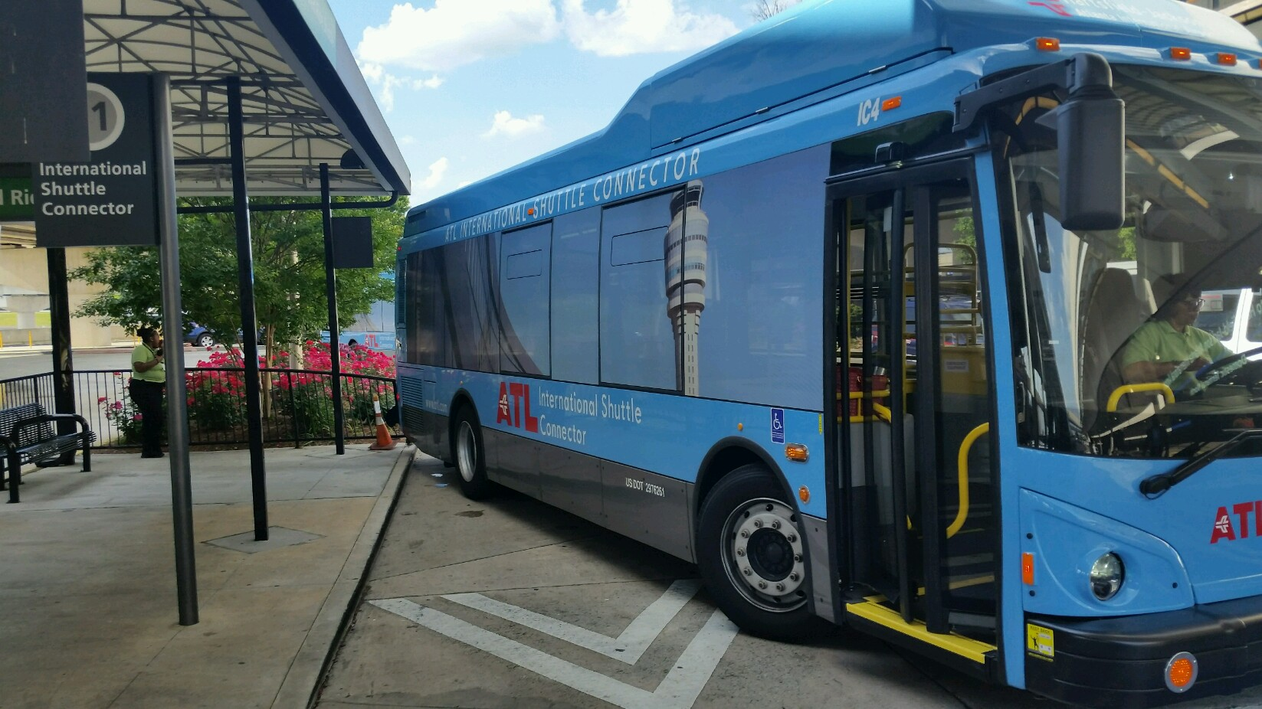

GROUND TRANSPORTATION
TERMINAL TO TERMINAL SHUTTLE
HARTSFIELD-JACKSON
Customer Service shuttle service between terminals and Rental Car Center utilizing a fleet of 35 shuttles (16 buses and 19 shuttles)
This service connects the following passenger/customer types:
Non-Delta International connecting passengers (Qatar, Lufthansa, British Airways, Turkish, and Air Canada)
MARTA International passengers (Arrivals/Departures) and MARTA bus connections
Employees (non-SIDA Concourse F)
Rental Car Center passengers (terminating at F)
Contract Cost:
$5M (Operating & Maintenance)
Airport Ground Transportation System

Slide 10
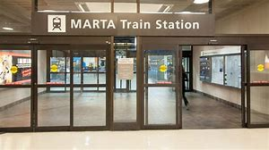

GROUND TRANSPORTATION
MARTA – BUS/RAIL
HARTSFIELD-JACKSON
MARTA provides bus service at the International Terminal and rail service to the Domestic Terminal
The Airport MARTA station is in the domestic terminal of the Airport
MARTA bus stop at International Arrivals curb just pass door A3
MARTA Fare
Regular Fare: $2.50 Single / $5.00 Roundtrip
Airport Fees
None
Airport Ground Transportation System

Slide 11
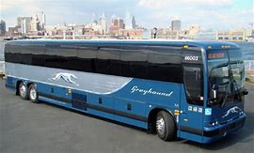
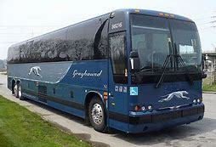
GROUND TRANSPORTATION
GREYHOUND
HARTSFIELD-JACKSON
Greyhound has a 1,600 Vehicle Fleet
Facts & Figures
4,000 destinations incl. the ATL Airport
Pickup location at the Terminal North lower level near door LN1
Greyhound Fare
Dependent upon passenger destination
Airport Fees
Standard Real Estate Lease with the Airport
$14K annual for 294 sq. of lease space
Airport Ground Transportation System

Slide 12
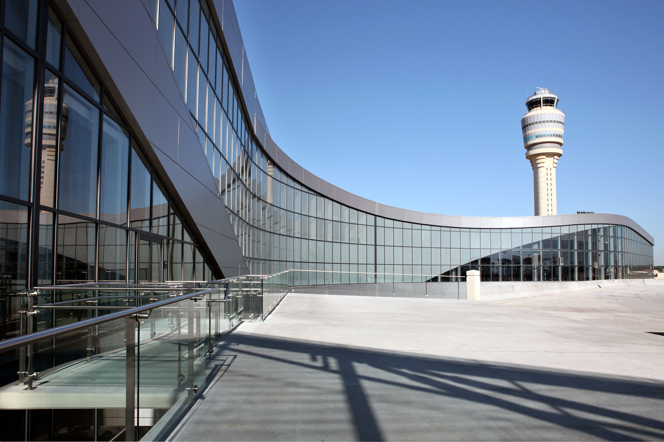
GROUND TRANSPORTATION
SUMMARY
HARTSFIELD-JACKSON
Mode of Transportation | Expenses | Revenue | % of Total Revenue | Trip Activity | % of Total Trip Activity
Rideshare (TNCs) | $8,867,077 | $8,151,418 | 82.3% | 2,018,371 | 48.0%
Taxicabs | $2,262,948 | $883,991 | 8.9% | 638,889 | 15.2%
Off-Airport Parking | $394,923 | $262,461 | 2.7% | 680,954 | 16.2%
Courtesy Vehicles (Hotel/Motel) | $167,900 | $111,584 | 1.1% | 430,408 | 10.2%
Limousines | $721,441 | $479,461 | 4.8% | 258,342 | 6.1%
Shared-Ride (Local & Regional) | $74,722 | $49,659 | 0.5% | 114,003 | 2.7%
Charter | $20,816 | $13,834 | 0.1% | 61,933 | 1.5%
Terminal to Terminal | $5,038,005
TOTAL | $17,547,832 | $9,952,408 | 100.0% | 4,202,900 | 100.0%
Airport Ground Transportation System
Notes:
Expense Incl.:
Personnel
Supplies
Purchased/Contract Services
Curbside Management
Taxi Overflow
Terminal to Terminal
Terminal to Terminal Maintenance
Rideshare Tracking
Interdepartmental
Other Division Costs:
ATL Enforcement
APD
Maintenance
IT

Slide 13
GROUND TRANSPORTATION
JOHN’S OBSERVATIONS
HARTSFIELD-JACKSON
THANK YOU
Airport Ground Transportation System

Slide 14
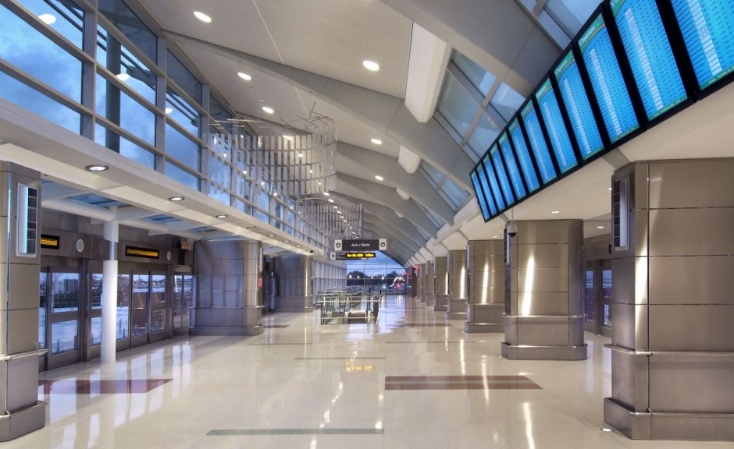
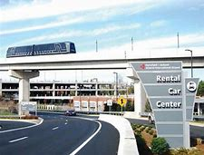
GROUND TRANSPORTATION
RENTAL CAR
HARTSFIELD-JACKSON
12 Brand Companies providing rental car service at the Airport
2018 Activity & Revenue
7.9M transaction days
10% of gross receipts to the Airport totaling $41,969,173
Rental Car Passenger Cost
Dependent upon rental type (one way/roundtrip), duration and company
Airport Fees
Approx. $5/transaction Customer Facility Charge (CFC) totaling $41,029,105
Airport Ground Transportation System

