Slide 1
City of Atlanta
COVID-19 Funds Report
Department of Finance
September 18, 2024

Slide 2
COVID-19 Reporting Requirements
The City of Atlanta adopted four pieces of legislation which required the Chief Financial Officer to prepare and submit certain reports in a timely fashion regarding the financial impact of COVID-19.
20-R-3773 requires the “Chief Financial Officer provide a report on the accounting of all federal and state funds the City of Atlanta has received or will receive to assist with battling the harmful effects of the COVID-19 pandemic.”
20-R-3774 requires the “Chief Financial Officer to provide the Council President and all members of the City Council an accounting of all funds that will be contributed to non-profit and philanthropic organizations as part of the City’s emergency assistance in response to the COVID-19 pandemic.”
20-R-3787 (not to exceed $5M) and 20-R-3914 (not to exceed $20k) requires that the “Chief Financial Officer shall submit to the Atlanta City Council and to the Atlanta Ethics Office before the 15th of each month a report listing for the previous month, the details of ... each donation . . .”

Slide 3
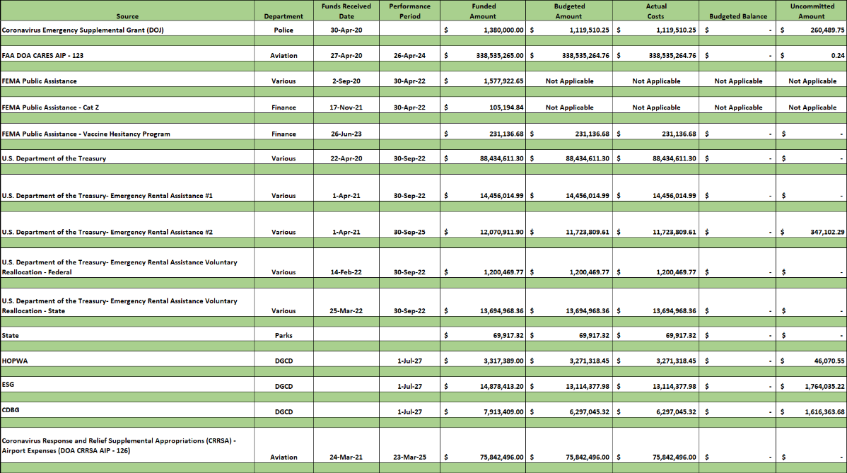
Federal Funds 20-R-3773

Slide 4
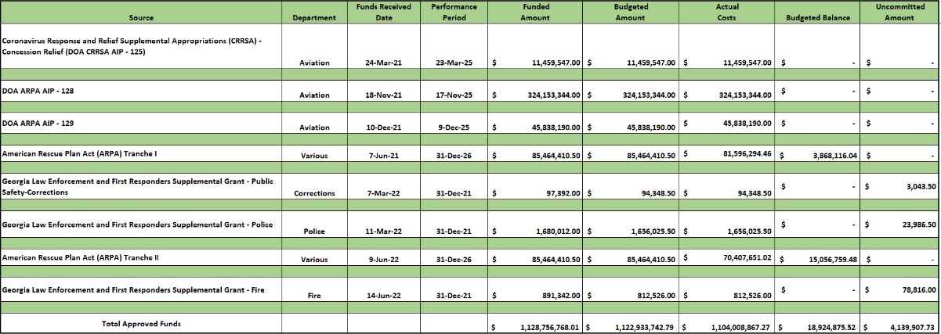
Federal Funds Con’t 20-R-3773

Slide 5
Performance Period Deadline 6 Months Look ahead

Slide 6
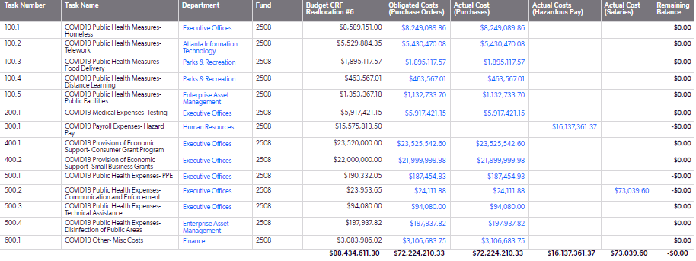
CRF Obligation & Spend Breakdown 20-R-3773
U.S. Treasury Cares Act:
Funded Amount- $88.4M
Obligated Costs - $88.4M
Actual Costs - $88.4M
Available Balance - $0
Performance Period:
Obligation Deadline: December 31, 2021
Expenditure Deadline: September 30, 2022

Slide 7
ERA Obligation & Spend Breakdown 20-R-3773
Emergency Rental Assistance (ERA):
Funded Amount- $41.4M
Total Committed - $41.07M
Obligated Costs - $41.07M
Total Expended Costs - $41.07M
Available Balance - $347,102.29
Performance Period:
ERA 1: September 30, 2022
ERA 2: September 30, 2025
ERA 1 Reallocation: December 29, 2022

Slide 8
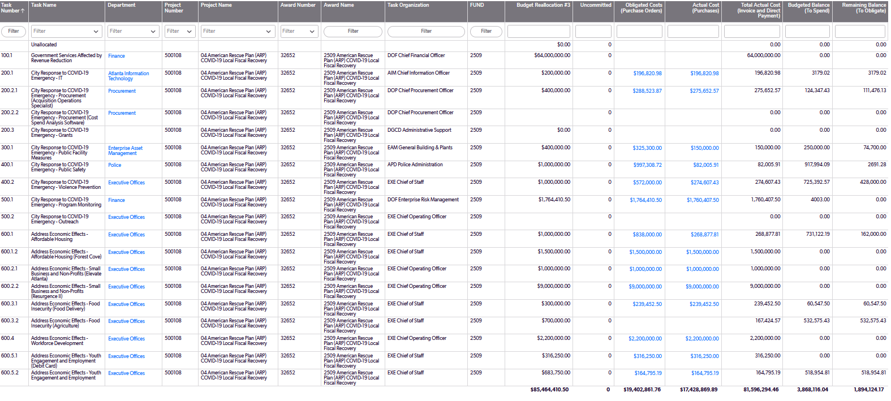
ARPA Tranche I Obligation & Spend Breakdown 20-R-3773
American Rescue Plan Act (ARPA) Tranche I:
Funded Amount – $85.4M
Total Committed – $85.4M
Obligated Costs – $19.40M/Direct Payments – $64.16M
Total Expended Costs – $81.59M
Performance Period:
Obligation Deadline: December 31, 2024
Expenditure Deadline: December 31, 2026

Slide 9
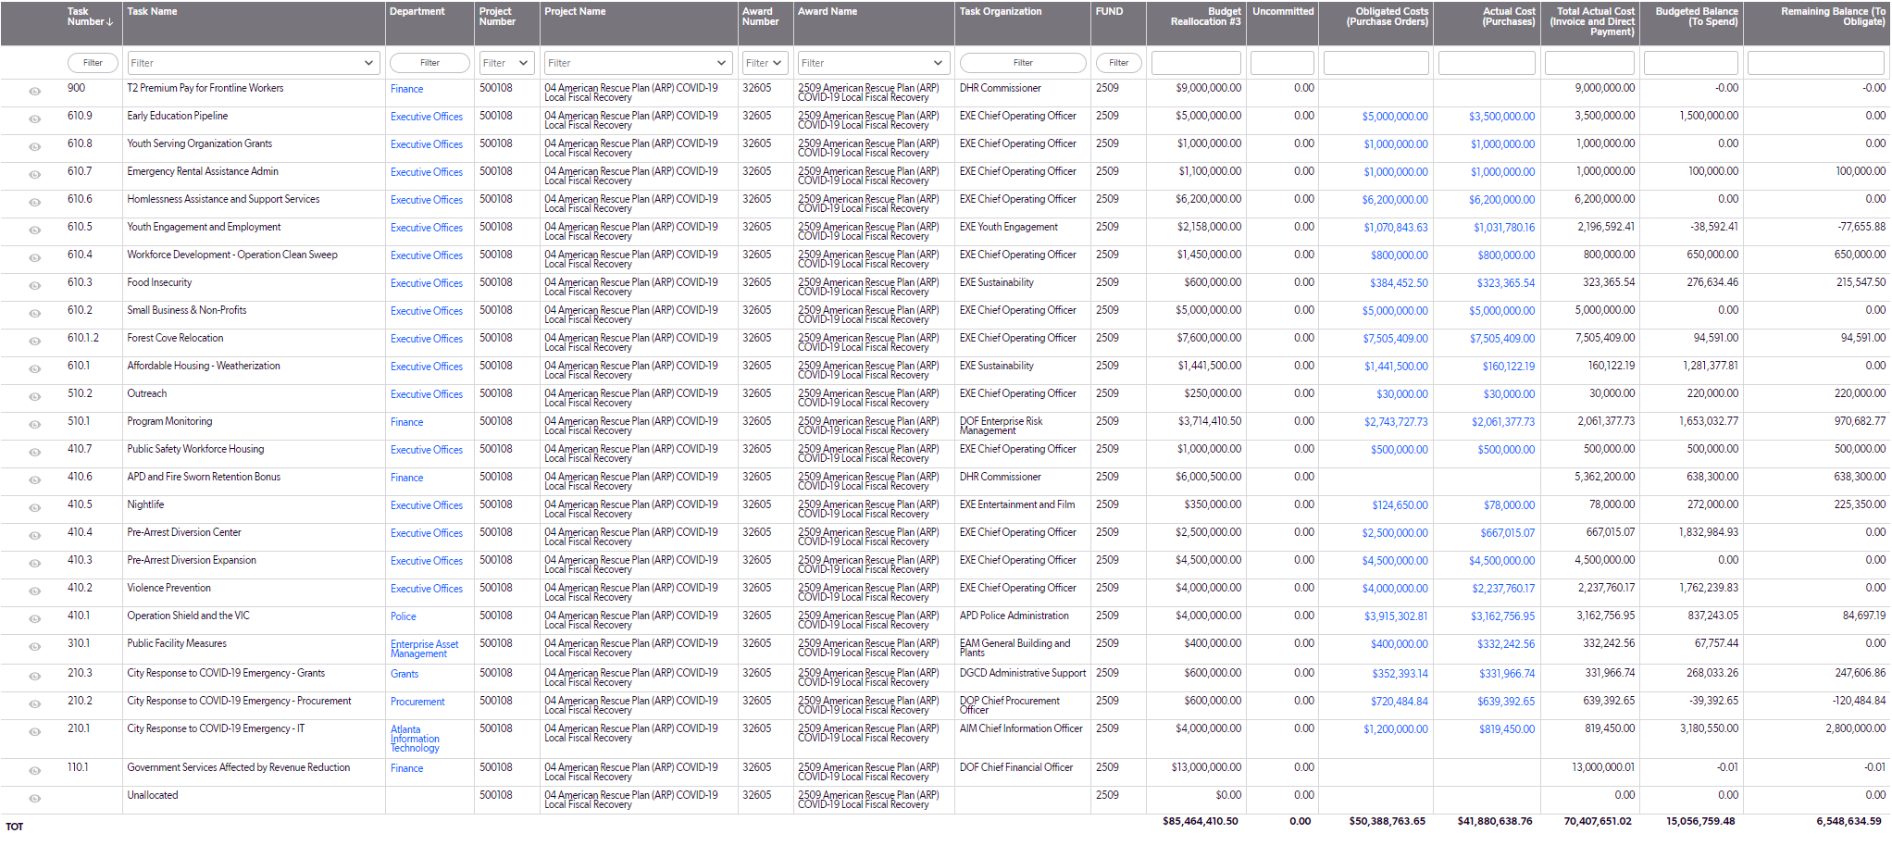
ARPA Tranche II Obligation & Spend Breakdown 20-R-3773
American Rescue Plan Act (ARPA) Tranche II:
Funded Amount – $85.4M
Total Committed – $85.4M
Obligated Costs – $50.38M/Direct Payments - $28.51M
Total Expended Costs – $70.40M
Performance Period:
Obligation Deadline: December 31, 2024
Expenditure Deadline: December 31, 2026

Slide 10
DOA CARES AIP – 123 Spend Breakdown Details
Major Category | Costs
Equipment | $ 800.00
Utilities | $ 293,130.59
Personnel Services and Employee Benefits | $ 37,723,586.90
Consulting Services | $ 50,615,835.23
Debt Service | $ 249,901,912.04
Grand Totals | $ 338,535,264.76
Federal Aviation Administration (FAA):
Funded Amount- $338,535,265.00
Obligated Costs - $338,535,264.76
Actual Costs - $338,535,264.76
Available Balance - $0.24
Performance Period:
April 27, 2021 – April 26, 2024

Slide 11
DOA CRRSA AIP – 125 Spend Breakdown Details
Major Category | Costs
Consulting Services | $ 11,459,547.00
Grand Totals | $ 11,459,547.00
DOA CRRSA AIP:
Funded Amount- $11.4M
Obligated Costs - $11.4M
Actual Costs - $11.4M
Available Balance - $0
Performance Period:
March 24, 2021 – March 23, 2025

Slide 12
DOA ARP AIP – 128 Spend Breakdown Details
Major Category | Costs
Software | $ 4,000.00
Supplies | $ 5,147.72
Subscriptions | $ 6,600.00
Uniforms | $ 12,190.80
Property Tax | $ 243,681.32
Equipment | $ 212,425.77
Memberships | $ 249,411.00
Repairs/Maintenance Equipment | $ 413,802.07
Utilities | $ 4,722,384.17
Telephone & Wireless Expense | $ 12,463,055.32
Medicare Contribution | $ 16,963,423.81
Debit Services | $ 17,544,449.59
Consulting Services | $ 112,318,168.74
Personnel Services and Employee Benefits | $ 158,994,603.69
Grand Totals | $ 324,153,344.00
DOA ARP:
Funded Amount- $324M
Obligated Costs - $324M
Actual Costs - $324M
Available Balance - $0
Performance Period:
November 18, 2021 – November 17, 2025

Slide 13
DOA ARP AIP – 129 Spend Breakdown Details
Major Category | Costs
Consulting/Professional Services | $ 45,838,190.00
Grand Totals | $ 45,838,190.00
DOA ARPA-MAG:
Funded Amount- $45.8M
Obligated Costs - $45.8M
Actual Costs - $45.8M
Available Balance - $0
Performance Period:
December 10, 2021 - December 09, 2025

Slide 14
DOA ARPA AIP – 126 Spend Breakdown Details
Major Category | Costs
Debt Service | $ 75,842,496.00
Grand Totals | $ 75,842,496.00
Federal Aviation Administration (FAA):
Funded Amount- $75.8M
Obligated Costs - $75.8M
Actual Costs - $75.8M
Available Balance - $0.00
Performance Period:
March 24, 2021 – March 23, 2025

Slide 15
Emergency Solution Grant Spend Breakdown Details
Major Category | Costs
Equipment | $ 1,230.00
Personnel Services and Employee Benefits | $ 26,078.66
Subrecipient Payments | $ 13,087,069.32
Grand Totals | $ 13,114,377.98
Emergency Solution Grant (ESG):
Funded Amount- $14.87M
Obligated Costs - $13.11M
Actual Costs - $13.11M
Available Balance $ 1.76M
Performance Period:
July – 2027

Slide 16
Community Dev. Block Grant Spend Breakdown Details
Major Category | Costs
Telephone Expense | $ 41.07
Consulting Services | $ 154.05
Equipment | $ 1,230.00
Training/Registration | $ 4,050.00
Service Grants | $ 397,273.70
Subrecipient Payments | $ 5,894,296.50
Grand Totals | $ 6,297,045.32
Community Development Block Grant (CDBG):
Funded Amount- $7.91M
Obligated Costs - $6.29M
Actual Costs - $6.29M
Available Balance - $1.61M
Performance Period:
July – 2027

Slide 17
HOPWA Grant Spend Breakdown Details
Major Category | Costs
Supplies | $ 949.03
Personnel | $ 59,115.41
Subrecipient Payments | $ 3,211,254.01
Grand Totals | $ 3,271,318.45
Housing Opportunities for Persons with AIDS (HOPWA):
Funded Amount- $3.3M
Obligated Costs - $3.2M
Actual Costs - $3.2M
Available Balance - $46K
Performance Period:
July – 2027

Slide 18
Atlanta Police Dept. Grant Spend Breakdown Details
Major Category | Costs
Supplies | $ 927,745.60
Consulting/Prof Services | $ 191,764.65
Grand Totals | $ 1,119,510.25
Atlanta Police Dept. (APD):
Funded Amount- $1.38M
Obligated Costs - $1.1M
Actual Costs - $1.1M
Available Balance - $260K

Slide 19
FIRST RESPONDERS GRANT Spend Breakdown Details
Major Category | Costs
Personnel Services and Employee Benefits | $ 94,348.50
Grand Totals | $ 94,348.50
Public Safety-Corrections:
Funded Amount- $97,392.00
Actual Costs - $ 94,348.50
Available Balance - $3,043.50
Major Category | Costs
Personnel Services and Employee Benefits | $ 1,656,025.50
Grand Totals | $ 1,656,025.50
Police:
Funded Amount- $1,680,012.00
Actual Costs - $1,656,025.50
Available Balance - $23,986.50
Major Category | Costs
Personnel Services and Employee Benefits | $ 812,526.00
Grand Totals | $ 812,526.00
Fire:
Funded Amount- $891,342.00
Actual Costs - $ 812,526.00
Available Balance - $78,816.00

Slide 20
Non-Profit and Philanthropic Organizations 20-R-3774
*includes $50k donation received from Arthur Blank Foundation

Slide 21
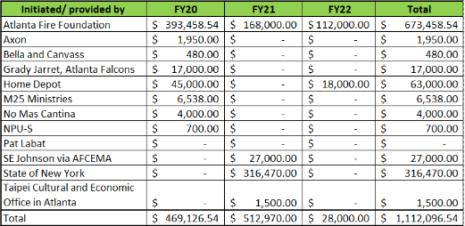
Donations (Summary)
20-R-3787 and 20-R-3914

Slide 22
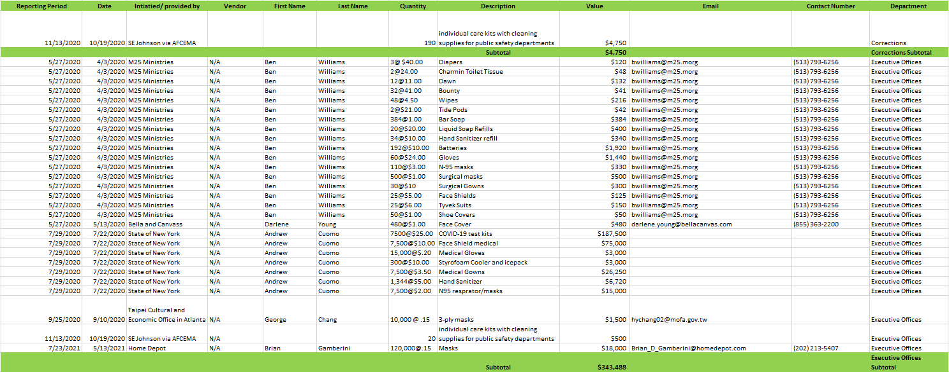
Donations (Detail)
20-R-3787 and 20-R-3914
EOC 1

Slide 23
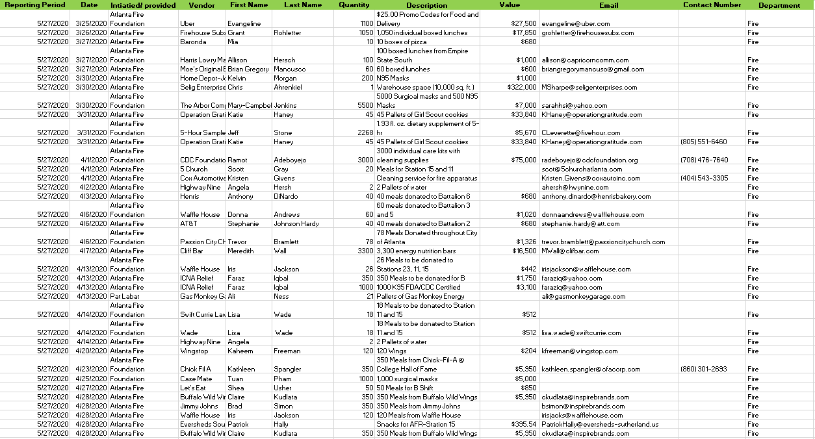
Donations (Detail) Con’t
20-R-3787 and 20-R-3914
Fire 1

Slide 24
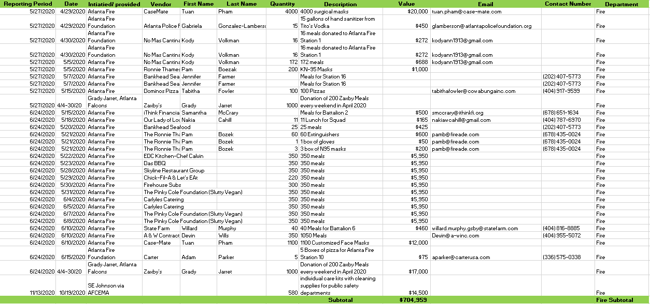
Donations (Detail) Con’t
20-R-3787 and 20-R-3914
Fire 1

Slide 25
Donations (Detail) Con’t
20-R-3787 and 20-R-3914
Fire 1

Slide 26
COVID-19 Expenditures (Function Activity 5510001)
As of September 13, 2024
Expenditure Data Date: 09/13/24

Slide 27
COVID-19 Expenditures (Function Activity 5510001)
As of September 13, 2024 (Cont’d)
*Hazardous Pay reported covers April 2020 through July 2021. (Process Date Period)
Reimbursements have been submitted to FEMA and are currently under review.
Expenditure Data Date: 09/13/24

