Slide 1
PSLA FY25-1st Quarter Metric Report
Roderick M. Smith, Fire Chief
ATLANTA FIRE RESCUE DEPARTMENT
1ST QUARTER METRIC REPORT | SEPTEMBER 23, 2024

Slide 2
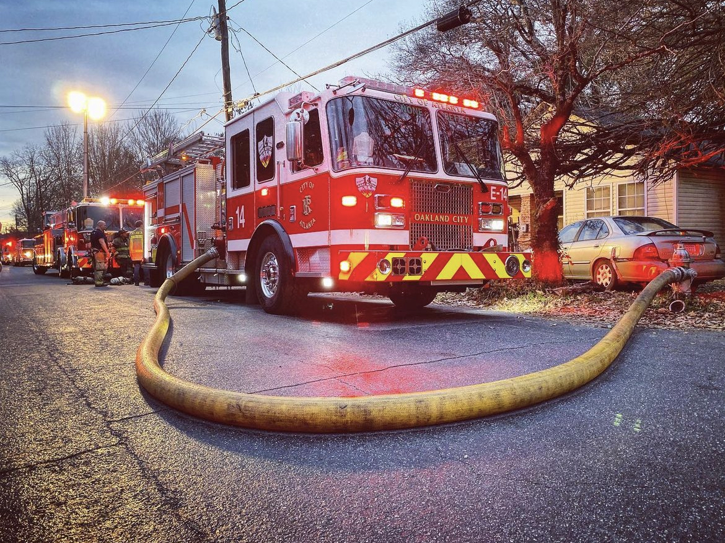
Goals & Objectives
Atlanta Fire Rescue Department:
Provide the safest possible work environment for all members
All recruitment & hiring needs are met
Continued focus on AFRD initiatives, enhancements, & accomplishments
City Council:
Maintain competitive compensation of AFRD members
Regularly review and monitor AFRD's emergency services that are provided to the City of Atlanta
Regularly review the condition and needs of AFRD fleet and facilities
ATLANTA FIRE RESCUE DEPARTMENT
1ST QUARTER METRIC REPORT | SEPTEMBER 23, 2024

Slide 3
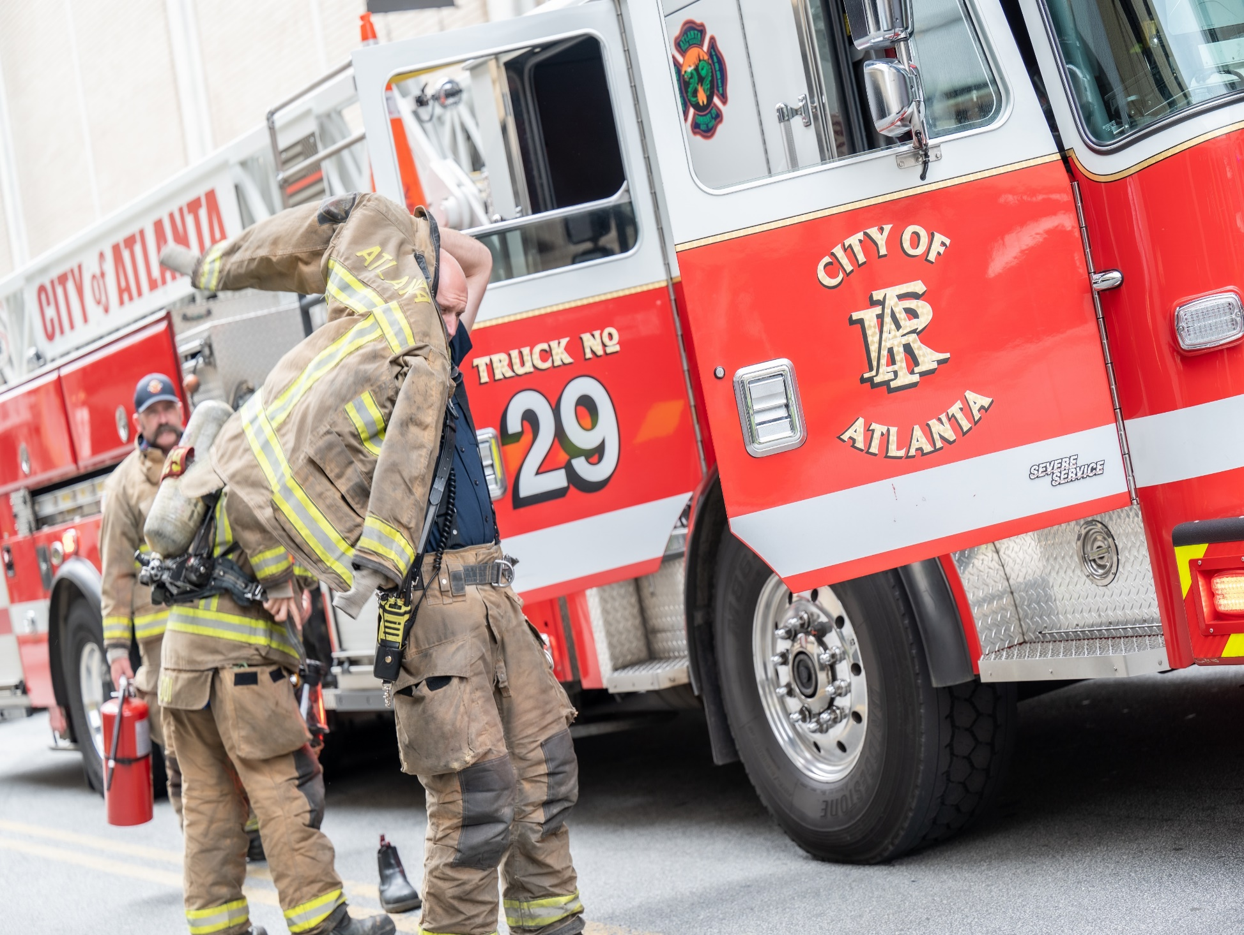
Total Calls for Service
Downtown & Aviation:
CFS Category | FYTD 2025
ARFF | 40
Bomb Threat | 3
EMS | 14,056
Fire | 4,803
Hazmat | 148
Jet Fuel Spilled | 26
Other | 2,554
Technical Services | 585
Total | 22,215
Note:
Data Source: P1CAD
Data Export by: A&P 09/17/2024
FYTD: July 1, 2024 – September 17, 2024
ATLANTA FIRE RESCUE DEPARTMENT
1ST QUARTER METRIC REPORT | SEPTEMBER 23, 2024

Slide 4
Service Metrics
Total Situations Found: Downtown & Aviation
Situations Found Category | FYTD 2025 | FY24-Q1 | FY25-Q1 | % Change
EMS | 8,181 | 9,237 | 8,181 | -11.4%
Structure Fire | 141 | 137 | 141 | 2.9%
Hazmat | 559 | 560 | 559 | -0.2%
Technical Rescue | 26 | 31 | 26 | 13.1%
Other Services | 10,941 | 12,873 | 10,941 | 15.0%
Total | 19,848 | 22,838 | 19,848 | -13.1%
Total Calls for Service Downtown & Aviation for FYTD 2025
Section | FYTD
Downtown | 19,340
Aviation | 2,875
Total | 22,215
Note:
FYTD 2025: 07/01/2024 - 09/17/2024
FY24-Q1: 07/01/2023 - 09/30/2023
FY25-Q1: 07/01/2024 - 09/17/2024
Data Source: ImageTrend RMS
Data Export by: A&P 09/17/2024
AFRD: Downtown & Aviation Division
Downtown: Field Operations Downtown Division
Aviation: Aviation Division (Airport)
ATLANTA FIRE RESCUE DEPARTMENT
1ST QUARTER METRIC REPORT | SEPTEMBER 23, 2024

Slide 5
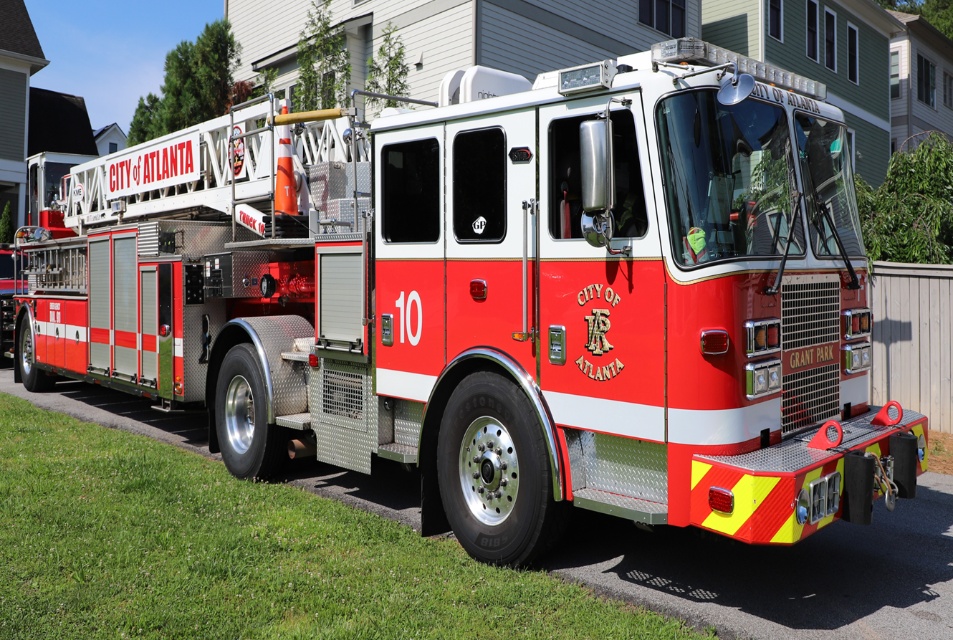
Service Metrics
Total Situations Found: Downtown
Situations Found Category | FYTD 2025 | FY24-Q1 | FY25-Q1 | % Change
EMS | 6,555 | 7,498 | 6,555 | -12.6%
Structure Fire | 135 | 134 | 135 | 0.7%
Hazmat | 479 | 483 | 479 | -0.8%
Technical Rescue | 26 | 31 | 26 | -16.1%
Other Services | 9,988 | 11,683 | 9,988 | -14.5%
Total | 17,183 | 19,829 | 17,183 | -13.3
Note:
FYTD 2025: 07/01/2024 - 09/17/2024
FY24-Q1: 07/01/2023 - 09/30/2023
FY25-Q1: 07/01/2024 - 09/17/2024
Data Source: ImageTrend RMS
Data Export by: A&P 09/17/2024
Downtown: Field Operations Downtown Division
ATLANTA FIRE RESCUE DEPARTMENT
1ST QUARTER METRIC REPORT | SEPTEMBER 23, 2024

Slide 6
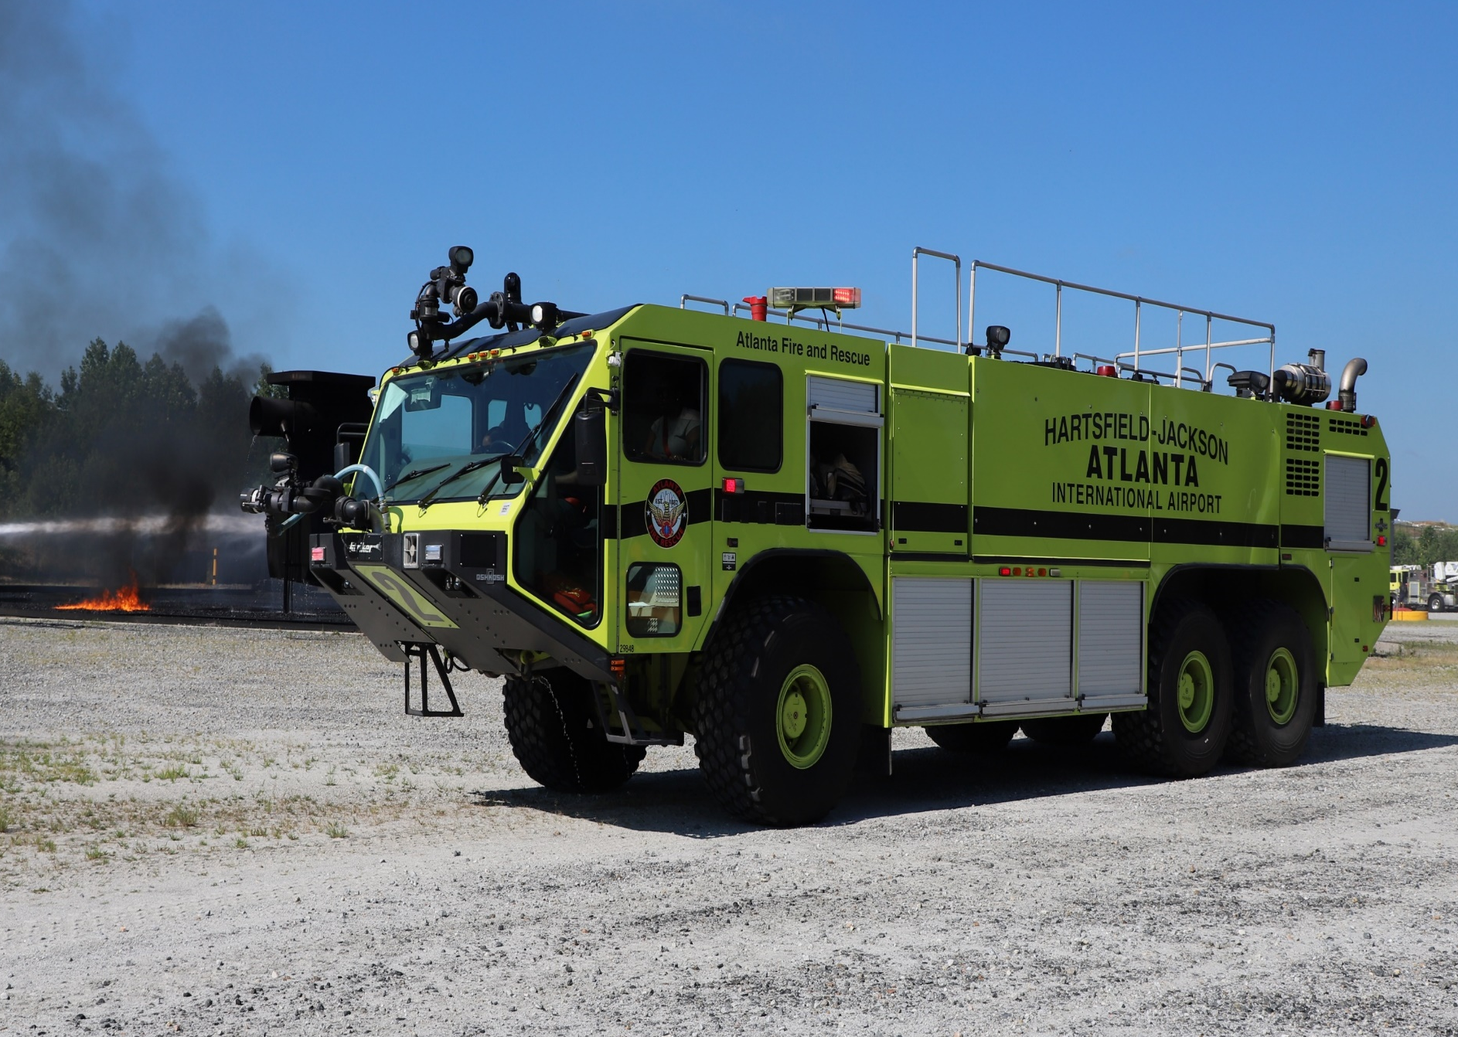
Service Metrics
Total Situations Found: Aviation
Situations Found Category | FYTD 2025 | FY24-Q1 | FY25-Q1 | % Change
EMS | 1,626 | 1,739 | 1,626 | -6.5%
Structure Fire | 6 | 3 | 6 | 100.0%
Hazmat | 80 | 77 | 80 | 3.9%
Technical Rescue | -- | -- | -- | --
Other Services | 953 | 1,190 | 953 | -19.9%
Total | 2,665 | 3,009 | 2,665 | -11.4
Note:
FYTD 2025: 07/01/2024 - 09/17/2024
FY24-Q1: 07/01/2023 - 09/30/2023
FY25-Q1: 07/01/2024 - 09/17/2024
Data Source: ImageTrend RMS
Data Export by: A&P 09/17/2024
Aviation: Aviation Division (Airport)
ATLANTA FIRE RESCUE DEPARTMENT
1ST QUARTER METRIC REPORT | SEPTEMBER 23, 2024

Slide 7
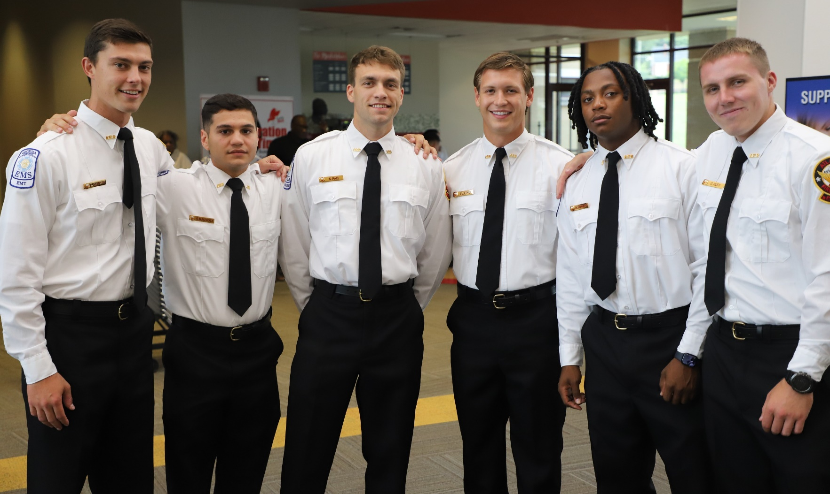
FY24 1ST Quarter Attrition HR and Hiring
Sworn Attrition
 | July | August | September
Retired | 0 | 0 | 0
Resigned | 1 | 2 | 4
Terminated | 0 | 0 | 0
Hired | 7 | 15 | 0
Net +/- | 6 | 13 | -4
Civilian Attrition
 | July | August | September
Retired | 0 | 0 | 0
Resigned | 1 | 2 | 0
Terminated | 0 | 0 | 0
Hired | 0 | 2 | 0
Net +/- | -1 | 0 | 0
Vacancy Rate
as of 8/31/2024
18.72%
ATLANTA FIRE RESCUE DEPARTMENT
1ST QUARTER METRIC REPORT | SEPTEMBER 23, 2024

Slide 8
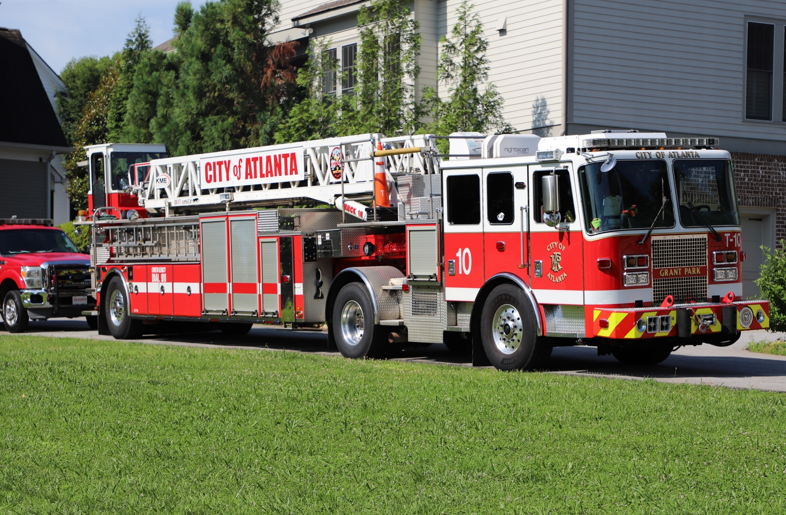
Fleet
Fleet | Status | Estimated Completion Date
Spartan TDA Support Truck (3) | Arrived in Georgia middle of September | End of September 2024
S180 Reserve Pumper (3) | 1/3 Reserved Pumpers arrived on 9/19/2024 | Beginning of October 2024
Command Vehicle Trucks (7) | Arrived at vendor; Being upfitted for emergency equipment | Middle of October 2024
EMS Supervisor Trucks (3) | Arrived at vendor; Being upfitted for emergency equipment | Middle of October 2024
Black Chevy (Investigation) (1) | Arrived at vendor; Being upfitted for emergency equipment | Middle of October 2024
Black Chevy (Homeland Security) (1) | Arrived at vendor; Being upfitted for emergency equipment | Middle of October 2024
(Aviation) Frontline Pumper (1) | In production phase | Middle of November 2024
Spartan TDA (1) | In production phase | February 2025
ATLANTA FIRE RESCUE DEPARTMENT
1ST QUARTER METRIC REPORT | SEPTEMBER 23, 2024

Slide 9
Facility Enhancements
Stations | Status | Estimated Completion
New Construction
Fire Station 25 | New Construction: Design has been submitted for Land disturbance Permit and demolition permits; will start pricing with Contractors | 2026
Fire Station 26 | New Construction: Demolition; DOT project complete, Start date October 2024 | 2026
Fire Station 30 | New Construction: groundbreaking ceremony 9/20/2024 | 2026
Fire Station 31 | New Construction: road design required in process to make road accessible to new Station; once complete we will submit for building permits | 2027
Renovations
Fire Station 14 | Renovation: Final Drawing approved, in process | 2026
Fire Station 22 | Renovation: In Progress | October 2024
AFRD Bay Doors (Phase II) | Renovation: In Progress | 1st Quarter 2027
Stations | Status | Completion Date
AFRD Bay Doors (Phase I) | Completed | October 17, 2023
Fire Station 36 | Completed | December 1, 2023
EMS Station 37 | Completed | January 26, 2023
ATLANTA FIRE RESCUE DEPARTMENT
1ST QUARTER METRIC REPORT | SEPTEMBER 23, 2024

Slide 10
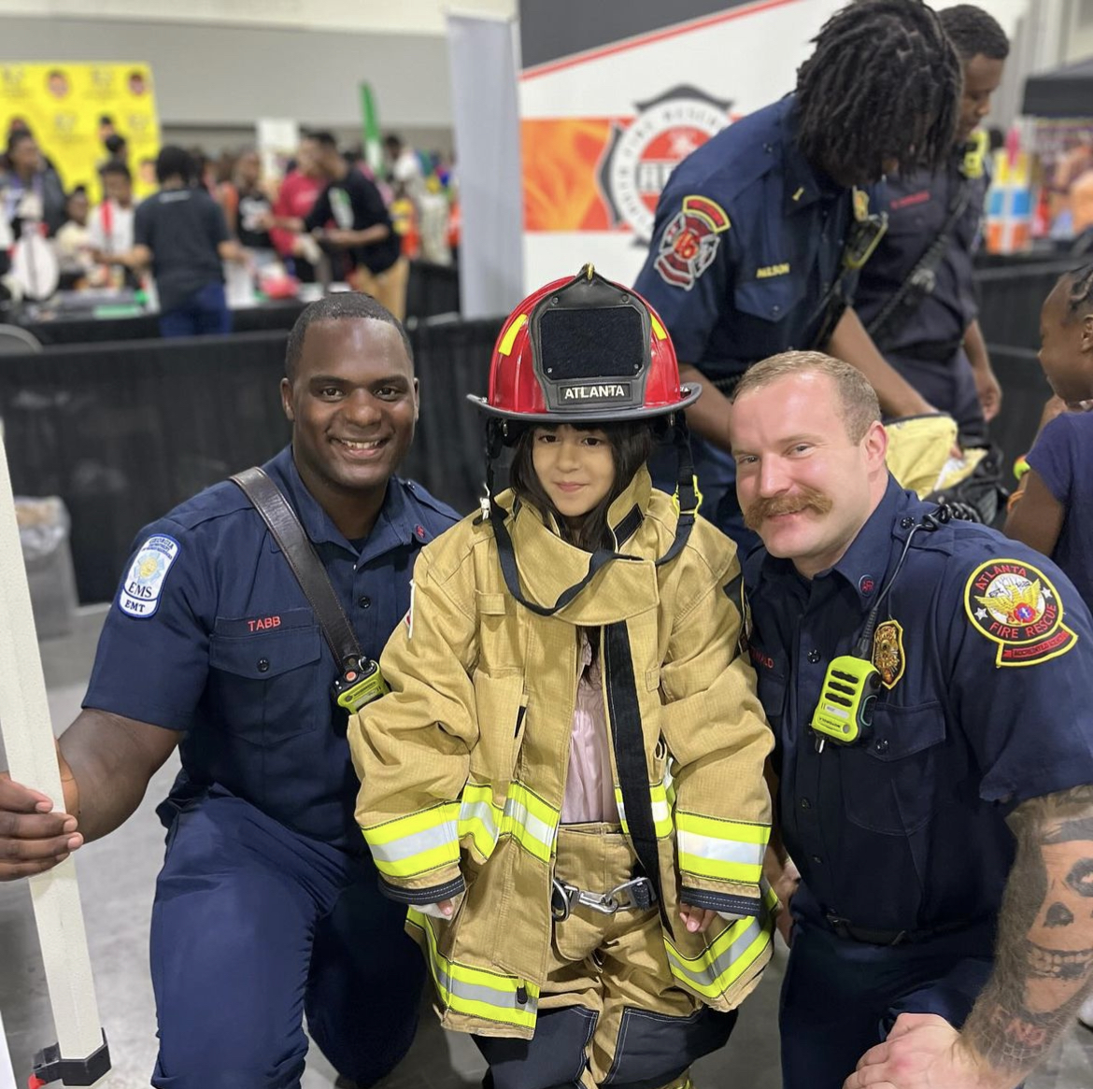
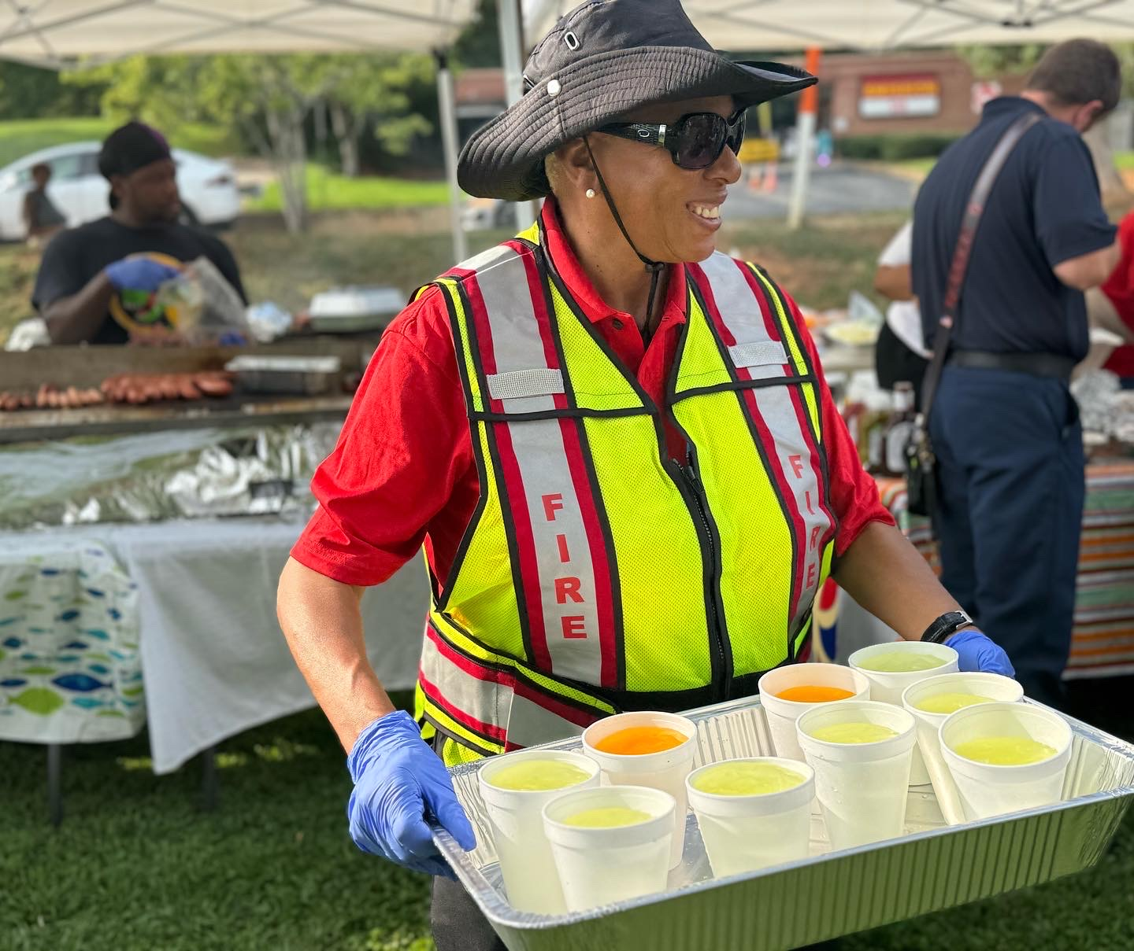
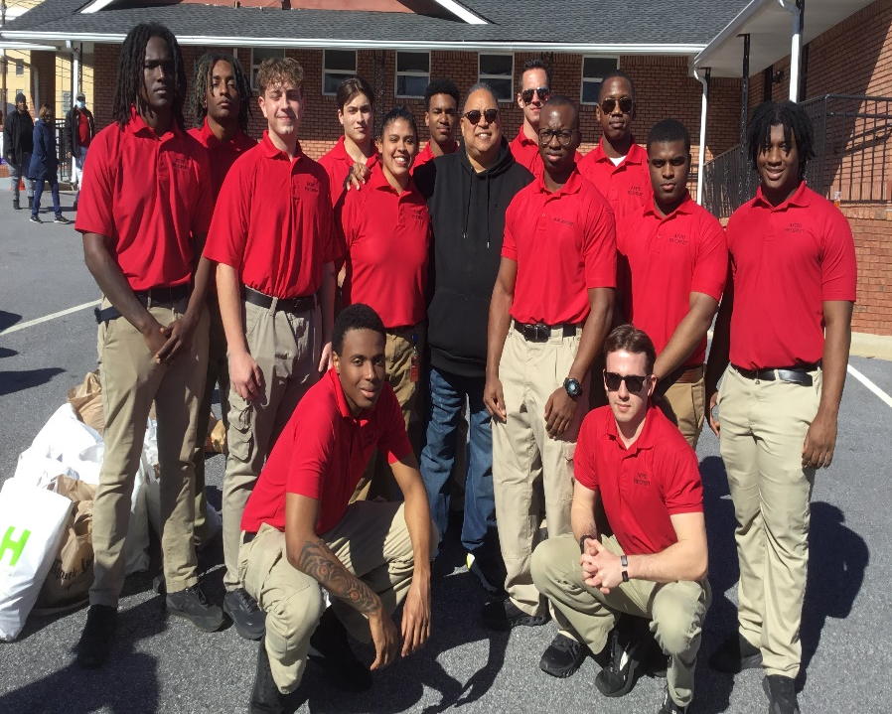
Community Engagement
FY25- 1st Quarter (July, August, September 2024)
Food Distribution
Back to School Book Bag Drive
Parks & Rec Summer Basketball
NPU Meetings
Cooling Center
National Night Out
Popsicles in the Park
Senior Citizens Outreach
National Senior Citizens’ Day
Blue Mass
Mayor’s Senior Ball
AED Installation Event
Community Blitz
Town Hall Meeting
Open Hands
Firefighter 5K
ATLANTA FIRE RESCUE DEPARTMENT
1ST QUARTER METRIC REPORT | SEPTEMBER 23, 2024

Slide 11
Camp Ignite
Registration is now open!!
Free 3-day career exploration camp
Exposes ladies, ages 14-18, to jobs in fire and emergency medical services
Registration Link: https://fs6.formsite.com/mAFRD/wbt3bqgjnp/index
ATLANTA FIRE RESCUE DEPARTMENT
1ST QUARTER METRIC REPORT | SEPTEMBER 23, 2024

Slide 12
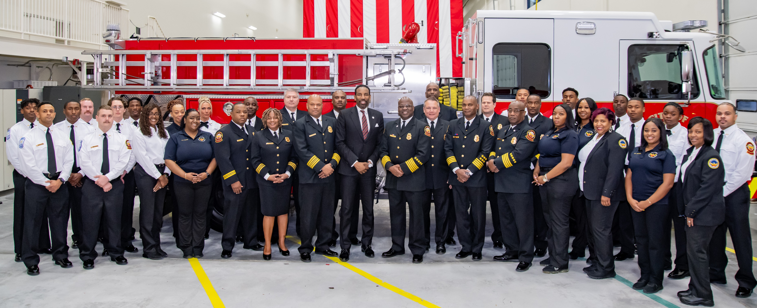
Questions?
ATLANTA FIRE RESCUE DEPARTMENT
1ST QUARTER METRIC REPORT | SEPTEMBER 23, 2024

