Slide 1

NPU Project CD/HS Update
December 11, 2018

Slide 2

Rohit Malhotra
Founder & Executive Director
Thanks for your time and your service!
Kyle Kessler
Policy & Research Director

Slide 3
Outline
What is the Center for Civic Innovation?
Why do we care about the NPUs?
What are we proposing?
What have we done so far?
What’s planned next?
How can you help?

Slide 4
What is the
Center for Civic Innovation?
Our mission is to empower people to shape the future of our city by designing local public policy from the ground up.

Slide 5
People are empowered to understand issues of inequality
Our Goals
what we aim to achieve
People are empowered as a fundamental voice in public decision-making
People are empowered to be problem-solvers

Slide 6
Why do we care about NPUs?
They exist to get people the information they need to make good decisions about their communities and solve problems –
aligning with all three of our goals.

Slide 7
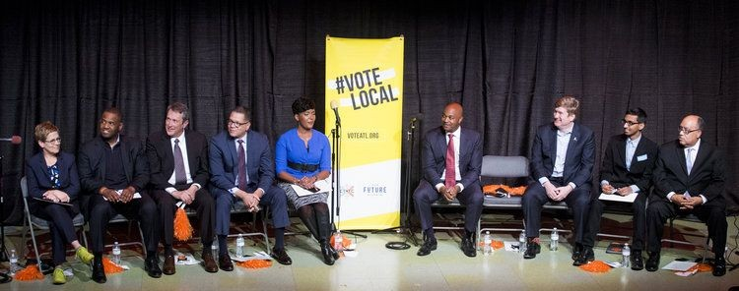
#VoteLocal Mayoral Forum
How many NPUs are there?
What’s your NPU?
What commitment will you make to the NPU system?
#VoteLocal Mayoral Candidate Forum – October 30, 2017 – http://youtu.be/7ZVNLdFfvhg?t=1930

Slide 8
Atlanta City Design
1.2 Civic Participation
1.2b Neighborhood Planning Unit (NPU) 1.0
Restore the incredible utility and value of the NPUs through rejuvenated staffing and resources.
Utilize NPUs for renewed transparency in government, civic dialogue and action campaigns for various initiatives. Reframe the community process for development and ensure equitable representation on NPU boards.
1.2c NPU 2.0
Acknowledging the digital divide, embrace new methods and expectations for participation in
city-building efforts that are now possible with changing technologies. Include online access to information and meetings, as well as input on issues and crowdsourcing on reporting issues like code violations.
approved by charter amendment December 13, 2017 – 17-O-1706 – atlcitydesign.com

Slide 9
Resilient Atlanta
Target 4.2 Support policies and systems to increase civic participation from Metro Atlantans.
Action 4.2.3 Audit Atlanta’s Neighborhood Planning Units
Conduct an audit of the City of Atlanta’s Neighborhood Planning Unit (NPU) system in 2018 to
ensure that the NPUs are adequately enabling neighborhood input as well as tailoring public policies to the neighborhood. Established in 1974 to provide an opportunity for citizens to actively participate in the execution of the City’s Comprehensive Development Plan, NPUs are citizen advisory councils that make recommendations to the Mayor and City Council on zoning, land use, and other planning issues. The city is divided into 25 NPUs spanning all 242 Atlanta neighborhoods. The system is a valuable asset that serves as an avenue for the City to provide information to its residents and enable residents to inform policy from a neighborhood level, but it is arguably not currently maximizing its potential. The results of the audit will be used to revitalize the structure of NPUs and implement changes by 2019 that promote more meaningful civic participation.
released November 2, 2017 – 100resilientcities.org/strategies/atlanta/

Slide 10
HouseATL
Community Engagement Recommendations
Strengthen civic infrastructure by evaluating the Neighborhood Planning Unit (NPU) system and identifying opportunities for deeper engagement while leveraging arts & culture, parks & greenspace, and other ways to meet Atlantans in their neighborhoods.
released September 18, 2018 – houseatl.org/recommendations

Slide 11
Atlanta City Council
Community Development/Human Services Committee 2018 Goals & Objectives
1. Review NPU system to evaluate the level of citizen participation in the process and the benefits.
citycouncil.atlantaga.gov/standing-committees/community-development-human-services/2017-goals-and-objectives

Slide 12
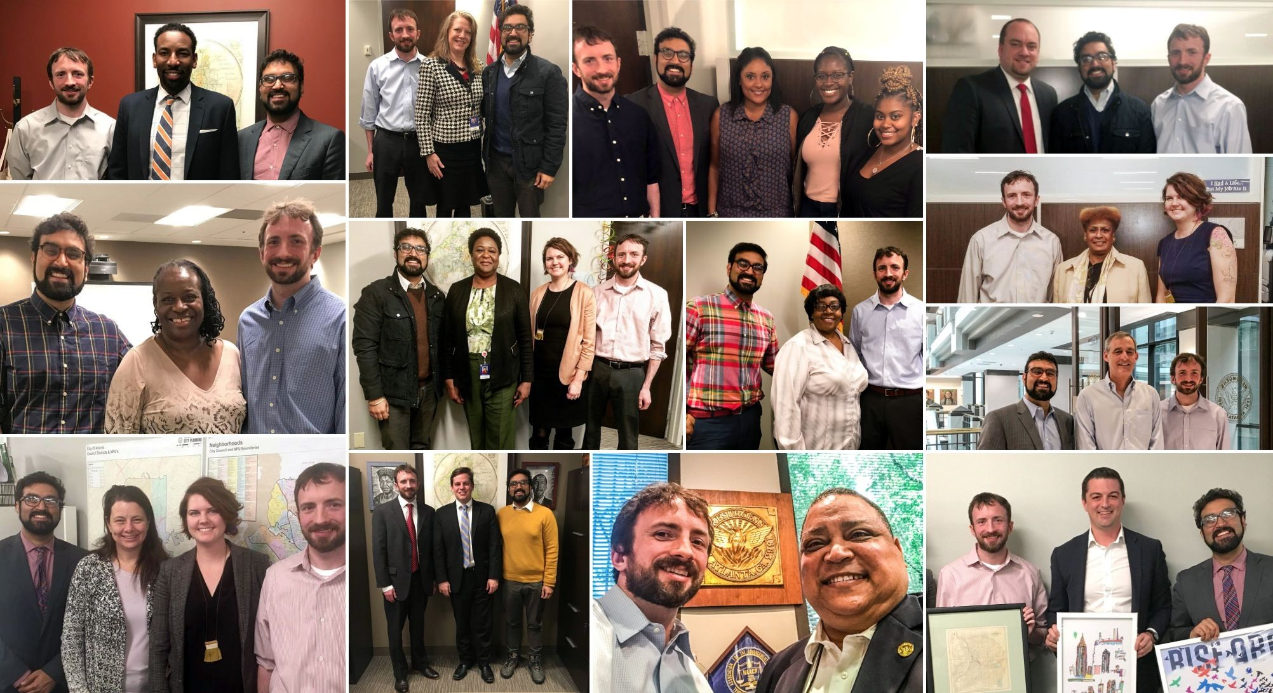
We asked everybody about NPUs.
follow us: @civicatlanta on Facebook, Instagram, and Twitter

Slide 13
What are we proposing?
a comprehensive review and evaluation of the Neighborhood Planning Unit system

Slide 14

drafting a plan
gathering stakeholders and partners
hiring and preparing a team
issuing a research report on the history of the NPU system
hosting a public information event
Q3 2018 – Q1 2019

Slide 15

conducting a city-wide survey of Atlanta residents on their interactions with the NPU system
auditing all 25 NPUs
working with key stakeholders to gain deeper insight into community engagement challenges and opportunities
developing and implementing a
city-wide education program of “NPU 101” events to educate Atlantans on the purpose and current use of NPUs
Q2 2019 – Q4 2019

Slide 16
using the collected data to create ideas to improve the NPU system
working with the public to bring attention to new ideas related to civic participation
Q1 2020 – Q2 2020

Slide 17

working with city officials to craft and pass any policies that reflect public preferences for changes
work with community members to test and evaluate the effectiveness of new ideas
Q3 2020 – Q2 2021

Slide 18
Phase I
Developing Plans, Partners, and Research

Slide 19
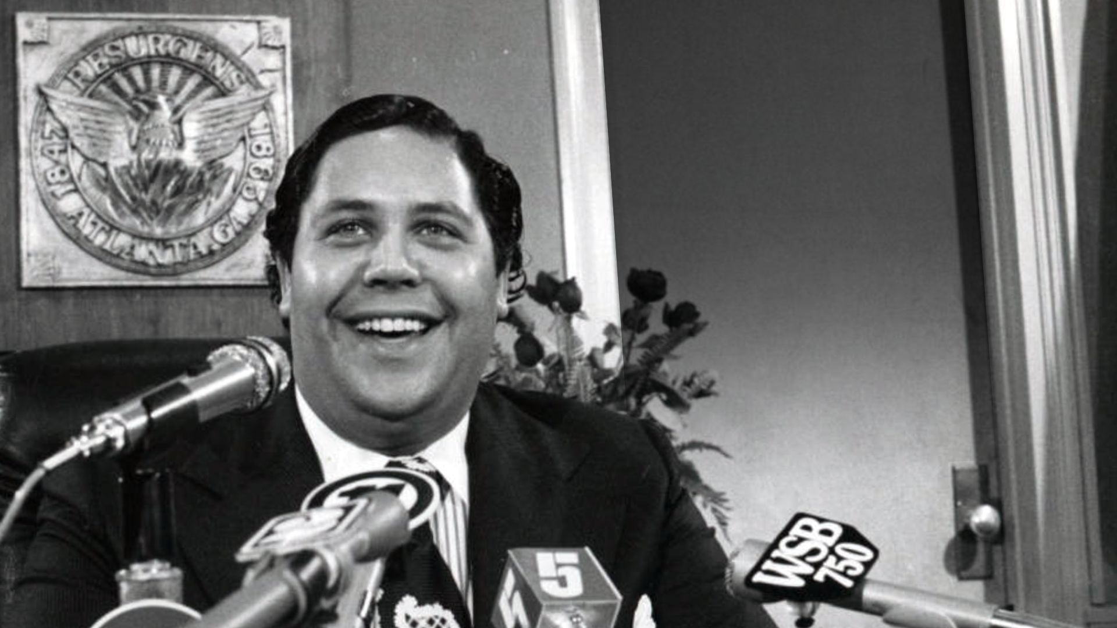
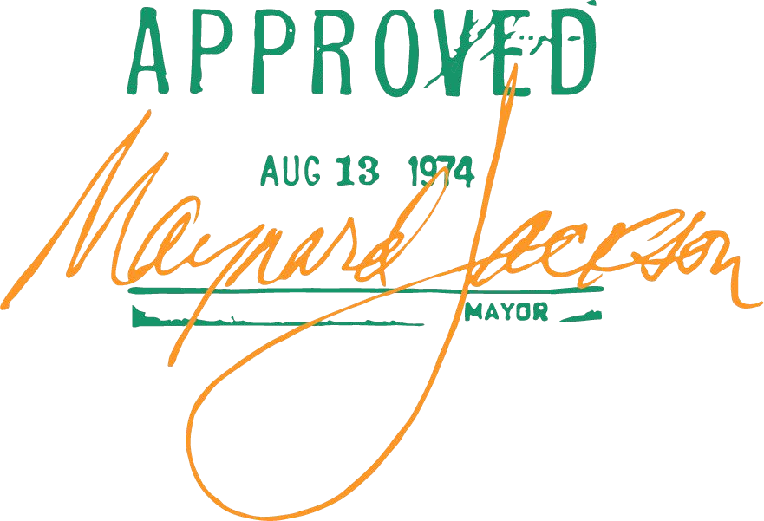
Mayor Maynard Jackson
AJCP553-012b, Atlanta Journal Constitution Photographic Archives, Special Collections and Archives, Georgia State University Library.

Slide 20
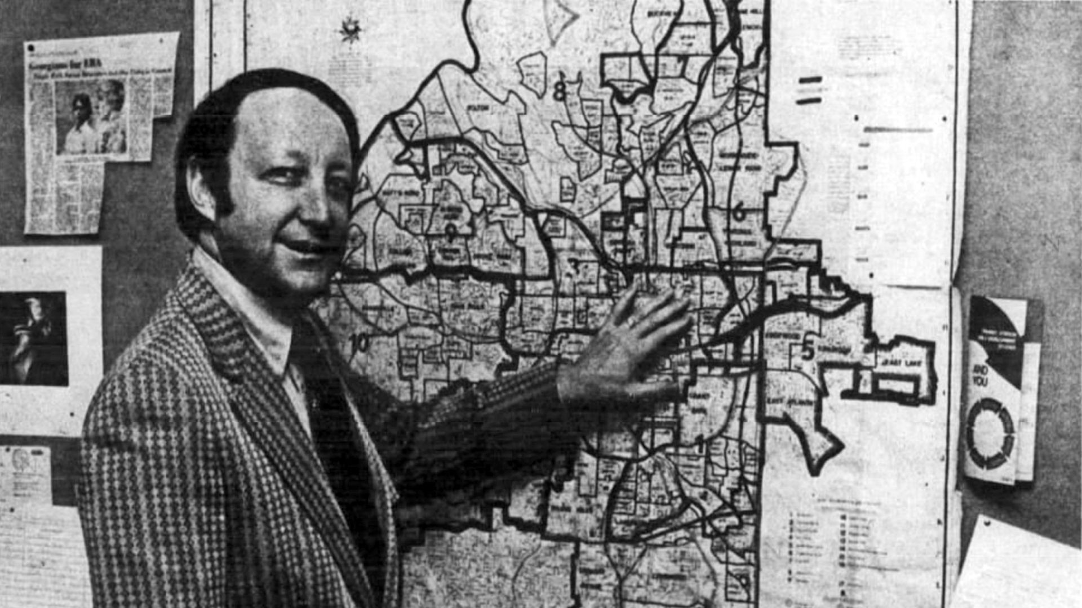
Budget & Planning Commissioner Leon Eplan
“Democracy Comes to City Planning,” The Atlanta and Journal Constitution Sunday Magazine, 08 December 1974, Atlanta Constitution Archives. newspapers.com

Slide 21
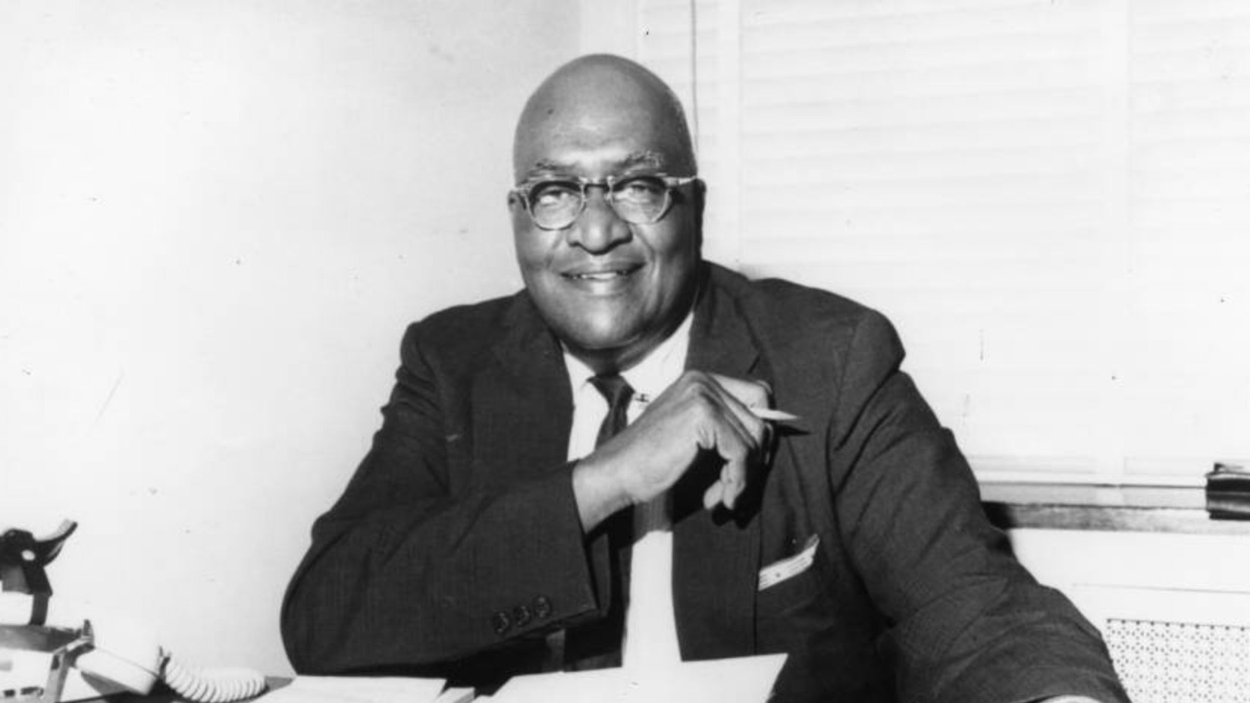
District 1 Councilmember John H. Calhoun
AJCP363-030a Atlanta Journal Constitution Photographic Archives, Special Collections and Archives, Georgia State University Library.

Slide 22
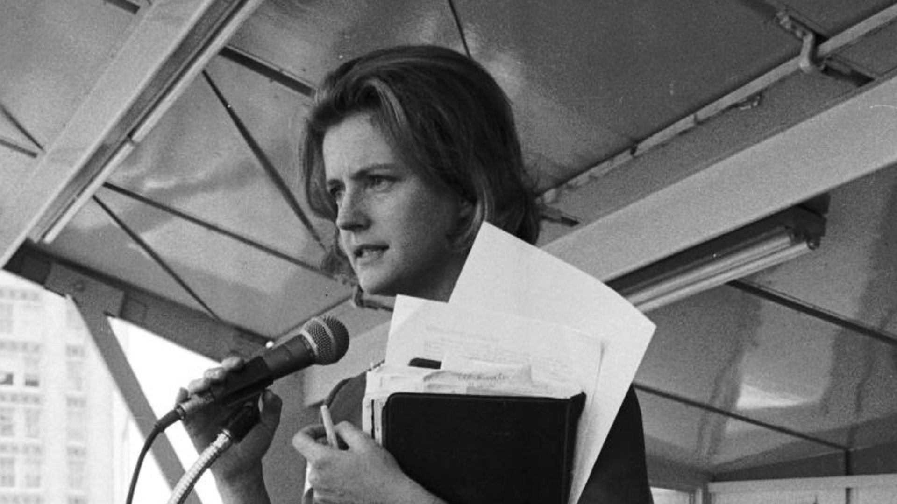
Post 15 Councilmember Panke Bradley
VIS 101.889.046, MSS 602, Boyd Lewis Papers, Kenan Research Center, Atlanta History Center.

Slide 23
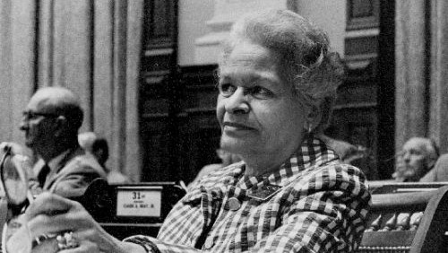
Grace Towns Hamilton & Charter Commission
VIS 101.889.053, MSS 602, Boyd Lewis Papers, Kenan Research Center, Atlanta History Center.

Slide 24
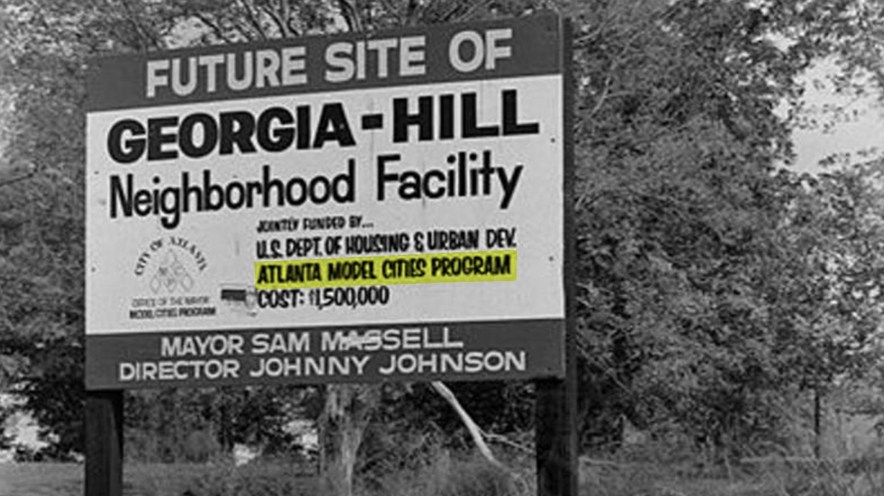
the Feds & “maximum feasible participation”
VIS 101.703.004, MSS 602, Boyd Lewis Papers, Kenan Research Center, Atlanta History Center.

Slide 25
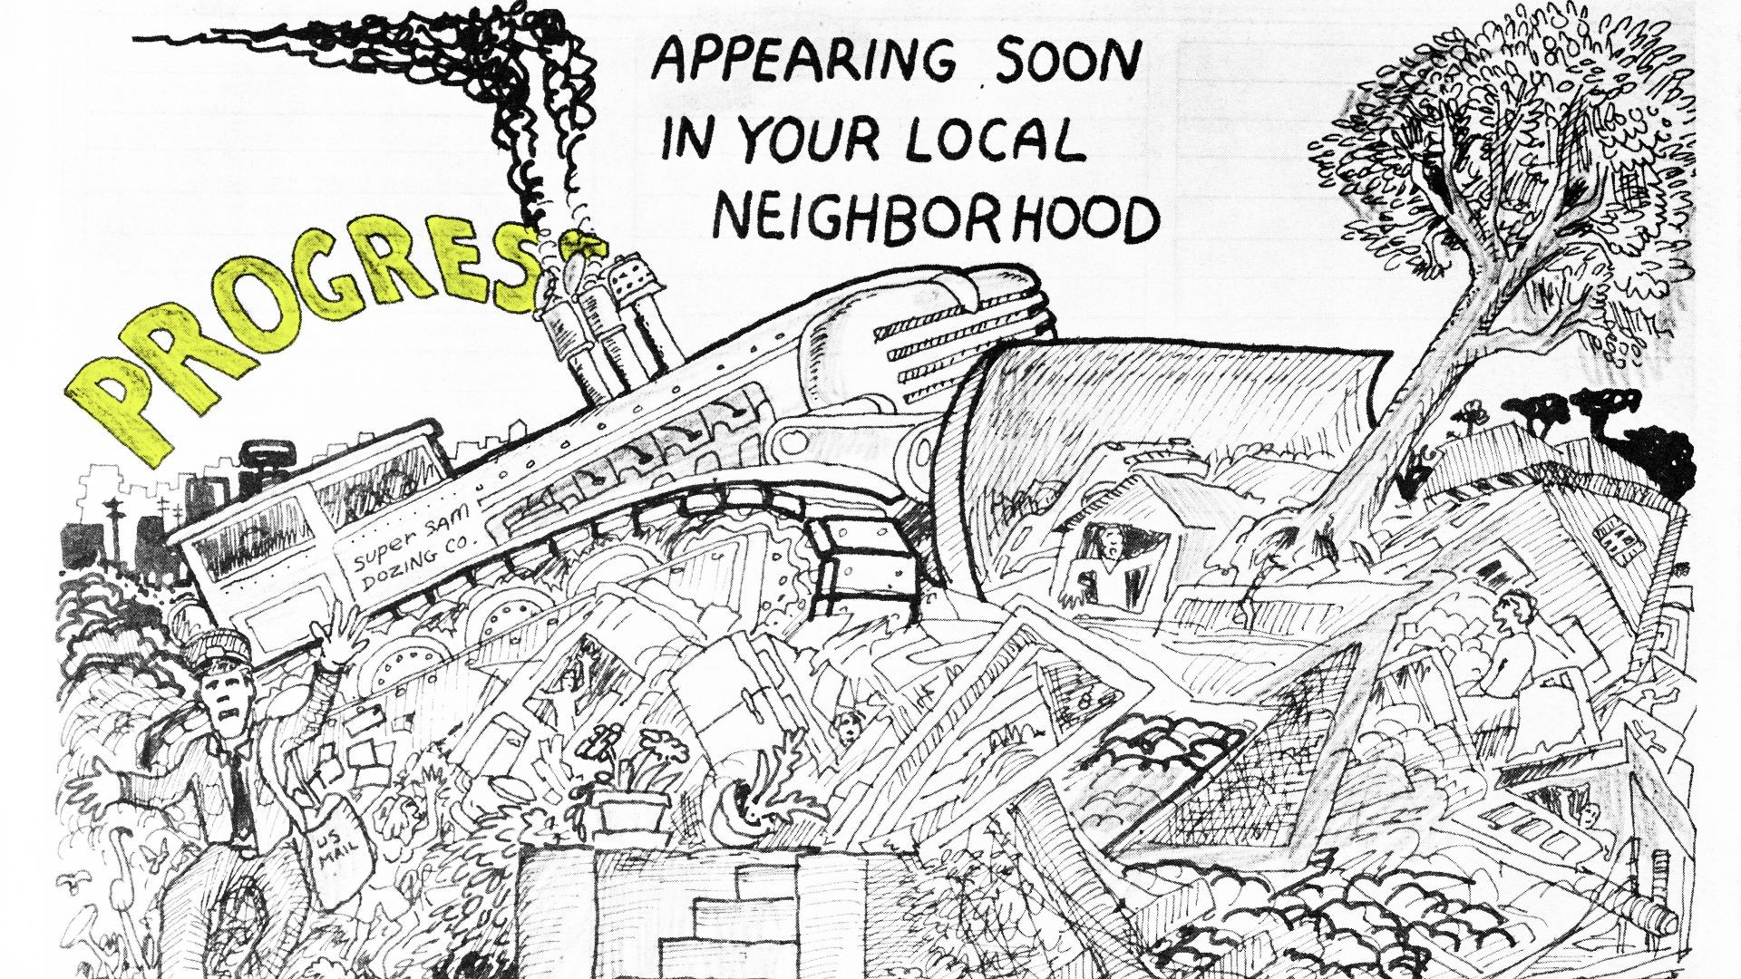
freeways & neighborhood activism
Great Speckled Bird. v.5 no.1 (10 January 1972) p4. Special Collections and Archives, Georgia State University Library.

Slide 26
1874 Charter vs. 1974 Charter
1874 Charter (as amended) 1974 Charter
“weak” mayor
board of aldermen – all elected city-wide
9 districts with 2 representatives each
committees run departments
project- and department-specific planning
possible citizen input
“strong” mayor
city council – combination of district and city-wide (“at-large”)
12 districts with 1 representative each
commissioners run departments
comprehensive planning (physical,
social, and economic)
●
ensured citizen input
data source: Georgia Legislative Documents – galileo.usg.edu/scholar/databases/zlgl

Slide 27

Comprehensive Development Plan, January 1975, Special Collections and Archives, Georgia State University Library.

Slide 28
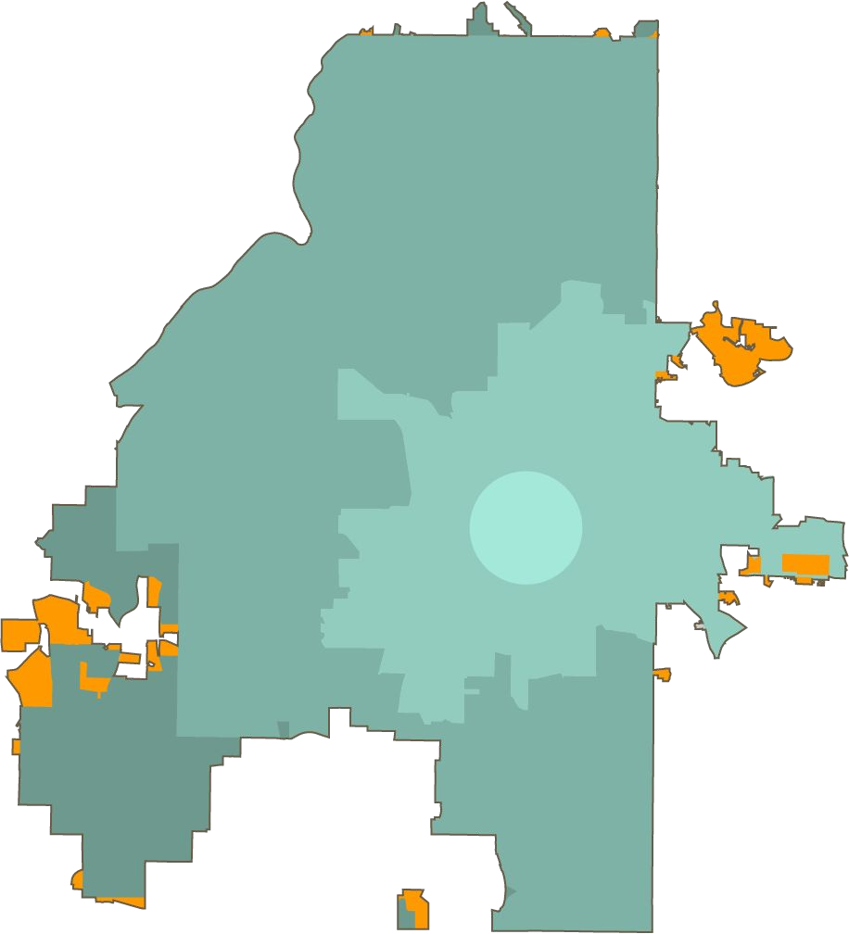
1974 vs. 2018
the city is 3.6% larger
1952
land annexed into the City of Atlanta since 1974
1854-1951
1847
1953-1973
data source: gis.atlantaga.gov, accessed November 27, 2018

Slide 29
1974 vs. 2018
the city is the same size*
 | 1970 | 2010 | est. 2017
total population | 496,973 | 420,003 | 486,290
by age
under 18 | 32.1% | 19.4% | 24.1%
18-64 | 58.8% | 70.8% | 62.4%
65+ | 9.1% | 9.8% | 13.5%
by race
white | 48.4% | 38.4% | 40.1%
non-white | 51.6% | 61.6% | 59.1%
households | 162,291 | 185,142 | 189,343
average size | 2.95 | 2.11 | 2.24
* “ish” based on available data
data source: census.gov, accessed November 27, 2018

Slide 30
1974 vs. 2018
major amendments to ordinances affecting the NPUs
1974 – original “citizen participation” ordinance is approved
1975 – NPU system fleshed out with criteria and boundary maps
1979 – added statement of purpose, by-laws requirement, elections and voting procedures, prohibition as political forum
1988 – officers required to file financial disclosure statements, one vote
1990 – no actions outside scope of planning and advisory functions
1999 – annual vote on by-laws open to all residents
sources: City of Atlanta Records, Kenan Research Center, Atlanta History Center. // Atlanta City Council Legislation – citycouncil.atlantaga.gov/legislation

Slide 31
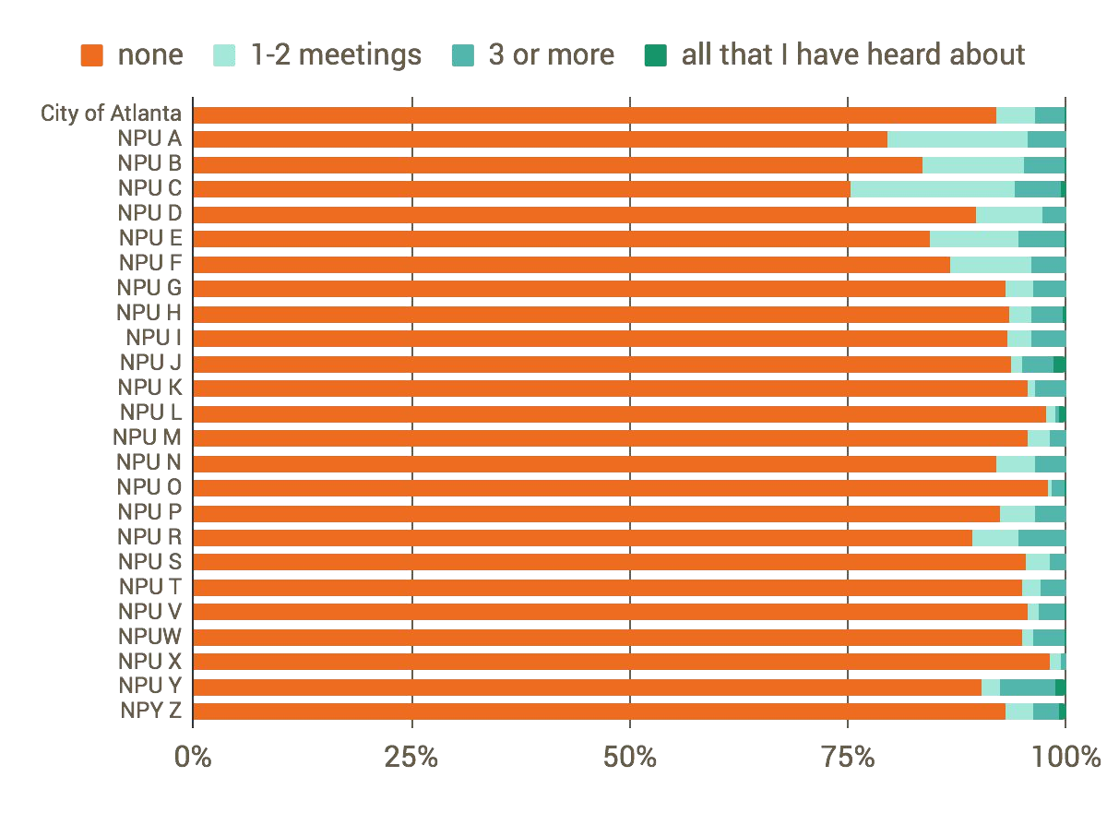
1974 vs. 2018
are NPUs any different?
Table 21.
Attendance of Neighborhood Planning Meeting(s) in Past Year (Summer, 1975 through Summer, 1976)
About how many neighborhood planning meetings have you attended in the past year?
survey of 5,487 Atlanta residents
source: “Data for Neighborhood Planning, Report #2,” February 1979, City of Atlanta Records, Kenan Research Center, Atlanta History Center.

Slide 32
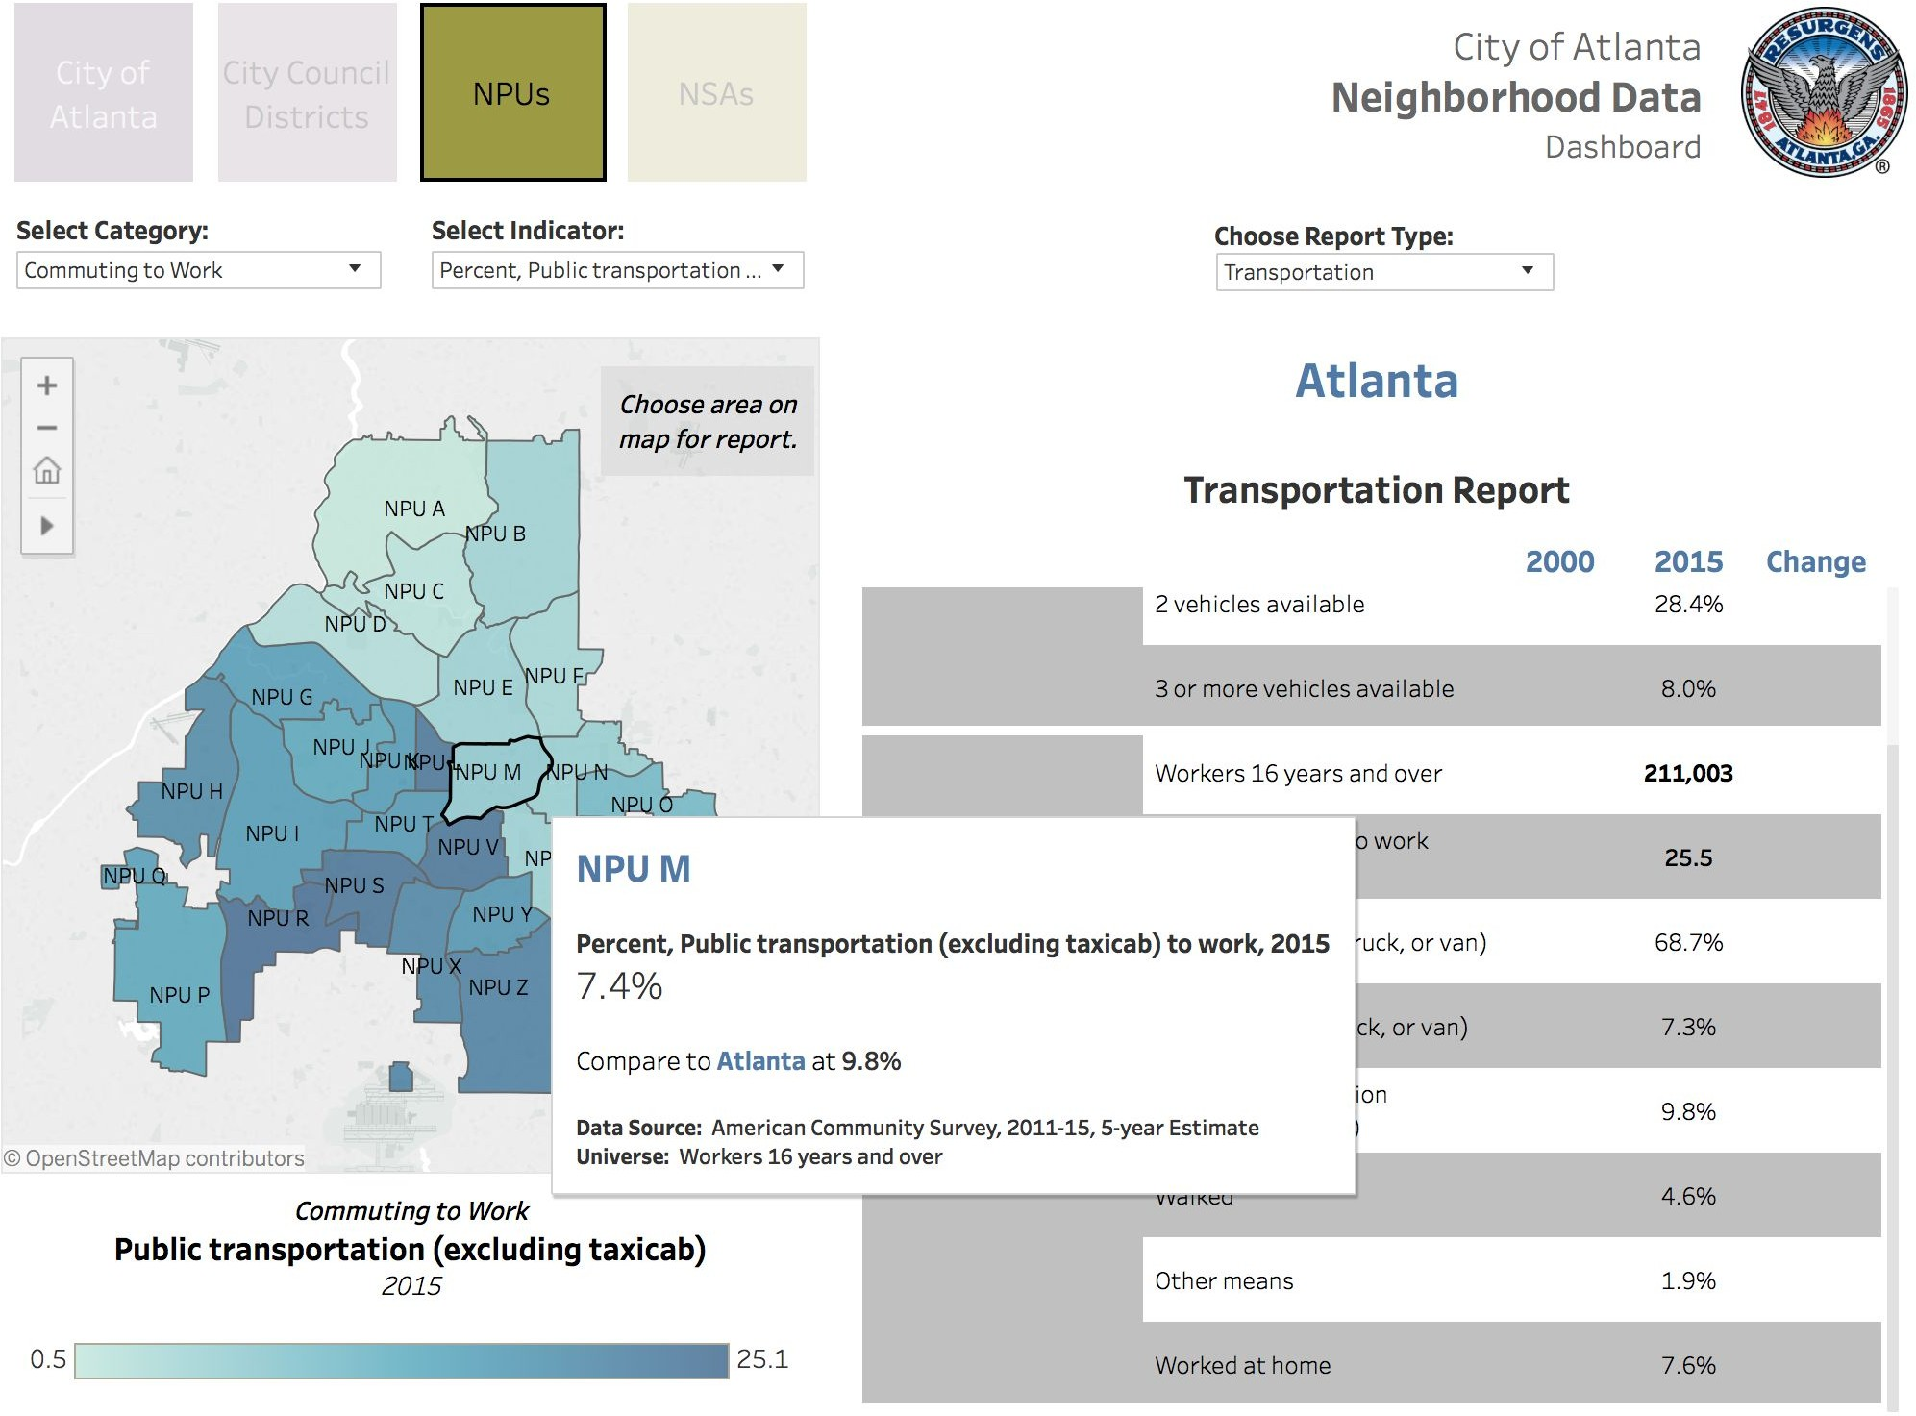
data
source: neighborhoodnexus.org/coa_scir

Slide 33
by-laws, agenda, planner’s reports, attendance sheets, etc.
That’s just 3½ years of documents.

Slide 34
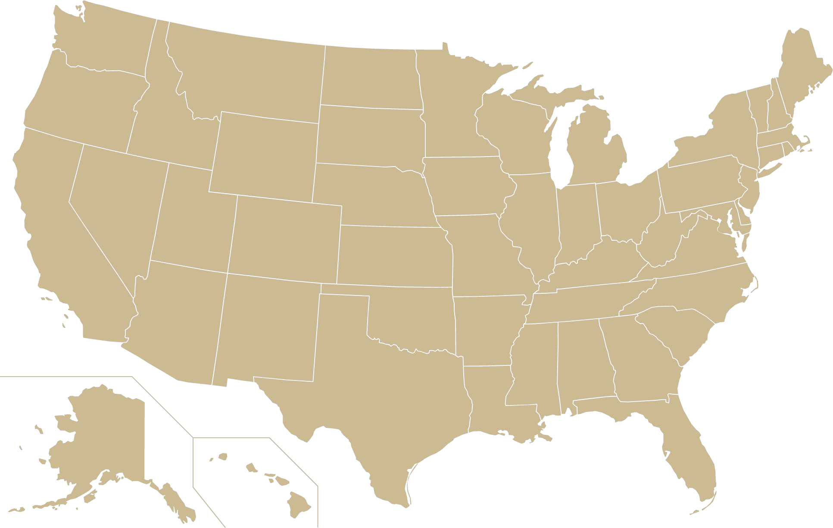
Seattle
Neighborhood District Councils
Portland
other
District Coalitions
cities
Columbus
Area Commissions
Washington, DC Advisory Neighborhood Commissions
Los Angeles
Neighborhood Councils
Atlanta
NPUs
Houston
Super Neighborhoods
Honolulu
Neighborhood Boards

Slide 35
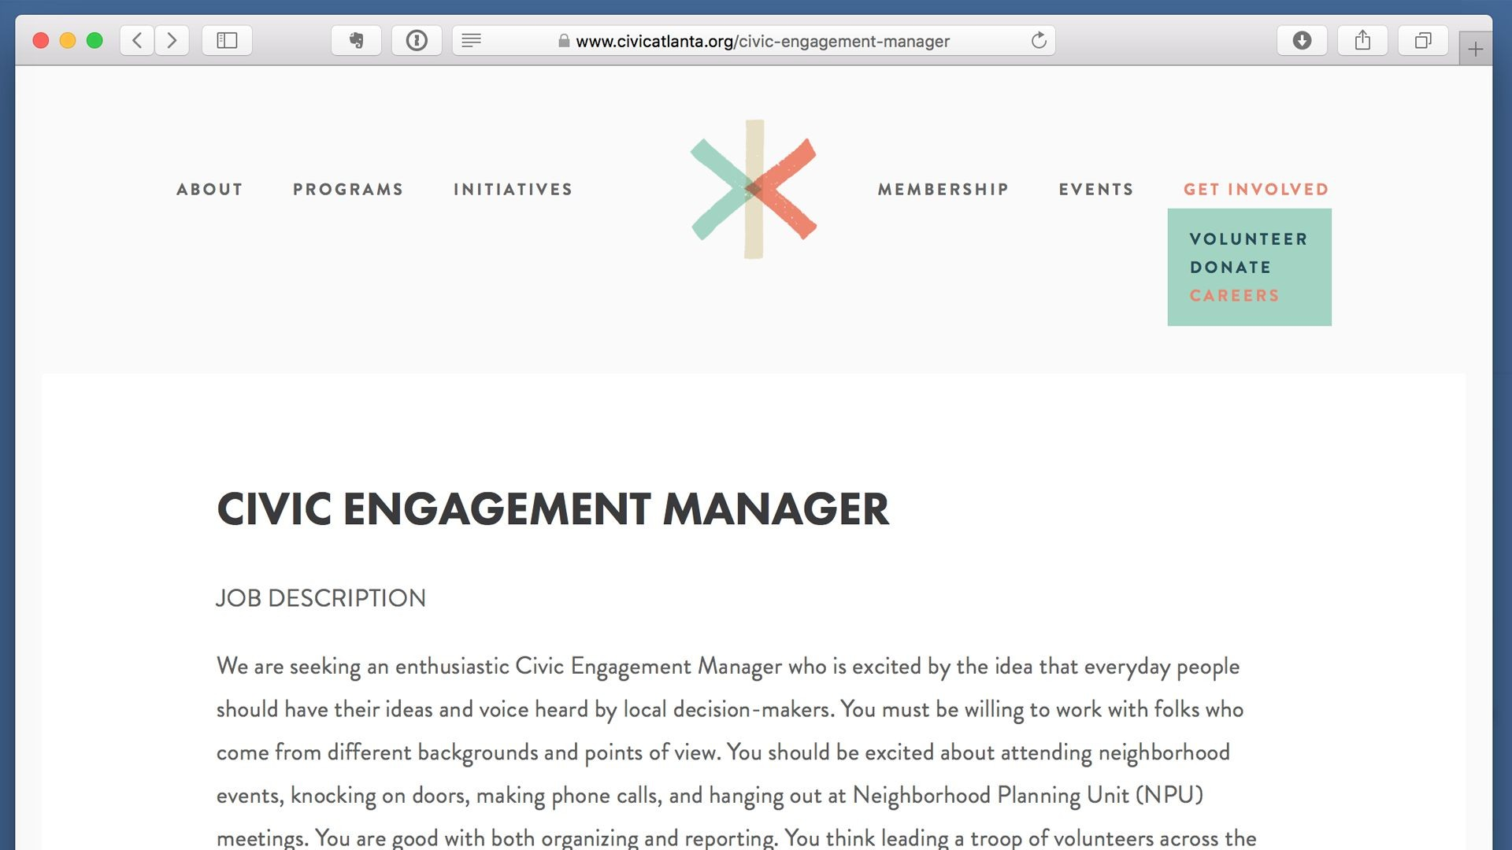

Slide 36
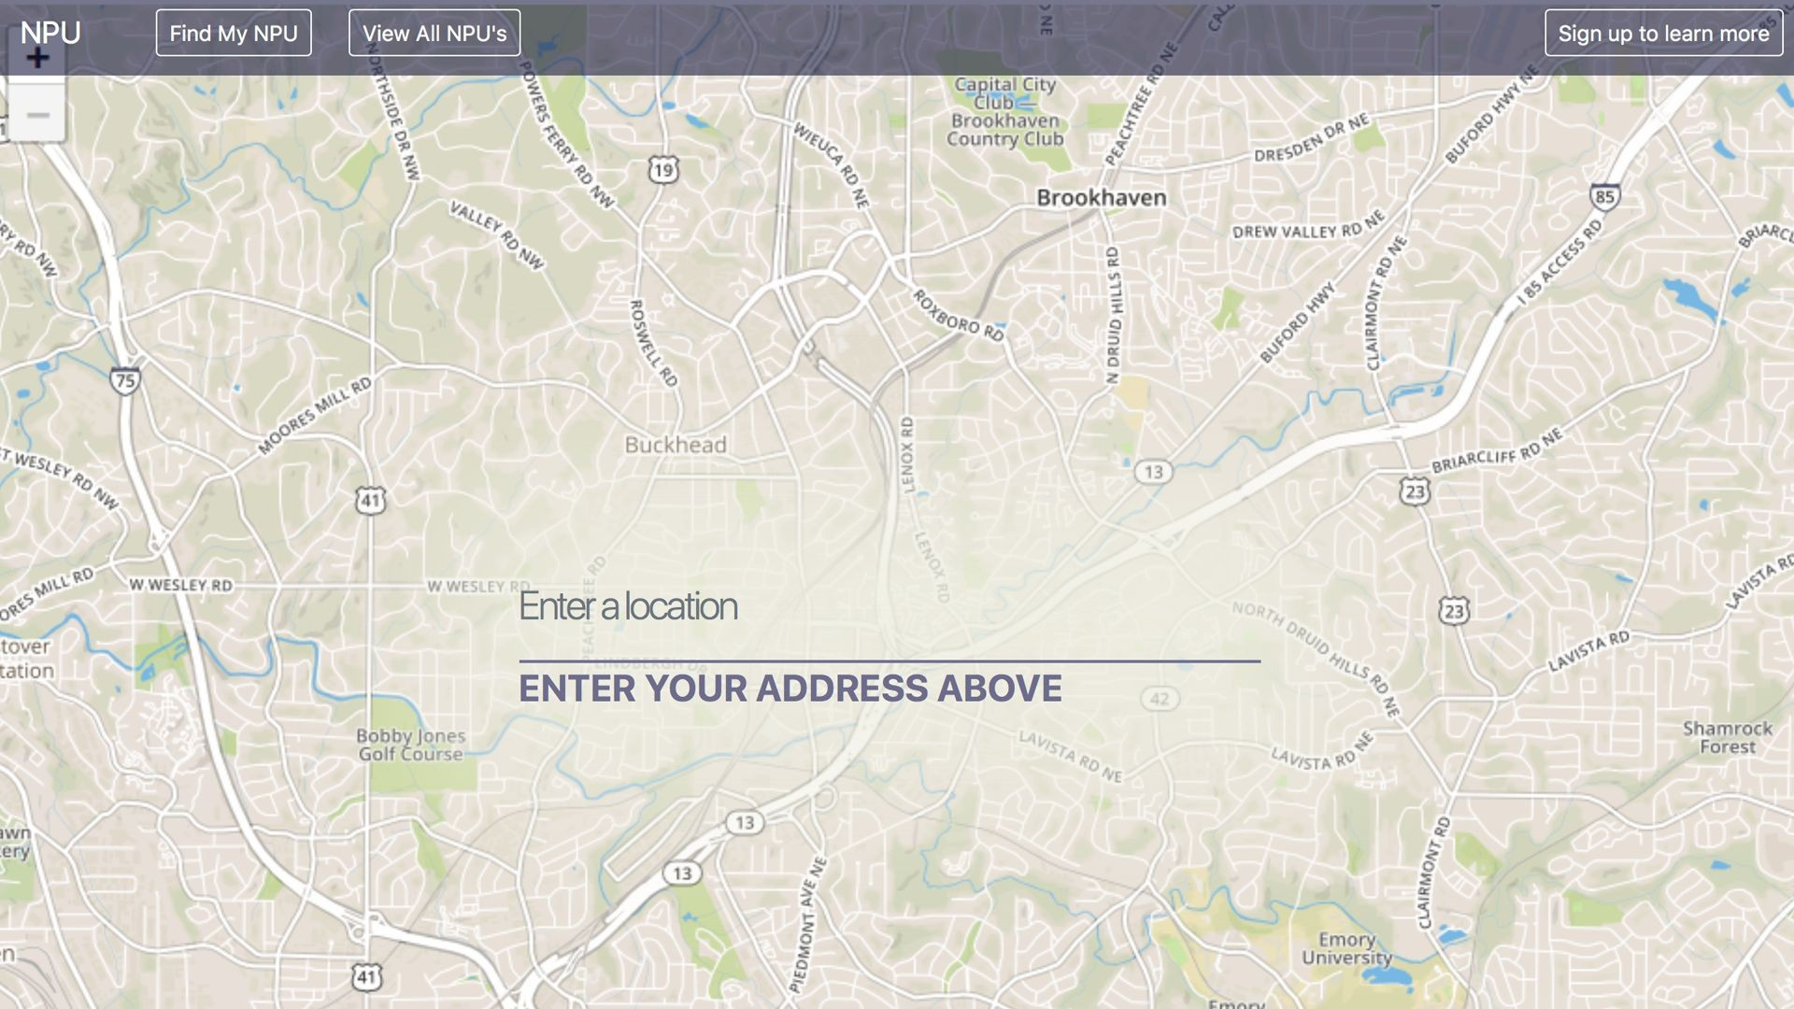

Slide 37
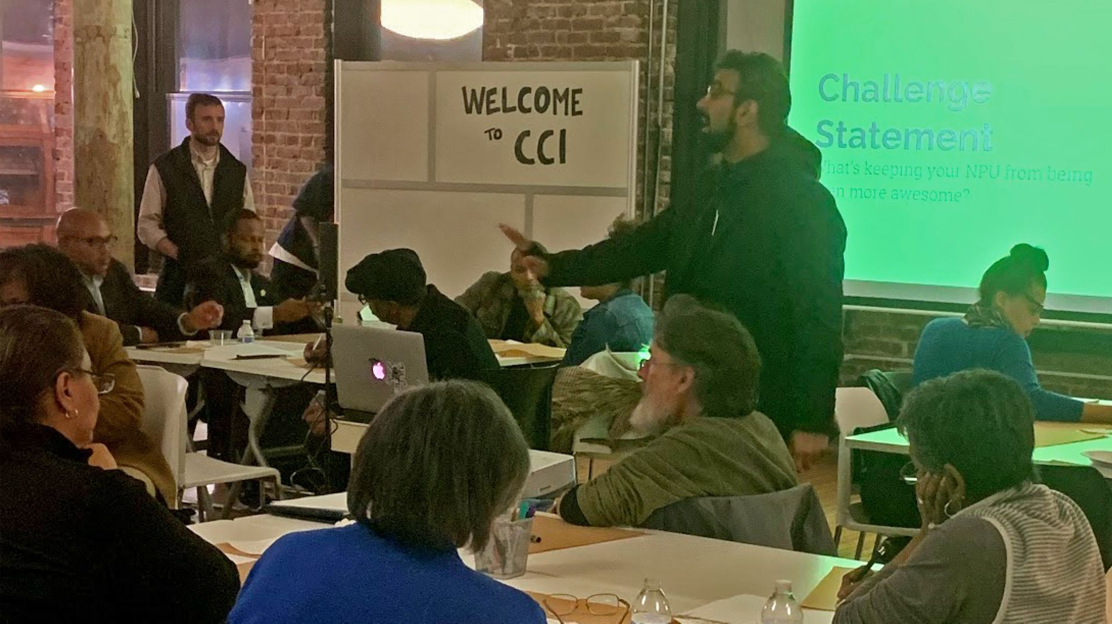
NPU Leaders Listening Session
November 29, 2018
30 attendees representing 15 different NPUs

Slide 38
Coming Soon

Slide 39
January 15, 2019
6:00pm - Center for Civic Innovation
organization community engagement convening

Slide 40
February 12, 2019
6:00pm - Auburn Avenue Research Library
public information event

Slide 41
TBD
meetings with other stakeholders
neighborhood leaders, city officials, any many more

Slide 42
Q&A
What do you like? What/who are we missing?

Slide 43
THANKS!
civicatlanta.org @civicatlanta

