Slide 1
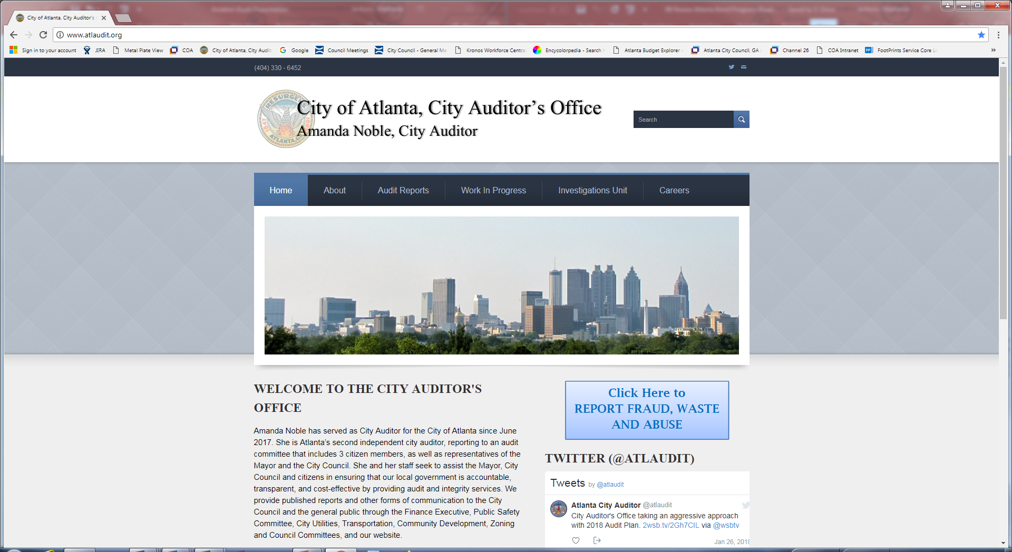
Water Quality Testing
Amanda Noble, City Auditor
Stephanie Jackson, Deputy City Auditor
Diana Lynn, Audit Manager
Jamie Amos and Randi Qualls, Senior Performance Auditors
October 9, 2018

Slide 2
Audit Objectives
Does the city have controls in place to comply with the Safe Drinking Water Act?
Does the city meet service level agreements for customer water quality complaints?

Slide 3
Methodology
Reviewed federal and state drinking water laws and regulations
Interviewed EPA and EPD officials as well as Watershed Management staff
Toured Chattahoochee and Hemphill water treatment plants to understand treatment methods
Observed operators and laboratory technicians who conduct water quality testing throughout the systems
Analyzed drinking water quality complaints from July 2017 through May 2018 to assess whether DWM met service level agreement

Slide 4
Methodology (cont.)
Compared hard copy laboratory sampling and testing records against information entered into DWM’s internal reporting system (LIMS) and reported to the state
Observed tri-annual microbiology laboratory certification
Observed water quality control specialists during an event-based service call
Reviewed the boil water advisory issued for calendar year 2018 to assess compliance with legal requirements

Slide 5
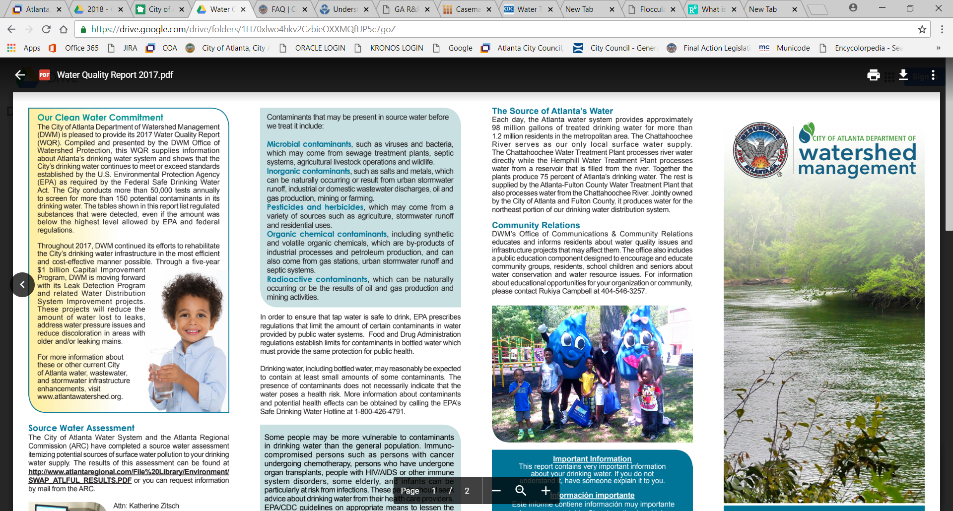
Findings
Testing and treatment consistent with Safe Drinking Water Act
Contaminants Found in Drinking Water
    Treatment plant operations comply with key provisions of Safe Drinking Water Act
    Water quality testing and reporting generally meet EPD standards
    Watershed Management notifies customers of changes regarding water quality
Source: 2017 City of Atlanta Water Quality Report

Slide 6
Water Is Treated Using 4-Step Process

Slide 7
Treatment Plant Operations Comply with State Rules
    Watershed Management maintains certified operators on duty at all times
      Treatment plants operate year-round and have at least one certified operator on duty
    Drinking water plants keep records of water quality
      Plants use SCADA system to monitor water quality
      Plants keep records of daily test results and periodically reports to EPD
    Watershed Management is enhancing its Operations and Maintenance Plan

Slide 8
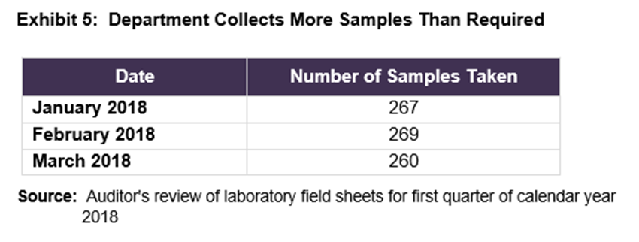
Water Quality Testing Meets EPD Standards
    Watershed Management collects and analyzes more water samples than the 240 required by the EPD
    Certified laboratory to test samples
    Lab technicians collect water samples according to a written sampling site plan approved by the EPD

Slide 9
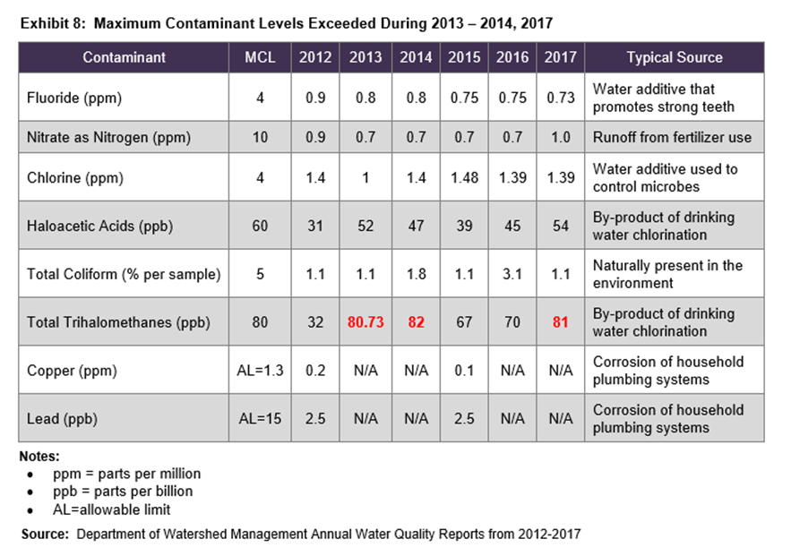
Reporting Consistent with EPD Standards
    Watershed Management must report water quality annually to EPD and customers
    Maximum contaminant levels were exceeded during three of the last five years’ water quality reports
Notes:
The city also received a violation in July 2015 because watershed management missed the deadline to release the 2014 Water Quality Report to the EDP; the report was submitted in October 2015.

Slide 10
Customers Notified of Water Quality Changes
    The Department of Watershed Management issued one boil water advisory in February 2018 for Fairburn, Union City, and South Fulton because of low water pressure
      EPD requires customer notification when pressure drops and/or there is possible water contamination
      Boil water advisory must remain for minimum of 24 hours
      EPD must approve request to lift boil water advisory

Slide 11
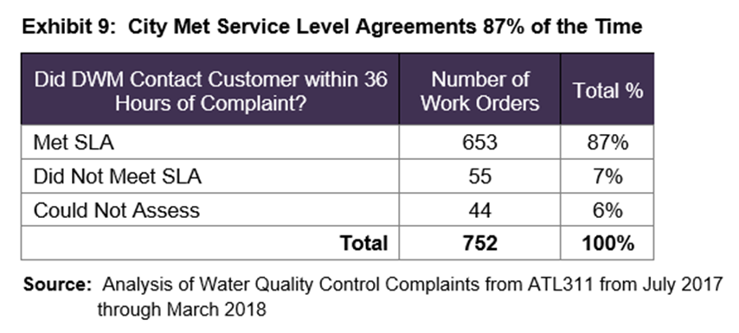
City Met SLA for Water Quality Complaints
  City met service level agreement for 87% of water quality complaints

Slide 12
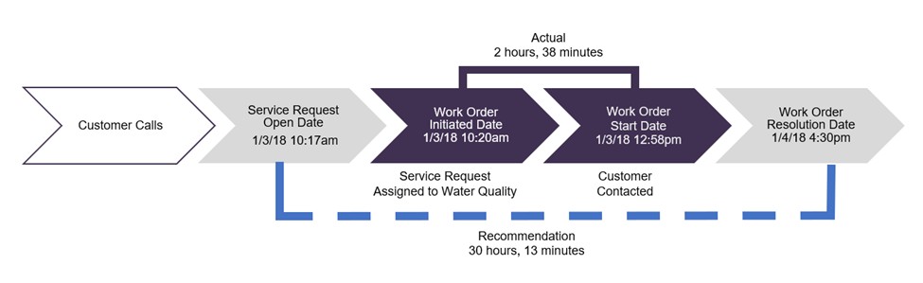
Reported Metrics Should Track Resolution
  City measures initial customer contact for complaints, but does not track and monitor the amount of time to resolve a complaint

Slide 13
Recommendations
  Create a service level agreement to measure the water quality complaint resolution, tracking the time that it takes to resolve the complaint from the date of the customer call
  Ensure that work order dates are correctly entered into the service order management system to be able to accurately track performance

Slide 14
Questions?

