Slide 1
Renew Atlanta: Fire Station Renovations
Amanda Noble, City Auditor
Stephanie Jackson, Deputy City Auditor
Brad Garvey, Audit Manager
Nia Young and Matt Ervin, Senior Performance Auditors
September 12, 2018

Slide 2
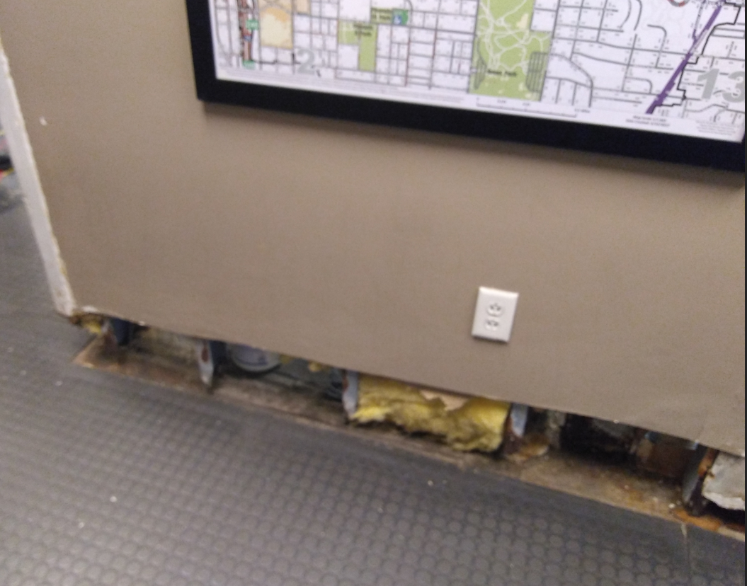
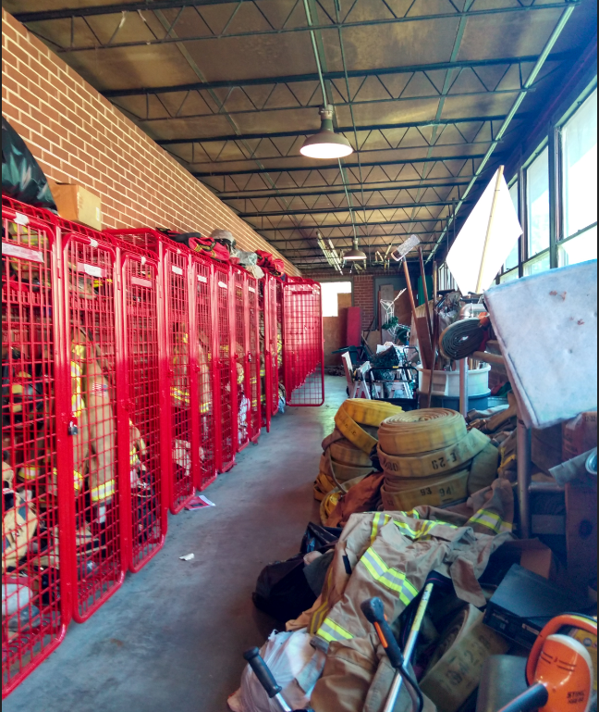
Stakeholder Concerns
Fire Station 29
Fire Station 4

Slide 3
Audit Objectives
What are the bottlenecks or other barriers in the process to bring a project to the start of construction on budget and on schedule?
Are the payments to architecture and engineering consultants reasonable, appropriate, and properly supported?

Slide 4
Methodology
Reviewed contracts for design services
Interviewed staff from Renew Atlanta and Atlanta Fire Rescue
Reviewed Renew Atlanta Project Control Board authorizing documents and Oracle budgets, commitments, and expenditures
Selecting three fire stations as case studies to identify causes of delays by reviewing related documentation and interviewing project managers
Reviewing seven payments to design consultants to assess payment controls
Visiting four fire stations with Atlanta Fire Rescue staff

Slide 5
Findings
Design costs are high and funding was inadequate
Funds allocated for upgrades identified in 2015 needs assessment fell $4.4 million short of estimated costs
Design costs were high as a percentage of estimated construction costs
Procurement challenges have caused schedule delays
Controls over payments were functioning

Slide 6
Insufficient Funds Allocated
Condition Assessment in 2015 | 5-Year Lifecycle Needs | Total Identified Needs | Renew Atlanta Allocated | Difference
$10,361,086 | $2,760,167 | $13,121,253 | $8,681,658 | $(4,439,595)
Source: Facility Condition Assessments and Oracle (2/23/2018)

Slide 7
High Design Costs
Fire Station | Design Commitment | Estimated Construction Cost | Design as % of ECC
29 | $ 31,910 | $271,149 | 11.8%
3 | $19,659 | $107,258 | 18.3%
12 | $ 50,190 | $255,530 | 19.6%
4* | $34,323 | $161,981 | 21.2%
10 | $24,547 | $107,424 | 22.9%
26 | $39,994 | $135,179 | 29.6%
25 | $56,254 | $156,173 | 36.0%
16 | $36,025 | $95,328 | 37.8%
20* | $45,440 | $94,200 | 48.2%
Source: Architects’ estimated construction costs, oracle, and Renew Atlanta documents
*For stations 4 and 20, amounts are based on design costs at the design consultants produced construction cost estimates and do not include amounts for later scope changes.

Slide 8
Procurement Is a Challenge
Despite efforts to expedite procurement through cooperative agreements and citywide contracts, lack of interest from contractors has contributed to project delays.

Slide 9
Payment Controls Were Functioning
Invoice administrators ensured payments were authorized and supported

Slide 10
Recommendations
Use the estimated cost of construction for only the work covered by the design as a benchmark when negotiating design task orders.
Adjust the project implementation plan documents to show the design cost as a percentage of construction cost, calculated using estimates for only the work covered by the design.

Slide 11
Questions?

