Slide 1
Finance/Executive Committee Update
July 11, 2018
Rocky Atkins
Executive Director
Office of Customer Service

Slide 2
January – June 2018 Highlights
Expanded our reach and improved our core customer service capabilities
Extended ATL311 opening hours to 8pm
Began handling calls for Code Enforcement
Expanded social media capability
Ramped up NotifyATL utilization
Expanded community outreach efforts
Operational / process improvements: call center infrastructure, DPW/DWM collaboration
ATL311 Mobile App
Finished FY18 under budget

Slide 3
Call / Service Request Volume
Over 260,000 calls handled in the first half of 2018.
Increase due to weather events (Jan/Feb) and cyber-attack.

Slide 4
Service Level
Weather impact to SL in Jan/Feb
Shorter call handling times pushed SL up in March - May

Slide 5
311 Usage by Department
DWM continues to represent roughly half of ATL311’s volume

Slide 6
Operational Improvements
Upgraded ATL311 telephony infrastructure
Service Order Management (SOM)
Operational for ATL311, DPW, some DWM departments, OEAM
Launch for Parks & Rec, remaining DWM teams in the next 3 months
Ongoing collaboration between ATL311 / DWM / DPW on multiple initiatives, including:
Improved end-to-end management of service requests
Rewrite of Knowledge Based Articles (KBAs) to ensure customers receive accurate information on the phone and via the ATL311 portal

Slide 7
Social Media Highlights
Increasingly important support and communications channel
820 service requests in June, up from 88 in January
Live on NextDoor in February
SeeClickFix growth driven by District 2’s Let’s Fix It Together campaign and District 9 code enforcement requests
Collaboration with other departments / ATL311 tagging
Growth in community advocates

Slide 8
ATL311 Community Outreach
Supported over 25 community events and neighborhood meetings throughout the city, including:
AFRD Block Party
Atlanta Prepareathon
Atlanta Streets Alive
Buckhead Neighborhood meeting
Live Fresh Cascade Festival
Keep Atlanta Beautiful Tea w/ Seniors
Earth Day Clean Up
Fight Against Blight
Fourth and Sand Neighborhood meeting
Freedom Farmers Market
National DPW Month
Office of Immigrant Affairs MyCity Academy
Office of Resilience Vendor Fair
Old Fourth Ward Alliance meeting
Peachtree Road Farmer’s Market
Public Safety Events
Safety Awareness Fairs
South Atlantans For Neighborhood Development
17th Annual Focus Upon Senior Services
2018 Seasoned Fair
Various NPU meetings

Slide 9
NotifyATL Update
The City of Atlanta’s mass notification system based on Everbridge
Used extensively in the last 6 months for weather alerts, the ransomware attack, the 14th Street water main repair and DPW route changes
Re-launch planning underway, including consolidation of multiple departments under single NotifyATL brand

Slide 10
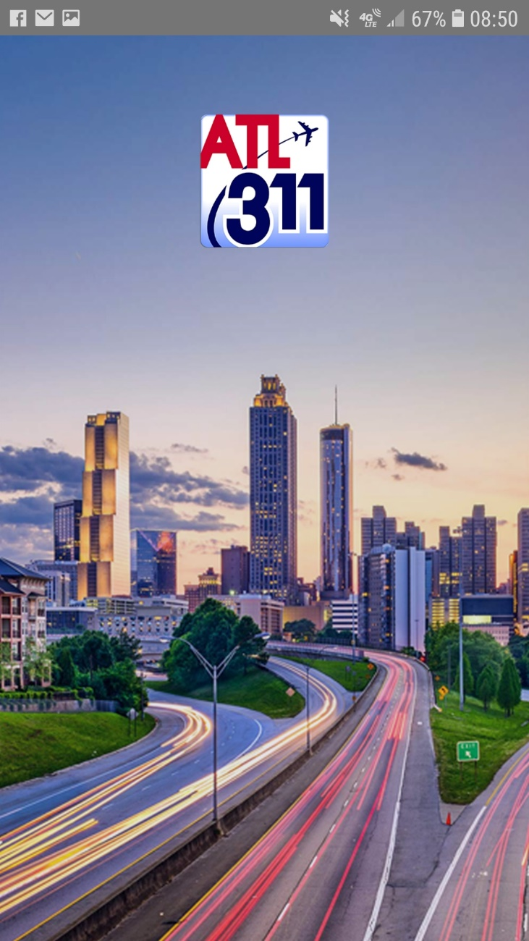
ATL311 Mobile App
Final testing underway for phase 1 for Android & iPhone
Initial focus on DPW and Code Enforcement
My City will provide location-specific info on everything from City Council district to closest fire station

Slide 11
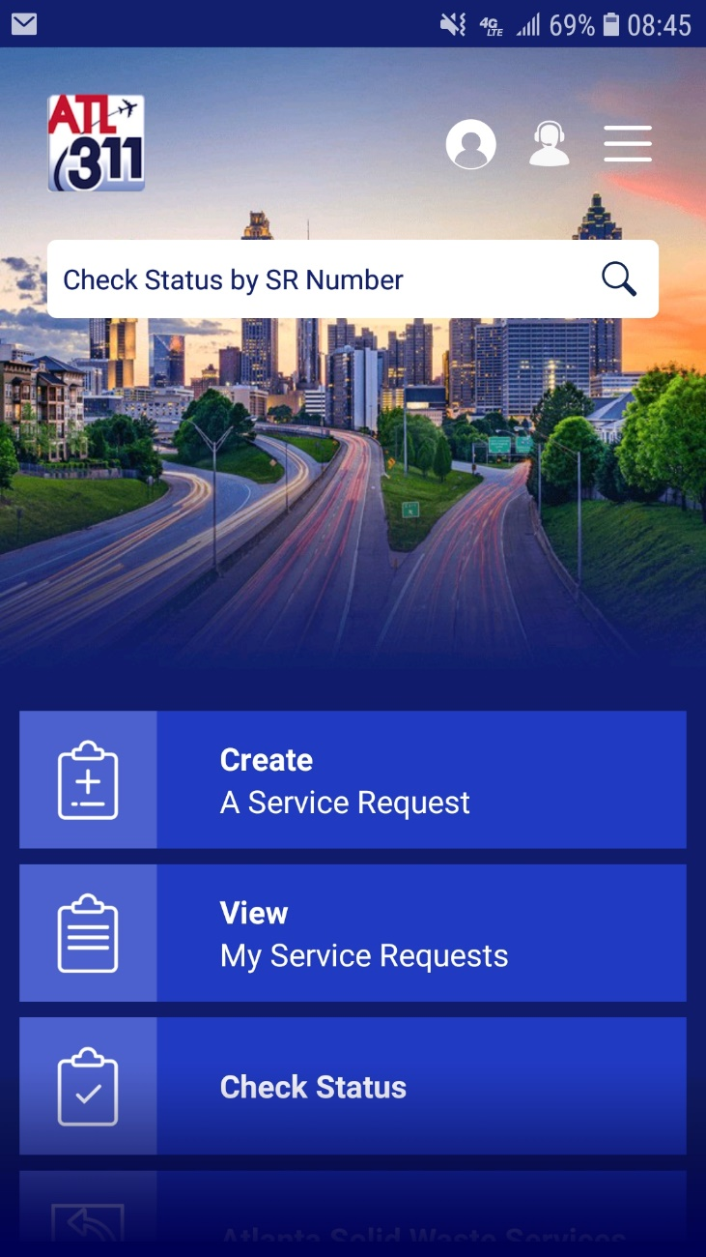
ATL311 Mobile App

Slide 12
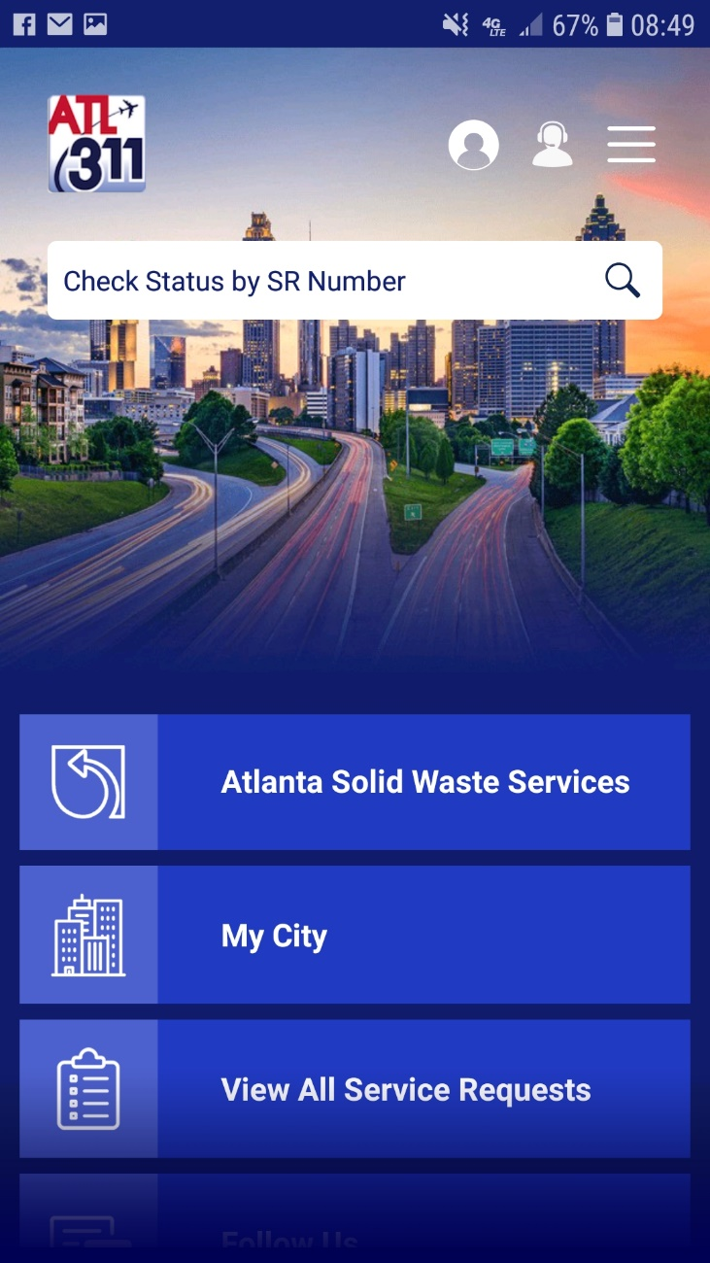
ATL311 Mobile App

Slide 13
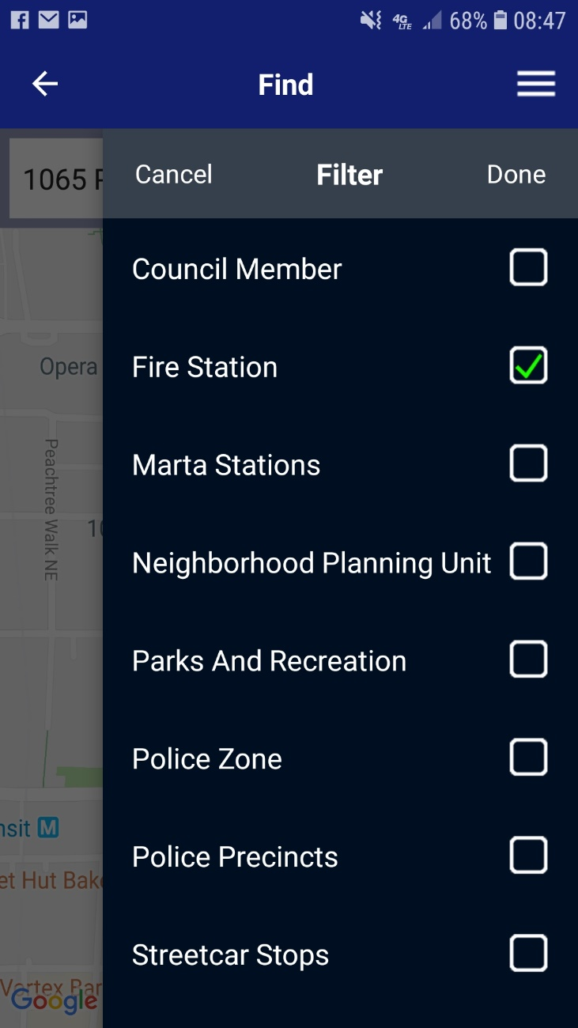
ATL311 Mobile App

Slide 14
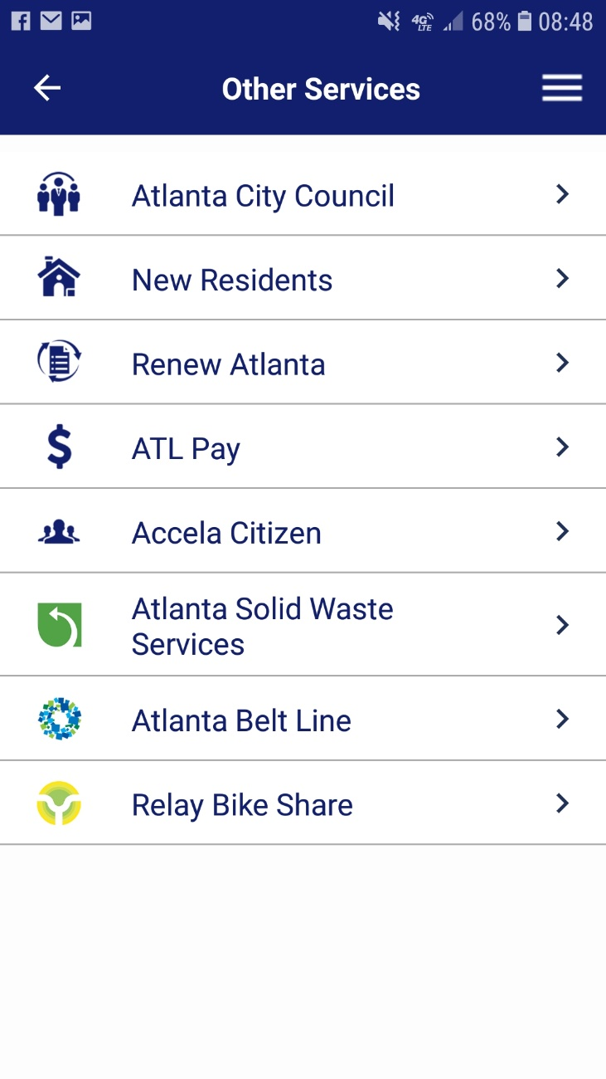
ATL311 Mobile App

Slide 15
Next 6 Months
ATL311 Mobile App launch
Service Order Management (SOM) launch for Parks, DWM
NotifyATL relaunch
Consolidated district-specific performance reporting
ATL311 Newsletter
Customer surveys via the ATL311 voice response system (IVR)
Continue consolidation of calls into ATL311
Atlanta Municipal Court – August target
WorkSource Atlanta, Office of Film & Entertainment, Corrections under review

Slide 16
One Source for City Services
Questions?

