Slide 1
Transportation Committee Quarterly Review
Tom Weyandt, Interim Renew Atlanta General Manager
Michele Wynn, Horizontal Program Management Officer
JULY 11, 2018

Slide 2
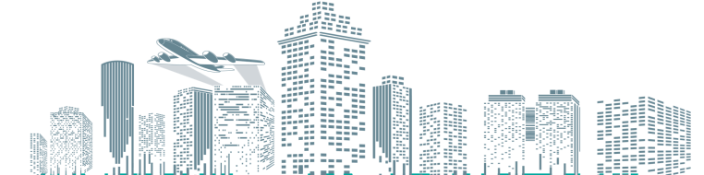
Core Values:
Innovation
Quality/Value
Integrity
Equity

Slide 3
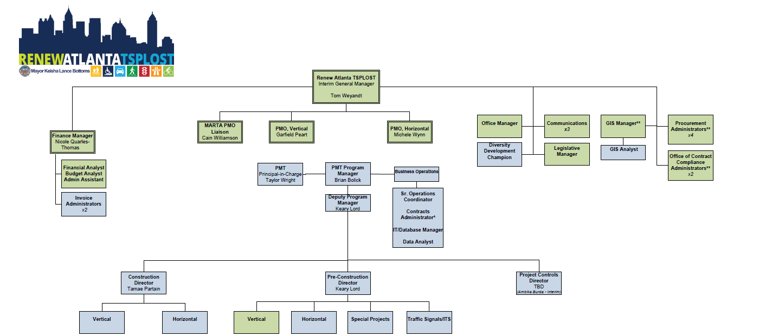
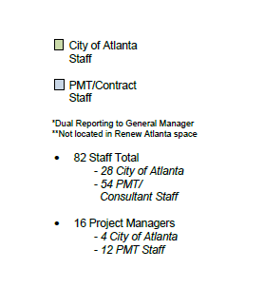
Organizational Chart

Slide 4
Renew Atlanta + TSPLOST Program Life Cycle
Project Close-Out
Bond/TSPLOST Funding
Project Delivery
Program Management Plan
Project Construction
Project Conceived
Continuous
Progress Reporting
Project PIP Review Board
Project Funded
Project Design (60%)
Project Legislated
Project Activated
Project Req./POs

Slide 5
Key Accomplishments to Date
Renew Atlanta and Partnerships from December 2015 to date:
From 90 to 513 projects active
From $13.8M to $214M Under Contract
Quick start on TSPLOST
TSPLOST: $29.2M Under Contract
MARTA Coordination on TSPLOST
$98M committed partnership funding from GDOT
December 2017 Diversity Payments Issued: 35.51%
North Avenue Smart Corridor – 4 awards and counting
Equity in Design
Traffic signalization improvements, including TSPLOST operational cost capitalization
Citywide impact
Resurfacing: $50.7M under contract/complete
Traffic management: $24.9M under contract/complete
Safer Roads Challenge designation
Lead development of MARTA IGA
Governance – Multilayered internal and external, Project Control Board, City Council, Internal Audit, Infrastructure Stakeholder Committee, Finance and ACP Infrastructure Task Force
Martin Luther King, Jr. Recreation & Aquatic Center completion
Project Snapshot to Date
152 miles (over 400 lane miles) paved or underway
5.7 miles of repaired or new sidewalk complete or underway
2 bridges under design 2 bridges pre-construction 1 bridge under construction
69 signal intersections improved/connected (includes TCC)
35 signal upgrades underway for construction, plus 180 signals under minor upgrades
632/940 signal intersections communicating though Atlanta and GDOT
147 additional signals currently being connected through Atlanta and GDOT
14 complete streets under design
9 facilities renovated
15 facilities underway
12 art projects underway
17 art pieces restored

Slide 6
Renew Atlanta/TSPLOST Program to-Date: Capital Project Capability-Build
Accomplishments
Opportunities / Challenges
Business Culture aimed at quality, equity and performance
Program Management:
Ramped up team by only 25% for additional $300M TSPLOST deployment
Solid scopes and cost estimates – ongoing
TSPLOST readiness – separate financial management system
Communication and Reporting:
“Design Developing / Dirt's Moving & Under Construction” weekly updates
Monthly website updates
Renew/TSPLOST Project Update Portal (NotifyATL notification system)
Daily tweets – resurfacing updates and community engagement events
118% increase in tweet views from June 2018 to date
Event recaps
Internal audits – 3 completed, 2 underway
Renew Lessons Learned – have citywide applicability
Expectation management
Utility coordination complexity
Communication
Ongoing
Project readiness: ensuring projects are meaningfully scoped and ready to go – ongoing
Project quality and project controls – ongoing
Event traffic management plan – stadium
Smart Corridor Suite – North Avenue, Campbellton Road, Buckhead, event venues

Slide 7
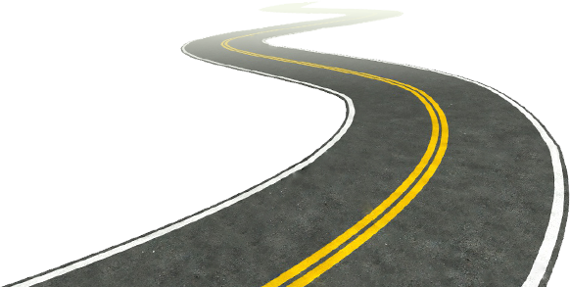
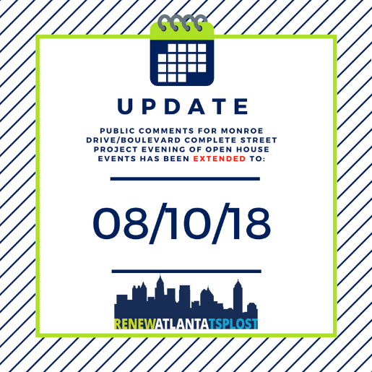
3-Month Work Plan Highlights
Resurfacing Contracts:
Group 2 (local)- 18th Street, Aurora Avenue, Hills Place, Huber St, McAfee Street, Mims Street, Montgomery Ferry Drive Phase 2, Mountain Way Resurfacing, N. Ivy Rd Resurfacing, North Morningside Resurfacing, Old Chattahoochee Ave Phase 1, Old Ivy Rd, Pine Street, Morehouse Dr, Sunset Avenue, Travis Street, Verbena St, Westminster Dr, Whitaker Circle, Whitaker Street
Major A- Fairburn Rd (Phase 1, 2 &3), Stone Hogan Connector, Stanton Rd. Bolton Rd, 8th Street, Beecher St., Collier Dr., Ellsworth Industrial Boulevard, Fair Dr., Hills Ave., Howell Mill, Huff Rd., Margaret Mitchell Dr., Peachtree Battle Ave., Campbellton Rd., Northside Pkwy 1 & 2, Metropolitan Pkwy.
Major B- To advertise this summer
Marietta Street
Traffic Communication Corridors (TCC): Piedmont Ave TCC, Centennial Olympic Park Drive TCC, Monroe Drive TCC, Juniper Street TCC, West Marietta and Marietta Blvd TCC and Signal Upgrades
TCC Combo 2- Georgia Ave, Atlanta Ave, Boulevard, Hosea Williams, McDaniel St and Glenwood) Phase 1 and Barnett @ St. Charles signal removal
Bridges: Powers Ferry Road Bridge Replacement
Childress Bridge Replacement- Ground breaking ceremony was on 6/20/18
TSPLOST: Proctor Creek Greenway- Construction complete
Midtown ITS Projects- Bid advertisement
Bobby Jones / Atlanta Memorial Park / Northwest Beltline Connector- Construction
10th St Pedestrian and Bicycle Safety Project- Construction
Complete Streets:
Monroe Boulevard- Open House Series (3 meetings) was on 6/28/18. Public comments are open until 08/10/18.

Slide 8
Horizontal Projects: completed and underway
Renew Atlanta Bond (Horizontal) 399
PROJECTS CONSTRUCTED | 166
Projects in Progress | 233
Activation phase | 10
Design/Preconstruction phase | 90
Construction phase | 133
TSPLOST 24
PROJECTS CONSTRUCTED | 1
Projects In Progress | 23
Activation phase | 1
Design/Preconstruction phase | 19
Construction phase | 3
Grand Total | 423

Slide 9
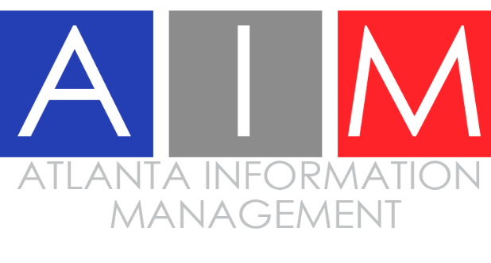
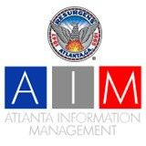
Suite of Smart Corridors
Event management – traffic management for special events
North Avenue Smart Corridor – AV, connected vehicles, data analytics
Pre-bid- 6/1/18
RFPs Due- 7/11/18
Ted Turner Drive Resiliency Corridor – sustainability
Winner: University of Georgia
Runners-Up: Morehouse College and Georgia Tech
Campbellton Road Smart Corridor – transit
Technology tested in Midtown (North Avenue)
Initial Transit Priority Technology (Glance)- currently being installed
Buckhead – traffic management
Estimated Completion: December 2018
Technology is being used- Maxview Traffic Responsive and Wavetronix Radar Detection
Georgia Tech Studio Class Spring 2019

Slide 10
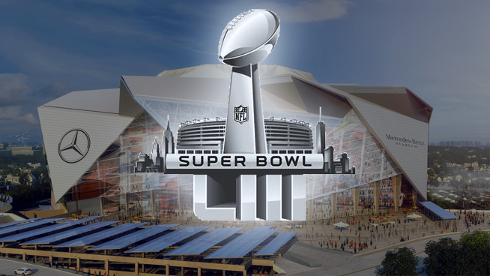
Smart City Initiatives
Philips Arena, Georgia World Congress Center, Mercedes Benz Stadium, Centennial Olympic Park, etc.
Upcoming active traffic management efforts:
Super Bowl January 2019 – here we come!
“ I just wanted to express my gratitude on all of the coordinated efforts that have made real, measurable improvements to the fan experience coming to and leaving from our games thus far. The attention to each detail and the follow up emails and meetings have been incredibly helpful to make immediate improvements and to make sure all are aligned on the playbook we are using. Thank you very much. ”
Date | Day | Start Time | Event | Estimated Attendance
5/20/2018 | Sunday | 7:00 pm | United vs Red Bulls | 35,000
5/26/2018 | Saturday | 7:00 pm | Kenny Chesney | 65,000
6/2/2018 | Saturday | 7:00 pm | United vs Philly | 35,000
6/24/2018 | Sunday | 4:30 pm | United vs Portland | 35,000
6/30/2018 | Saturday | 7:00 pm | United vs Orlando | 70,000
Date | Day | Start Time | Event | Estimated Attendance
7/15/2018 | Sunday | 2:00 PM | United vs Seattle | 70,000
7/21/2018 | Saturday | 3:30 PM | United vs DC | 35,000
8/1/2018 | Wednesday | 7:30 PM | MLS All Star Game | 70,000
8/4/2018 | Saturday | 4:00 PM | United vs Toronto | 35,000
8/10/2018 | Friday | 8:00 PM | Taylor Swift | 70,000
– Mike Gomes, SVP, Fan Experience,
AMB Sports + Entertainment
“ We had 50 members of the CFP production team in the city this weekend observing all operations and they were very pleased with traffic!!
Congratulations on all the great work you and the team have done!! ”
– Amy Patterson, Manager, Operations & Logistics, Atlanta Football Host Committee

Slide 11
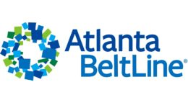
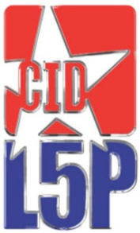
Partnership Efforts
Community Improvement Districts (CIDs):
Midtown CID – Midtown Alliance
Buckhead CID
Downtown CID – Central Atlanta Progress
Little Five Points CID
Upper Westside CID
Atlanta Committee for Progress (ACP)
Infrastructure Stakeholder Committee oversight
Georgia Pacific Communications plan review
Customer service training
Mentor/protégé program
Georgia Tech Smart City collaboration
Georgia Pacific/Koch Industries – Smart city visit

Slide 12
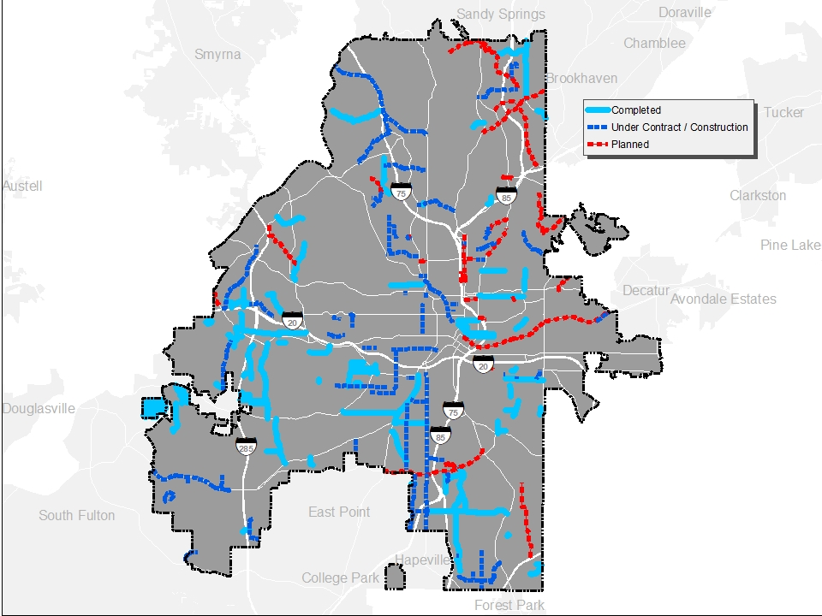
Resurfacing Projects: Completed +
Under Contract + Planned

Slide 13
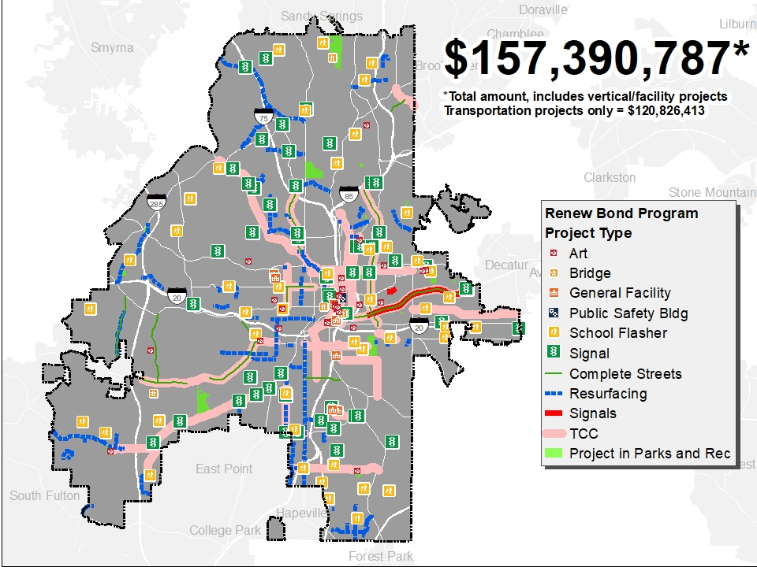
Citywide:
Bond Projects
Under Contract

Slide 14
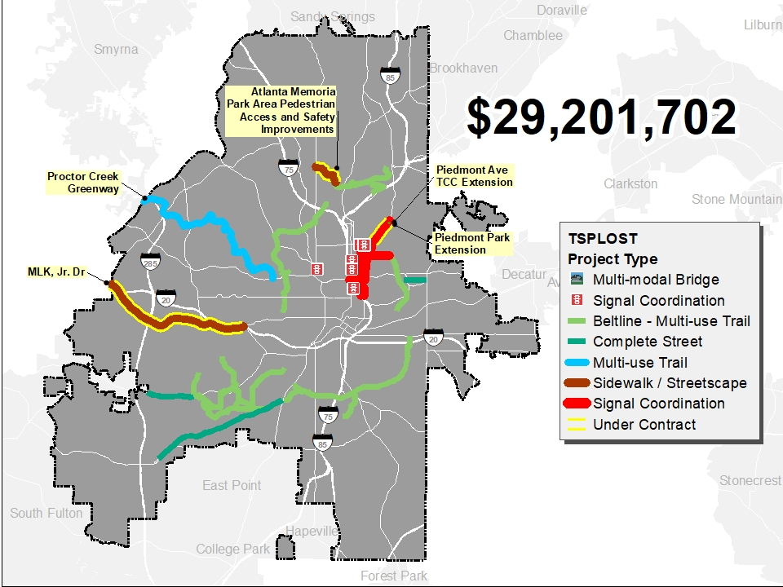
TSPLOST Projects: Under Contract

Slide 15
