Slide 1
Affordable Housing
Amanda Noble, City Auditor
Stephanie Jackson, Deputy City Auditor
Brad Garvey, Audit Manager
Josh Winfield and Rebecca Robinson, Performance Auditors
July 10, 2018

Slide 2
Audit Objectives
Is the City of Atlanta’s housing affordable?
How are the city’s recent initiatives likely to affect the amount of affordable housing stock?
Are city subsidized developments distributed equitably throughout the city?
Is the city monitoring developers’ compliance with affordable housing agreement terms?

Slide 3
Methodology
Analyzed property tax and income data
Reviewed city code provisions on affordable housing and zoning, and reviewed proposed city efforts to promote affordable housing and zoning code reform
Interviewed community stakeholders and staff from the Department of City Planning’s Office of Housing and Community Development, Invest Atlanta, and City Council
Reviewed a random sample of:
25 subsidized rental units within the Office of Housing and Invest Atlanta’s portfolio to assess developers’ compliance with recordkeeping and monitoring requirements
33 homes purchased in the Eastside tax allocation district with assistance from Invest Atlanta to determine whether the homes are still owned by the original buyers
Reviewed quality of life data within City Council districts and around sampled housing developments

Slide 4
Over Half of Atlanta’s Housing is Affordable

Slide 5
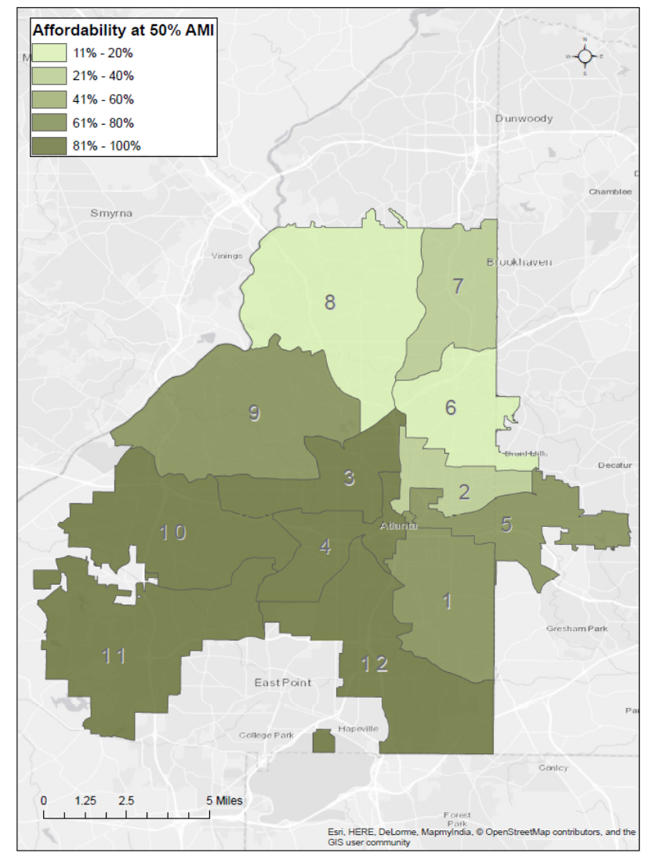
Affordable Housing is Unevenly Dispersed

Slide 6
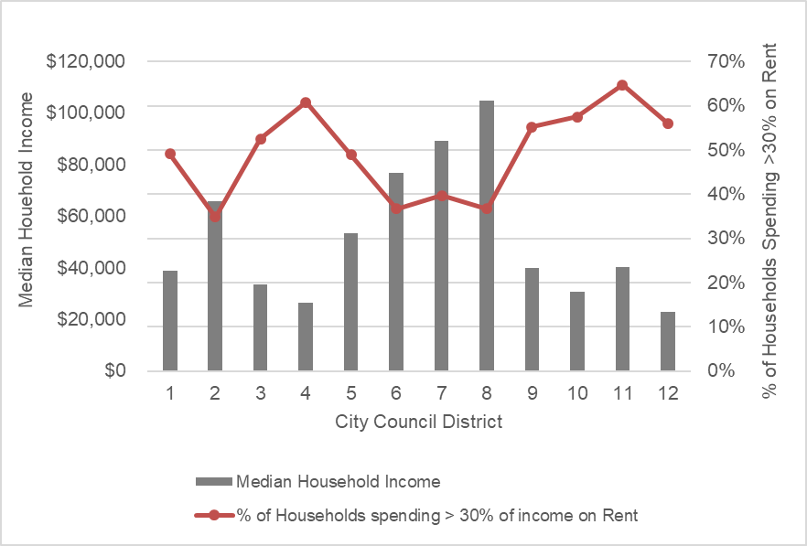
Over Half of Renters Are Cost-Burdened

Slide 7
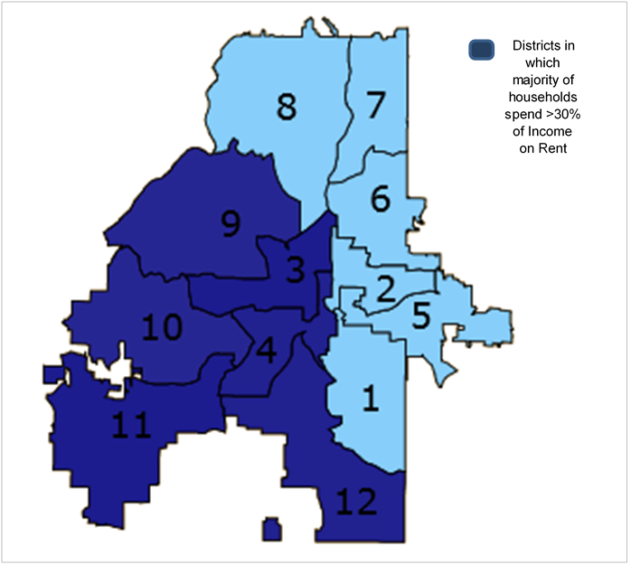
High Percentage of Cost-Burdened Renters Are in the Southern Part of the City

Slide 8
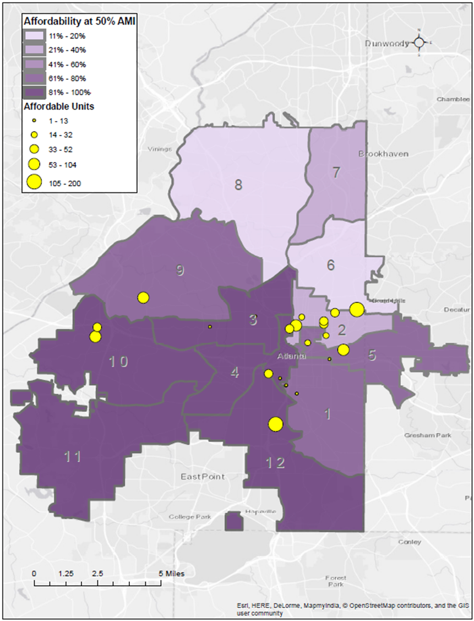
Half of Subsidized Housing Is in Low-Income Areas

Slide 9
Future Subsidies Should Target Areas with Positive Quality of Life Factors
3 of 9 sampled subsidized rental developments were located in areas where the schools were rated as above average; the remaining 6 were in areas where the schools were ranked as below average
3 of 9 developments are in areas with average access to public transportation
5 developments are in areas with some transit, and one is in an area of minimal transit

Slide 10
Strategies Are Needed to Create Additional Affordable Housing
Atlanta’s citywide affordable housing strategy could be more cohesive, with measurable goals and programs targeted to achieve stated outcomes
Key information related to housing programs should be consolidated and more readily accessible
The reestablishment of the Housing Commission should help to target housing efforts

Slide 11
Proposed Zoning Changes Should Result in Additional Affordable Housing
The Department of City Planning’s proposed zoning quick fixes could reduce some barriers to affordable housing
Proposed longer term changes in the zoning code would create additional housing density
Smaller lot sizes are more affordable

Slide 12
Atlanta is Implementing Methods to Create and Preserve Affordable Housing
Recently adopted inclusionary housing legislation to create affordable housing
Affordable housing impact statements should provide meaningful information to decision-makers about the effect of proposed legislation on the city’s housing stock
City supports an anti-displacement tax fund program to help prevent homeowners from being displaced by the effects of gentrification

Slide 13
No Mechanism to Maintain Affordability of Subsidized Homes Once Sold

Slide 14
The City Should Consider Using Additional Methods to Increase Affordable Housing
Community land trusts - provides affordable housing through land leasing and home ownership
Density bonuses - allows developers to build more units at a site than zoning rules typically allow

Slide 15
Recommendations
Address the unbalanced distribution of affordable housing between the northern and southern parts of the city.
Target areas with positive quality of life factors such as public transportation, access to education, and proximity to job centers when subsidizing affordable housing developments.
Consolidate key information related to available housing programs and make that information more readily available to citizens and developers.
Consider longer affordability periods when subsidizing rental housing.
Develop a mechanism to maintain affordability when subsidizing for-purchase housing.
Expand the use of programs such as providing density bonuses to developers and increasing the use of community land trusts.

Slide 16
Questions?

