Slide 1
DEPARTMENT OF PROCUREMENT
Performance
Contracts Awarded
Alternative Procurements
United One Update
Oracle Cloud Update
Vacancy Update

Slide 2
FY 16 PERFORMANCE
Average Spend per Contract
Commodities - $714,505
Services - $349,126
277
32
$22,864,170
$96,708,020

Slide 3
FY 17 PERFORMANCE
Average Spend per Contract
Commodities - $1,242,813
Services - $11,124,299
70
35
$86,996,875
$389,350,453

Slide 4
FY 18 PERFORMANCE
Average Spend per Contract
Commodities - $1,978,517
Services - $1,022,751
177
131
$259,185,675
$181,026,957

Slide 5
ALTERNATIVE PROCUREMENTS
121

Slide 6
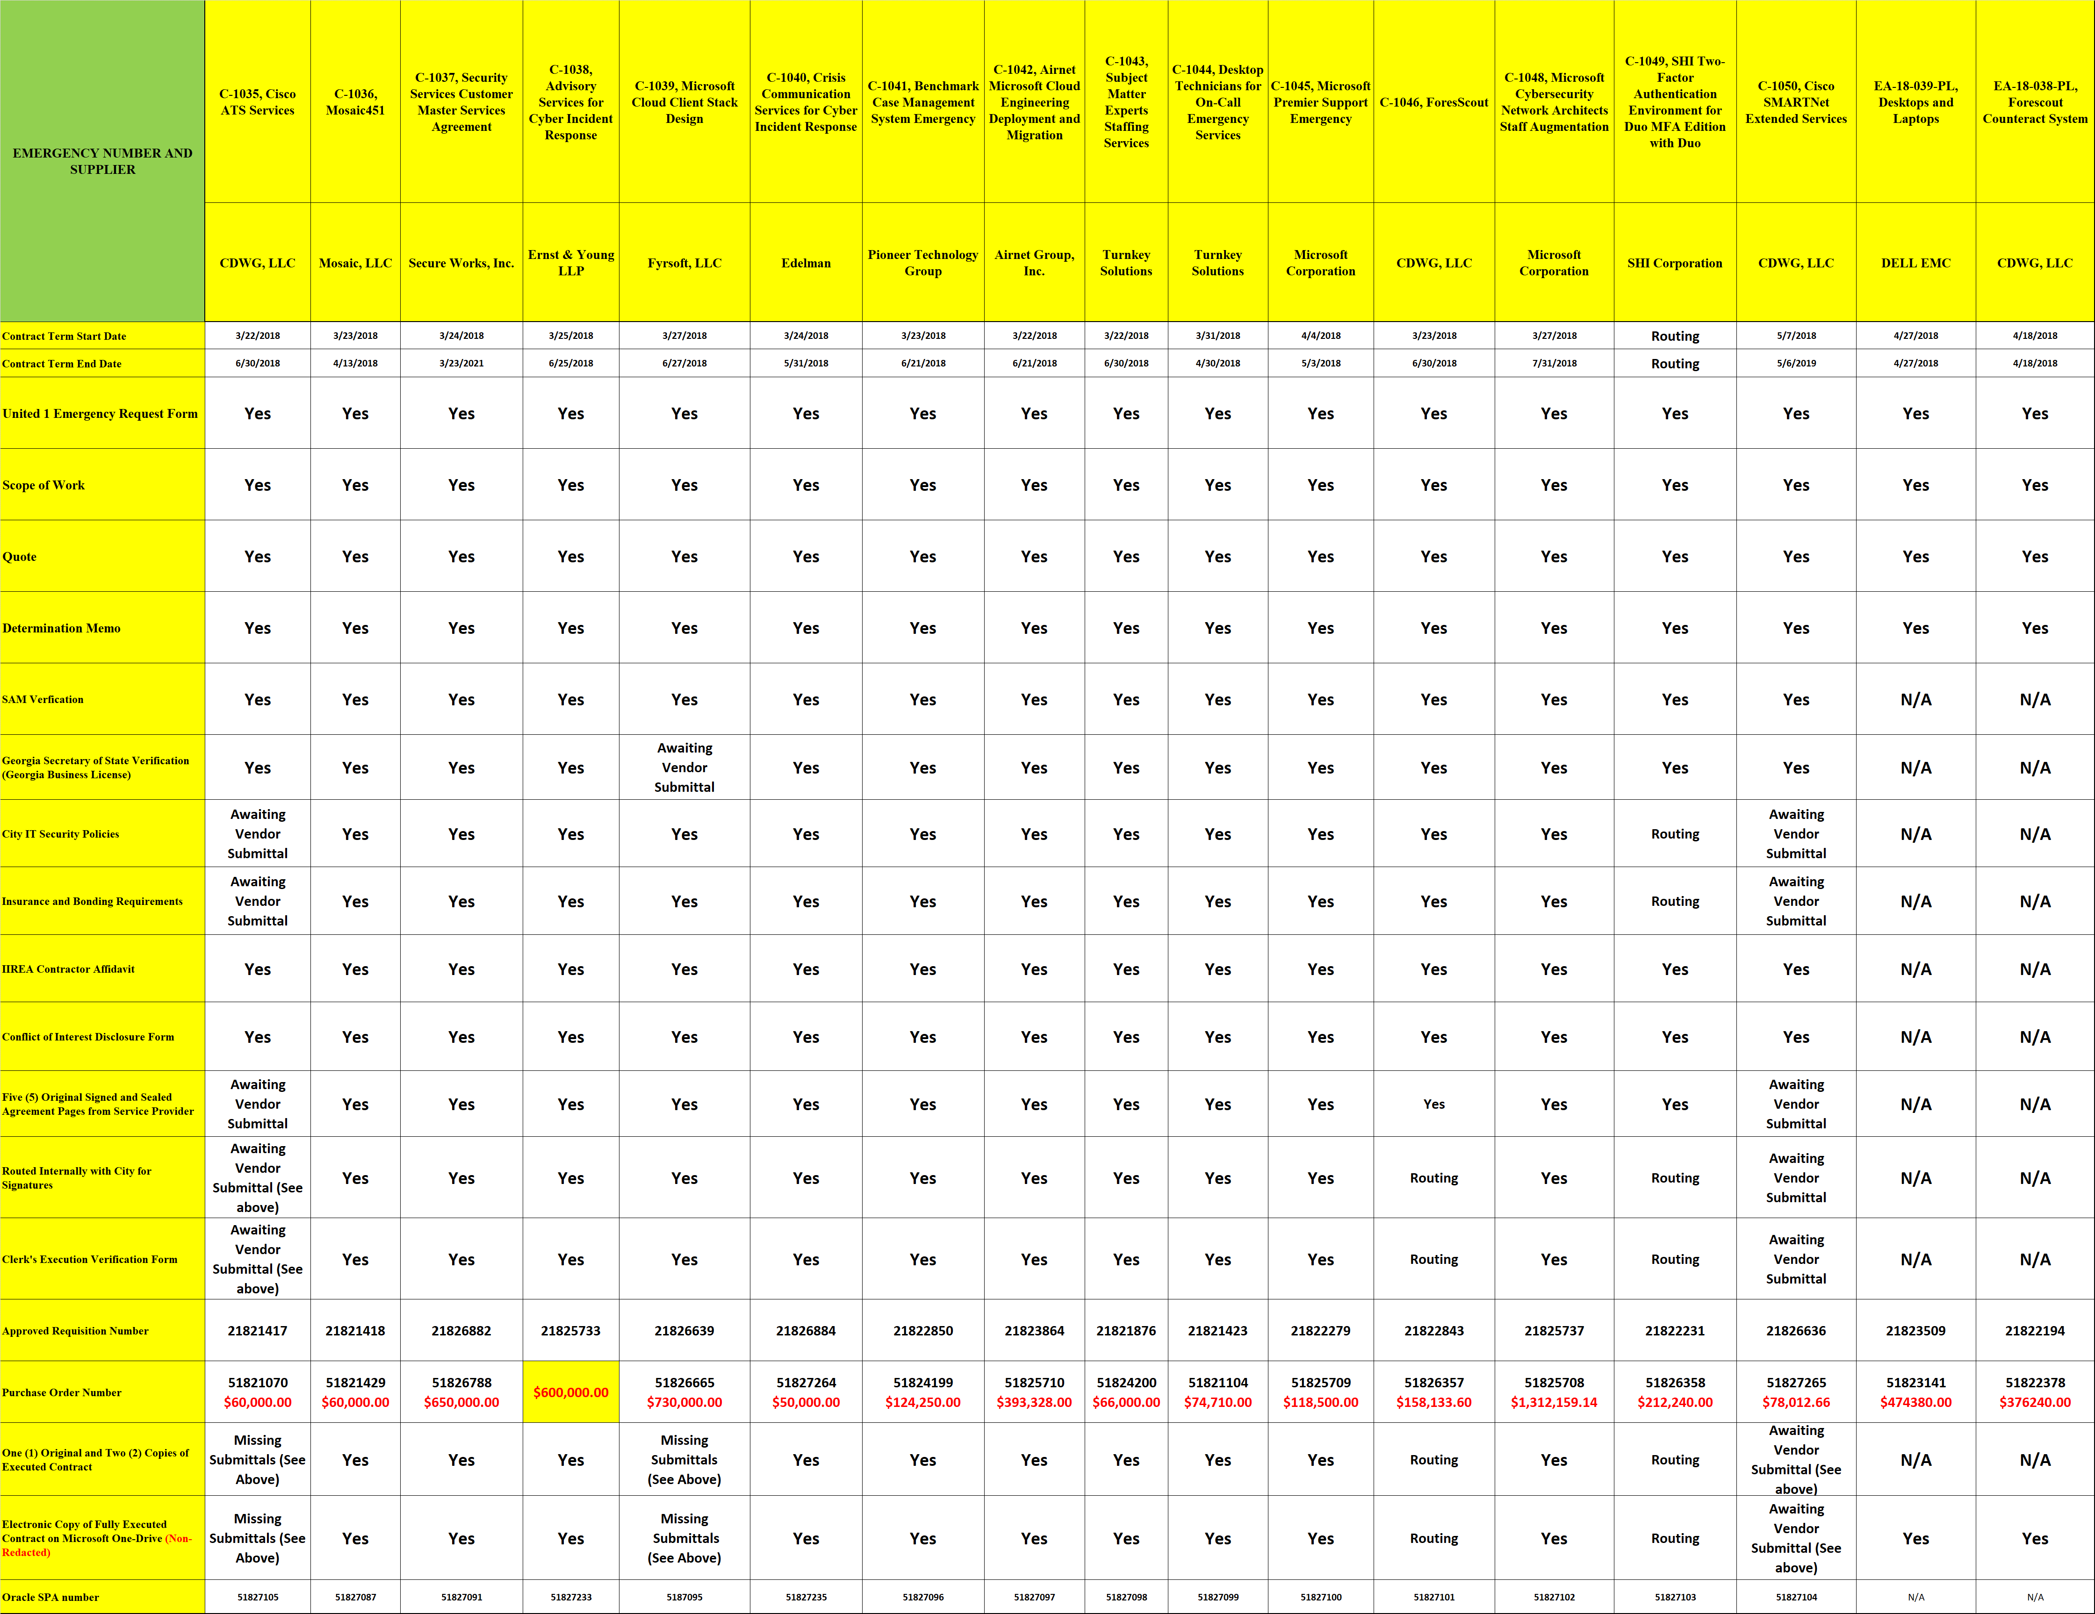
UNITED ONE UPDATE – OVERVIEW OF EMERGENCY AUTHORIZATIONS BY DOP

Slide 7
UNITED ONE EMERGENCY CONTRACTS AWARDED AND PROCESS INTEGRITY MEASURES
AWARDS
PROCESS ENGAGED FOR EACH AWARD
C-1035, Cisco ATS Services
C-1036, Mosaic451
C-1037, Security Services Customer Master Services Agreement
C-1038, Advisory Services for Cyber Incident Response
C-1039, Microsoft Cloud Client Stack Design
C-1040, Crisis Communication Services for Cyber Incident Response
C-1041, Benchmark Case Management System Emergency
C-1042, Airnet Microsoft Cloud Engineering Deployment and Migration
C-1043, Subject Matter Experts Staffing Services
C-1044, Desktop Technicians for On-Call Emergency Services
C-1045, Microsoft Premier Support Emergency
C-1046, ForesScout
C-1048, Microsoft Cybersecurity Network Architects Staff Augmentation
C-1049, SHI Two-Factor Authentication Environment for Duo MFA Edition with Duo
C-1050, Cisco SMARTNet Extended Services
EA-18-039-PL, Desktops and Laptops
EA-18-038-PL, Forescout Counteract System
United 1 Emergency Request Form
Scope of Work
Quote
Emergency Determination Memo
Verification Contractor Not Debarred or Suspended
Verification of Authority to do Business in Georgia
City IT Security Policies
Insurance and Bonding Requirements
IIREA Contractor Affidavit
Conflict of Interest Disclosure Form
Contractor’s Acknowledgment of Agreement Terms
Routing for Appropriate City for Signatures
Clerk's Execution Verification Form
Approved Requisition and Purchase Order Protocols in Oracle
Public Notifications Posted on City’s Website

Slide 8
PROCUREMENT IN THE ORACLE CLOUD
ATLcloud Timeline
First round of testing completed as of June 20.
Training materials being created and logistics being finalized.
Second round of testing, including end-to-end process flows, begins July 9.
Procurement completed 100% of their test cases in the first round of testing
Training materials being created and logistics being finalized
Second round of testing, including end-to-end process flows, begins July 9.

Slide 9
PROCUREMENT IN THE ORACLE CLOUD
Suppliers
Sourcing
Electronic sourcing and communication between Procurement, User Agencies, and Suppliers for:
Solicitations
Responses – Suppliers submit bids electronically **
Evaluations - Bids are systematically scored and presented to contract officer for review **
Awards - Purchase orders can be systematically created from awards **
Ability to track total spend over the life of a contract
E-signature using DocuSign for contract signing with suppliers and user agencies **
Purchase Orders
Departmental supervisors will have visibility to all departmental purchases
Implementation of Purchasing Agreements:
Increased accuracy of spend analytics
Agreements controlled by security so user agencies can have their own agreements **
Reduce ad-hoc purchases by departments **
Centralized purchasing so DOP has total visibility of all items being purchased **
** - indicates DOP process change

Slide 10
STAFFING AND VACANCY UPDATE
PERSONNEL
FY18 Authorized Personnel: 81
(Budget reduction)
Current vacancy rate: 11%
FY17 Authorized Personnel: 82
Vacancy rate: 20%
(as of July 2017)
POSITION VACANCIES
Five (5) Contracting Officers
(2 – General Fund, 2 – Aviation, 1 – Watershed)
Three (3) Procurement Specialists
(2 – General Fund and 1 – Watershed)
One (1) Data Reporting Analyst
(Aviation)

