Slide 1
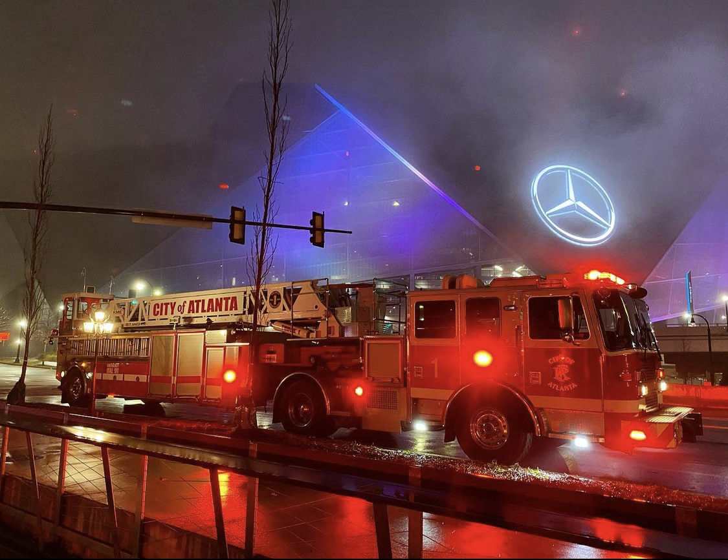
Atlanta Fire Rescue Department FY23 Third Quarter Update
April 24, 2023
Roderick Smith, Fire Chief

Slide 2
Goals and Objectives
City Council
Atlanta Fire Rescue Department
Maintain competitive compensation of AFRD members
Regularly review Emergency Services provided to the City of Atlanta
Regularly review the condition and needs of AFRD fleet and facilities
Provide the safest possible work environment for all members
All HR needs are met
Staffing & Compensation
Continued focus on enhancements & maintenance of AFRD fleet & facilities

Slide 3
Service Metrics Calls for Services
Calls for Services – FY22-Q3 vs FY23-Q3
Year | January | February | March | Total
FY23-Q3 | 7,106 | 6,114 | 6,874 | 20,094
FY22-Q3 | 7,212 | 6,098 | 6,988 | 20,298
Downtown Inspections FY22-Q3 vs FY23-Q3
Year | January | February | March | Total
FY23-Q3 | 742 | 724 | 819 | 2,285
FY22-Q3 | 651 | 594 | 560 | 1,805

Slide 4
FY23 Third Quarter Attrition
SWORN ATTRITION
 | January | February | March
Retired | 2 | 1 | 2
Resigned | 6 | 1 | 2
Terminated | 4 | 6 | 1
Hired | 4 | 9 | 9
Net +/- | -8 | +1 | +4
Vacancy Rate
as of 3/31/23
18.38%
CIVILIAN ATTRITION
 | January | February | March
Retired | 0 | 0 | 0
Resigned | 0 | 1 | 1
Terminated | 0 | 0 | 0
Hired | 7 | 2 | 4
Net +/- | +7 | +1 | +3

Slide 5
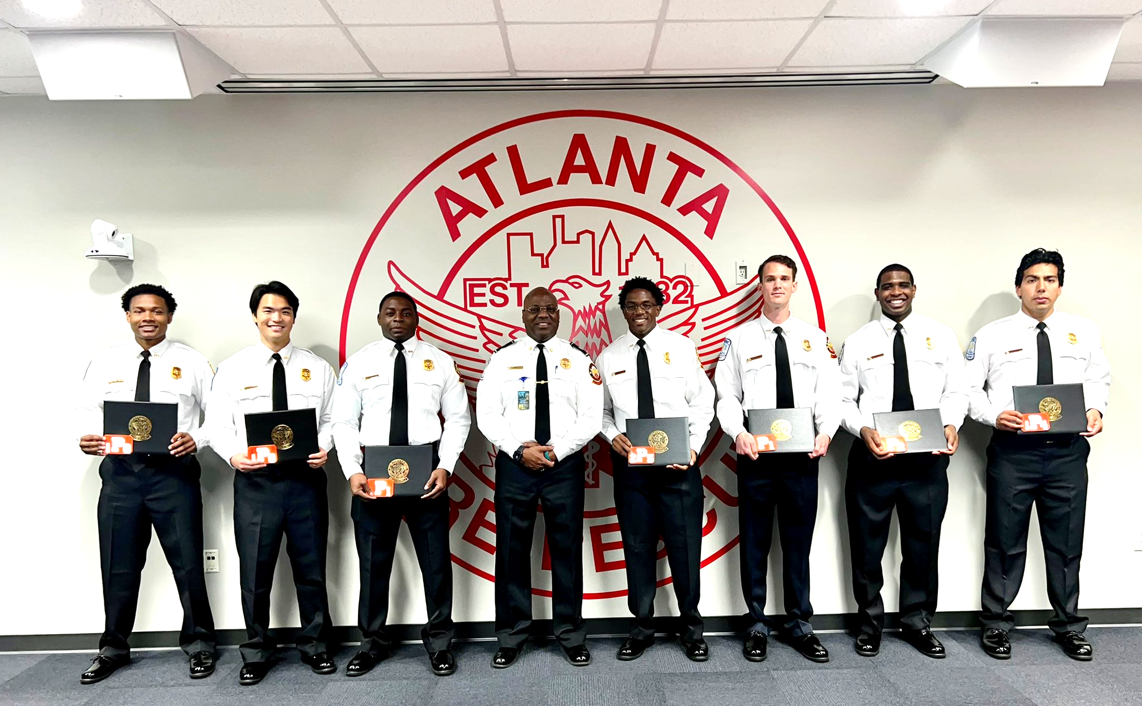
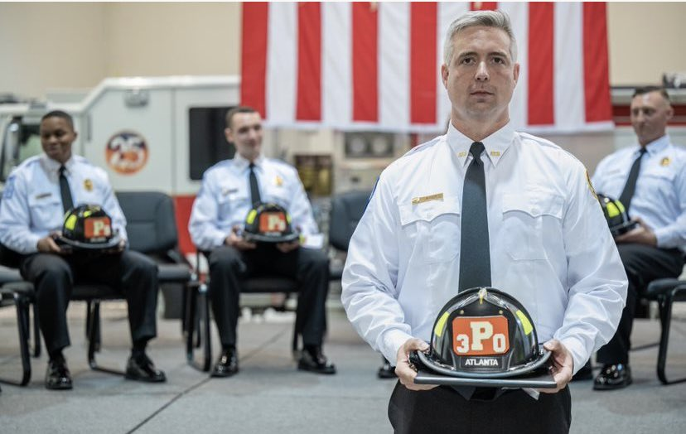
Current Recruit Classes
Recruitment
Recruit Class Summary Q3 FY 23
4 Recruit Classes
88 Recruits
Class 21-02B
22 Recruits
Anticipated Graduation Date
May 16, 2023
Class 22-02
26 Recruits
Anticipated Graduation Date
May 16, 2023
Class 22-03
27 Recruits
Anticipated Graduation Date
August 8, 2023
Class 23-01
21 Recruits
Anticipated Graduation Date
January 23, 2024

Slide 6
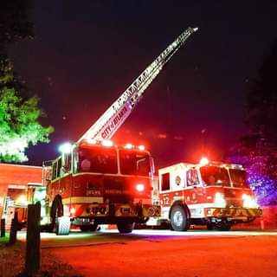
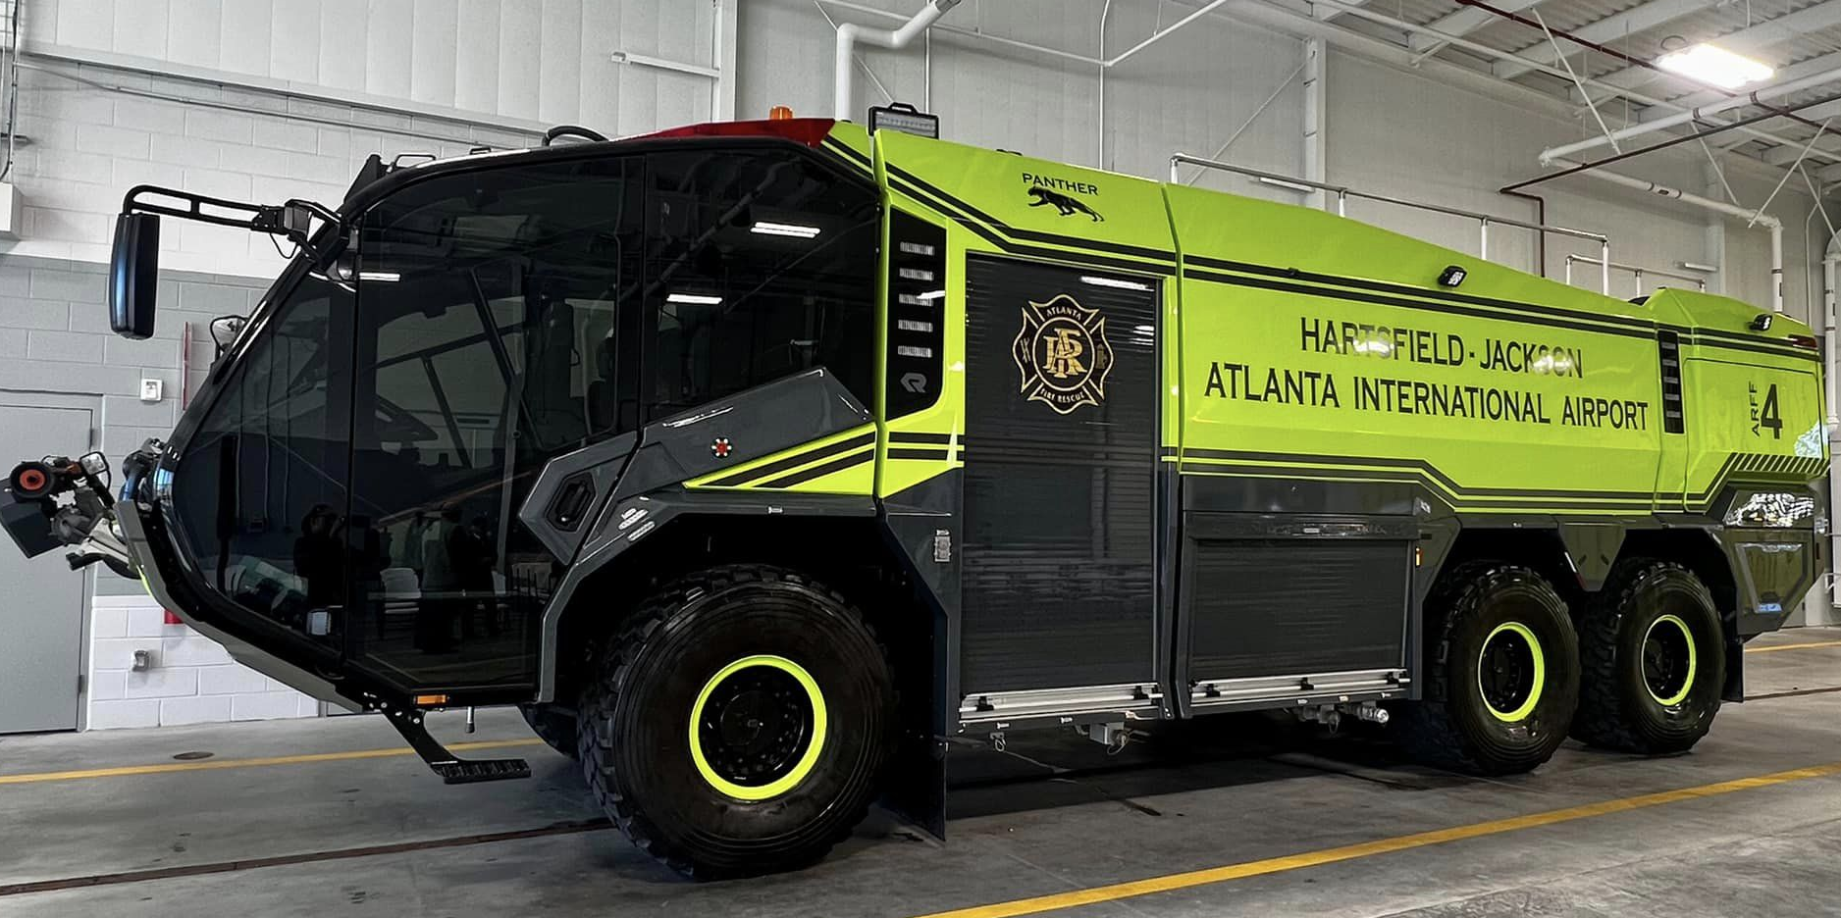
FLEET
AVIATION FLEET
Rosenbauer 6x6 Panther ARFF Truck (1)​ | 1- In construction | July 2023
2023 Ford F350 Mini Pumper (2)​ | 2 - In construction | August 2023
Battalion 7 Ford Expedition SUV (1) | Ordered by DOA Fleet | Mid-year 2023
1500 GPM Pumper (1)​ | In production phase | June 2023 (1)
 |  | July 2023 (2)
 |  | October 2023 (1)
Tractor Drawn Aerial Truck (1)​ | In production phase | October 2023
FY 22 - 3/3 | Reserved apparatus purchased pre-construction phase | October 2023

Slide 7
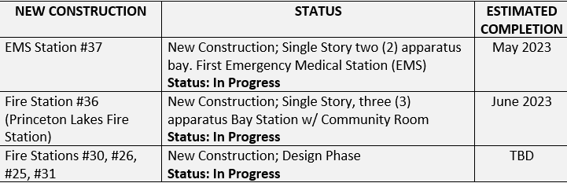
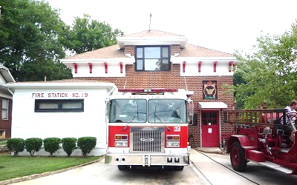
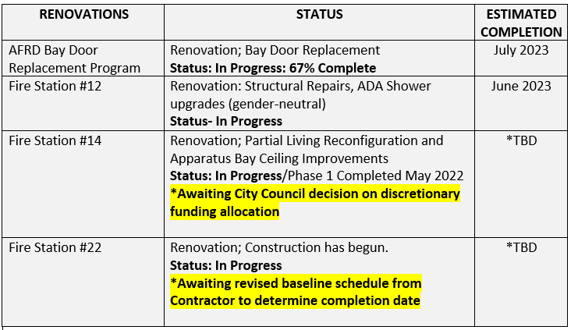
FACILITIES
7

Slide 8
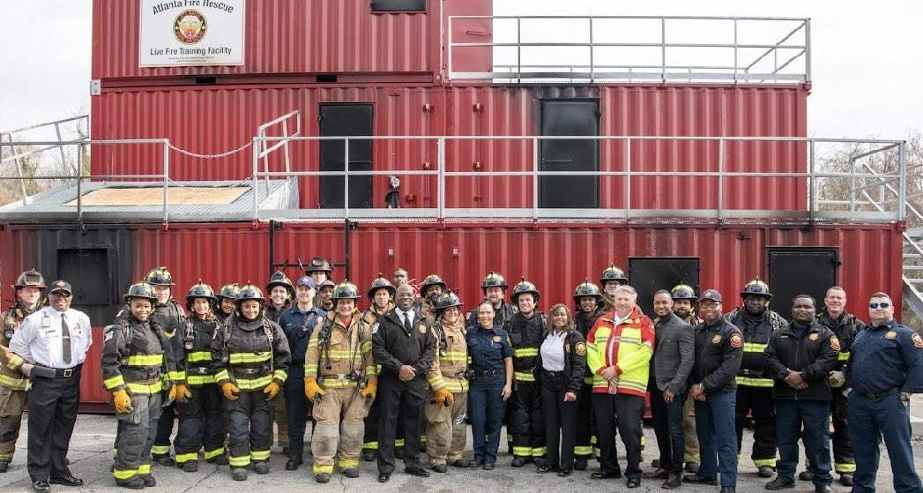
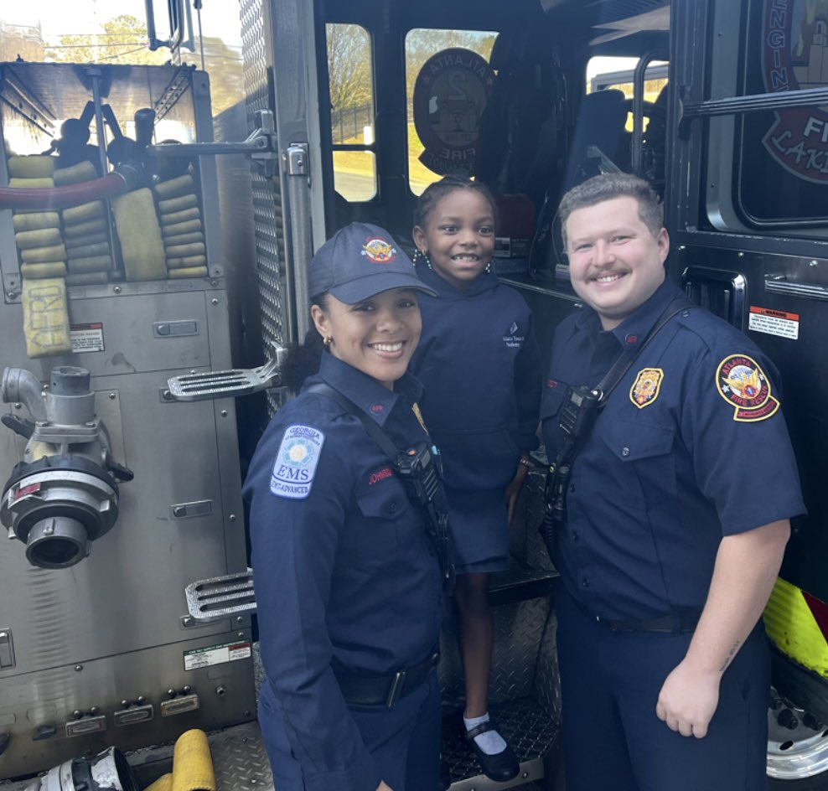
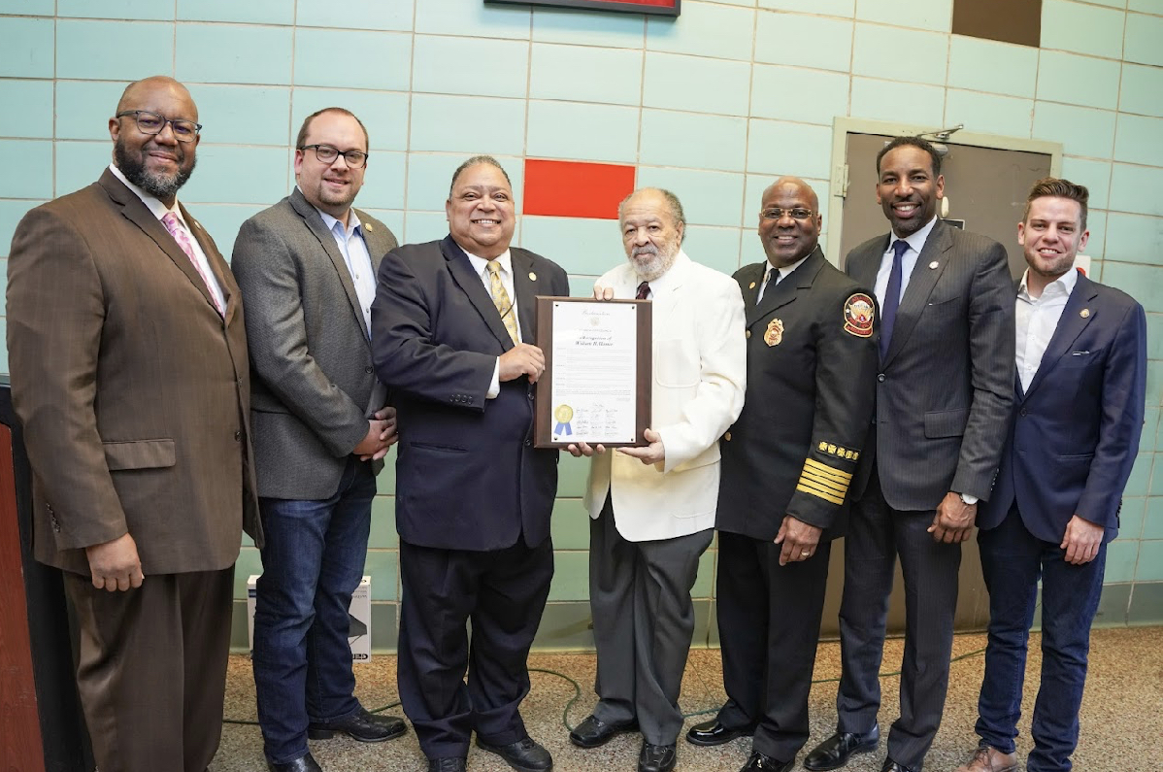
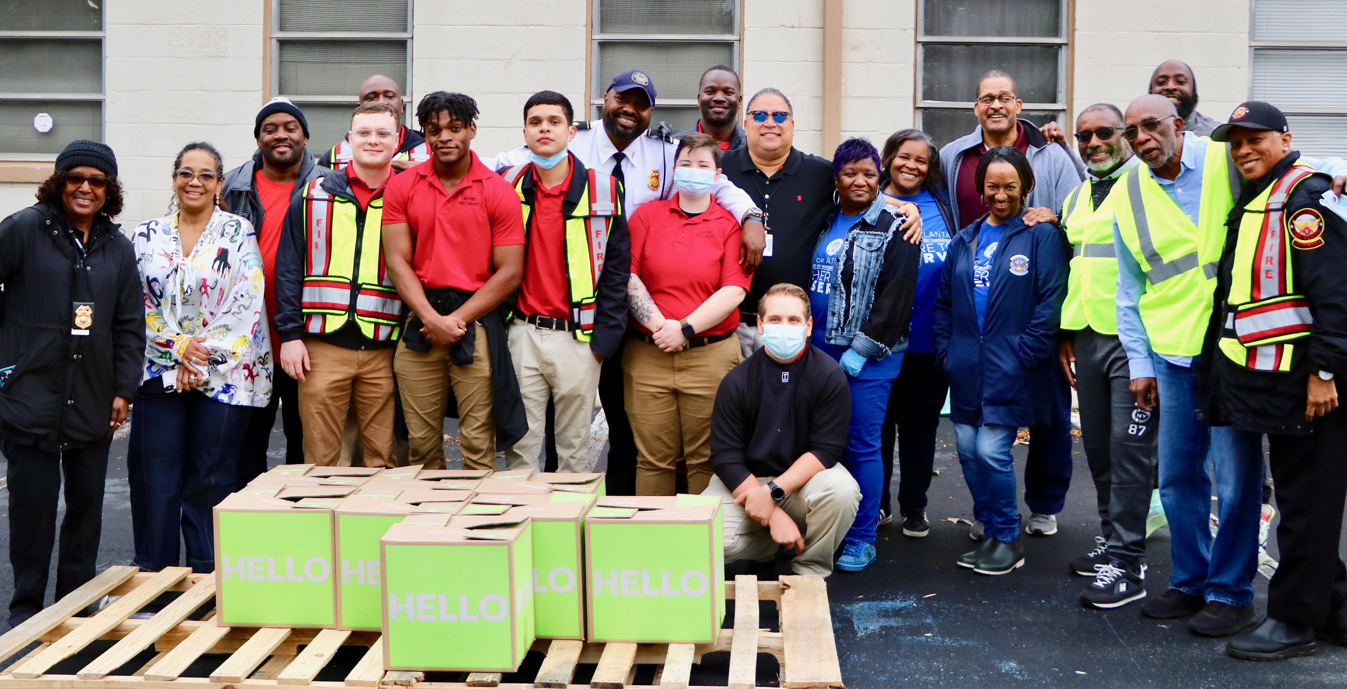
AFRD IN THE COMMUNITY
AFRD 60th Integration Anniversary Celebration
Atlanta Scholars Firefighter Meet & Greet
Atlanta Youth Academy’s Career Week
City of Atlanta Fire Academy
Monthly Community Food Drives

Slide 9
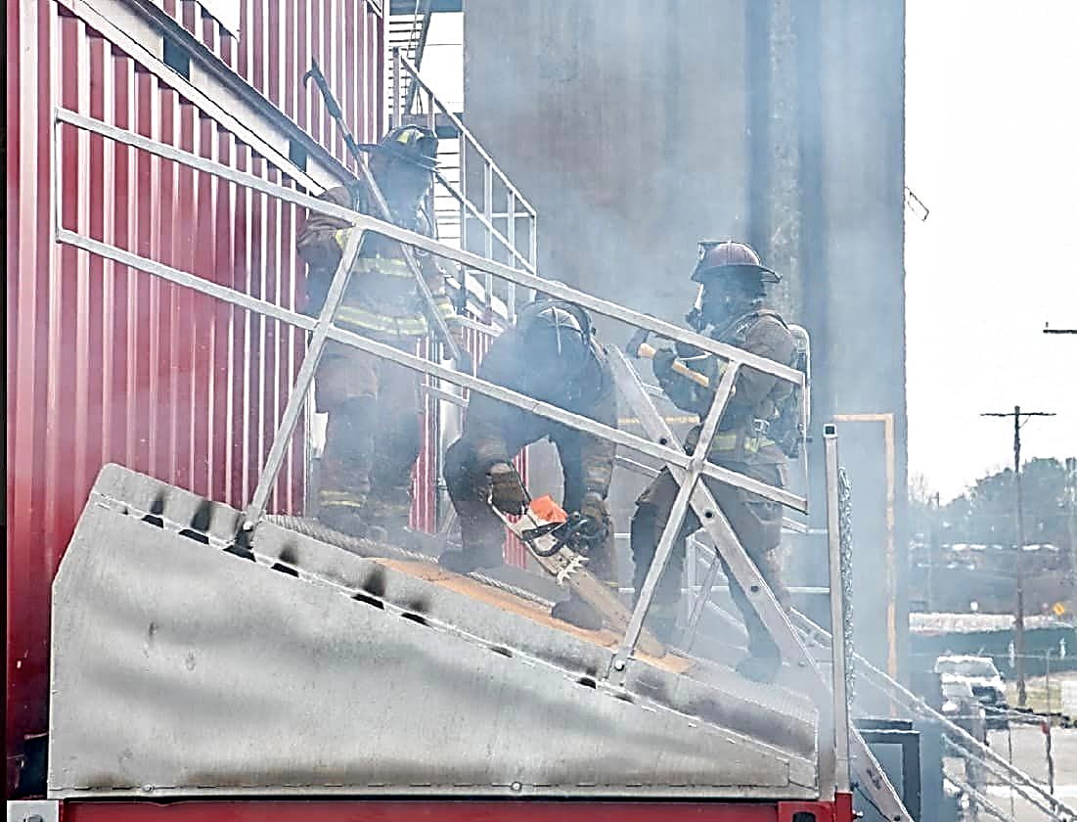
FY23 Recent Accomplishments
Hosted City of Atlanta Fire Academy
Passed Annual FAA Inspection
Celebrated AFRD 60th Integration Anniversary Celebration
Inducted 18 new Atlanta Firefighters
Completed New Construction of Station 32
Completed Renovation of Station 19

Slide 10
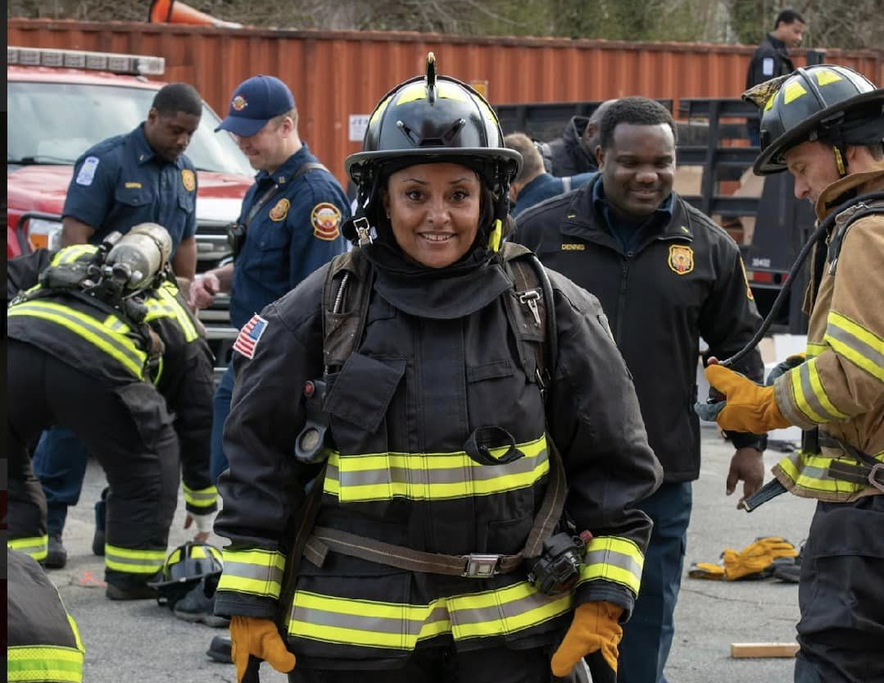
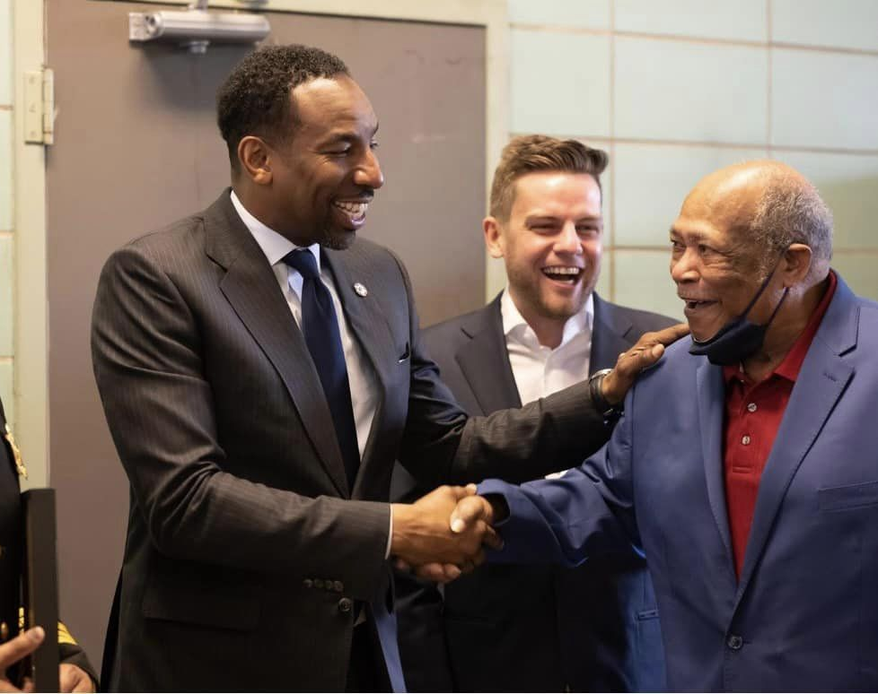
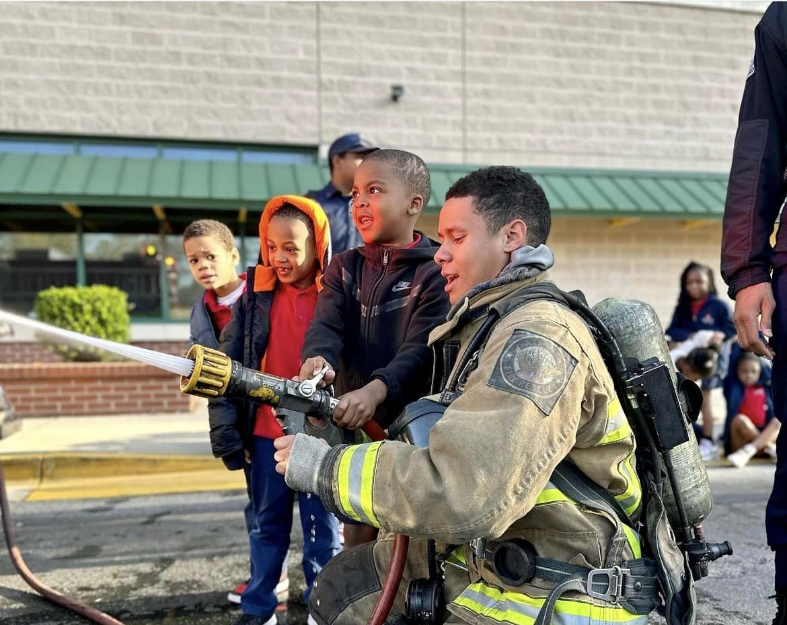
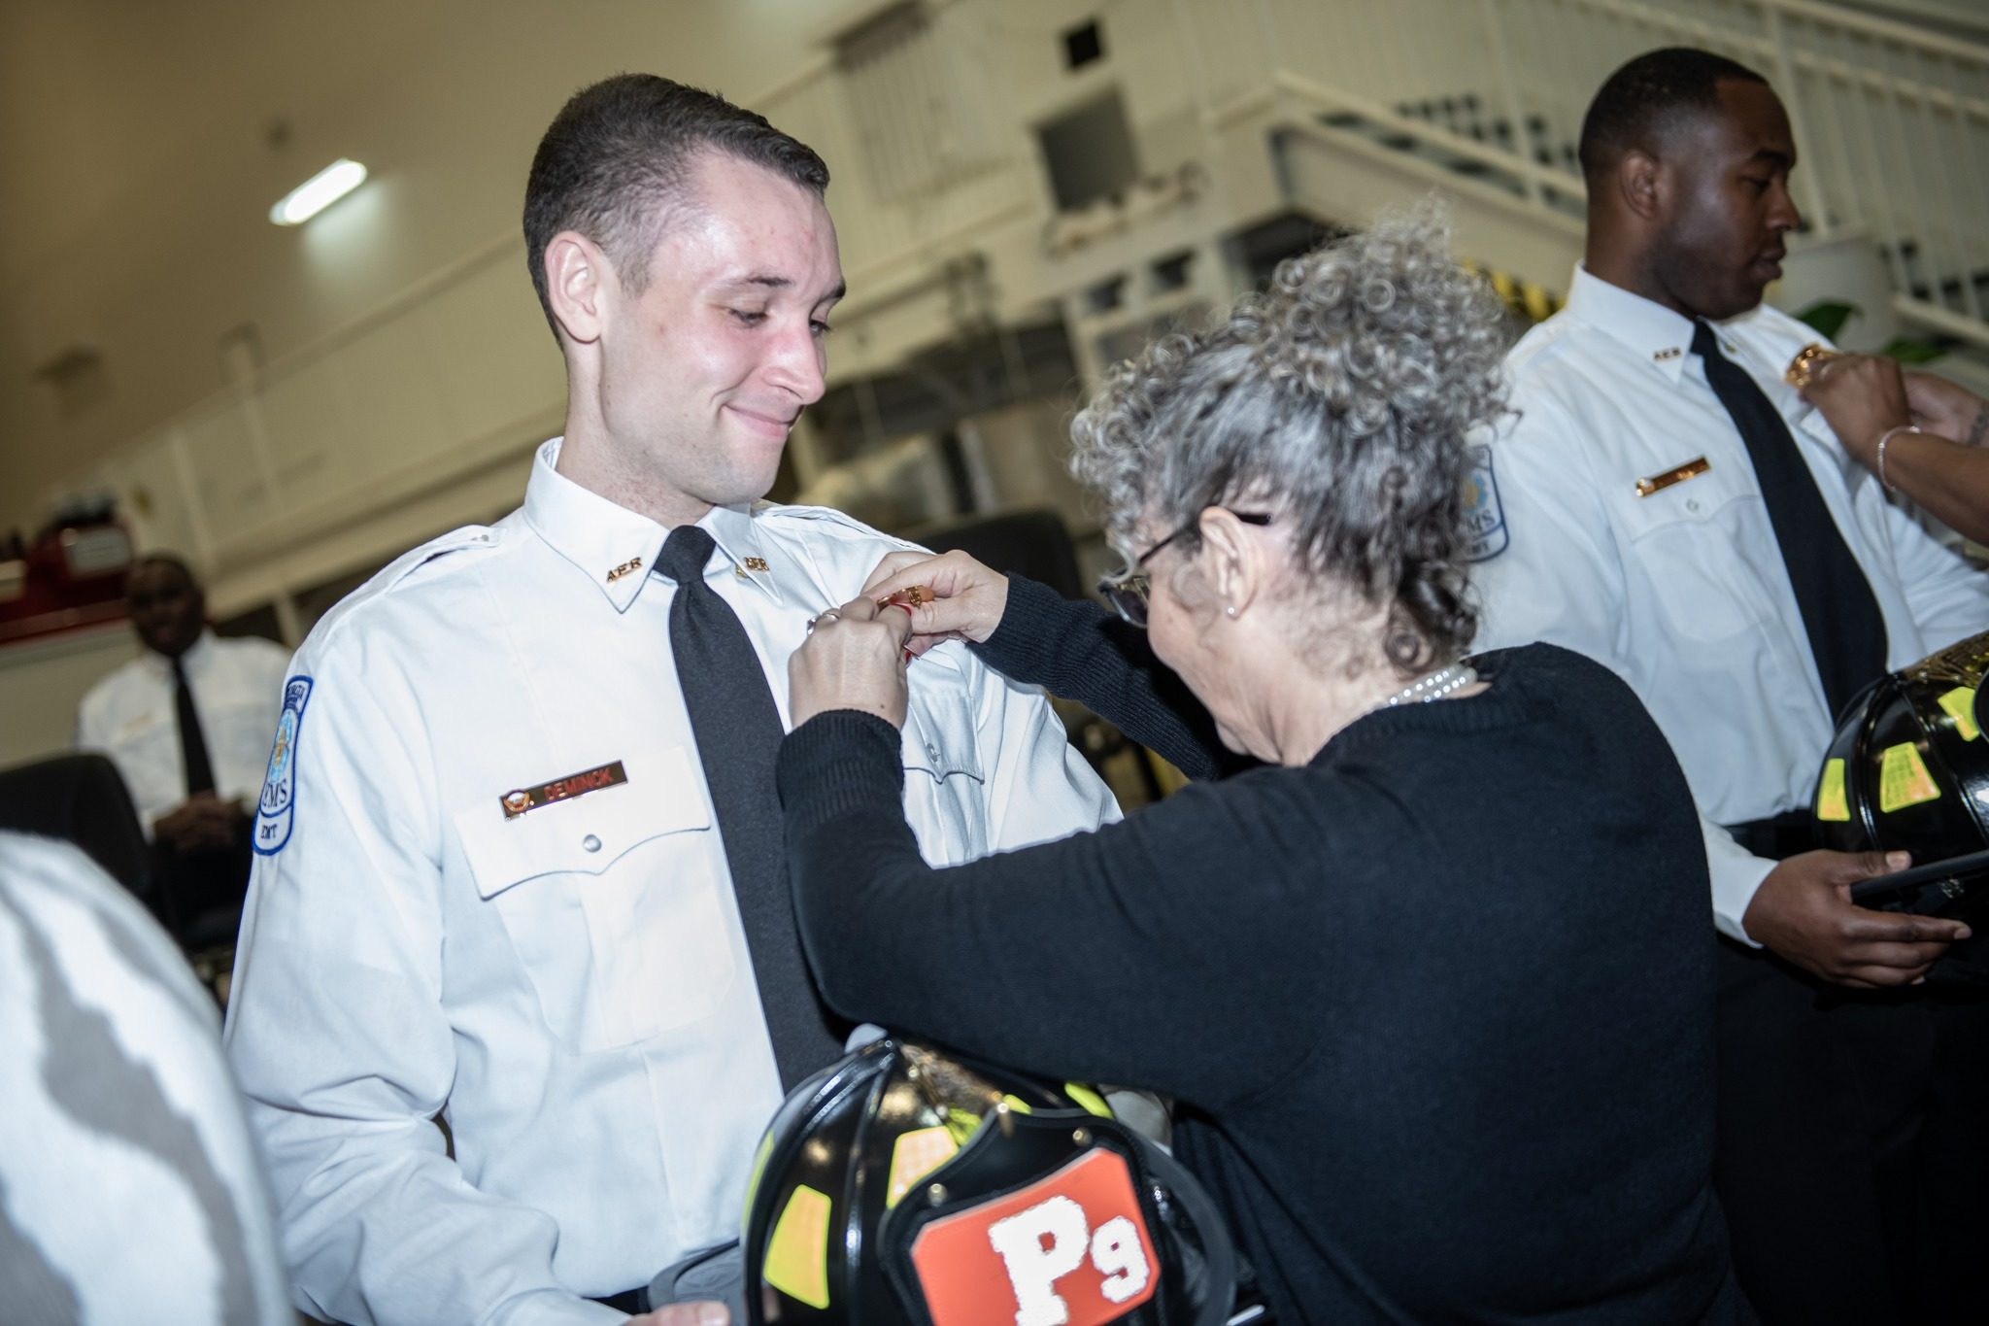
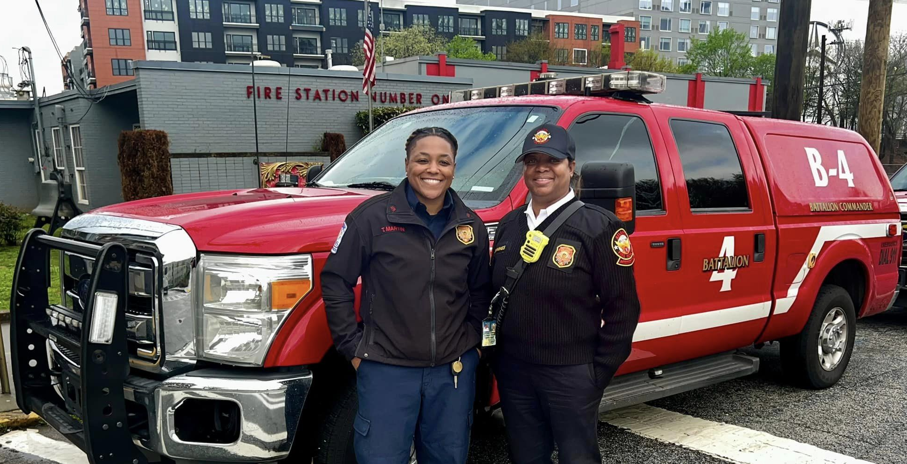
QUESTIONS or COMMENTS

