Slide 1
Department of Law
Nina R. Hickson, Interim City Attorney
FY19 Departmental Budget Briefing
June 6, 2018

Slide 2
Department of Law Mission Statement
The Department of Law is a team of professionals committed to providing best-in-class legal representation to the City of Atlanta. Our attorneys combine mastery of the law with an understanding of the unique needs of municipal government. In addition to defending the City in all types of civil litigation, we work proactively to prevent legal challenges by delivering sound advice, legislation, and training.
The Department of Law emphasizes the importance of professional growth. Education and development of all staff result in improved skills, increased productivity and satisfaction, an enhanced work environment and excellent customer service.

Slide 3
Department of Law Goals
Lead an ethical, transparent and fiscally responsible Law Department.
Provide advice and counsel to the Mayor and City Council.
Deliver world-class legal services by hiring and retaining attorneys who provide exemplary legal representation city-wide.
Assist departments with accomplishing infrastructure and service projects.
Provide counsel regarding public safety initiatives to ensure a safe and welcoming City.
Engage in proactive revenue recovery.
Work proactively to reduce liability by identifying, preparing and delivering relevant training to City employees and elected officials in areas where risk is identified.

Slide 4
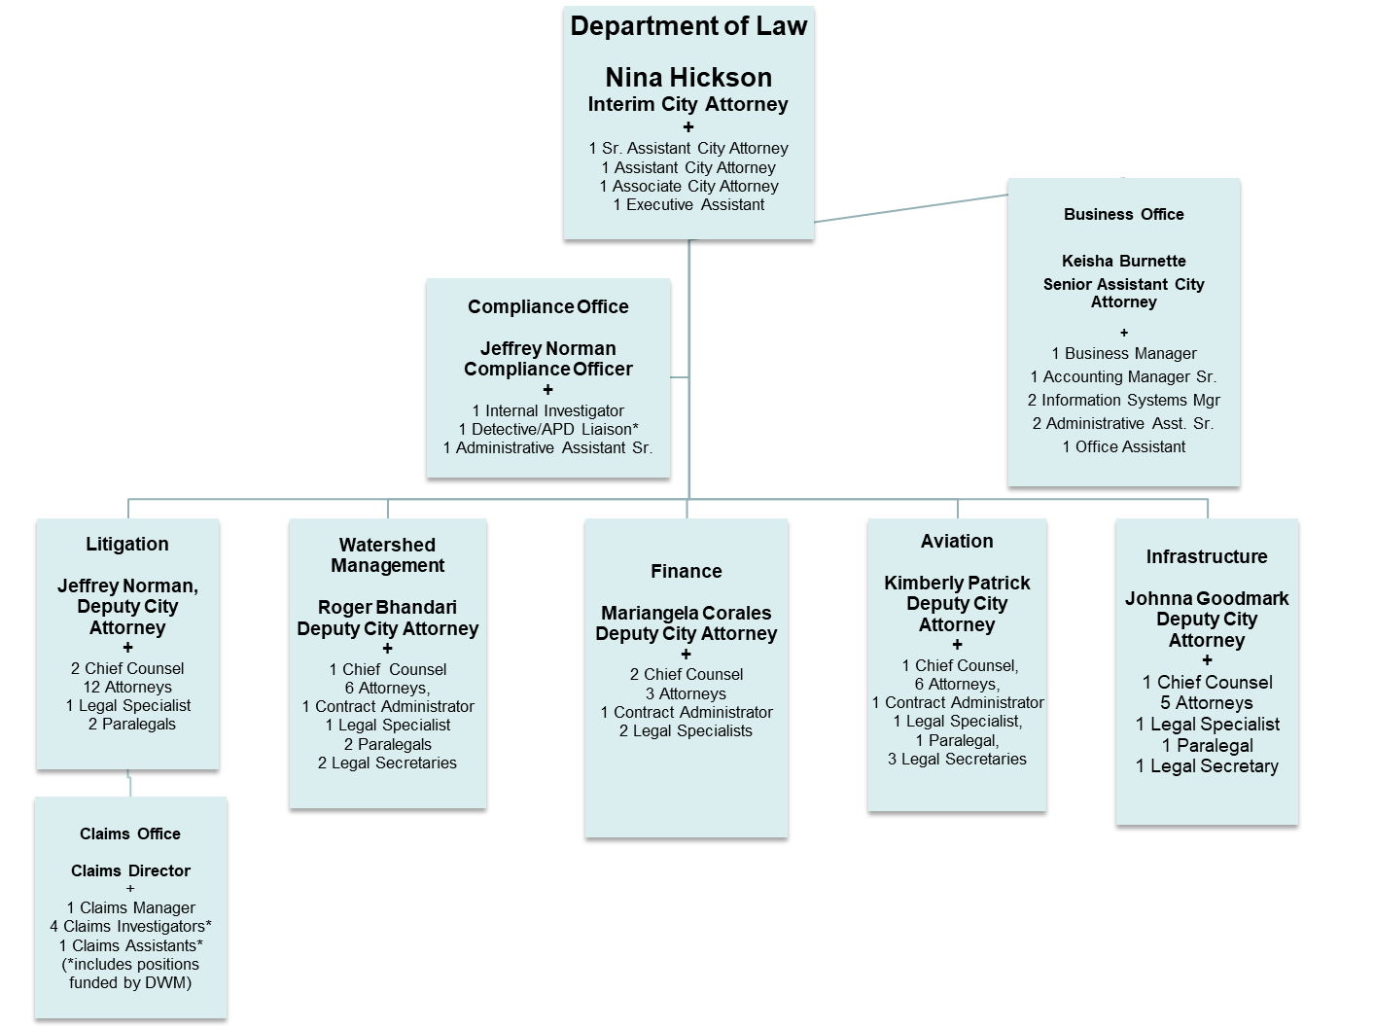
Department of Law Organizational Chart

Slide 5
Department of Law FY18 Vacancies, Attrition and Retention
Current Vacancies
Total Current Department of Law Vacancies – 14*
Attorney Vacancies - 12
Support Staff Vacancies - 2
Total Vacancies by Fund
General Fund - 5.34, Aviation Fund - 3.33 and Watershed Fund - 5.33
Attrition and Retention
FY18 Attrition Rate 11%, Retained 89% of Law Staff.
Attrition Rate for Attorneys 10%, Retained 90% of Attorneys
Attrition Rate for Support Staff 11%, Retained 89% of Support Staff
FY17 Attrition Rate 19%, Retained 81% of Law Staff.
Attrition Rate for Attorneys 24%, Retained 76% of Attorneys
Attrition Rate for Support Staff 11%, Retained 89% of Support Staff
* Not Fully Funded

Slide 6
Department of Law FY18 Highlights and Accomplishments
APS Deeds: The Law Department reviewed and analyzed title issues for over 50 properties requested for transfer by Atlanta Public Schools (“APS”). The Law Department negotiated the resolution of title issues and prepared the legislation and quitclaim deeds to transfer 31 of the requested properties and is working to resolve title issues to effectuate the transfer of the remaining properties to APS. The property transfers facilitated the resolution of a long-standing dispute between the City and APS.

Slide 7
Department of Law FY18 Highlights and Accomplishments
Phillips Arena: The Law Department assisted in the negotiation of the Memorandum of Understanding among the City, the Atlanta Fulton County Recreation Authority, Arena Co., and the Atlanta Hawks (the “MOU”) requiring the Atlanta Hawks remain at Phillips Arena through the last day of the Team’s 2047-2048 NBA season. Further the Law Department provided legal guidance on the issuance of one hundred thirty-seven million, four hundred sixty thousand dollars ($137,460,000) in revenue refunding and improvement bonds for Phillips Arena renovations to be paid from Car Rental Tax and one hundred fifty-two million dollars ($152,000,000) in lease revenue refunding and improvement bonds for Phillips Arena renovations to be paid from lease payments by the arena operator.

Slide 8
Department of Law FY18 Highlights and Accomplishments
Emory/CDC Annexation: The Law Department provided legal services for Emory/CDC Annexation, which is the largest Atlanta annexation in nearly 70 years, containing 744 aces of internationally renowned educational and health institutions.

Slide 9
Department of Law FY18 Revenue Recovery $10.1M
FEMA/GEMA Flood Damage Recovery: The City recovered $6,700,000 for flood damage to a Department of Watershed Management facility.
Water/Sewer Collections: The City collected $1,638,234 in past due water/sewer bills on behalf of the Department of Watershed Management.
Twitter Recovery: The City recovered $1,049,000 in occupation tax for tax years 2014-2017.
Watershed Management Facility Recovery: The City recovered $570,000 for damages done by a contractor at a Department of Watershed Management facility.
Hotels.com Recovery: The City recovered $211,584 in Hotels.com Revenue.
Settlement Paid to Finance: The City recovered $10,745 from Midtown One Partners for occupation tax owed.

Slide 10
Department of Law FY19 Proposed Operating Budget: $20,409,294
General Fund $7,035,751
Enterprise Funds $13,373,543
FY15 Budget FY19 Budget $18,178,228 $20,409,294
Key Operations
Strategic Initiatives
Lead an ethical, transparent and fiscally responsible Law Department.
Provide advice and counsel to the Mayor and City Council.
Deliver world-class legal services by hiring and retaining attorneys who provide exemplary legal representation city-wide.
Assist departments with accomplishing infrastructure and service projects.
Provide counsel regarding public safety initiatives to ensure a safe and welcoming City.
Engage in proactive revenue recovery.
Work proactively to reduce liability by identifying, preparing and delivering relevant training to City employees and elected officials in areas where risk is identified.
Operational Area | Budget ($) | Authorized Positions | KPIs | Strategic Alignment
Salaries and Benefits | $4,776,392 (68%) | 42 | Deliver best-in-class legal services by retaining and recruiting excellent caliber attorneys. Quarterly retention report to City Council. | Ethical, transparent and fiscally responsible government
Outside Counsel Expenses | $1,750,000 (25%) |  | Monthly variance analysis and quarterly report to City Council. | Ethical, transparent and fiscally responsible government
Other Operating Costs | $509,359 (7%) |  | Monthly variance analysis and quarterly report to City Council. | Ethical, transparent and fiscally responsible government

Slide 11
Department of Law FY19 Proposed Operating Budget: $20,409,294
General Fund $7,035,751
Airport Fund $6,542,109
Water Fund $6,831,434
FY15 Budget FY19 Budget $18,178,228 $20,409,294
Key Operations
Strategic Initiatives
Lead an ethical, transparent and fiscally responsible Law Department.
Provide advice and counsel to the Mayor and City Council.
Deliver world-class legal services by hiring and retaining attorneys who provide exemplary legal representation city-wide.
Assist departments with accomplishing infrastructure and service projects.
Provide counsel regarding public safety initiatives to ensure a safe and welcoming City.
Engage in proactive revenue recovery.
Work proactively to reduce liability by identifying, preparing and delivering relevant training to City employees and elected officials in areas where risk is identified.
Operational Area | Budget ($) | Authorized Positions | KPIs | Strategic Alignment
Salaries and Benefits | $1,651,100 (25%) | 20 | Deliver best-in-class legal services by retaining and recruiting excellent caliber attorneys. Quarterly retention report to City Council. | Ethical, transparent and fiscally responsible government
Outside Counsel Expenses | $4,700,000 (72%) |  | Monthly variance analysis and quarterly report to City Council. | Ethical, transparent and fiscally responsible government
Other Operating Costs | $191,010 (3%) |  | Monthly variance analysis and quarterly report to City Council. | Ethical, transparent and fiscally responsible government

Slide 12
Department of Law FY19 Proposed Operating Budget: $20,409,294
General Fund $7,035,751
Airport Fund $6,542,109
Water Fund $6,831,434
FY15 Budget FY19 Budget $18,178,228 $20,409,294
Key Operations
Strategic Initiatives
Lead an ethical, transparent and fiscally responsible Law Department.
Provide advice and counsel to the Mayor and City Council.
Deliver world-class legal services by hiring and retaining attorneys who provide exemplary legal representation city-wide.
Assist departments with accomplishing infrastructure and service projects.
Provide counsel regarding public safety initiatives to ensure a safe and welcoming City.
Engage in proactive revenue recovery.
Work proactively to reduce liability by identifying, preparing and delivering relevant training to City employees and elected officials in areas where risk is identified.
Operational Area | Budget ($) | Authorized Positions | KPIs | Strategic Alignment
Salaries and Benefits | $2,056,798 (30%) | 24 | Deliver best-in-class legal services by retaining and recruiting excellent caliber attorneys. Quarterly retention report to City Council. | Ethical, transparent and fiscally responsible government
Outside Counsel Expenses | $4,500,000 (66%) |  | Monthly variance analysis and quarterly report to City Council. | Ethical, transparent and fiscally responsible government
Other Operating Costs | $274,636 (4%) |  | Monthly variance analysis and quarterly report to City Council. | Ethical, transparent and fiscally responsible government

