Slide 1
DEPARTMENT
OF
HUMAN RESOURCES FY19 Proposed Budget
June 5, 2018

Slide 2
Department of Human Resources
Core Functions
Policy & Planning
Serves as consultants and partners to city departments, offering the full range of human resource services.
Employee and Labor Relations
Monitors all labor and employee relations activity across the City, offering advice and counseling to HR Business partners and department leaderships.
HR Information Systems and Records Management (HRIS)
Responsible for the accurate presentation of employee and position data in the human resources information system.
Department of Human Resources FY19 Proposed Budget 2
Notes:
Briefing description of the Core Functions of the Department of Human Resources

Slide 3
Department of Human Resources
Core Functions
Employee & Retiree Benefits
Administers the City’s employee/retiree insurance benefit and pension program
Organizational Development
Responsible for design, implementation and evaluation of citywide executive, supervisory and employee development programs.
Psychological Services
Responsible for assisting employees and their household family members in solving a variety of personal and workplace issues.
Department of Human Resources FY19 Proposed Budget 3
Notes:
Briefing description of the Core Functions of the Department of Human Resources

Slide 4
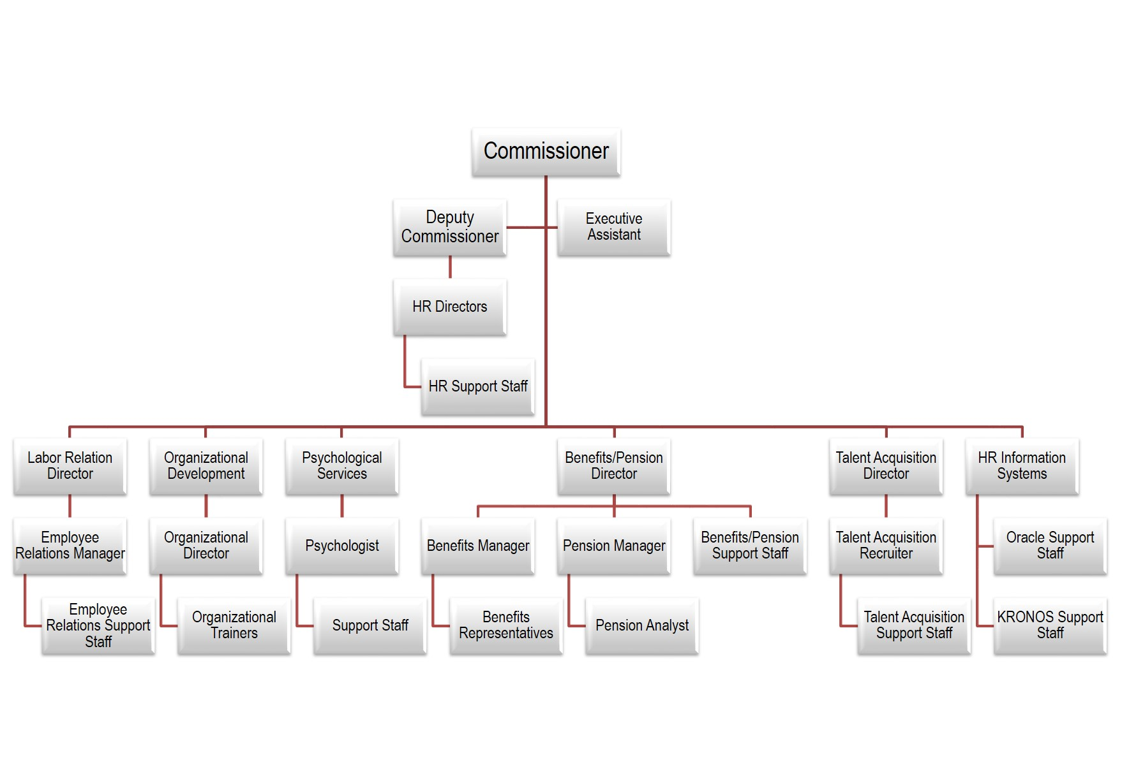
Department of Human Resources Organizational Chart
Department of Human Resources FY19 Proposed Budget 4

Slide 5
Department of Human Resources FY18 Accomplishments
Served as advisor and consultant to the twenty-two departments across the City of Atlanta
Opened $3.5 million dollar-14,000 square Onsite Employee wellness Center
Negotiated health insurance premiums below national average for six (6) straight years including the overall medical cost increases associated with chronic disease
Led the performance management review process for the City
Partnered with APD on mentoring training program for approximately 30 Command Staff on Influencing and Coaching
Reduced an 11-case backlog to 6 open cases (45.4% reduction) (2 in litigation; 4 still under EEOC review)
Department of Human Resources FY19 Proposed Budget 5

Slide 6
Department of Human Resources FY18 Accomplishments
Developed and implemented a specialized Conflict Resolution training to over 200 Department of Public works Employees who are assigned to the Solid Waste Section
Promoted optimal emotional health and wellness for over 8000 COA employees, and their dependents.
Processed 20K+ transactions
Filled over 3000 open records and employment verification requests
Upgraded Kronos application in Parks & Recreation, Law, Executive, OEAM and City Planning
Hosted 6 Hooked on Books events
Department of Human Resources FY19 Proposed Budget 6

Slide 7
Department of Human Resources FY19 Goals
Launch the “Your Possibilities are Endless” campaign
Go live with ATLCloud - Oracle upgrade - October 1, 2018
Improve individual and organizational effectiveness by executing a workforce development strategy
Develop “Employability” outreach/training for City of Atlanta residents
Collaborate DWM and DPW on a workforce development plan to provide employee development and promotional opportunities
Implement Retiree Health Initiatives Program
Roll-out Kronos to Judicial, Public Defender, Solicitors, DPW, DWM, & Sworn Departments
Department of Human Resources FY19 Proposed Budget 7

Slide 8
Department of Human Resources Historical Budget
Department of Human Resources FY19 Proposed Budget 8

Slide 9
Department of Human Resources Total FY19 Proposed Budget
7% Decrease
Department of Human Resources FY19 Proposed Budget 9

Slide 10
Department of Human Resources FY19 Proposed Operating Budget: $12,999,633
General Fund $6,043,489
Enterprise Funds $6,956,144
FY15 Budget FY19 Budget
$12,543,281 $12,999,633
Key Operations
Strategic Initiatives
Attracting qualified candidates for key positions
Retaining public safety personnel to ensure a safe city for constituents and visitors
Upgrading our technological infrastructure for optimal data access, accuracy and reporting
Managing employee benefit costs vs national market place increases
Operational Area | Budget ($) | Authorized Positions | KPIs | Strategic Alignment
Administration | $2,154,287 | 15.85 | Performance Review Completion | Ethical, transparent and fiscally responsible government
Operations | $3,889,202 | 53 | Workforce Availability-Vacancy and Leave ratios Succession Planning Employee Engagement | World-class workforce, infrastructure and services
Department of Human Resources FY19 Proposed Budget 10

Slide 11
Department of Human Resources FY19 Proposed Budget – Other Funds
Other Funds: $7,468,555
 | Enterprise | Group Insurance | Trust Fund
Budget | $5,231,876 | $1,724,268 | $512,411
Principal objectives (Ongoing initiatives) | Committed to developing and providing innovative services that support and align with departmental goals. | Provide quality affordable and accessible health care benefits in the most cost-efficient manner while maintaining financial accountability. | Financial wellness initiative which includes state-of-art fitness facility.
Department of Human Resources FY19 Proposed Budget 11

Slide 12
Department of Human Resources FY19 Group Insurance Fund
Revenue | FY17 Adopted | FY18 Adopted | FY19 Proposed
Group Insurance | $ 150,599,694 | $ 157,520,018 | $ 153,520,750
Expenditures | FY17 Adopted | FY18 Adopted | FY19 Proposed
Personnel Services and Employee Benefits | $ 2,218,271 | $ 2,268,528 | $ 2,330,877
Purchase/Contract Services | $ 609,560 | $ 2,997,453 | $ 2,146,698
Supplies | $ 10,155 | $ 13,557 | $ 13,558
Interfund/Interdepartmental | $ 1,818,701 | $ 2,222,433 | $ 3,650,955
Other Cost | $ 132,328,221 | $ 137,620,810 | $ 145,378,662
Conversion Summary | $ 13,614,786 | $ 12,397,237 | $ -
Total Expenditures | $ 150,599,694 | $ 157,520,018 | $ 153,520,750
Department of Human Resources FY19 Proposed Budget 12

Slide 13
Department of Human Resources Position Count
Total Position Count 146
Vacant Positions 20
Department of Human Resources FY19 Proposed Budget 13

Slide 14
Department of Human Resources FY19 Position Changes
3 Position Abolishment's:
Psychologist
HR Assistant Sr.
Administrative Assistant
3 Position Creations to transition Extra Help Employees
HR Director, Public Safety
HR Director, EXE
Marketing and Communication Director
4 Position Reclassification without Incumbent:
From Compensation Analyst To Compensation Analyst, Sr.
From Human Resources Assistant, Sr To Human Resources Representative
From Management Analyst To Management Analyst, Sr.
From HR Assistant, Sr To HR Manager II
1 Position Reclassification with Incumbent:
From Human Resources Assistant, Sr To Human Resources Representative
Department of Human Resources FY19 Proposed Budget 14

Slide 15
Questions
Department of Human Resources FY19 Proposed Budget 15

