Slide 1
City of Atlanta, department of finance FY18 second quarter report
J. Anthony Beard, CFO | John Gaffney, Deputy CFO

Slide 2
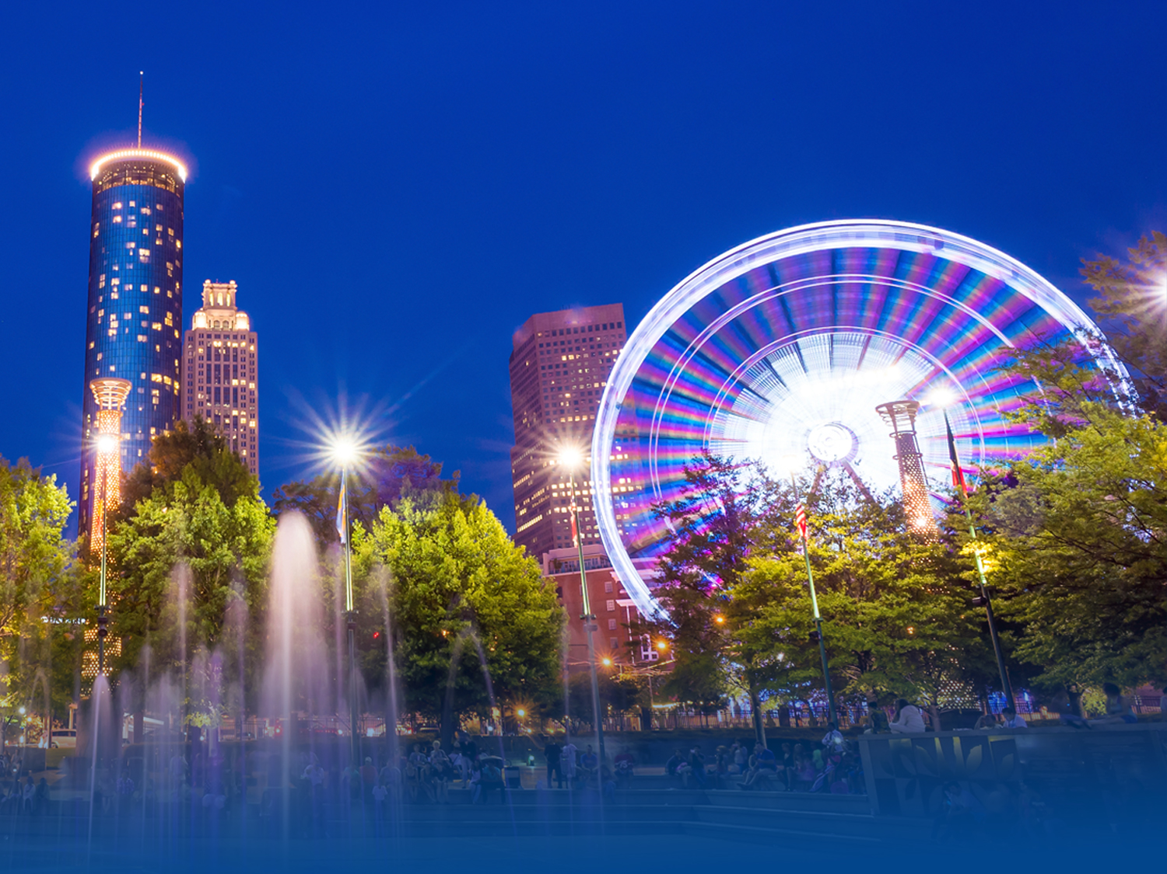
AGENDA
OPERATING FUNDS OVERVIEW
Governmental Funds Overview
General Fund Trend and Projection
General Fund Department Highlights
Proprietary Funds Overview
Enterprise Funds
CASH POOL REPORT
STATEMENT OF CASH FLOWS
DEBT/INVESTMENT PORTFOLIOS
BOND RATINGS

Slide 3
GOVERNMENTAL FUNDS OVERVIEW

Slide 4
GENERAL FUND ACTUAL TREND As of December 31, 2017 (000's)
As of December 31, 2017, General Fund revenues are projected to be on target.
Notes:
The additional revenue in fiscal year 2018 is due primarily to revenues collected from property taxes billed in a prior year and miscellaneous revenues from equipment rentals.
Update: As of December 31, 2017, General Fund revenues were $351MM. As of the second quarter, revenues are on pace to meet the anticipated budget.

Slide 5
FY18 GENERAL FUND BUDGET PROJECTION (000's)
General Fund expenditures are projected to be over budget by $12.9MM.
General Fund revenues are projected to exceed the anticipated budget by $0.5MM.
*This information is referenced on pg. 16 in the FY18 Second Quarter Financial Status Report.
Notes:
General Fund is over budget by $12.9MM:
Surplus of $6MM in Nondepartmental and $1.5MM in City Council offset by
Overages of $7.7MM in APD; $3.4MM in Corrections, $3MM in Parks and Recreation,$1.9MM in Executive Offices; $1.7MM in Public Works; $1.1MM in AIM and $1.1MM in Fire Services.

Slide 6
FY18 GENERAL FUND BUDGET PROJECTION (000's)
Expenditure Drivers:
Salaries
Overtime
Extra-help
Notes:
Projected deficit in Salaries by $5.5MM or 5%; Overtime by $15.4MM or 139%; Extra-Help by $3.2MM or 55%.

Slide 7
DEPARTMENT OF CORRECTIONS FY18 GENERAL FUND DEPARTMENT HIGHLIGHTS (000's)
The Department of Corrections is expected to be over budget by 10.4% or $3.5MM due to overtime related to inclement weather events and special operations.
Body worn camera maintenance and uniforms expenses
*This information is referenced on pg. 21 in the FY18 Second Quarter Financial Status Report.
Notes:
Over budget due to Overtime of $2.3MM; Salaries Sworn by $740K; and Body Worn Camera maintenance, Steel Based Boarding and uniforms more than anticipated by $155K.

Slide 8
Department of Public Works FY18 GENERAL FUND DEPARTMENT HIGHLIGHTS (000's)
The Department of Public Works is expected to be over budget by 3.9% or $1.7MM due to overtime related to inclement weather events.
*This information is referenced on pg. 24 in the FY18 Second Quarter Financial Status Report.
Notes:
The Department of Public Works is expected to be over budget by 3.85% or $1.7M due to:
Surplus in Supplies $910K and Contracted Services $300K; offset by Salaries, Reg ($1.6M) and Overtime (760K), Benefits (565K); Extra Help ($200K).
Note: Inclement weather pre and post 12-hr shifts.

Slide 9
Department of Parks and Recreation FY18 GENERAL FUND DEPARTMENT HIGHLIGHTS (000's)
The Department of Parks and Recreation is expected to be over budget by 8.6% or $3.1MM.
*This information is referenced on pg. 25 in the FY18 Second Quarter Financial Status Report.
Notes:
Overage due to:
1. Wage compression associated with salary increases– $300K over budget ; $100K Overtime over budget
Repair/maintenance of equipment and facilities - $2.7MM over budget (Pool Maintenance Contract, Camp Best Friends, Hot Meals Program)
Capital Outlay less than anticipated: security camera purchases and van transportation purchase costs

Slide 10
Department of Police Services FY18 GENERAL FUND DEPARTMENT HIGHLIGHTS (000's)
The Atlanta Police Department is expected to be over budget by 4.1% or $7.7MM due to overtime related to inclement weather, holiday, and special events.
Uniform and equipment expenses
*This information is referenced on pg. 30 in the FY18 Second Quarter Financial Status Report.
Notes:
The Department of Police Services is expected to be over budget by 4.07% or $7.73M due to overtime related to special events, Hurricane Irma, and Holiday events and uniform contracts with GALLS.

Slide 11
Proprietary Funds Overview

Slide 12
FY18 Airport Revenue Fund Projection (000's)
$79MM savings related to:
$63MM reserves
$12MM service contracts
$2MM vacant positions
$2MM supplies
*This information is referenced on pg. 37 in the FY18 Second Quarter Financial Status Report.
Notes:
Expenditure Variance
The Airport Revenue Fund expenditure variance is due mainly to reserves, service contracts, vacant positions and supplies less than anticipated.

Slide 13
FY18 Water & Wastewater Revenue Fund Projection (000's)
$72MM savings related to:
$22MM Fund-wide reserves
$18MM Bad debt reserves
$13MM GEFA loan reserves
$12MM contractual services
$7MM vacant positions and supplies
*This information is referenced on pg. 66 in the FY18 Second Quarter Financial Status Report.
Notes:
Revenue Variance
Variance in Water & Wastewater Revenue due to increased usage and collection efforts; Investment income more than anticipated.
Expenditure Variance
The Water & Wastewater Revenue Fund expenditure variance is due mainly to fund-wide reserves, GEFA loan reserves, bad debt reserves, less than anticipated.

Slide 14
Cash Pool Report
Notes:
John Gaffney will present the Cash Pool and Cash Flow reports.

Slide 15
Investment in the Cash Pool As of December 31, 2017 (000's)
Funds with Positive Balances Total $1.9B
*This information is referenced on pgs. 97-99 in the FY18 Second Quarter Financial Status Report.
Notes:
Due to challenges in the Fulton County Assessor’s office, the 2016 tax bills did not go out consistent with last year.

Slide 16
Investment in the Cash Pool As of December 31, 2017 (000's)
Funds with Negative Balances total $20M

Slide 17
General Fund Statement of cash flows report

Slide 18
FY17 vs. FY18 General Fund Cash Flows (000's)
Ending Balance as of December 31, 2017 Totals $230M
*This information is referenced on pg. 100 in the FY18 Second Quarter Financial Status Report.

Slide 19
Debt/Investment Portfolios
Notes:
Paul Kwaw will present the Debt and Investment portfolios and bond ratings.

Slide 20
Debt Portfolio – Total Debt Outstanding As of December 31, 2017 (000's)
Total Debt Outstanding is $7.31B
Net Increase $142.25MM; 2%
 | Q2 FY18 | Q2 FY17
General Obligation | $352,430 | $350,285
General Fund & Other | $713,692 | $500,911
Tax Allocation Districts | $493,020 | $502,335
Department of Aviation | $2,762,370 | $2,880,645
Department of Watershed | $3,013,090 | $2,931,179
*This information is referenced on pg. 101 in the FY18 Second Quarter Financial Status Report.

Slide 21
Investment Portfolio As of December 31, 2017
Total Investment Portfolio
$2.27B
Net Decrease $28.1M
1.22%
*This information is referenced on pg. 106 in the FY18 Second Quarter Financial Status Report.
Notes:
2Q’18 investment portfolio value totaled $2.268 billion

Slide 22
Investment Portfolio As of December 31, 2017
 | Dec 2016 |  | Mar 2017 |  | June 2017 |  | Sept 2017 |  | Dec 2017
Interest | $11.82mm |  | $13.58mm |  | $13.71mm |  | $12.20mm |  | $10.472mm
**Numbers do not reflect interest from the Atlantic Station and the Eastside TAD.
Notes:
**These number do not reflect approx. $27.4mm in the Atlantic TAD

Slide 23
BOND RATINGS

Slide 24
BOND RATINGS As of December 31, 2017
 | MOODY’S | S&P | FITCH
General Obligation Bonds | Aa1 Positive Outlook | AA+ Stable Outlook | AA+ Stable Outlook
Water & Wastewater | Aa2 Stable Outlook | AA- Stable Outlook | A+ Stable Outlook
Airport Senior Lien GARBs | Aa3 Stable Outlook | AA- Stable Outlook | AA- Stable Outlook
Airport Subordinate Lien GARBs and PFCs | Aa3 Stable Outlook | AA- Stable Outlook | A+ Stable Outlook
Airport Senior Lien CFC’s | A3 Stable Outlook | A- Stable Outlook | A Stable Outlook
GARB: General Airport Revenue Bond
PFC: Passenger Facility Charge Revenue Bond
CFC: Customer Facility Charge Revenue Bond
*This information is referenced on pg. 111 in the FY18 Second Quarter Financial Status Report.
24
Notes:
Rating Upgrades
Moody’s GO Ratings outlook upgrade from Aa2 to Aa1
S & P GO ratings upgrade from AA to AA+

Slide 25
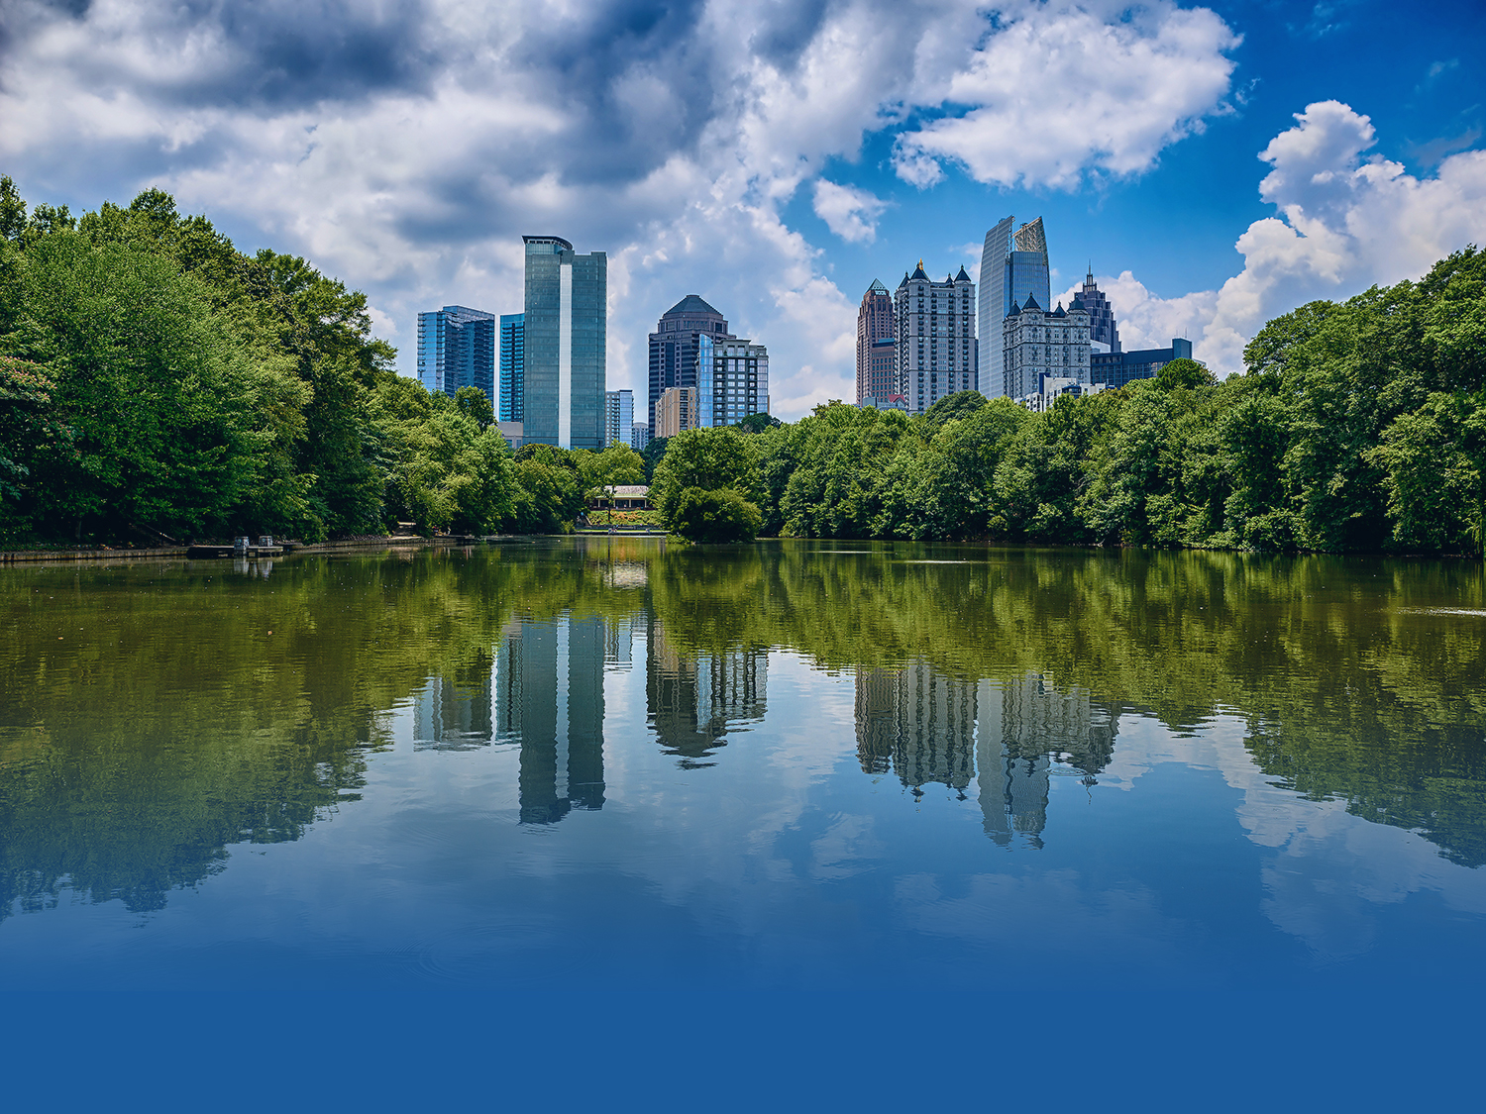
QUESTIONS/ANSWERS SESSION

