Slide 1
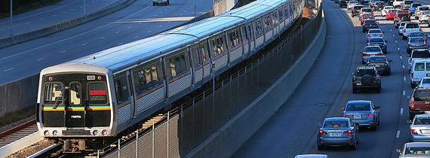
MARTA Jurisdictional Briefing City of Atlanta
April 25, 2018

Slide 2
PRESENTATION OVERVIEW
Legislative Outlook
State of Service

Slide 3
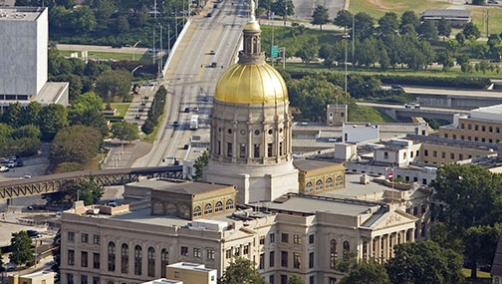

LEGISLATIVE OUTLOOK

Slide 4
STATE LEGISLATIVE OUTLOOK
State Legislative Update - HB 930
  Regional governance and funding model to be “administratively attached” to GRTA under name “The ATL”
  16-member board
  13 counties divided into 10 “Transit Districts” with one designee to new ATL Board per district
  Remaining Board members comprised of Gubernatorial appointee (Chair), 2 appointees each from Speaker and Lt. Gov. and GDOT Commissioner (ex-officio)
  New counties can opt-in to the ATL by passing a one-cent transit referendum
  MARTA autonomy in current footprint preserved, including pursuit of federal funding for expansion
  MARTA designated as sole rail operator throughout both current system and any new jurisdictions that move forward with rail under The ATL model
  Gov. Deal pledged $100M in state bonds in this year’s state budget for transit per passage of this bill
Notes:
Last Thursday, the Georgia General Assembly passed HB 930, sweeping legislation that will create a Regional Transit Authority serving 13 metro counties, including the current MARTA jurisdictions. The top-line as this development relates to MARTA and Clayton County is that nothing about MARTA’s arrangements with Clayton, nothing about MARTA’s pursuit of high capacity transit for the county and nothing about the way MARTA governs itself or works with the Federal government on expanding the current MARTA system will change. MARTA retains full autonomy inside its own footprint and it retains full autonomy over pursuit of expansion inside its own footprint.
The ATL, as it is currently named, will operate as an arm of GRTA with the sole purpose of helping unify transit across the region, increase funding opportunities both though the state and the federal government and oversee a unified transit plan for the Atlanta metro region, including MARTA’s vision and existing project list.
In addition, Governor Deal has pledged $100 million in state bonds for this year’s state budget per the passage of this bill. We expect this funding to be distributed in a fashion similar to the Go Transit! bonds that were competitively awarded to systems across the state in 2016. You may recall MARTA received $30M in Go Transit! funding that was subsequently used to update our Audio/Visual Information Systems (AVIS) system-wide.

Slide 5
FEDERAL LEGISLATIVE OUTLOOK
Federal Legislative Update
  FY2018 Omnibus Appropriations enacted on March 23
  The bill provides the FAST Act authorized levels of $10.3 billion for the formula-based programs funded out of the Mass Transit Account of the Highway Trust Fund
  TIGER - funded at $1.5 billion which is $1 billion more than any other prior year. Notice of Funds Availability is to be published within 60 days or by May 23
  Capital Investment Grants - A total of $2.6 billion for major capital investment grants. Federal funding capped at 51 percent of total project costs
  Transit Infrastructure Grants - A total of $834 million over authorized funding is provided for the following:
    $400 million for bus and bus facilities
    $400 for state of good repair
    $30 million for increasing high density state formula monies
    $4 million for bus testing facility
Notes:
On March 23, President Trump signed a federal omnibus spending package into law for FY 2018. The top-lines for MARTA with regard to this legislation are that MARTA will see increases in funding for state of good repair projects as we as bus & bus facilities needs. We’re also encouraged at the increases across the board for transit generally, including in the TIGER Grant program (of which MARTA just won one) and Capital Investment Grant program (from which expansion funding generally comes).

Slide 6
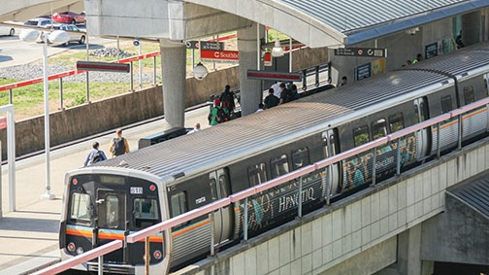
STATE OF SERVICE

Slide 7
OPERATING DEFICIT/SURPLUS BY FISCAL YEAR

Slide 8
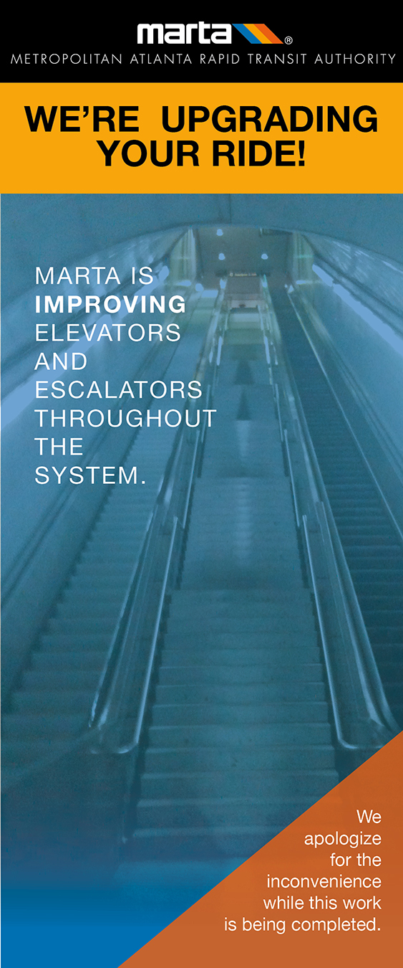
VERTICAL TRANSPORTATION
MODERNIZATION PROGRAM UPDATE
Initiative to overhaul 115 elevators and 150 escalators
Status
  Modernization of 6 elevators and 21 escalators are complete
  Modernization of 4 elevators and 3 escalators are underway
What should patrons expect?
  Elevators will typically be out of service for 8 -10 weeks
  Escalators will typically be out of service for 14 - 20 weeks
  Avg. 12 elevators and 12 escalators per year through 2027
  Signage and social media being used to keep patrons informed
  Station staff assisting patrons with alternatives
Notes:
Implementation update
On June 19, 2017 MARTA’s Office of Vertical Transportation launched an ongoing initiative to overhaul our vertical transportation system – elevators and escalators. The MARTA portfolio of vertical transportation equipment includes a total of 150 escalators and 115 elevators.
Elevators and escalators could be out for several months at a time.
When complete, elevators will be more aesthetically pleasing, with graffiti-resistant wall panels, a more durable design and brighter LED lighting.
Escalators will have new tread and handrails installed - electrical mechanical systems will be replaced.
To date we have completed both elevators at the West Lake, H.E. Holmes, and West End MARTA Stations. Two escalators at Peachtree Center and one escalator at Five Points are complete. Under a former rehabilitation initiative, we modernized 10 escalators out of 24 at Peachtree Center and 8 out of 28 escalators at Five Points station.
We’re currently working on elevators at North Avenue , King Memorial, Ashby, and Oakland City Stations. Escalator work is underway at CNN/Dome, Five Points, and East Point Stations.
We plan to modernize approximately 12 elevators and 12 escalators over the next 8.5 years.
Elevators will typically be out-of-service for approximately 8 - 10 weeks and escalators for 14 - 20 weeks depending on the length of travel (height).
We ask for the public’s patience and understanding as we continue with this major capital project initiative.
Are there alternatives offered for individuals with limited mobility who are unable to access stairs?:
We have worked closely with our marketing partner, Jones Worley, and MARTA staff to provide many layers of informational signage, social media updates and postings on our websites. The communications and signage provide directions for those needing an elevator.
Other station enhancements of note:
King Memorial – In Progress: Water-proofing and repainting of the station
King Memorial – Completed: Landscape enhancement is scheduled for Spring 2018
On schedule. We are reviewing the designers proposal.
Ashby – Upcoming: Landscape enhancement is scheduled for Spring 2018
West End – Upcoming: Landscape enhancement is scheduled for Spring 2018
West End – Upcoming: Parking lot enhancement is scheduled for Summer 2018
College Park: Upcoming: Sidewalk entrances to be enhanced Fall 2018
Oakland City – Upcoming: Bus Loop landscape enhancement is scheduled for Spring 2018
Garnett – Upcoming: New gutter installation by Summer 2018
Inman Park – Upcoming: Pedestrian bridge upgrade by Fall 2018

Slide 9
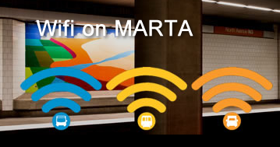
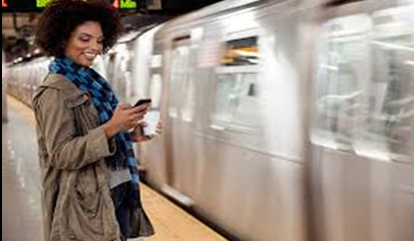
WIFI UPDATE/ CELLULAR SERVICE IN TUNNELS
Notes:
Wi-Fi is standard equipment on most mobile devices, and used for Internet access to surf the web, email, read on-line publications, and entertainment (music, movies, books, etc.)
Cellular 3G/4G service for phones, which are cellular basedand used primarily for voice communication (complete by Dec 2018)
WiFi on MARTA Buses and Rail Cars
MARTA now has free Wi-Fi Lite on all buses and trains.
Riders can catch up on emails on the way to work, check stats on the way to a game or check in on the way to the airport.

Slide 10
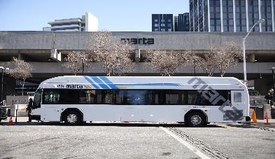
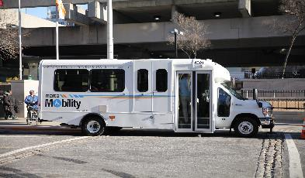
BUS & MOBILITY VAN REPLACEMENT
The Authority will replace 83 percent of its current bus and paratransit fleet over the next 6 years
Between now and 2024, the Authority will introduce:
  - 432 new buses
  - 208 new paratransit vehicles
The new vehicles will feature:
  - Wi-Fi
  - High-definition security cameras
  - High-capacity heating and air conditioning
Notes:
The Metropolitan Atlanta Rapid Transit Authority (MARTA) plans to replace 83 percent of its bus and paratransit fleet over the next six years.
MARTA will introduce 432 buses and 208 Mobility vans from now until 2024. The new buses feature Wi-Fi, high definition security cameras, high capacity heating and air conditioning, including heated entry and exit floors to prevent icin. The new Mobility vans have three wheelchair positions, non-slip flooring, and ambulatory seats with three-point seatbelts.
The new vehicles rolling out this month. They were paid for with the local sales tax collected in Fulton, DeKalb, and Clayton Counties, and the City of Atlanta.

Slide 11
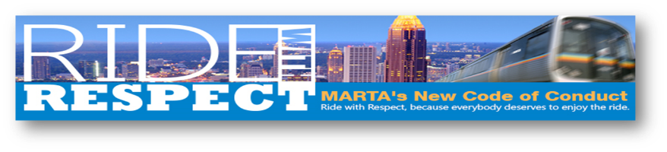
RIDE WITH RESPECT SUSPENSION RESULTS
    13,449 total suspensions
    6,576 fare evasion suspensions
    960 appeals
    947 repeat offenders
Data: November 9, 2013 – February 14, 2018

Slide 12



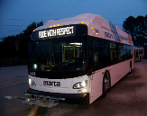


RIDE WITH RESPECT REFRESH
MARTA is refreshing the Ride with Respect Campaign to:
Reassure patrons that MARTA is committed to their safety and comfort
Reinforce the fact that MARTA takes code violations seriously
Improve service delivery by creating a positive transit experience
Attract new patrons and increase the frequency of current riders
Notes:
MARTA is refreshing the Ride with Respect Campaign to:
Reassure patrons that MARTA is committed to their safety and comfort
Reinforce the fact that MARTA takes code violations seriously
Improve service delivery by creating a positive transit experience
Attract new patrons and increase the frequency of current riders
Strengthen the overall image of MARTA
The campaign will include:
Transit system advertising
Printed materials (brochures, flyers)
Digital and social media advertising
Radio ads
Newspaper ads
Local cable TV ads
Press releases

Slide 13
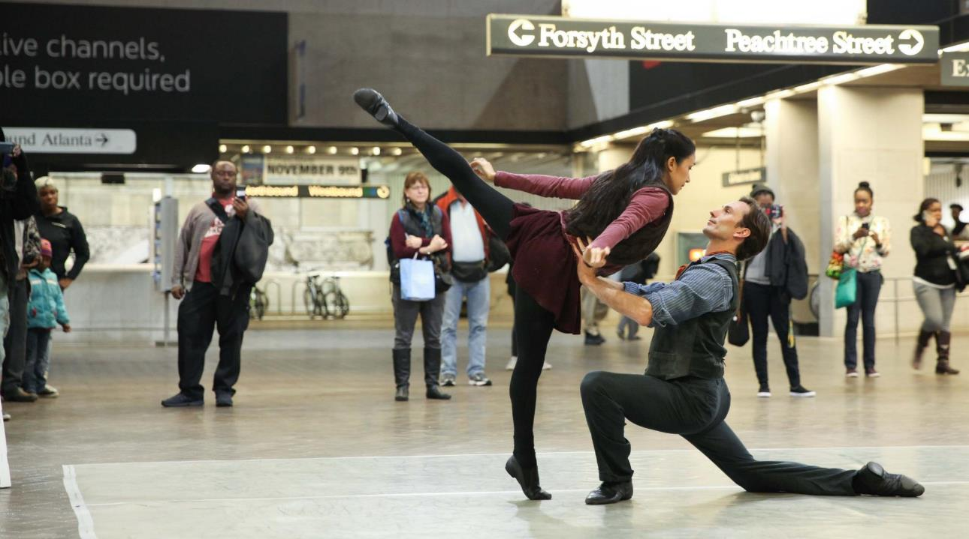
Notes:
Artbound LIVE
Program launched November 16, 2017
54 live music offerings were presented in six stations during the 6-week period until January 1.
Participating Stations:
Five Points
West End
Kensington
Lindbergh
North Springs
H.E. Holmes
Music begins again March 16 – April 30
MWF at Five Points until May 1 when full schedule resumes
Gold Line station (besides Lindbergh) will be added this summer

Slide 14
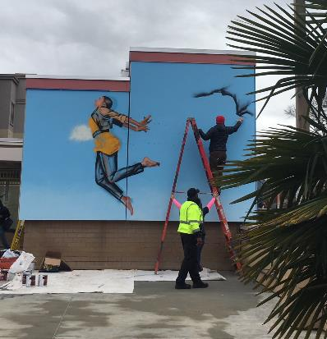
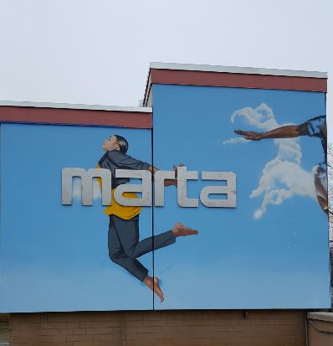
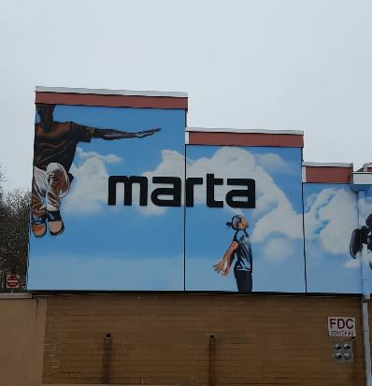
En Route Murals: Ashby Station
The People Could Fly
Notes:
Saturday, March 24
Ribbon cutting at 1:30 pm.
Ashby Block Party – 2:00 pm – 5:00 pm

Slide 15


Slide 16
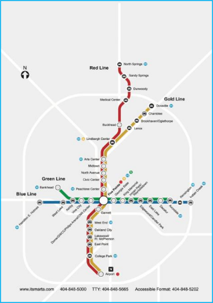
REGIONAL EXPANSION – RAIL
Existing
Future
Notes:
Per long-term plans, the four main high-capacity expansion projects that remain on MARTA’s horizon include light rail on Clifton Corridor (DeKalb), bus rapid transit and heavy rail along I-20 E (DeKalb), bus rapid transit in managed lanes along GA 400 N (Fulton) and a high-capacity option in Clayton County.

Slide 17
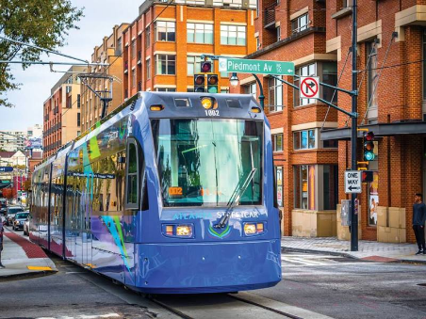
ATLANTA STREETCAR
Highlights
  IGA approved in September 2017
  Work closely with GDOT & FTA
  Complete three phase transition by fall 2018
    - Assets/operations
    - Financial
    - Regulatory
Goals
  Address all safety and operational concerns
  Efficient operations, reducing costs
  Implement ridership growth program
Notes:
Current state:
O & M IGA governs roles and responsibilities
ASC is operated directly by City of Atlanta employees
MARTA Director of Streetcar Services provides technical oversight, reporting to MARTA COO
Monthly Executive Management meetings are held involving all project partners
Engagement with GDOT occurring on a frequent basis
Funding comprises FTA CMAQ funds, Rental car fees and partner support from the ADID
Financial: Development of Transition Program Financial Plans for three Authority fiscal areas:
Transition Mobilization Plan; capital + operating
Streetcar Operating Budget
Streetcar Capital Budget

Slide 18
MORE MARTA Public Involvement Plan
FINANCIAL SUMMARY
Revenues:
  Sales tax is forecasted to raise $65M per year (current year dollars)
  Collections started in April 2017
Expenditures
  Enhanced bus service totaling approximately $11.4M
  Atlanta Streetcar operations since July 2017 (pending invoice form City of Atlanta)

Slide 19
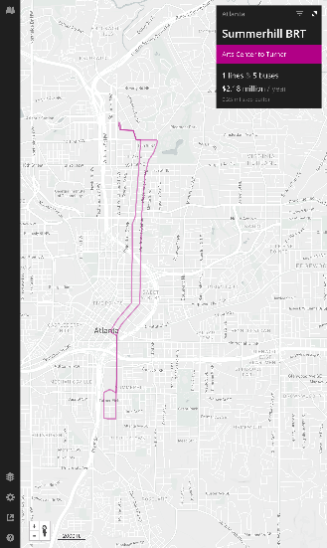
FEDERAL TIGER GRANT AWARD
$12.6M Federal Grant for Bus Rapid Transit (BRT) project connecting Summerhill/GA State with Midtown
Grant also provides funds for five new BRT vehicles
Final 9.4-mile route will operate in a mix of exclusive and shared roadways
Notes:
MARTA has received a $12.6 million federal grant to help fund a planned bus-rapid transit (BRT) project connecting the Summerhill area of Atlanta with Midtown. The 9.4-mile BRT route will connect a neighborhood anchored by Georgia State University to MARTA’s heavy rail system and the Atlanta Streetcar network.
The federal money will come through the National Infrastructure Investments Transportation Investment Generating Economic Recovery (TIGER) discretionary grants program.
“Passengers, drivers and so many others will benefit from this grant, which will address mobility, access and safety challenges in some of our vital Atlanta transportation corridors,” said U.S. Sen. Johnny Isakson, R-Ga., who supported the grant. “The project, once completed, will offer much better links between neighborhoods, office buildings, higher education institutions and medical facilities that area residents rely on daily."
Sen. David Perdue, R-Ga., credited MARTA with playing an important role in moving people around following the collapse of the Interstate 85 bridge over Piedmont Road last March. U.S. Secretary of Transportation Elaine Chao attended the dedication of the new bridge there last June.
It’s great to see the federal government not only recognizes the value of MARTA but also is willing to invest further in this infrastructure asset," Perdue said. "I applaud President
Trump and Secretary Chao for making this project a priority.”
The project also will include the purchase of five new BRT vehicles that will operate in a mix of exclusive and shared roadways and the installation of some 30 transit station locations.

Slide 20
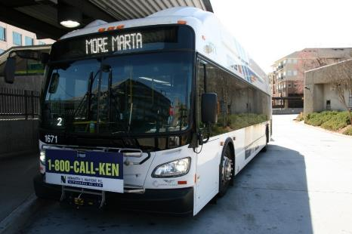
MORE MARTA
Highlights:
  IGA approved in January 2018
    Planning, design, construction, and operations of transit expansion with City
    Program management
    Public outreach
Program Management:
  Bus and rail service improvements
  Minor capital investment projects
  Major capital investment projects

Slide 21
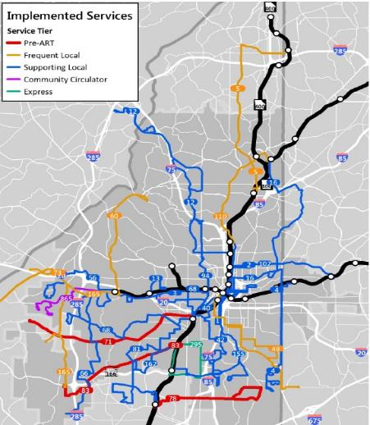
MORE MARTA Program
21
PROGRESS TO DATE – BUS
Bus service improvements
  28 route improvements
  2 new routes
    Northside Drive
    Dollar Mill/Plainville
Service improvements include
  New types of buses (e.g. circulators)
  More frequent service
  Late night/weekends
  Amenities
Notes:
Started in February 2017
Bus service improvements
28 route improvements
2 new routes
- Rt# 94 Northside Drive
- Rt# 865 Dollar Mill/Plainville
1 new express route (Rt# 295 - Metropolitan Campus Express)
3 routes with service frequency and span aligned with rail
14 routes with increased service frequencies
15 routes with increased spans of service
13 routes modified for more streamlined services
This new service will be the footprint in the corridor for establishing ridership to support the proposed BRT service which is included in the project list menu. Additionally, Route 865 will be a new community circulator that will operate within the Dollar Mill and Plainville communities replacing the current 40 foot vehicles that operate within the neighborhoods yet continuing connection to Holmes station with improved service frequency.

Slide 22
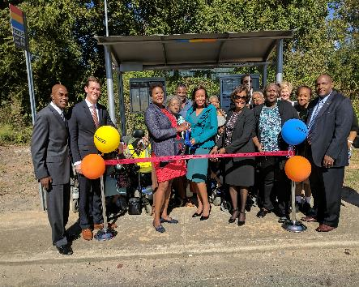
BUS STOP AMENITIES PROGRAM
Existing conditions:
  9,016 total stops/shelters
  642 shelters
  143 benches
  28 Simme Seats
City of Atlanta amenities expansion:
  7 shelters opened within the last 12 months
  32 shelters anticipated in 2018
Concurrently developing comprehensive amenities program for MARTA service area
Notes:
MARTA recently partnered with Councilmember Felicia Moore, residents of Marietta High Rise and Atlanta Housing Authority on October 3rd to host a ribbon cutting ceremony for the installation of a new bus shelter at Marietta Road & Bolton Road.

Slide 23
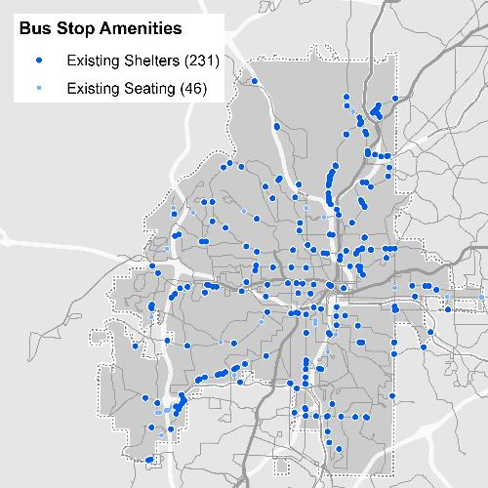
TRANSIT AMENITIES – EXISTING CONDITIONS
277 bus stops in City of Atlanta have amenities today
46
Current seating
Current shelters
231

Slide 24
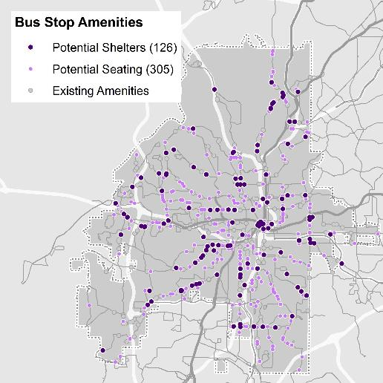
TRANSIT AMENITIES – FUTURE EXPANSION
An additional 431 stops qualify for potential amenities in the future
305
Qualified for benches
Qualified for
shelters
126

Slide 25
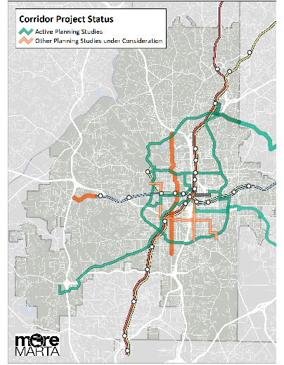
PROGRESS TO DATE – HIGH CAPACITY TRANSIT
Currently in detailed planning phase:
  Atlanta BeltLine sections
  Campbellton Corridor Transit Initiative*
  Clifton Corridor Transit Initiative
  Crosstown Downtown Line
  Crosstown Midtown Line
  I-20 East Transit Initiative
* Initiating in 2018
Evaluating nearer term bus rapid transit
  Northside Drive
  Capital Avenue / Hank Aaron Drive

Slide 26

CAMPBELLTON CORRIDOR TRANSIT INITIATIVE /
LINK SOUTHWEST
11 mile high capacity transit corridor
Connects Greenbriar Mall with Fort McPherson redevelopment area
Link into the MARTA heavy rail transit system
Initiating a planning study MARTA to analyze:
  High capacity transit options (BRT or LRT)
  Alignments to include dedicated guideway and/or street running
18-24 month study
Route 83 on Campbellton Rd was upgraded to Arterial Rapid Transit (ART) service levels in Feb 2017 as part of the FAST Track Initiative
  Route 83 has 2nd highest daily ridership in MARTA bus system

Slide 27

MORE MARTA Outreach Summary
MORE MARTA OUTREACH

Slide 28
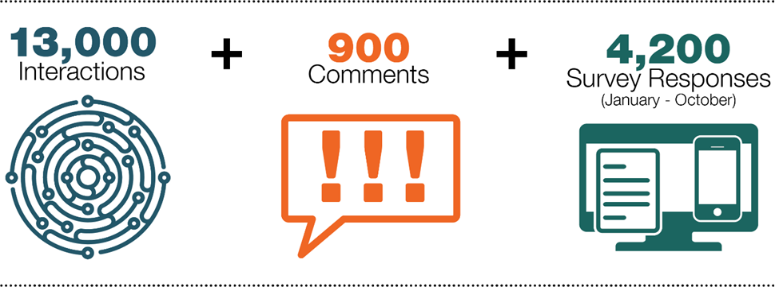
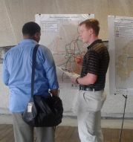
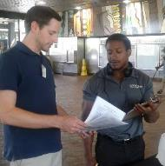
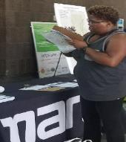
MORE MARTA Outreach Summary
MORE MARTA OUTREACH

Slide 29
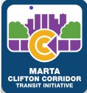


MORE MARTA Public Involvement Plan
2018 WORK PROGRAM
Atlanta Streetcar transition
Bus service
  Expanded service frequencies and span
  Arterial Rapid Transit
  Community circulators
High capacity transit
  Initiate Campbellton Corridor Transit Initiative (BRT/LRT)
  Clifton Corridor Transit Initiative Project Development
  Atlanta Streetcar Extension Design (east/west)
  Capitol Avenue Bus Rapid Transit Project Definition (Summer Hill)
  Northside Drive Bus Rapid Transit
Other improvements
  Reynoldstown/Inman Park pedestrian enhancements
  Oakland City elevator access
  Comprehensive shelter program

Slide 30
MORE MARTA Public Involvement Plan
NEXT STEPS
Review MORE MARTA survey data to inform project selection
  Identify preferred projects and service improvements
  Highlight projects preferences by neighborhood
Develop More MARTA program options
Review with City of Atlanta
MARTA Board approval

Slide 31
Questions

