Slide 1
Atlanta City Council | City Utilities Committee
Department Quarterly Report
Mayor Keisha Lance Bottoms | Kishia L. Powell, Commissioner
February 27, 2018

Slide 2




Reports to Council

Slide 3
Customer Billing: Estimated Bills
Service Delivery
Overall estimated bills account for 2.4% of all bills
1.5% of active accounts (inside city) are receiving estimated bills due to needed repairs
Industry benchmark is 3%; DWM target is less than 1%
Council District | Total No. of Accounts | Number Estimated | Percentage
1 | 7,889 | 100 | 1.3%
2 | 5,835 | 183 | 3.1%
3 | 6,455 | 96 | 1.5%
4 | 7,948 | 97 | 1.2%
5 | 10,575 | 142 | 1.3%
6 | 11,415 | 111 | 1.0%
7 | 8,668 | 161 | 1.9%
8 | 12,237 | 219 | 1.8%
9 | 7,903 | 116 | 1.5%
10 | 7,990 | 84 | 1.1%
11 | 9,912 | 135 | 1.4%
12 | 6,778 | 66 | 1.0%
 | 103,605 | 1,510 | 1.5%

Slide 4
Administrative Highlights

Slide 5
FY 2018 Budget
Financial Resilience
Revenue Sources ($610M)
Appropriations ($610M)
Operation & Maintenance
Miscellaneous: IJ Revenue, tap meter sales, stormwater charges, interest earnings, administrative services
Non-Departmental (Debt Service, indirect costs, PILOT/franchise fees, OPEB, GEFA payments/reserve, bad debt reserve, fund-wide reserve)
 | OPERATION & MAINTENANCE (O&M)
 | Personnel | Non-Personnel
FY18 Budget | $119.0 | $134.7
Through 2nd QTR of FY18 | $60.8 | $41.2
% Spent | 51% | 31%
*July 1, 2017 through December 31, 2017.

Slide 6
FY18 Operational Results
Financial Resilience
Fiscal Year 2018
Month | Revenues (M)* |  | Expenses
 | Projected | Actual | Actual
Jul '17 | $52.2 | $50.9 | $24.7
Aug '17 | $106.4 | $104.0 | $49.3
Sep '17 | $154.9 | $157.6 | $74.6
Oct '17 | $205.3 | $216.3 | $232.4
Nov '17 | $254.1 | $265.5 | $260.7
Dec '17 | $298.9 | $313.0 | $293.8
Jan '18 | $345.8
Feb '18 | $385.5
Mar '18 | $433.8
Apr '18 | $478.8
May '18 | $527.3
Jun '18 | $575.2
* Does not include miscellaneous revenues

Slide 7
Collections Efforts
Commercial Accounts (OFA)
Vacant Accounts (OFA & OSS)
Multi-Family Accounts (OFA)
Amnesty Program (OFA)
  FY18 Performance
  $3,931,094.69 collected
  1,665 delinquent payments collected
  Next Steps
  Continue to maximize collection efforts with site visits by collections staff for larger commercial water users.
  Increasing cuts from 50 to 85-100 per week starting in February 2018.
  FY18: Performance
  Commercial (OFA)
  $1,646,401.46 collected
  126 new service accounts enforcement
  Residential (OSS)
  $110,302.85 collected
  574 new service accounts enforcement.
  Next Steps
  New service policies and procedures currently under review to identify best practices, process efficiencies, and controls.
  FY18: Performance
  $5,069,023.84 collected
  1,181 delinquent payments collected.
  Top 50 delinquent accounts isolated for collection efforts
  Next Steps
  Execute disconnection strategy with stakeholders to coordinate essential services by March 2018.
  Work with DOL about suggested code changes to enhance City’s legal position and collection abilities.
  NOV & DEC 2017
  Over eight thousand letters sent to customers late October 2017
  1,161 customer contacts
  610 Amnesty enrollments
  $271,322.40 collected
  Walk-in Dates
  Fridays: 11/3,11/17,12/8,12/15
  Saturdays:
  12/4,12/12
*July 1, 2017 through December 31, 2017.

Slide 8
Vacant Accounts w/ Consumption
Financial Resilience
Accounts Resolved Oct. 2017 through Dec. 2017
DWM has resolved more than 70% of vacant accounts with consumption in FY18.
Maintaining a 96% or better customer satisfaction rating at the Customer Service Walk-In Center
Improved process of customer data reviews, field verifications and meter repairs, resulting in increased revenue of $2.5M annually
A/R REDUCTION: $2.3M for the last quarter of 2017
Vacant with Consumption Investigations Results: Establishment of 2,800+ new accounts and more than $1M in recovered revenue (FY17-18)

Slide 9
Adjustments, High bills, and WSAB
Service Delivery
Water Sewer Appeals Board hearings
Month | October – December (Q4) 2017
 | Scheduled | Approved | Amount Adjusted
October | 115 | 60 | $53,684.54
November | 61 | 32 | $44,878.59
December | 67 | 32 | $75,495.75
Total | 243 | 124 | $174,058.88
Adjustment Requests and Billing Complaint Reviews
Council District | Adjustment Requests |  |  | Billing Complaints
 | Received | Completed | Open | Received | Completed | Open
1 | 30 | 27 | 3 | 96 | 82 | 14
2 | 2 | 1 | 1 | 54 | 39 | 15
3 | 26 | 17 | 9 | 72 | 61 | 11
4 | 33 | 29 | 4 | 103 | 91 | 12
5 | 17 | 16 | 1 | 98 | 84 | 14
6 | 8 | 7 | 1 | 92 | 66 | 26
7 | 11 | 10 | 1 | 90 | 76 | 14
8 | 36 | 36 | 0 | 107 | 101 | 6
9 | 20 | 18 | 2 | 59 | 54 | 5
10 | 38 | 37 | 1 | 95 | 86 | 9
11 | 29 | 25 | 4 | 117 | 103 | 14
12 | 20 | 17 | 3 | 73 | 62 | 11
Outside City | 2 | 2 | 0 | 42 | 34 | 8
TOTAL | 272 | 242 | 30 | 1098 | 939 | 159

Slide 10
Customer Assurance & Satisfaction Team (CAST)
High/Low Bill Calls: 3,584 (Dec 2017 – Feb 2018)
  Customers contacting DWM to inquire about a high or low bill, account analysis conducted and customer contacted to thoroughly discuss billing inquiry; average call time ranges between 30-45 minutes
Council District | Closed | Escalated | In Progress | Grand Total
1 | 74 |  | 107 | 181
2 | 47 | 1 | 56 | 104
3 | 76 | 1 | 93 | 170
4 | 90 | 1 | 129 | 220
5 | 85 | 1 | 131 | 217
6 | 63 |  | 87 | 150
7 | 58 |  | 63 | 121
8 | 94 |  | 95 | 189
9 | 83 | 1 | 116 | 200
10 | 136 | 3 | 158 | 297
11 | 120 | 1 | 144 | 265
12 | 97 | 1 | 152 | 250
Outside City | 629 | 3 | 588 | 1,220
Grand Total | 1,652 | 13 | 1,919 | 3,584

Slide 11
Position Report: Filled & Vacant
# Positions: 1745
Authorized Positions: 1639
Position Status: 81%
Notes:
Filled/Vacancy by Office: 81%
Hiring Blitz 10/3/2017 # 35 candidates attended; # 10 candidates hired
88% → 81% occupancy rate w/on-boarding (candidate identified/selected)
40% of the vacancies are within OLIO
Over 900 transactions completed

Slide 12
Operations and Compliance

Slide 13
Key Figures
Fiscal Year 2018 Key Figures
 | FY18 | FY17 | FY16
Technical Service Requests
Created | 10,318 | 24,060 | 23,021
Completed | 12,532 | 22,915 | 23,147
Available Crews
Budgeted (Distribution/Collections) | 86 (45/41) | 86 (45/41) | 87 (46/41)
Actual (Distribution/Collections) | 55 (29/26) | 55 (29/26) | 58 (31/27)
Compliance Rate
Drinking Water | 100.0% | 100.0% | 100.0%
Wastewater | 99.4% | 99.6% | 97.9%
Infrastructure Failures
Water Main Breaks/Leaks | 140/1,432 | 557/2,932 | 376/2,727
Hydrants | 469 | 1,793 | 1,346
Sewer Collapse | 185 | 520 | 429
Sewer Spills | 54 | 174 | 244

Slide 14
Service Request Performance

Slide 15
Operations Highlights
Maintained 100% Compliant operations at water treatment facilities
OLIO has reduced backlog of outstanding service requests/work orders (2001-2016) by 56%

Slide 16
Linear Infrastructure Operations
Service Delivery
OLIO Received 4,833 Service Requests During the Quarter
Includes activity for SRs created within the month; inspected and resolved figures are a subset of the total.

Slide 17
Main Breaks
Infrastructure Reliability
Main Breaks by Month
* The upward trend of main breaks continued into January with our second-highest month of recorded main breaks since 2010.

Slide 18
Metal Plate Tracker
Number of Plates in Place (Jan. 3, 2018): 32* Average Age of Current Plates: 56 Days*
Install Dates of Current Plates
Current Plates by Council District
*Data as of January 3, 2018

Slide 19
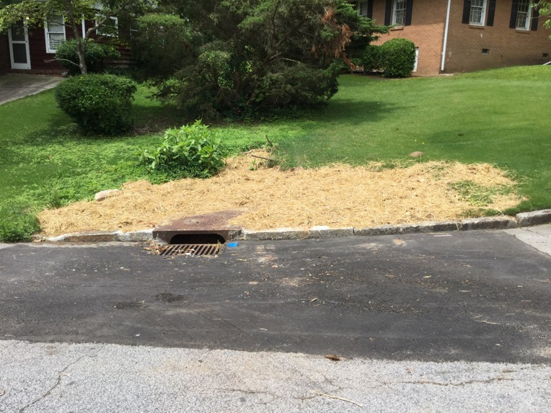
Utility Cut Restoration Efforts
Summary as of January 5, 2018:
The Office of Linear Infrastructure Operations (OLIO) has partnered with the Department of Public Works (DPW) to catch up on backlog of utility cut restoration needs
Total number of restoration work orders in backlog as of June 1, 2017: 2,643.
Total number remaining as of January 5, 2018: 797
Restoration work order backlog has decreased by 1,846 as a result of OLIO re-prioritizing work; physical verification of locations and closing work orders confirmed as completed.
DPW’s Contractor has a total of 3 working crews dedicated to addressing backlog restoration repairs, as of January 5, 2018
Total number of work orders delivered to DPW for repair: 367
Total number of work orders completed by DPW’s Contractor: 254

Slide 20
Spill Data
Compliance
All Spills
Quarter | 2015 | 2016 | 2017
Q4 | 76 | 32 | 35
Q3 | 39 | 28 | 28
Q2 | 47 | 41 | 58
Q1 | 32 | 88 | 56
Total | 194 | 189 | 179
Major Spills (> 10,000 Gallons) | 17 | 9 | 15
Spills Prevented (Flow Monitoring Alert Program) | 14 | 21 | 21
Major Spills for the Quarter
No | Date/Location/Receiving Water | Details
1 2 | OCTOBER 17TH 2060 Peachtree rd NW Peachtree Creek December 28th 650 Selig Dr SW Utoy Creek | Volume 50,070 gallons Cause: Collapse. Line Bypassed then COA crews repaired. Volume: 137,200 gallons Cause: Collapse. Tree fell on 42 in. pipe in creek bank Line bypassed, COA contractor performing repairs.

Slide 21
National Pollutant Discharge Elimination System (NPDES) Permit Compliance Status
Facility | Cause | Mitigation
RM Clayton WRC | Operational - 17 | Completion of the RM Clayton Facility Upgrades
 | Phosphorous Limits – 9 Major Spill – 3 Total Suspended Solids Limit – 4 pH Limit - 1
Consolidated Limits | Operational - 6 | Completion of the RM Clayton Facility Upgrades
 | Phosphorous Limits – 6

Slide 22
CIP Updates

Slide 23
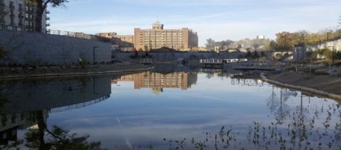
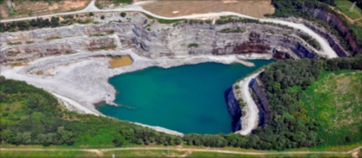



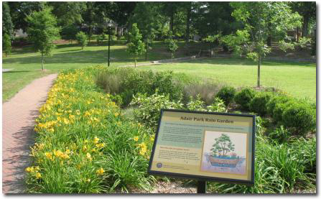


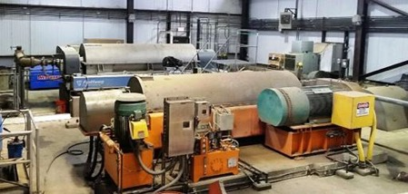
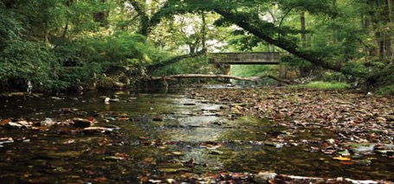





Current Program Estimates – January 2018 5-YR Total: $1.26 B; 76 Projects
$9.3 M
Water Facilities
Projects: 2
$344.7 M
Water Supply Program
Projects: 3
MAJOR PROJECTS
Clean Water Atlanta - Sewer Groups 3&4
Water Supply Program
Urban Waters Federal Program for Proctor Creek
Downtown Water Storage
Capacity Relief Ponds at Cook Sr. Park
Water Line Replacement – Renew ATL
Peachtree Creek Trunk Sewer Stabilization
Energy Performance Projects
MOST Funded Stormwater Projects
$126.1 M
Water Distribution
Projects: 8
$56.0 M
Green Infrastructure Projects: 6
$361.7 M Wastewater Facilities
Projects: 28
$45.6 M
Upper Proctor Creek
Projects: 3
57
Active Projects
6
Projects Closed
$163.1 M Wastewater Collection
Projects: 14
$31.0 M
Watershed Protection Projects: 2
$823M
COMMITTED TO DATE
$404M
PAID TO DATE
$661M
UNDER CONTRACT
40.4%
MBE/WBE
$121.4 M in GENERAL Capital Improvements (10 Projects)

Slide 24
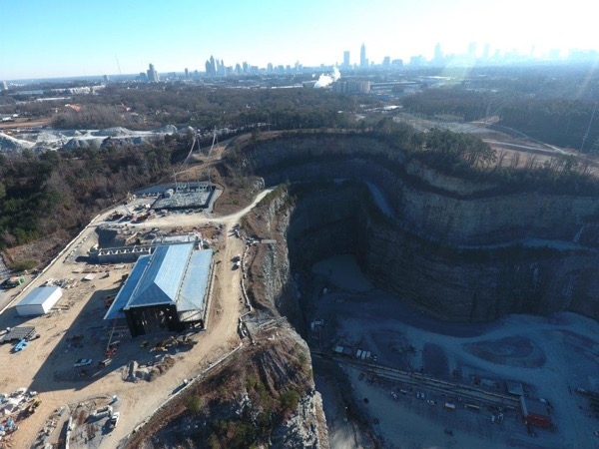
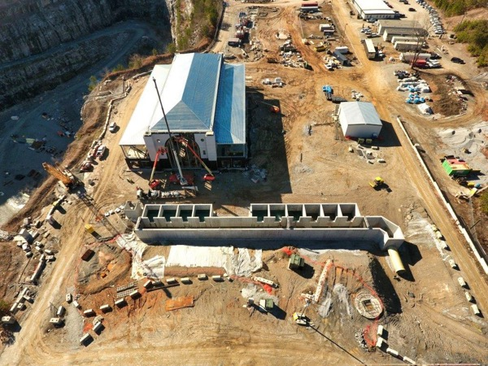
Raw Water Supply Program
Program Update (Construction progress):
  Two (2) new pump stations (at Quarry and Hemphill WTP) – Completion by December 2018.
  Conveyance tunnel: 10 ft. diameter; 23,800 feet long – 13,337 ft. excavated by Driller Mike.
  Repurpose Bellwood Quarry – 2 PS Shafts and adits are completed; 2 Flow Shafts to be completed by December 2018.
  Condition assessment and rehabilitation of raw water mains
  Hemphill PS Shafts – Blind bore drilling of 4 out of 5 shafts completed. Program on schedule for March 2018 completion.
  Chattahoochee construction/drop shaft – Shaft excavation and lining completed; grouting in February 2018.
Program Update (Construction Cost):
  CMAR Guaranteed Maximum Price (GMP) $301M
  Authorized Construction: $301M
  Approved Funds: $301M
New Peachtree Pump Station:
  Design of the new 90MGD Peachtree Pump Station at the Chattahoochee Water Treatment Plant is in progress. Completion of design by May 2018.
Tunnel and Quarry/Hemphill PS Completion: September 2019

Slide 25
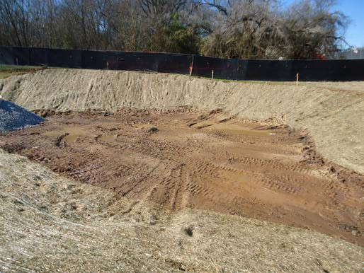
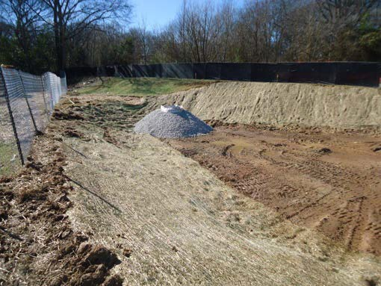
Upper Proctor Creek Capacity Relief Pond in Rodney Cook Sr. Park at Historic Vine City
Project Scope:
  The Upper Proctor Creek Capacity Relief Project – Rodney Cook, Sr. Park in Historic Vine City is a collection of innovative stormwater practices designed to redirect surface runoff away from the combined sewer system.
  This project is a multi-phase effort to reduce flooding and combined sewer flows in the surrounding area.
  The components of this project will be a wet pond, green infrastructure (bioretention, stormwater planters, rainwater harvesting cisterns, and soil restoration), aerating water features, separated storm drain pipelines, new sidewalks and roadway improvements.
Project Activities:
  Construction Authorization #1 issued 10/3/17, for Early Work Package.
  Land Disturbance permit issued 10/6/17 for first phase.
  Fall festival outreach participation with partners Trust for Public Land, Department of Parks and Recreation, along with Astra-Rohafox at Cosmopolitan Church 10/21/7.
  Construction trailers setup 11/16/17.
  City Council and the Mayor’s Office approved Guaranteed Maximum Price construction funding on 12/4/17.
  Tree removal and clearing commenced; Security guard station installed on 12/13/17.
  Soil Remediation to began 2/1/18.
Project construction cost: $22M

Slide 26
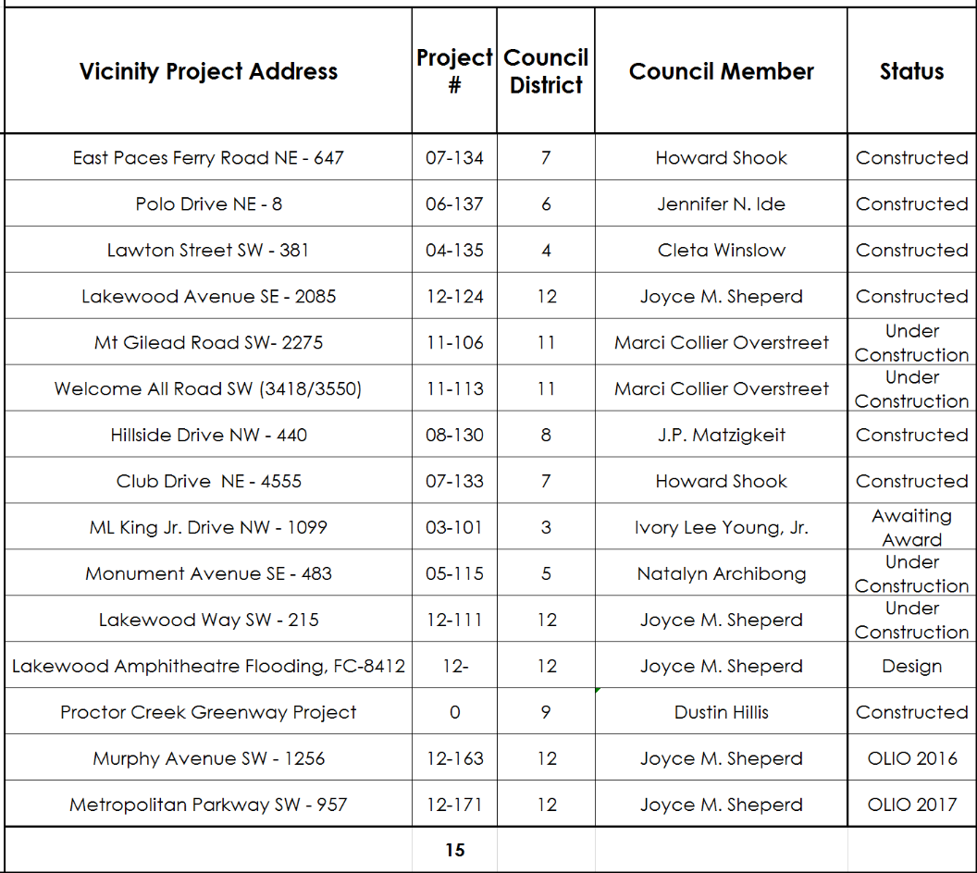
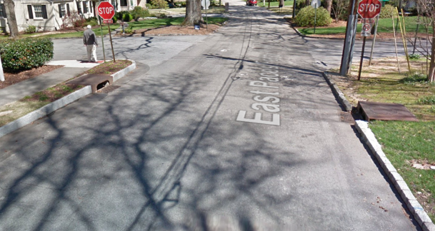
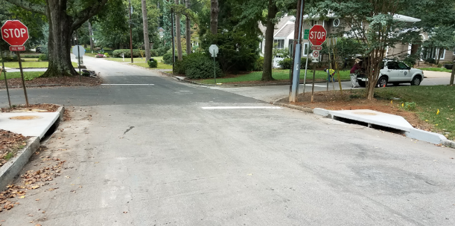
MOST-Funded Stormwater Projects
FY 2018 15 Projects
9 Completed
4 Under Construction
2 Remaining
Before
After

Slide 27
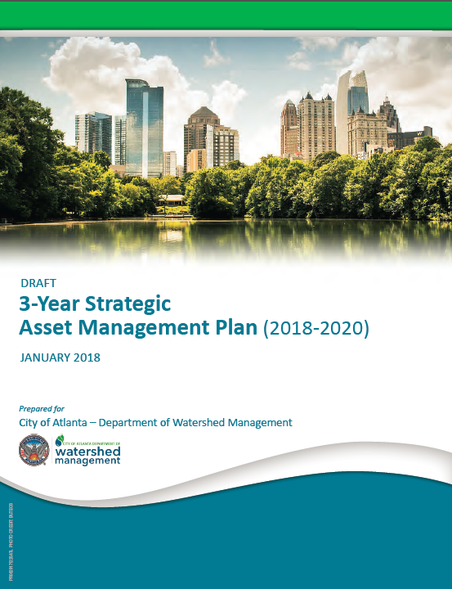
3-Year Strategic Asset Management Plan
A 3-Year Asset Management Plan has been developed and under final review
Achieving vision of being a leading utility in innovation, service and value
Strategic Initiatives include
  Organizational Development/Knowledge Management
  Database and Information Management
  Work Management
  Maintenance and Reliability
  Planning and Scheduling
  Inventory Management
  Metrics and Performance

Slide 28
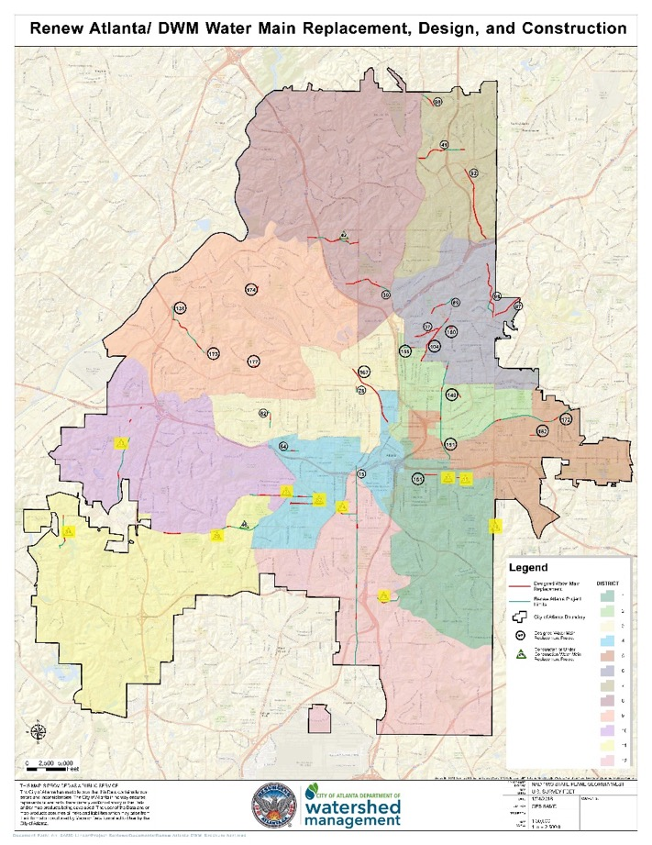
Renew ATL Water Line Renewal & Replacement
Renew Atlanta
  Construction began in March 2017 and continues
Department of Watershed Management
  Working closely with Renew ATL to assess needed corrective actions before resurfacing efforts
  Assessed 191 projects
  Designed 37 water main replacement projects
  Construction of 10 water main replacements is complete
  Approximately 17,000 LF of water main replaced to date and in service
  Two sites are currently under construction, totaling 11,000 LF.
  Highlighted numbers in figure to the right are completed

Slide 29
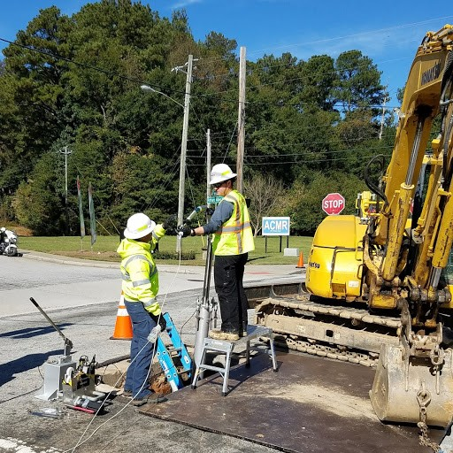
Large Diameter Waterline Condition Assessment
Prime Contractor: Pure Technologies, Inc. (JV)
Cost and duration: $3 Million/2 years
Length of mains to be inspected: 50 miles (estimated)
Length of mains inspected to-date: 2,000 feet
Future planned inspections:
  20 miles by end of April, 2018
  10 miles by end of August, 2018
  10 miles by end of December, 2018
  10 miles by end of April, 2019

Slide 30
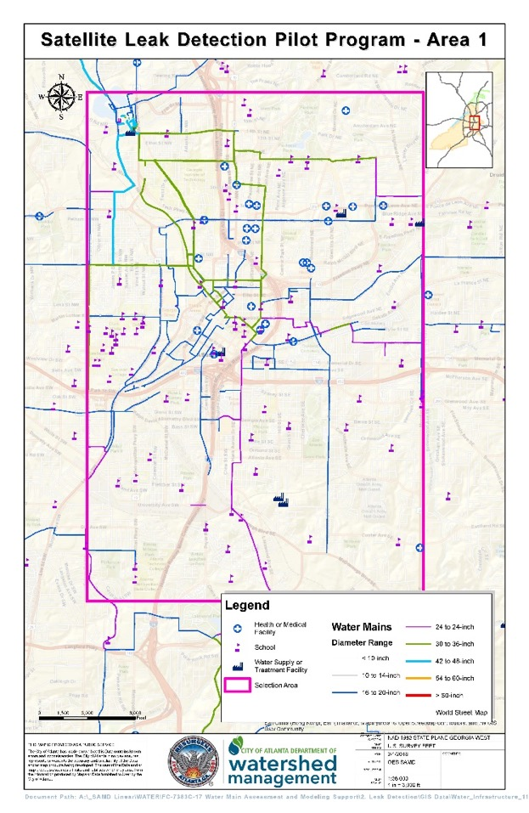
Satellite Leak Detection Pilot Program
Provider: Hydromax USA
Cost and duration: $147,000; three deliverables over six months
Est. length of mains analyzed: 500 miles per deliverable
100 leak points of interest to be correlated per deliverable
Status:
  Kick-off January 19, 2018
  Est. first image acquisition mid-February 2018
  Est. field verification to begin in mid-March 2018

Slide 31

Strategic Priorities
Major Initiatives by Strategic Priority
Service Delivery | Customer Service Action Plan Service Order Management Automated Metering Infrastructure/Smart Meters Smart Hydrants
Infrastructure Reliability | Water Line Replacement Development of Asset Management Framework Capital Plan Delivery Asset & Information Security Strategy
Workforce Development | StreamWorks Competitive Pay Study
Operational Efficiency | ESCO Projects WaterStat
Digital Transformation | Smart H2O & Innovation Framework
Financial Resiliency | MOST Stormwater Utility Alternative revenue from projects
Compliance | Integrated Planning GI Strategic Action Plan
Safety | Remote Surveillance

Slide 32





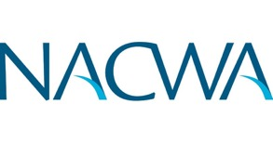
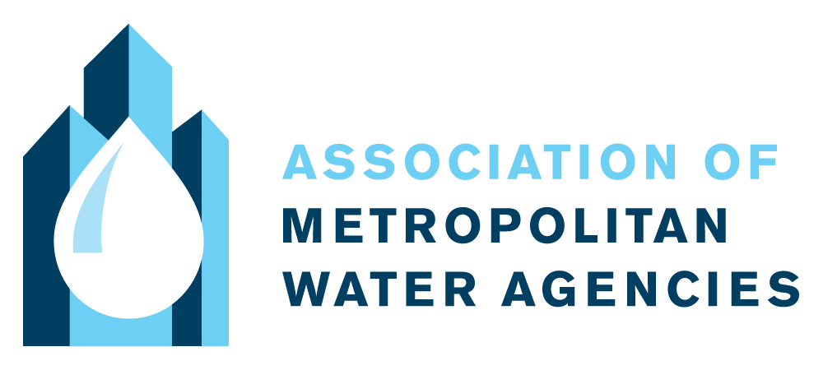
^{2017 Achievements}
Platinum Award Chattahoochee and Hemphill Water Plants
Awarded by
Global Water Leaders
The MOST has generated $1.2 billion since 2004, money that has made it possible for the Department to issue the bonds that largely funded Clean Water Atlanta without increasing rates even higher than they were.
Awarded for Power Savings at Hemphill Complex
Platinum and Gold Awards
Honor Award for Southeast Atlanta Permeable Pavers Project
Operations & Environmental Performance Award
World Smart Cities Awards Finalist
Sustainable Water Utility Management Award

