Slide 1
Fulton/Atlanta Land Bank Authority, Inc. Overview and Update
Community Development/Human Services Committee – Atlanta City Council
February 27, 2018
Presented by Christopher Norman, Executive Director

Slide 2
What is a Land Bank
Clear Mission
Land Banks are public or nonprofit entities created by local governments to acquire, manage, maintain and facilitate the redevelopment of underutilized, vacant blighted, tax delinquent properties.

Slide 3
What is a Land Bank
Tool for converting vacant, abandoned, or distressed property into productive use. This includes residential, commercial, industrial and greenspace purposes.
Core competency is acquisition and disposition of troubled, surplus, or vacant property.
Does NOT have eminent domain or taxing authority.
Steps in where market does not or cannot work due to administrative/legal barriers.

Slide 4
LBA Mission Statement
The mission of the Fulton County/City of Atlanta Land Bank Authority is to facilitate the transformation of the City and County into a vibrant community by:
Returning non-revenue generating, non-tax producing, or blighted property to an effective utilization status in order to provide market and affordable housing, public space, new industry and jobs for the citizens of the City and County.
Extinguishing past due tax liens from property foreclosed upon by Fulton County and the City of Atlanta in their tax collection capacities.

Slide 5
Blighted
Tax Delinquent
Distressed
Non-Tax Producing
Foreclosed
Abandoned

Slide 6
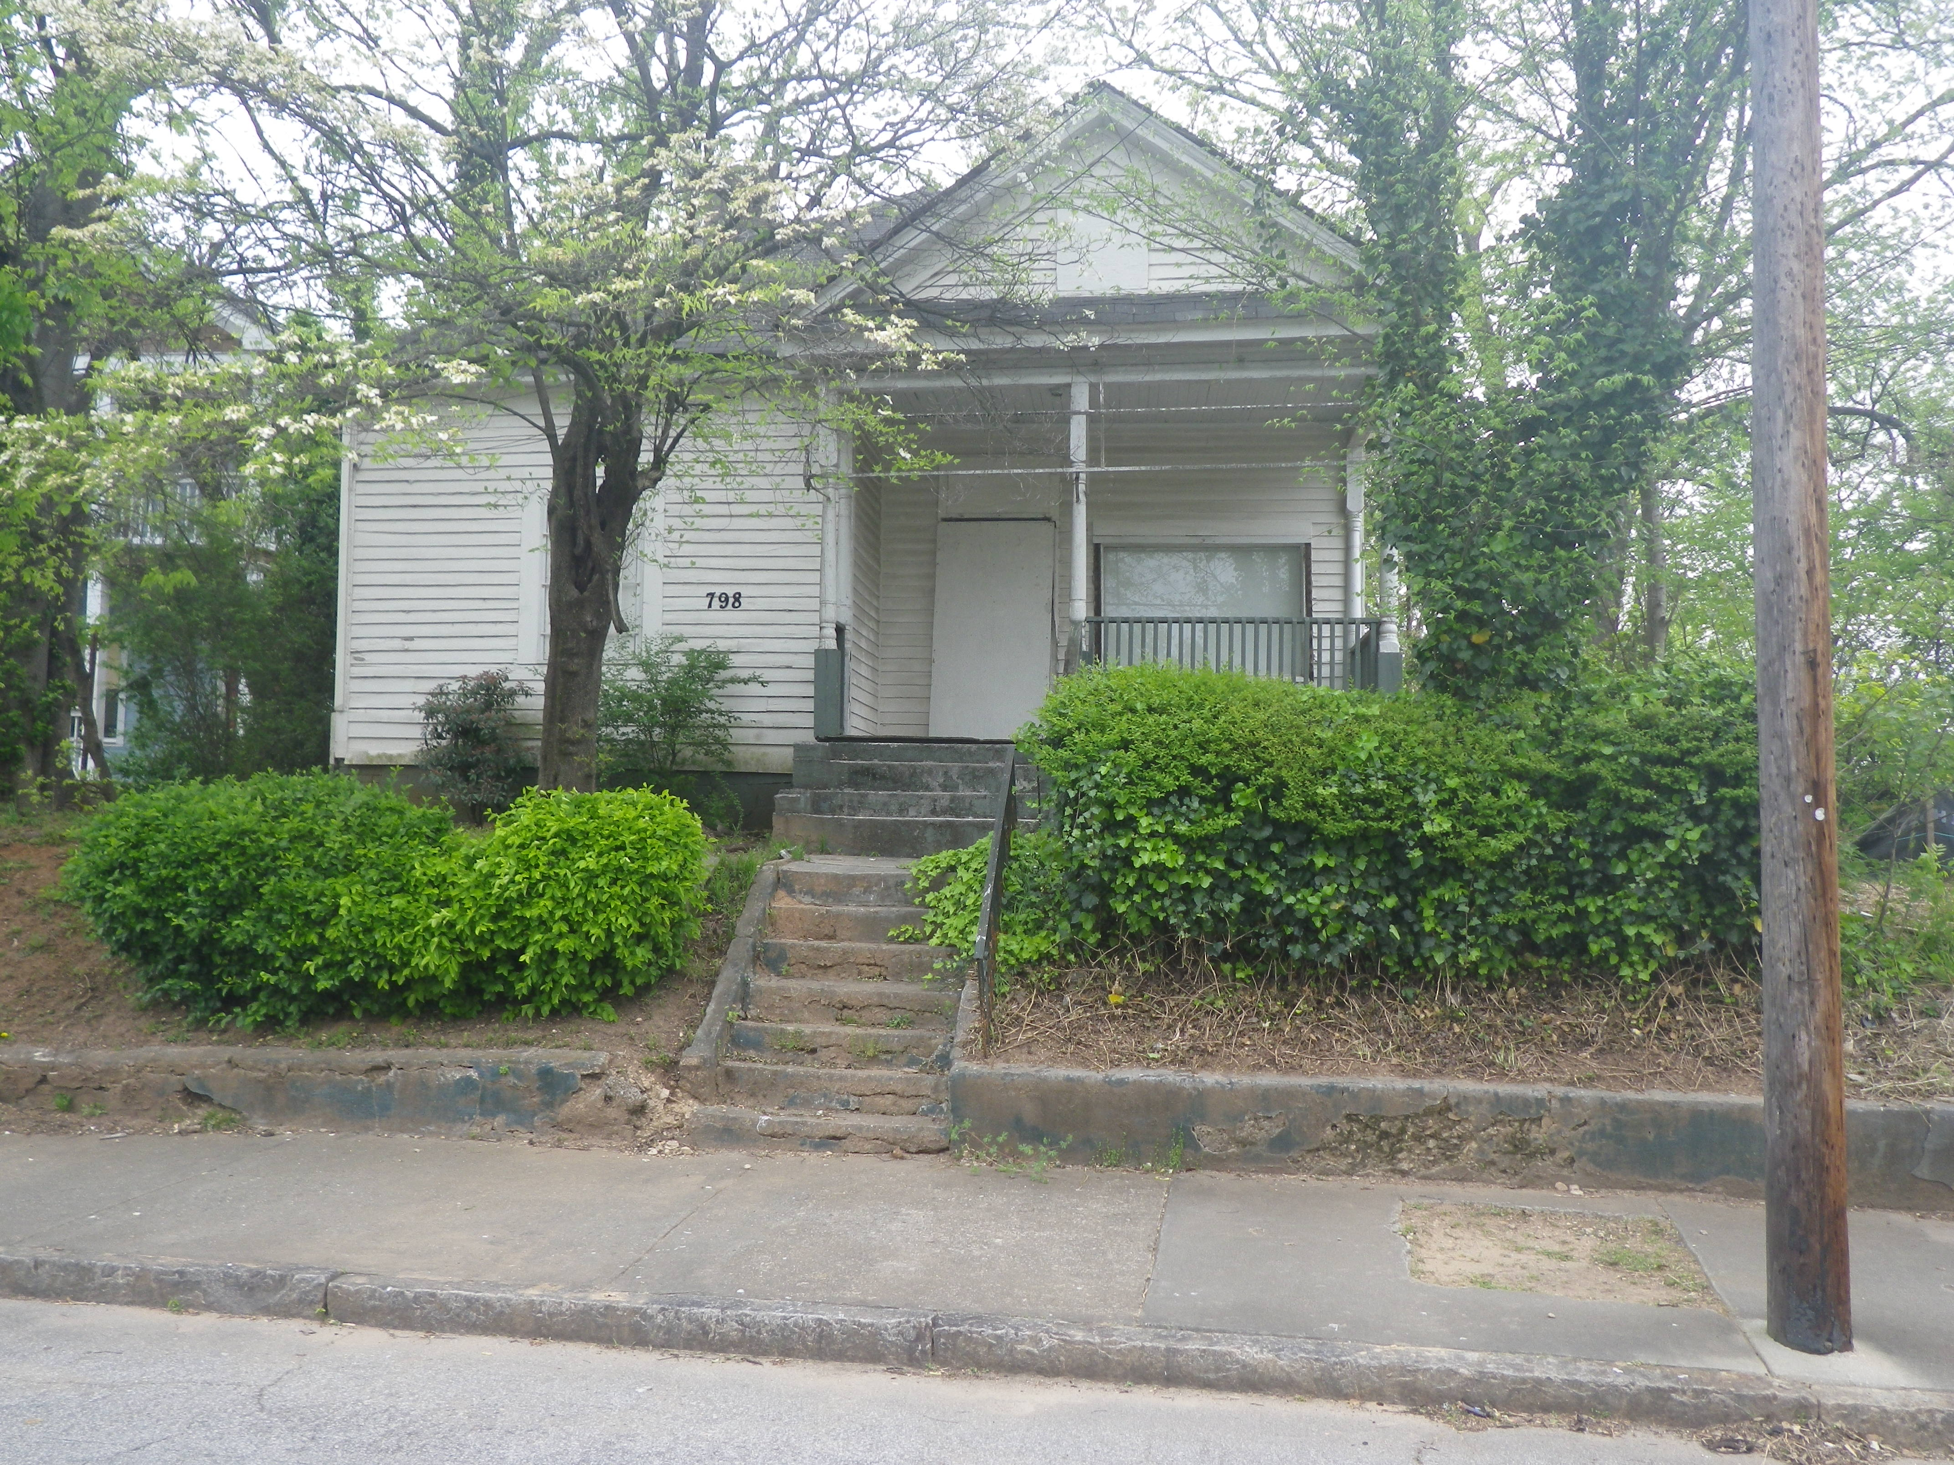

Slide 7
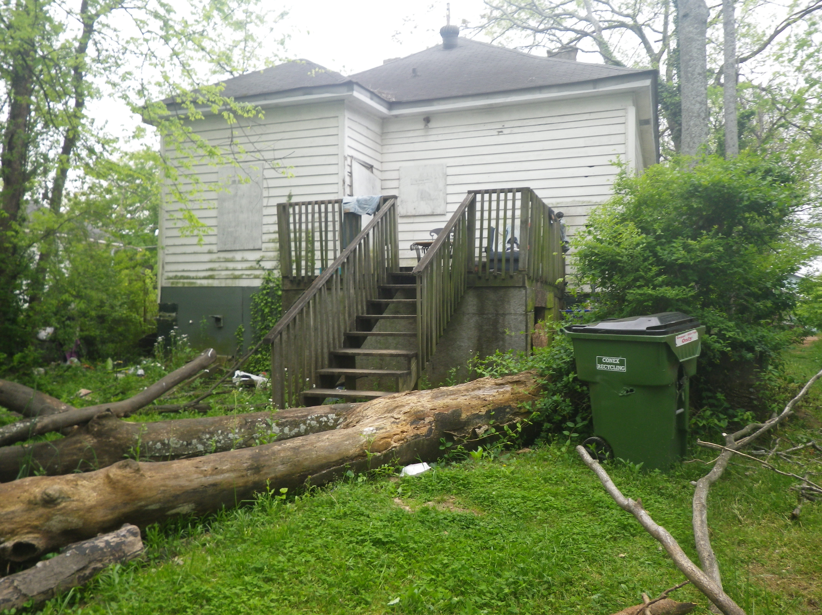

Slide 8
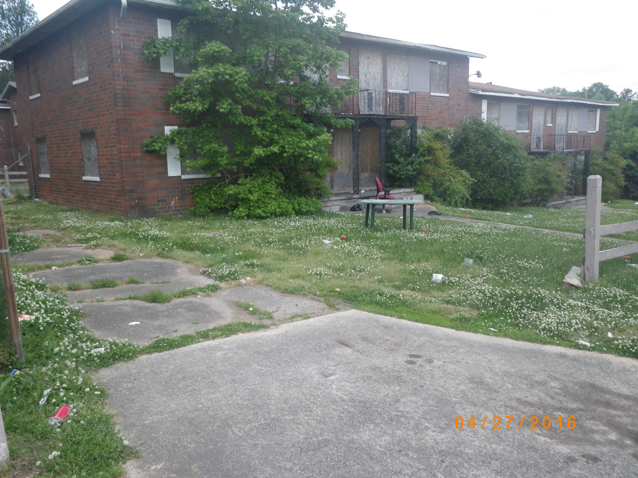

Slide 9
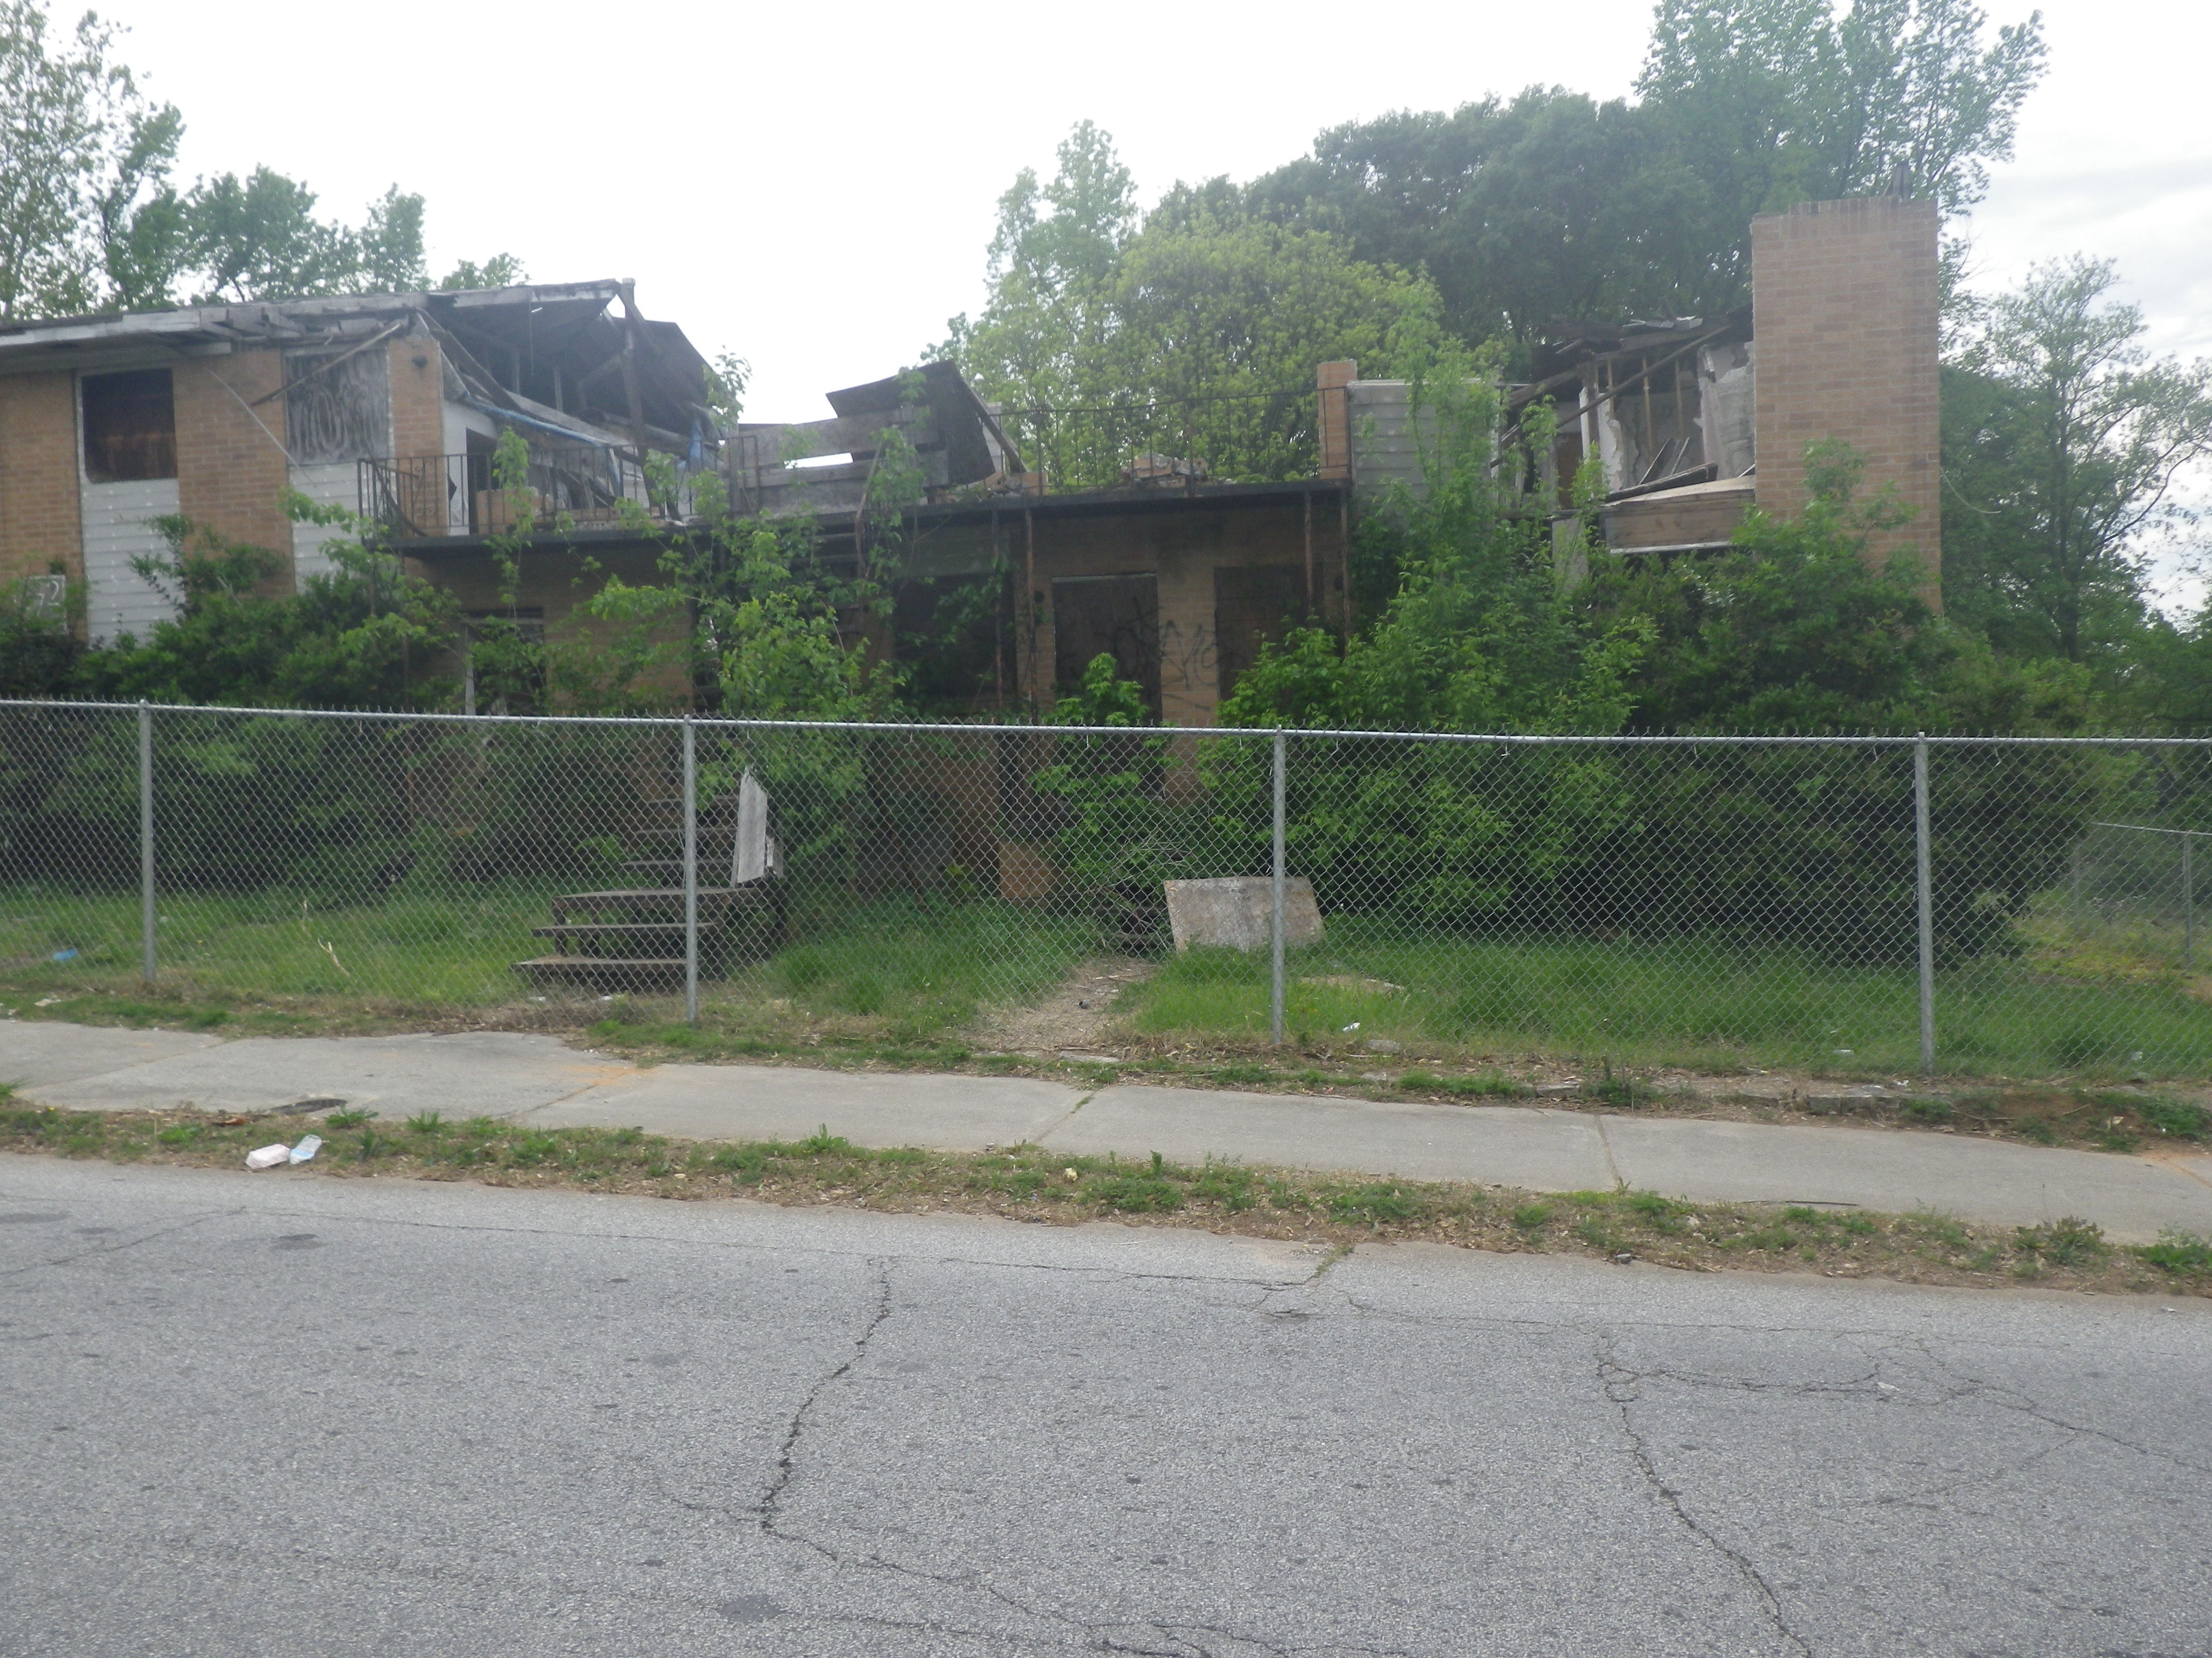

Slide 10
Desired Property Outcomes
Code Compliant Property
Tax Producing Property
Occupied Structures
Maintained Property and Structures
Shared Community Space
Vibrant and Safe Communities

Slide 11
History of Land Banks
St. Louis 1971
Cleveland 1976
Louisville 1989
Atlanta 1991 (updated 2012)
Genessee 2002
Cuyahoga 2008
New York 2011
Philadelphia 2014
Virginia 2016

Slide 12
Some Existing Georgia Land Banks
Jurisdiction | County Population | City Population
Fulton County-Atlanta | 1,023,336 | 472,522
DeKalb County-Lithonia-Clarkston | 734,871 | 2,082 | 12,742
Chatham County-Savannah | 286,956 | 146,763
Muscogee County-Columbus | 200,579 | 197,485
Richmond County-Augusta | 201,793 | 197,182
Bibb County-Macon | 153,721 | 87,059
Clarke County-Athens | 123,912 | 123,371
Lowndes County-Valdosta | 112,865 | 56,474
Whitfield County-Dalton | 104,216 | 34,077
Floyd County-Rome | 96,504 | 36,407
Spalding County-Griffin | 64,051 | 22,928
Thomas County–Thomasville | 45,063 | 18,826
Dougherty County-Albany | 91,332 | 73,801

Slide 13
Land Bank Focus
Broad Usage Categories
Residential
Commercial
Industrial
Green space
Surplus Public Property
Foreclosed Properties
Abandoned Properties
Tax delinquent Properties
Land Banks focus on properties that are underutilized.

Slide 14
LBA Vision Statement
The Fulton County/City of Atlanta Land Bank Authority (“LBA”) will serve as a central vehicle for returning all tax-delinquent and non-revenue producing property within Atlanta and Fulton County to a productive status. This will simultaneously create vibrant communities, affordable housing and economic opportunity. The LBA will operate as the premier Land Bank Authority within the region and the United States, and will serve as an example and facilitator of best practices.

Slide 15
LBA Vision Statement (cont’d)
The LBA will be guided by the following seven principles of:
Transparency
Accountability
Professionalism
Thoroughness
Customer Focus
Collaboration
Innovation

Slide 16
1991 - 1998
Tax Abatement
1998 – 2008
Tax Abatement
2008 - 2009
Tax Abatement
Sheriff/Marshal Deed Property Interest Conveyance
2009 – 2015
2016 - Present
Greenspace Assemblage
Tax Abatement
Tax Abatement
Greenspace Assemblage
Sheriff/Marshal Deed Property Interest Conveyance
In-Rem Judicial Tax Foreclosure
In-Rem Judicial Tax Foreclosure
Greenspace Assemblage
Property Assemblage
Greenspace Assemblage
Sheriff/Marshal Deed Property Interest Conveyance
Property Assemblage
Land Banking
Neighborhood Stabilization Program
Community Land Trust
Secure Neighborhood Initiative
Public/Private Development Partnerships
Greenspace Assemblage
Sheriff/Marshal Deed Property Interest Conveyance
Property Assemblage
Land Banking
Neighborhood Stabilization Program
Community Land Trust
Public/Private Development Partnerships
Secure Neighborhood Initiative
Chronic Distressed Property Strategy
??????

Slide 17
LBA Activity – Housing Units
 | 2010 | 2011 | 2012 | 2013 | 2014 | 2015 | 2016 | 2017 | Totals
Acquisition
Land Banking | 127 | 28 | 1 | 4 | 0 | 4 | 68 | 30 | 262
Neighborhood Stabilization Program | 96 | 18 | 9 | 13 | 4 | 0 | 0 | 0 | 140
Donation | 0 | 0 | 4 | 1 | 1 | 2 | 1 | 12 | 21
Total | 223 | 46 | 14 | 18 | 5 | 6 | 69 | 42 | 423
Disposition
Land Banking | 0 | 0 | 4 | 8 | 7 | 83 | 3 | 11 | 116
Neighborhood Stabilization Program | 0 | 0 | 37 | 17 | 8 | 0 | 46 | 49 | 157
Donation | 0 | 0 | 0 | 0 | 1 | 1 | 0 | 1 | 3
Total | 0 | 0 | 10 | 25 | 16 | 84 | 3 | 61 | 276

Slide 18
Approved LBA Programs – FY2018
Program | Role
Strategic Place Based Assemblage/Revitalization | Lead and/or Partner/Participant
Neighborhood Stabilization Program (NSP) | Partner/Participant
Troubled Asset Workouts | Lead
Land Banking | Lead
Secure Neighborhood Initiative | Partner/Participant
Municipal Joint Venture Projects | Partner/Participant
Community Land Trusts (Atlanta Land Trust) | Partner/Participant

Slide 19
Approved LBA Programs – FY2018
Program | Role
National Community Stabilization Trust/Neighborhood Stabilization Initiative | Partner/Participant
TransFormation Alliance | Participant
Greenspace Assemblage | Lead and/or Partner/Participant
Small Building Preservation | Partner/Participant

Slide 20
Tools
Demolition
Deed in Escrow Conveyance (to be potentially implemented)
Development Partner Bids/Partnerships
Environmental Review
In Rem Judicial Code Lien (potential for foreclosure of lien)
In Rem Judicial Tax Foreclosure
Intergovernmental Transfer
Property Donation
Property Management
Property Seizure – US Attorney/District Attorney/City Solicitor
Quiet Title Action
Real Estate Acquisition via Market Purchase
Tax Abatement
Title Research
Transaction Structuring

Slide 21
Primary Acquisition Methods
Acquisition Method | Status
Donation | Available.
Market Purchase | Available. Contingent upon acquisition funds.
In Rem Judicial Tax Foreclosure | Not available. Not currently conducted by Tax Commissioner.
In Rem Judicial Code Foreclosure | Not available. Not currently conducted by Tax Commissioner.
Criminal Seizure and Conveyance | Available.
Public Entity Conveyance | Available. Surplus or property from Blight Eminent Domain process.

Slide 22
Comprehensive Chronic Distressed Property Strategy
prepared by
Fulton/Atlanta Land Bank Authority, Inc.
(Applicable to Strategic Development Area or City Wide)
As of March 10, 2015
“Bad” Property
Status
Tax Delinquent**
> 12 months
REO
Foreclosed
Code Violations/
Blighted
Criminal
Activity
**Assumes all tax liens held by Tax Commissioner
Article 5 Judicial
In-Rem Code
Enforcement:
Certified “Super
Priority “Lien
Conveyance
Action
Options
Voluntary
Donation
Judicial
In-Rem
Tax Foreclosure
Market
Negotiated
Purchase
Property
Seizure
Coordinating
Entity
LBA
Tax Commissioner/
LBA
LBA
Code Enforcement/
Solicitor’s Office/
Revenue Office
Solicitor’s
Office/DA/
US Attorney
Required
Resources
Acquisition Funds
Property Management Funds
Staff/Personnel Support
Demolition Funds
Funds for legal costs (closings, title, filings, etc.)
Funds for Judicial Tax Foreclosure Proceedings
Property Insurance
Disposition
Options
Application
RFP
Auction
“Good” and Productive
Property

Slide 23
Targeted Outcomes
Convert status of minimum 300 properties to productive use via Programs within 24 months
Achieve measurable economic impact
New skills for staff members and consultants.
Lead diverse groups of stakeholders to achieve “stretch goals”
Cooperatively create comprehensive development plans
Perform and deliver in accordance with SMART goals
Utilize a global or neighborhood centric perspective versus the historical transactional perspective
Perform sophisticated financial analysis.

Slide 24
Program Execution
Activate Conveyance Action Options per Chronic Distressed Property Strategy
Identify strategic redevelopment areas in consultation and coordination with COA – Department of Planning & Community Development, Office of Housing.
Intention is leverage and collective impact of activities

Slide 25
Program Execution
Individual Programs to be executed by cross-functional teams composed of LBA employees, strategic vendors and partners. This will require:
Hiring of additional full time employees
Engagement of strategic vendors
Active collaboration with existing and new partners
Each Program will have a designated Primary lead that will have responsibility for successful execution of assigned Program

Slide 26
Current Structure
= Direct LBA Employee
= Contractor or Vendor
Executive Director
Office Manager
Program Manager
Griffin & Strong PC - General Counsel
Legal Support
City of Atlanta Attorney
Fulton County Attorney
Board of Directors
= Municipal partner
April 2017

Slide 27
Approved New Structure
- Expanded
Executive Director
(Senior) Program Director
Office Manager
Management Analyst
Griffin & Strong PC - General Counsel
Kutak Rock LLP
Dye Snyder LLP
Development Partners
Real Estate Agents/ Consultants
Bookkeeper/ Accountant
IT/Website Support
Legal Support
City of Atlanta Attorney
Fulton County Attorney
Board of Directors
Community Engagement
Program Director
Asset Manager
Property Management Vendors
Demolition Vendors
Property Insurance Vendors
= Direct LBA Employee
= Contractor or Vendor
= Municipal partner
April 2017

Slide 28
Supported Strategic Outcomes
Outcomes
Blight Elimination
Affordable and Market Housing
Neighborhood Revitalization
CONTROLLING LAND IS IMPERATIVE

Slide 29
Contact Information
Christopher Norman
Executive Director
cnorman@fccalandbank.org
Main 404-525-9336
Direct 404-525-9130
www.fccalandbank.org

